Slide 1
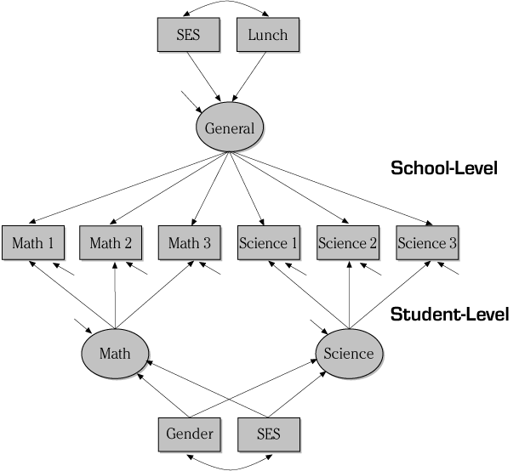
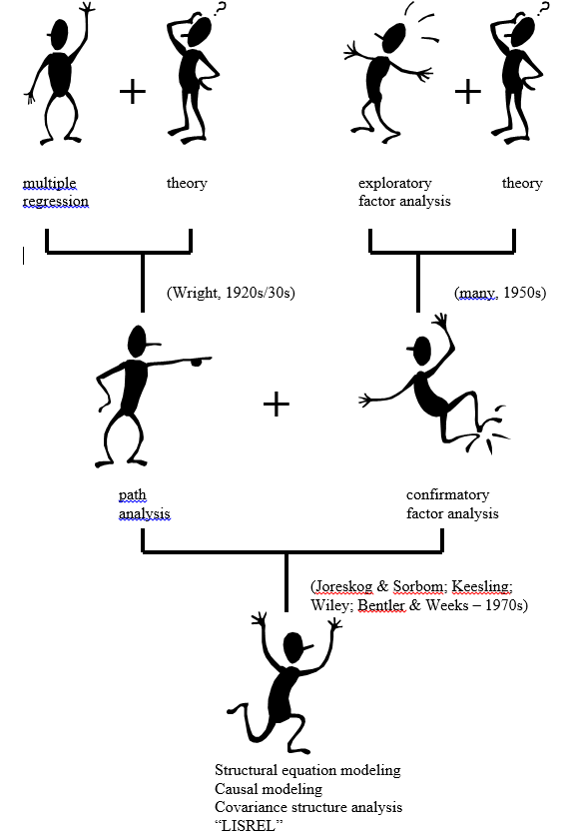



SEM Family Tree
SEM Software
Mplus: http://www.statmodel.com/
Multivariate Software, Inc. (maker of EQS): http://www.mvsoft.com/
IBM® SPSS® Amos: http://ibm.com/products/structural-equation-modeling-sem
Scientific Software Int’l (maker of LISREL): http://www.ssicentral.com

