Slide 1
FP8/FP4/BF16 dense GEMM
Fine-grained scaling and the UE8M0 layout in DeepGEMM
DeepSeek-AI · DeepGEMM (deck 25)
Explainer deck · Industrial Pretraining Architecture & Infra Tech Landscape (2026)
GEMM & MoE Kernels · github.com/deepseek-ai/DeepGEMM

Slide 2
FP8 is the training format, and it is narrow
DeepSeek-V3 pre-trained 14.8T tokens with FP8 linear layers
E4M3 carries 3 mantissa bits: max 448, min normal 2⁻⁶
Every projection and expert FFN is one of these GEMMs
2
Notes:
The format numbers are Table 1 of the FP8-formats paper: E4M3 has a 4-bit exponent, 3-bit mantissa, max normal 448 and 18 binades of range. Narrow enough that how you scale matters more than that you scale.

Slide 3
The tensor core's own accumulator loses precision
~2%
maximum relative error of an FP8 GEMM at K = 4096 — H800 tensor cores keep only about 14 bits of the accumulation
DeepSeek-V3 technical report, §3.3.2 (p. 17); error measured on two random matrices
3
Notes:
This is before any quantization error. The partial products are right-shifted to a common exponent and only the top ~14 bits are kept, so the error grows with K, exactly where large models live. FP32 accumulators in registers do not help: the truncation is inside the MMA.

Slide 4
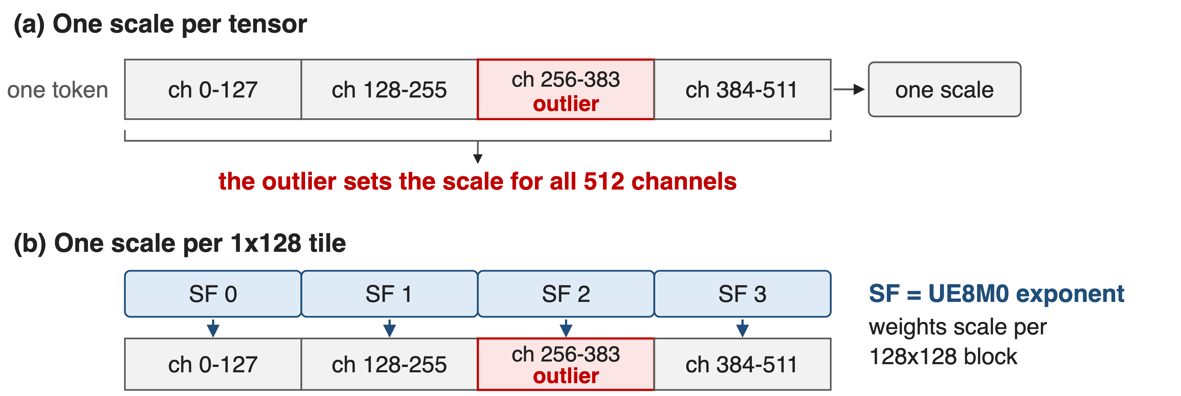
One scale per tensor cannot survive outliers
Per-group scaling along K is "not directly supported" by a standard FP8 GEMM (DeepSeek-V3 §3.3.2)
4
Notes:
V3 calls FP8 training highly sensitive to activation outliers. Their fix is to scale per 1x128 activation tile and per 128x128 weight block, with the max-abs computed online rather than from a history. The catch is in the callout: a scale that changes along K has to be applied inside the GEMM's K loop, which a standard FP8 GEMM does not offer.

Slide 5
Insight: make every scale an exact power of two
A power-of-two scale is exactly representable and costs an exponent add
It fits in 8 bits: UE8M0, no sign, no mantissa
5

Slide 6
Insight: make every scale an exact power of two
A power-of-two scale is exactly representable and costs an exponent add
It fits in 8 bits: UE8M0, no sign, no mantissa
Then the scale becomes an operand the TMA streams and the MMA consumes, not a fix-up outside the GEMM
6
Notes:
DeepGEMM asserts this on device: a scale factor whose sign or mantissa bits are non-zero trips an assert, and the cast kernels round scales to powers of two. That constraint is what makes packing into UE8M0 lossless.

Slide 7
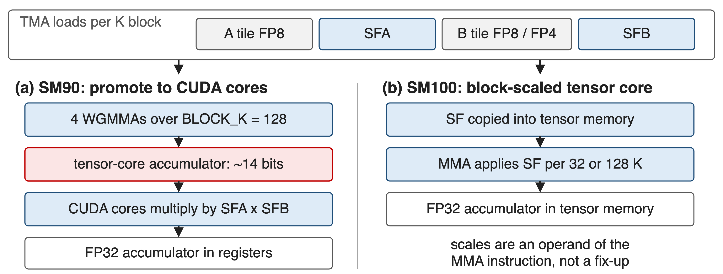
Scales ride with the tiles into the inner loop
Same kernel family, two ways to apply the scale: CUDA-core promotion (SM90) or block-scaled MMA (SM100)
7
Notes:
Per K block the kernel TMA-loads the A tile, the B tile and both scale-factor blocks. On Hopper the WGMMA accumulator is the imprecise one, so the kernel promotes. On Blackwell the scale factors go into tensor memory and the tcgen05 MMA applies them itself.

Slide 8
❶ The recipe fixes the scale-factor shapes
recipe = (gran_m, gran_n, gran_k): one SF per gran_m x gran_k block of A
SFA: [ceil(M/gran_m), ceil(K/gran_k)], FP32 before transform
V3 uses 1x128 activations, 128x128 weights; SM100 also takes 1x32
8
Notes:
The recipe describes storage granularity, not compute granularity. gran_k must be 128 on SM90; SM100 accepts 32 or 128, which is how MX-style FP4 weights fit in. On SM90, gran_n = 1 selects the 1d1d kernel and gran_n = 128 the 1d2d kernel.

Slide 9
❷ SM90 promotes to CUDA cores every 128 elements
4 WGMMAs fill the tensor-core accumulator, then CUDA cores apply SFA x SFB
Partial sums land in FP32 registers; N_C = 128 is the minimal interval
Two warpgroups overlap: one promotes while the other issues MMA
9
Notes:
V3 section 3.3.2 reports 128 elements, equivalent to four WGMMAs, as the smallest interval that fixes the precision without substantial overhead. The scale multiply is nearly free there because dequantization has to happen anyway. On SM100 this step disappears into the instruction.

Slide 10
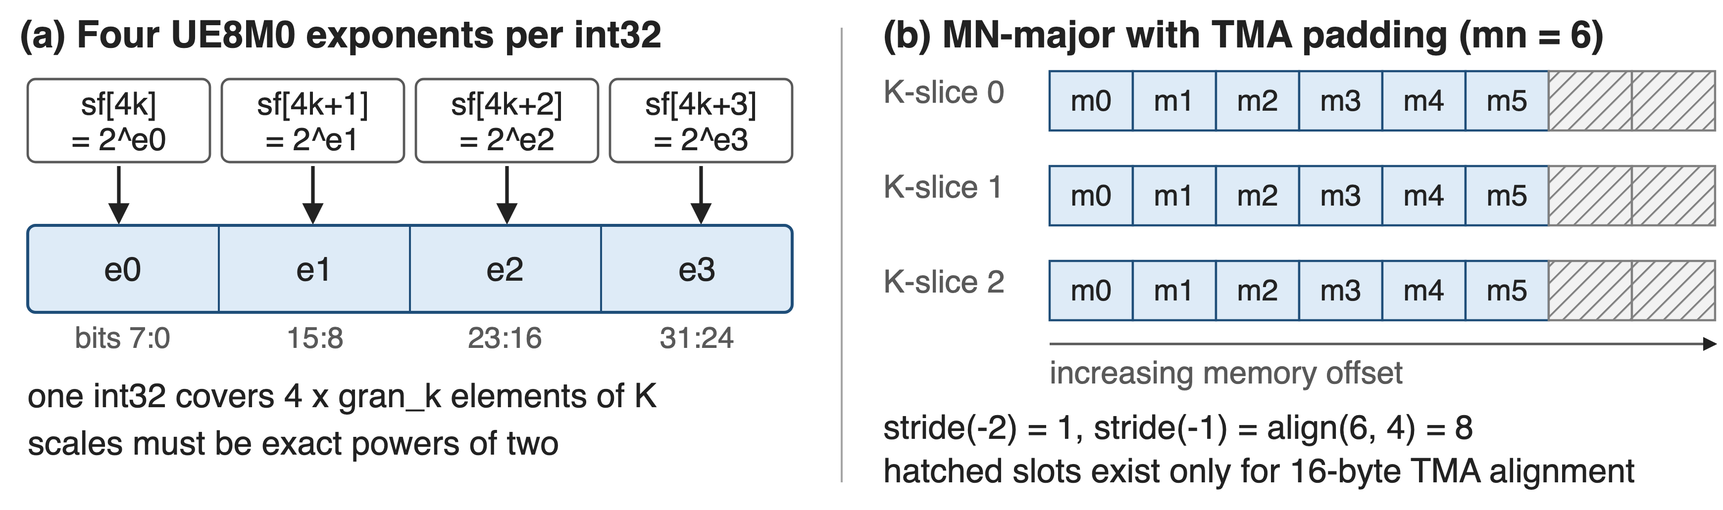
❸ The layout contract: packed, MN-major, aligned
packed_sf_k = ceil(K / (gran_k x 4)); pre-transformed factors are validated, not rebuilt
10
Notes:
Two ways to supply scale factors: FP32 and let DeepGEMM launch a transform kernel on every call, or hand over the packed int32 layout and have it only validated. Weights are transformed once and cached; activation scales come straight out of the quantization cast kernel in this layout.

Slide 11
FP4 and BF16 ride the same path
FP8 x FP4 weights: 1x32 scales, BLOCK_K = 256, two values per byte
BF16 GEMM dispatches to cuBLASLt unless determinism is requested
Epilogues can emit FP8 directly, with per-32 UE8M0 output scales
11
Notes:
The FP4 path is what V4 uses for routed expert weights. The BF16 note matters for reproducibility: with use_deterministic_algorithms(True) the library stays on its own kernels, which deck 39 covers.

Slide 12
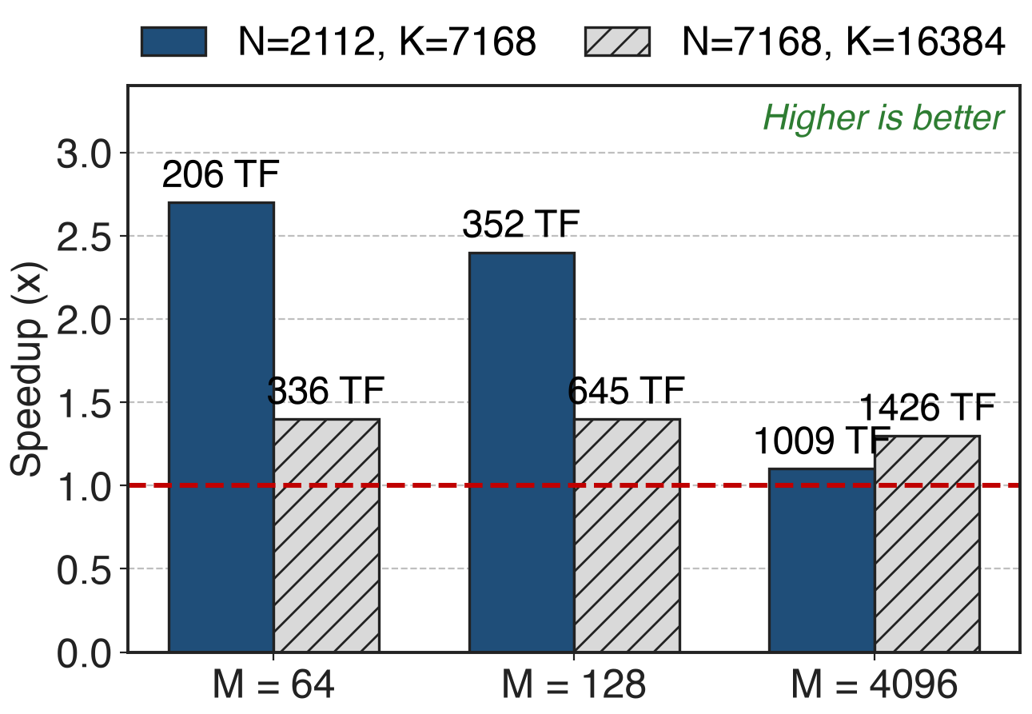
2.7x at decode shapes, 1.3x at prefill
Red line: tuned CUTLASS 3.6 build, H800 SXM5
At M = 64 the kernel is bandwidth-bound at 2.6 TB/s
Peak across shapes: 1550 TFLOPS
12
Notes:
The gain is largest where the GEMM is small and memory-bound, which is decoding; at M=4096 with a big K the kernel is compute-bound and the margin narrows to 1.1-1.3x. All numbers from the March 2025 README table; the 1550 TFLOPS peak is the April 2025 release note.

Slide 13
Fine-grained FP8 trains within 0.25% of BF16
<0.25%
relative training-loss error of the FP8 recipe against a BF16 baseline, two model scales, about 1T tokens
DeepSeek-V3 technical report, §3.3.1 (p. 16) and Appendix B.1
13
Notes:
This is the number that justifies the whole scheme: the scaling layout is not just fast, it keeps FP8 training on the BF16 loss curve. V3 also reports no irrecoverable loss spikes across the full 14.8T-token run.

Slide 14
What it costs you
SM90: NT layout only, FP32 scale factors; SM100: all majors, packed UE8M0
Scales must be exact powers of two; unpacked ones cost a transform per call
Casting, transposition and scale production stay in your kernels
14
Notes:
The library optimizes the GEMM and expects the quantization cast to be fused into whatever produced the activations. If you hand it FP32 scale factors it will still work, but you pay a transform kernel launch on every GEMM call.

Slide 15

Summary
FP8 tensor cores keep ~14 bits: up to ~2% error at K = 4096
Insight: power-of-two scales fit in 8 bits and stream with the tiles
1x128 and 128x128 scaling, promotion on SM90, block-scaled MMA on SM100
2.7x over tuned CUTLASS at decode shapes, 1550 TFLOPS peak, <0.25% loss error
https://github.com/deepseek-ai/DeepGEMM
15
Notes:
Related decks: 25 is the DeepGEMM library overview, 32-34 the grouped GEMM layouts, 39 the JIT and determinism switches, 35 Mega MoE.

