Slide 1
Masked Grouped GEMM
Expert GEMMs whose token counts never leave the GPU
DeepSeek-AI · DeepGEMM masked layout + DeepEP low-latency kernels
Explainer deck · Industrial Pretraining Architecture & Infra Tech Landscape (2026)
GEMM & MoE Kernels · github.com/deepseek-ai/DeepGEMM

Slide 2
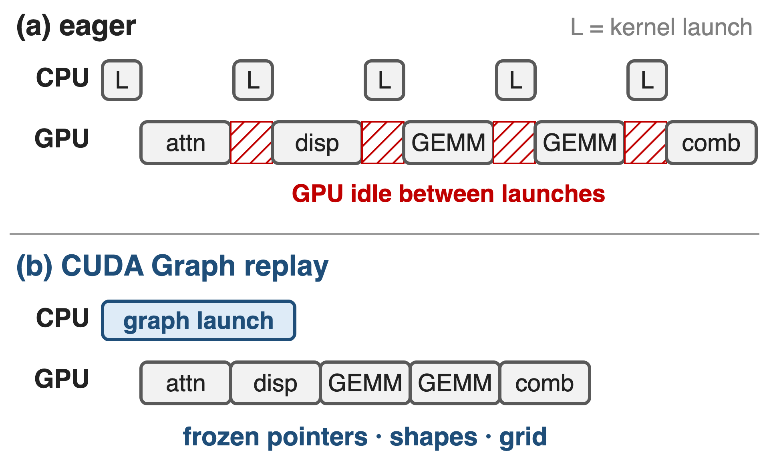
Decode runs tiny MoE layers as CUDA Graphs
DeepSeek-V3 decode: EP320, ≤ 256 tokens per expert
Memory-bound kernels; each launch costs CPU µs
A graph replays a whole step with one launch
2
Notes:
In decoding, every MoE layer processes a handful of tokens per expert, so its kernels are short and memory-bound, and CPU-side launch cost starts to show as GPU idle time. CUDA Graphs capture the kernel sequence once and replay it with a single launch, but they freeze each kernel's pointers, shapes and grid size. Sources: DeepSeek-V3 report §3.4.2 p.19-20 (EP320, one expert per GPU, batch per expert usually within 256 tokens, memory-bound); Megatron-Core MoE report §4.3.6 p.38-39 (several microseconds of CPU cost per launch; graphs need static shapes); LMSYS large-scale EP blog (launch overhead is a significant bottleneck in decode). CUDA Graph strategies in general: deck 38.

Slide 3
Host-shaped GEMMs cost 58 syncs per step
58
blocking reads of expert token counts per DeepSeek-V3 decode step, one per MoE layer, if the GEMM is shaped on the host
Derived: 58 MoE layers (DeepSeek-V3 §4.2; MCore report §4.2.1) × one count read per layer (MCore §4.3.7 p.43; DeepEP README: normal dispatch makes the CPU wait)
3
Notes:
A grouped GEMM whose shape lives on the host needs each layer's per-expert token counts on the CPU before it can be sized and launched. DeepSeek-V3 has 58 MoE layers, so that is 58 device-to-host round trips per decode step, each one stalling the launch pipeline, and a shape that depends on GPU data makes the step impossible to capture as a CUDA Graph. This is a derived count, not a measured latency; no source reports the time per sync. Sources: DeepSeek-V3 §4.2 p.22; Megatron-Core MoE report §4.2.1 p.30 and §4.3.7 p.43; DeepEP README (V1) l.173.

Slide 4
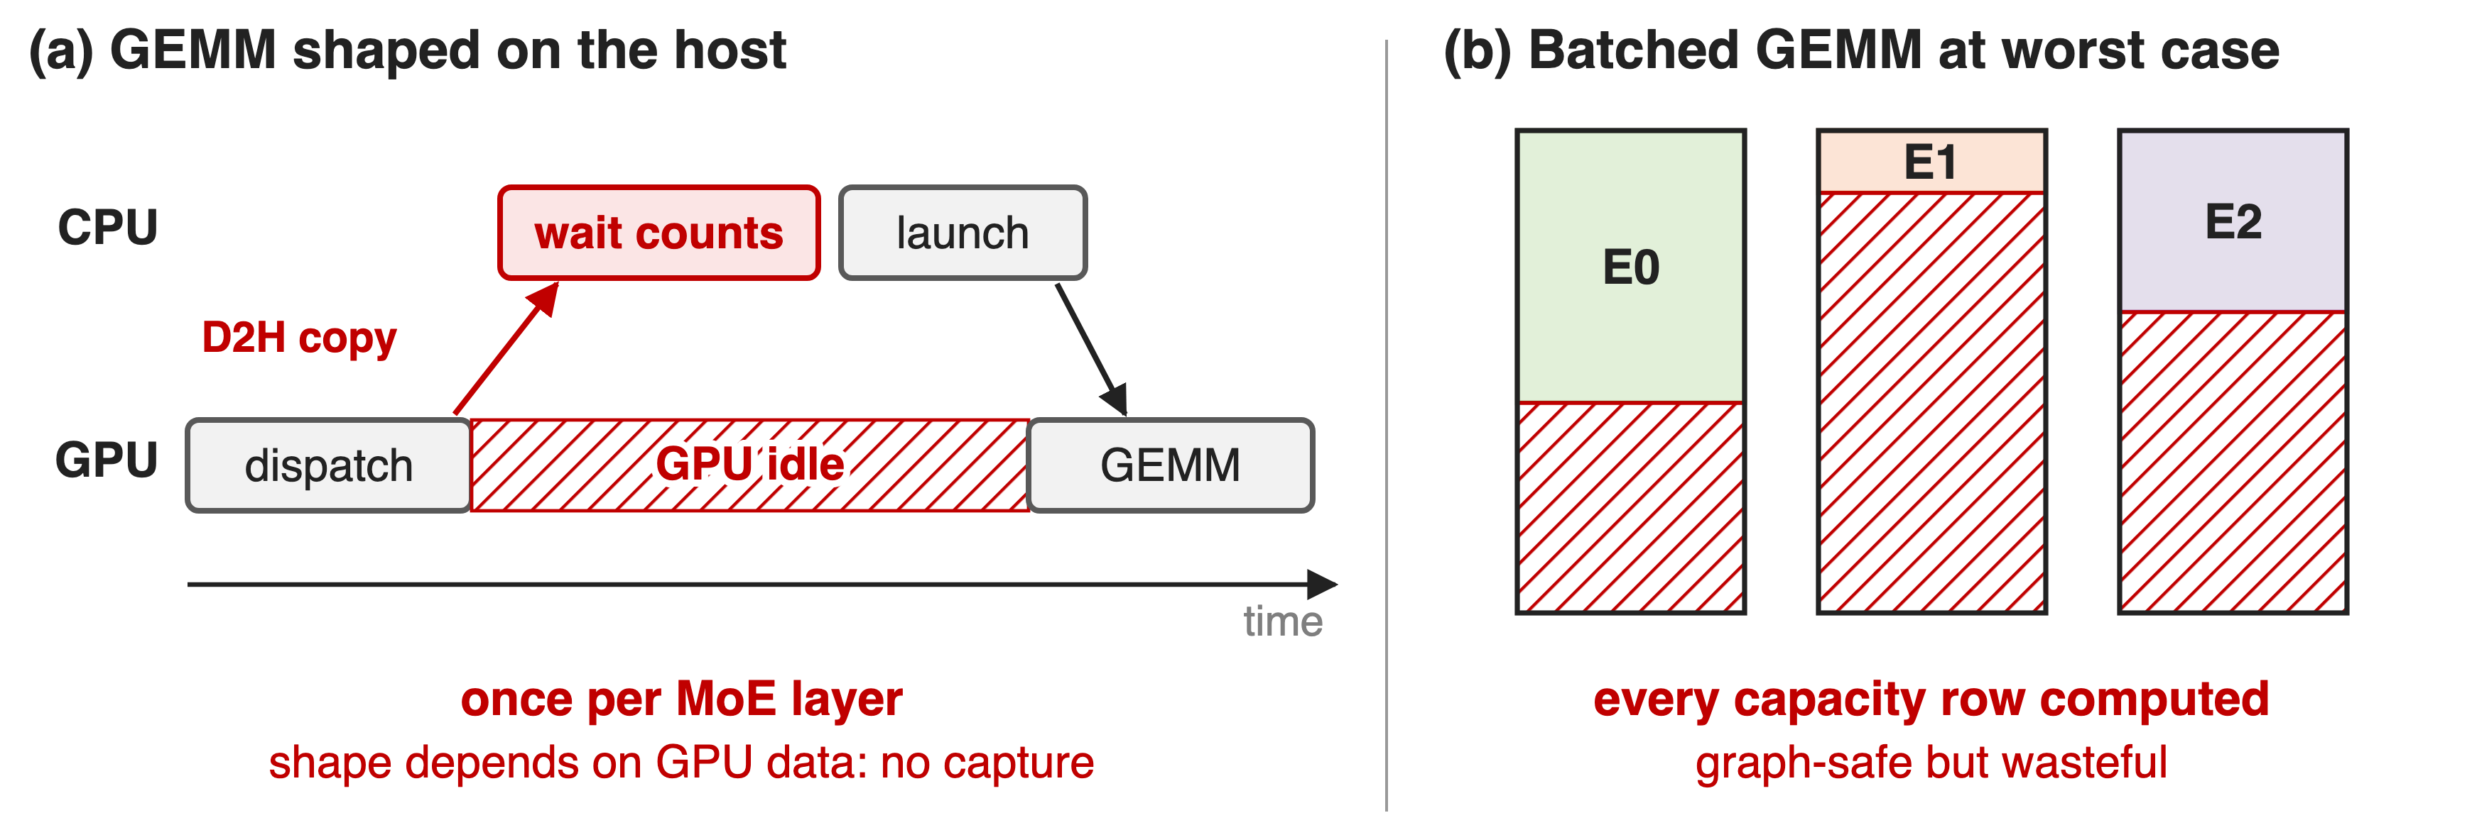
Host shapes stall; worst-case shapes waste
Either the CPU waits every layer, or every slot row is computed
4
Notes:
Panel a: with DeepEP's normal dispatch and a contiguous grouped GEMM, the CPU waits for the counts, then sizes and launches the GEMM; the GPU idles meanwhile, and DeepEP documents that this path is not CUDA-Graph compatible. Panel b: a plain batched GEMM over fixed worst-case slots is graph-safe but multiplies every capacity row, valid or not. Sources: DeepEP README (V1) l.173; LMSYS blog dispatch-mode table; Megatron-Core MoE report §4.3.7 p.43. Contiguous layout: deck 33.

Slide 5
Insight: graphs freeze arguments, not memory
Captured: pointers, shapes, grid size
Not captured: what kernels read from GPU memory
5

Slide 6
Insight: graphs freeze arguments, not memory
Captured: pointers, shapes, grid size
Not captured: what kernels read from GPU memory
Keep shapes at a fixed capacity, keep per-expert counts on the GPU, let the kernel skip invalid rows
6
Notes:
A CUDA Graph fixes every kernel argument at capture time: pointers, scalars and the launch grid. It does not fix the contents of device memory. So the per-expert token counts, the only quantity that changes from step to step, can stay in a device tensor that the kernel reads at run time, as long as every shape is sized for the worst case and the launch grid does not depend on the counts. FlashInfer makes its attention kernels graph-safe the same way: persistent kernels with a fixed grid and capacity-sized buffers. Sources: FlashInfer (MLSys 2025) §3.3 p.7 and App. D.1 p.19; DeepGEMM README (masked layout).

Slide 7
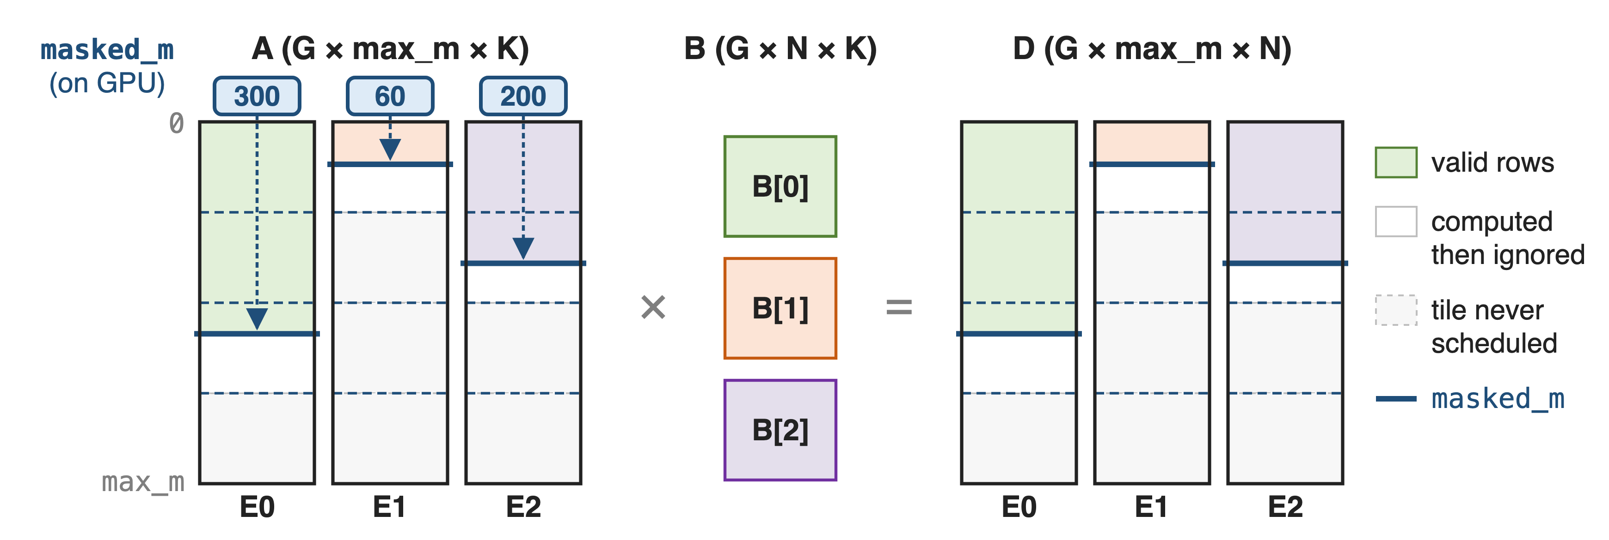
Masked layout: fixed slots, counts on the GPU
m_grouped_fp8_gemm_nt_masked((A, sfa), (B, sfb), D, masked_m, expected_m) · A FP8 [G, max_m, K] · B FP8 [G, N, K] · D BF16 [G, max_m, N]
7
Notes:
A holds one slot of max_m rows per local expert, B the expert weights, D one output slot per expert. masked_m is an int32 tensor on the GPU with the valid row count of each slot; expected_m is a plain host integer used only as a hint. Only 128-row tiles that contain valid rows are scheduled; rows past masked_m inside the last tile are computed and ignored. Sources: DeepGEMM 2025 docstring of m_grouped_gemm_fp8_fp8_bf16_nt_masked; csrc/apis/gemm.hpp l.269-318. Running example (300, 60, 200 of 512) is illustrative.

Slide 8
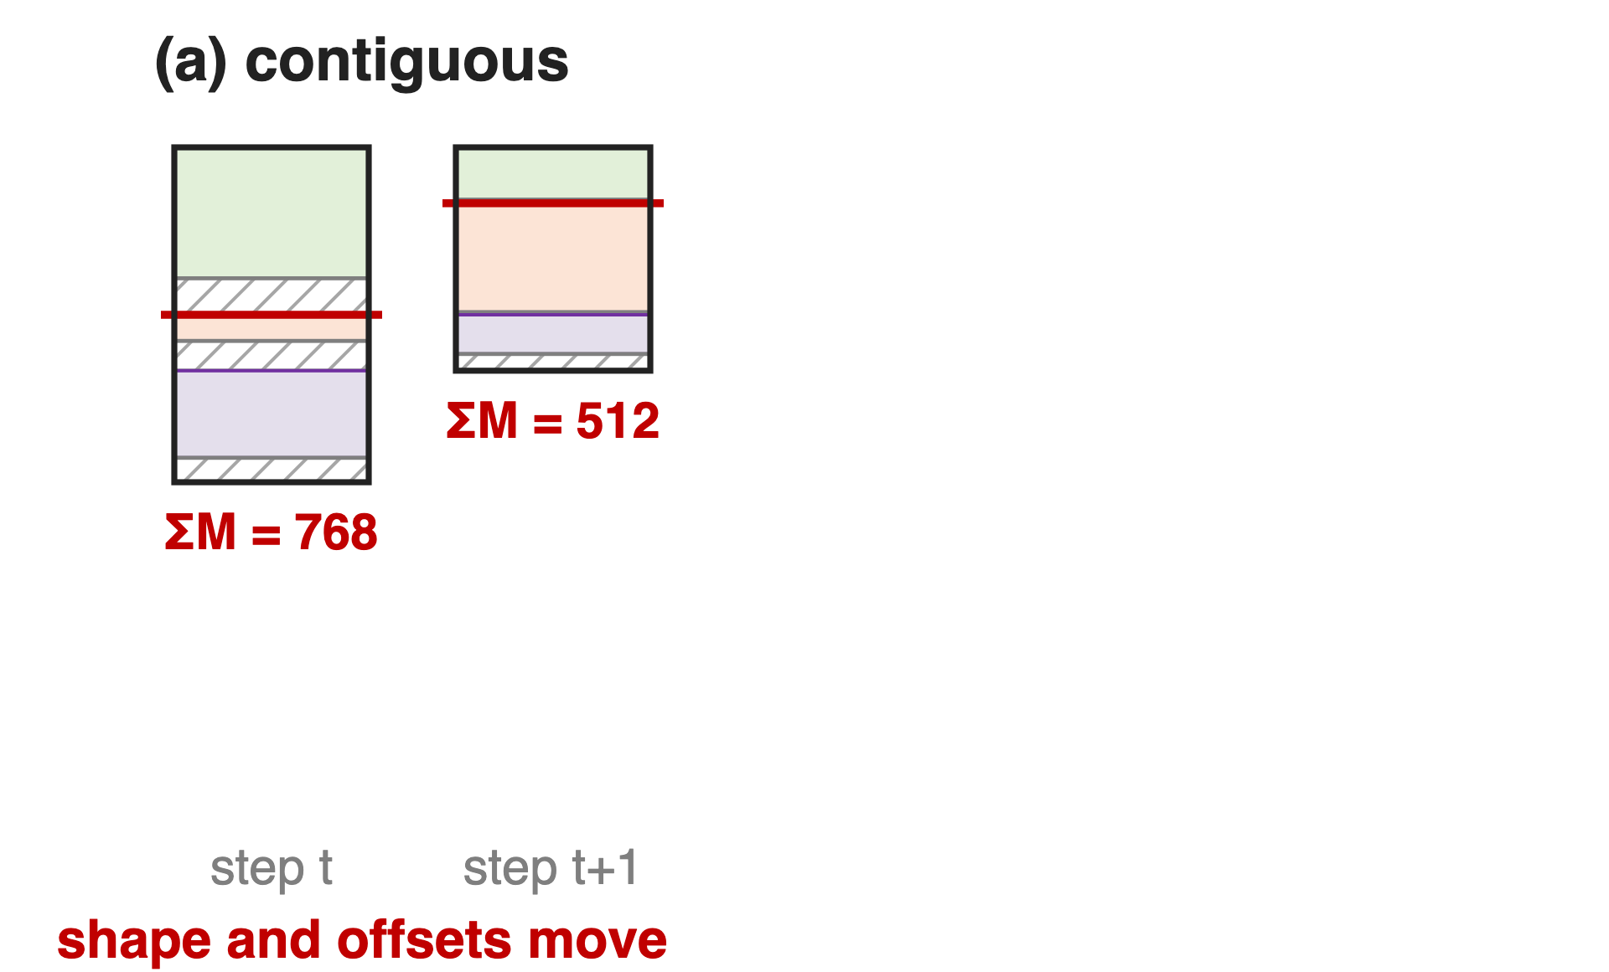
❶ Fixed slots keep every pointer and shape static
Contiguous: ΣM and offsets change each step
A captured kernel would read stale shapes
8

Slide 9
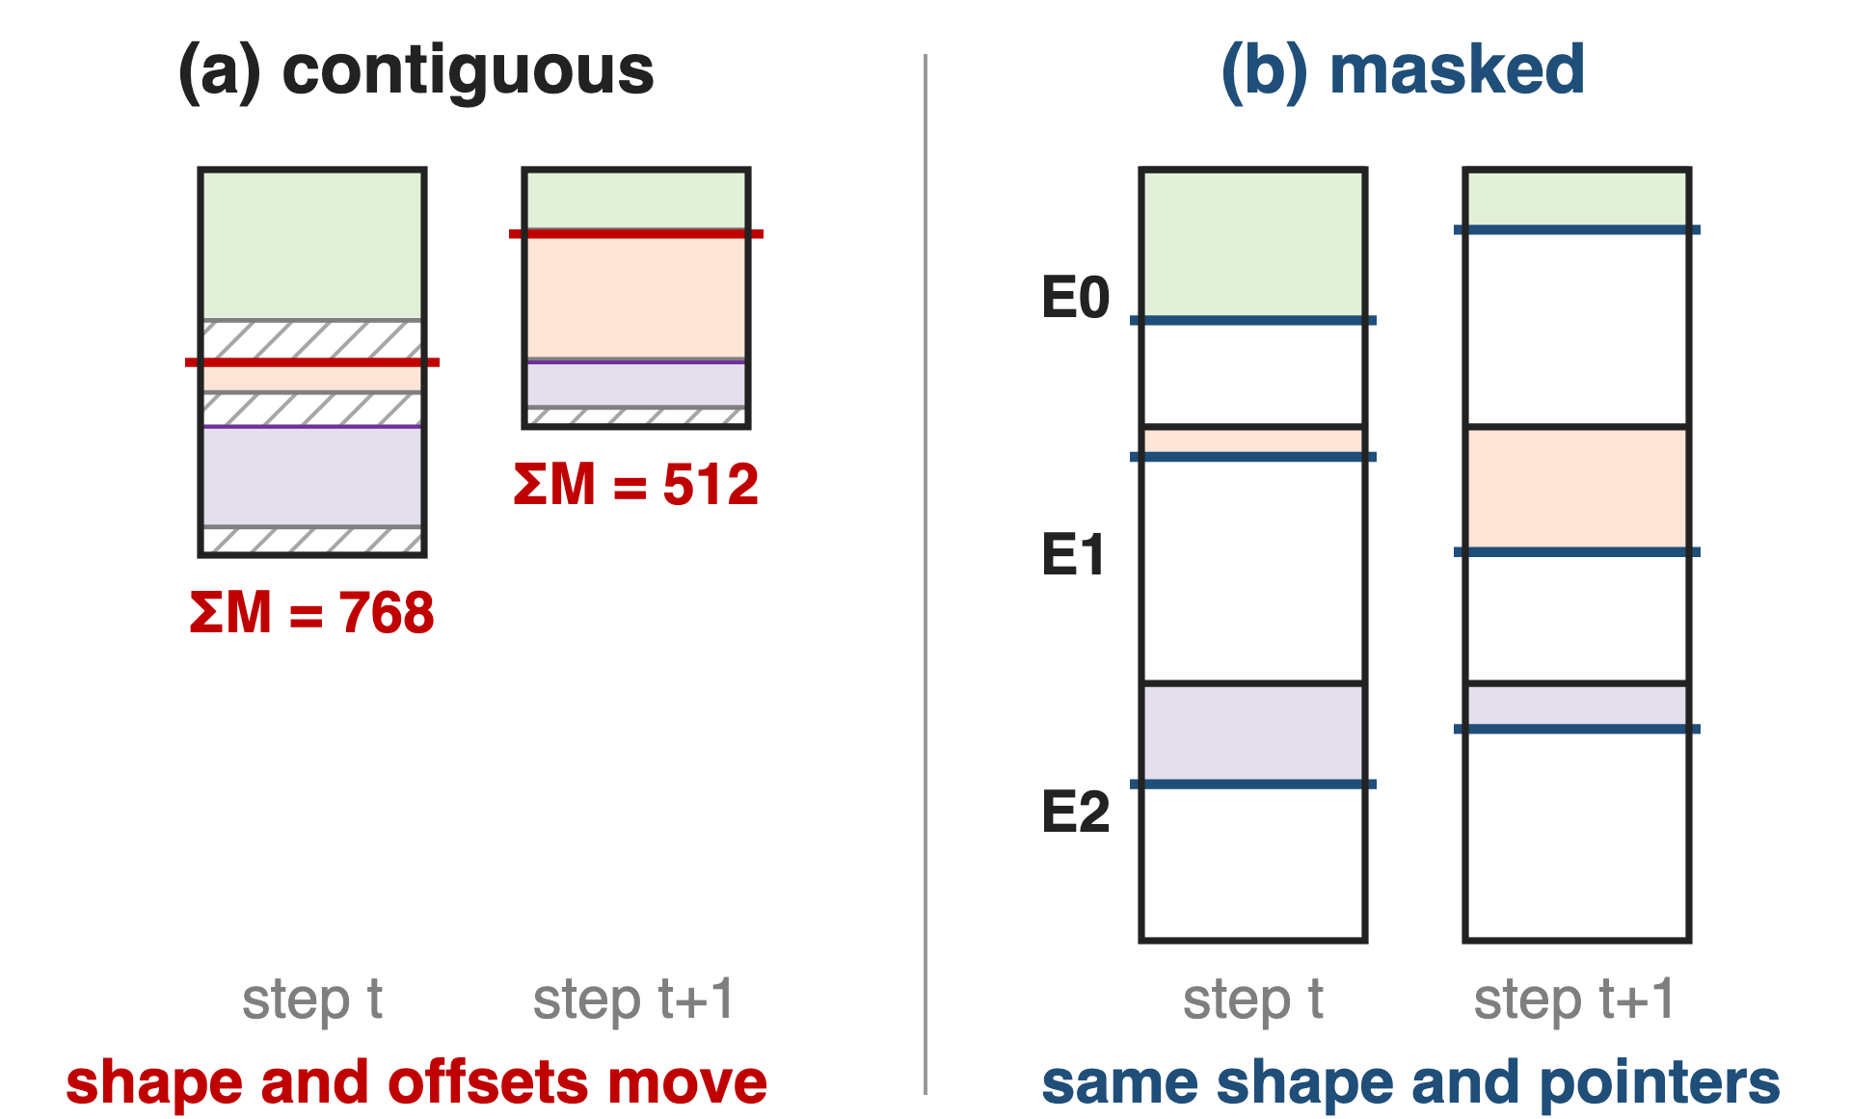
❶ Fixed slots keep every pointer and shape static
Contiguous: ΣM and offsets change each step
A captured kernel would read stale shapes
Masked: slot g starts at g × max_m, always
Only masked_m changes between steps
9
Notes:
In the contiguous layout the total row count and every expert's offset depend on the routing of this step, so a graph captured at one step would replay wrong shapes at the next. The masked layout gives each local expert a fixed slot of max_m rows; with DeepEP's low-latency dispatch, max_m is the maximum tokens per rank times the number of ranks, because one expert can receive at most every token of every rank. When G > 1, max_m must be a multiple of the M block. Sources: DeepGEMM 2025 m_grouped_gemm.py l.114-136 and l.166-168; DeepEP V1 buffer.py low_latency_dispatch docstring.

Slide 10
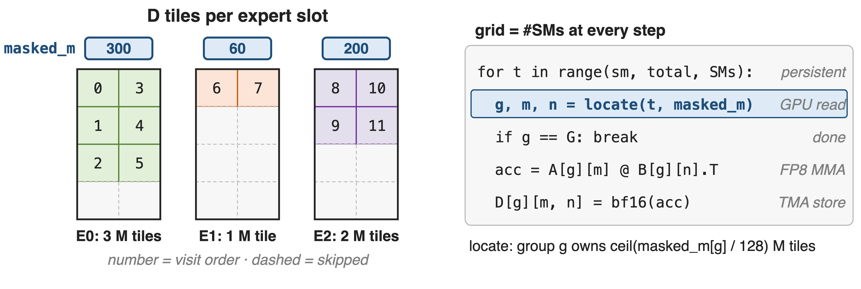
❷ The scheduler reads masked_m on the device
The launch never changes; how much work each CTA finds does
10
Notes:
The kernel always launches one CTA per SM. Each CTA walks the experts in order, computes from masked_m[g], read from device memory, how many 128-row tiles expert g owns, and takes its share of tiles in a swizzled order; tiles with no valid rows are never visited, and on Hopper even 64-row sub-blocks past masked_m are skipped. Sources: scheduler/gemm.cuh l.188-204 and l.301-302; DeepGEMM 2025 launch code (grid = num_sms); PR #103 (skipping useless M computation).

Slide 11
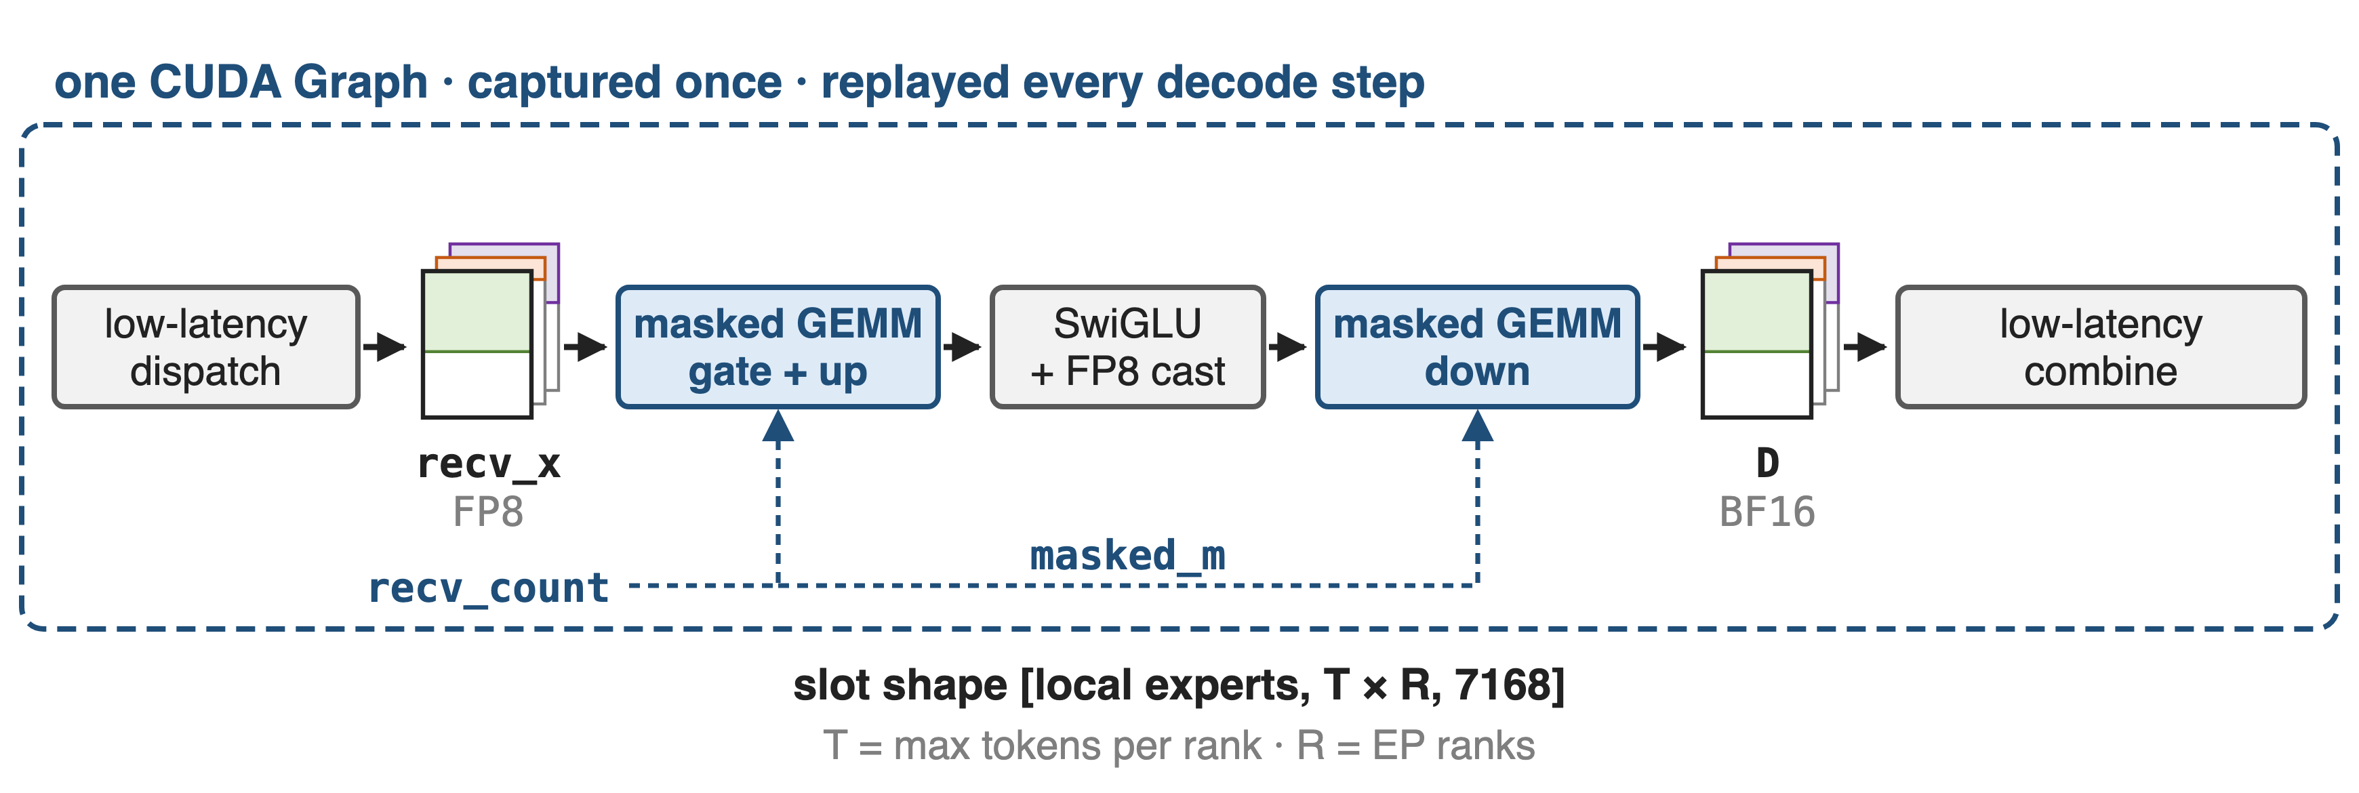
❸ DeepEP low-latency buffers plug straight in
recv_count becomes masked_m; expected_m is the only host input, a hint for the JIT config
11
Notes:
DeepEP's low-latency dispatch returns recv_x already in the masked layout, local experts by tokens-per-rank times ranks by hidden, FP8 with TMA-aligned scales, plus recv_count on the GPU; it deliberately does not sync the counts to the CPU. Both expert GEMMs take recv_count as masked_m, and low-latency combine reads the BF16 output in the same layout. expected_m is a host integer chosen once, for example the average load; DeepGEMM uses it to pick block sizes, and its test notes that performance can drop when real counts exceed it. Sources: DeepEP V1 buffer.py l.554-650; DeepEP README (V1) l.7, l.265, l.281; DeepGEMM README (masked layout); sm90 heuristics l.202-207; tests/test_fp8_fp4.py l.181.

Slide 12
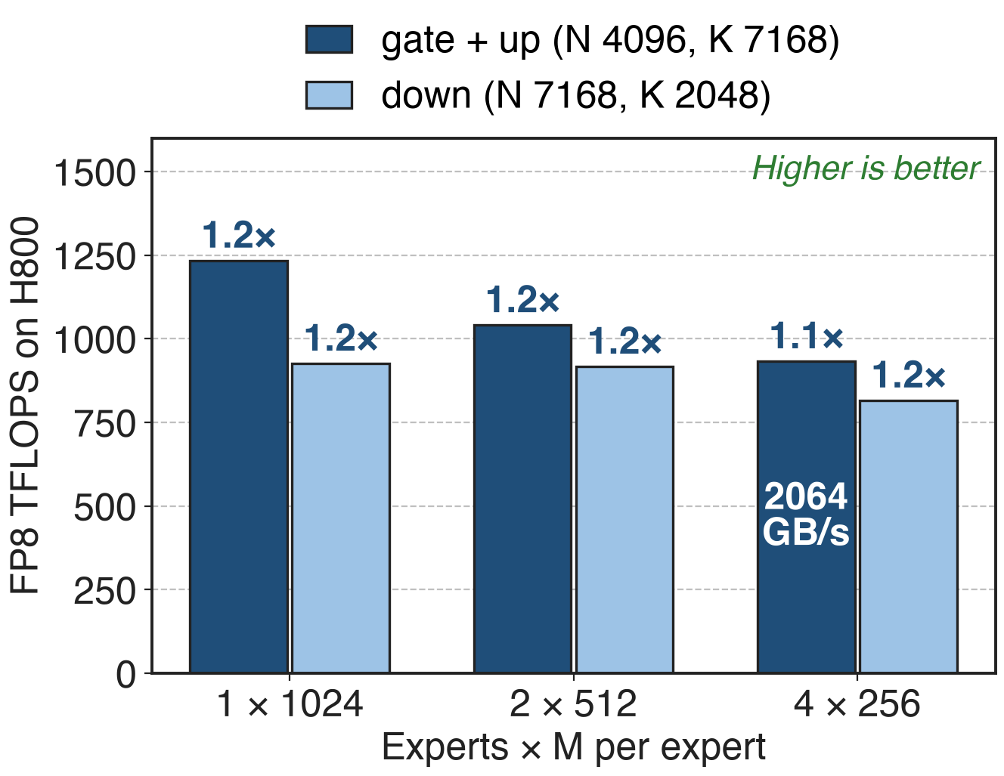
Masked GEMM keeps 1.1–1.2× at decode sizes
815–1233 TFLOPS on H800
vs a tuned CUTLASS 3.6 kernel
At 4 × 256: weight-streaming, 2064 GB/s
12
Notes:
Last published masked-layout numbers, DeepGEMM README of March 2025, H800 SXM5, NVCC 12.8: 1233 down to 932 TFLOPS on the gate-plus-up shape and 925 down to 815 on the down shape as the rows per expert shrink from 1024 to 256, 1.1 to 1.2 times DeepSeek's internal CUTLASS 3.6-based kernel. At 256 rows per expert the kernel moves 2064 GB/s, so decode-size expert GEMMs are bandwidth-bound, matching DeepSeek-V3's description of decode. Source: DeepGEMM README @ 8002b769, masked table; DeepSeek-V3 §3.4.2 p.20.

Slide 13
Prefill takes contiguous, decode takes masked
Prefill: normal dispatch
Contiguous layout (deck 33)
Host counts, no CUDA Graph
Decode: low-latency dispatch
Masked layout
Fixed buffers, CUDA Graph
SGLang runs both via PD disaggregation: 22,282 decode tokens/s per H100 node (EP72, full stack)
13
Notes:
SGLang's large-scale EP deployment uses DeepEP's normal dispatch with the contiguous DeepGEMM kernel for prefill, and low-latency dispatch with the masked kernel for decode, and separates the two phases with prefill-decode disaggregation because one communication group cannot serve both modes. Its decode reached 22,282 tokens per second per node on 9 nodes of 8 H100 with EP72; LMSYS attributes most of the gain over TP16 to the larger batches EP allows, so this is a system number, not the masked kernel's speedup. Source: LMSYS blog 2025-05-05, dispatch modes, DeepGEMM integration, decode results.

Slide 14
Static slots cost memory: 32× the balanced load
Slots sized for the worst case: 32× the balanced load
Overflow past capacity is an error
DeepEP: keep tokens per rank < 256
Low expected_m: slower config
Successor: psum layout in DeepEP V2.5
SM100 small batches: Mega MoE (deck 35)
14
Notes:
A slot must hold the worst case: T tokens per rank times R ranks. With balanced routing an expert gets T times R times k over E rows, so the slot is E over k times larger: 256 over 8 = 32 for DeepSeek-V3 (derived). Megatron-Core describes the same O(EP size) worst-case buffer problem. LMSYS notes that exceeding the preallocation is a runtime error, and DeepEP recommends fewer than 256 tokens per rank in low-latency mode. DeepEP V2.5 removed the V1 low-latency API; its decode path keeps capacity-sized buffers but emits a 2D layout with per-expert prefix sums on the GPU, which DeepGEMM consumes through the psum contiguous layout with expected_m. On SM100, DeepGEMM points small workloads to Mega MoE. Sources: DeepEP V1 buffer.py, README l.249-250; DeepEP README V2.5 l.19, l.163; LMSYS blog; MCore §4.3.7 p.43; DeepGEMM heuristics/runtime.hpp l.57-64.

Slide 15

Summary
Host-shaped expert GEMMs: 58 count syncs per decode step
Insight: graphs freeze arguments, not memory: counts stay on the GPU
Fixed slots + masked_m + persistent grid: graph-safe
815–1233 TFLOPS on H800, 1.1–1.2× over CUTLASS
https://github.com/deepseek-ai/DeepGEMM
15
Notes:
The masked grouped GEMM trades memory for static shapes: every expert gets a fixed slot, the real counts stay on the GPU, and a persistent kernel decides at run time how many tiles to compute, so the whole MoE layer can live inside a CUDA Graph. Related decks: 33 (contiguous layout), 32 (K-grouped weight gradients), 25 (DeepGEMM overview), 24 (DeepEP V2), 38 (CUDA Graphs), 35 (Mega MoE), 20 (MoonEP static shapes).

