Slide 1
DeepJIT, PDL and determinism switches
Compiling DeepGEMM's kernels once the shape is known
DeepSeek-AI · DeepGEMM (deck 25) · DeepJIT
Explainer deck · Industrial Pretraining Architecture & Infra Tech Landscape (2026)
Kernel Fusion & Runtime · github.com/deepseek-ai/DeepJIT

Slide 2
Every DeepGEMM kernel is compiled on first use
Installing the library compiles no CUDA kernels
compiled_dims = "nk": N and K become constants, M stays dynamic
The shapes arrive at run time: tokens, experts, context length
2
Notes:
DeepGEMM ships Python plus CUDA headers; DeepJIT builds each kernel the first time it is called and caches the cubin on disk. The compiled_dims default matters: model dimensions are burned in, the token count is not, so one binary serves every batch size.

Slide 3
A power-of-two tile can idle 20 SMs
112 / 132
thread blocks that get an SM at M = 256, N = 7168 with a 128x128 tile — BLOCK_N = 112 fills 128 of 132 instead
DeepGEMM README @ commit 8002b769 (2025-03-25), section "Unaligned block sizes"
3
Notes:
(256/128) x (7168/128) = 112 blocks on a 132-SM H800. The fix is a tile size nobody would pick by hand, 112, which divides 7168 exactly 64 times. You can only make that choice once you know N, and N is a property of the model, not of the library build.

Slide 4
Ahead-of-time libraries pick tiles before the shape exists
A template library freezes its tile set at build time
Autotuning pays a benchmark at startup, and the winner varies per machine
DeepGEMM selects block sizes, warpgroups, stages and cluster size deterministically — "without auto-tuning"
4
Notes:
Two obvious routes both fail. Compile every variant ahead of time and installation takes forever, or ship a few and fall back to a generic kernel. Autotune at runtime and you pay measurement time, and the kernel you get, hence the numerics, depends on the machine's mood that day.

Slide 5
Insight: compile at the first call
Then the shape is a constant: scheduler bounds, stages, SM budget, switches
The compiler can unroll the MMA pipeline fully and spend fewer registers
5

Slide 6
Insight: compile at the first call
Then the shape is a constant: scheduler bounds, stages, SM budget, switches
The compiler can unroll the MMA pipeline fully and spend fewer registers
One compile per shape and config, then a content-addressed cache that every process on the node shares
6
Notes:
This is the Triton-style bet, made explicit in DeepGEMM's first release notes: JIT compilation mainly buys you small shapes, where full unrolling and constant bounds matter most. The cache is what keeps the bet affordable.

Slide 7
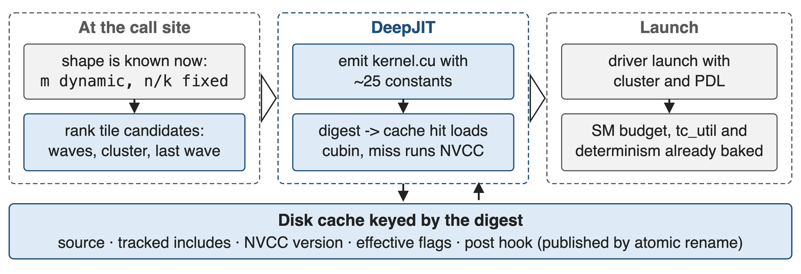
DeepJIT turns a call into a cached cubin
The digest covers the source, tracked includes, NVCC version, flags and post hook
7
Notes:
DeepJIT is now a separate header-only library with CUDA and Ascend backends. Entries are published by atomic rename with a .committed marker, so several processes can race on the same kernel and still share the result; DJ_JIT_CACHE_DIR can list a private cache in front of a read-only shared one.

Slide 8
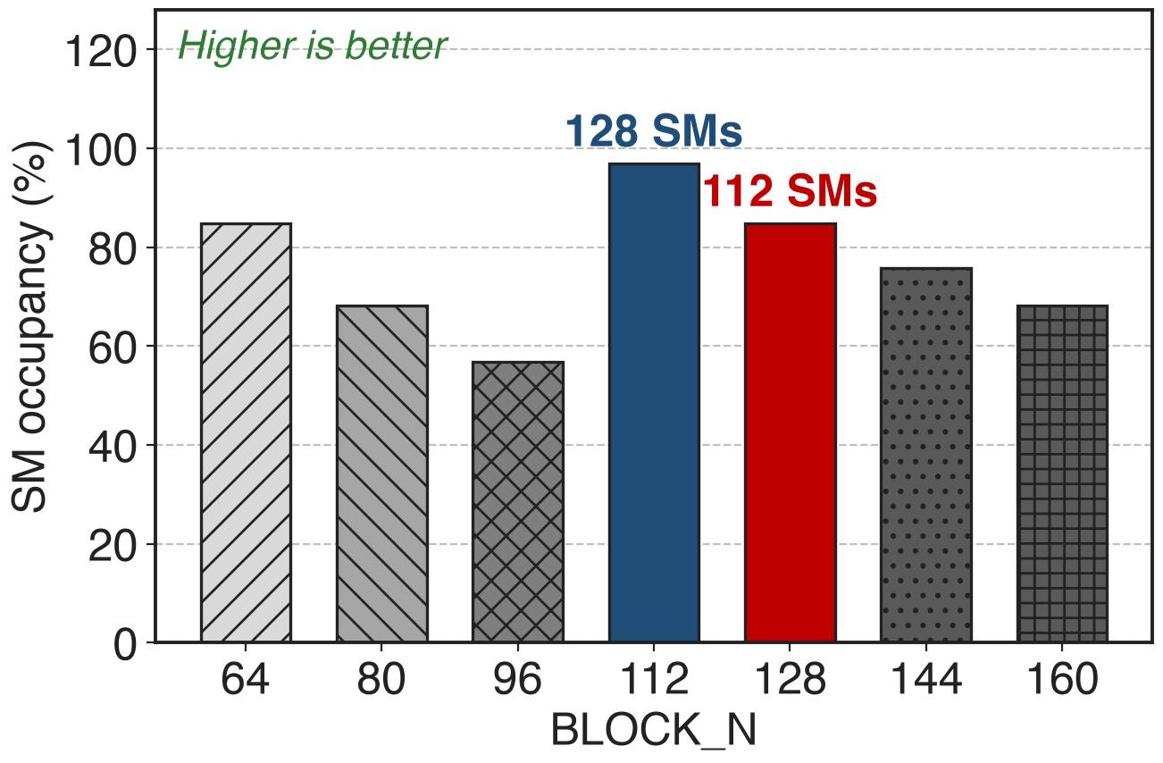
❶ The heuristic ranks tiles, never benchmarks
Candidates: swap-AB x BLOCK_M x BLOCK_N x cluster
Ranked by single wave, multicast, fewer waves, last-wave fill
analytic: blocks that get one of the 132 SMs at M = 256, N = 7168
8
Notes:
The ranking is a pure function of the shape, so the same call always compiles the same kernel - which is also what makes the numerics reproducible. The chart applies the heuristic's own occupancy formula across the BLOCK_N candidates; 112 and 128 are the two values the README names.

Slide 9
What the JIT burns into the generated source
BLOCK_M/N/K, pipeline stages, swizzle modes, cluster size, thread counts
num_sms, the tensor-core utilisation cap, the epilogue, the dtypes
set_tc_util(80) compiles in idle cycles after each MMA so the clock does not drop
9
Notes:
About 25 template arguments per instantiation. Because the SM budget is a constant, a GEMM can be told to use 100 of 132 SMs and leave the rest to communication kernels; because the utilisation cap is a constant, the kernel inserts a computed number of dummy cycles after each UMMA instead of branching at run time.

Slide 10
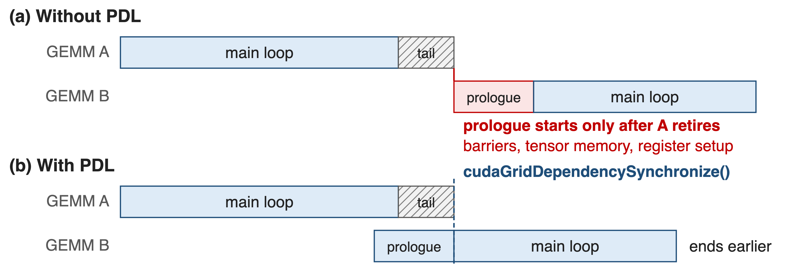
❷ PDL overlaps the next kernel's prologue
Every kernel calls cudaGridDependencySynchronize() after its own setup work
10
Notes:
The launch carries the programmatic-stream-serialization attribute, so the next grid may start while the previous one drains. DeepGEMM's kernels initialise barriers, allocate tensor memory and reconfigure registers first, and only then wait on the dependency - that prologue is the part that gets hidden. set_pdl() flips it for the whole library.

Slide 11
❸ One switch buys bitwise batch invariance
use_deterministic_algorithms(True): no cuBLASLt dispatch, no split-K
Mega mHC falls back to a fixed 16-way split, reduced in a later kernel
The test suite re-runs each GEMM 20 times and demands bitwise equality
11
Notes:
Batch invariance means a token's output does not depend on where it sits in the batch. Split-K breaks it because the number of partial sums changes with the shape, and cuBLASLt breaks it because its heuristics pick different kernels for different batch sizes. Since the 2026-09 release the switch defaults to False, so you opt in.

Slide 12
DeepSeek-V4 replaced cuBLAS to keep tokens stable
Goal: bitwise alignment across pre-training, post-training and inference
Split-K abandoned in most scenarios, then recovered by other optimisations
cuBLAS "cannot achieve batch invariance", so V4 replaced it end-to-end with DeepGEMM (§3.3)
12
Notes:
This is the payoff for RL and for debugging: when a loss spike appears you can replay the step and get the same bits. V4 reports that their matrix multiplication matches or surpasses split-K performance in most major scenarios, so batch invariance is not paid for in throughput.

Slide 13
The cost: the first call compiles
SGLang ships a precompile pass with a 3600 s default timeout; vLLM a warm-up module
Kernels must be compiled and loaded before CUDA Graph capture
The digest tracks includes, NVCC version and flags; other deps need extra_signature
13
Notes:
Be honest about the cold start: a serving stack that meets a new shape mid-flight pays a compile. Both major engines therefore walk the model once and compile everything first. The include parser is a line scanner, so a dependency it cannot see - CUTLASS, for example - has to be named in the signature or the cache will hand back a stale kernel.

Slide 14

Summary
A fixed tile can leave 20 of 132 SMs idle; the right tile fills 128
Insight: compile at the first call, when the shape is still a constant
Ranking without benchmarking, PDL overlap, SM and determinism switches baked in
Bitwise batch invariance on demand; V4 replaced cuBLAS end-to-end
https://github.com/deepseek-ai/DeepJIT
14
Notes:
Related decks: 25 for the DeepGEMM library, 30 for the dense GEMM and its scaling layout, 43 for TileLang's batch-invariant kernels.

