Slide 1
TileLang + Batch-Invariant Kernels
Same token, same bits, in training and serving
DeepSeek-AI · DeepSeek-V4
Explainer deck · Industrial Pretraining Architecture & Infra Tech Landscape (2026)
Kernel Fusion & Runtime · arxiv.org/abs/2606.19348

Slide 2
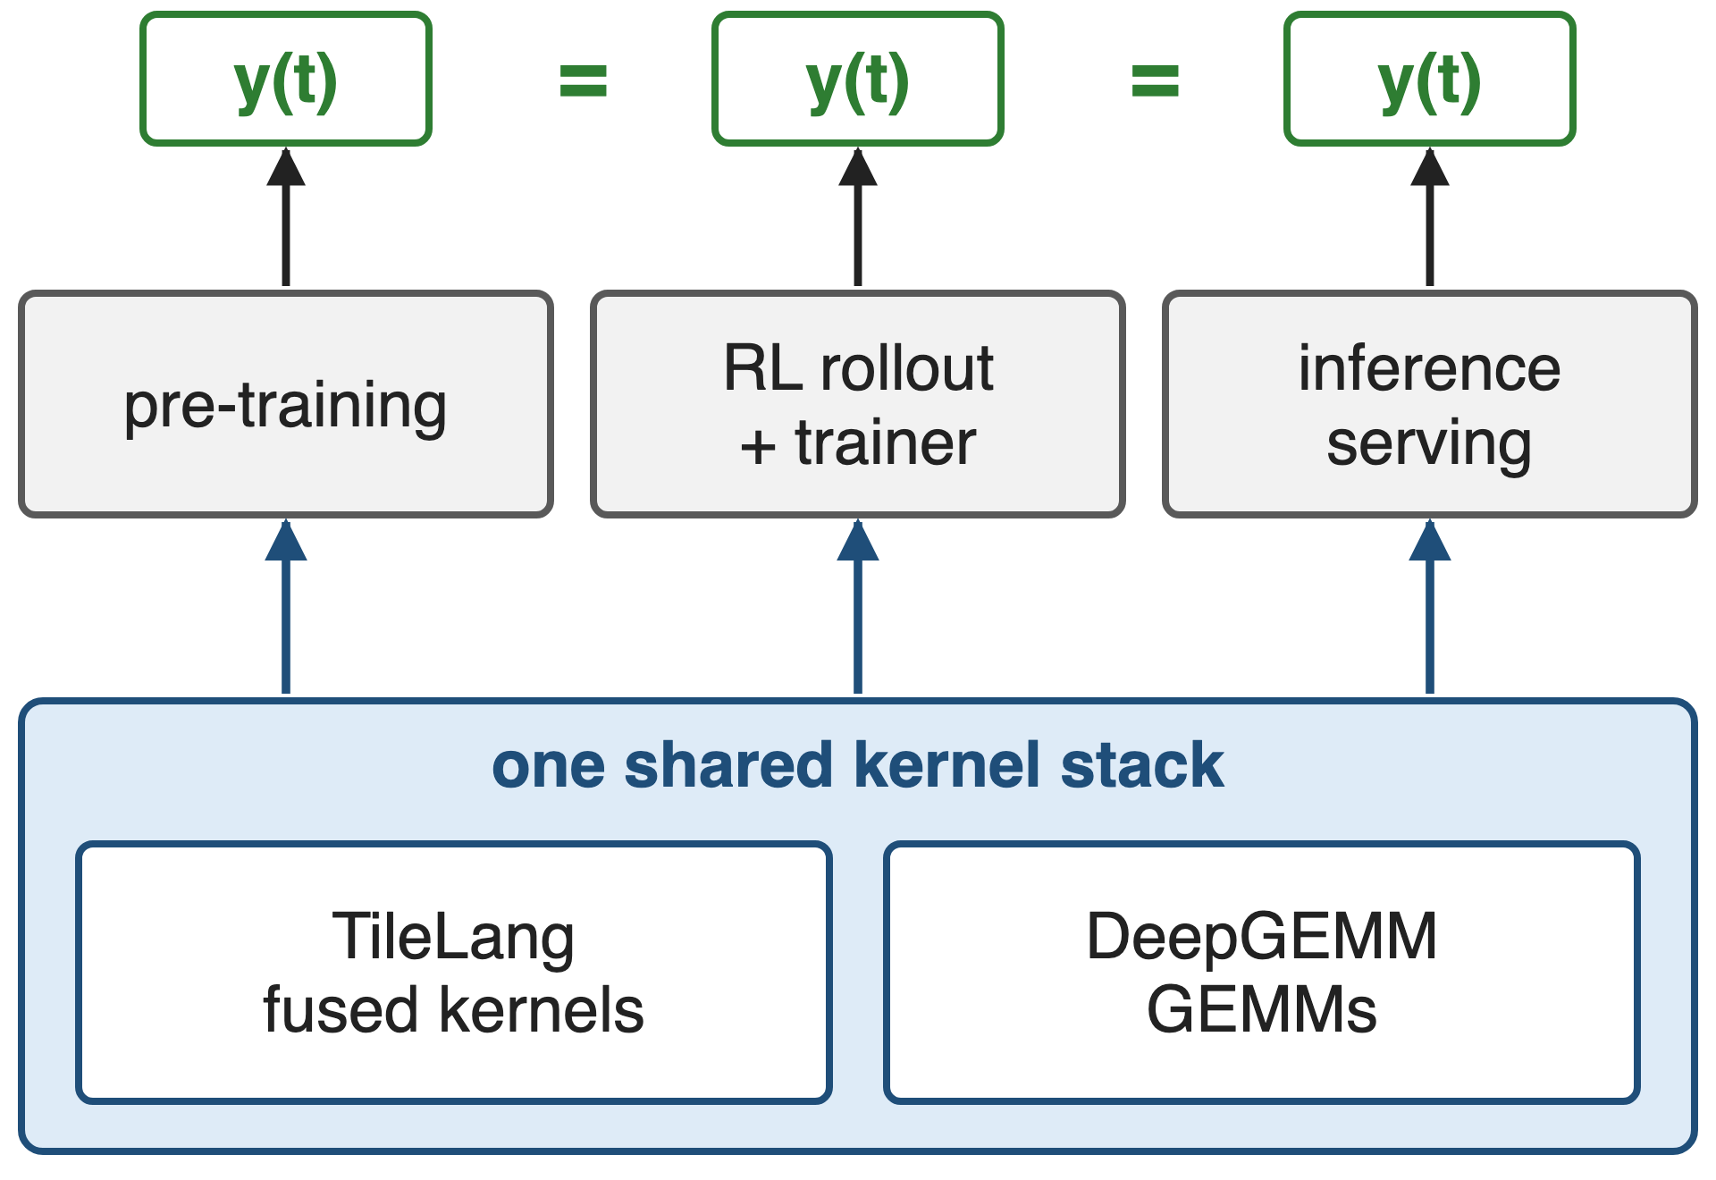
Pre-training, RL and serving must agree bit for bit
V4-Pro: 1.6T params, 49B active
New layers (CSA/HCA, mHC) would mean hundreds of small ATen ops
One kernel stack serves every pipeline
2
Notes:
DeepSeek-V4's architecture, with hybrid compressed attention and manifold-constrained hyper-connections, would otherwise run as hundreds of fine-grained PyTorch ATen operators. DeepSeek replaces most of them with fused kernels written in TileLang and runs all matrix multiplications on DeepGEMM. One design goal is that pre-training, post-training and inference produce bitwise identical results for the same token. Sources: DeepSeek-V4 abstract, §3.2, §3.3.

Slide 3
Same request, 80 different answers
80 / 1000
distinct completions from 1000 identical temperature-0 requests to Qwen3-235B served by vLLM
Thinking Machines Lab, "Defeating Nondeterminism in LLM Inference" (Sep 2025)
3
Notes:
DeepSeek does not publish a reproducibility measurement, so here is the size of the problem from Thinking Machines: the same prompt at temperature zero, sent 1000 times to Qwen3-235B on vLLM, gave 80 distinct completions; they first diverge at token 103, where 992 say "Queens, New York" and 8 say "New York City". For RL, the sampler and the trainer then compute different log-probabilities, so on-policy RL silently becomes off-policy. For pre-training, rerunning a loss spike does not reproduce it. Source: Thinking Machines blog, "How nondeterministic are completions?".

Slide 4
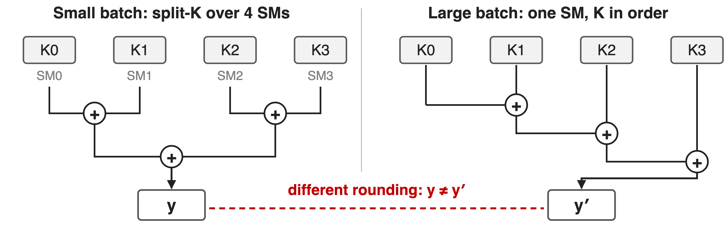
Reduction order follows the batch, not the token
K0–K3: partial dot products over four chunks of the reduction dimension (schematic)
Float addition is not associative: batch-dependent splits and atomics change the bits
4
Notes:
The villain is not randomness but order. Kernels pick their strategy from the batch shape: a small batch has too few output tiles, so split-K or split-KV spreads one reduction over several SMs and merges partial sums as a tree; a large batch reduces the same row sequentially on one SM. Same inputs, different rounding. In the backward pass, atomicAdd adds contributions in whatever order threads arrive. A request's output therefore depends on who else is in its batch, i.e. on server load. Sources: DeepSeek-V4 §3.3; Thinking Machines blog, "Batch invariance and determinism".

Slide 5
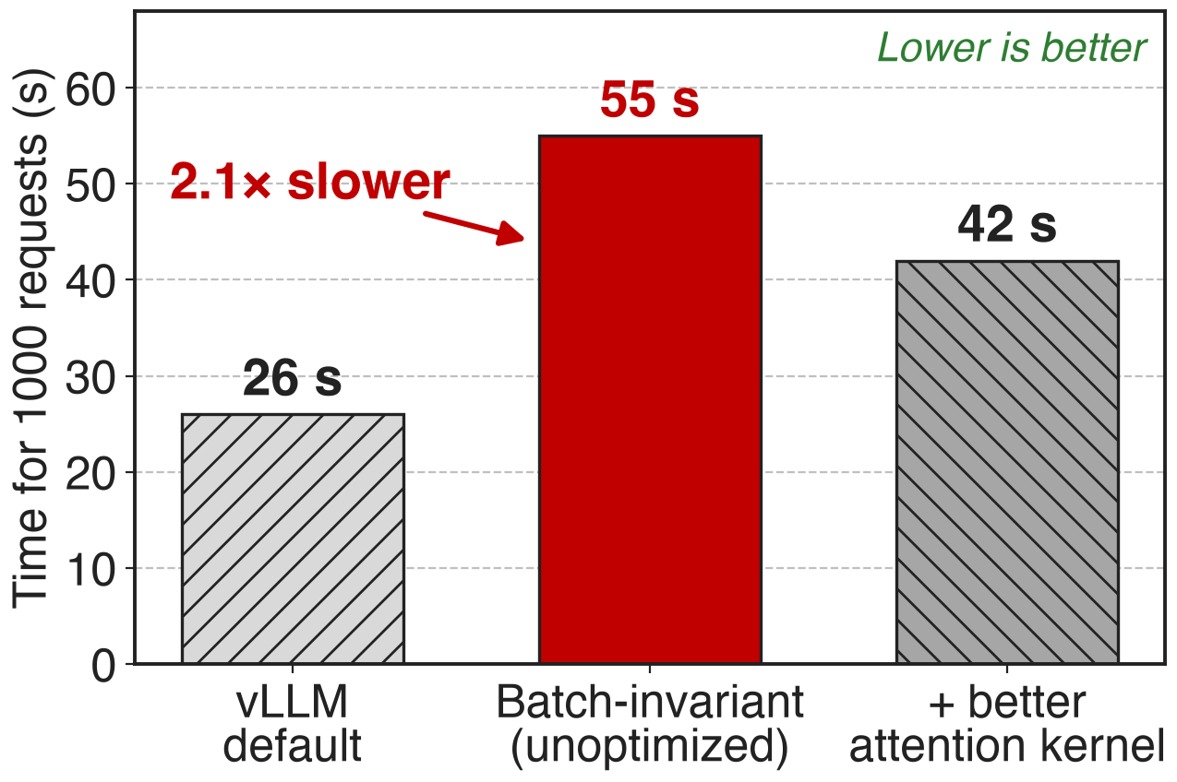
Naive batch invariance costs 2.1× serving time
One fixed kernel config: no split-K, no split-KV
Small batches and tail waves lose parallelism
Better attention kernel: still 1.6×
Thinking Machines, Qwen3-8B on one GPU; ratios derived
5
Notes:
The obvious fix is to use one kernel configuration for every shape and never split a reduction. Thinking Machines did exactly that in vLLM: 1000 requests took 55 seconds instead of 26, and 42 with an improved attention kernel. Their batch-invariant matmul alone was about 20% slower than cuBLAS. The other obvious fix, hand-writing hundreds of exact CUDA kernels, does not scale with V4's pace of architecture changes. Source: Thinking Machines blog, "Performance" and "Batch-invariant matrix multiplication"; 2.1x = 55/26 and 1.6x = 42/26 are derived.

Slide 6
Insight: fix the order, then add parallelism back
A token's bits depend only on its accumulation order
So fix that order per token, at every batch size
6

Slide 7
Insight: fix the order, then add parallelism back
A token's bits depend only on its accumulation order
So fix that order per token, at every batch size
Regain parallelism without reordering: spread tails across SMs, sum per-SM buffers in order
7
Notes:
Batch invariance means a token's output is bitwise identical regardless of its position within the batch. The observation behind DeepSeek's kernels is that parallelism and a fixed order are not in conflict, as long as extra parallelism is added around the order rather than by changing it: a tail sequence can be spread over several SMs if they combine in the single-SM order, and an atomic accumulation can become per-SM buffers summed in a fixed order. Source: DeepSeek-V4 §3.3.

Slide 8
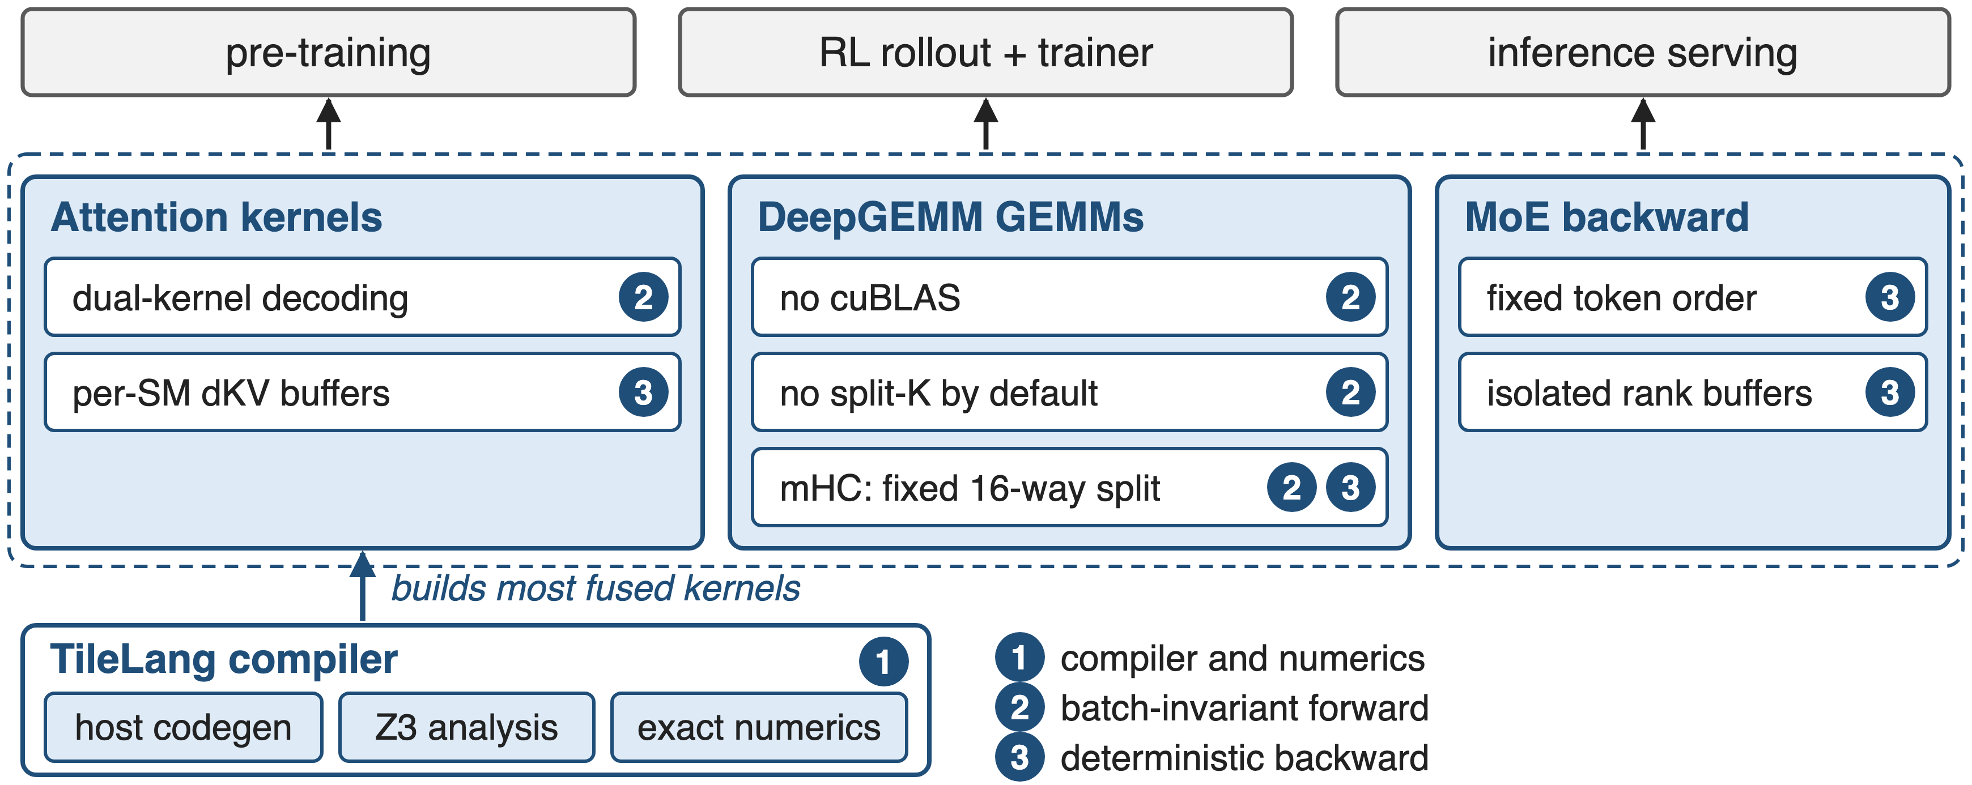
Three layers make V4's kernels reproducible
Where each fix lives in DeepSeek-V4 (§3.2–3.3)
8
Notes:
The overview. At the bottom, the TileLang compiler, which builds most of V4's fused kernels and adds host code generation, Z3-based integer analysis and exact numerics. In the middle, the kernels: attention, DeepGEMM matrix multiplications and the MoE backward. Mechanism 2 makes the forward pass batch-invariant; mechanism 3 makes the backward pass deterministic. All three pipelines on top share this stack. Sources: DeepSeek-V4 §3.2, §3.3; DeepGEMM mega_mhc.hpp for the fixed 16-way split.

Slide 9
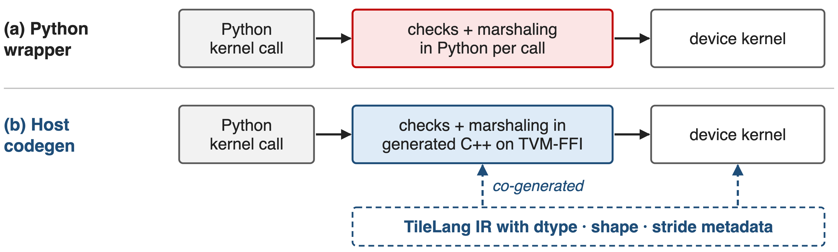
❶ TileLang generates the host launcher too
Per-call checks drop from tens–hundreds of µs in Python to under 1 µs
9
Notes:
As GPUs get faster, small kernels become dominated by fixed CPU overhead, and a common source is Python-side contract checks on every call. TileLang now co-generates the device kernel and a lightweight host launcher from the same IR, with the dtypes, shapes and strides embedded; the launcher is C++ on TVM-FFI, which has a compact calling convention and zero-copy tensor interop. DeepSeek measured the validation overhead dropping from tens or hundreds of microseconds to less than one microsecond per invocation. Source: DeepSeek-V4 §3.2 "Reducing Invocation Overhead with Host Codegen".

Slide 10
❶ TileLang keeps numerics exact by default
Exact by default: fast-math off
Approximations opt-in: T.__exp, T.__log
IEEE intrinsics: T.ieee_fdiv, explicit rounding
Bit-identical to CUDA: NVCC-aligned lowering
T.annotate_layout pins accumulation order
Z3 checks index math in seconds
A TileLang kernel can be tested bit for bit against its CUDA reference
10
Notes:
Fast-math is disabled at the compiler level; precision-affecting approximations exist only as explicit operators such as T.__exp, and when strict IEEE-754 semantics are needed there are intrinsics with explicit rounding modes. TileLang's simplification and lowering rules are aligned with NVCC, and layout annotations pin layout-dependent lowering, so the evaluation and accumulation order can match a hand-written CUDA kernel exactly. The Z3 SMT solver, using quantifier-free non-linear integer arithmetic, proves index facts for vectorization, barrier insertion and simplification at a compile cost of a few seconds. DeepSeek reports the conservative defaults remain competitive. Source: DeepSeek-V4 §3.2.

Slide 11
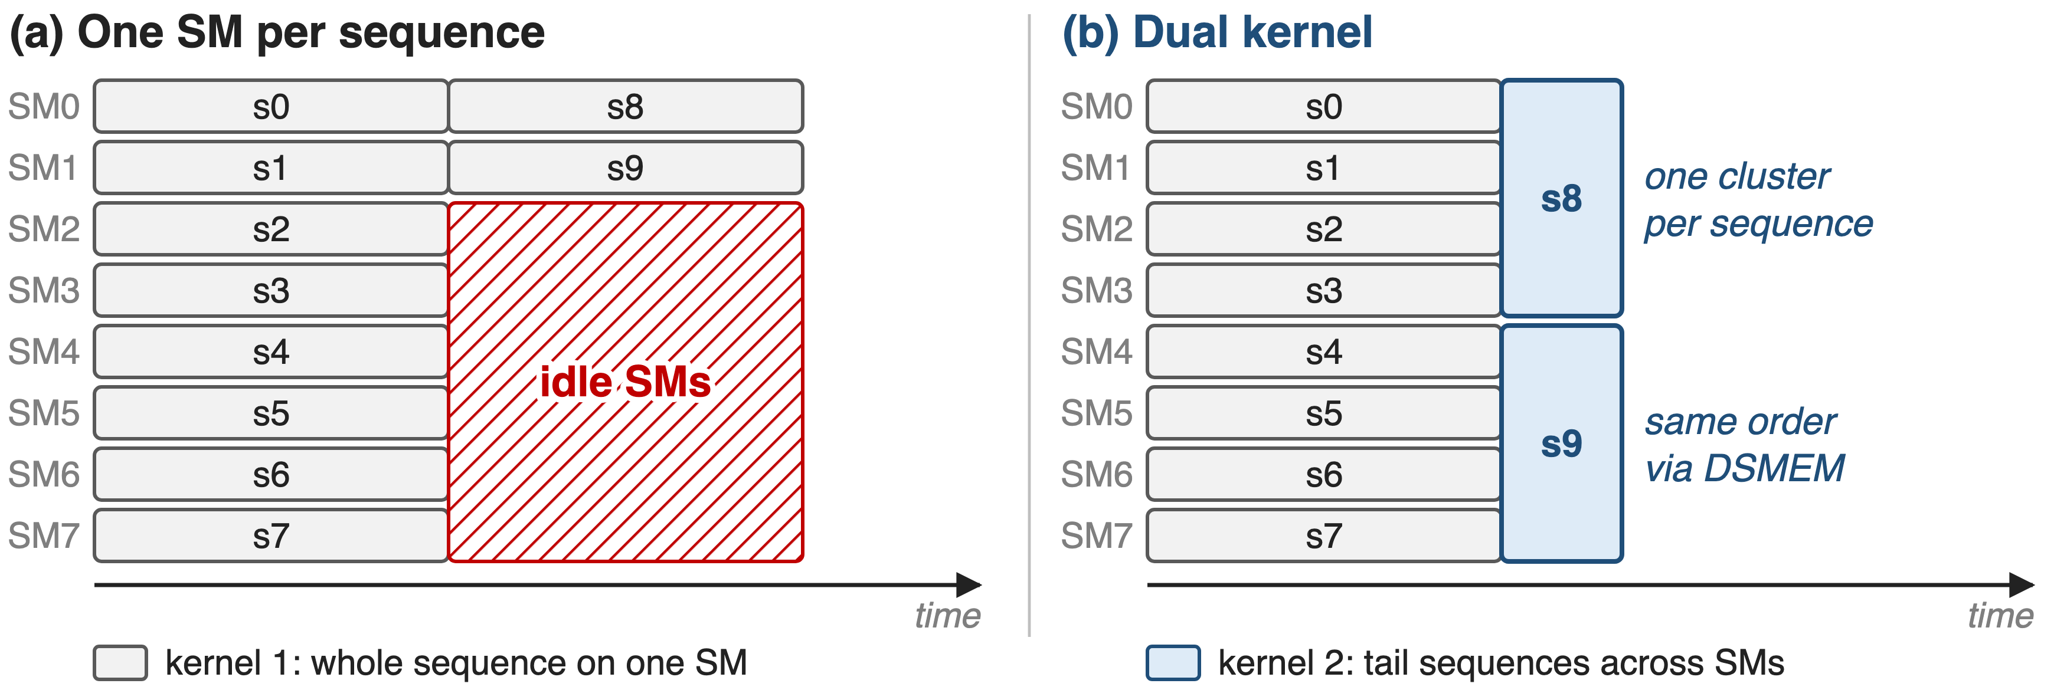
❷ Decode attention splits only the tail wave
No split-KV: the tail kernel follows kernel 1's accumulation order exactly
11
Notes:
Batch-invariant decoding cannot use split-KV, because how a sequence is split would depend on the batch. With one SM per sequence, full waves run at full throughput, but the last, partially filled wave leaves most SMs idle: wave quantization. DeepSeek uses two kernels. Kernel 1 computes a whole sequence on one SM for the full waves. Kernel 2 handles the final partial wave by spreading each sequence over the SMs of a thread-block cluster, exchanging data through distributed shared memory, along a calculation path designed to keep kernel 1's accumulation order. Which kernel a sequence lands in depends on the batch, but its bits do not. DeepSeek calls the overhead negligible. Schematic: 8 SMs, 10 sequences. Source: DeepSeek-V4 §3.3.

Slide 12
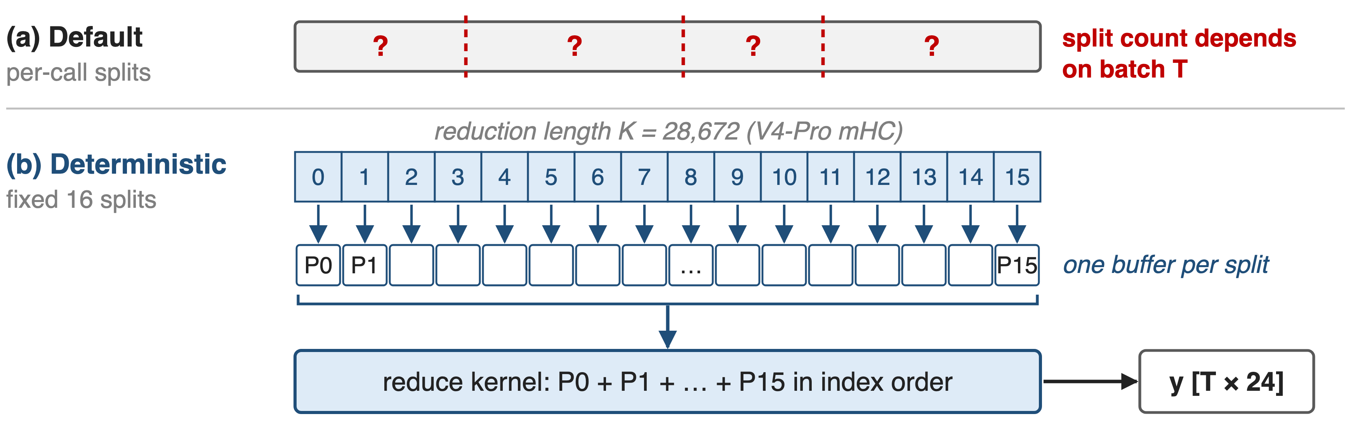
❷ GEMMs keep one K order at every batch
Elsewhere: DeepGEMM replaces cuBLAS end to end and drops split-K
12
Notes:
cuBLAS is not batch-invariant, so V4 replaces it end to end with DeepGEMM, and drops split-K in most scenarios, adding other optimizations so the GEMMs match or beat split-K in most major cases. One GEMM cannot avoid splitting: mHC's projection has only 24 output columns (4 + 4 + 16 for n_hc = 4) but a reduction length of 4 × 7168 = 28,672 on V4-Pro (both derived from the paper's configuration). DeepGEMM's deterministic mode always uses 16 splits, writes each split's partial output separately, and a later kernel reduces them in index order. Sources: DeepSeek-V4 §3.3; DeepGEMM csrc/apis/mega_mhc.hpp and layout/mega_mhc.cuh.

Slide 13
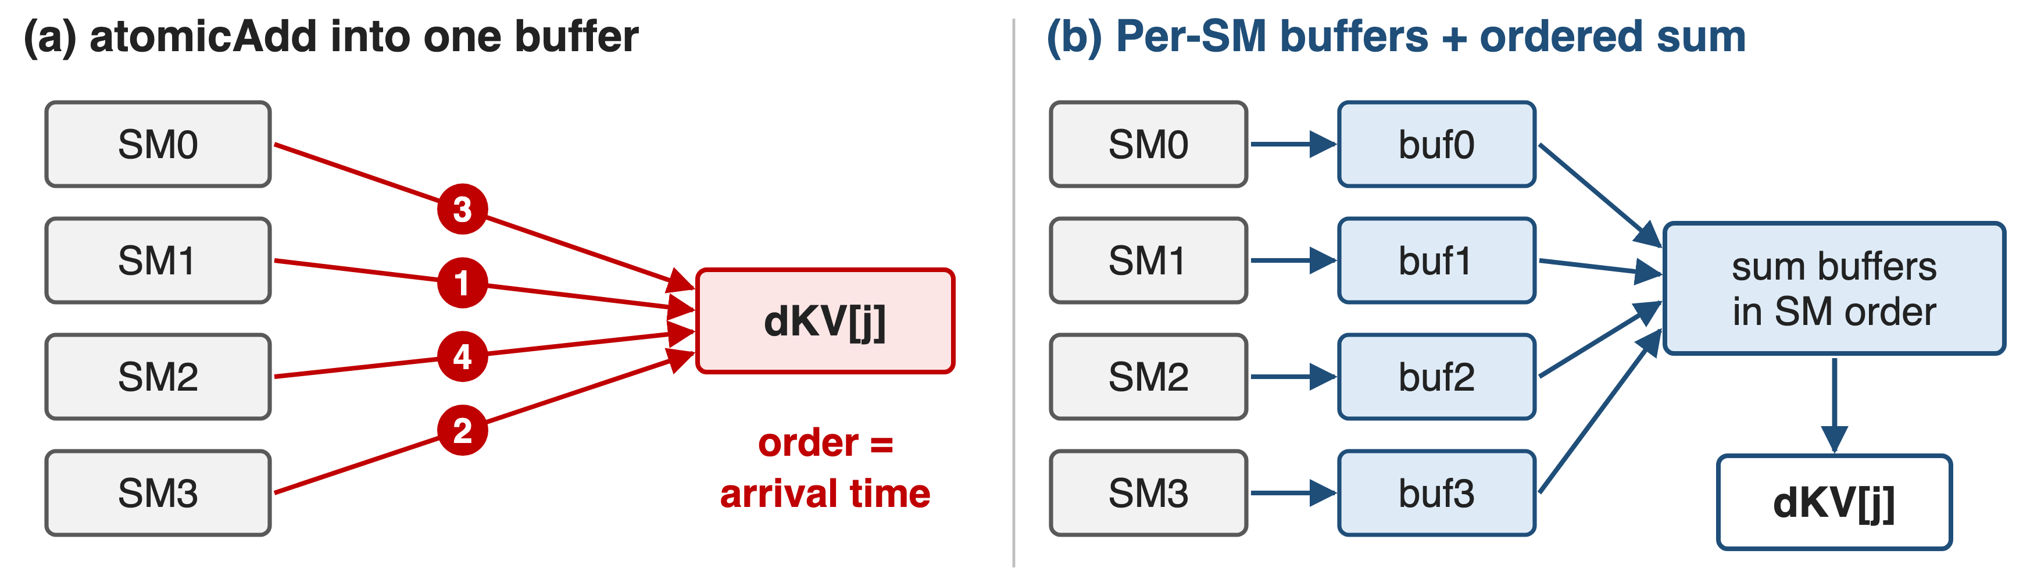
❸ Backward sums in a fixed order, not atomically
MoE backward: a fixed token order and per-rank buffers pin every write position
13
Notes:
Run-to-run non-determinism mostly comes from atomic additions in the backward pass. In sparse attention, many query blocks contribute to the gradient of the same KV token; with atomicAdd the order is whatever order SMs arrive in. V4 gives each SM its own accumulation buffer and then performs a global deterministic summation. In the MoE backward, SMs from different ranks writing into the same receive buffer would negotiate write positions at run time; V4 pre-processes the token order within each rank and isolates buffers across ranks, which fixes both what expert parallelism sends and the accumulation order. Source: DeepSeek-V4 §3.3 "Determinism".

Slide 14
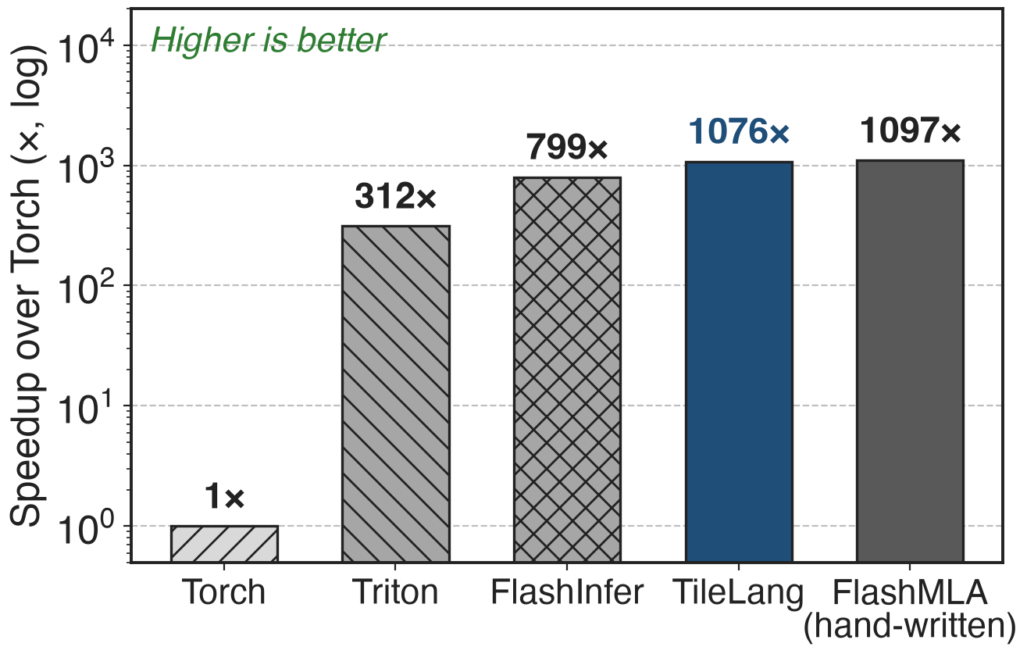
TileLang reaches 98% of FlashMLA in ~70 lines
MLA decoding on H100 (TileLang paper)
Hand-written FlashMLA: 1097× over Torch
TileLang: 1076×, about 70 lines of Python
The DSL costs little speed: 98% of the hand-written kernel
14
Notes:
Is the DSL a performance compromise? In the TileLang paper's MLA decoding benchmark on H100, the TileLang kernel reaches up to 98 percent of hand-optimized FlashMLA, ahead of FlashInfer and Triton, in about 70 lines of Python. This is TileLang's own 2025 benchmark, not a DeepSeek-V4 measurement; DeepSeek only says that TileLang kernels remain competitive under conservative numeric defaults. Source: TileLang paper arXiv 2504.17577, §5.2 and Fig. 14(a).

Slide 15
The cost: own kernels, lost split-K, no numbers
No published overhead: only "minimal"
Split-K dropped in most GEMMs
Every GEMM from DeepGEMM, none from cuBLAS
Tail kernel needs clusters and DSMEM
Invariant to batch position, not parallel layout
Z3 adds seconds of compile time
15
Notes:
DeepSeek publishes no overhead or reproducibility numbers for V4, only "minimal" and "negligible". Dropping split-K needs other GEMM optimizations to stay fast, and the guarantee requires owning every GEMM: cuBLAS is gone from the stack. The tail-wave kernel relies on thread-block clusters and distributed shared memory, available since Hopper. The guarantee is about a token's position in a batch and alignment across pre-training, post-training and inference; the paper does not claim invariance across different parallel layouts. Sources: DeepSeek-V4 §3.2-3.3. Related: deck 39 (DeepJIT determinism switches), deck 25 (DeepGEMM).

Slide 16

Summary
Non-invariant kernels: 80 / 1000 distinct answers (Qwen3, vLLM)
Insight: fix each token's accumulation order, add parallelism around it
TileLang: host checks < 1 µs, 98% of FlashMLA
V4: batch-invariant forward, deterministic backward
https://arxiv.org/abs/2606.19348
16
Notes:
Reproducibility is a kernel property: decide each token's accumulation order once, and spend engineering on keeping parallelism without changing it. Related decks: 14 (Mega MoE, whose fused output is tested bit-identical to the non-fused path), 25 (DeepGEMM), 39 (DeepJIT and determinism switches), 61 (mHC), 63 (anticipatory routing, where reproducible runs help chase loss spikes). Sources: DeepSeek-V4 §3.2-3.3; Thinking Machines blog; TileLang paper.

