Slide 1
FP8 Training and FP8 Activation Compression
Per-tensor and blockwise FP8 GEMMs, FP8-cached activations
NVIDIA Transformer Engine · Megatron-Core · DeepSeek-V3 · Kimi K2
Explainer deck · Industrial Pretraining Architecture & Infra Tech Landscape (2026)
Low-Precision & Quantization · github.com/NVIDIA/TransformerEngine

Slide 2
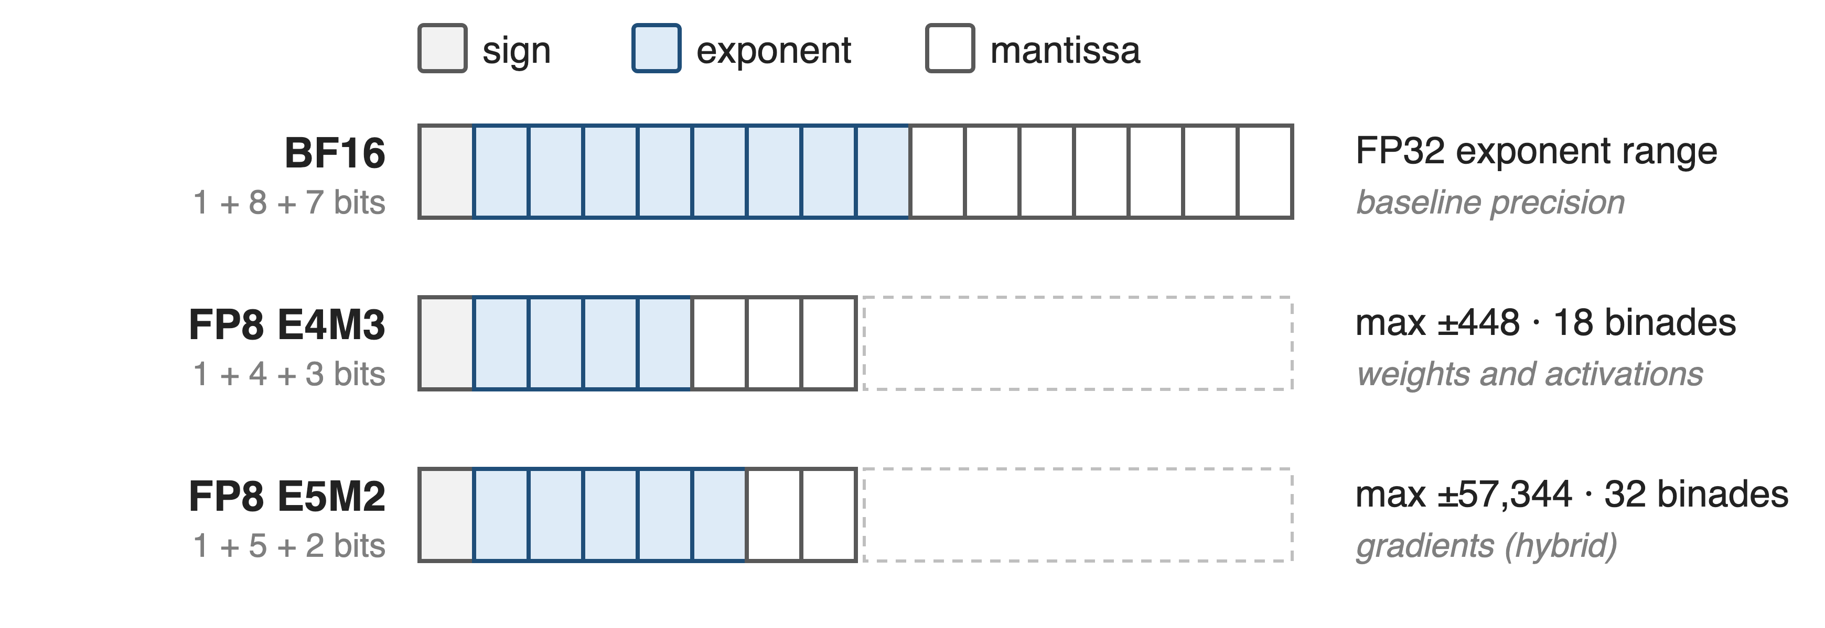
Hopper pretraining runs its GEMMs in 8-bit floats
DeepSeek-V3 (671B MoE, 14.8T tokens) ran every linear-layer GEMM in FP8 on H800s
2
Notes:
FP8 is two formats: E4M3 with 3 mantissa bits and a max of 448, and E5M2 with 2 mantissa bits and a max of 57,344; BF16 keeps FP32's 8-bit exponent. This deck is rung one of a precision ladder: FP8 on Hopper here, MXFP8 on Blackwell in deck 47, NVFP4 in deck 48. Sources: FP8 Formats for Deep Learning (arXiv 2209.05433) Table 1 and Sec. 3.1; DeepSeek-V3 report Sec. 3.3 and abstract.

Slide 3
BF16 training leaves the FP8 tensor cores idle
1.92×
raw FP8 GEMM speed over BF16 on H200, 5B-model shapes
The catch: E4M3 spans only 18 binades per scale
Transformer Engine docs, "GEMM Speedups Across Precisions": 5B model on H200 NVL, pre-quantized inputs
3
Notes:
With inputs already in FP8, TE measures 1.92x the BF16 GEMM throughput for a 5B model's shapes on H200. Getting there in training means fitting activations, weights and gradients into 8 bits, and E4M3 spans just 18 binades for any one scale factor (FP8-formats paper Sec. 3.1).

Slide 4
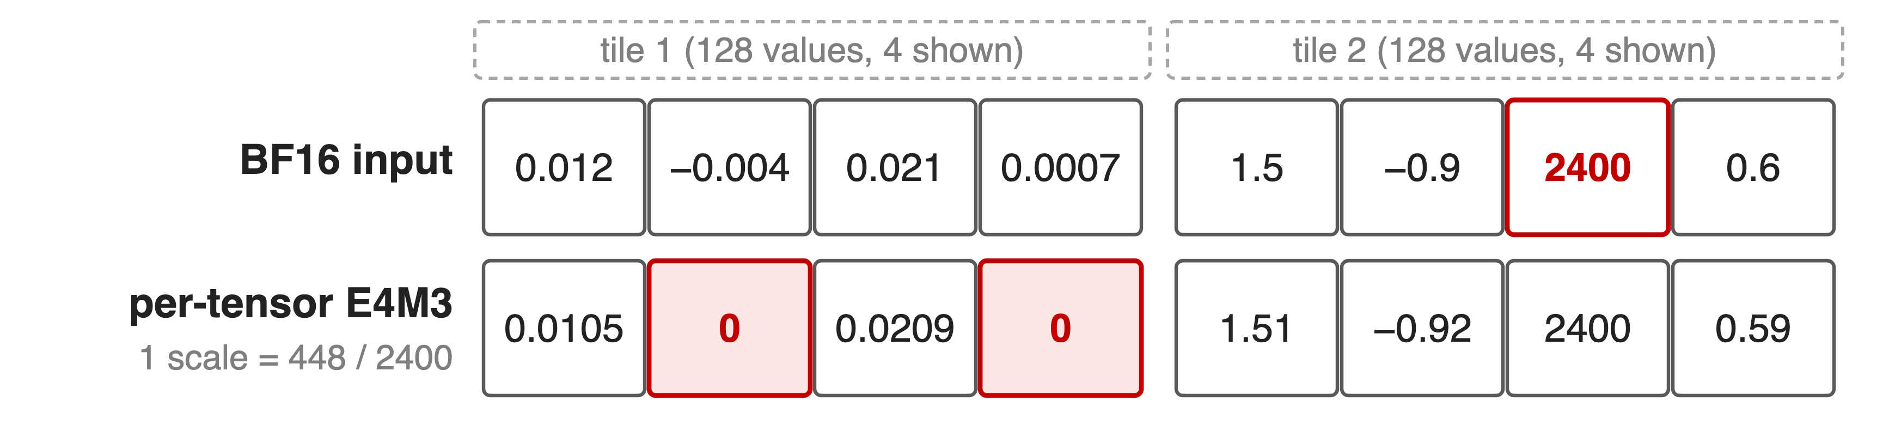
One scale per tensor lets outliers erase values
One outlier (2400) sets the scale; small values fall below E4M3's 2⁻⁹ floor and flush to 0
4
Notes:
Worked example computed with round-to-nearest-even E4M3 and scale 448/amax (sources.md, analytic). FP16's single global loss scale cannot work for FP8, so TE gives every tensor its own scale (TE FP8 primer). Delayed scaling makes this worse: it predicts amax from a history window, and Megatron-Core does not recommend it for precision reasons (arXiv 2603.07685 Sec. 5.3.1). Current scaling fixes staleness but costs a second pass over the tensor and still has one scale; gradients then need E5M2 with only 2 mantissa bits.

Slide 5
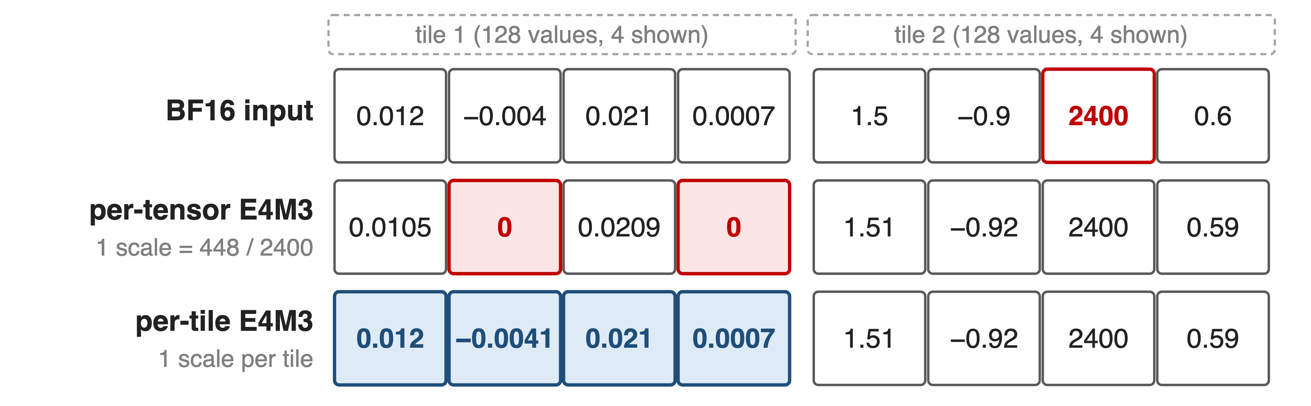
Insight: outliers are local, so scales must be local
Give every 128 values their own scale, and E4M3 holds activations, weights and gradients
5
Notes:
DeepSeek-V3 observes that outliers follow tokens and channels, so a scale per small group effectively shares exponent bits within the group; with that, it uses E4M3 for all tensors instead of the hybrid E4M3/E5M2 split (DeepSeek-V3 Sec. 3.3.2, "Mantissa over Exponents"). Same worked example: tile 1 now gets its own scale and keeps all four values.

Slide 6
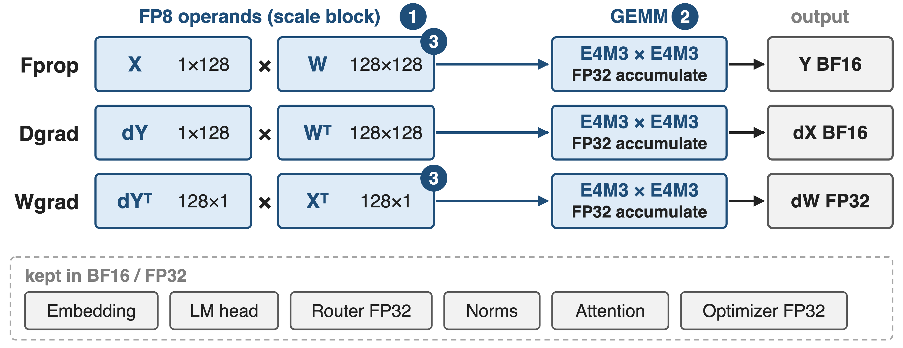
Each linear layer runs three GEMMs in FP8
❶ scale blocks · ❷ FP32 accumulation · ❸ FP8 caching and FP8 all-gather
6
Notes:
Fprop, Dgrad and Wgrad all take FP8 inputs and write BF16 or FP32 (DeepSeek-V3 Fig. 6, Sec. 3.3.1; TE Performance Considerations Table 2 for which operand is read rowwise or columnwise). Embedding, LM head, router, norms and attention stay in BF16 or FP32, as do master weights, gradients and optimizer states (DeepSeek-V3 Sec. 3.3.1; Megatron-Core report Sec. 5.1). Three mechanisms follow, numbered as in the figure.

Slide 7
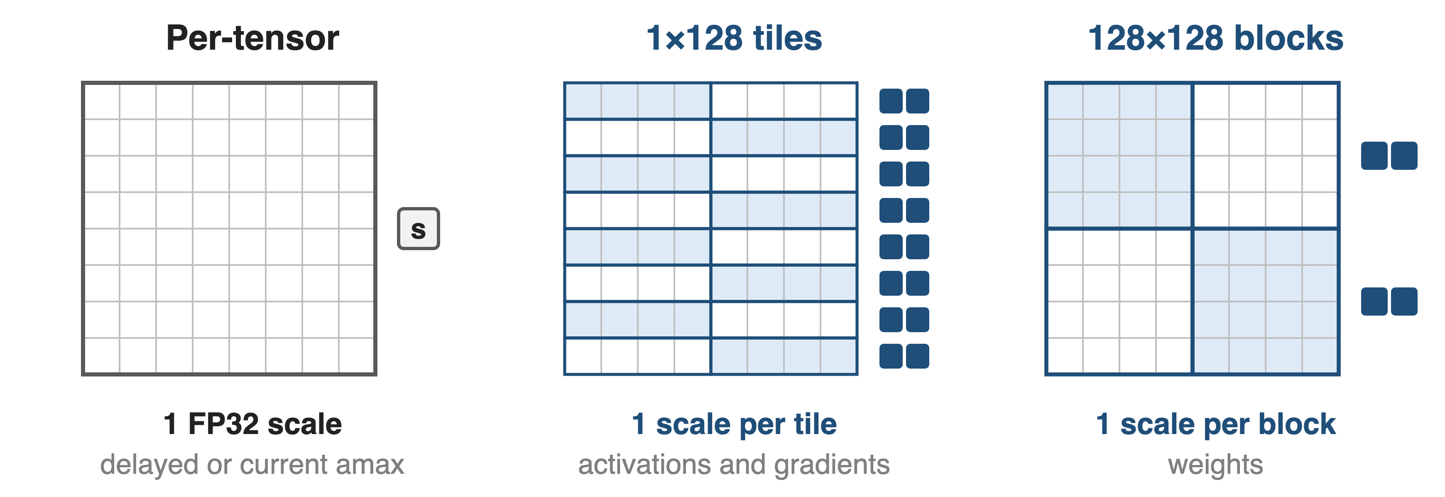
❶ Scale each 1×128 tile and 128×128 block
Scale = 448 / amax of the block, rounded down to a power of 2, kept in FP32
7
Notes:
TE's Float8BlockScaling (the DeepSeek-V3 scheme): activations and gradients use 1x128 tiles, one scale per token per 128 channels; weights use 128x128 blocks. Scales are computed online from the current block amax, so there is no amax history and no cross-rank scale synchronization (TE FP8 Blockwise Scaling docs; DeepSeek-V3 Sec. 3.3.2 "Online Quantization").

Slide 8
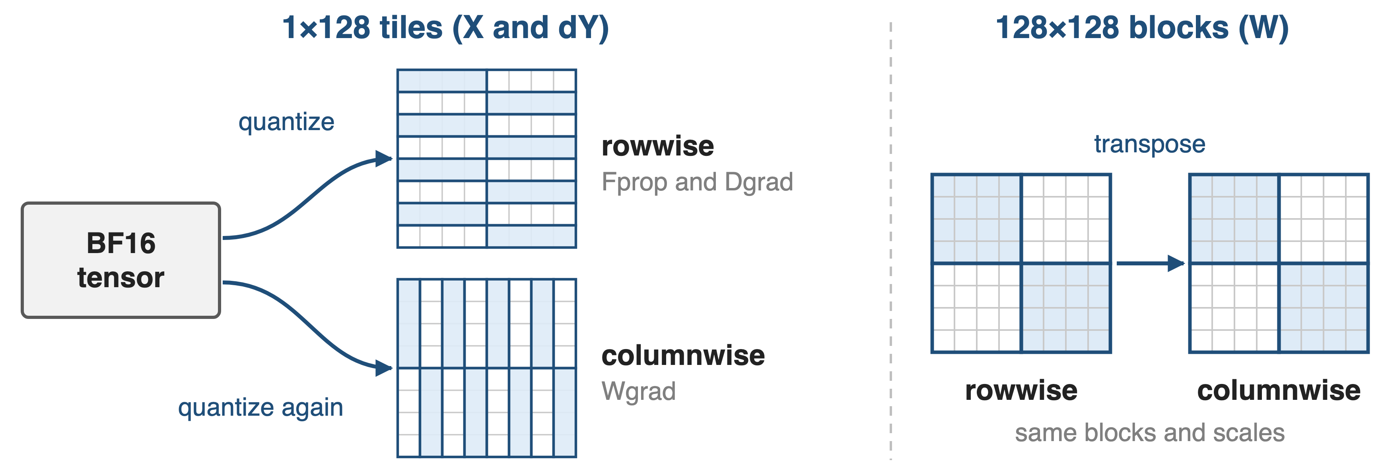
❶ Row tiles must be quantized twice
Why not 128×128 everywhere? Block-scaled activation gradients diverged a 16B MoE at ~300B tokens
8
Notes:
Wgrad reads X and dY columnwise, and Hopper FP8 GEMMs need that operand physically transposed. A 1x128 tile and a 128x1 tile cover different elements, so TE quantizes both copies from the BF16 source; a 128x128 block covers the same elements either way, so data and scales are just transposed (TE FP8 Blockwise Scaling docs, "Handling transposes"). DeepSeek-V3 App. B.2 tried 128x128 for Dgrad tensors and the 16B MoE diverged after about 300B tokens.

Slide 9
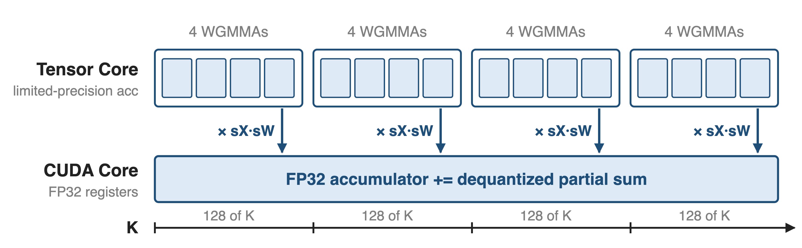
❷ Accumulate in FP32 every 128 elements
H800 FP8 tensor cores keep ~14 accumulator bits: nearly 2% max error at K = 4096
9
Notes:
DeepSeek-V3 Sec. 3.3.2, "Increasing Accumulation Precision": after 128 elements of K (4 WGMMAs) the partial result moves to FP32 registers on CUDA cores, where it is multiplied by the two per-group scales and added. One promotion interval equals one scale group, so dequantization is free there; two warpgroups overlap promotion and MMA to keep tensor cores busy.

Slide 10
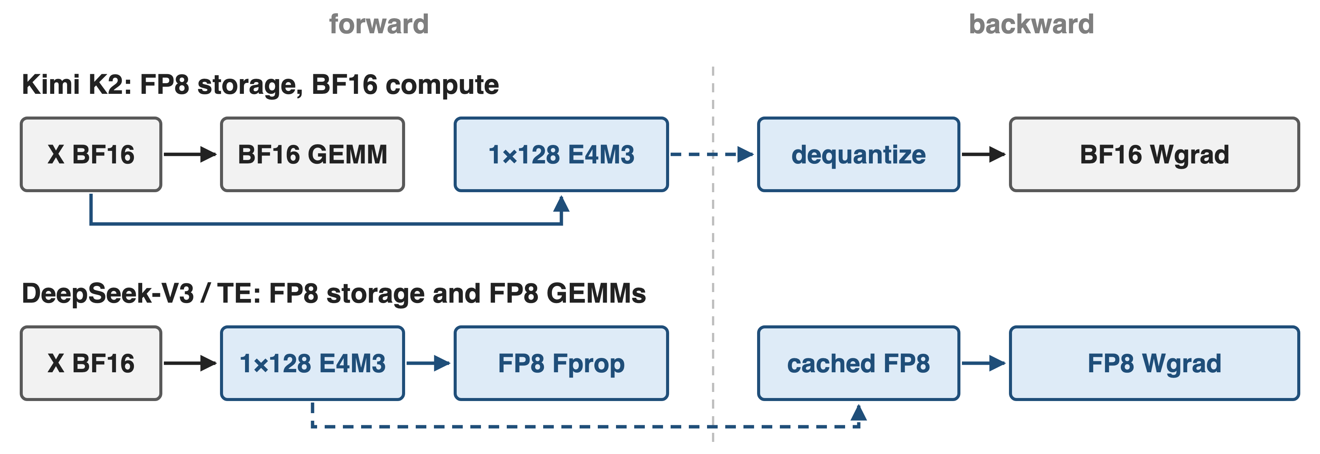
❸ Cache activations in FP8, even for BF16 GEMMs
Kimi K2: MoE up-projection and SwiGLU inputs as 1×128 E4M3 tiles, no measurable loss increase
10
Notes:
Kimi K2 Sec. 2.4.3: those inputs are compressed to FP8-E4M3 in 1x128 tiles with FP32 scales; K2 deliberately does not run FP8 GEMMs because preliminary studies showed risk. DeepSeek-V3 Sec. 3.3.3 caches FP8 inputs for Wgrad, keeps the linear after attention in a custom E5M6 format, and recomputes SwiGLU from FP8 inputs. Each cached tensor costs about 1.03 bytes per element instead of 2 (derived: 128 bytes plus a 4-byte scale per tile).

Slide 11
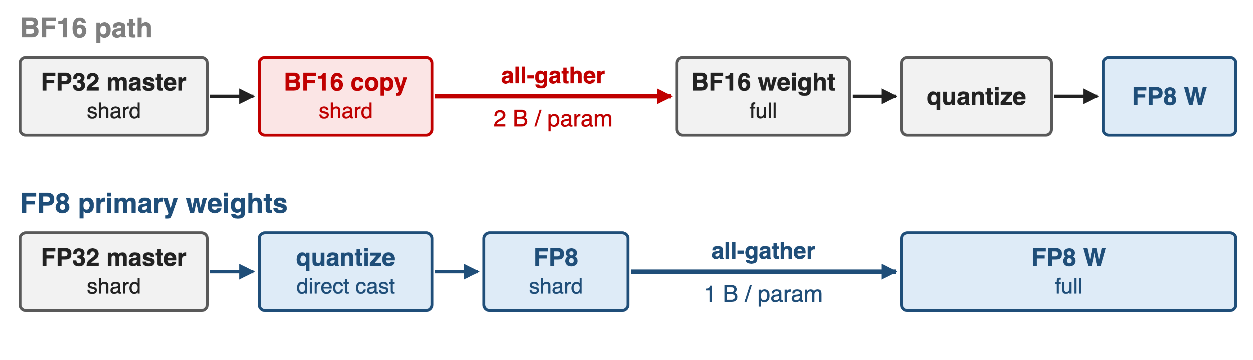
❸ Cast FP32 masters straight to FP8 for all-gather
Half the all-gather bytes and no BF16 weight copy; MXFP8 cannot do this (deck 47)
11
Notes:
Megatron-Core "FP8 primary weights" (--fp8-param-gather): after the optimizer step, FP32 shards are quantized directly to FP8, so the parameter all-gather moves 1 byte per parameter instead of 2 (arXiv 2603.07685 Sec. 5.2.2 and 5.3.5). Per-tensor recipes all-reduce the amax first; blockwise needs a 2D-aware amax kernel. MXFP8 still gathers BF16 because it would need both quantization directions. EP dispatch in FP8 is the same idea for tokens: deck 18.

Slide 12
Blockwise FP8 stays within 0.25% of BF16 loss
< 0.25%
relative loss error vs BF16: 16B MoE (1.33T tokens), 230B MoE (0.9T tokens)
Per-tensor FP8 (simulated): GPT-175B perplexity 6.68 vs 6.65
DeepSeek-V3 Technical Report, Sec. 3.3 and App. B.1 (1×128 / 128×128 scales + FP32 promotion)
12
Notes:
DeepSeek-V3 validated the full recipe on two MoE models before using it for the 14.8T-token run; the relative loss error stayed below 0.25%. The older per-tensor evidence, from the FP8-formats paper Table 4, used simulated FP8 and reports GPT-175B at 75% of training: 6.68 FP8 vs 6.65 16-bit perplexity.

Slide 13
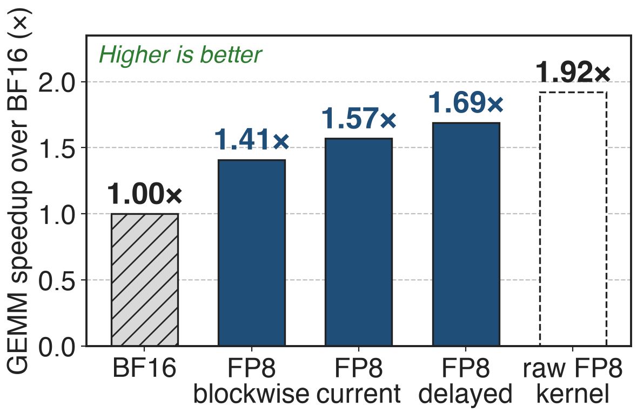
FP8 GEMMs run 1.4–1.7× faster than BF16 on H200
Includes per-step quantization (5B model)
Blockwise is slowest: Hopper emulates block scales
End to end: ~10–25% for large MoE
At scale: DeepSeek-V3 on 1,024 H100s reaches 368 TFLOPS/GPU with blockwise FP8
13
Notes:
TE "GEMM Speedups Across Precisions", 5B model (hidden 4096, FFN 16384, 24 layers) on H200 NVL in autocast mode: delayed 1.69x, current 1.57x, blockwise 1.41x; raw pre-quantized FP8 1.92x. The gap to 1.92x is the quantization work. Megatron-Core reports roughly 10-25% end-to-end gains for large-scale MoE (Sec. 4.3.5) and 368 TFLOPS/GPU for DeepSeek-V3 on 1,024 H100 with FP8-BLK (Table 11).

Slide 14
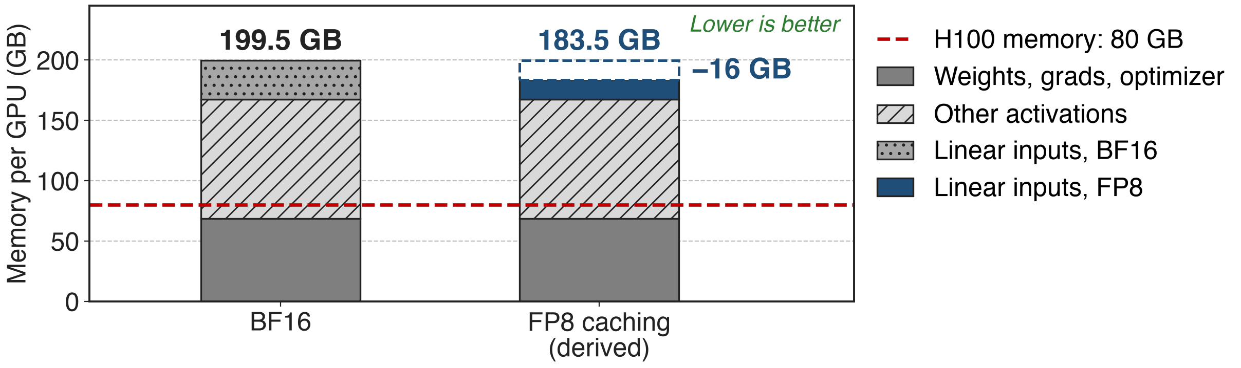
FP8 caching saves ~16 GB of activations per GPU
Only ~32 of 131 GB are FP8-eligible; pair with recompute (deck 52) and offload (deck 54)
14
Notes:
Megatron-Core report Table 3: DeepSeek-V3 in BF16 with PP4 x VPP4 x EP64 on 256 GPUs needs 199.5 GB per GPU, 131 GB of it activations. FP8 halves the roughly 32 GB of linear-layer inputs saved for backward, saving about 16 GB, about 12% (Sec. 4.1.3). The FP8 bar is derived: 199.5 minus 16. So "activations halved" holds per cached tensor, not for the whole model.

Slide 15
The price: emulated scales, copies, padding
Hopper emulates block scales: 1.41× vs 1.69× per-tensor
Two FP8 copies per 1×128 tensor; BF16-weight layers save no memory
Shapes must divide by 128; MoE pads tokens per expert
On Blackwell, MXFP8 (deck 47) makes block scaling native; NVFP4 (deck 48) goes to 4 bits
15
Notes:
TE FP8 Blockwise docs: block-scaled GEMMs are software-emulated on Hopper. TE Performance Considerations: a 1024x1024 Linear uses 6.00 MB after forward in BF16 and 6.02 MB in FP8 with BF16 weights, because the FP8 weight copy offsets the FP8 input. Alignment: blockwise needs the last dimension and the leading product divisible by 128; Megatron-Core pads tokens per expert to 128 (Sec. 5.4.1). Router, embeddings, head and attention stay in high precision. TE runs Float8BlockScaling on Blackwell by emulating it with MXFP8.

Slide 16

Summary
BF16 leaves 1.92× raw FP8 GEMM speed unused on H200
Insight: outliers are local, so scale per 1×128 tile / 128×128 block and accumulate in FP32
< 0.25% loss gap; 1.41–1.69× GEMM speedup; ~16 GB activations saved
Next rungs: MXFP8 (deck 47), NVFP4 (deck 48)
https://github.com/NVIDIA/TransformerEngine
16
Notes:
Pain: 1.92x raw FP8 GEMM throughput idle under BF16 (TE docs). Insight: local scales let E4M3 hold every tensor; FP32 promotion every 128 elements fixes Hopper's 14-bit accumulation. Results: DeepSeek-V3 under 0.25% loss error; TE 1.41x to 1.69x GEMM speedups on H200; Megatron-Core about 16 GB of DeepSeek-V3 activations saved.

