Slide 1
Work Introduction Slides
Zerui Wang @ Shanghai Jiao Tong University

Slide 2
SchedMate: Semantic-Aware Scheduling for GPU Clusters with LLMs

Slide 3
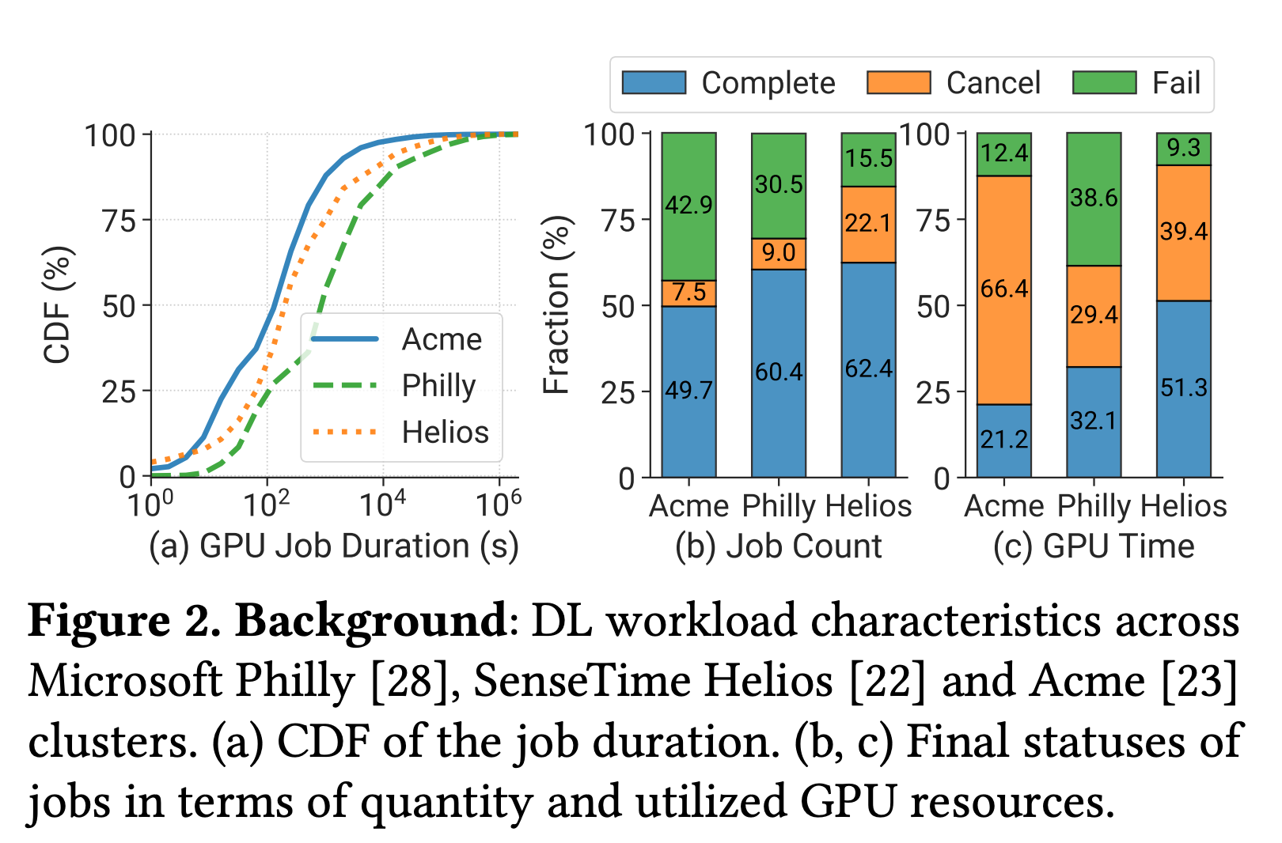
Motivation: The Semantic Gap
现有 DL 集群调度器的核心问题：
1. 高性能分析开销 (High Profiling Overhead)
调度器需要耗费大量时间来 profiling，短任务可能profiling时间会超过任务本身
2. 不可靠的时长估计 (Unreliable Duration Estimation)
仅依赖有限的 metadata，无法准确预测作业运行时间
3. Failure Handling 缺失
无法理解运行日志中的错误语义，难以智能处理故障
4. 可观测性差 (Poor Observability)
缺乏对作业语义的深层理解，运维人员难以获得有意义的洞察

Slide 4
SchedMate: Semantic-Aware Scheduling
Core Idea
DL 调度器无法理解 Job 的语义信息，导致资源分配效率低下。
SchedMate 利用 LLM 从源代码、运行日志和历史作业中提取深层语义，弥合 Scheduler 和 Job 之间的 Semantic Gap
Three LLM-based Components:
1) Schedule Advisor: 从源代码提取模型架构与训练配置语义
2) Metric Tracker: 实时追踪训练指标，预测作业进度与剩余时间
3) Failure Handler: 理解日志错误语义，智能诊断故障根因
Key Result: 在 128-GPU 集群上，平均作业完成时间（JCT）降低达 1.91x

Slide 5
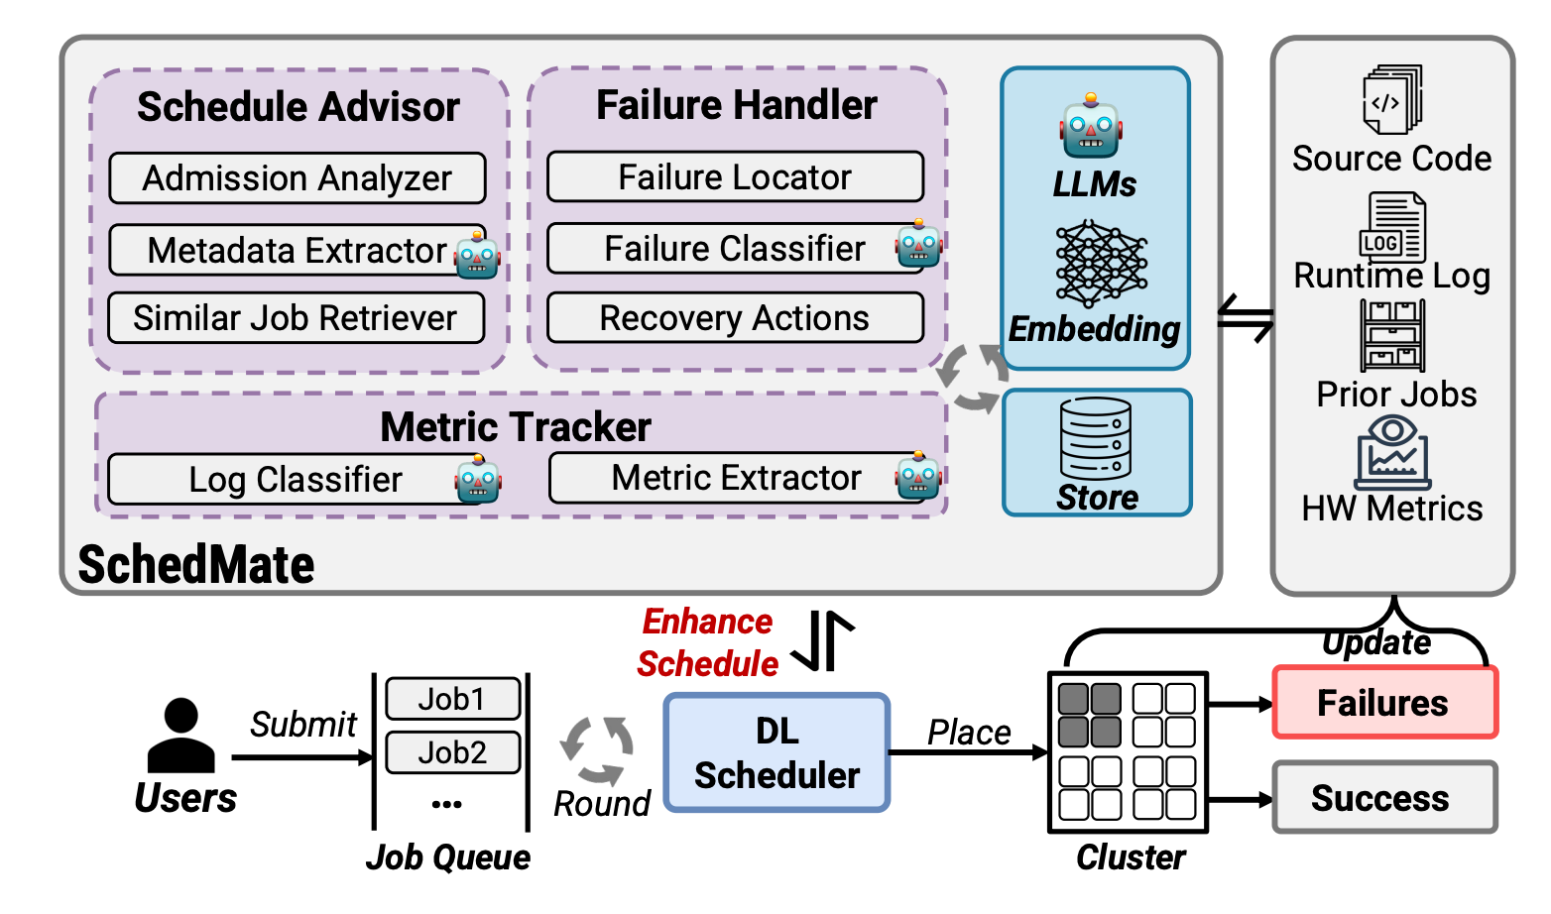
SchedMate Framework
SchedMate 通过三个基于 LLM 的组件，非侵入式地增强现有调度器：
1. Schedule Advisor
分析作业源代码，提取模型架构、训练配置等语义信息，降低 profiling 开销
2. Metric Tracker
以非侵入的方式从日志中提取调度器需要的metric信息
3. Failure Handler
理解运行日志中的错误语义，智能识别故障根因并提供处理建议
Design Principle: 非侵入式设计，作为模块化库实现在 Ray 之上，可无缝接入现有调度器而无需修改任务代码，无需对任务有任何侵入

Slide 6
Contributions & Results
Contributions
• 提出语义感知的 DL 集群调度新范式
• 设计三个 LLM 组件，从源代码/日志/历史数据中挖掘语义
• 非侵入式集成，可无缝接入现有调度系统
Evaluation
• 在 128-GPU 物理集群上进行真实实验
• 基于生产环境 trace 的大规模仿真实验
• 平均 JCT 降低最高 1.91x
• 显著提升调度性能和集群资源利用率

Slide 7
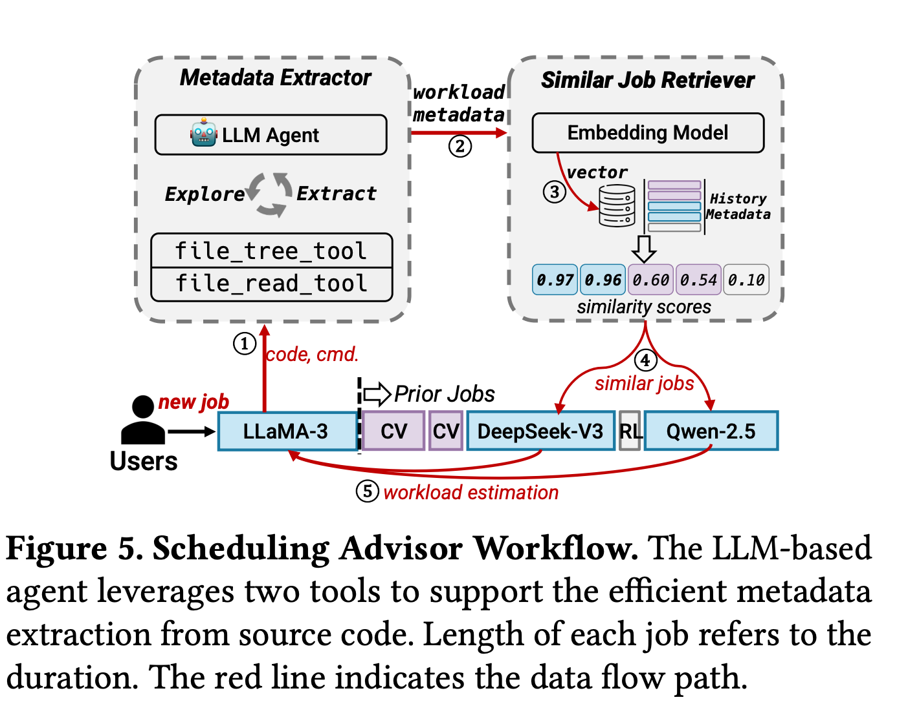
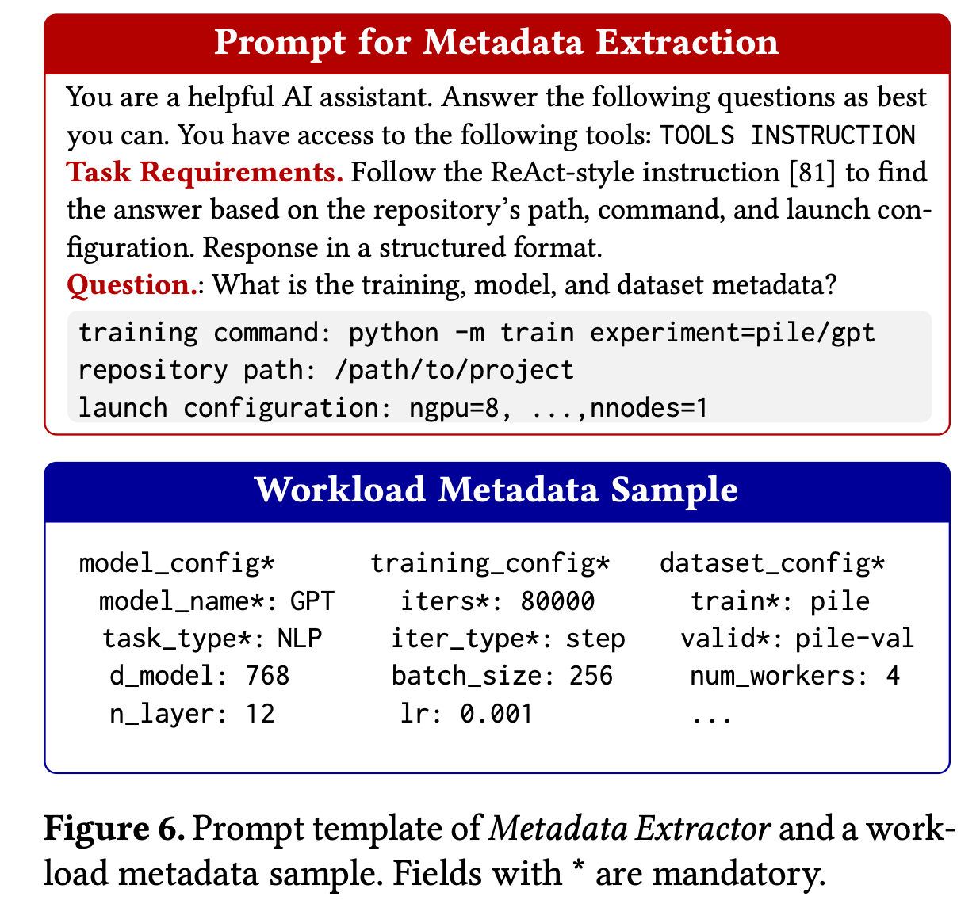
Schedule Advisor
Schedule Advisor 使用 ReAct 风格 LLM Agent 分析源代码，提取模型架构（Model Arch）、数据集（Dataset Settings）、训练参数（Training Config）等语义元数据，生成结构化 JSON 指纹。通过 embedding vector 的相似度匹配 top-k 历史作业，以其平均时长和 SM 利用率作为预测值，替代昂贵的 real profiling。

Slide 8
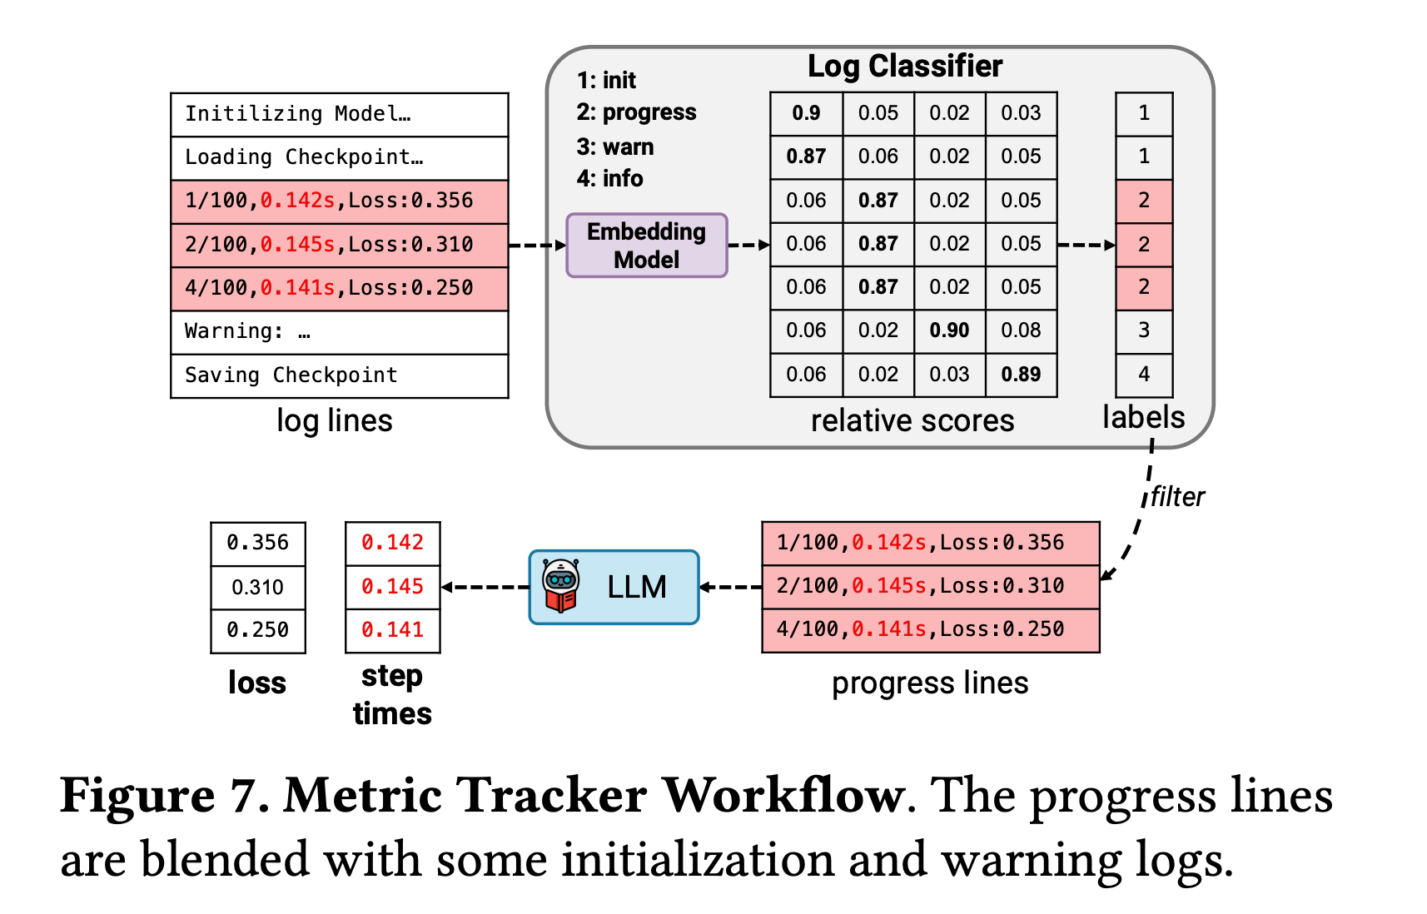
Metric Tracker
Metric Tracker 采用两阶段轻量 pipeline：先由 Log Classifier（嵌入模型）从海量日志中快速筛出进度相关行，再由 LLM 精确提取 step time 和 loss 等结构化指标。提取过程以逆序处理日志，获取到足够指标（N 行）后即停止，兼顾低延迟与高精度，成功率达 84.3%，显著优于纯 LLM 方案（59.2%）。
提取到step time可以用来识别slowdown用来指导 job packing 决策

Slide 9
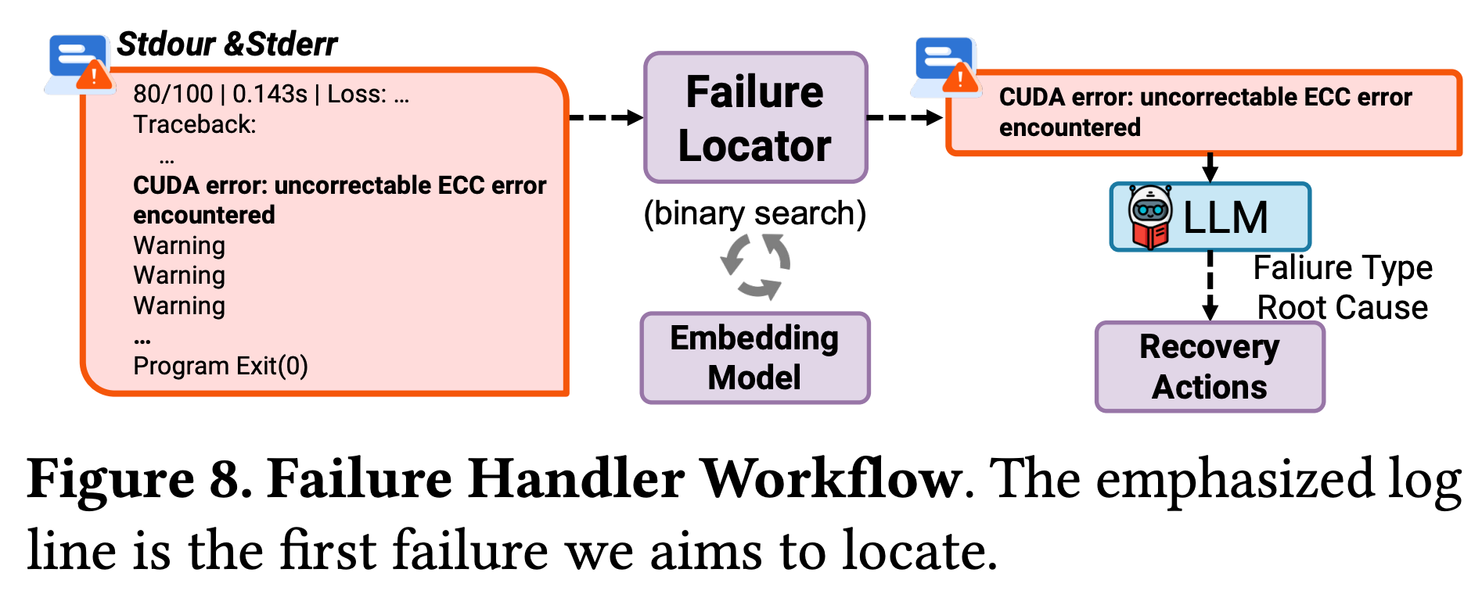
Failure Handler
Failure Handler 采用三阶段 pipeline：①Failure Locator 通过二分查找结合 Log Classifier 在海量日志中定位首个真实错误行；② LLM 对错误上下文（约 500 行）做细粒度分类，区分基础设施故障（GPU/NVLink/节点故障）vs 应用层错误；③ 对基础设施故障触发自动化 Recovery Actions（nccl 测试、节点隔离、节点替换、从 checkpoint 恢复），无需人工干预。
识别错误是否可恢复，可恢复错误直接重启，降低任务重排时间

Slide 10
Case Studys
Non-intrusive Lucid: 接入 Lucid 调度器，Schedule Advisor 绕过 profiling 并改善时长估计，Metric Tracker 实现干扰感知 packing 撤销。物理集群 JCT 降低 23.2%；仿真提升 1.23×∼1.91×。
Elastic Scheduler Sia: 接入 Sia 弹性调度器，Job 到来时先用 Schedule Advisor 匹配历史作业，复用性能数据跳过 profiling（Pre-profiling-free Bootstrapping）。平均 JCT 降低 13.3%∼20%，p99 JCT 与 makespan 同步改善。
Standalone SchedMate: SchedMate 独立运行，同时启用 Schedule Advisor 与 Failure Handler。相较 QSSF 平均 JCT 提升 25.7%，较 Tiresias 提升 16%；加入 Failure Handler 再额外减少约 12.5% JCT。

Slide 11
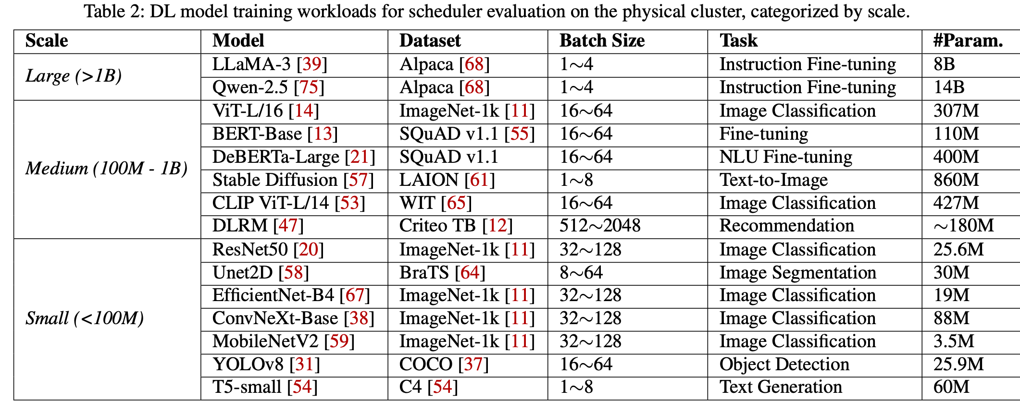
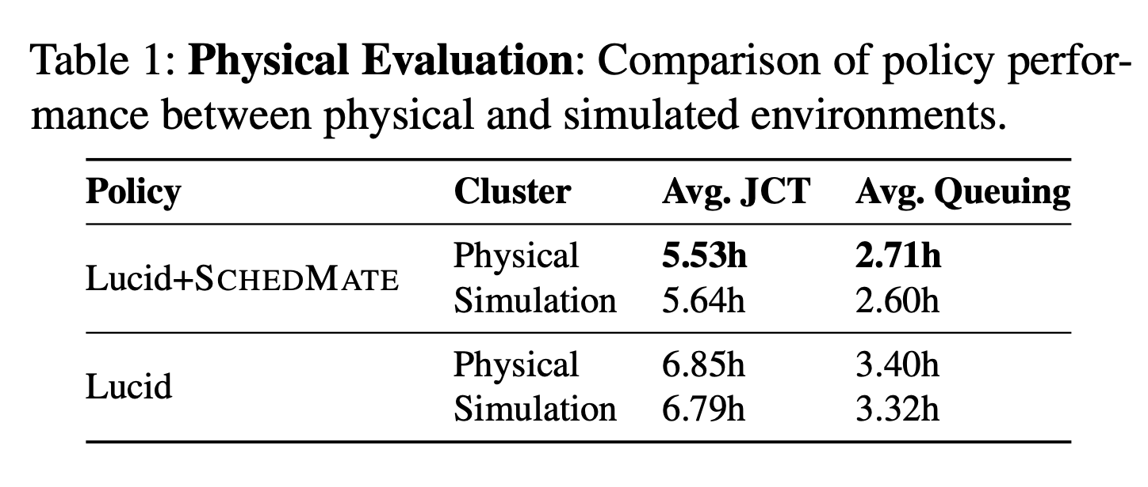
Evaluation on a 128GPU Cluster

Slide 12
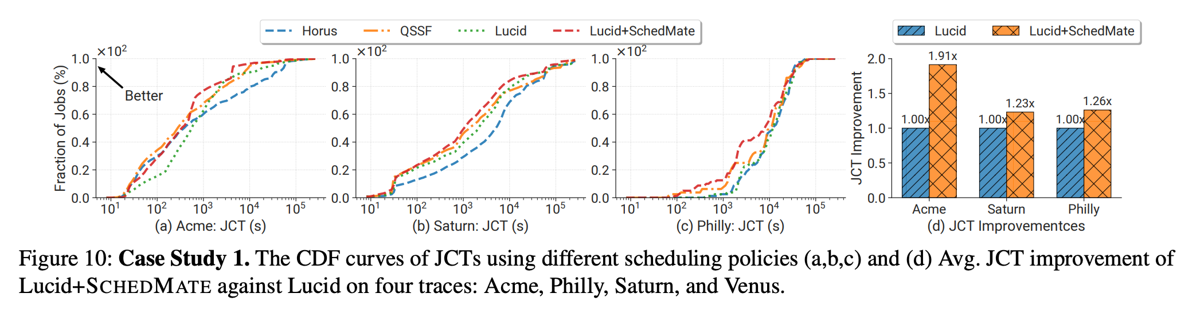
Simulation-based Evaluation
Non-intrusive Lucid: 接入 Lucid 调度器，Schedule Advisor 绕过 profiling 并改善时长估计，Metric Tracker 实现干扰感知 packing 撤销。物理集群 JCT 降低 23.2%；仿真提升 1.23×∼1.91×。

Slide 13
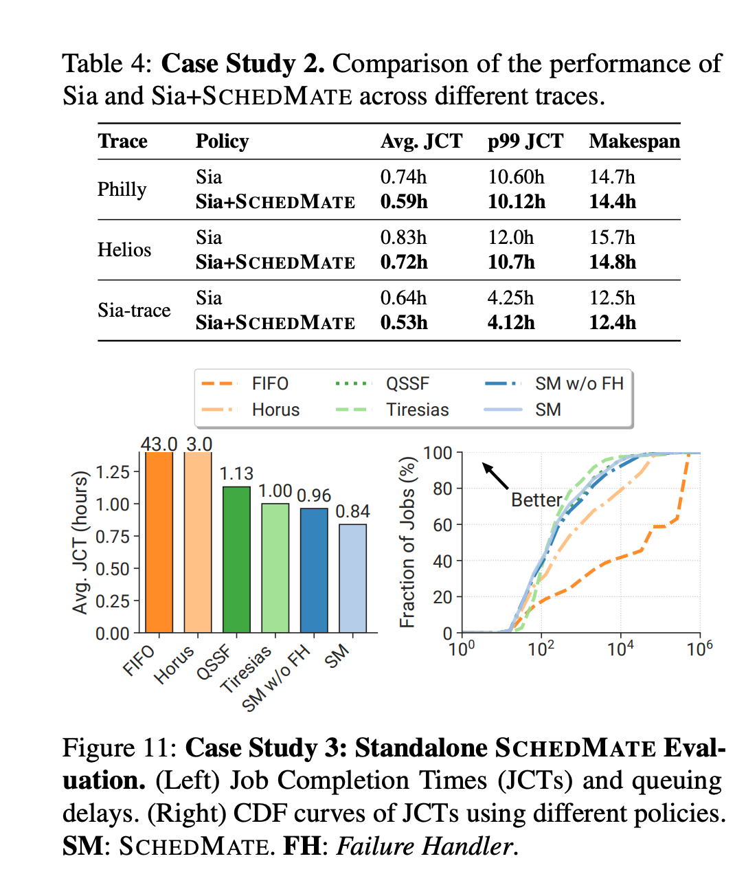
Simulation-based Evaluation
Elastic Scheduler Sia: Job 到来时先用 Schedule Advisor 匹配历史作业，复用性能数据跳过 profiling（Pre-profiling-free Bootstrapping）。平均 JCT 降低 13.3%∼20%，p99 JCT 与 makespan 同步改善。
Standalone SchedMate: SchedMate 独立运行，启用 Schedule Advisor 与 Failure Handler。相较 QSSF 平均 JCT 提升 25.7%，较 Tiresias 提升 16%；加入 Failure Handler 再额外减少约 12.5% JCT。

Slide 14
OSDI 26 Reviews Overview
Paper #232: Unlocking the Black Box: Semantic-Aware Scheduling for GPU Clusters with LLMs
Review A: Weak Reject 2
Review B: Weak Reject 2
Main Concerns
系统贡献不够清晰：LLM 信息提取更像工程选择，而非新的调度抽象
缺乏与更简单方法的对比（embedding-based, 轻量级分析）
实用性论证不充分：缺少生产环境经验支撑
LLM 输出错误时的容错机制未充分讨论

Slide 15
Review #232A
Weaknesses:
It is unclear what the fundamental technical challenge is beyond applying LLM-based information extraction, or which new system abstractions, scheduling mechanisms, or design principles are introduced as a result.
The motivation largely frames the problem as “LLMs are better tools” rather than as a new systems problem. It remains unclear why lighter-weight approaches (embedding-based methods or simpler analysis pipelines) would not be sufficient.
Scheduling Advisor: unclear how sensitive predictions are to the choice of T and k, and how the system behaves when semantically similar jobs still have very different runtimes due to configuration choices.
The Failure Handler seems loosely connected to the main scheduling design. It appears more like an auxiliary log-analysis tool than a core part of the scheduling system.
Comments for authors:
The paper would benefit from more clearly articulating its core systems contribution. Clarifying what scheduling capabilities become possible with the proposed LLM-based semantic extraction, and why these capabilities cannot be achieved with simpler techniques, would significantly strengthen the work.

Slide 16
Review #232A
Weaknesses:
It is unclear what the fundamental technical challenge is beyond applying LLM-based information extraction, or which new system abstractions, scheduling mechanisms, or design principles are introduced as a result. 没有明显技术挑战
The motivation largely frames the problem as “LLMs are better tools” rather than as a new systems problem. It remains unclear why lighter-weight approaches (embedding-based methods or simpler analysis pipelines) would not be sufficient.
Scheduling Advisor: unclear how sensitive predictions are to the choice of T and k, and how the system behaves when semantically similar jobs still have very different runtimes due to configuration choices.
The Failure Handler seems loosely connected to the main scheduling design. It appears more like an auxiliary log-analysis tool than a core part of the scheduling system.
Comments for authors:
The paper would benefit from more clearly articulating its core systems contribution. Clarifying what scheduling capabilities become possible with the proposed LLM-based semantic extraction, and why these capabilities cannot be achieved with simpler techniques, would significantly strengthen the work.

Slide 17
Review #232A
Weaknesses:
It is unclear what the fundamental technical challenge is beyond applying LLM-based information extraction, or which new system abstractions, scheduling mechanisms, or design principles are introduced as a result.
The motivation largely frames the problem as “LLMs are better tools” rather than as a new systems problem. It remains unclear why lighter-weight approaches (embedding-based methods or simpler analysis pipelines) would not be sufficient.
没有与轻量级方法对比
Scheduling Advisor: unclear how sensitive predictions are to the choice of T and k, and how the system behaves when semantically similar jobs still have very different runtimes due to configuration choices.
The Failure Handler seems loosely connected to the main scheduling design. It appears more like an auxiliary log-analysis tool than a core part of the scheduling system.
Comments for authors:
The paper would benefit from more clearly articulating its core systems contribution. Clarifying what scheduling capabilities become possible with the proposed LLM-based semantic extraction, and why these capabilities cannot be achieved with simpler techniques, would significantly strengthen the work.

Slide 18
Review #232A
Weaknesses:
It is unclear what the fundamental technical challenge is beyond applying LLM-based information extraction, or which new system abstractions, scheduling mechanisms, or design principles are introduced as a result.
The motivation largely frames the problem as “LLMs are better tools” rather than as a new systems problem. It remains unclear why lighter-weight approaches (embedding-based methods or simpler analysis pipelines) would not be sufficient.
Scheduling Advisor: unclear how sensitive predictions are to the choice of T and k, and how the system behaves when semantically similar jobs still have very different runtimes due to configuration choices. 消融实验
The Failure Handler seems loosely connected to the main scheduling design. It appears more like an auxiliary log-analysis tool than a core part of the scheduling system.
Comments for authors:
The paper would benefit from more clearly articulating its core systems contribution. Clarifying what scheduling capabilities become possible with the proposed LLM-based semantic extraction, and why these capabilities cannot be achieved with simpler techniques, would significantly strengthen the work.

Slide 19
Review #232A
Weaknesses:
It is unclear what the fundamental technical challenge is beyond applying LLM-based information extraction, or which new system abstractions, scheduling mechanisms, or design principles are introduced as a result.
The motivation largely frames the problem as “LLMs are better tools” rather than as a new systems problem. It remains unclear why lighter-weight approaches (embedding-based methods or simpler analysis pipelines) would not be sufficient.
Scheduling Advisor: unclear how sensitive predictions are to the choice of T and k, and how the system behaves when semantically similar jobs still have very different runtimes due to configuration choices.
The Failure Handler seems loosely connected to the main scheduling design. It appears more like an auxiliary log-analysis tool than a core part of the scheduling system. Failure Handler似乎不是很关键
Comments for authors:
The paper would benefit from more clearly articulating its core systems contribution. Clarifying what scheduling capabilities become possible with the proposed LLM-based semantic extraction, and why these capabilities cannot be achieved with simpler techniques, would significantly strengthen the work.

Slide 20
Review #232B
Weaknesses:
Schedule Advisor: Job metadata like model name and number of steps are important. However, there are many other factors: the version of the source code, the underlying training framework, the NCCL library, etc may have an effect; the hardware, failures/preemptions, exact GPU allocation topology, data source distance may all have an effect. Missing those factors → inaccurate match; consider all factors → may not get a match.
Failure Handling: Production systems need to consider: 1) degraded hardware (may not have a clear error message); 2) silent data corruptions (SDCs); 3) failures in the dependent system (which may include the logging system itself). If we still need a separate diagnosis system, is it more convenient to just build one system?
LLM error output: Since LLMs are still imperfect, what could go wrong if LLMs output wrong information? The paper argues that if LLMs cannot find correct information, we can fall back to old approaches, but what happens if LLMs give wrong information? Do the authors meet such cases in their experiments?
Comments for authors:
This is not a paper that tries to propose novel techniques, but instead it tries to leverage some known ideas to address problems in ML scheduling in a practical way. I like its practical aspect, but unfortunately, I think it’s really challenging to make a convincing argument about practicability without some production experience.

Slide 21
Review #232B
Weaknesses:
Schedule Advisor: Job metadata like model name and number of steps are important. However, there are many other factors: the version of the source code, the underlying training framework, the NCCL library, etc may have an effect; the hardware, failures/preemptions, exact GPU allocation topology, data source distance may all have an effect. Missing those factors → inaccurate match; consider all factors → may not get a match. 对matching准确率的质疑
Failure Handling: Production systems need to consider: 1) degraded hardware (may not have a clear error message); 2) silent data corruptions (SDCs); 3) failures in the dependent system (which may include the logging system itself). If we still need a separate diagnosis system, is it more convenient to just build one system?
LLM error output: Since LLMs are still imperfect, what could go wrong if LLMs output wrong information? The paper argues that if LLMs cannot find correct information, we can fall back to old approaches, but what happens if LLMs give wrong information? Do the authors meet such cases in their experiments?
Comments for authors:
This is not a paper that tries to propose novel techniques, but instead it tries to leverage some known ideas to address problems in ML scheduling in a practical way. I like its practical aspect, but unfortunately, I think it’s really challenging to make a convincing argument about practicability without some production experience.

Slide 22
Review #232B
Weaknesses:
Schedule Advisor: Job metadata like model name and number of steps are important. However, there are many other factors: the version of the source code, the underlying training framework, the NCCL library, etc may have an effect; the hardware, failures/preemptions, exact GPU allocation topology, data source distance may all have an effect. Missing those factors → inaccurate match; consider all factors → may not get a match.
Failure Handling: Production systems need to consider: 1) degraded hardware (may not have a clear error message); 2) silent data corruptions (SDCs); 3) failures in the dependent system (which may include the logging system itself). If we still need a separate diagnosis system, is it more convenient to just build one system? Failure 要考虑的问题太多，仍然需要一个外部的系统
LLM error output: Since LLMs are still imperfect, what could go wrong if LLMs output wrong information? The paper argues that if LLMs cannot find correct information, we can fall back to old approaches, but what happens if LLMs give wrong information? Do the authors meet such cases in their experiments?
Comments for authors:
This is not a paper that tries to propose novel techniques, but instead it tries to leverage some known ideas to address problems in ML scheduling in a practical way. I like its practical aspect, but unfortunately, I think it’s really challenging to make a convincing argument about practicability without some production experience.

Slide 23
Review #232B
Weaknesses:
Schedule Advisor: Job metadata like model name and number of steps are important. However, there are many other factors: the version of the source code, the underlying training framework, the NCCL library, etc may have an effect; the hardware, failures/preemptions, exact GPU allocation topology, data source distance may all have an effect. Missing those factors → inaccurate match; consider all factors → may not get a match.
Failure Handling: Production systems need to consider: 1) degraded hardware (may not have a clear error message); 2) silent data corruptions (SDCs); 3) failures in the dependent system (which may include the logging system itself). If we still need a separate diagnosis system, is it more convenient to just build one system? Failure 要考虑的问题太多，仍然需要一个外部的系统
LLM error output: Since LLMs are still imperfect, what could go wrong if LLMs output wrong information? The paper argues that if LLMs cannot find correct information, we can fall back to old approaches, but what happens if LLMs give wrong information? Do the authors meet such cases in their experiments? LLM 输出错误信息的情况没有讨论
Comments for authors:
This is not a paper that tries to propose novel techniques, but instead it tries to leverage some known ideas to address problems in ML scheduling in a practical way. I like its practical aspect, but unfortunately, I think it’s really challenging to make a convincing argument about practicability without some production experience.

Slide 24
改进方向
系统贡献阐述
突出 system challenges
明确提出 LLM 语义提取带来的新调度能力，而非仅仅“更好的工具”
Scheduling Advisor
增加与 embedding-based / 轻量级方法的实验对比
LLM 的容错机制
去掉 Failure Handling (and metric tracker)？
Reviewer 主要关注第一个组件，Failure和Metric几乎被忽略。

Slide 25
FlexRL:
Scaling VLM RL Training via Efficient Load Balancing
Zerui Wang, Qinghao Hu, Chang Chen, Jiecheng Zhou,
Haojie Duanmu, Xingcheng Zhang, Peng Sun, Dahua Lin
Shanghai Jiao Tong University · Shanghai AI Lab · MIT · USTC · Peking University · CUHK
1

Slide 26
Executive Summary
1. Problem
2. System
3. Impact
Two bottlenecks dominate VLM RL:
• data loading is centralized on one controller
• heterogeneous batches create compute / memory imbalance across GPUs
• fixing only one side is not enough
FlexRL has two pieces:
• ShadowLoader: metadata-only scheduling on the controller; workers do preprocessing
• FlexUlysses: adaptive sharding, hierarchical device groups, and overlapped execution
On 7B / 32B models and two 128-GPU clusters:
• up to 8.47× end-to-end speedup
• 117.42× data-loading speedup
• balance ratio reaches 1.0 in the Ulysses comparison
2

Slide 27
Why VLM RL Training is Hard
Bottleneck A — Data preparation on the controller
Bottleneck B — Cross-GPU execution imbalance
Image/video decoding, frame sampling, and preprocessing are CPU- and I/O-heavy.
Attention compute grows quadratically with sequence length, while activation memory grows linearly.
In the veRL multimodal baseline, data loading takes 57.1% of the iteration time.
Text length is a poor proxy for visual cost: image counts and video frame counts change both compute and memory.
As batch size grows, the controller becomes the single straggler and can hit host-memory OOM.
Length-only bucketing can still leave one DP rank as the straggler—or even OOM on long contexts.
Observed in baseline
Failure mode
Skew source
Why prior work falls short
57.1%
OOM
Mixed modalities
Bucketing ≠ balancing
of step time spent on data loading
Controller-side CPU memory becomes the bottleneck
short image-text + long video-text in the same RL batch
fixed parallelism or coarse buckets cannot eliminate stragglers
3

Slide 28
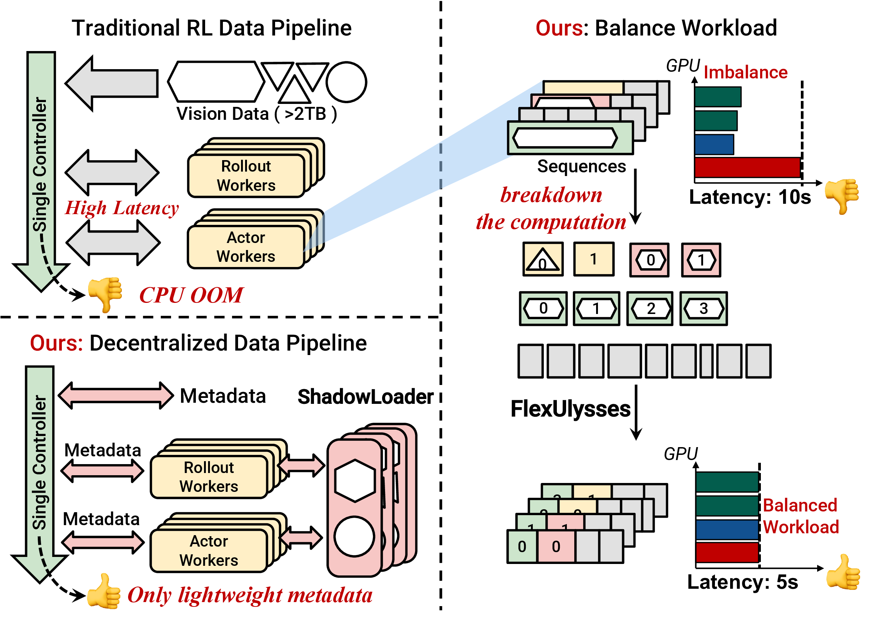
FlexRL Overview
Core idea
ShadowLoader decentralizes multimodal preprocessing and keeps only lightweight metadata on the controller.
FlexUlysses shards only the sequences that need it, balancing both compute and memory at sub-sequence granularity.
The two components are co-designed so sharding decisions can guide slice-aware data loading and reduce transfer volume.
4

Slide 29
ShadowLoader
Workflow
Proxy
Dataloader
Local
Preprocessor
MetaStore
Materializer
Controller keeps FakeTensor metadata only
→
Worker-side decode, frame sampling, and caching
→
Track sample ID → physical location mapping
→
Workers fetch actual visual tensors on demand
Key mechanisms
• keep only metadata on the controller
• overlap preprocessing / transfer with GPU work
• fetch only the slices needed after sharding is decided
ShadowLoader
ShadowLoader + FlexUlysses
84.09×
117.42×
5

Slide 30
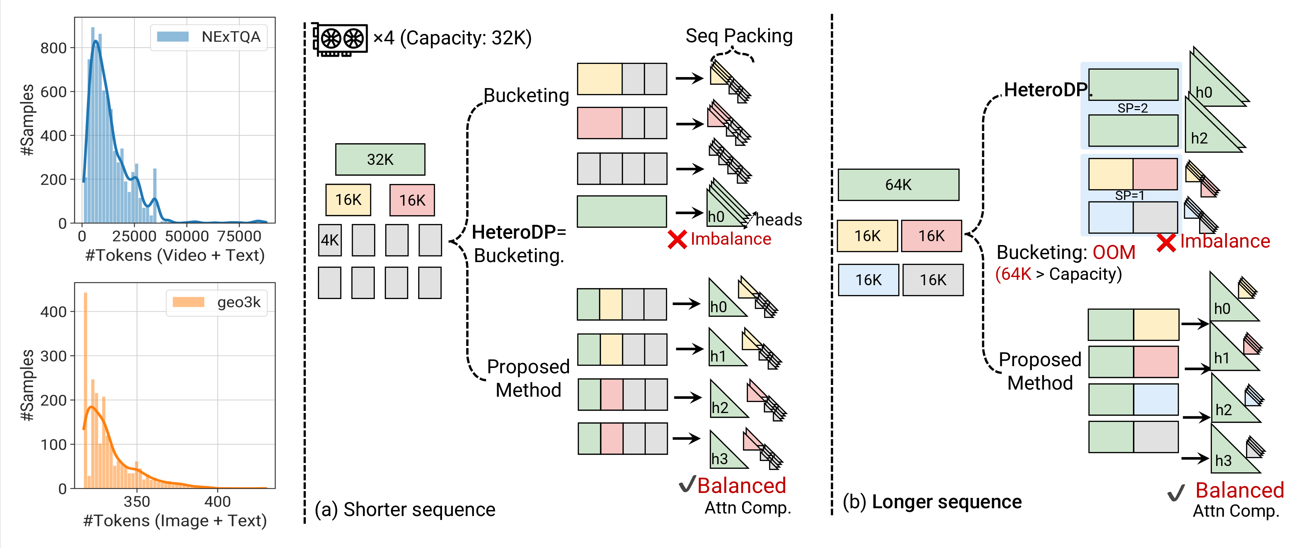
FlexUlysses Motivation
Observation 1
Observation 2
Key insight
Even when memory does not force SP, one long sample can dominate the entire RL step.
For longer contexts, fixed buckets may still OOM or leave severe attention imbalance.
Use Ulysses chunks as scheduling units, and shard sequences only as much as needed.
6

Slide 31
FlexUlysses Design
1. Adaptive sharding degree
2. Hierarchical device groups
3. Highest-Sharding-First + overlap
For each sequence i, choose p_i ∈ {1, 2, 4, …, p_max} based on its length and the current batch composition.
Most sequences stay unsharded or lightly sharded, which preserves compute efficiency and avoids paying communication on every sample.
Candidate groups are nested (for example, on 8 GPUs: [0-7], [0-3]/[4-7], [0,1]/[2,3]/…).
This laminar structure makes placement simpler: any two groups are either disjoint or one contains the other, which is the basis for deadlock-free scheduling.
All ranks execute larger collectives before smaller ones, ensuring a consistent order across nested groups.
Within this schedule, FlexRL packs short sequences into sequence groups and overlaps all2all communication with attention computation to reduce GPU bubbles.
Vision tower balancing is handled separately by evenly distributing images and video frames across GPUs.
7

Slide 32
Evaluation Setup
Hardware
Models & training
Datasets & baselines
• two 128-GPU clusters
• H800 and H200
• NVLink / NVSwitch intra-node
• RoCEv2 RDMA inter-node
• MiMo-VL-7B-RL and Qwen2.5-VL-32B
• GRPO
• response length = 1024
• p_max = 8
• Geo3K, NExTQA, LongVILA-Reason
• image-heavy / video-heavy / only-video
• baselines: veRL+Bucketing and fixed-degree Ulysses-SP
8

Slide 33
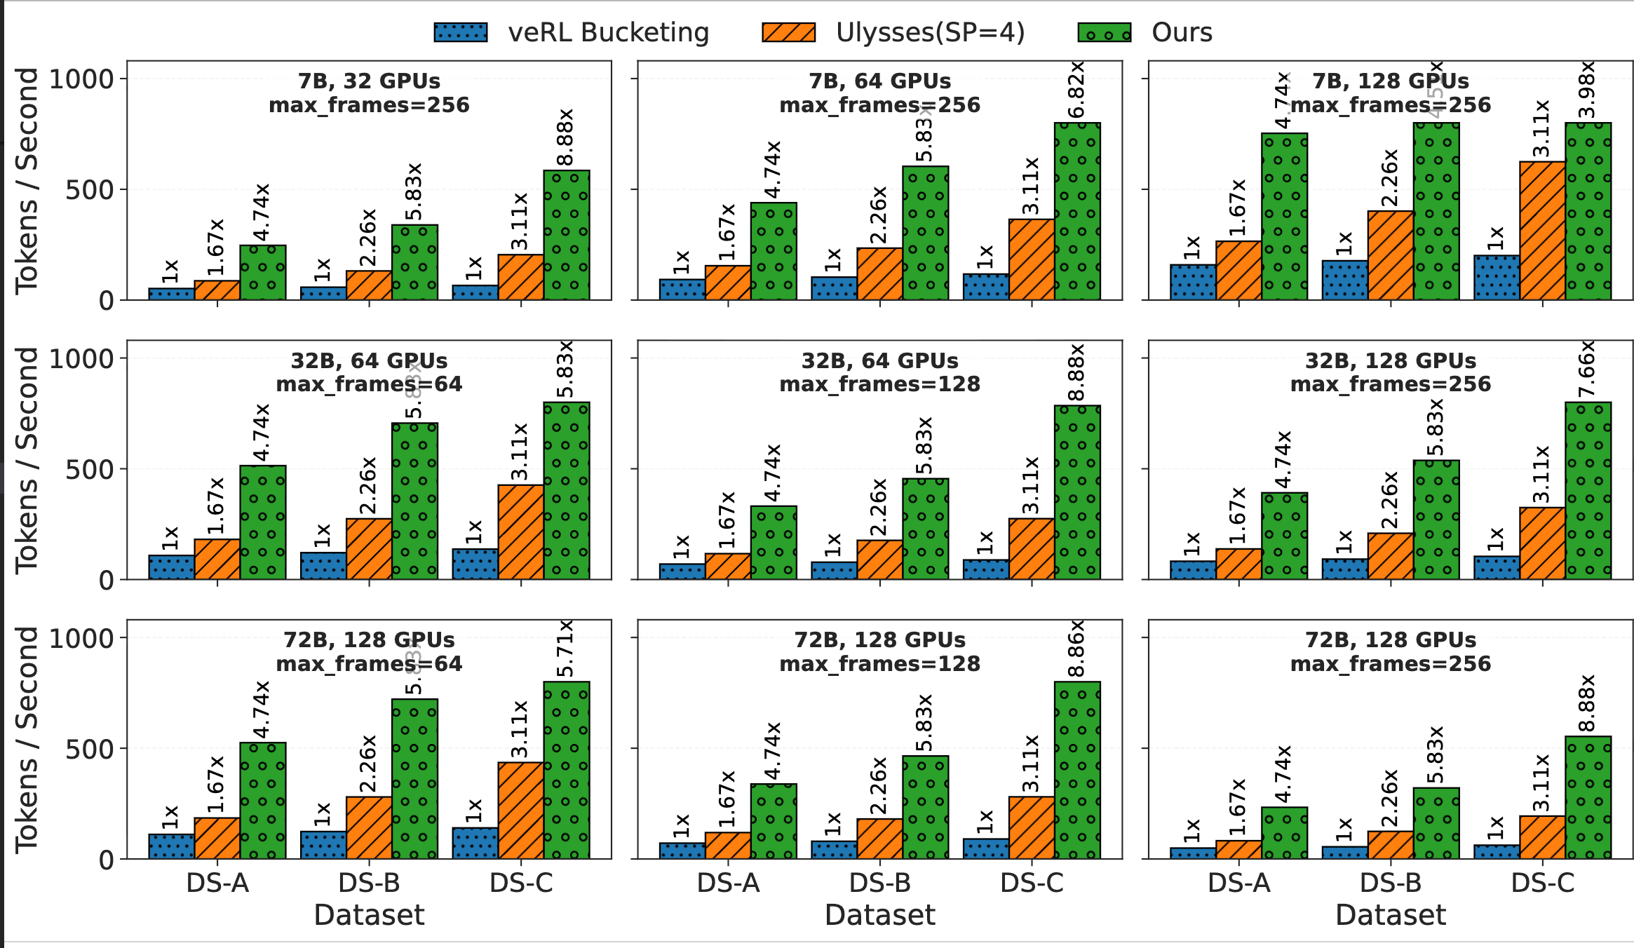
Main Results
9

Slide 34
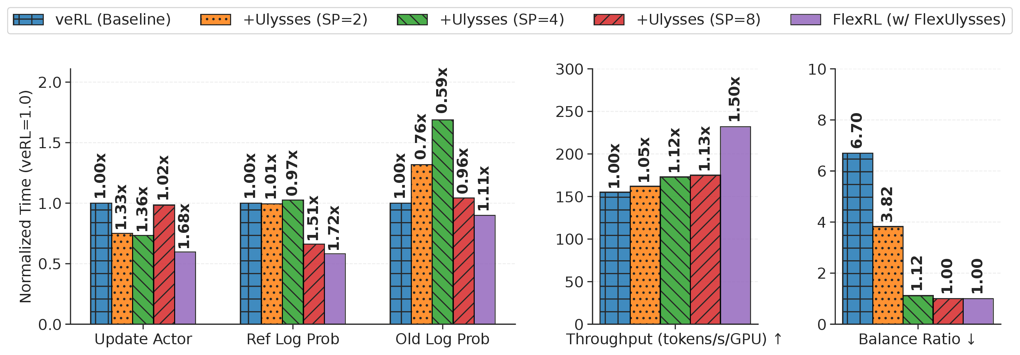
Comparison with Fixed-Degree Ulysses-SP
Takeaway 1
Takeaway 2
Takeaway 3
Higher fixed SP improves balance, but communication quickly dominates.
FlexUlysses reaches balance ratio 1.0 without fixed communication on all sequences.
Throughput is 1.50× higher than the veRL baseline in this comparison.
10

Slide 35
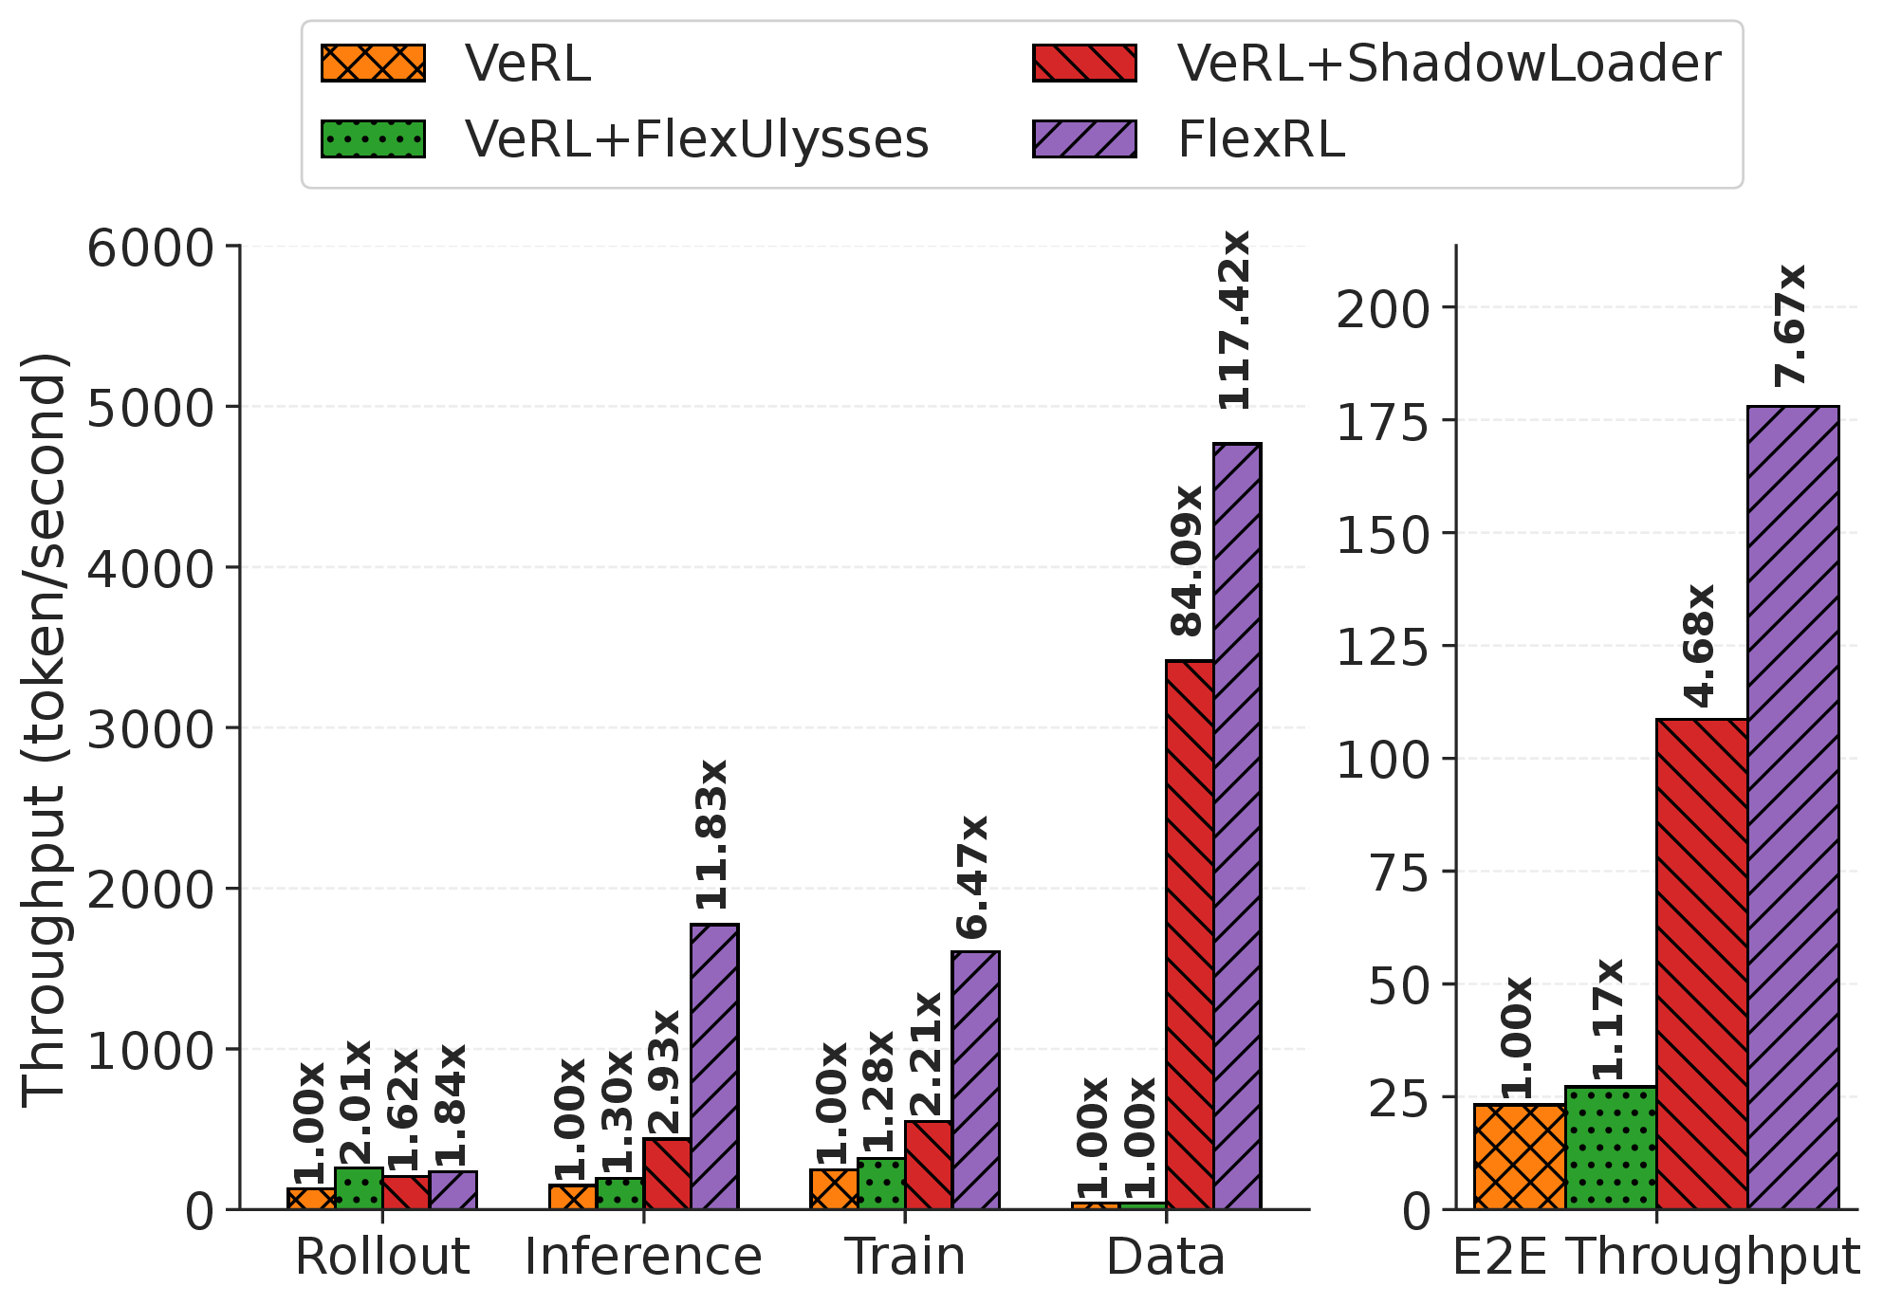
Ablation Study
ShadowLoader alone
84.09× data loading
4.68× end-to-end
5.35× lower step time
FlexUlysses alone
2.01× rollout
1.28× training
1.17× end-to-end when data loading still dominates
Both together = FlexRL
117.42× data loading
7.67× end-to-end
7.68× lower overall step time
11

Slide 36
Takeaways
1. Diagnose the whole pipeline
VLM RL is bottlenecked by both multimodal data handling and execution imbalance.
2. Co-design loading and execution
ShadowLoader and FlexUlysses are coupled through metadata, slice-aware loading, and hierarchical placement.
3. Real gains on real clusters
Across 7B/32B VLMs and two 128-GPU clusters, throughput improves by up to 8.47×.
FlexRL makes large-scale VLM RL training practical by balancing both data and compute.
12

Slide 37
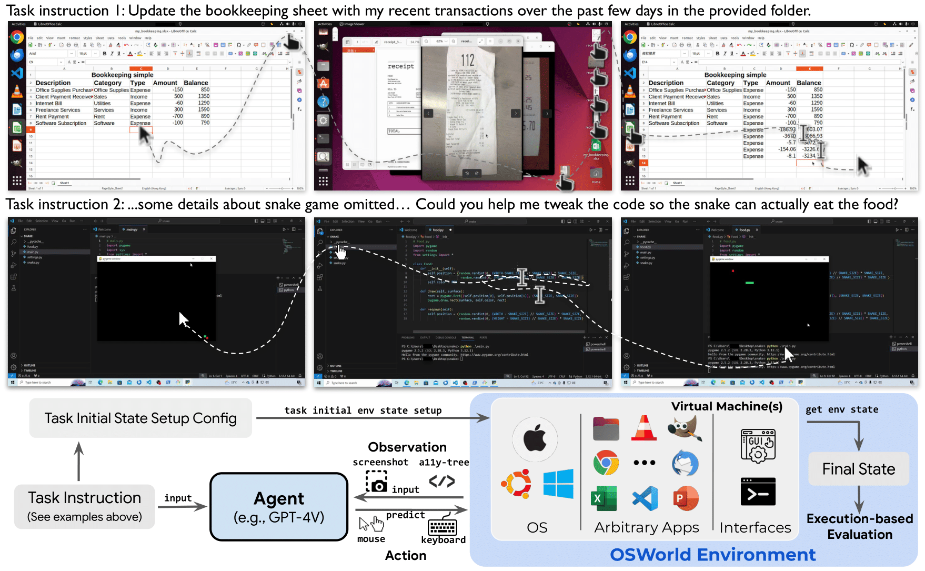
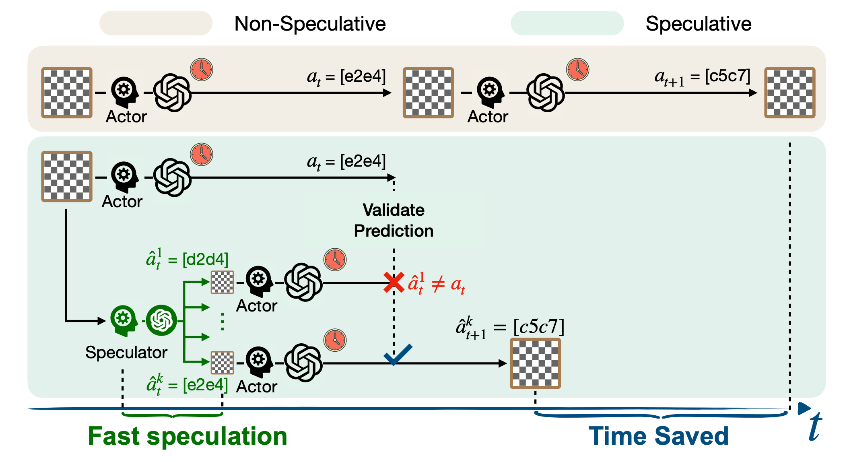
Acelerating VLM Agentic RL Training via Efficient Sandbox Fork and Speculative Actions

Slide 38
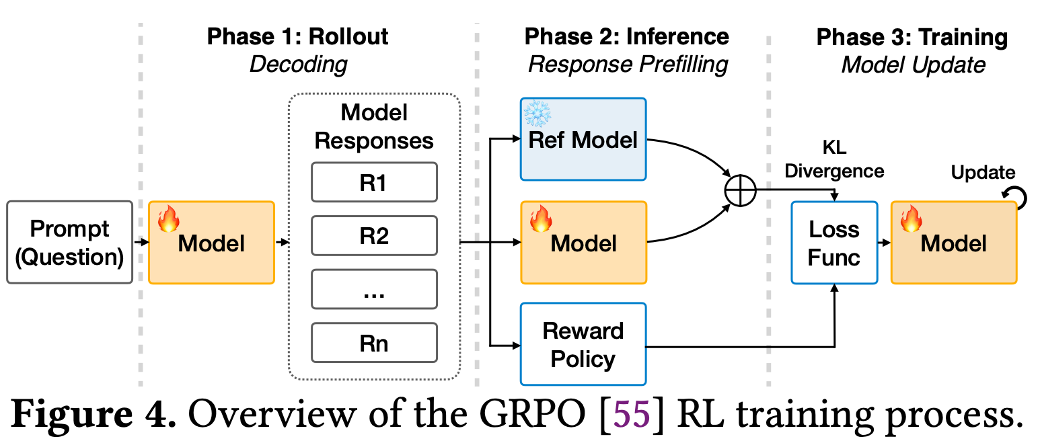
VLM Agentic RL Training

Slide 39
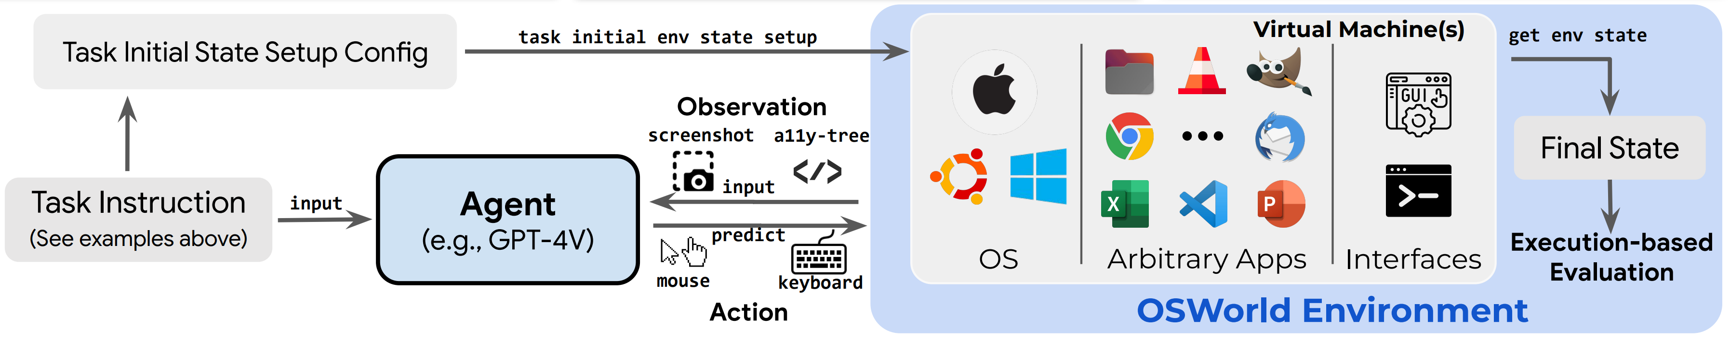
VLM Agentic Rollout/Inference
接收指令 （打开Excel，创建一个表格）
模型思考
生成动作 （e.g. 移动鼠标，点击 Excel），本质是MCP调用
执行动作：在虚拟机环境中实际执行动作，作用于真实 OS/App 界面
返回截图
Verify: 后通过 Execution-based Evaluation 判断最终状态是否达成目标，如果没有完成则重复 2~5

Slide 40
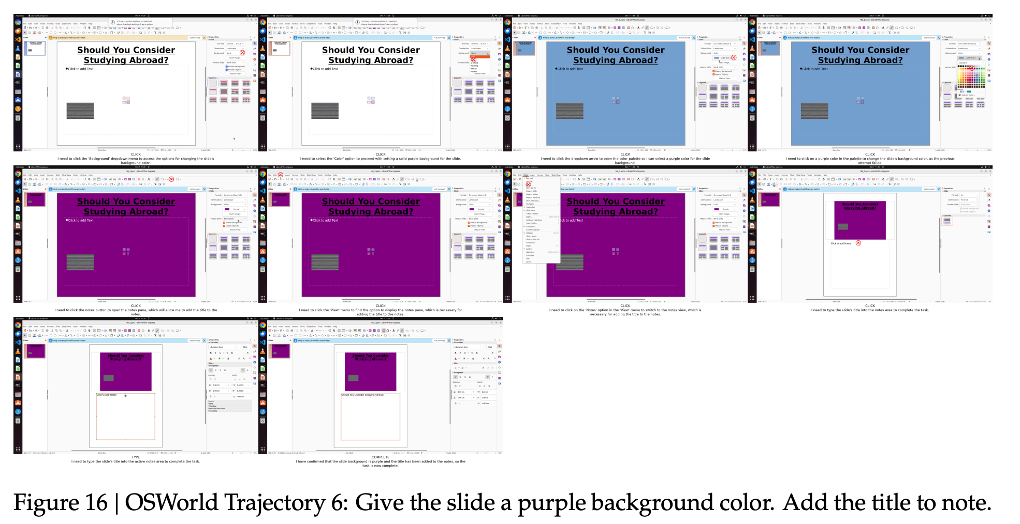
OSWorld Workload

Slide 41
Problems
RL Rollout 时 Sample 长尾分布明显
Env.step 时间过长，并且在critical path上
Env reset 时间过长
负载不均。序列长度差别多大，导致训练负载不均， 这个和前一篇ICLR比较像

Slide 42
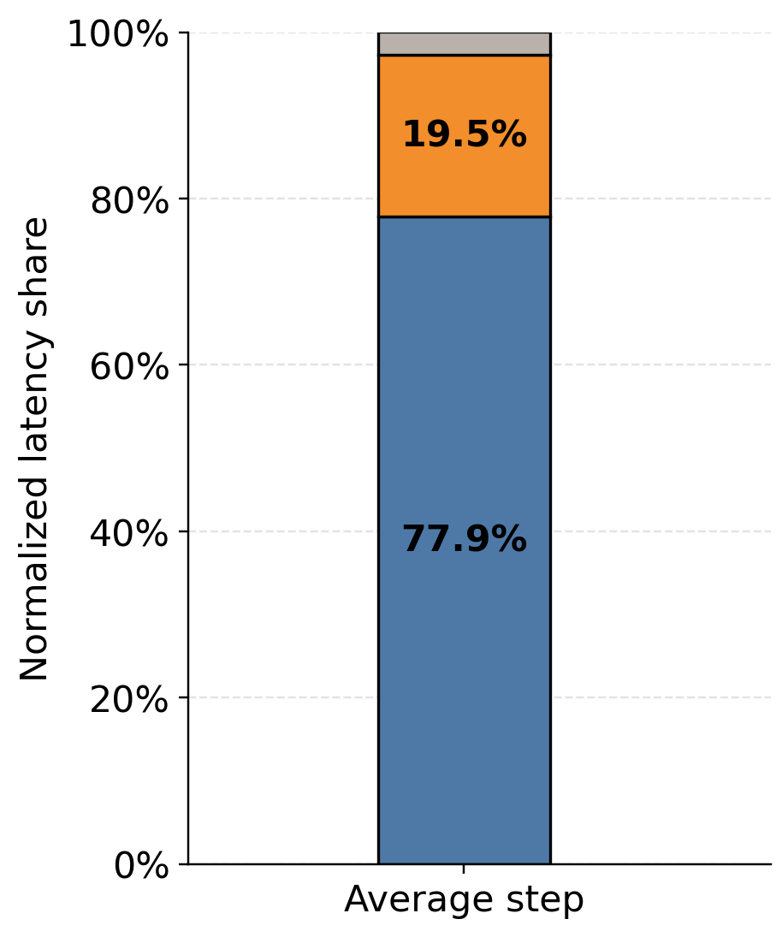

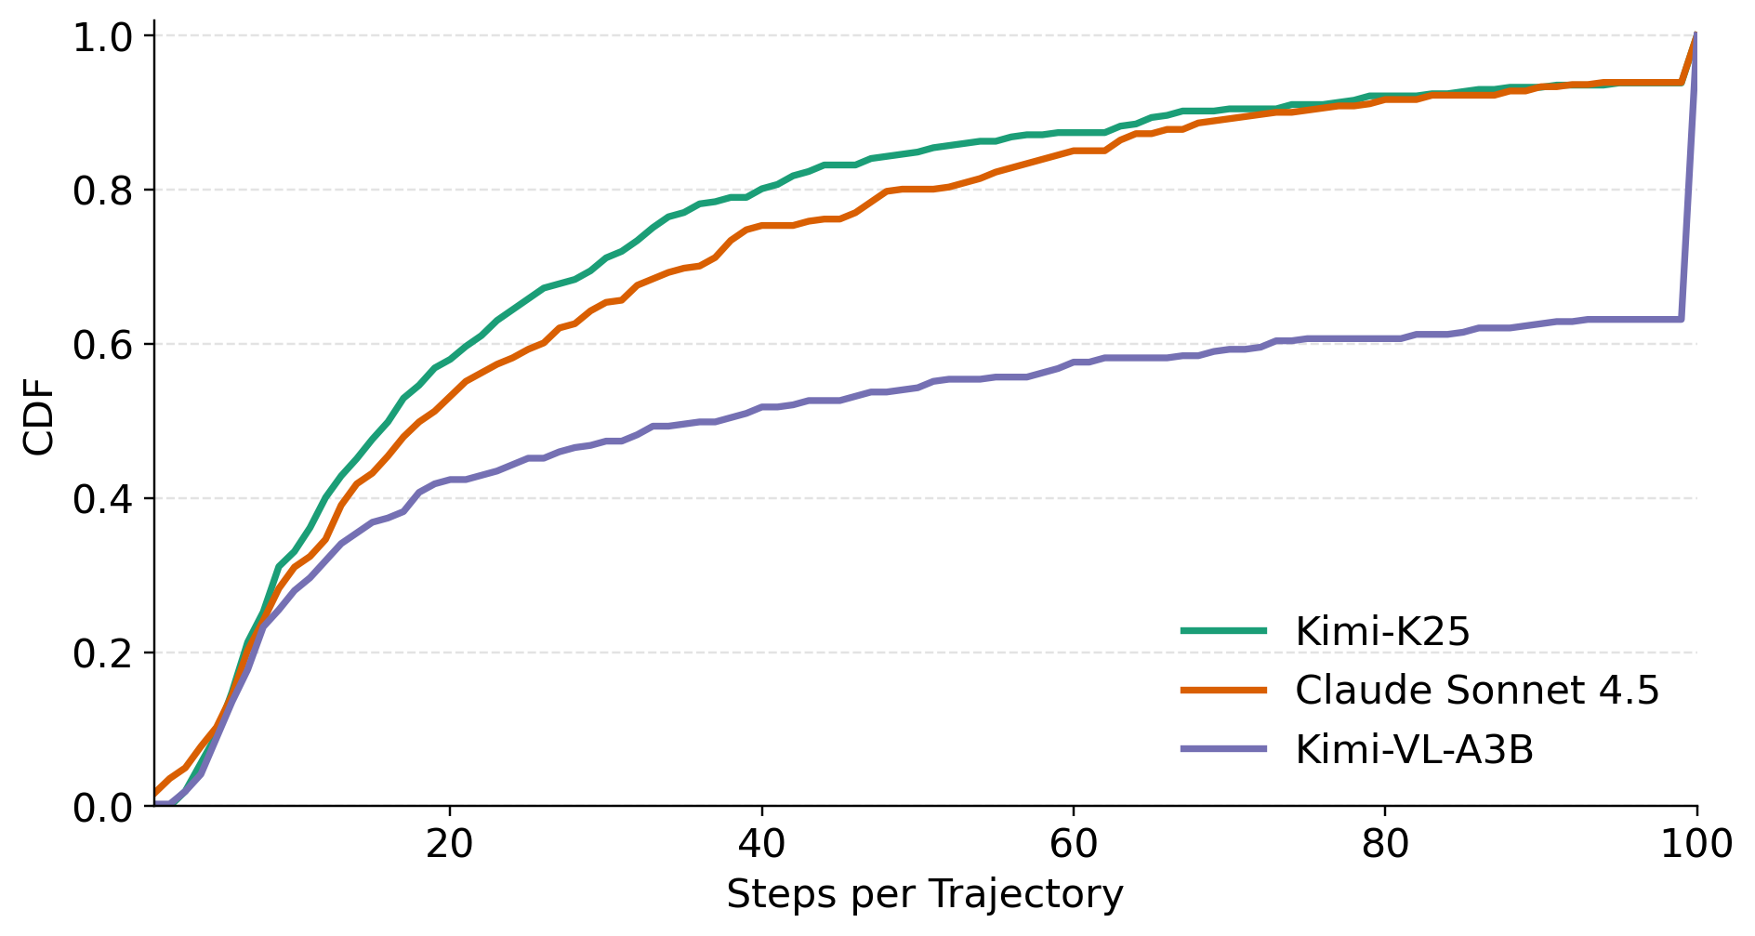
Long Tail of VLM Agentic RL Rollout
Think 模型存在明显的长尾分布
Act. Latency Breakdown
(Qwen3-VL8B)
Frontier thinking模型长尾明显
P90 ~ 66 steps
P95 ~ 90 steps
P50 ~ 20 steps

Slide 43
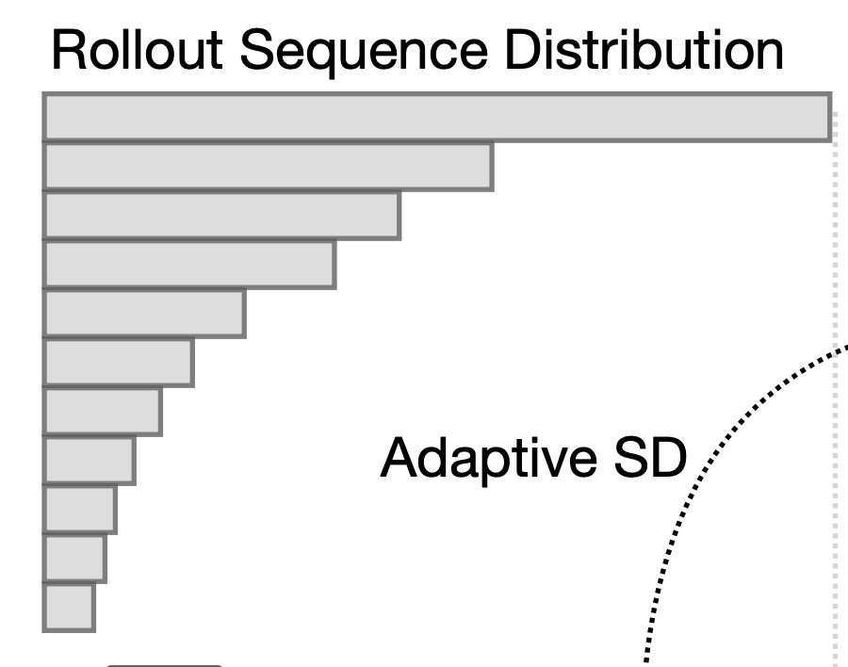

Impact of Long Tail
GPU IDLE
部分卡空闲
SM 利用率低
长尾 decoding
Tool latency

Slide 44
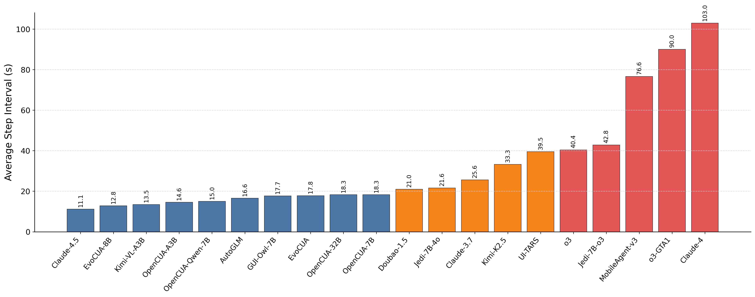
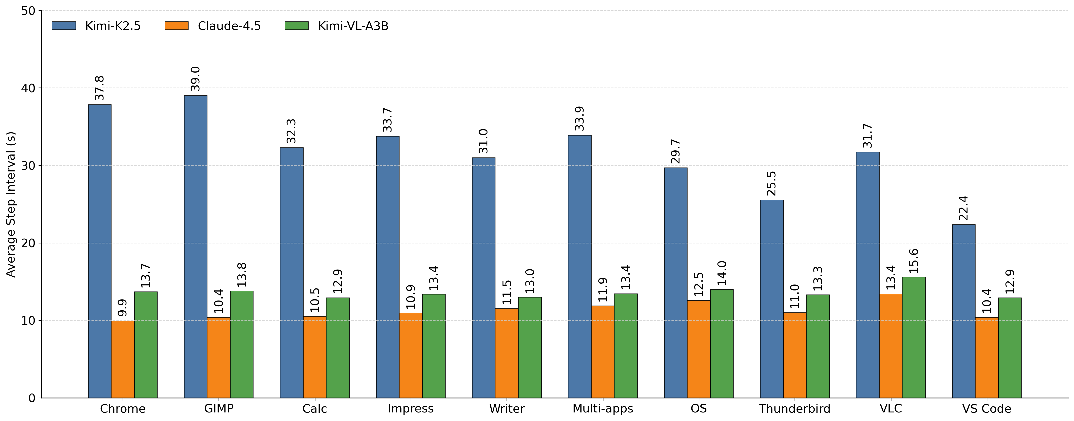
Avg. Action Step Latency
Average Action Step Latency of Different Tasks (OSWorld)

Slide 45
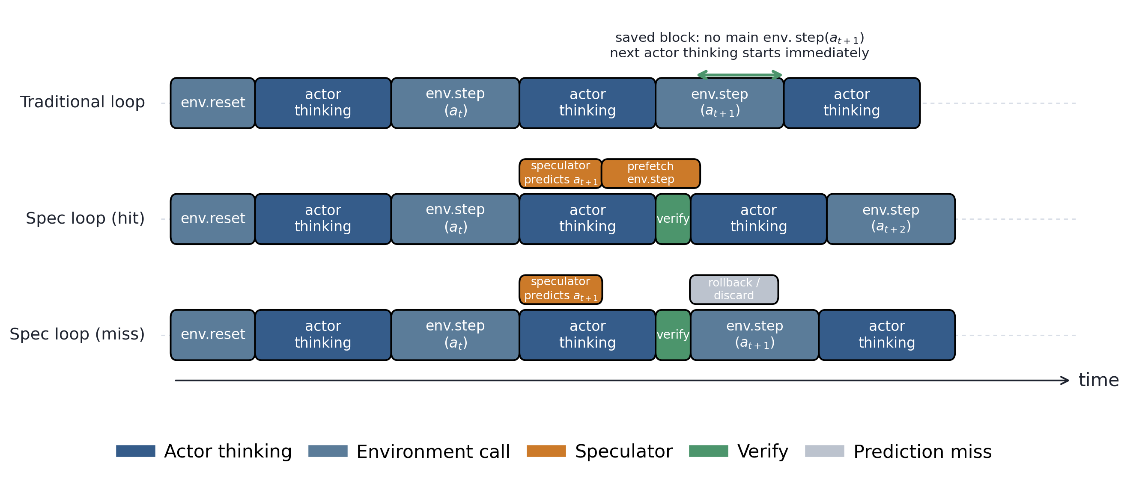
Core Idea: Leverage Speculative Actions
Single Step Speculation Overview

Slide 46
Theoretical Benefit
Single Step Predict:
Best case:
ENV : THINKING = 1:1 并且speculator准确率=1 时，加速 2x
Multi Step Predict:
- TODO
文章最终期望可能是 1.5x到2x

Slide 47
Challenges
不可回溯环境，国际象棋这种是可以回溯的，但是GUI这种环境无法回溯
Solution: Checkpoint Restore，Container Fork
Challenges of Container Fork
重环境：GUI RL 的 Fork 操作相比于一般的Serverless Function更重
完整的Ubuntu桌面
更大的应用，比如 LibreOffice
C/R 比 MOTISIS report的时间明显更长 （8~10s）
需要在线做，因为状态随每个step变化

Slide 48
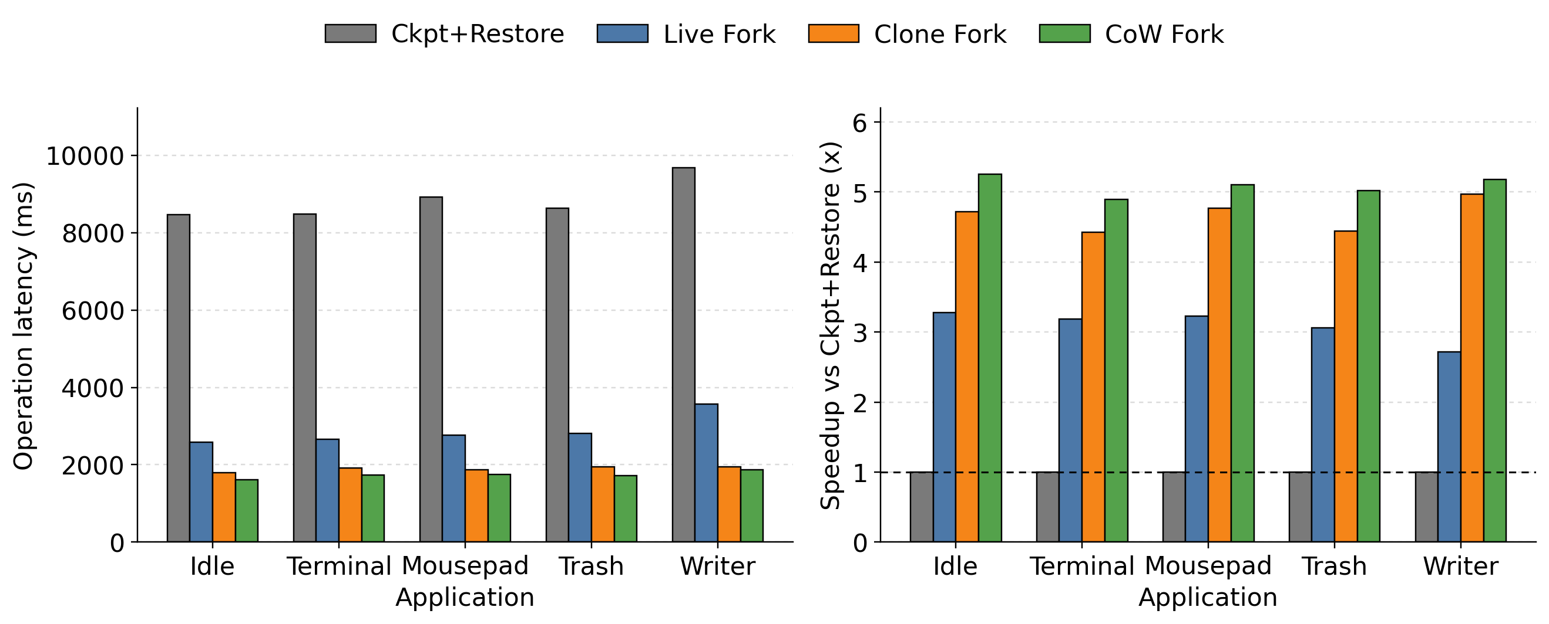
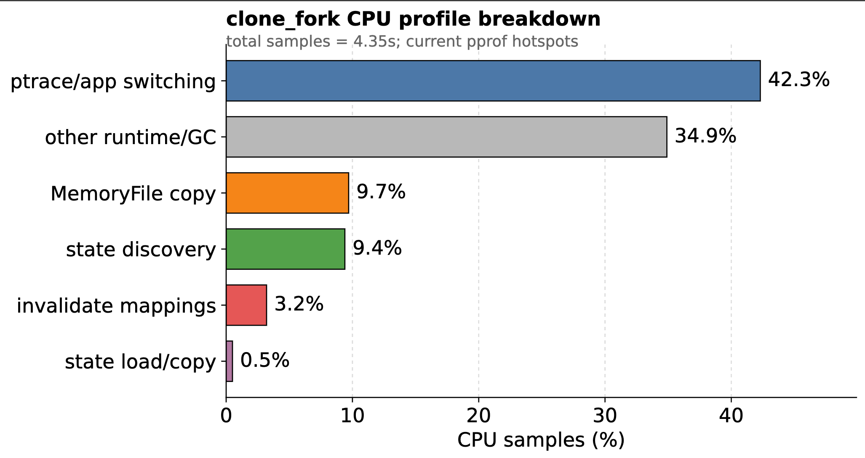
Contrain Fork Latency Breakdown (Vibe版本)
ptrace/app switching 指的是 runsc 在 ptrace 平台下，应用线程和 gVisor/sentry 之间反复切换执行控制权的开销。更具体地说，就是 guest 应用一跑到需要内核介入、信号处理、
syscall trap、fault 处理、线程停止/恢复这些点时，CPU 会在“被 sandbox 的应用线程”和“gVisor 的宿主侧控制逻辑”之间来回切；这些 stop/continue、寄存器同步、上下文切换、等待事
件的时间，profile 里就常被归到这一类。它本质上不是你的应用逻辑本身在算东西，而是 ptrace 这种实现机制带来的调度与陷入/返回成本。

Slide 49
经验数字
问了字节那边，一个 env.step 大概是1s左右
Fork 到几百ms级别可能可以接受

