Slide 1
FlexRL:
Scaling VLM RL Training via Efficient Load Balancing
Zerui Wang, Qinghao Hu, Chang Chen, Jiecheng Zhou,
Haojie Duanmu, Xingcheng Zhang, Peng Sun, Dahua Lin
Shanghai Jiao Tong University · Shanghai AI Lab · MIT · USTC · Peking University · CUHK
ShadowLoader for data loading.
FlexUlysses for execution balancing.
1

Slide 2
Executive Summary
1. Problem
2. System
3. Impact
Two bottlenecks dominate VLM RL:
• data loading is centralized on one controller
• heterogeneous batches create compute / memory imbalance across GPUs
• fixing only one side is not enough
FlexRL has two pieces:
• ShadowLoader: metadata-only scheduling on the controller; workers do preprocessing
• FlexUlysses: adaptive sharding, hierarchical device groups, and overlapped execution
On 7B / 32B models and two 128-GPU clusters:
• up to 8.47× end-to-end speedup
• 117.42× data-loading speedup
• balance ratio reaches 1.0 in the Ulysses comparison
2

Slide 3
Why VLM RL Training is Hard
Bottleneck A — Data preparation on the controller
Bottleneck B — Cross-GPU execution imbalance
Image/video decoding, frame sampling, and preprocessing are CPU- and I/O-heavy.
Attention compute grows quadratically with sequence length, while activation memory grows linearly.
In the veRL multimodal baseline, data loading takes 57.1% of the iteration time.
Text length is a poor proxy for visual cost: image counts and video frame counts change both compute and memory.
As batch size grows, the controller becomes the single straggler and can hit host-memory OOM.
Length-only bucketing can still leave one DP rank as the straggler—or even OOM on long contexts.
Observed in baseline
Failure mode
Skew source
Why prior work falls short
57.1%
OOM
Mixed modalities
Bucketing ≠ balancing
of step time spent on data loading
Controller-side CPU memory becomes the bottleneck
short image-text + long video-text in the same RL batch
fixed parallelism or coarse buckets cannot eliminate stragglers
3

Slide 4
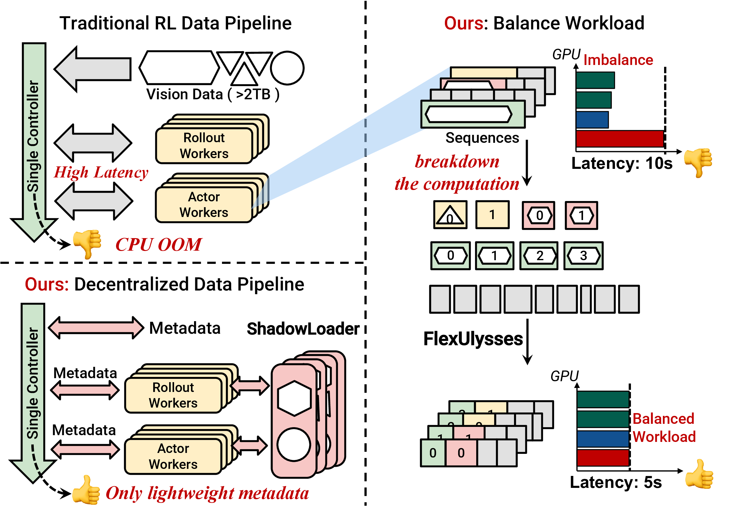
FlexRL Overview
Core idea
ShadowLoader decentralizes multimodal preprocessing and keeps only lightweight metadata on the controller.
FlexUlysses shards only the sequences that need it, balancing both compute and memory at sub-sequence granularity.
The two components are co-designed so sharding decisions can guide slice-aware data loading and reduce transfer volume.
4

Slide 5
ShadowLoader
Workflow
Proxy
Dataloader
Local
Preprocessor
MetaStore
Materializer
Controller keeps FakeTensor metadata only
→
Worker-side decode, frame sampling, and caching
→
Track sample ID → physical location mapping
→
Workers fetch actual visual tensors on demand
Key mechanisms
• keep only metadata on the controller
• overlap preprocessing / transfer with GPU work
• fetch only the slices needed after sharding is decided
ShadowLoader
ShadowLoader + FlexUlysses
84.09×
117.42×
5

Slide 6
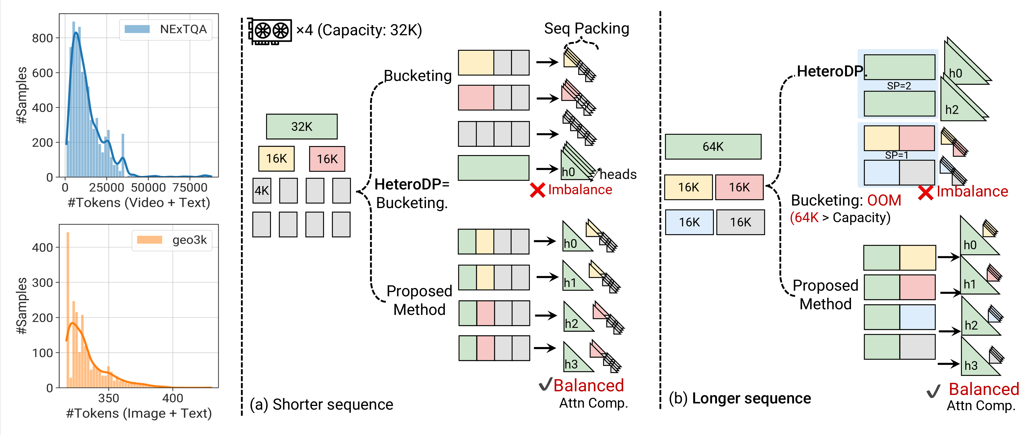
FlexUlysses Motivation
Observation 1
Observation 2
Key insight
Even when memory does not force SP, one long sample can dominate the entire RL step.
For longer contexts, fixed buckets may still OOM or leave severe attention imbalance.
Use Ulysses chunks as scheduling units, and shard sequences only as much as needed.
6

Slide 7
FlexUlysses Design
1. Adaptive sharding degree
2. Hierarchical device groups
3. Highest-Sharding-First + overlap
For each sequence i, choose p_i ∈ {1, 2, 4, …, p_max} based on its length and the current batch composition.
Most sequences stay unsharded or lightly sharded, which preserves compute efficiency and avoids paying communication on every sample.
Candidate groups are nested (for example, on 8 GPUs: [0-7], [0-3]/[4-7], [0,1]/[2,3]/…).
This laminar structure makes placement simpler: any two groups are either disjoint or one contains the other, which is the basis for deadlock-free scheduling.
All ranks execute larger collectives before smaller ones, ensuring a consistent order across nested groups.
Within this schedule, FlexRL packs short sequences into sequence groups and overlaps all2all communication with attention computation to reduce GPU bubbles.
Vision tower balancing is handled separately by evenly distributing images and video frames across GPUs.
7

Slide 8
Evaluation Setup
Hardware
Models & training
Datasets & baselines
• two 128-GPU clusters
• H800 and H200
• NVLink / NVSwitch intra-node
• RoCEv2 RDMA inter-node
• MiMo-VL-7B-RL and Qwen2.5-VL-32B
• GRPO
• response length = 1024
• p_max = 8
• Geo3K, NExTQA, LongVILA-Reason
• image-heavy / video-heavy / only-video
• baselines: veRL+Bucketing and fixed-degree Ulysses-SP
8

Slide 9
Main Results
Image-heavy
Video-heavy
Only-video
7.35×
5.35×
8.47×
5 : 2 : 1 mix
1 : 2 : 5 mix
LongVILA-Reason only
Largest gains appear when multimodal skew is strongest.
9

Slide 10
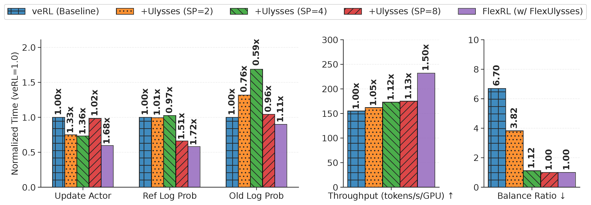
Comparison with Fixed-Degree Ulysses-SP
Takeaway 1
Takeaway 2
Takeaway 3
Higher fixed SP improves balance, but communication quickly dominates.
FlexUlysses reaches balance ratio 1.0 without fixed communication on all sequences.
Throughput is 1.50× higher than the veRL baseline in this comparison.
10

Slide 11
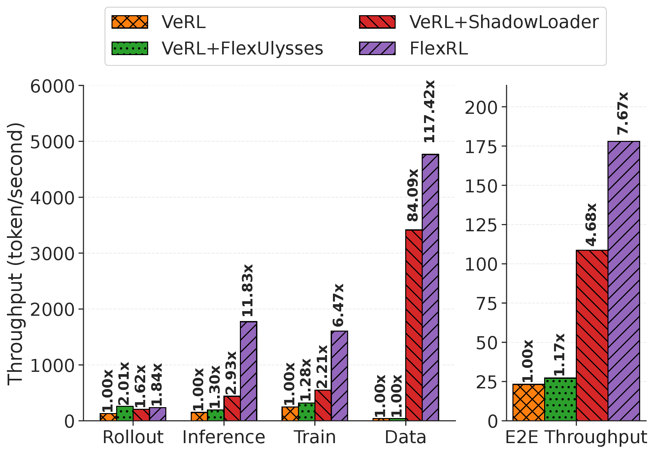
Ablation Study
ShadowLoader alone
84.09× data loading
4.68× end-to-end
5.35× lower step time
FlexUlysses alone
2.01× rollout
1.28× training
1.17× end-to-end when data loading still dominates
Both together = FlexRL
117.42× data loading
7.67× end-to-end
7.68× lower overall step time
11

Slide 12
Takeaways
1. Diagnose the whole pipeline
VLM RL is bottlenecked by both multimodal data handling and execution imbalance.
2. Co-design loading and execution
ShadowLoader and FlexUlysses are coupled through metadata, slice-aware loading, and hierarchical placement.
3. Real gains on real clusters
Across 7B/32B VLMs and two 128-GPU clusters, throughput improves by up to 8.47×.
FlexRL makes large-scale VLM RL training practical by balancing both data and compute.
12

