Slide 1
FlexRL: Scaling VLM RL Training via Efficient Load Balancing
Peak end-to-end speedup
8.47×
ICLR 2026 camera-ready · Zerui Wang, Qinghao Hu, Chang Chen, Jiecheng Zhou, Haojie Duanmu, Xingcheng Zhang, Peng Sun, Dahua Lin
Compared with veRL bucketing or fixed-degree Ulysses-SP, depending on feasibility.
Shanghai Jiao Tong University · Shanghai AI Lab · MIT · USTC · Peking University · CUHK
An end-to-end system for VLM RL: ShadowLoader removes multimodal data bottlenecks, and FlexUlysses balances heterogeneous compute and memory across GPUs.
Core system components
2
ShadowLoader
FlexUlysses
128-GPU clusters
ShadowLoader for data loading; FlexUlysses for execution load balancing.
Talk outline: problem → system design → evaluation → takeaways
1

Slide 2
Executive Summary
FlexRL · ICLR 2026
What the paper diagnoses, builds, and demonstrates end-to-end.
1. Problem
2. System
3. Impact
VLM RL training breaks down for two separate reasons:
• Multimodal data loading is centralized on a single controller, causing CPU I/O stragglers and host-memory pressure.
• Batches mix short image-text prompts with long video contexts, creating severe per-GPU compute and memory imbalance.
Optimizing only one side still leaves the other as the dominant bottleneck.
FlexRL combines two tightly coupled components:
• ShadowLoader: metadata-only scheduling on the controller, with worker-side preprocessing, caching, and asynchronous materialization.
• FlexUlysses: adaptive sub-sequence sharding, hierarchical device groups, and deadlock-free overlapped execution.
The two pieces are co-designed so sharding decisions can inform data loading early.
Across MiMo-VL-7B-RL and Qwen2.5-VL-32B on two 128-GPU clusters, FlexRL delivers:
• up to 8.47× end-to-end throughput improvement
• 117.42× data-loading throughput improvement
• balance ratio driven down to 1.0 in the Ulysses comparison
The gains grow as workloads become more multimodal and sequence skew becomes more extreme.
2

Slide 3
Why VLM RL Training is Hard
FlexRL · ICLR 2026
The paper identifies one data bottleneck and one execution bottleneck.
Bottleneck A — Data preparation on the controller
Bottleneck B — Cross-GPU execution imbalance
Image/video decoding, frame sampling, and preprocessing are CPU- and I/O-heavy.
Attention compute grows quadratically with sequence length, while activation memory grows linearly.
In the veRL multimodal baseline, data loading takes 57.1% of the iteration time.
Text length is a poor proxy for visual cost: image counts and video frame counts change both compute and memory.
As batch size grows, the controller becomes the single straggler and can hit host-memory OOM.
Length-only bucketing can still leave one DP rank as the straggler—or even OOM on long contexts.
Observed in baseline
Failure mode
Skew source
Why prior work falls short
57.1%
OOM
Mixed modalities
Bucketing ≠ balancing
of step time spent on data loading
Controller-side CPU memory becomes the bottleneck
short image-text + long video-text in the same RL batch
fixed parallelism or coarse buckets cannot eliminate stragglers
3

Slide 4
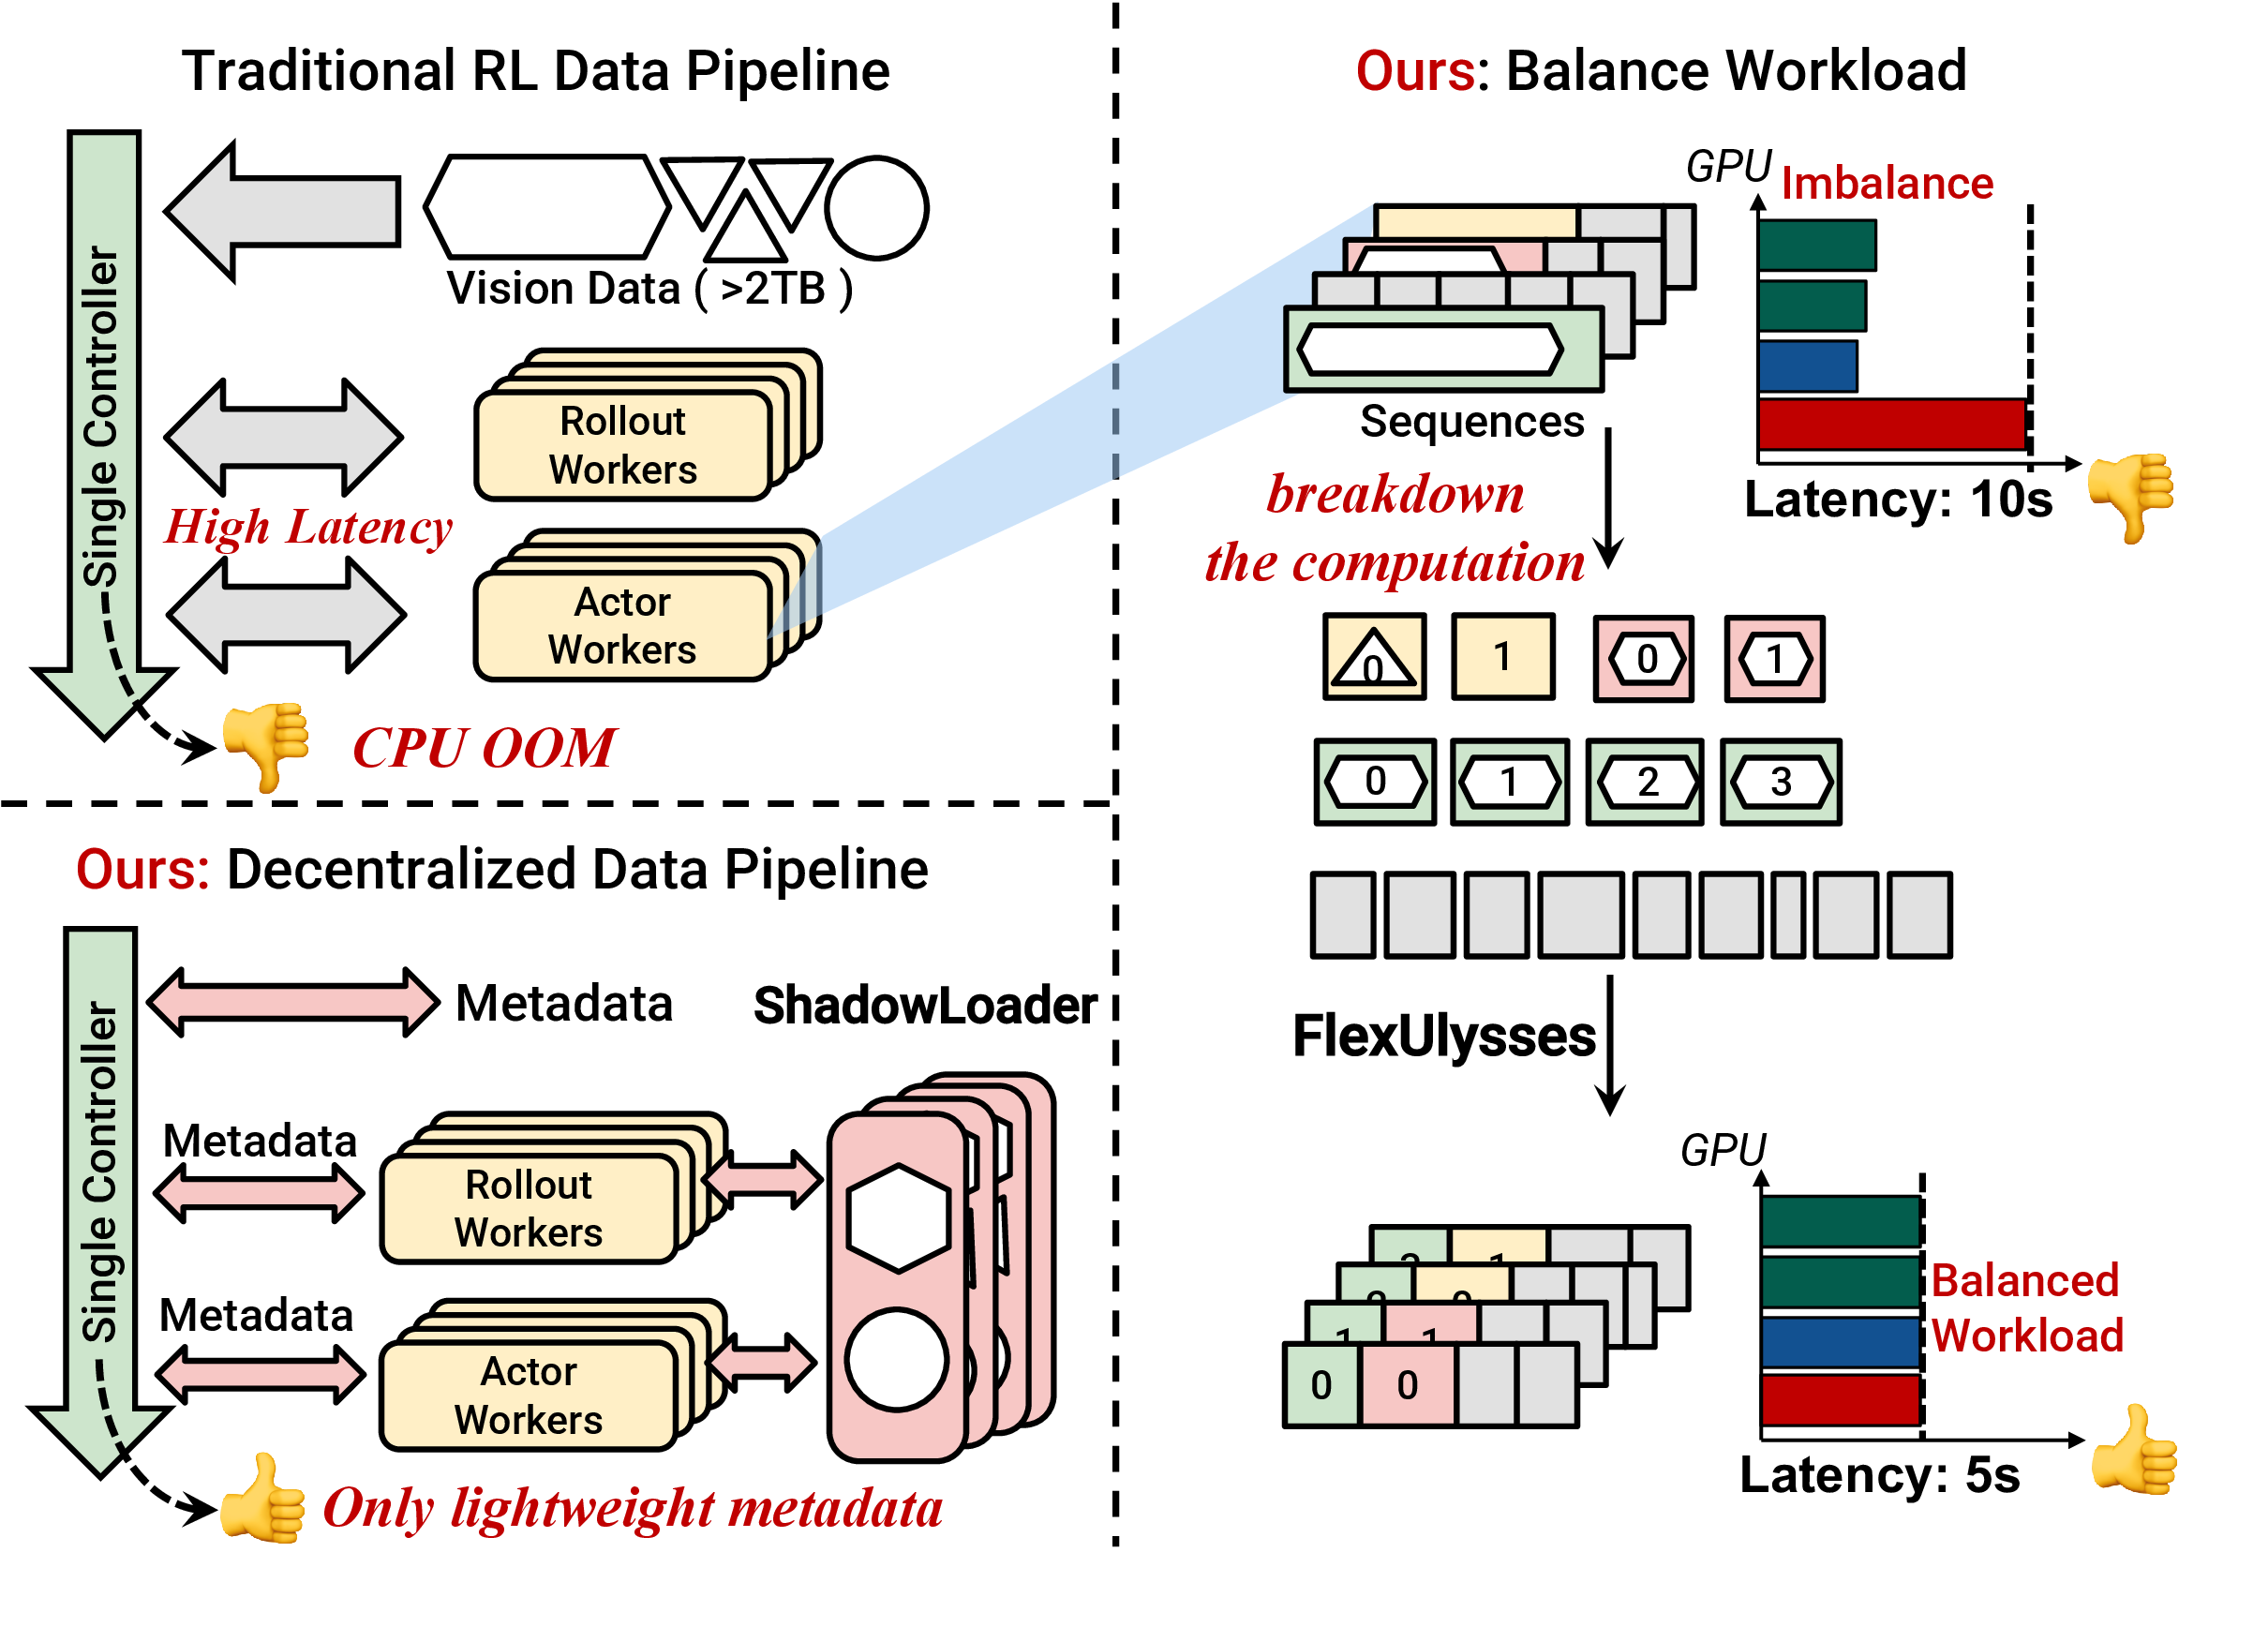
FlexRL Overview
FlexRL · ICLR 2026
The system addresses data loading and execution imbalance together, not in isolation.
Core idea
ShadowLoader decentralizes multimodal preprocessing and keeps only lightweight metadata on the controller.
FlexUlysses shards only the sequences that need it, balancing both compute and memory at sub-sequence granularity.
The two components are co-designed so sharding decisions can guide slice-aware data loading and reduce transfer volume.
Design principle
Optimize the whole RL loop
Remove CPU bubbles and GPU stragglers at the same time.
Paper figure: traditional pipeline vs. FlexRL (ShadowLoader + FlexUlysses).
4

Slide 5
ShadowLoader
FlexRL · ICLR 2026
Metadata-driven loading that removes the single-controller bottleneck.
Workflow
Proxy
Dataloader
Local
Preprocessor
MetaStore
Materializer
Controller keeps FakeTensor metadata only
→
Worker-side decode, frame sampling, and caching
→
Track sample ID → physical location mapping
→
Workers fetch actual visual tensors on demand
Key mechanisms
ShadowLoader alone
With FlexUlysses
• FakeTensor placeholders preserve compatibility with the RL pipeline while storing only metadata on the controller.
• Prefetching and asynchronous materialization overlap I/O, CPU preprocessing, and network transfer with GPU computation.
• FlexUlysses-aware loading fetches only the needed slices (e.g., frame ranges) once sharding is decided.
84.09×
117.42×
data-loading throughput improvement
data-loading throughput improvement
5

Slide 6
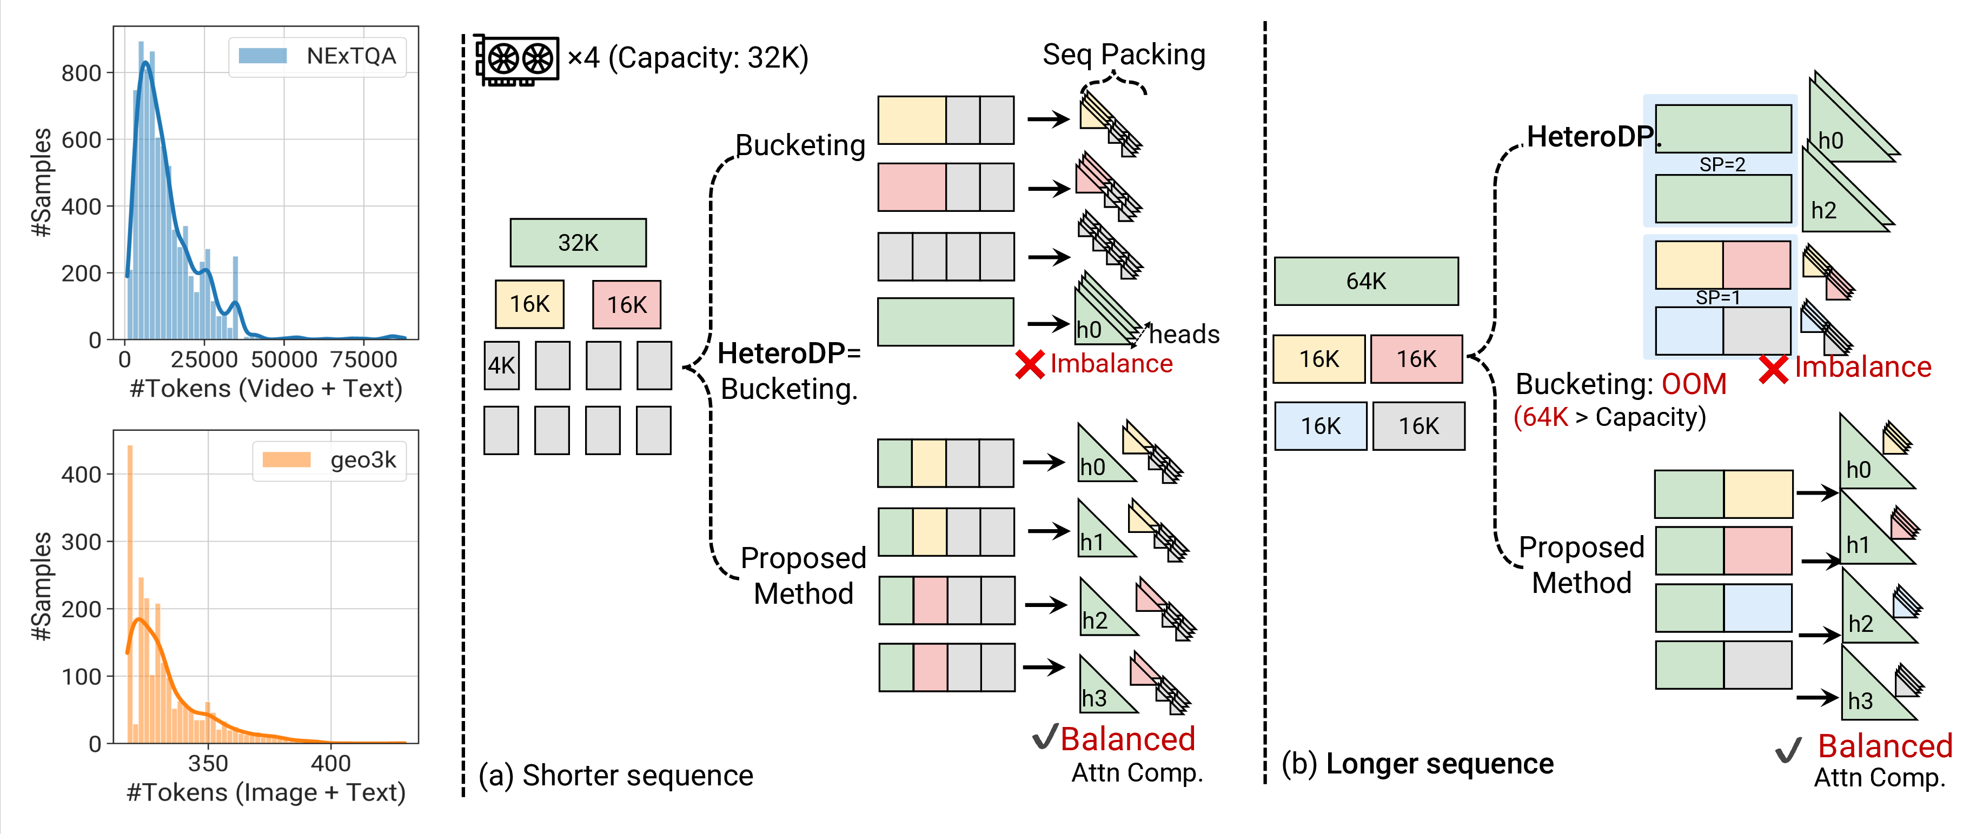
FlexUlysses Motivation
FlexRL · ICLR 2026
Bucketing cannot fully solve multimodal skew in either the short- or long-sequence regime.
Paper figure: left shows token-length distributions; middle/right compare bucketing with FlexUlysses on shorter and longer sequences.
Observation 1
Observation 2
Key insight
Even when memory does not force SP, one long sample can dominate the entire RL step.
For longer contexts, fixed buckets may still OOM or leave severe attention imbalance.
Use Ulysses chunks as scheduling units, and shard sequences only as much as needed.
6

Slide 7
FlexUlysses Design
FlexRL · ICLR 2026
Adaptive sharding is only useful if planning and execution remain low-overhead and deadlock-free.
1. Adaptive sharding degree
2. Hierarchical device groups
3. Highest-Sharding-First + overlap
For each sequence i, choose p_i ∈ {1, 2, 4, …, p_max} based on its length and the current batch composition.
Most sequences stay unsharded or lightly sharded, which preserves compute efficiency and avoids paying communication on every sample.
Candidate groups are nested (for example, on 8 GPUs: [0-7], [0-3]/[4-7], [0,1]/[2,3]/…).
This laminar structure makes placement simpler: any two groups are either disjoint or one contains the other, which is the basis for deadlock-free scheduling.
All ranks execute larger collectives before smaller ones, ensuring a consistent order across nested groups.
Within this schedule, FlexRL packs short sequences into sequence groups and overlaps all2all communication with attention computation to reduce GPU bubbles.
Important implementation detail
Vision tower balancing is handled separately by evenly distributing images and video frames across GPUs.
7

Slide 8
Evaluation Setup
FlexRL · ICLR 2026
Large-scale experiments cover two hardware platforms, two model scales, and three workload mixes.
Hardware
Models & training
Datasets & baselines
• Two 128-GPU clusters (16 nodes × 8 GPUs)
• NVIDIA H800 and NVIDIA H200
• NVLink/NVSwitch intra-node bandwidth: 400 GB/s (H800) and 900 GB/s (H200)
• RoCEv2 RDMA inter-node connectivity
• MiMo-VL-7B-RL and Qwen2.5-VL-32B
• GRPO for all experiments
• max response length = 1024
• max sharding budget p_max = 8
• Geo3K (image-text), NExTQA (short video), LongVILA-Reason (long video)
• Image-heavy = 5:2:1
• Video-heavy = 1:2:5
• Only-video = LongVILA-Reason only
• Baselines: veRL+Bucketing and fixed-degree Ulysses-SP
H800
H200
7B
32B
Geo3K
NExTQA
LongVILA-Reason
8

Slide 9
Main Results
FlexRL · ICLR 2026
Peak end-to-end speedup reported in the paper, by workload mix.
Image-heavy
Video-heavy
Only-video
7.35×
5.35×
8.47×
Geo3K : NExTQA : LongVILA-Reason = 5 : 2 : 1
Geo3K : NExTQA : LongVILA-Reason = 1 : 2 : 5
LongVILA-Reason only; longest and most heterogeneous sequences
What this means
Baseline note
FlexRL delivers the largest gains exactly where multimodal skew is the strongest: larger models, longer videos, and more heterogeneous batches.
Speedups are computed against veRL Bucketing when it is feasible; otherwise the paper compares against fixed-degree Ulysses-SP because Bucketing OOMs.
9

Slide 10
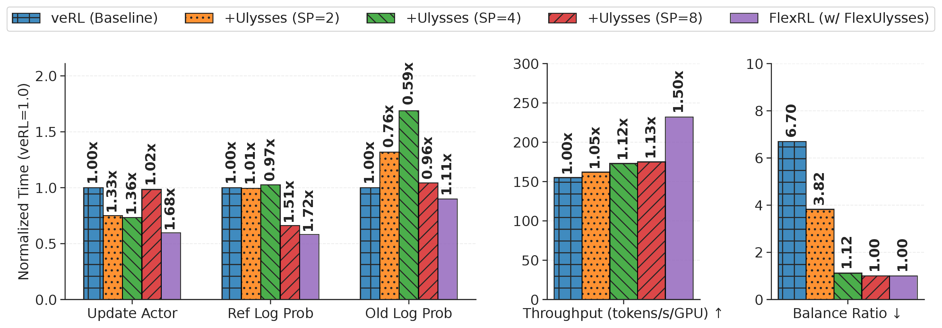
Comparison with Fixed-Degree Ulysses-SP
FlexRL · ICLR 2026
Adaptive sharding outperforms fixed SP because it avoids over-sharding short sequences.
Paper figure: fixed-degree Ulysses-SP vs. FlexUlysses on per-stage time, throughput, and balance ratio.
Takeaway 1
Takeaway 2
Takeaway 3
Higher fixed SP degrees improve balance, but communication overhead quickly dominates.
FlexUlysses reaches a balance ratio of 1.0 without paying fixed communication on all sequences.
In this comparison, FlexUlysses improves throughput by 1.50× over the veRL baseline.
10

Slide 11
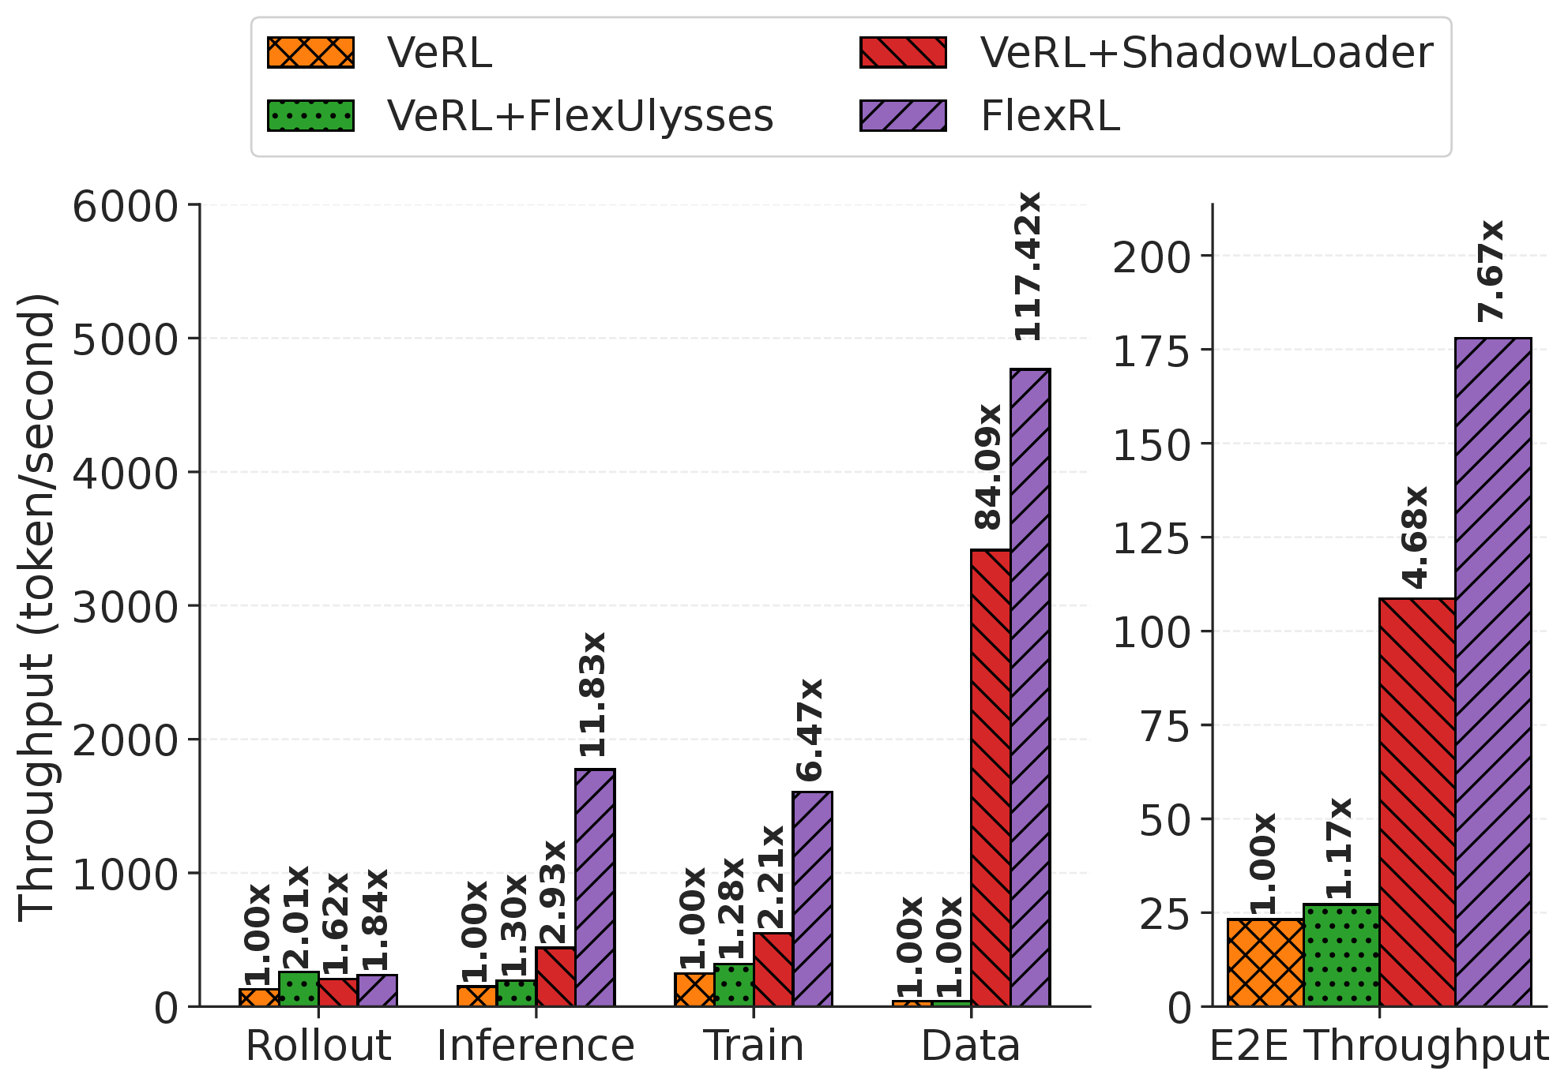
Ablation: ShadowLoader and FlexUlysses are Complementary
FlexRL · ICLR 2026
Removing only one bottleneck leaves large performance on the table.
ShadowLoader alone
84.09× data-loading throughput
4.68× end-to-end throughput
5.35× lower step time
FlexUlysses alone
2.01× rollout throughput
1.28× training throughput
Only 1.17× end-to-end when data loading still dominates
Both together = FlexRL
117.42× data-loading throughput
7.67× end-to-end throughput
7.68× reduction in overall step time
Paper figure: stage-wise throughput and step-time breakdown under the ablation study.
11

Slide 12
Takeaways
FlexRL · ICLR 2026
Why this paper matters as a systems contribution for multimodal RL.
1. Diagnose the whole pipeline, not just one kernel
The paper shows that VLM RL is bottlenecked by both multimodal data handling and execution imbalance; solving only one of them leaves the other as the dominant straggler.
2. Co-design data movement and execution planning
ShadowLoader and FlexUlysses are coupled by metadata, slice-aware loading, hierarchical placement, and overlapped execution—this is what turns isolated ideas into an end-to-end system.
3. Real gains on real clusters
Across 7B/32B VLMs and two 128-GPU clusters, FlexRL improves throughput by up to 8.47× and removes the controller-side bottleneck that makes multimodal RL hard to scale in practice.
Bottom line
FlexRL makes large-scale VLM RL training practical by balancing both data and compute.
12

