Slide 1
Sequence Alignment
with Needleman-Wunsch and Smith-Waterman
Dynamic Programming · CS 5800 Final Project
Presenter: Yuqing Xu, Zirui Wang
Northeastern University · Spring 2026 · April 16th

Slide 2
TABLE OF CONTENTS
1
Algorithm
(Part 1)
2
Correctness Verification of Implementation
(Part 2)
3
Operational Efficiency Testing
(Part 3)
4
Conclusion and Limitation
(Part 4)

Slide 3
PART 1 · PROBLEM DEFINITION
What is Sequence Alignment?
Real-World Applications
Seq 1
🧬 Genomics
A C G T A C G T
Find conserved genes across species
Seq 2
A C - T A A G T
💊 Drug Design
Identify binding-site similarities
Why Dynamic Programming?
🦠 Epidemiology
Brute-force: enumerate all alignments → exponential in sequence length DP insight: optimal alignment of prefixes S[1..i], T[1..j] depends only on smaller subproblems → O(mn) table
Track viral mutation (e.g. SARS-CoV-2)
🔬 Proteomics
Align protein sequences for function prediction

Slide 4
PART 1 · ALGORITHM DESIGN: NW vs SW
Needleman-Wunsch (Global)
Smith-Waterman (Local)
Initialization
Initialization
F[i,0] = i·gap F[0,j] = j·gap
H[i,0] = 0 H[0,j] = 0
Recurrence
Recurrence
F[i,j] = max(
F[i-1,j-1] + sub(i,j),
F[i-1,j] + gap,
F[i,j-1] + gap
)
H[i,j] = max(
0,
H[i-1,j-1] + sub(i,j),
H[i-1,j] + gap,
H[i,j-1] + gap
)
VS
Traceback
Traceback
Start: (m, n) → Stop: (0, 0)
Start: argmax(H) → Stop: H=0
Every character must be aligned — gaps forced even for mismatching ends
max(0,…) floor prevents negative propagation — low-scoring flanks simply reset

Slide 5
PART 1 · DP FILL & TRACEBACK VISUALIZATION
Experiment 2 (Partial Similarity) — DP matrix fill + traceback
Needleman-Wunsch (Global)
Smith-Waterman (Local)
NW: borders initialized with gap penalties — forces full-length alignment · SW: all borders = 0, floor at max(0,…) — traceback stops at first 0 cell

Slide 6
PART 1 · GAP MODEL COMPARISON
Linear Gap
Affine Gap
(Gotoh)
General Gap
Formula
Formula
Formula
w(k) = g · k
w(k) = g_open + (k−1)·g_extend
w(k) = any function
Complexity
Complexity
Complexity
O(mn)
O(mn)
O(m²n + mn²)
✓ Simple, O(1) per cell
✓ Gap-open penalized once; extensions cheaper — matches biology
✓ Fully flexible: log, quadratic, arbitrary table
✗ Every base in a gap penalized equally — biologically unrealistic for long indels
✗ Requires 3 matrices (M, Ix, Iy) but still O(1) per cell
✗ Must re-scan all gap lengths at each cell → O(k) per cell → O(n³) total
e.g. w(3) = −6 (g=−2)
e.g. w(3) = −10 + 2×(−1) = −12
e.g. w(k) = −2·log(k+1)
Best for full genomic alignments
Standard in bioinformatics (BLAST)
Research / custom penalty shapes

Slide 7
PART 1 · NW vs SW COMPARISON
Property
Needleman-Wunsch (Global)
Smith-Waterman (Local)
Border init
F[i,0]=i·gap, F[0,j]=j·gap
All borders = 0
Recurrence floor
None — scores can be negative
max(0, …) — no negatives
Traceback start
(m, n) — bottom-right corner
argmax(H) — anywhere in matrix
Traceback stop
(0, 0) — top-left corner
First cell where H = 0
Alignment scope
Full length of both sequences
Best-scoring substring pair
Negative score?
Possible
Impossible
Time complexity
O(mn)
O(mn)
Best suited for
Similar-length complete seqs
Conserved domain / motif search

Slide 8
PART 1 · COMPLEXITY ANALYSIS
Method
Algorithm
Gap Model
Time
Space
NW (linear)
Needleman-Wunsch
Linear
O(mn)
O(mn)
SW (linear)
Smith-Waterman
Linear
O(mn)
O(mn)
Gotoh-NW
Gotoh global
Affine
O(mn)
O(mn)
Gotoh-SW
Gotoh local
Affine
O(mn)
O(mn)
General-NW
NW + any gap
Any w(k)
O(m²n+mn²)
O(mn)
General-SW
SW + any gap
Any w(k)
O(m²n+mn²)
O(mn)
Biopython
C-level SW
Affine
O(mn)
O(mn)
💡 Space optimization: Hirschberg's algorithm achieves O(mn) time with O(min(m,n)) space — useful when only the score is needed, not the full alignment path.

Slide 9
PART 2 · CORRECTNESS VERIFICATION — EXPERIMENT DESIGN
Small-Scale Verification
5 constructed experiments
①
Short sequences (8–17 bp), manually verifiable. Progressive stress test from zero noise → extreme length asymmetry.
Linear gap used here.
Statistical Hypothesis Testing
7 similarity levels × 50 pairs × 2 algorithms = 700 alignments
②
Controlled similarity levels (30%–100%), 50 pairs each. Verify 4 formal hypotheses about NW/SW relationship.
Real-World Application
SARS-CoV-2 spike protein from NCBI
③
Three variants (Wuhan, Delta, Omicron), ~1000 nt. 3 pairs × 4 methods to confirm alignment quality;
6 SARS-CoV-2 + 5 random negative controls, E-value to show statistical significance.

Slide 10
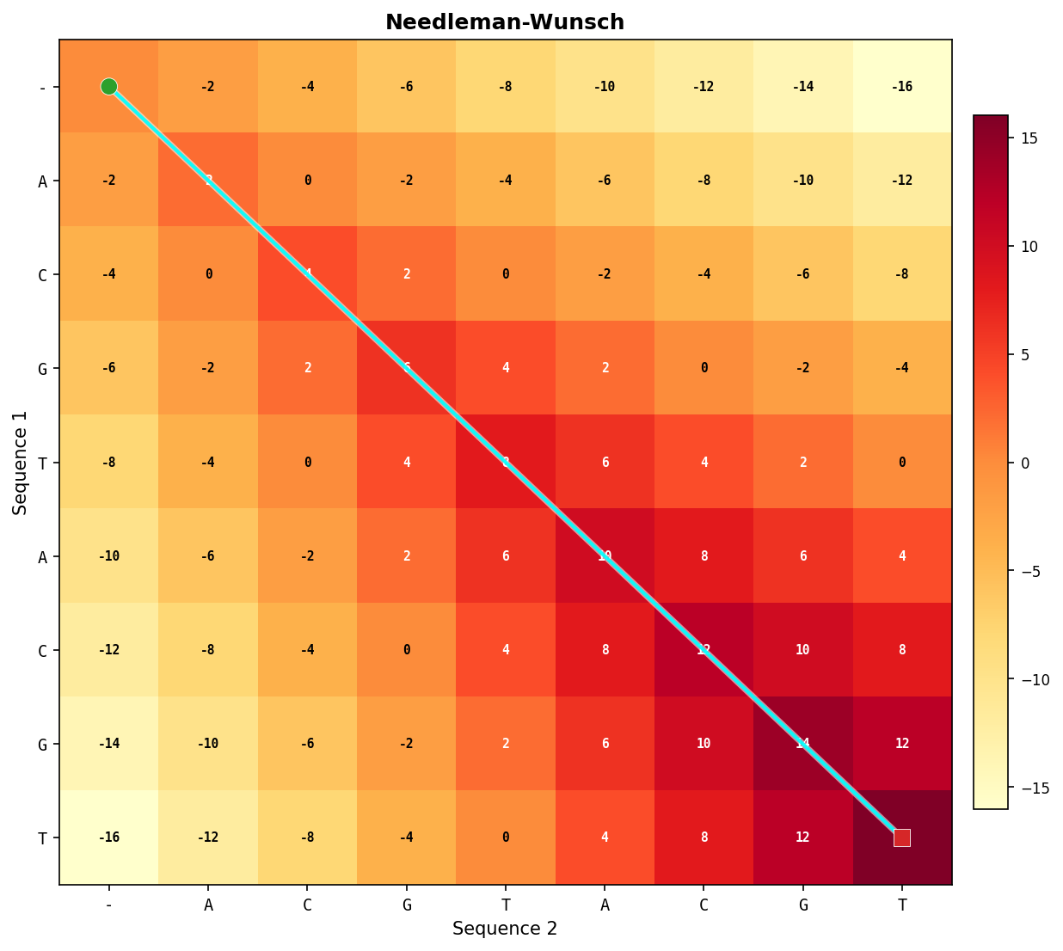
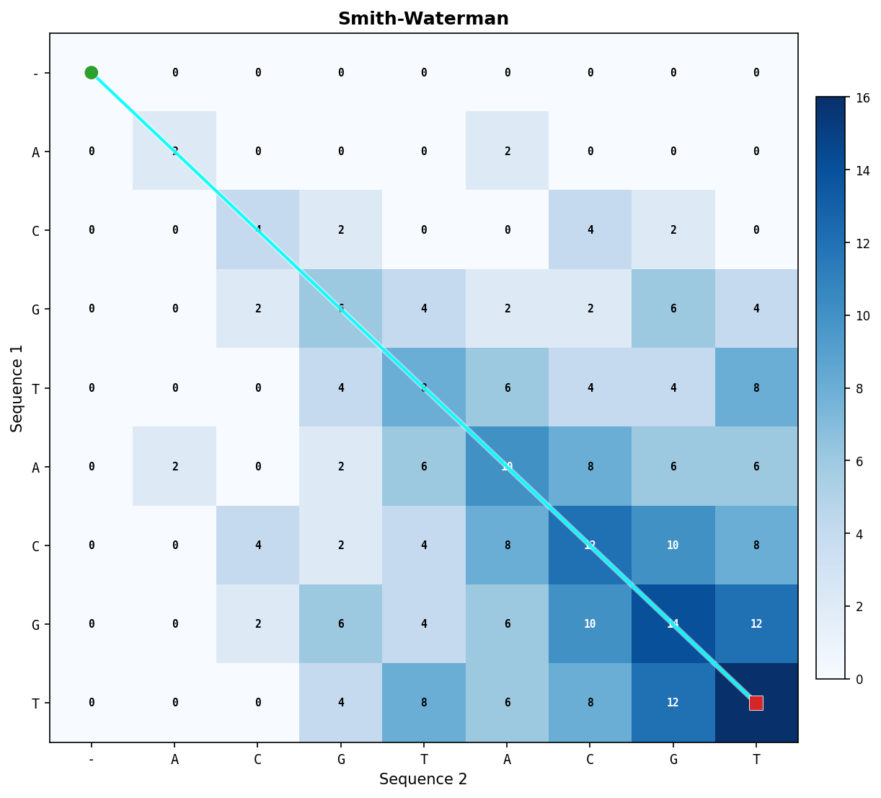
PART 2 · EXP 1 — FULL SIMILARITY
 | Sequence | Length
Seq1 | ACGTACGT | 8
Seq2 | ACGTACGT | 8
Metric | NW | SW
Score | 16 | 16
Aligned length | 8 | 8
Identity | 100.0% | 100.0%
Gap rate | 0.0% | 0.0%
Score density | 2.00 | 2.00
Coverage | 100.0% | 100.0%
📌 When the two sequences have full-length similarity, SW is a strict generalisation of NW and the two converge.

Slide 11
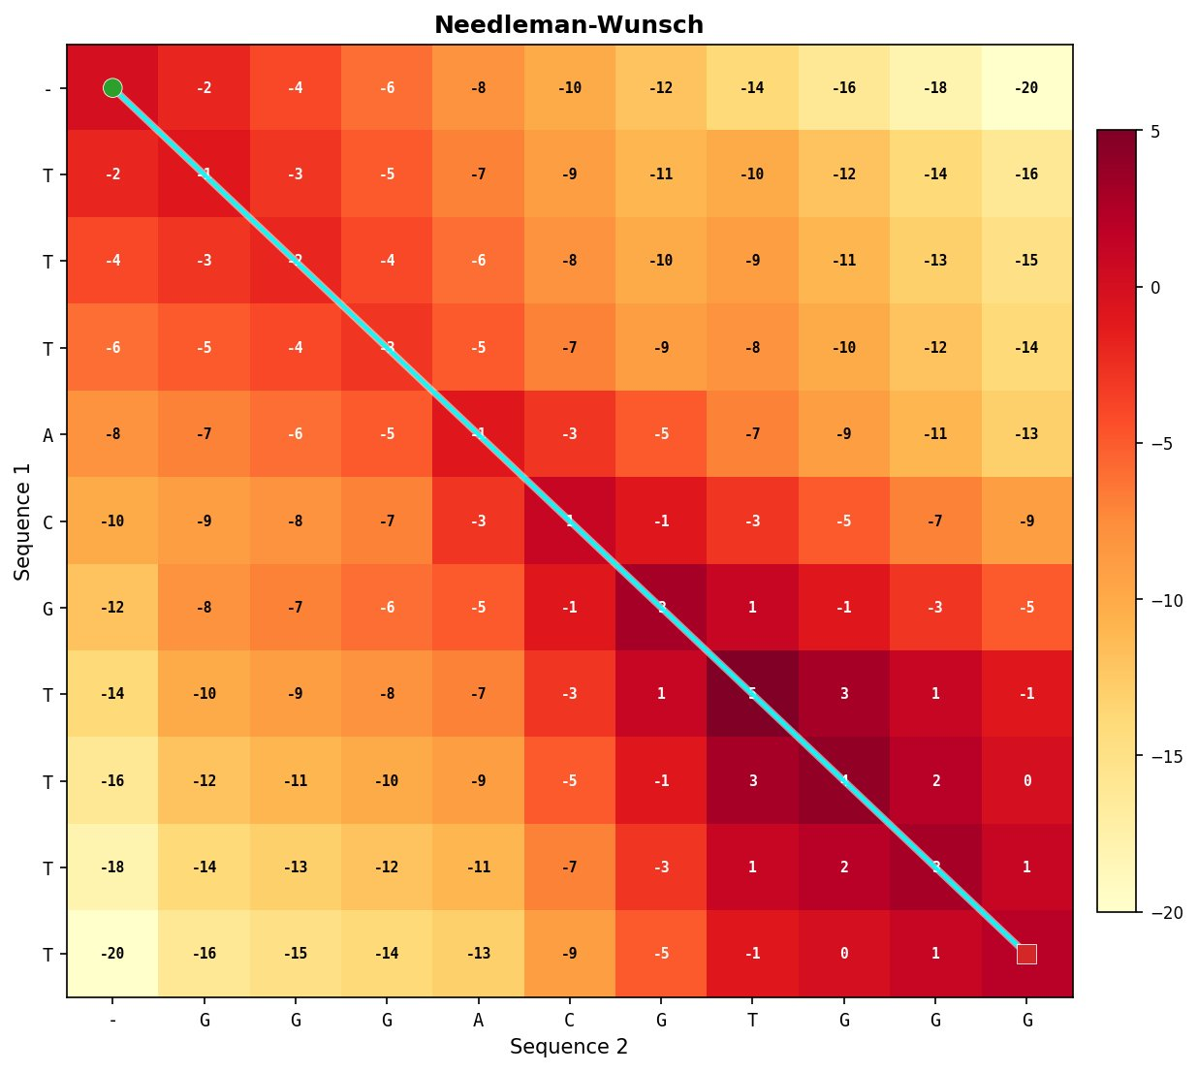
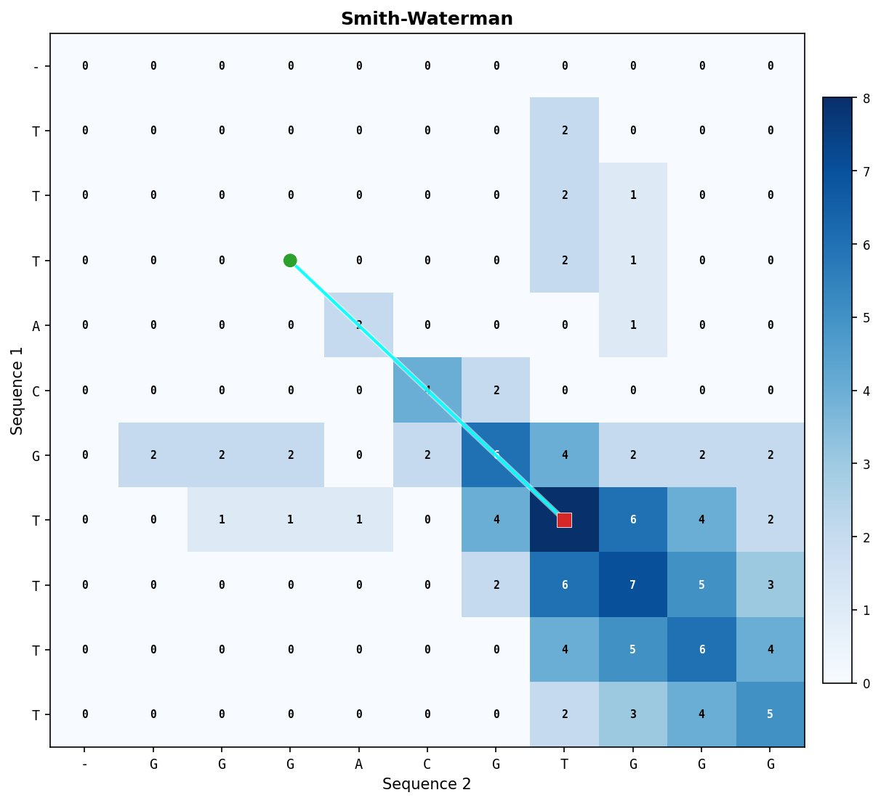
PART 2 · EXP 2 — PARTIAL SIMILARITY
Shared core flanked by noise
NW — score = 2 (flanks drag score down)
SW — score = 8 (isolates shared core)
 | Sequence | Length
Seq1 | TTTACGTTTT | 10
Seq2 | GGGACGTGGG | 10
Metric | NW | SW
Score | 2 | 8
Aligned length | 10 | 4
Identity | 40.0% | 100.0%
Gap rate | 0.0% | 0.0%
Score density | 0.20 | 2.00
Coverage | 100.0% | 40.0%
📌 NW penalized by mismatching flanks on both sides; SW resets at boundaries and finds the shared region cleanly.

Slide 12
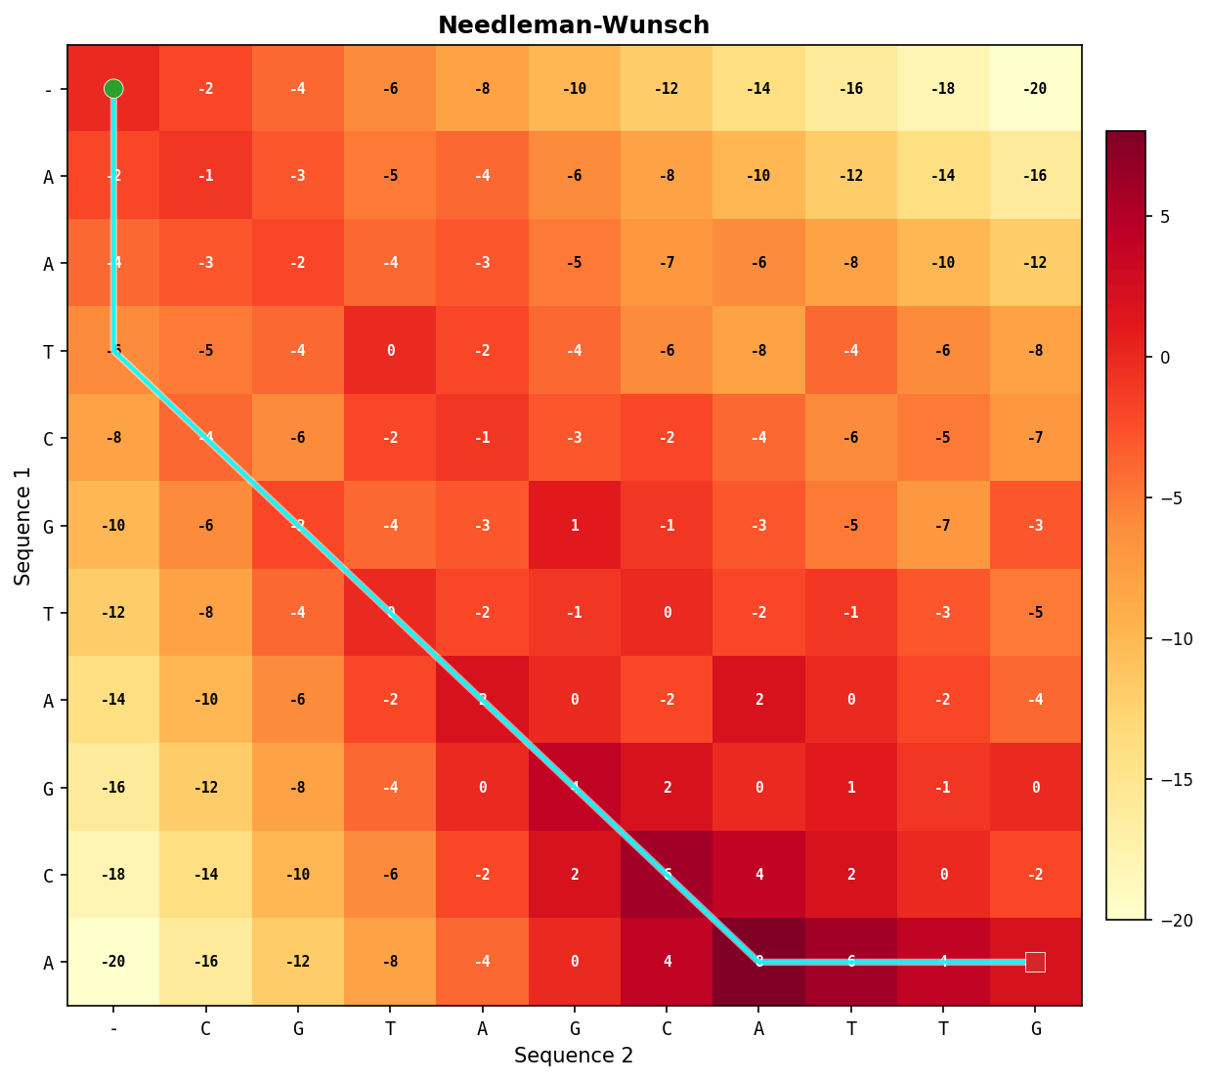
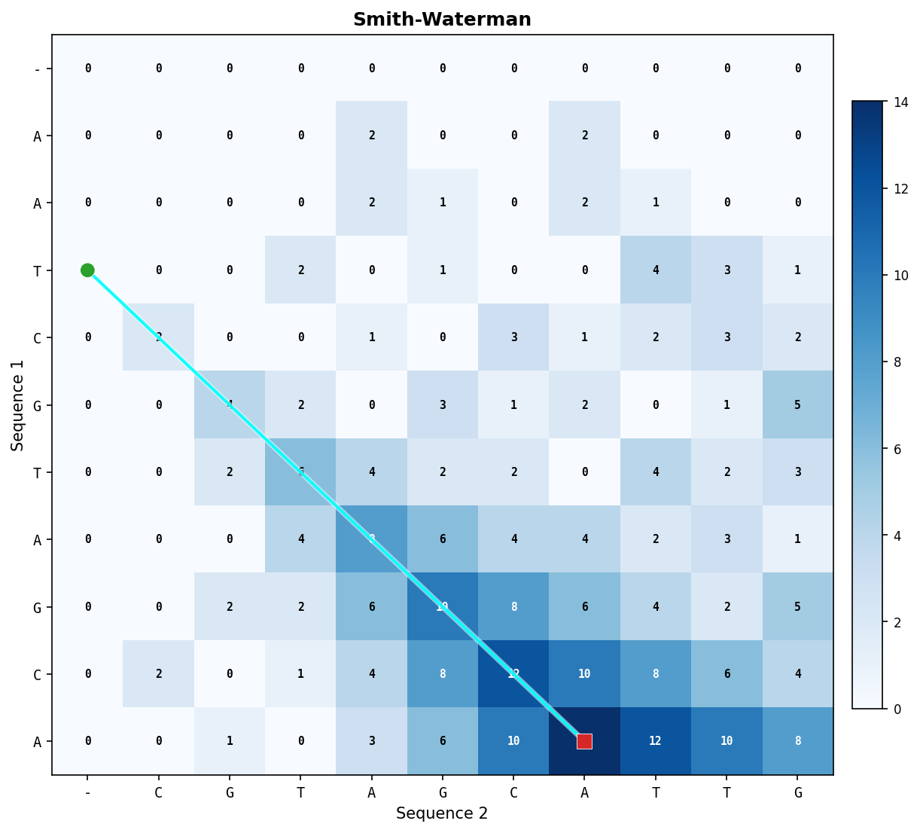
PART 2 · EXP 3 — Shifted / Overlapping
 | Sequence | Length
Seq1 | AATCGTAGCA | 10
Seq2 | CGTAGCATTG | 10
Metric | NW | SW
Score | 2 | 14
Aligned length | 13 | 7
Identity | 53.8% | 100.0%
Gap rate | 46.2% | 0.0%
Score density | 0.15 | 2.00
Coverage | 130.0% | 70.0%
📌 For shifted DNA sequences, Smith-Waterman provides a more accurate representation of the shared genetic material by maximizing the Score Density rather than the alignment coverage.

Slide 13
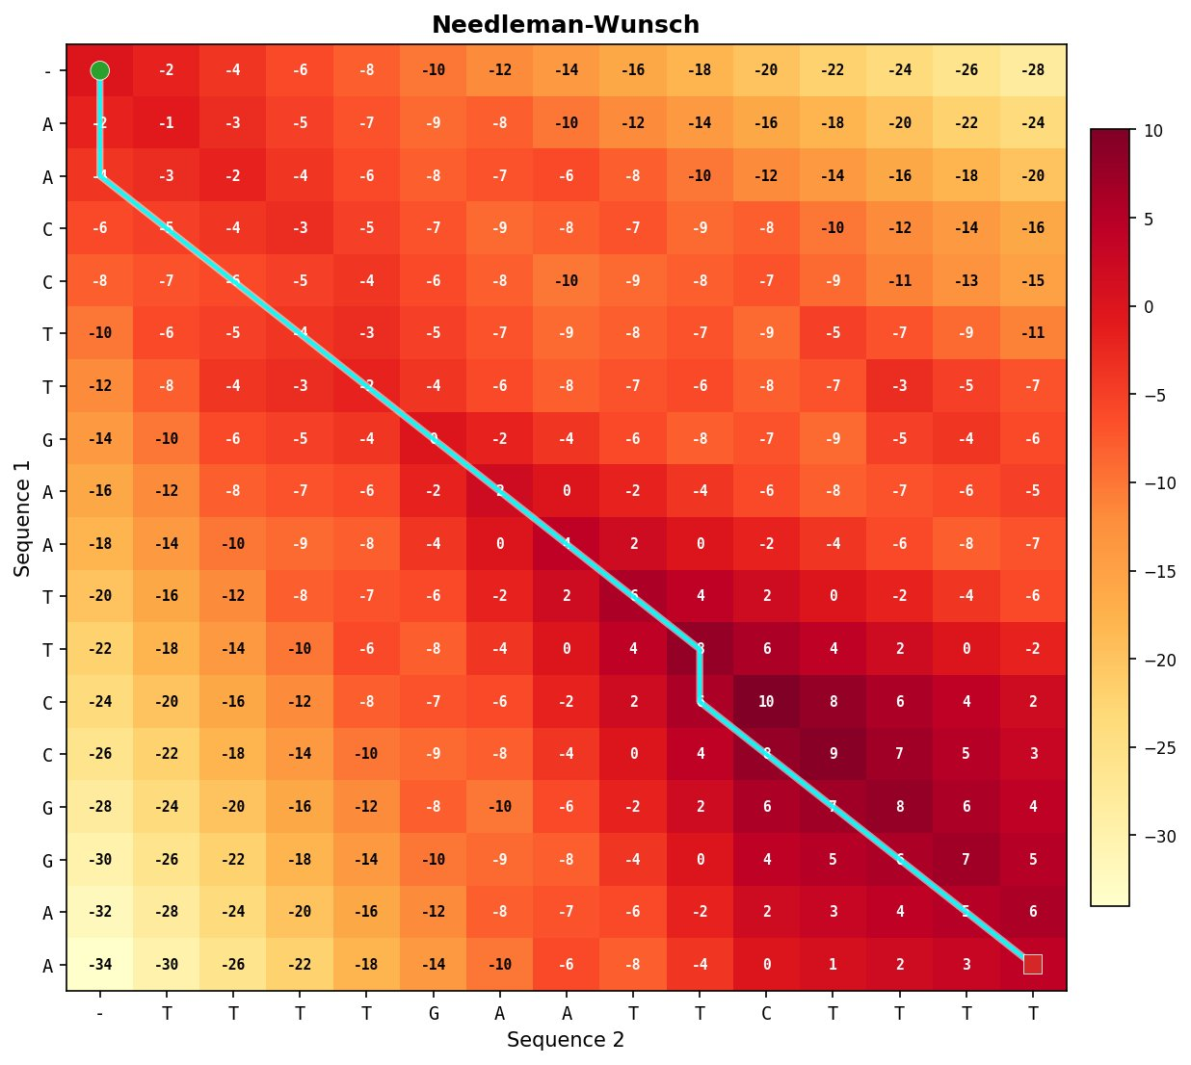
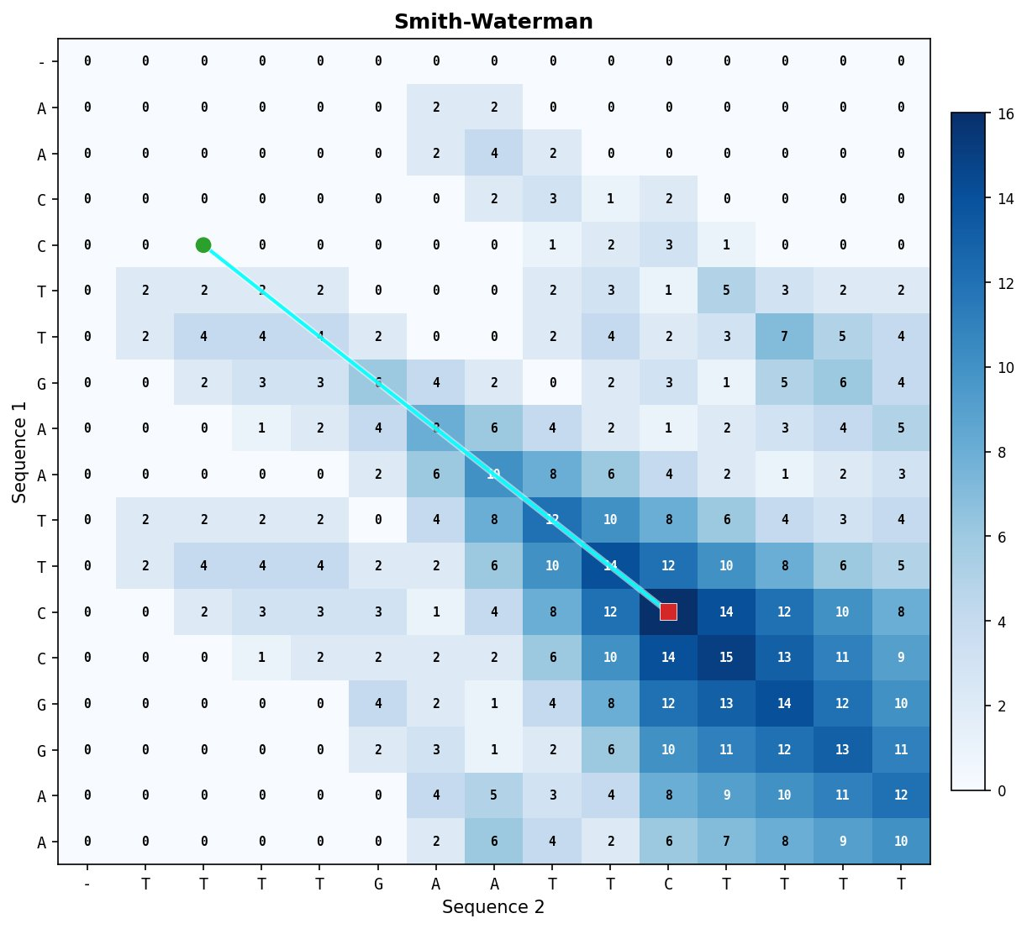
PART 2 · EXP 4 — EMBEDDED MOTIF (EcoRI: GAATTC)
Restriction site buried in unrelated flanks
NW — score = 4 (flanks penalize)
SW — score = 16 (perfect motif extraction)
 | Sequence | Length
Seq1 | AACCTTGAATTCCGGAA | 17
Seq2 | TTTTGAATTCTTTT | 14
Metric | NW | SW
Score | 4 | 16
Aligned length | 17 | 8
Identity | 47.1% | 100.0%
Gap rate | 17.6% | 0.0%
Score density | 0.24 | 2.00
Coverage | 100.0% | 47.1%
📌 The clearest demonstration: NW must align noisy flanks and scores poorly; SW's floor ignores them and recovers the exact motif.

Slide 14
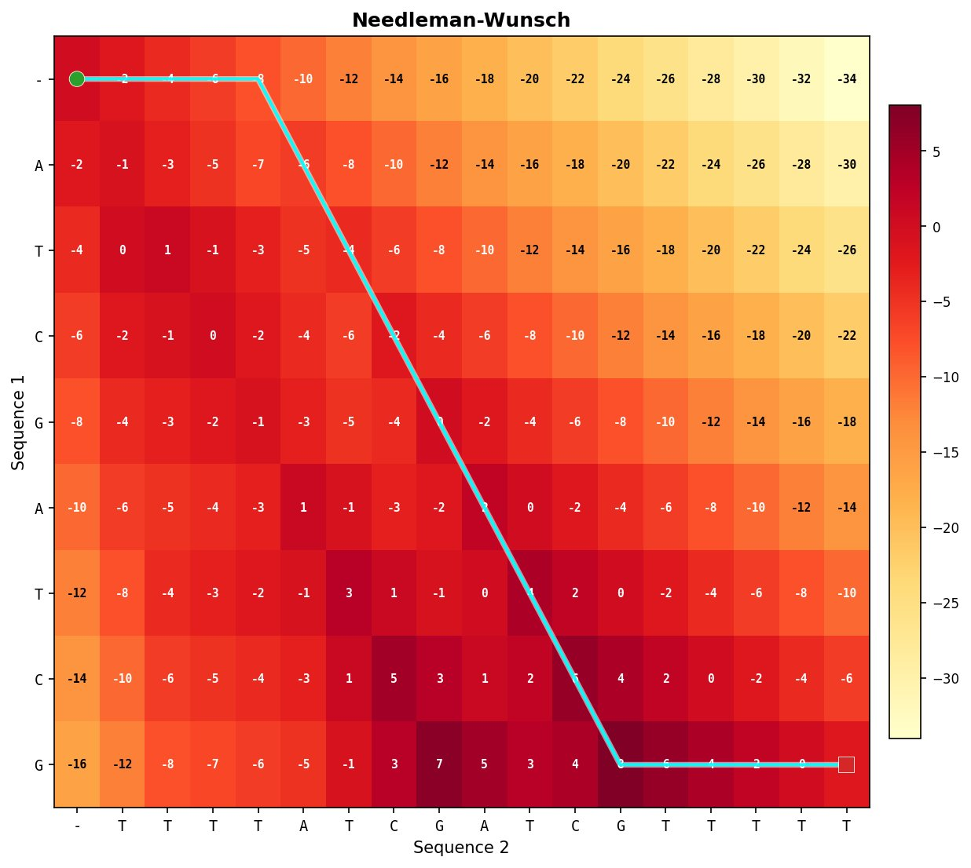
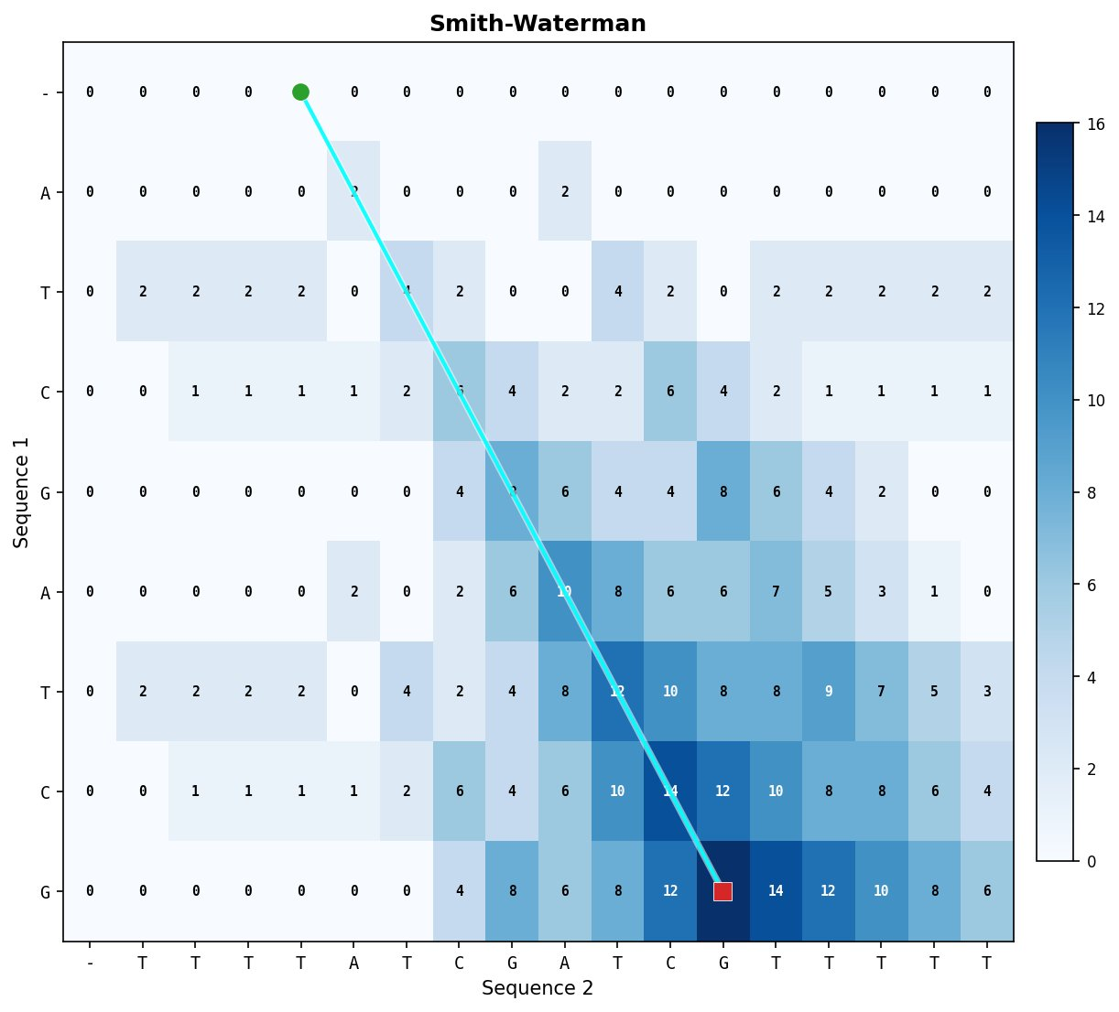
PART 2 · EXP 5 — DIFFERENT LENGTHS
Short 8bp query embedded in 17bp target
 | Sequence | Length
Seq1 | ATCGATCG | 8
Seq2 | TTTTATCGATCGTTTTT | 17
Metric | NW | SW
Score | -2 | 16
Aligned length | 17 | 8
Identity | 47.1% | 100.0%
Gap rate | 52.9% | 0.0%
Score density | -0.12 | 2.00
Coverage | 100.0% | 47.1%
📌 Extreme asymmetry: NW forced to fill every position with gaps, scoring below zero. SW ignores the length difference entirely.

Slide 15
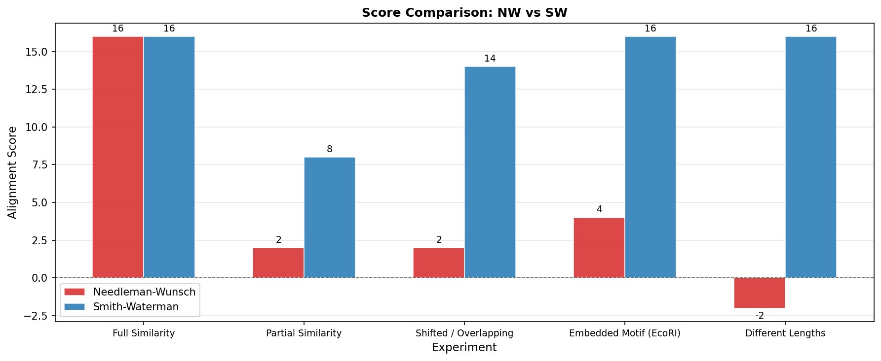
PART 2 · SMALL-SCALE EXPERIMENTS: DESIGN & SCORES
SW score ≥ NW score in all experiments — provable theorem;
The ratio grows as the proportion of irrelevant flanking material increases.

Slide 16
PART 2 · STATISTICAL VALIDATION
Gotoh affine gap | 350 synthetic pairs × 7 similarity levels × length 200 nt × seed 42
Sim% | NW Score | SW Score | SW/NW | NW Ident | SW Ident | H2 Pass
100% | 400.0 | 400.0 | 1.00 | 100.0% | 100.0% | 50/50
95% | 370.0 | 370.1 | 1.00 | 95.0% | 95.0% | 50/50
90% | 343.1 | 343.4 | 1.00 | 90.5% | 90.7% | 50/50
80% | 284.1 | 284.5 | 1.00 | 80.7% | 80.9% | 50/50
70% | 224.4 | 225.5 | 1.01 | 70.9% | 71.3% | 50/50
50% | 125.3 | 129.2 | 1.03 | 55.9% | 57.4% | 50/50
30% | 81.1 | 93.9 | 1.16 | 51.3% | 54.2% | 50/50
H1
H2
H3
H4
NW = SW at 100% similarity
SW ≥ NW always
(proven: SW solution space ⊇ NW)
SW/NW ratio grows as similarity drops
SW identity tracks true similarity better
✅ All 50 pairs identical
✅ 0 violations / 350
✅ 1.00 → ~1.16 at 30%
✅ NW diluted by forced gaps

Slide 17
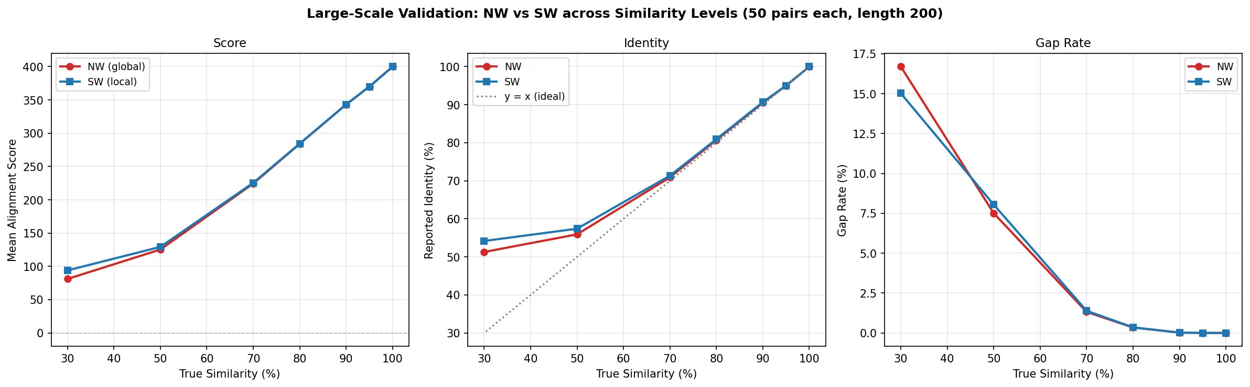
PART 2 · STATISTICAL VALIDATION
H1
H2
H3
H4
NW = SW at 100% similarity
SW ≥ NW always
(proven: SW solution space ⊇ NW)
SW/NW ratio grows as similarity drops
SW identity tracks true similarity better
✅ All 50 pairs identical
✅ 0 violations / 350
✅ 1.00 → ~1.16 at 30%
✅ NW diluted by forced gaps

Slide 18
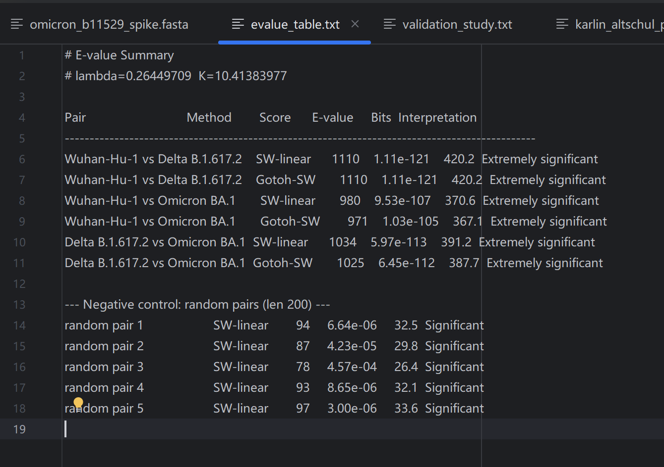
PART 2 · REAL-WORLD VALIDATION — SARS-CoV-2 SPIKE RBD
Pair | NW-lin score | SW-lin score | Gotoh-NW | Gotoh-SW | NW identity | SW identity | NW gaps
Wuhan↔Delta | 1002 | 1110 | 1036 | 1110 | 90.8% | 99.6% | 8.8%
Wuhan↔Omicron | 692 | 980 | 807 | 971 | 75.8% | 97.1% | 22.1%
Delta↔Omicron | 854 | 1034 | 915 | 1025 | 83.3% | 97.2% | 14.4%

Slide 19
PART 2 · REAL-WORLD VALIDATION — SARS-CoV-2 SPIKE RBD
Key Findings
• Sequence length: ~1000 nt — confirms implementation scales to real-world inputs
• High-similarity regime: NW ≈ SW at >97% identity — global/local distinction irrelevant when signal fills entire sequence
• Gap model impact: Omicron's indel load makes affine (Gotoh) score meaningfully higher than linear — real biological consequence
• E-value: All alignments statistically significant (E-value ≪ 0.01) — not random matches

Slide 20
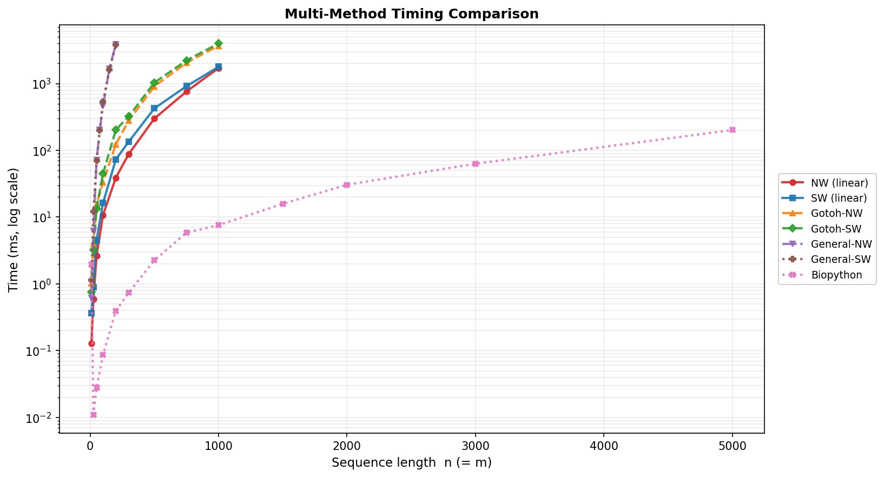

PART 3 · EFFICIENCY TESTING — TIMING BENCHMARK
Method
n=200 (ms)
n=1000 (ms)
NW (linear)
238
3,284
SW (linear)
86
2,422
Gotoh-NW
190
5,380
Gotoh-SW
230
6,134
General-NW
5,315
—
General-SW
5,235
—
Biopython
0.5
9
Same O(mn) algorithm: pure Python ~300× slower than C — constant factors dominate real use

Slide 21
CONCLUSIONS & LIMITATIONS
What We Found
Limitations & Future Work
NW vs SW
Space
NW guarantees full-length alignment; SW ignores low-scoring flanks — choose based on biological question
Full O(mn) matrix stored — Hirschberg could reduce to O(min(m,n)) for large inputs
Gap model matters
Python speed
Affine (Gotoh) handles real indels better; general-gap is O(n³) and impractical beyond n≈200
Pure Python is too slow for genome-scale (>10K nt); would need NumPy/Cython optimisation
SW ≥ NW always
Scoring matrix
Proven theorem — confirmed across all 350 synthetic pairs (0 violations)
Used simple match/mismatch; real tools use BLOSUM/PAM substitution matrices
Implementation cost
E-Value
Same O(mn) algorithm: pure Python ~300× slower than C — constant factors dominate real use
Karlin-Altschul E-value statistics assume uniform base frequencies; robustness under non-uniform distributions was not tested

Slide 22
Thank you!

