Slide 1
第二章 永磁同步伺服系统
三环控制器设计

Slide 2
Questions:
电流环、速度环、位置环控制器如何设计？
三个环路关系如何？
带宽是什么含义？

Slide 3
2.4 Designing Feedback Controllers for Motor Drives
Procedure
Control Objective.
Cascade Control Structure.
System Representation for Small-Signal Analysis
Design torque controller (fastest) firstly.
Design speed loop assuming torque loop to be ideal.
Design position loop (slowest) assuming speed loop to be ideal .
Further Issues

Slide 4
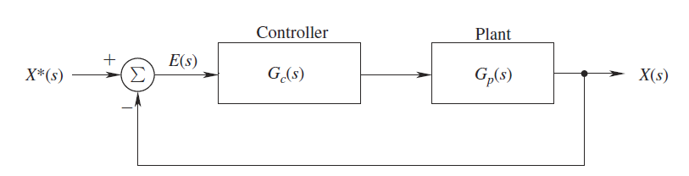
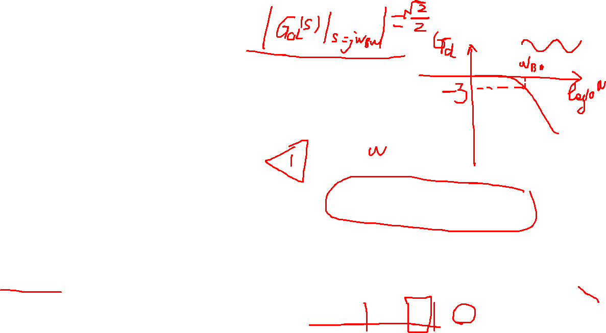
Review
Crossover frequency
Phase Margin (PM)
Closed-loop band width(PM)

Slide 5
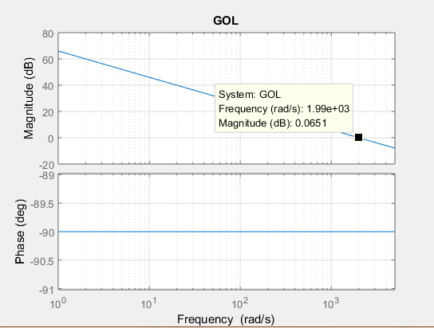
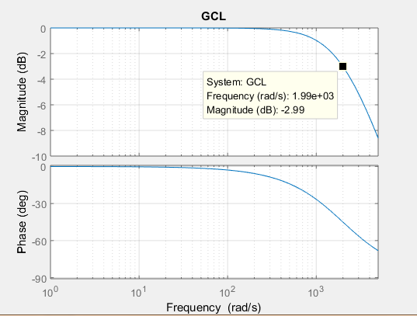
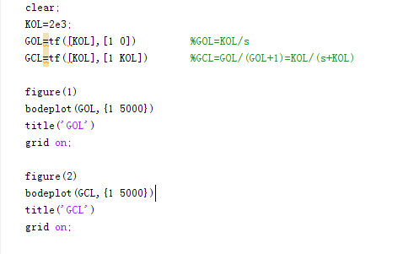
Exercise 1
In a unity feedback system, the open-loop transfer function is given as where rad/s. (a) Plot the open-loop transfer function. What is the crossover frequency? (b)Plot the closed-loop transfer function and calculate the bandwidth.

Slide 6
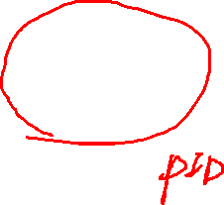
1. Control Objective

Slide 7
1. Control Objective
A zero steady state error
A good dynamic response (which implies both a fast transient response and a small settling time with very little overshoot)

Slide 8
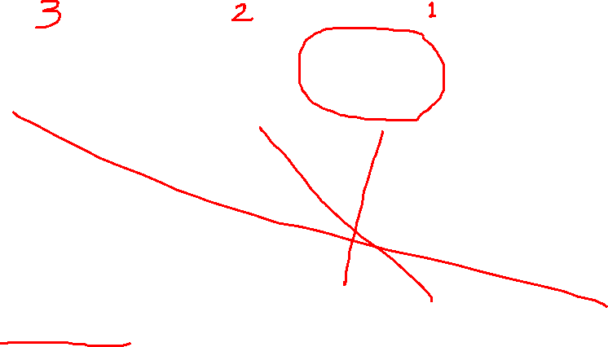
2. Cascade Control Structure
Fig. 1 Cascade control of a motor drive
Bandwidth: Torque loop > Speed loop > Position loop
(fastest) (middle) (slowest)

Slide 9
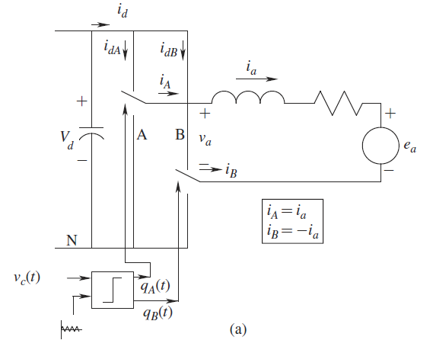
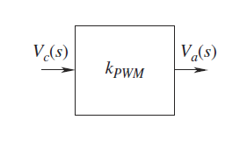
3. System Representation for Small-Signal Analysis
The Average Representation of the Power-Processing Unit (PPU)

Slide 10
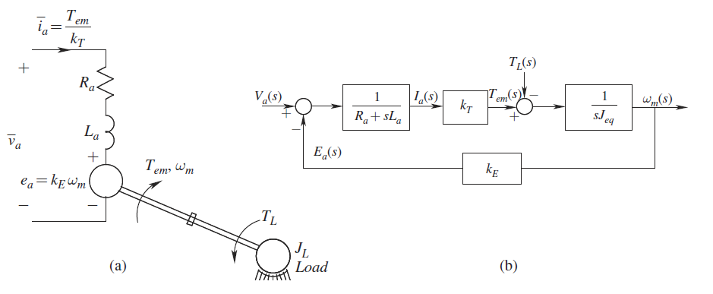
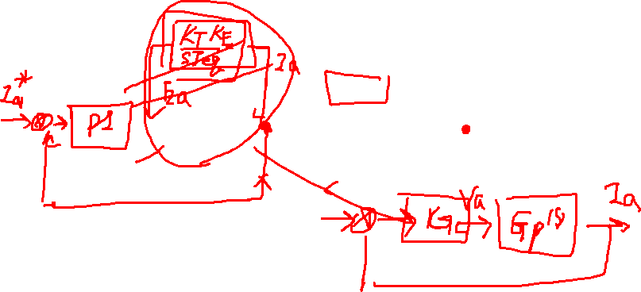
The Modeling of the DC Machine and the Mechanical Load
Electrical Time Constant

Slide 11
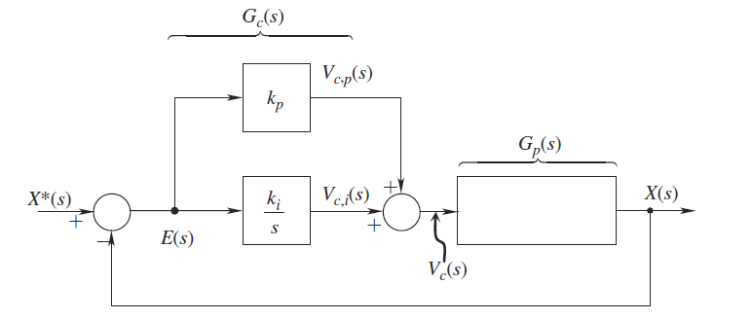
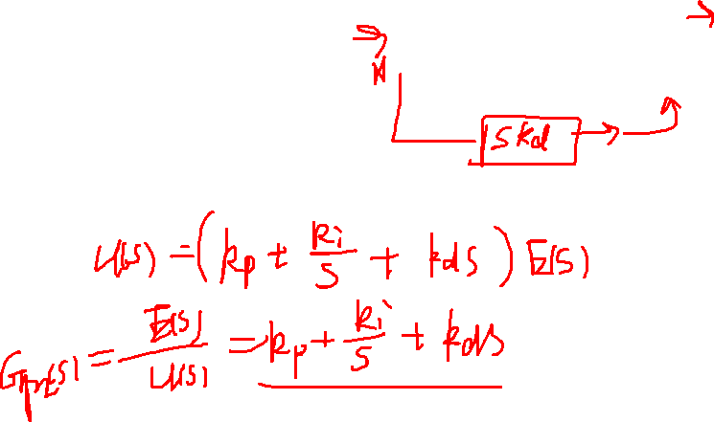
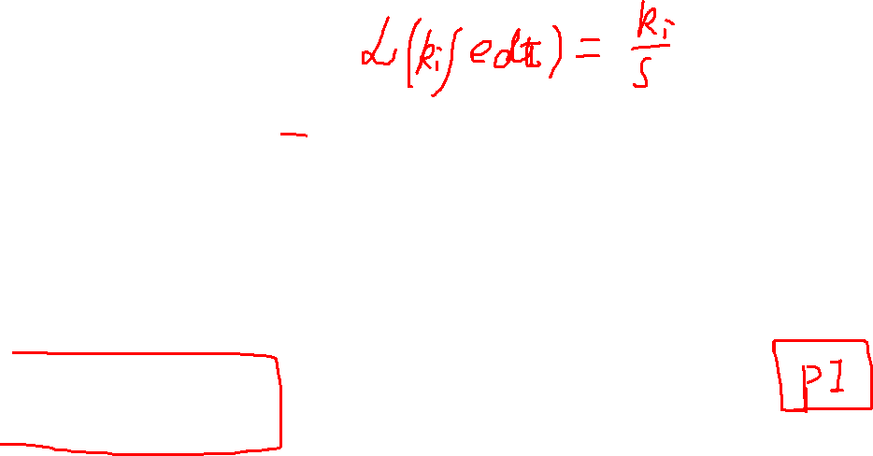
PI Controllers

Slide 12
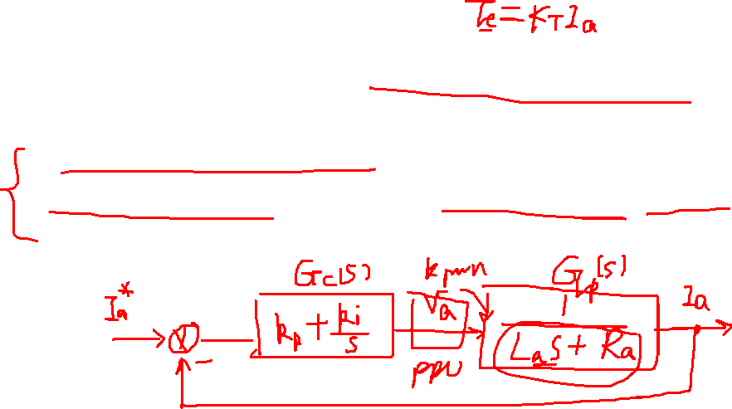
4. Design of the Torque (Current) Loop
Simplifying assumptions
Interleaved loops redrawn as nested loops
Assuming J_{eq} high enough, inner loop can ignored

Slide 13
4. Design of the Torque (Current) Loop
Selecting Parameters;
Select zero of PI to cancel motor pole;
Choose to achieve desired crossover frequency

Slide 14

No reduction
Redrawn
Simplify

Slide 15
Solutions
Phase margin:
Crossover frequency:

Slide 16
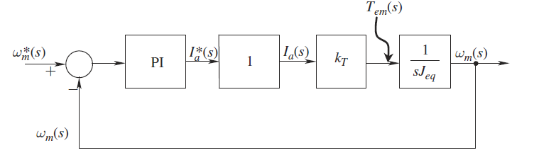
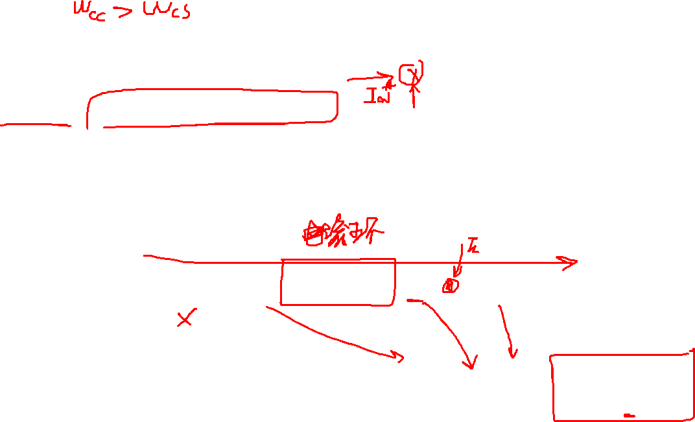
5. Design of the Speed Loop
Assume current loop to be ideal, represent by unity;
Choose crossover frequency ω_{CW} an order of magnitude lower than ω_{CI};
Choose a reasonable phase margin, 60 degrees is recommended.
Open-loop transfer function

Slide 17
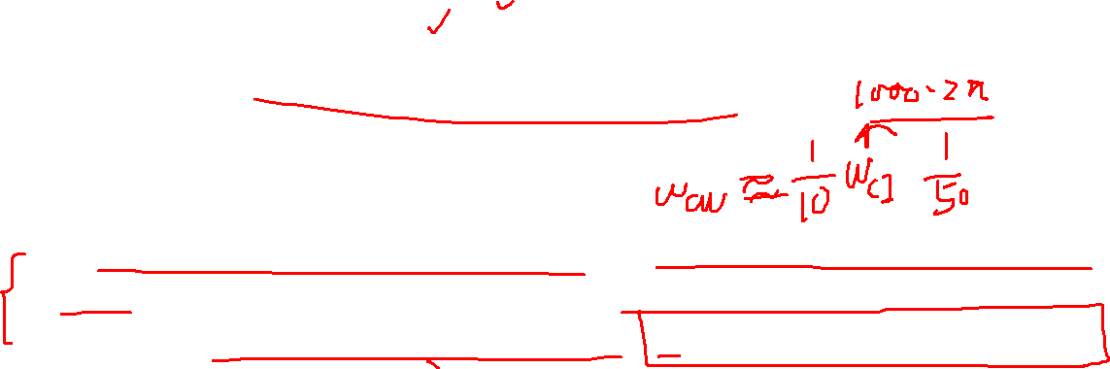
Two criteria for speed controller
Speed Controller Method ：s domain
Open-loop transfer function of speed loop
Choose crossover frequency ω_{CW} an order of magnitude lower than ω_{CI}
Choose a reasonable phase margin, 60 degrees is recommended

Slide 18
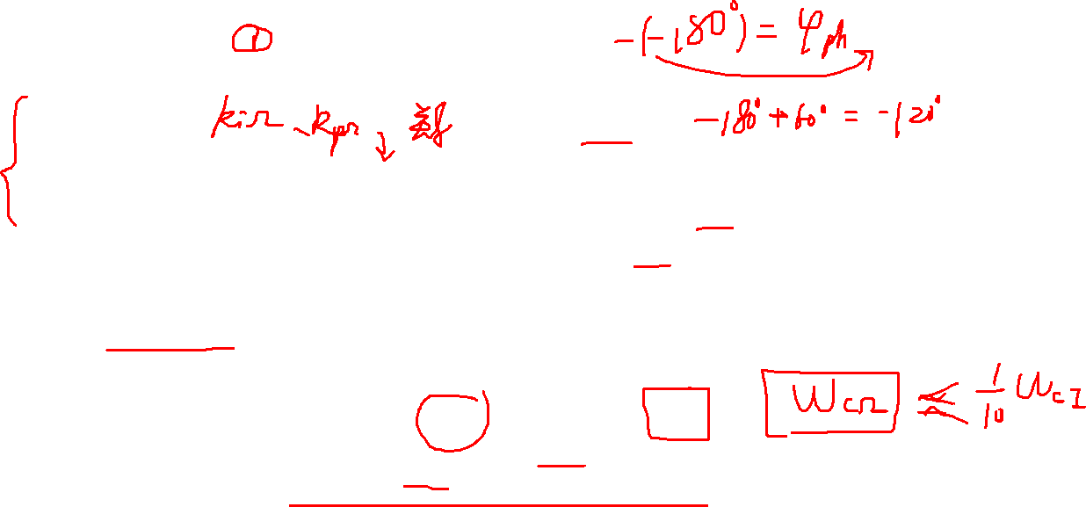
Speed Controller Method 1：s domain
Phase margin:
Crossover frequency:
Let ϕ_{phm} = 60 degrees and choose a reasonable crossover frequency ω_{CΩ}

Slide 19
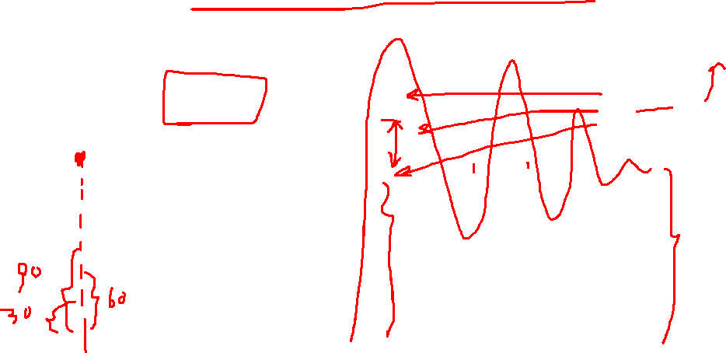
Comparison of different phase margin
Phase margin 60 degrees is better

Slide 20
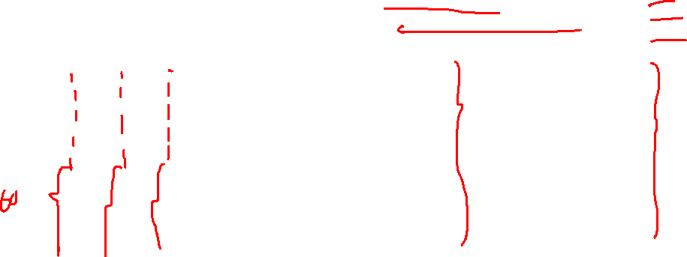
Comparison of different crossover frequency
Higher crossover frequency, faster response

Slide 21
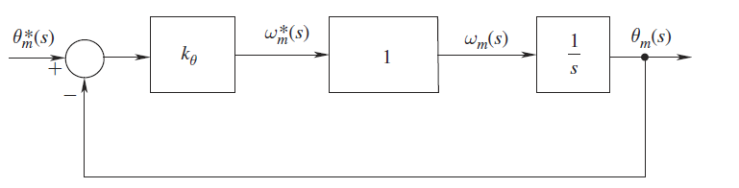
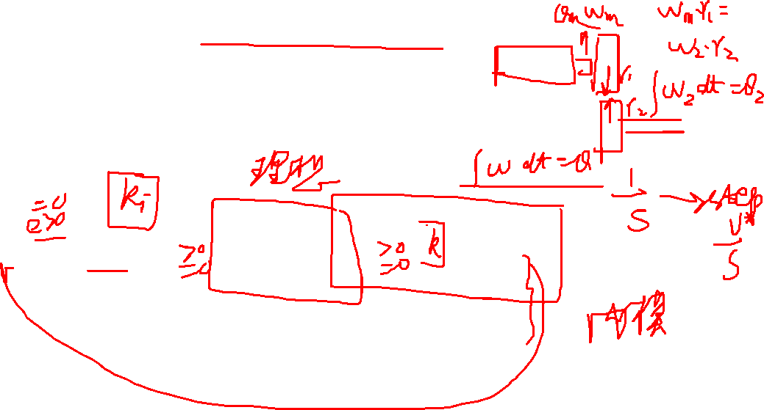
6. Design of the Position Loop
Assume speed loop to ideal
Proportional gain alone is adequate due to presence of pure integrator

Slide 22
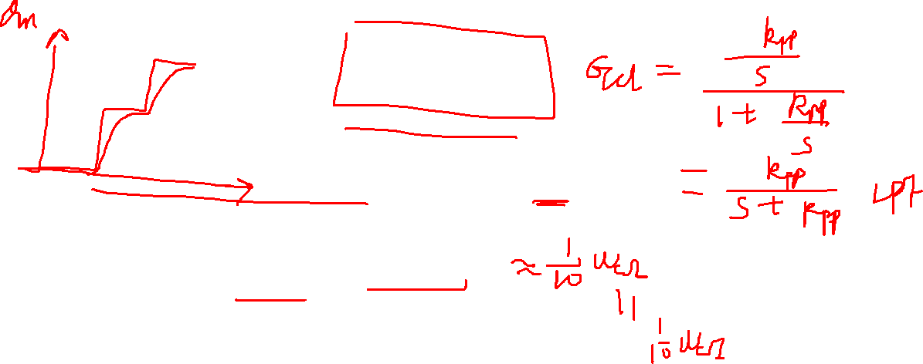
Solutions
Crossover frequency:

Slide 23
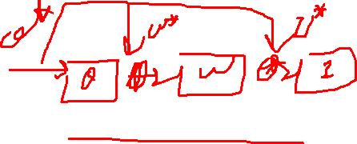
7. Further Issues
Effect of limits（限幅）
Voltage limit due to machine and materials
Current limit due to the materials
Speed and position limits due to the machine and mechanical system
Anti-windup（抗饱和）
Maintain stability in the presence of the limits
Feed-forward（前馈）
Cascade control disadvantages: slow dynamic response

Slide 24
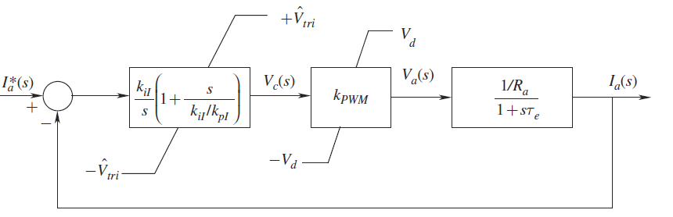

Effect of limits
The benefits of cascade control: the intermediate variables can be limited by putting limits on their reference values.

Slide 25
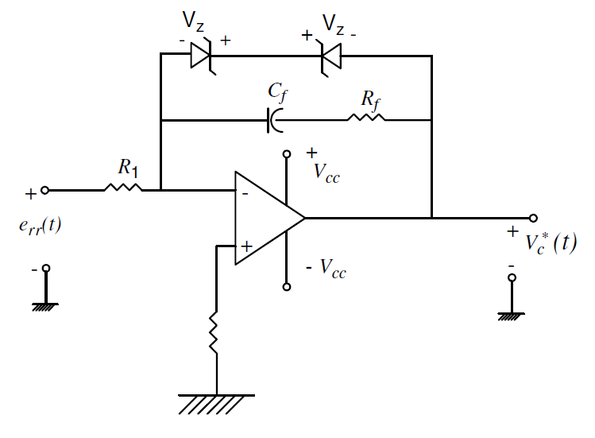
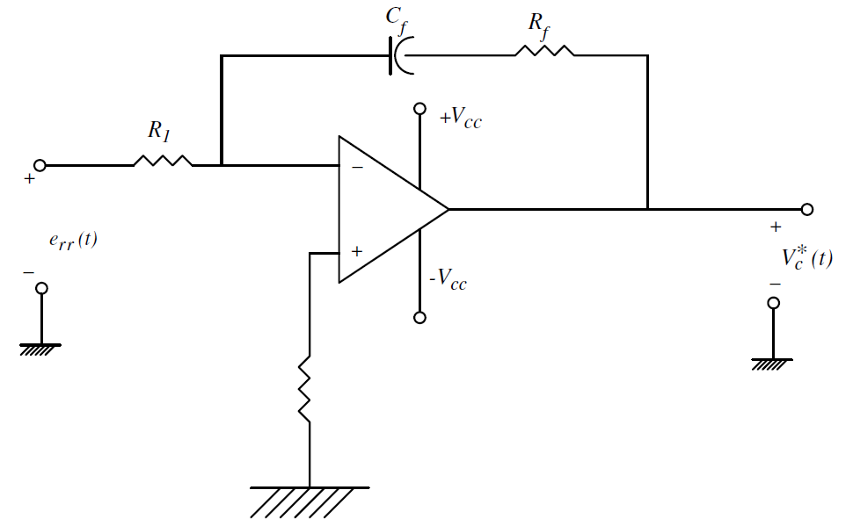
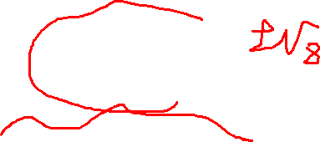
Anti-windup
The output of the regulator is increasing or decreasing all the time, but the system is bounded due to physical limitation, then where the regulator output has nothing to do with the input to the physical system under control.

Slide 26
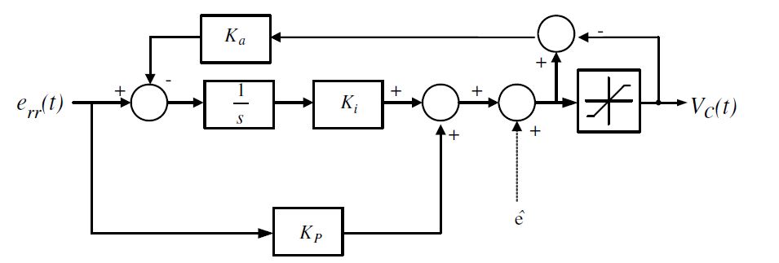
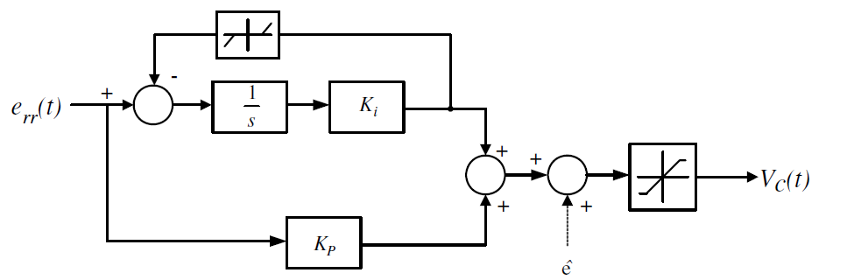
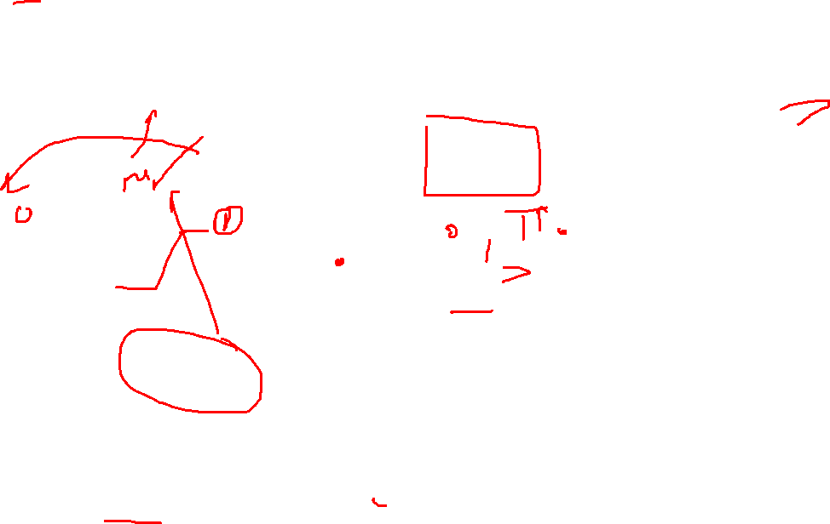
Anti-windup: methods
OR

Slide 27
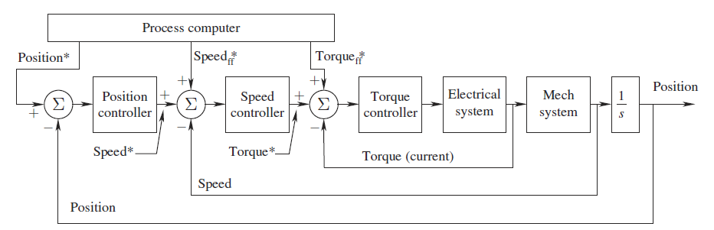
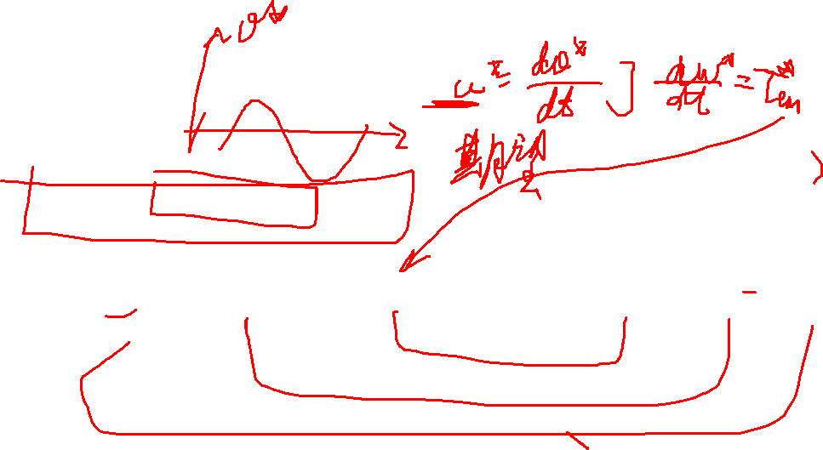
Feed-forward

Slide 28
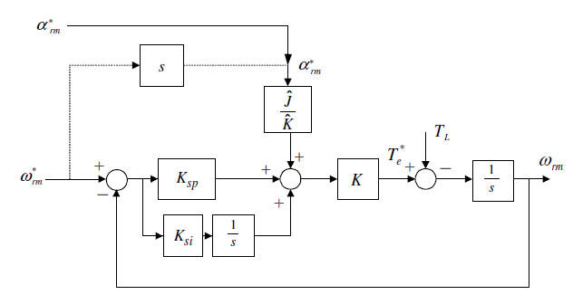
Feed-forward--Enhancement of Speed Control Performance with Acceleration Information

Slide 29
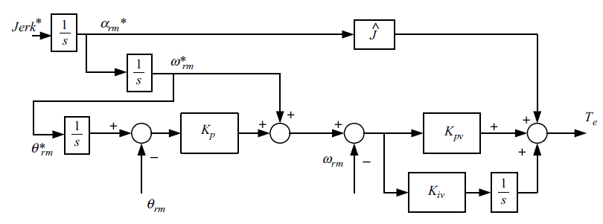
Feed-forward--Feed-Forwarding of Speed Reference and Acceleration Reference

Slide 30
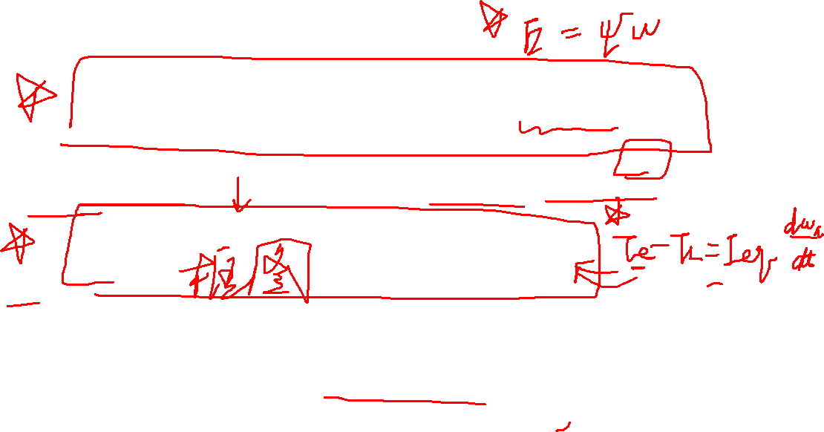
Mathematic Model of PMSM based on Field Oriented Control
IPMSM model on the dq-axis
SPMSM model on the dq-axis

Slide 31
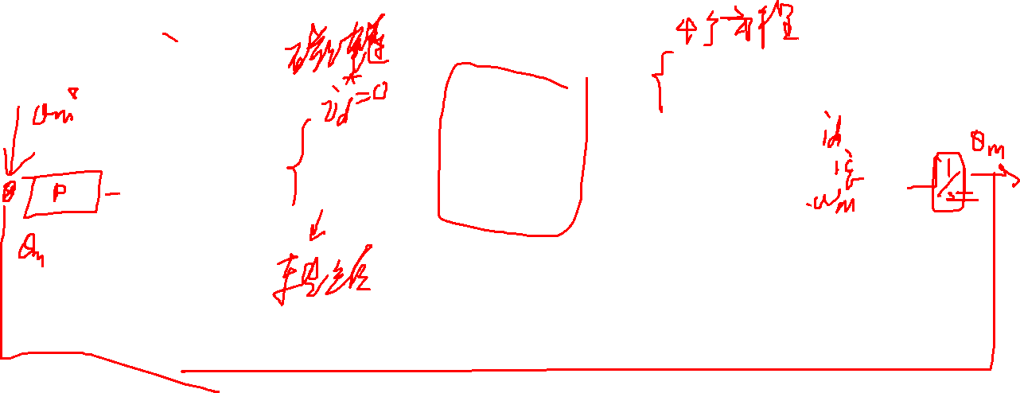
FOC implementation

Slide 32
Summary
Controller Design
Procedure
Design torque controller (fastest) firstly.
Design speed loop assuming torque loop to be ideal.
Design position loop (slowest) assuming speed
Some issues

Slide 33

仿真用电机参数
%控制器参数代码
Wci=1000*2*pi;%rad/s
Kpi=La*Wci/Kpwm;
Kii=Ra*Wci/Kpwm
Wcs=100*2*pi;
Kps=sqrt(3)*Jeq*Wcs/(2*KT);
Kis=Jeq*Wcs^2/(2*KT);
Imax=5;
Wcp=10*2*pi;
Kpp=Wcp;
Wmmax=200*2*pi;
Udc=24;
Kpwm=Udc/sqrt(3);
Rs=0.15;%
Ls=0.19e-3;%H
KT=0.087;%Nm/A
PsiPM=0.0116;%V/rad/s
Jeq=0.5e-4;%kg*m^2
Pole Pairs = 5;

Slide 34
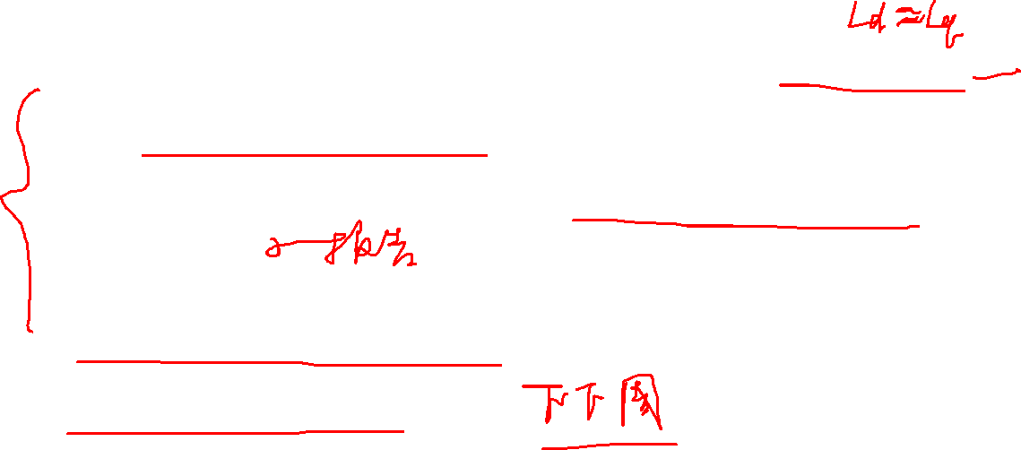
Homework
寻找一种不同于授课内容的三环PID设计方法，并在SPMSM上实现电流环、速度环、位置环三环参数设计；
仿真并撰写报告，报告中要列出参考文献、参数设计过程以及仿真波形；
上交压缩文档，以“学号_姓名”方式命名， 包括仿真报告、以及仿真模型以及参考文献。

