Slide 1
The scale-invariant feature transform(SIFT)
Presented by Wangzhiyong/20185105

Slide 2

Bayesian
Bayesian inference derives the posterior probability as a consequence of two antecedents: piror probability and likelihood function derived from a statistical model for the observed data.
The foundation stone:
Where
H is hypothesis whose probability may be affected by data
P(H) the prior probability, is the probability estimate of H before data E
P(H|E), the posterior probability, is the probability of H given E
P(E|H) is the probability of observing E given H, and is called the likelihood.
P(E) is termed the marginal likelihood or model evidence.

Slide 3
The scale-invariant feature transform(SIFT) is a feature detection algorithm in computer vision to detect and describe local features in images.
The scale space
Multi-scale nature of objects is quite common in nature.
For example, when we want to look at a leaf or the entire tree. We are able to see some detail of the tree, such as leaf, branch, and also we can get rid of these kinds of detail, only treat it as a tree like from a long perspective. This is Multi-scale.

Slide 4
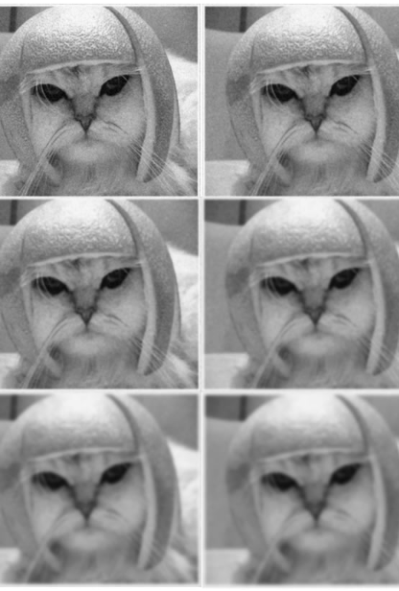
Scale space
Given an image when getting rid of details to generate multi-scale image, we must ensure don’t introduce new false details. To do this, the only way is with the Gaussian Blur.
Creating a scale space, like left images, the original image are progressively blurred.

Slide 5
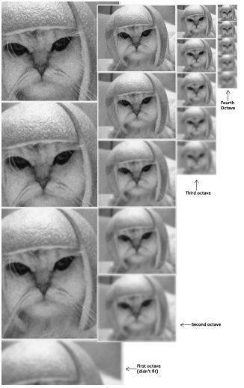
Scale spaces in SIFT
SIFT take the original image and generate progressively blurred out images.
Resize the original image to half size and generate blurred out images again
Keep repeating
This image shows 4 octaves, each octave has 5 scale images

Slide 6
Scale spaces in SIFT
The number of octaves and scale have to be decided by ourselves.
Blurred image
Gaussian blur has a particular expression or “operator” that is applied to each pixel.
Where:
L is a blurred image
G is the Gaussian Blur operator
I is an image
x,y are the location coordinates
* is the convolution operation in x and y.

Slide 7

Scale spaces in SIFT
Gaussian blur operator G:
σ is the “scale” parameter. Greater the value, greater the blur.

Slide 8
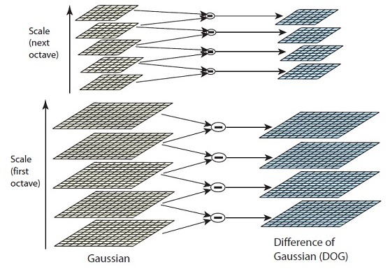
LoG approximations
In the previous step, we create the scale space of the image. Now we use those blurred images to generate another set of images, the Difference of Gaussians(DoG).
But LoG(Laplacian of Guassian) is a computationally intensive process, so as usual we use DoG, a simple subtraction.

Slide 9
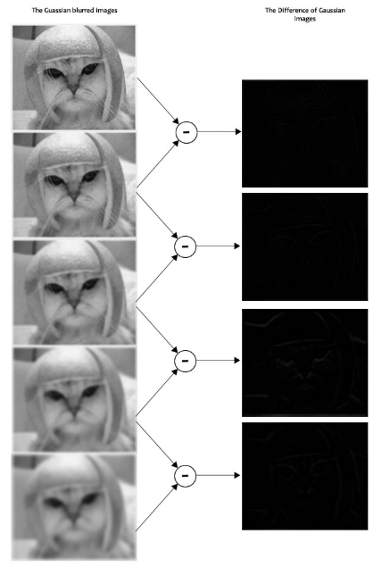
Example
Here is a gigantic image to demonstrate how this difference of Gaussians works.
This image do the subtraction for just one octave. The same thing is done for all octaves.

Slide 10
Finding keypoints
Finding key points is a two part process
1.Locate maxima/minima in DoG images
2.Find subpixel maxima/minima

Slide 11
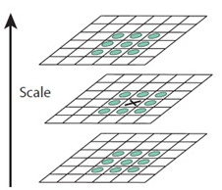
Locate maxima/minima in DoG images
This step is to coarsely locate the maxima and minima. The method is to check all it’s neighbours and iterate through each pixel.
X marks the current pixel.
The green circles mark the neighbours.

Slide 12
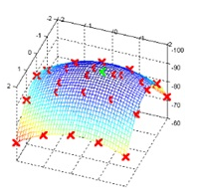
Locate maxima/minima in DoG images
As the result of the above process, the marked points are the approximate maxima and minima. The “approximate” means the maxima/minima almost never lies exactly on a pixel.
The red crosses mark pixels in the image. But the actual extreme point is the green one.
But we cannot access data between pixels, we have to compute the subpixel location.

Slide 13

Find subpixel maxima/minima
Use Taylor expansion of the image can generate subpixel values.
We can easily find the extreme points of this equation(differentiate and equate to zero).

Slide 14
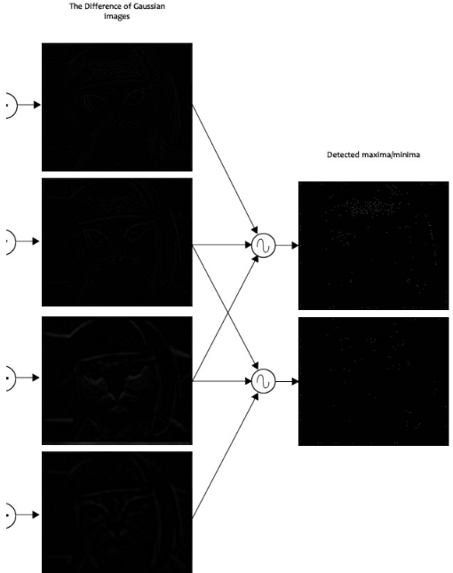
Example
To generate 2 such extrema images need exactly 4 Dog images.

Slide 15
Getting rid of low contrast keypoints
Some of the Key points generated in the previous step don’t have enough contrast.
Removing low contrast features
If those Key points’ magnitude is less than a certain value, we need reject the keypoint.
Removing edges
The main idea is to calculate two gradients at the keypoint, both perpendicular to each other. According to this truth:
A flat region: both gradients will be small
An edge: one gradient will be big(perpendicular to the edge) and the other will be small(along the edge)

Slide 16
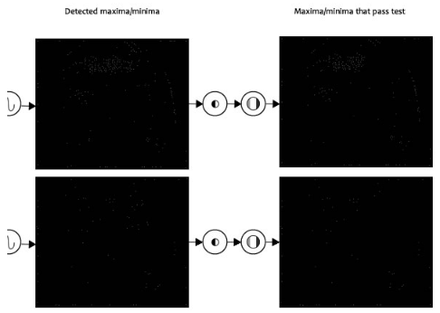
Getting rid of low contrast keypoints
A “corner”: both gradients will be big.
Corners are great keypoints.
Example --------->

Slide 17
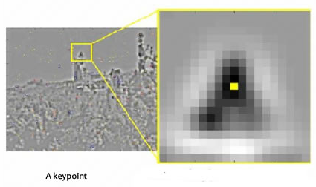
Keypoint orientations
This step we have to collect gradient directions and magnitude around each keypoint to figure out the most prominent orientation in that region.
The bigger the scale, the bigger the collection region.

Slide 18

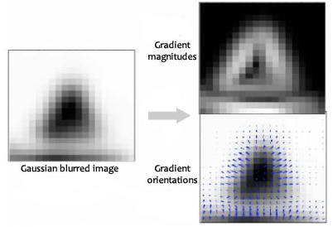
Keypoint orientations
Gradient magnitudes and orientations are calculated using these formulae:

Slide 19
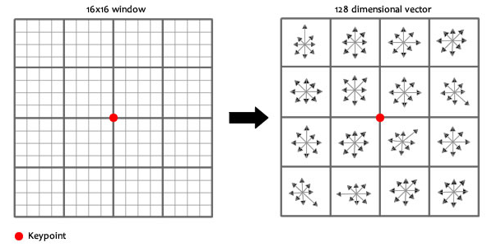
Generating a feature
Get a 16*16 window around the keypoint, and break this window into sixteen 4*4 windows.
With each 4*4 window, gradient magnitudes and orientations are calculated.
These orientations are put into an 8 bin histogram, and get the final result as below.

Slide 20
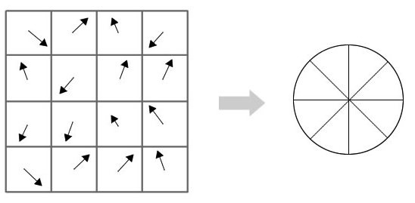
Generating a feature
Doing this for all sixteen 4*4 regions, we end up with 4*4*8=128 numbers, and then normalize them. These 128 numbers form the feature vector, This keypoint is uniquely identified by this feature vector.

