Slide 1
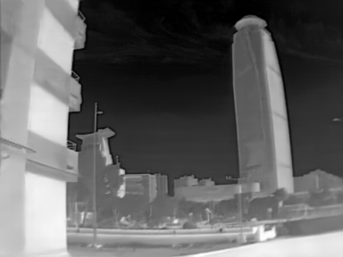







SuperToken-guided State Space Group
×n
（a）SuperToken-guided State Space Block(ST-SSB)
scale
scale
×n
LQ Image
HQ Image
+
Conv
FFN
+
+
Conv
FFN
+
Norm
Focal
modulation
Norm
Norm
+
+
+
Conv 3×3
ST-SM
Norm
ST-SSB
ST-SSB
Reconstruct
`
`
……
Conv 3×3
B×C$in$×H×W
B×N×48
B×C_{o}$ut$×H×W
FM3 Extra Residual Branch
（b）focal modulation
（c）SuperToken Global Stream
Hierarchical Contextualization
4096 pixel tokens → 64 supertokens
Gated Aggregation
Z^{out}
`
supertoken index k
`
×
+
Global SSM
Broadcast Back
×
Interact
Global
Pool
....
Gate
`
$$\bar{A}ₜ = exp\left(ΔₜA\right), \bar{B}ₜ = ΔₜBₜ$$
`
×
+
Q
....
`
$$h_{t}=\bar{A}ₜh_{\left\{t−1\right\}}+\bar{B}ₜc_{t}$$
Modulator
Gate
×
+
DWConv
5×5
Gate
`
……
$$y_{t}= C_{t}h_{t}+ D c_{t}$$
Aggregate
.....
×
……
……
……
……
DWConv
3×3
`
Gate
Linear
pixel 1
pixel 2
pixel 3
pixel N
B×K×C
K=64
……
……
……
……
B×K×C
K=64
Light-weight Linear
N = H × W
Global-enhanced Pixel Tokens X_{global}
B×N×C
$$\text{S}\text{ ∈ }\text{ℝ}\text{ᴮ×ᴺ×ᴷ}$$
Input
Linear
Linear
Input
Input pixel token X
Assignment Matrix
SuperToken Router
Region-level dependency modeling
Enhanced SuperTokens

