Slide 1
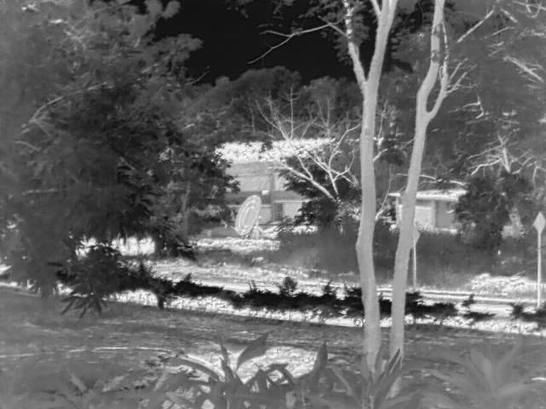

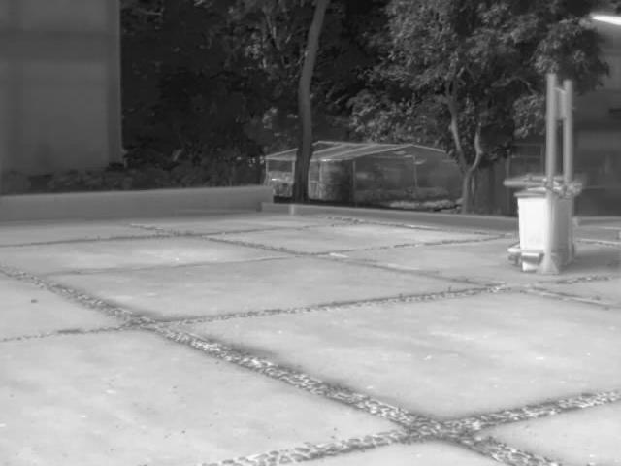

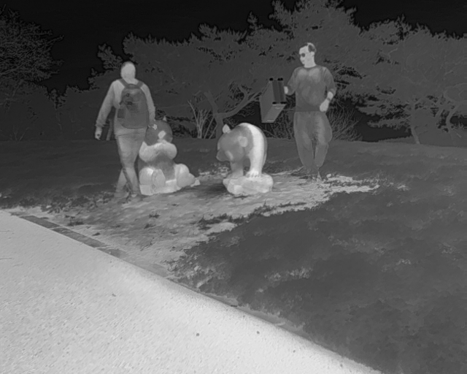

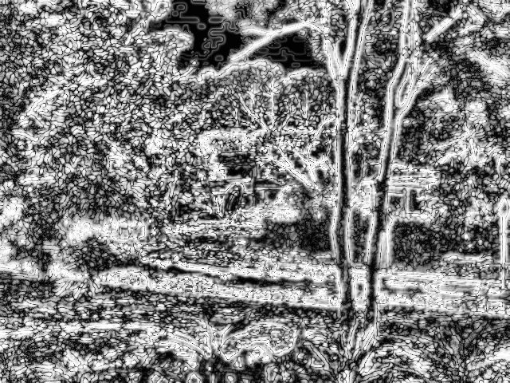
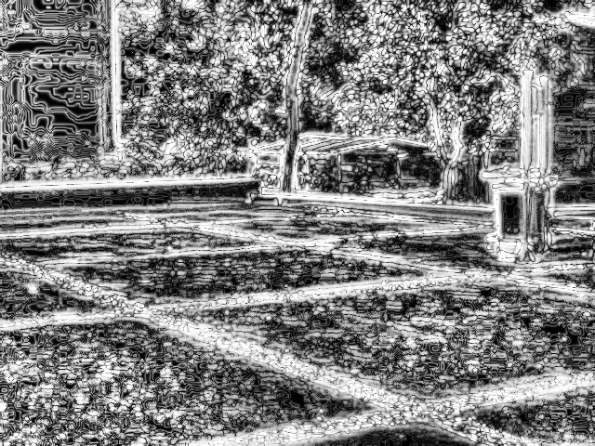
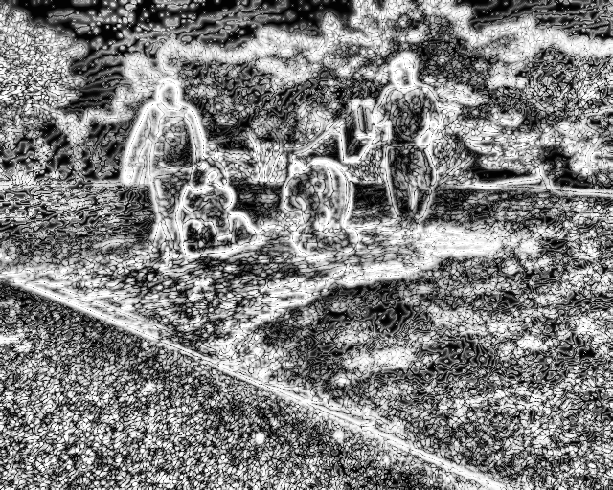
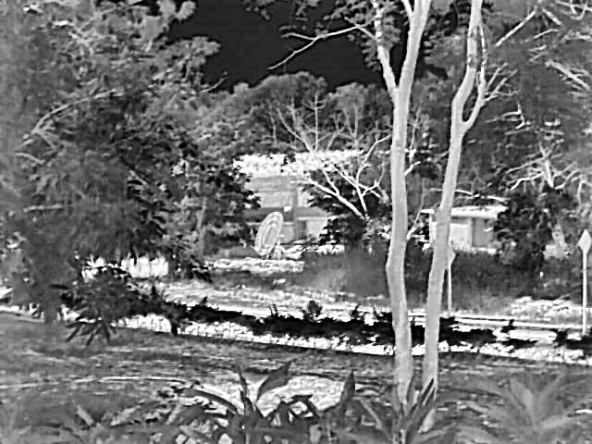
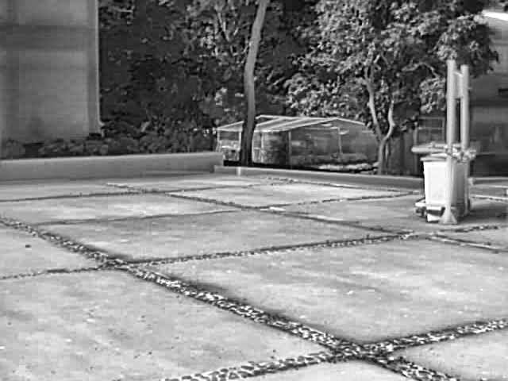























$$(a)\text{ST}\text{−}\text{SM}\text{:} {ℱ_{ST} }_{ }$$
$$X_{n}∈R^{B×N×C}$$
$$N=H×W$$
……
$$X_{global}=$$
$$S · SSM_{g\left(T_{in}\right)}$$
(b)$\text{High}\text{−}\text{Frequency} \text{Residual} \text{Branch}$:$ℱ_{HFR}$
Router
F
AvgPool 3×3
$$𝒢_{st}:$$
$$\text{SuperToken} \text{Global} \text{Stream}$$
$$S∈R^{B×N×K_{s}}$$
……
SuperToken
AvgPool 3×3
$$K_{s}≪N$$
AvgPool
3×3
$$T_{i}n=S^{T}{X_{n}}/{\left(ΣS+ε\right)}$$
Region-level
Selective Scan
—
……
$$F_{hf}$$
Input
$$T_{o}ut=SSM_{g}\left(T_{i}n\right)$$
……
$$X_{o}ut=$$
$$W_{f}\left(\left[X_{local},X_{global},X_{hf}\right]\right)$$
1×1 Conv
$$ℛ_{hf}:\text{High}\text{−}\text{Frequency} \text{Residual} \text{Branch}$$
$$F_{p}$$
Depthwise CPE / 3×3
$$X∈ℝ^{B×N×C},$$
$$N=H×W$$
Linear Projection
$$C→C_{h}→C$$
Linear Projection
1
7
Sigmoid
×
Pixel-level
Detail SSM
5
$$F_{g}$$
8
1
2
3
Priority Sorting
3
4
5
6
$$𝒟_{px}:$$
$$\text{Pixel}\text{−}\text{token}$$
$$\text{Detail} \text{Stream}$$
4
7
8
9
$$h_{t}= {\bar{A}}_{t}h_{\left\{t−1\right\}}+ {\bar{B}}_{t}x_{t}$$
2
1
6
$$d_{s}tate$$
$$=8$$
Selective Scan
$$X_{hfr}=X_{4}+γY_{hf}$$
7
$$y_{t}= C_{t}h_{t}+ D x_{t}$$
9
$$Y_{hf}=\operatorname{Gather}\left({\tilde{T}}_{π},π^{−1}\right)$$
$$X_{local}=$$
$$W_{l}^{o}SSM_{l\left(W_{l}^{i}X_{n}\right)}$$
5
1
2
3
8
4
5
6
3
7
8
9
4
2
6
9

