Slide 1
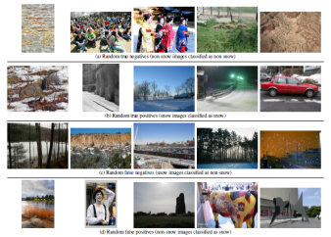
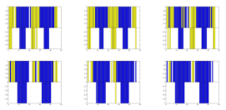
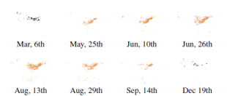


Observing ecology phenomenon on Flickr
Introduction
Scene classification
Combining image features
Snow: GIST, color histogram, tiny image, spatial color moments, spatial pyramid LBP
Vegetation: color SIFT, color GIST
Convolutional Neural Network
Sample image of snow Scene classification
Vegetation coverage
Numbers
Single place in 2 years
North America maps in 2010
 | Image features | CNN
Snow scene | 80.5% | ~85%
Vegetation scene | 85.9% | ~88%
Blue: place covered by vegetation
Yellow : place without vegetation
Top: prediction
Bottom: ground truth
Method
Confidence score is measuring the ratio of log likelihood of being a vegetation bin or not at each time period.
Experiments
Snow coverage
Numbers
Bar
maps
Conclusion
Dataset
Diversity of public sharing images
(a) Random positive images in vegetation dataset
(b) Random negative images in vegetation dataset
Remove images with inaccurate time and location info

