Slide 1




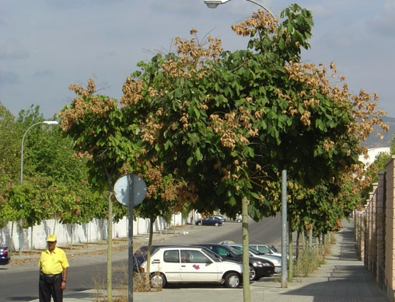
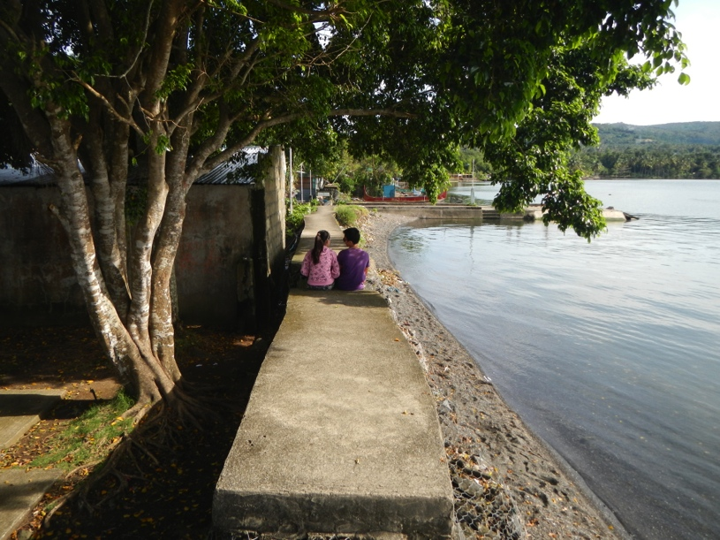
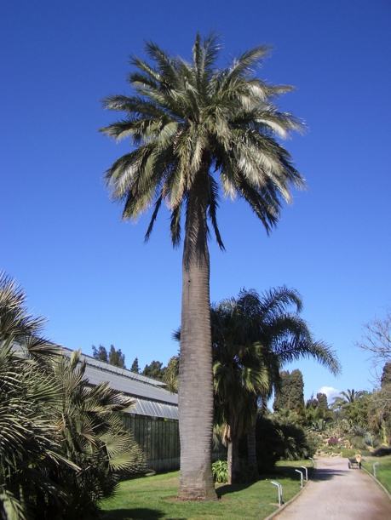






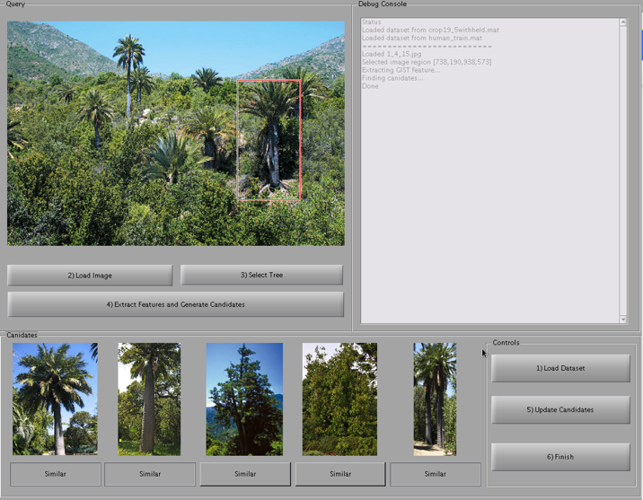
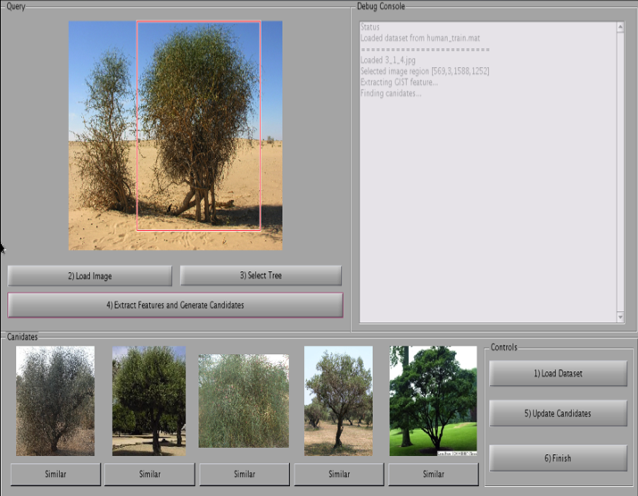


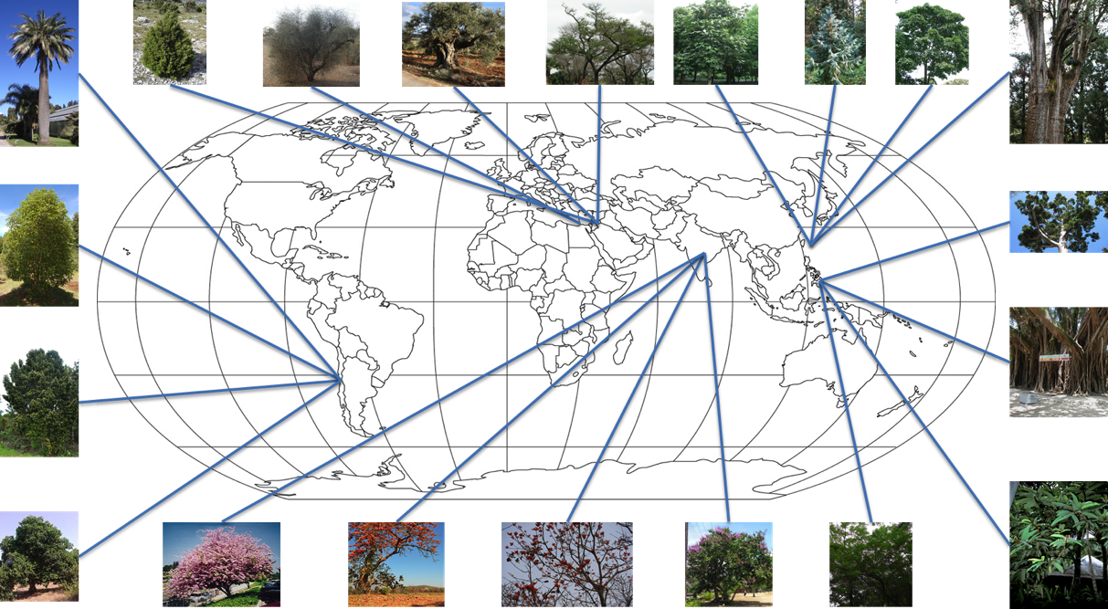
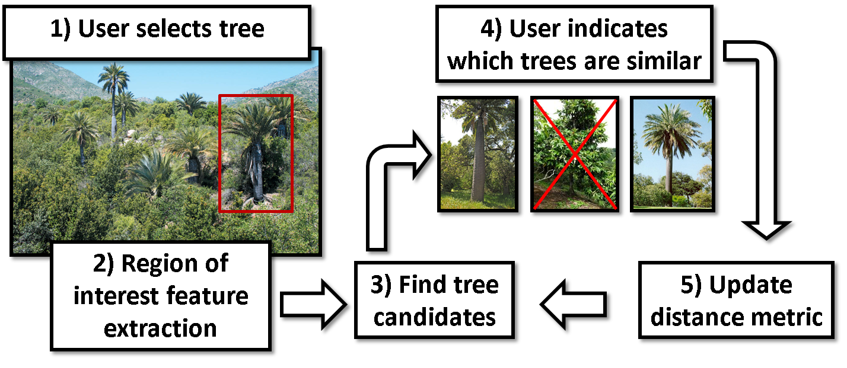
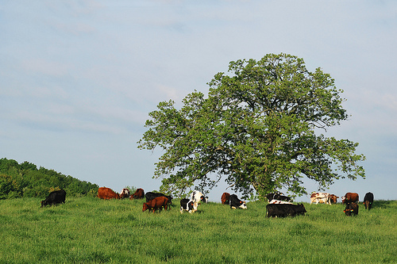
Learning to Identify Local Flora with Human Feedback
Stefan Lee, David Crandall
School of Informatics and Computing, Indiana University, Bloomington, IN
1. Overview
2. Semi-automatic Flora Classification
Where were these photos taken? (*Answers below.)
Geo-localizing these consumer images is easy, but only once you identify the species of tree.
Distinctive flora and fauna often appear in consumer images, but fine-grained species identification is hard for computers and people.
We use a human-in-the-loop, combining the computer’s ability to scan through large image sets with the user’s ability to confirm matches.
The system has two phases:
In the offline phase, we use labeled training data to learn a distance metric between visual features.
In the online phase, we update the distance metric by presenting nearest neighbors to the user, collecting similar/dissimilar feedback, and updating the metric iteratively until convergence.
Offline learning phase
Learning from human interaction
Randomly sample pairs of training images to generate similarity constraints.
Adapt Jin et al. (NIPS 2009) to learn distance metric, i.e. matrix A,
Cycle through the constraints, applying a single instance update rule and keeping solution with fewest errors in a pocket algorithm fashion.
User selects a tree in a query image.
System extracts visual features, finds k-NNs in training set under current distance metric.
User selects which NNs are visually similar and dissimilar, responses are added as constraints, and distance metric is updated.
Repeat this process until user finds good matches among the k-NNs, and infers tree species from training labels.
3. Data
4. Experiments
Selected four indigenous tree species from each of five regions (Philippines, Chile, Jordan, India, Taiwan), to create a 20-way classification task.
Collected 269 images from web; 10%-90% testing-training split.
Manually crop training images.
Used simple GUI for collecting user feedback, GIST features for finding nearest neighbor candidates.
Experiments compared automatic methods with human-in-the-loop and baselines (all with k=5):
5.0% - Baseline (random chance)
15.8% - k-NN with Euclidean distance
26.3% - k-NN with learned (offline) distance metric
36.8% - Non-expert human-in-the-loop
Human-in-the-loop accuracy 7x random baseline.
5. Ongoing and future work
Better (including domain-specific) visual features.
Larger datasets with weaker supervision.
Enhanced distance metric learning.
Other fine-grained classification tasks useful for geo-location (e.g. animal species, rock types, etc.).
Larger-scale user studies.
*Answers: Taiwan, Philippines, Chile
Supported by the Intelligence Advanced Research Projects Activity (IARPA) via Air Force Research Laboratory, contract FA8650-12-C-7212. The U.S. Government is authorized to reproduce and distribute reprints for Governmental purposes notwithstanding any copyright annotation thereon.
Disclaimer: The views and conclusions contained herein are those of the authors and should not be interpreted as necessarily representing the official policies or endorsements, either expressed or implied, of IARPA, AFRL, or the U.S. Government.
Notes:
<number>

