Slide 1

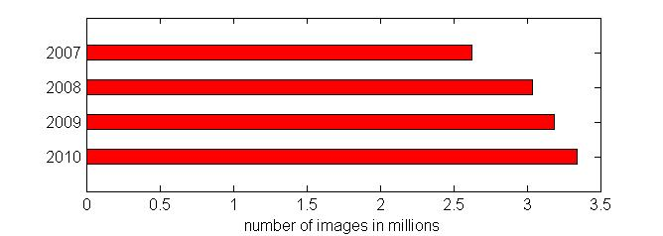
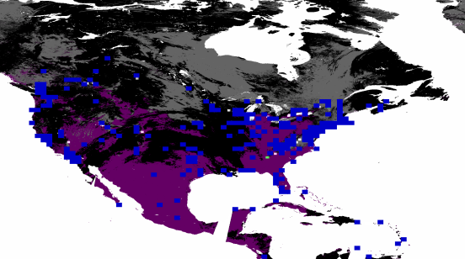
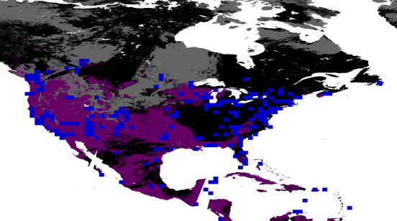
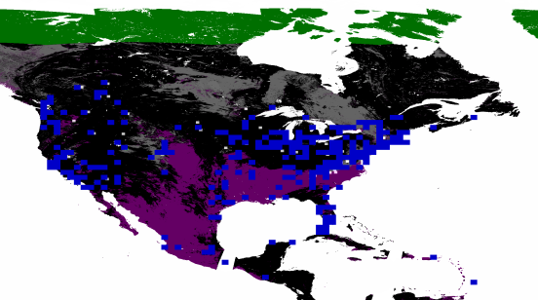
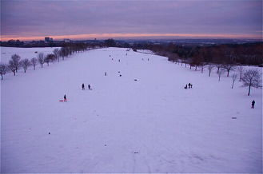
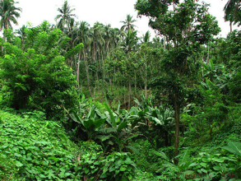
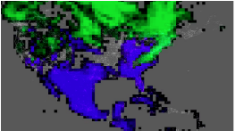
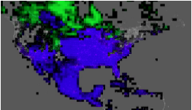
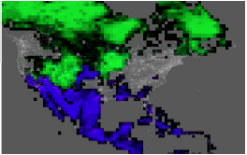
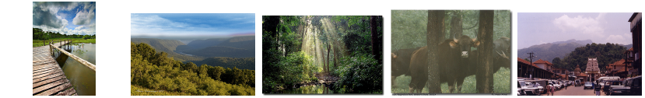
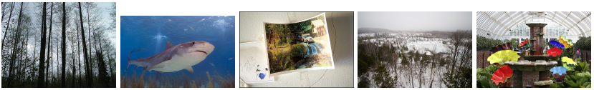
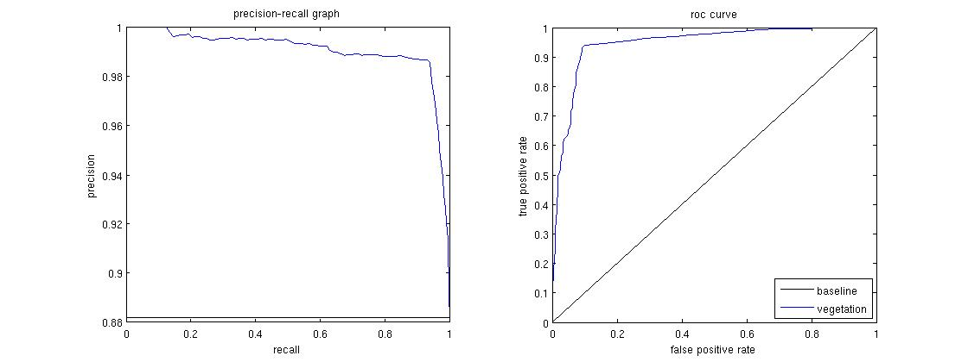
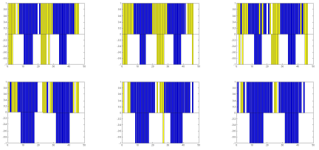
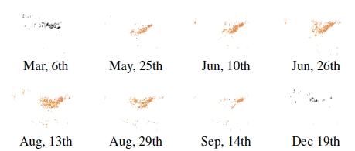
Can we observe nature by mining photos? We study three phenomena
Observing the Natural World with Flickr
Stefan Lee, David Crandall
School of Informatics and Computing, Indiana University, Bloomington, IN
1. Overview
3. Dataset
North America maps in 2010
Very large dataset from Flickr
Images in our dataset are
mid size images (about 350*500)
users allow downloading
GPS data accurate enough
without possibly inaccurate temporal data (taken time)
Flickr map
Diversity of public sharing images
MODIS
satellite map
Snow Cover
Vegetation Cover
We would like to “reconstruct” geo-temporal maps of where and when these phenomena are occurring:
Using ~1.2 billion geo-tagged, time-stamped Flickr photos
Comparing to data from weather stations and satellites
Mar,03,2009 Apr,06,2009 Dec,21,2009
Random positive images in vegetation dataset
Vegetation coverage
Random negative images in vegetation dataset
Accuracy: 93.19% vs. Baseline: 86.58%
Data availability (ours/satellite): 70.33%
Examples of single places over 2009-2010
North America maps in 2010
2. Method
4. Scene Classification
Hand-labeled dataset
Combining image features
Convolutional Neural Network
Flickr images
Scene
classification
Combining evidence of each time and location
Confidence
Results
 | Image features | CNN
Snow scene | 80.5% | ~85%
Vegetation scene | 85.9% | ~88%
Extracting semantics using tags from individual image :
we consider two learning paradigms.
The first is to produce a single exemplar for each bin in time and space consisting of the set of all tags used by all users
The second paradigm, our goal instead is to classify individual photos as containing phenomenon or not, then combine the outputs of the classifiers in probabilistic frameworks.
Extracting semantics from individual images
Tradition visual features (SIFT, HOG, LBP, GIST …)
Conventional Neural Network (CNN)
Combining evidence together across users
Confidence score is measuring the ratio of log likelihood of being positive or not at each time and location.
Performance and graph
Blue: place covered by vegetation
Yellow : place without vegetation
Top: prediction
Bottom: ground truth
5. Experiments
Snow coverage
Accuracy: 97.07% vs. Baseline: 97.77%
Data availability (ours/satellite): 92.80%
We pick 4 populated and snowy cities
6. Conclusion and future work
At a place and time of interest:
m : the number of photos contains evidence of
scene (event )
n : the number of photos without evidence of
scene (event )
p :
q :
: the prior probability of certain scene.
Notes:
1

