Slide 1

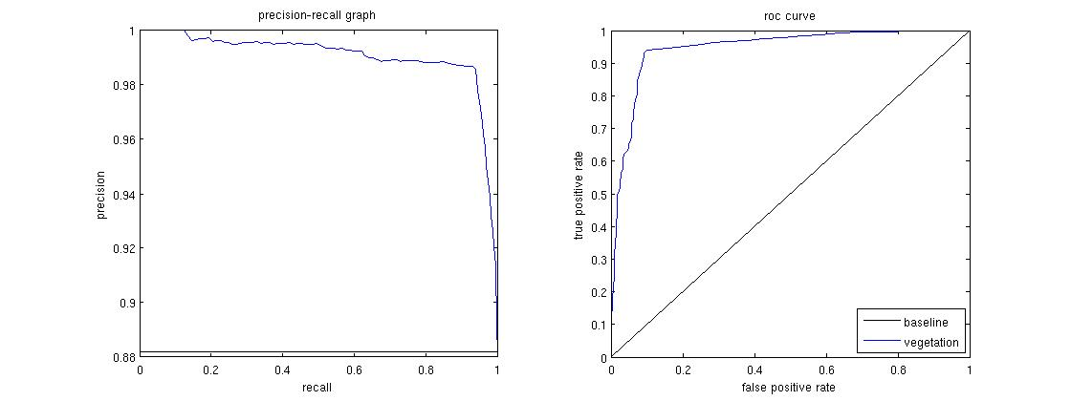


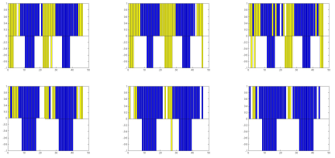


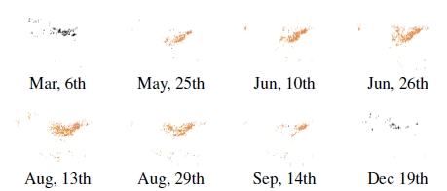
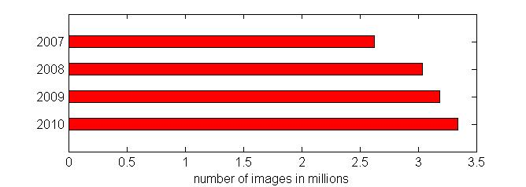
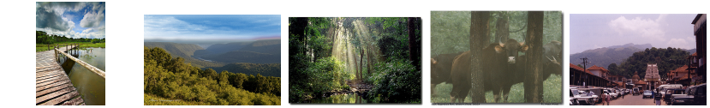
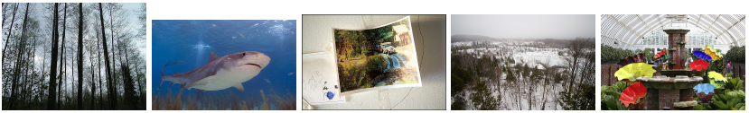
Observing ecology phenomenon on Flickr
Stefan Lee, David Crandall
School of Informatics and Computing, Indiana University, Bloomington, IN
1. Overview
4. Scene Classification
Combining image features
Snow: GIST, color histogram, tiny image, spatial color moments, spatial pyramid LBP
Vegetation: color SIFT, color GIST
Convolutional Neural Network
 | Image features | CNN
Snow scene | 80.5% | ~85%
Vegetation scene | 85.9% | ~88%
Vegetation coverage
\Hand-labeled dataset
Sample image of snow Scene classification
Numbers
Examples of single places over 2009-2010
North America maps in 2010
\Flickr images
Scene classification model
Cluster images by time and geo tag
Confidence
Results
Random true negatives (non-snow images classified as non-snow)
2. Method
Random true positives (snow images classified as snow)
Blue: place covered by vegetation
Yellow : place without vegetation
Top: prediction
Bottom: ground truth
Confidence score is measuring the ratio of log likelihood of being positive or not at each time and location.
Random false negatives (snow images classified as non-snow)
At a place and time of interest,
m : the number of photos contains evidence of scene (event )
n : the number of photos without evidence of scene (event )
p :
q :
: the prior probability of certain scene.
Random false positives (non-snow images classified as snow)
3. Dataset
Very large dataset from Flickr
5. Experiments
Images in our dataset are
mid size images (about 350*500)
users allow downloading
GPS data accurate enough
without possibly inaccurate temporal data (taken time)
Diversity of public sharing images
Snow coverage
Random positive images in vegetation dataset
6. Conclusion and future work
Random negative images in vegetation dataset
Hand-labeled dataset
We build 2 hand labeled datasets with equal number of positive and negative images. Vegetation dataset has over 10000 images. They are taken before 2009, and are composed by images with "forest" and "summer" like tags and also random images without any tag preference. We build a positive set with images in category "Outdoor Greenery" and a negative set with images in categories "Outdoor non-Greenery" and "Indoor". Snow dataset also has about 10000 images. These images are tagged with “snow” and “winter” like words. They are labeled in 4 categories: (1) obvious snow; (2) contains a trace amount of snow near the camera; (3) obvious snow but far away; and (4) does not contain snow. We consider (1) and (2) to be positive classes and (3) and (4) to be negative.
Supported by.
Notes:
1

