Slide 1
Global ENERGY Analysis
Yuyang Wang

Slide 2
Introduction
Global population swelling
Industrialization on the rise in developing nations
Humanity’s hunger for energy has reached unprecedented levels
Data visualization
HTML5
JavaScript
CSS
Google API
Echart API

Slide 3
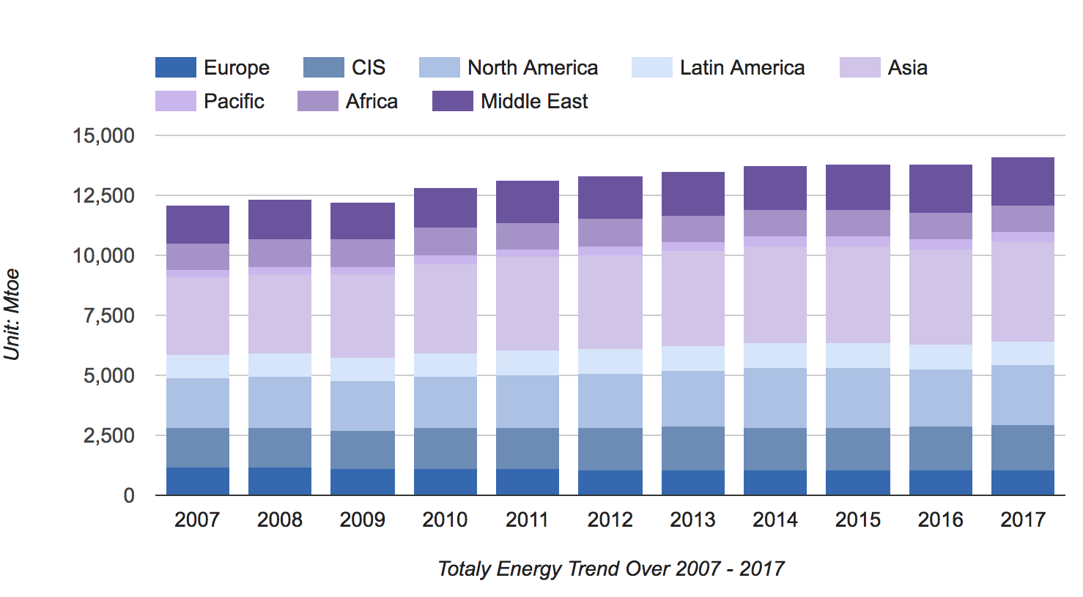
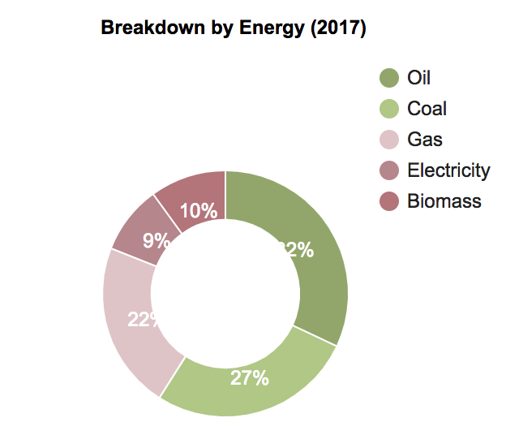
Total Energy

Slide 4
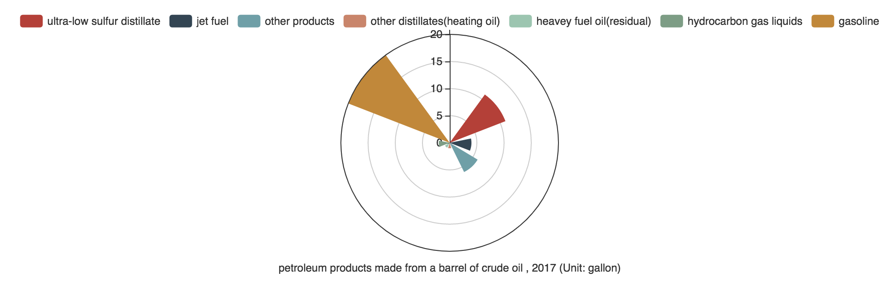
Oil

Slide 5
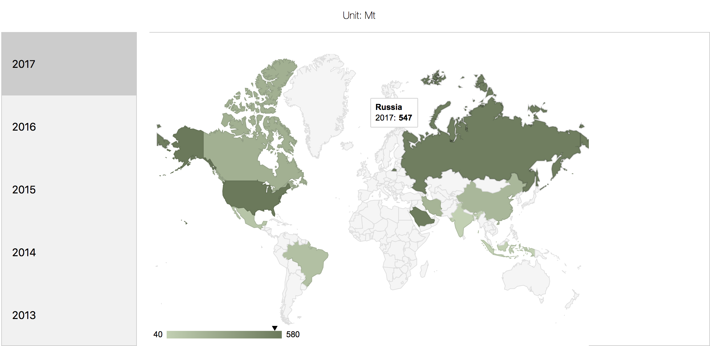
Crude oil production
Country
United States
Sauid Arabia
Russia
Canada
Iran
China
Brazil
Mexico
India
Indonesia

Slide 6
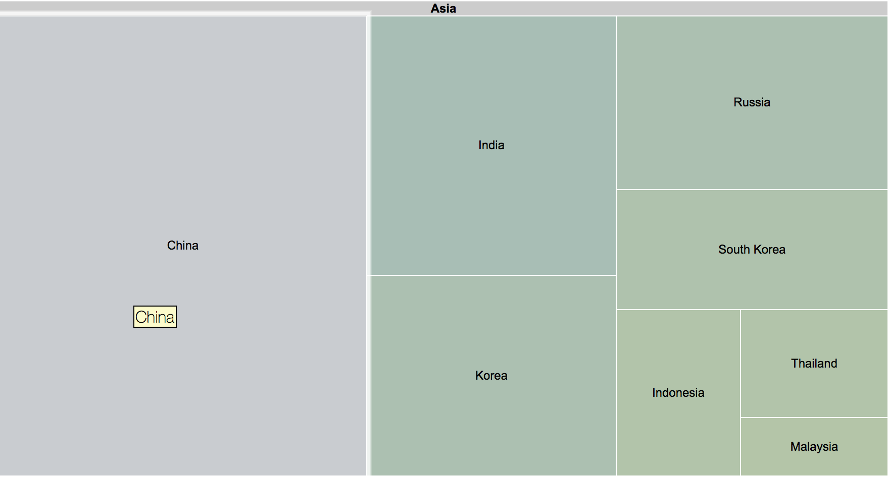
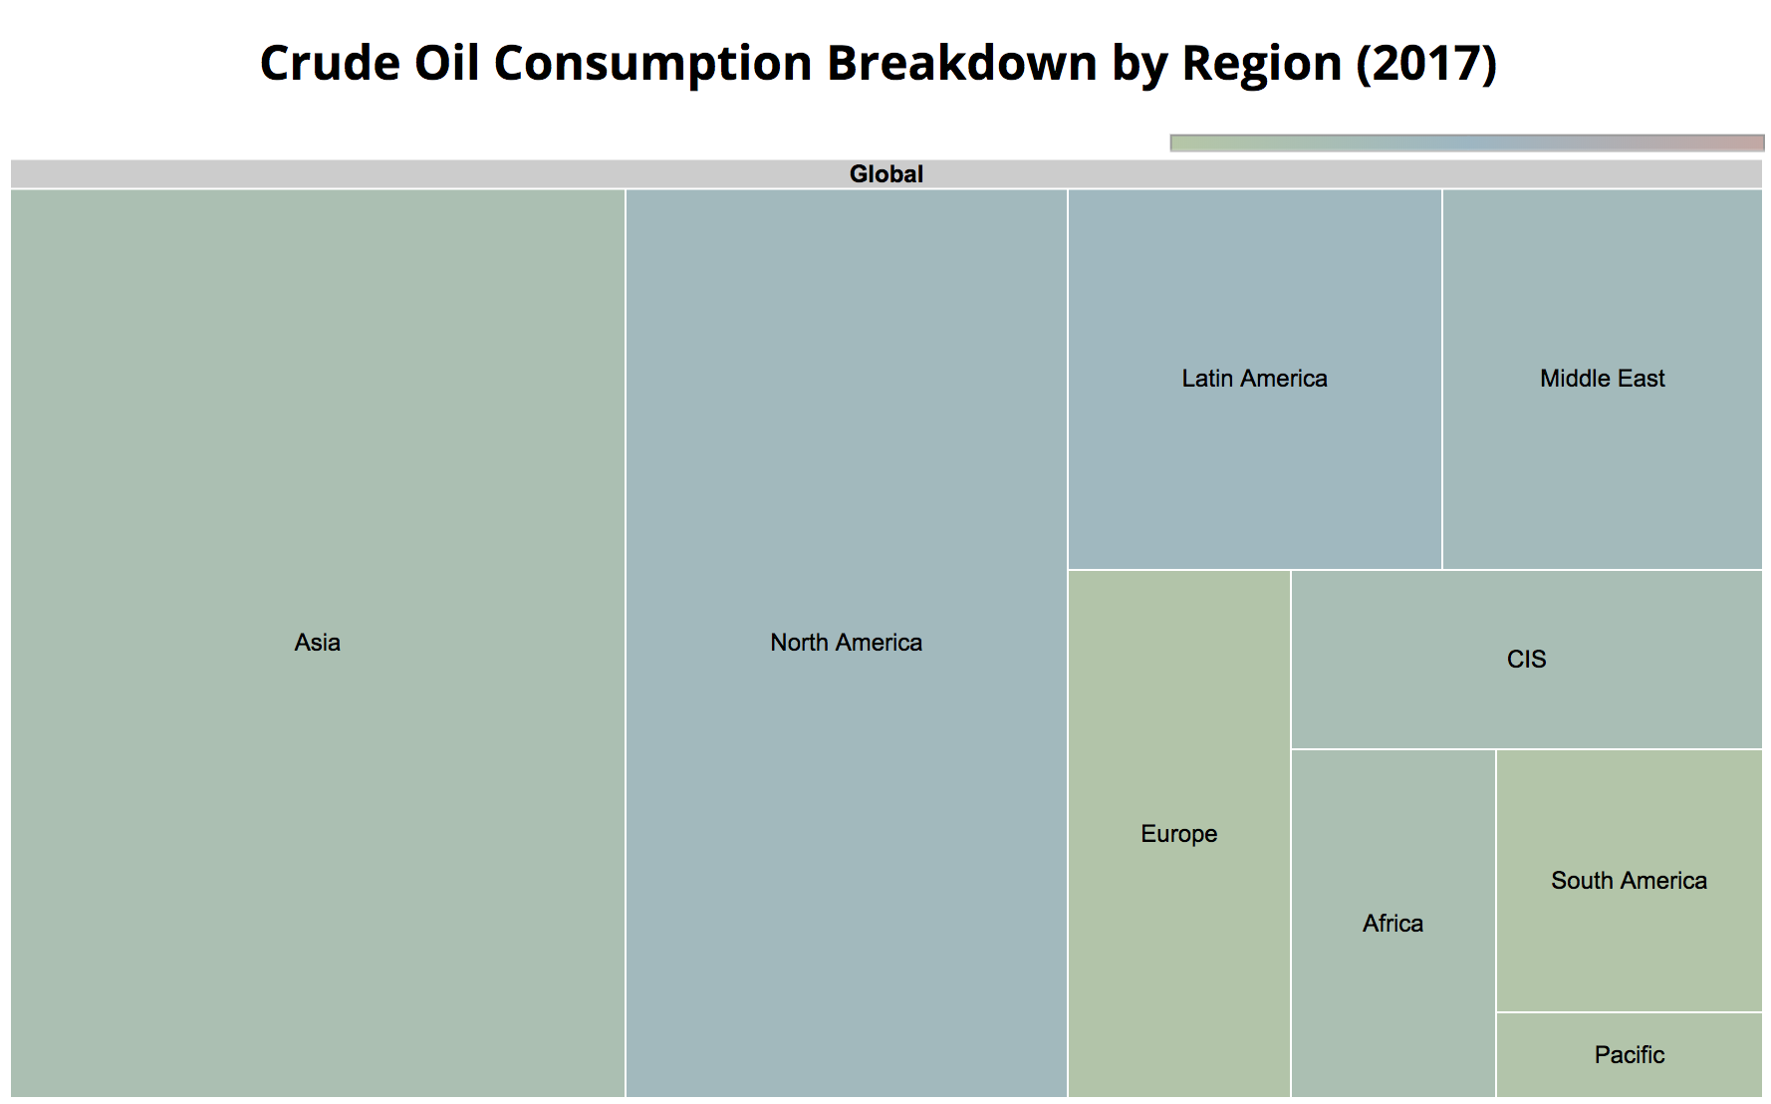
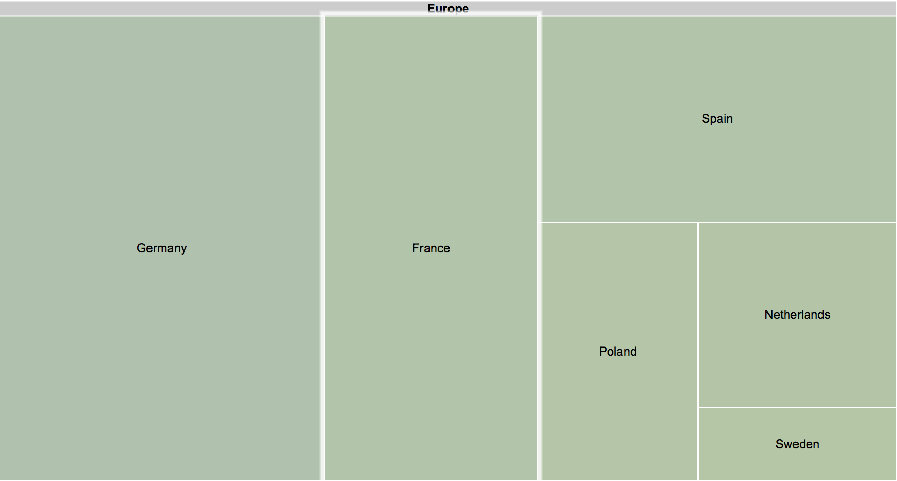
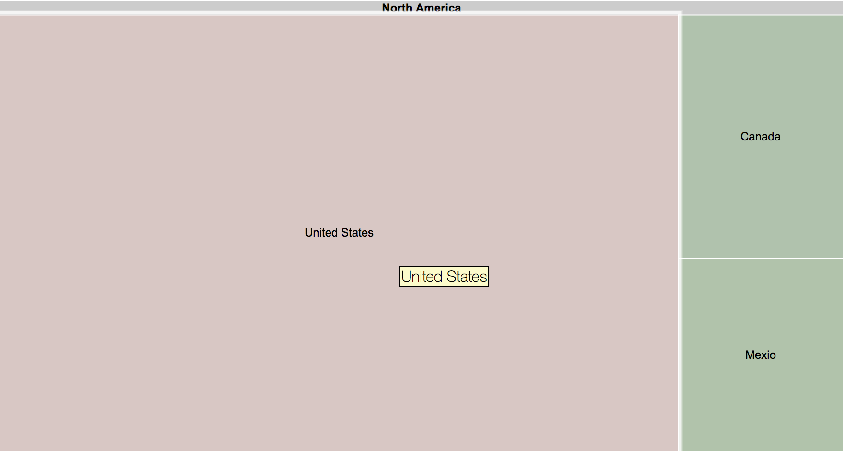
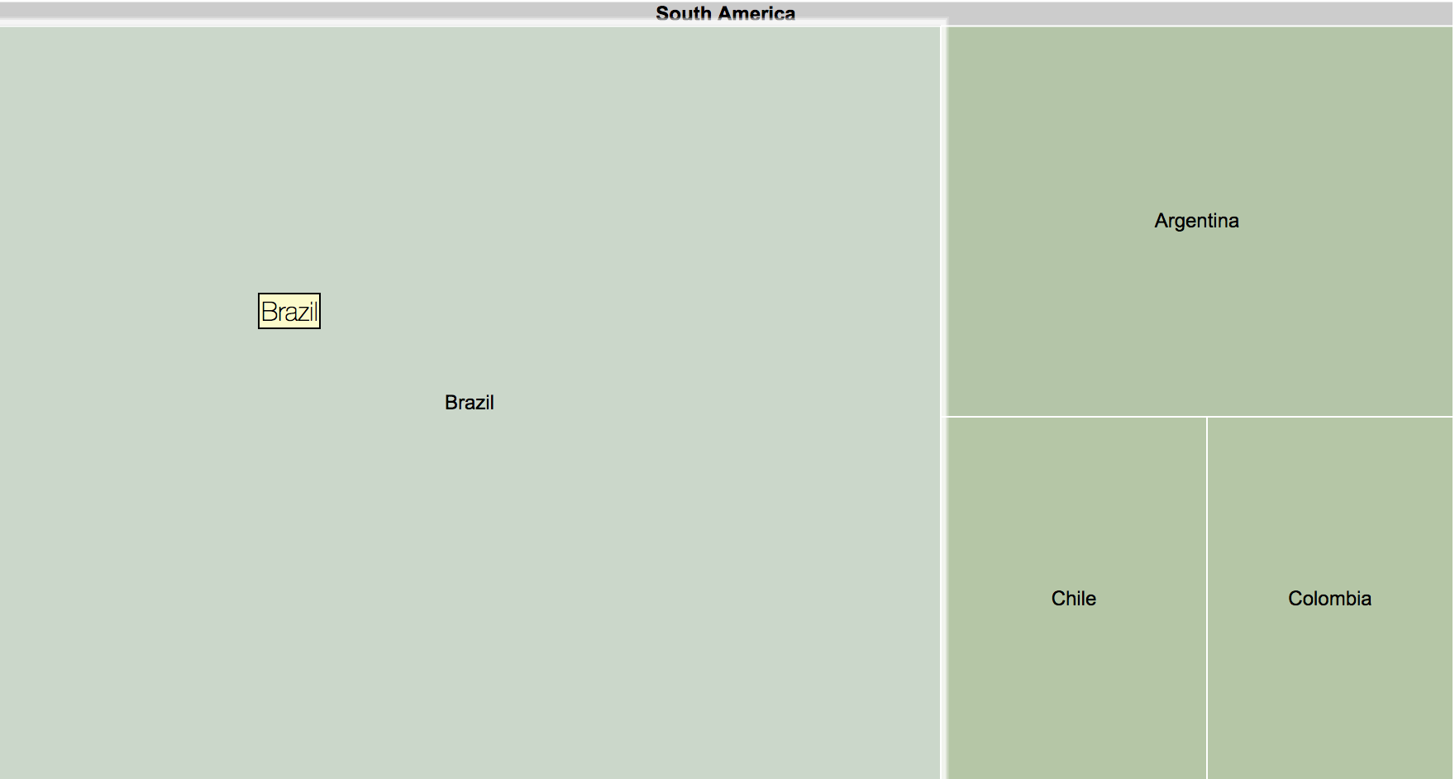
CRUDE OIL CONSUMPTION

Slide 7
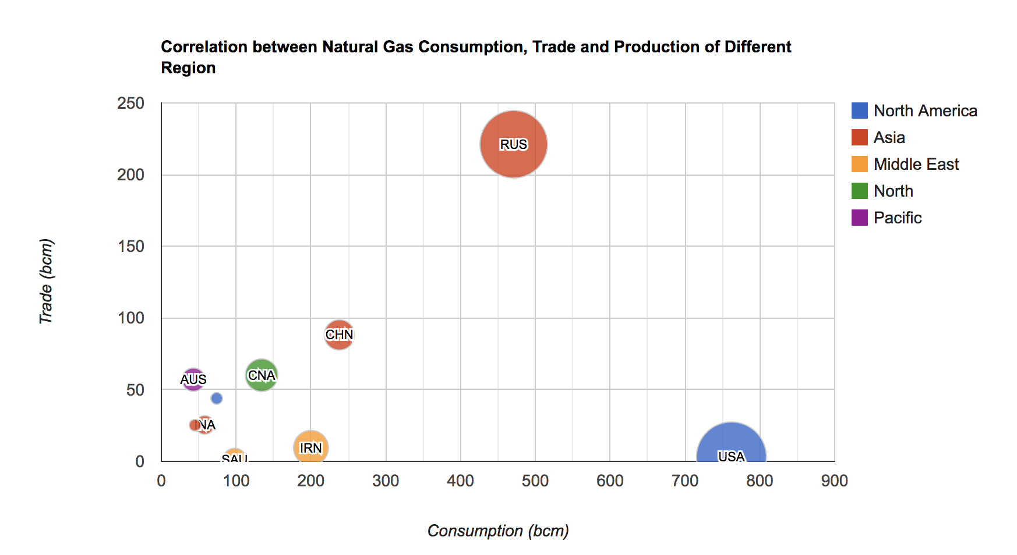
Natural gas

Slide 8
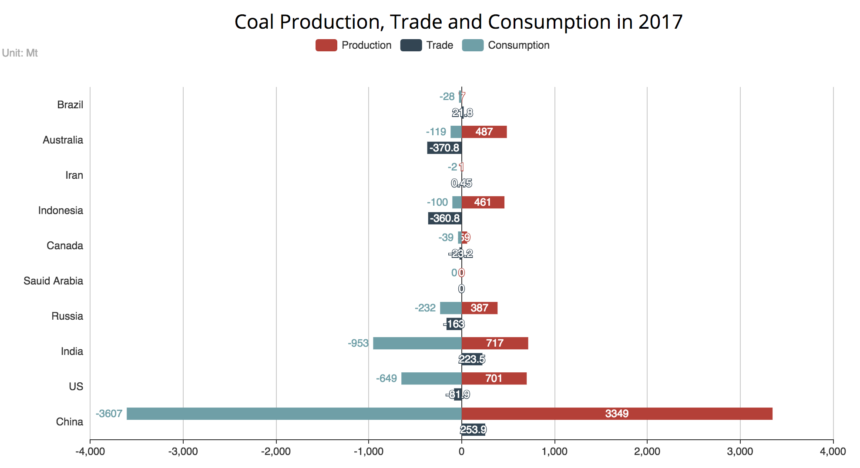
coal

Slide 9
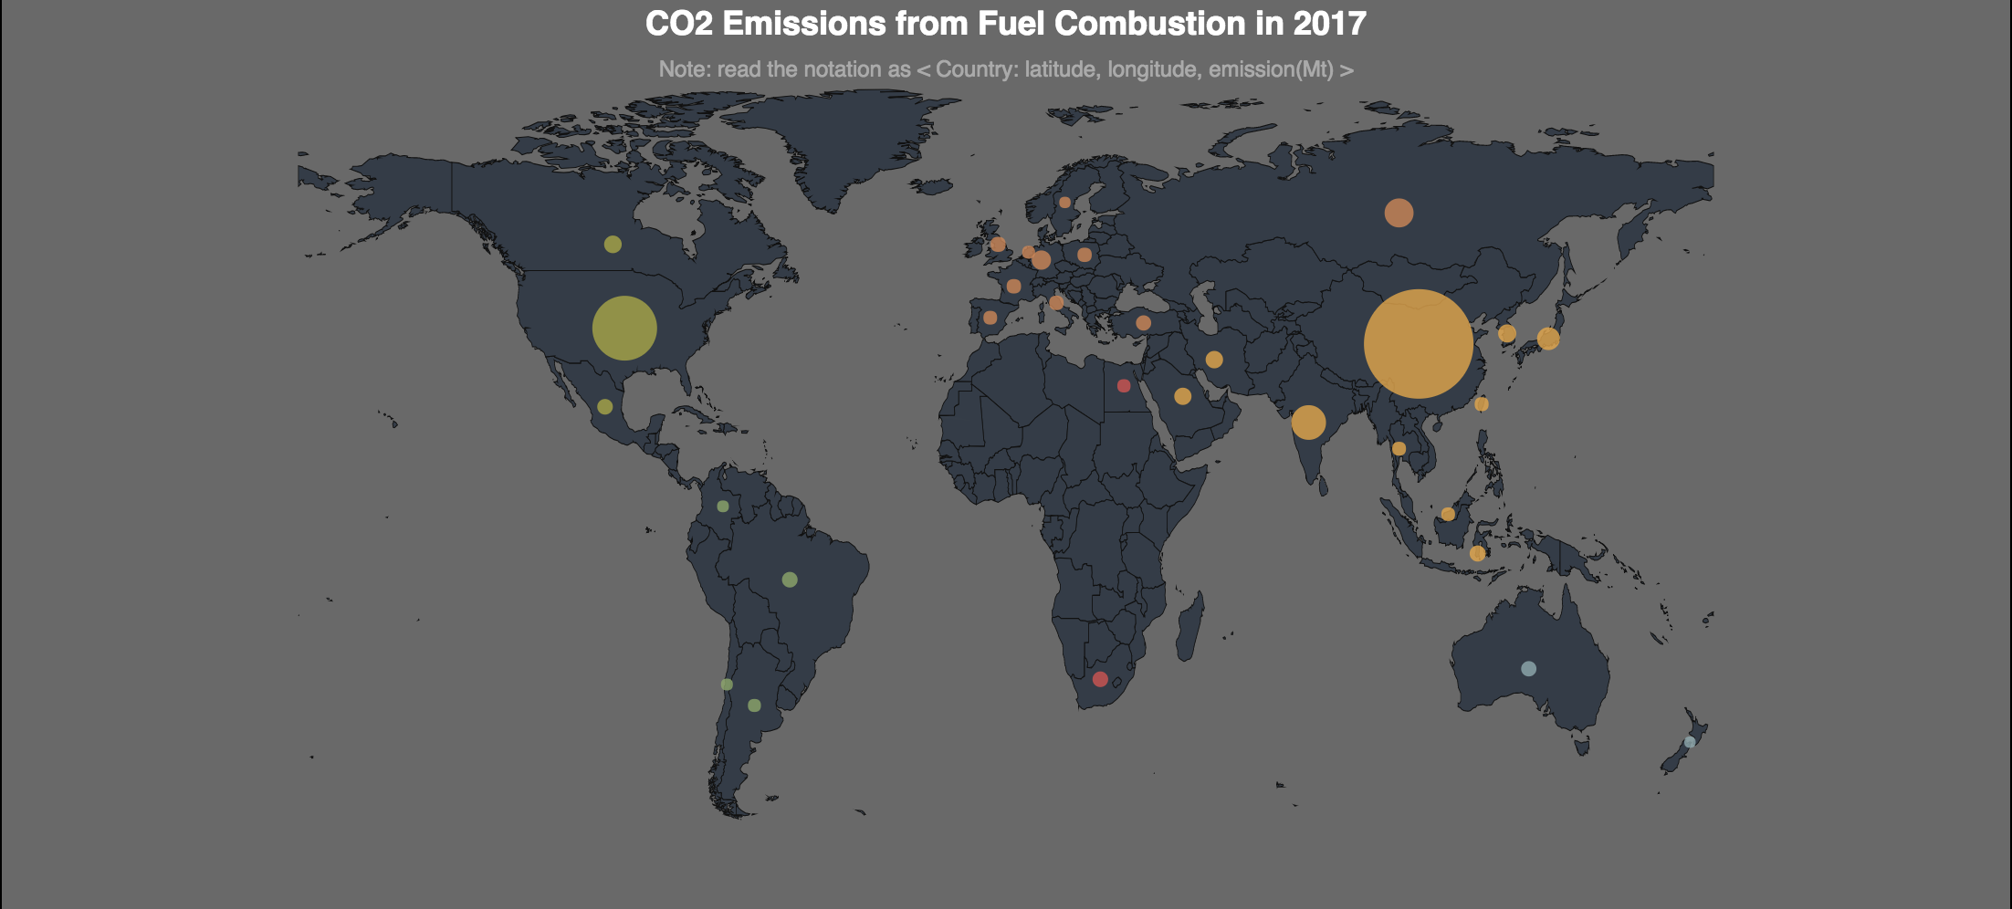
Co2 emissions

Slide 10
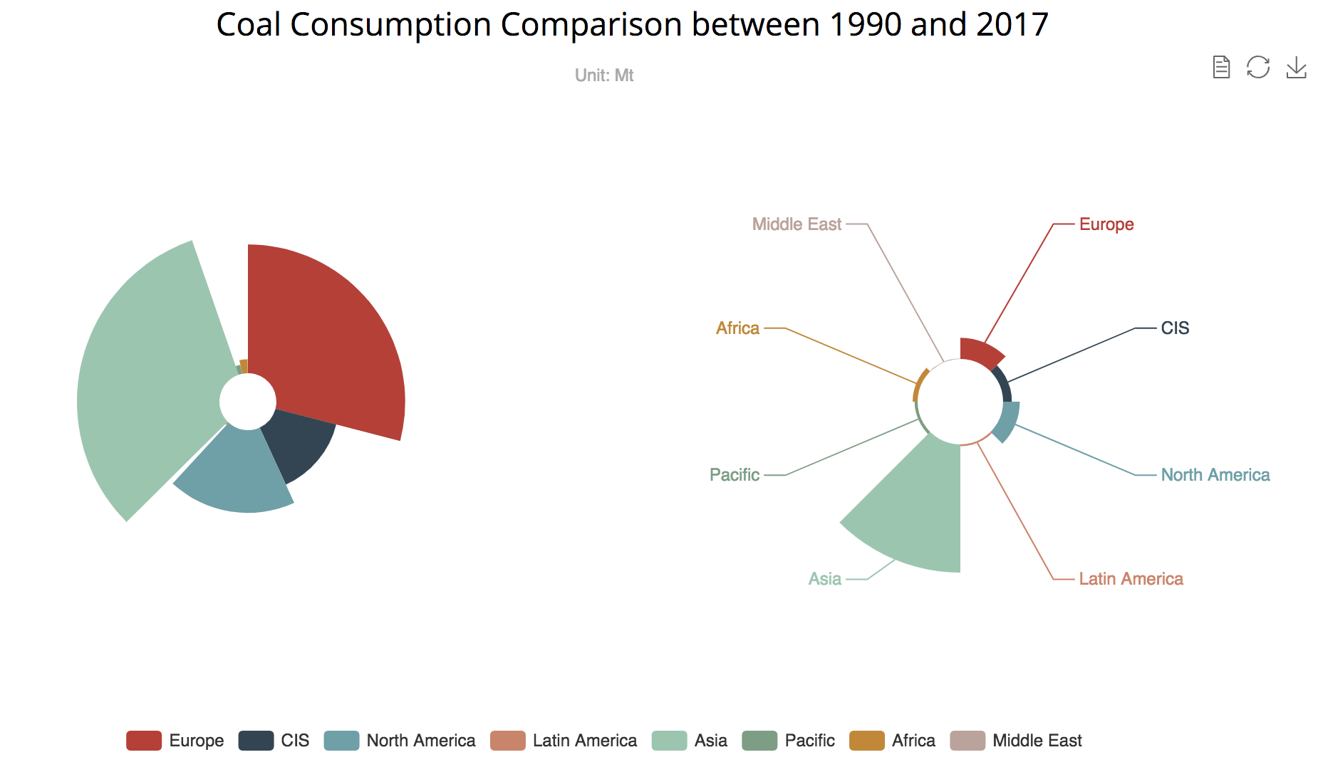
coal

Slide 11
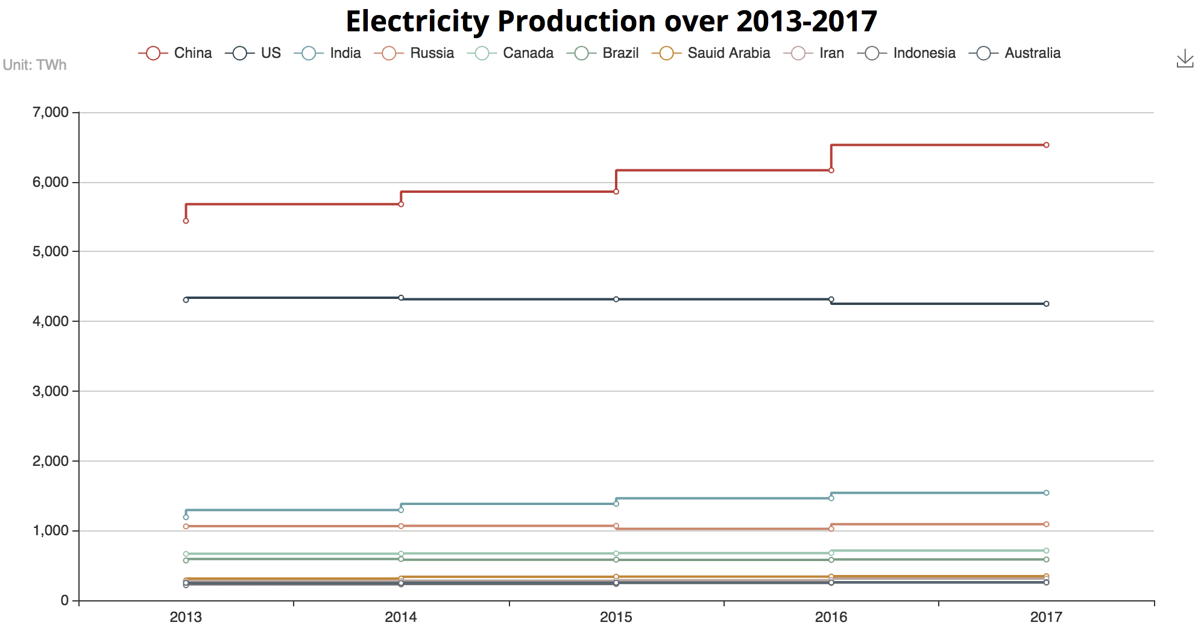
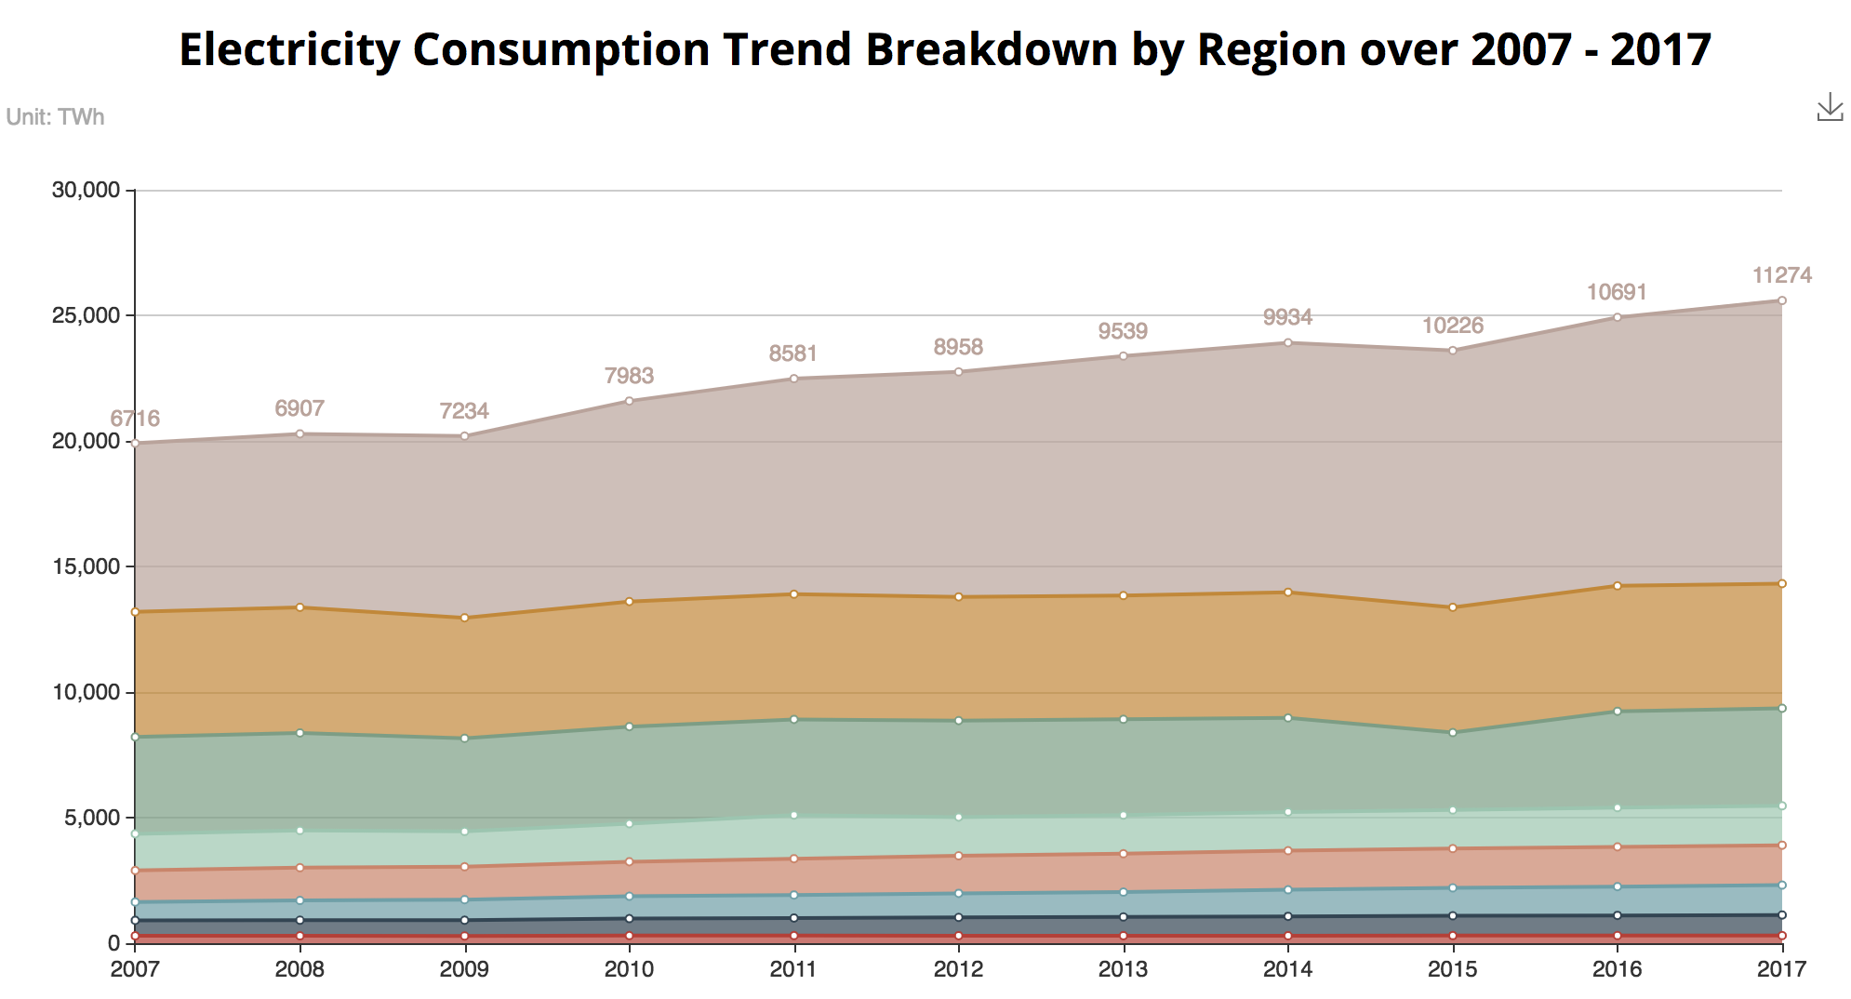
electricity

Slide 12
Renewable energy
Electricity
Air
Water heating/cooling
Transportation

Slide 13
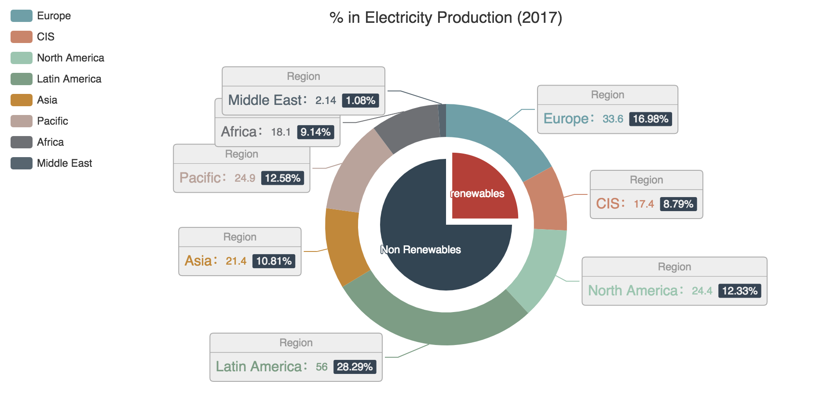
Renewable energy

Slide 14
THANK YOU

