Slide 1
Missing Stock Price
Sirui Wang
11/27/2018

Slide 2
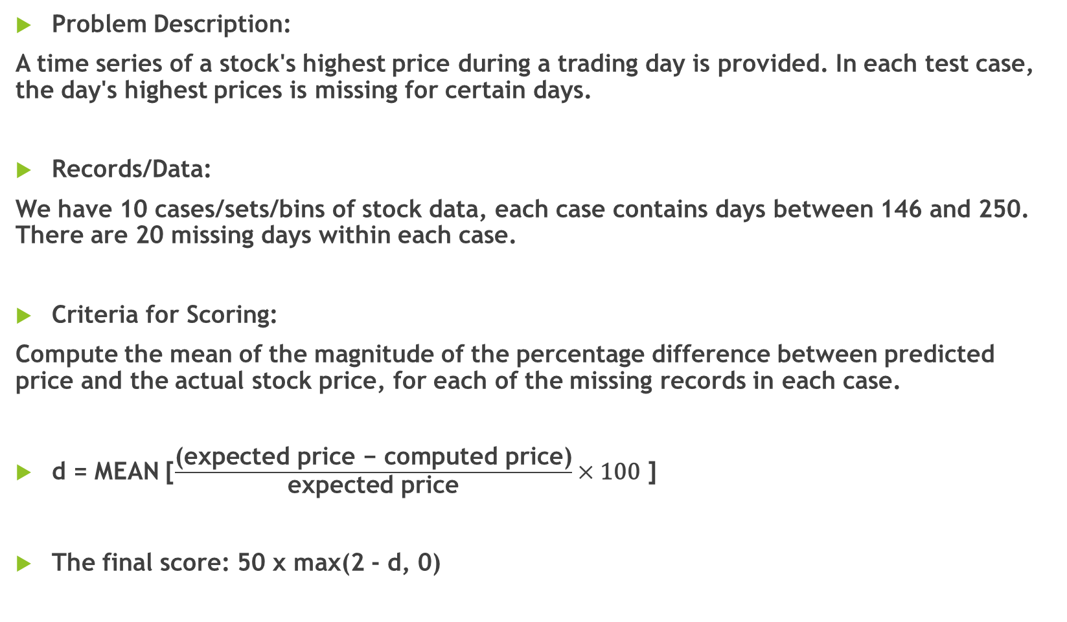
Problem Description:
A time series of a stock's highest price during a trading day is provided. In each test case, the day's highest prices is missing for certain days.
Records/Data:
We have 10 cases/sets/bins of stock data, each case contains days between 146 and 250. There are 20 missing days within each case.
Criteria for Scoring:
Compute the mean of the magnitude of the percentage difference between predicted price and the actual stock price, for each of the missing records in each case.
d = MEAN [$\frac{\text{(}\text{expected} \text{price}\text{ − }\text{computed} \text{price}\text{)}}{\text{expected} \text{price}}×\text{100}$]
The final score: 50 x max(2 - d, 0)
If d=1, then score = 50

Slide 3
Something is wrong…
No matter how I change the model, the final score is always 1.16 (out of 100), which is not reasonable.
So let's download the data, analyze them and calculate the score offline.

Slide 4
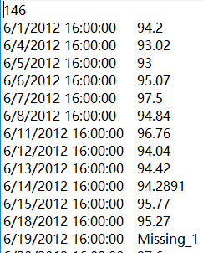
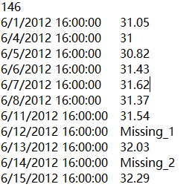
To build a predictive model, it is crucial to find out how the model utilizes the data through the online system.
When I hit "Run code" not "Submit" button, my model is run against three separate cases, one case at a time.
What the model does is that it uses the non-missing labels in that case to train the model, and then predicts the missing labels within the same case.
To verify this, I hit "Submit" button. Although the number of cases increases from 3 to 10, the predicted labels within the first 3 cases are all the same as the values obtained after I hit "Run code".
This indicates that the model only utilizes the training data within one case.

Slide 5
Can we use time series models?
My first idea was to see if there is any trend within each case of data.
Then we can find a proper time series model to fit the data.
Problems:
However, there are too many separate cases, manually find the trend one by one is not realistic.
The times series models are suitable for future forecasting. I find only Case3 and Case8 contain future missing data that need forecasting.

Slide 6

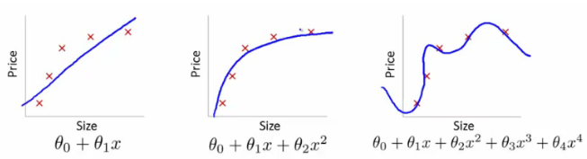



Ridge Regression (alpha=1)
Cost function for polynomial regression:
Cost function for ridge regression:
Cost function for Lasso regression:
Cost function for ElasticNet regression:

Slide 7
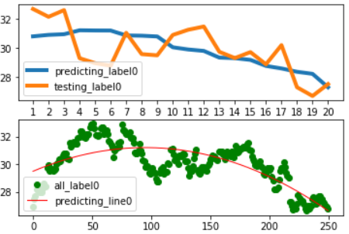
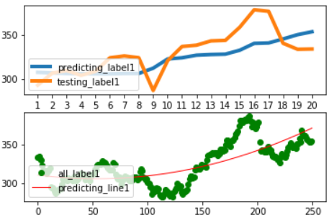
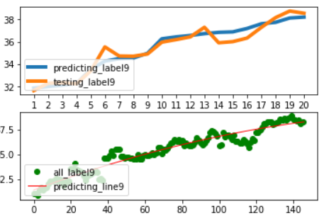
Ridge Regression (alpha=1)
Case0 Case1 …… Case9
Upper: predicted missing labels and the true values (20 dots in one case).
Lower: the whole trend of the regressed line through all the data.
Ridge regression lines capture the major trends within each case.
However, it is weak at predicting the missing labels.
The score is: 0

Slide 8
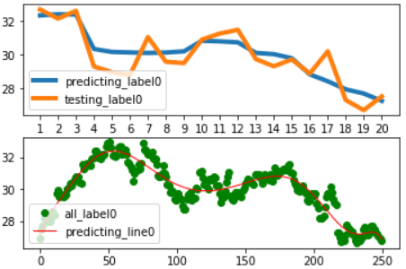
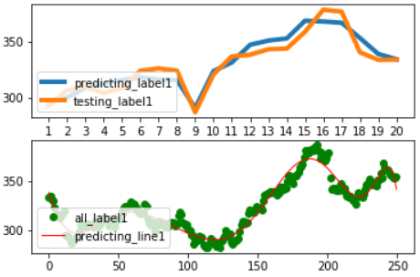
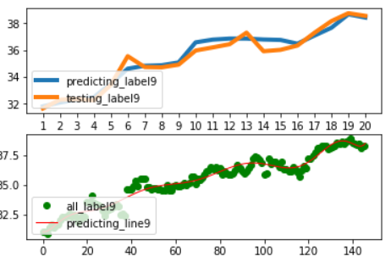
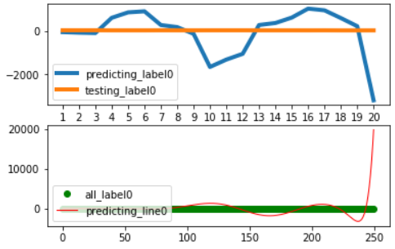
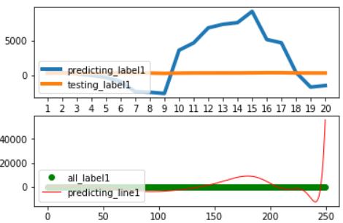
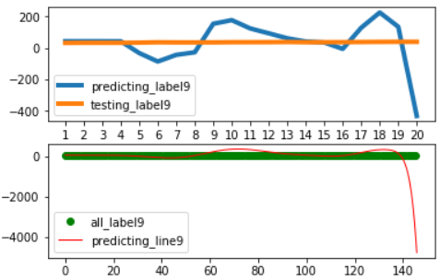
Ridge Regression (alpha=1)
Deg = 10, score = 9.57
Deg = 20, score = 0

Slide 9
Ridge Regression (alpha=1)
If we take out the regularization term (alpha term), ridge regression simply becomes a polynomial regression.
However, in order to fit the data well, we might need a high-order polynomial term. The drawback is, if it is linear term, then we get 0 turning point between two points. If it is a quadratic term, then we get 1 turning point（a parabola) between two points. If it is a cubic term, we get two turning points..... A polynomial wiggle.
A regression model may not be a good choice.

Slide 10
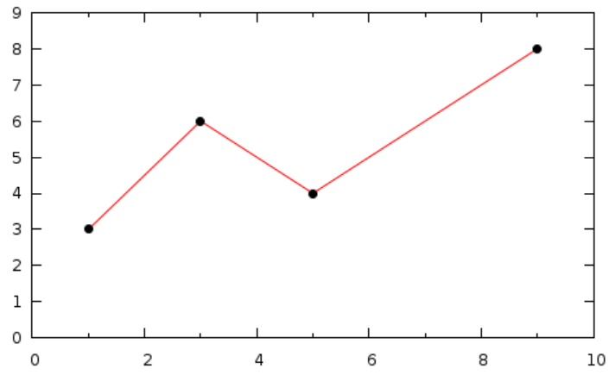
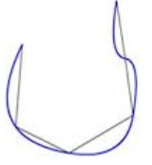
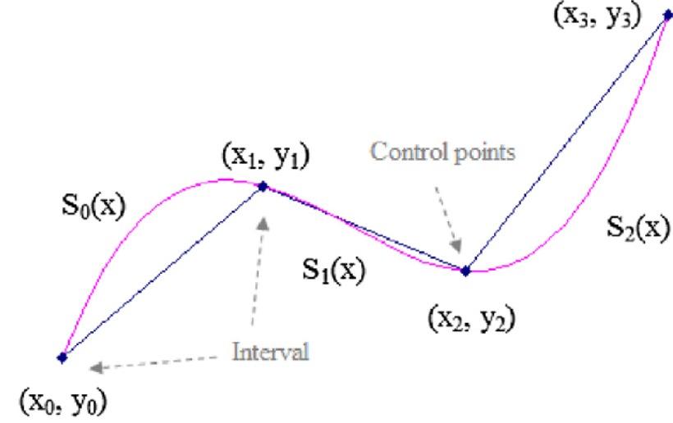
Piecewise Polynomial Interpolation
Linear Spline
Quadratic Spline
Cubic Spline

Slide 11

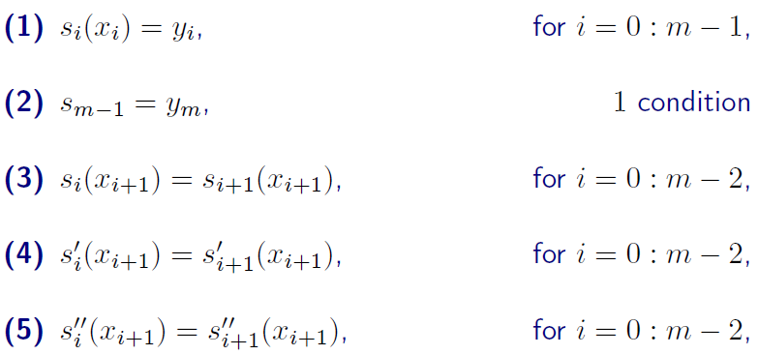





Piecewise Polynomial Interpolation (Cubic Spline)
4 Unknowns within each interval
$$m\text{+}\text{1}$$
$m$-1
$$4m\text{−2}$$
$m$-1
$m$-1

Slide 12

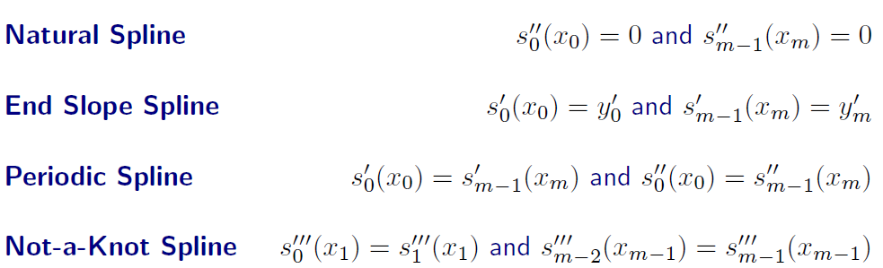
Piecewise Polynomial Interpolation (Cubic Spline)

Slide 13
Piecewise Polynomial Interpolation (Cubic Spline)
Let’s look at the interpolation models in Python!
Interpolate.interp1d:
Interpolate.CubicSpline:
Let’s try interpolate.interp1d package.

Slide 14
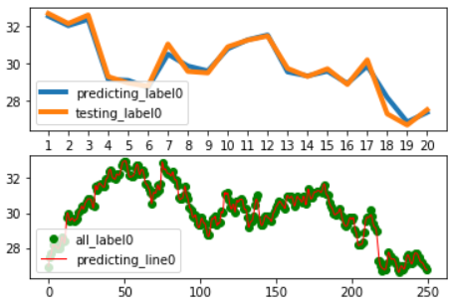
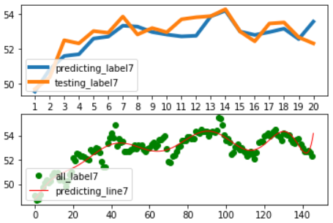
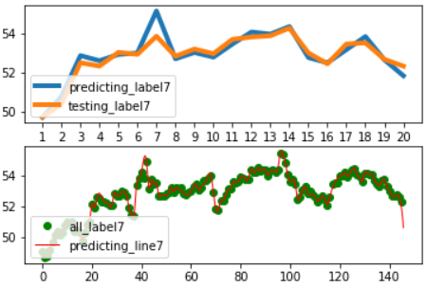
Piecewise Polynomial Interpolation (Cubic Spline)
Original Ridge model
(final score 9.57)
Interp1d model (Cubic Spline)
Case0
The score increases from 9.57 to 45.94!
Is there any way to further improve the accuracy?
Case7

Slide 15
Regularized Cubic Spline (Smoothing Cubic Spline)
Some potential problems with the piecewise polynomial interpolation (Cubic Spline):
Those constrains determine that the spline will pass every single knot…
This sometimes causes the second derivative (approximation of the curvature) to be large
Overfitting in Spline

Slide 16
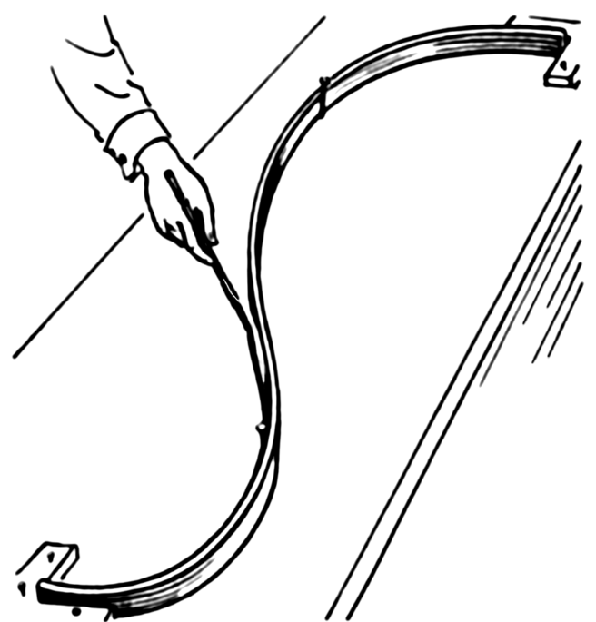

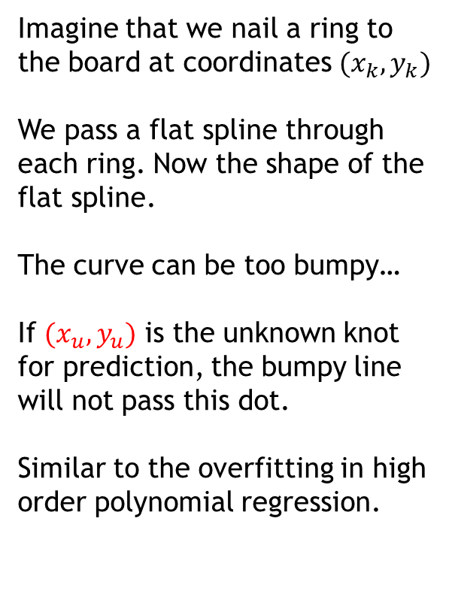


Let’s think about it in a physical way…
Imagine that we nail a ring to the board at coordinates ${(x}_{k}, y_{k})$
We pass a flat spline through each ring. Now the shape of the flat spline.
The curve can be too bumpy…
If ${(x}_{u}, y_{u})$ is the unknown knot for prediction, the bumpy line will not pass this dot.
Similar to the overfitting in high order polynomial regression.
$${(x}_{u}, y_{u})$$
$${(x}_{k}, y_{k})$$
Find a curve that doesn't go exactly through each point. But the function becomes less bumpy, more smooth.

Slide 17
Regularized Cubic Spline (Smoothing Cubic Spline)
Interpolate. UnivariateSpline:

Slide 18
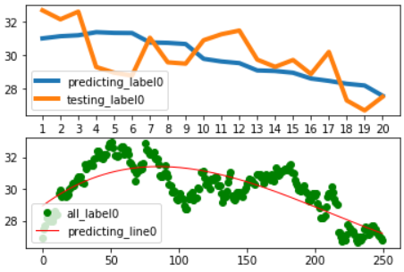
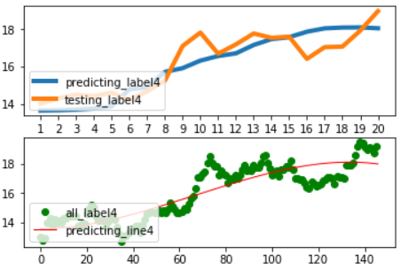
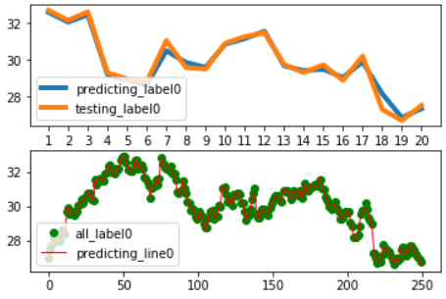
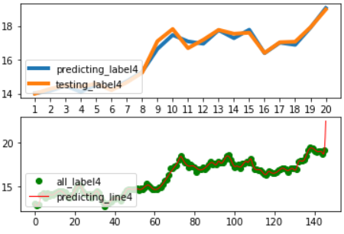

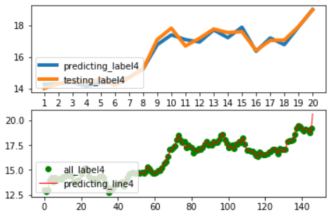
Case0 Case4
S = None
Score = 0
S = 0
Score = 39.10
S = 1
Score = 45.95

Slide 19
Regularized Cubic Spline VS. Cubic Spline
Score of Regularized Cubic Spline = 45.95 (When S = 1, K = 3)
Score of Cubic Spline = 45.94

Slide 20
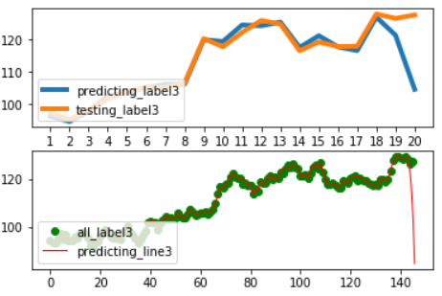
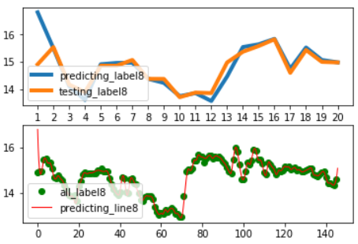
Problems for both models
Let’s now look at the major problems of both models.
Problem 1
The parameter S of the model determines the sensitivity of the fitting line. By choosing different S values, the results can be largely different, from 0 to 46.
Problem 2
For some of the cases (such as case 0), when choosing suitable parameter S, the model predicts each missing label with very high accuracy. However, for some other cases (such as case 8), when the stock prices are highly fluctuating, the same S will not be suitable.
Problem 3
Both models are robust to predict the inner points, they have poor performance in predicting the outer points. It is good for interpolation, but bad for extrapolation (case 3 and case 8).

Slide 21
Possible Solution
If using Regularized Cubic Spline, we may need to automatically select the best hyperparameter S for different data set.
Problem 1
Problem 2
Cross Validation
Separate the missing data depending on whether they are for interpolation or extrapolation
Problem 3

Slide 22
The model framework
Cross-Validation for Regularized Cubic Spline
Inner Data
Or?
Inner?
Cubic Spline
Missing Data
Combine the data together and output the predictions
Outer?
Cross-Validation for Polynomial Regression Model
Outer Data
Data
Training Data
Non-Missing Data
Evaluate
Evaluate

Slide 23
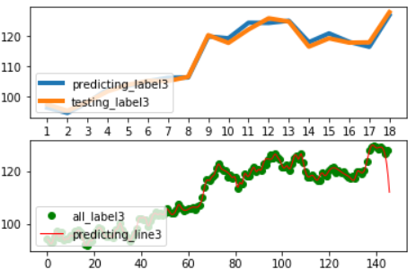
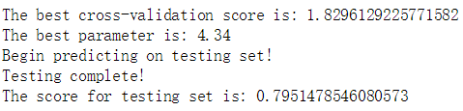
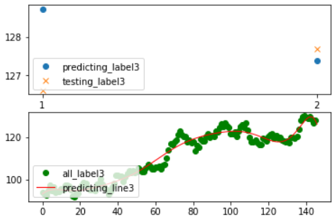
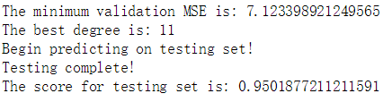
Results
Best S = 4.34
Best Degree = 11

Slide 24
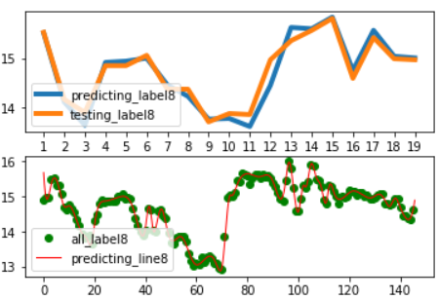
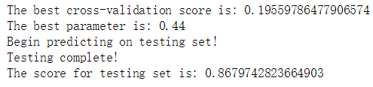
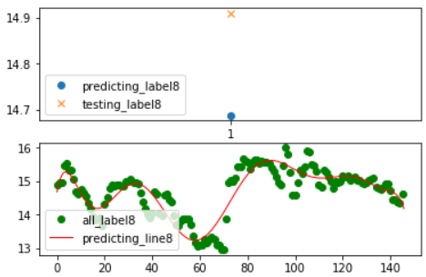
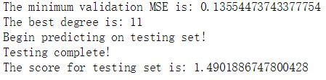
Results
Best S = 0.44
Best Degree = 11

Slide 25
Scores
Regularized Cubic Spline (Inner, CV)
+
Polynomial regression (Outer)
58.15
Highest score on Leaderboard: 60.22
Ridge Regression
9.57
Cubic Spline
45.94
Regularized Cubic Spline
45.95
Cubic Spline (Inner, No CV)
+
Polynomial regression (Outer)
53.93

Slide 26
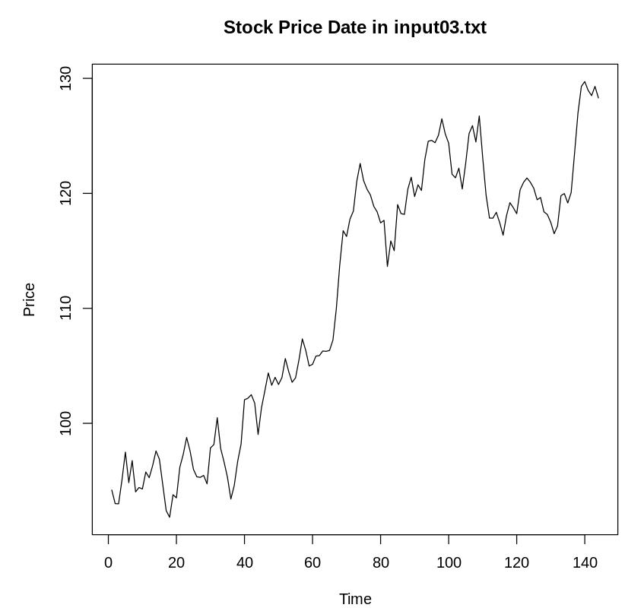
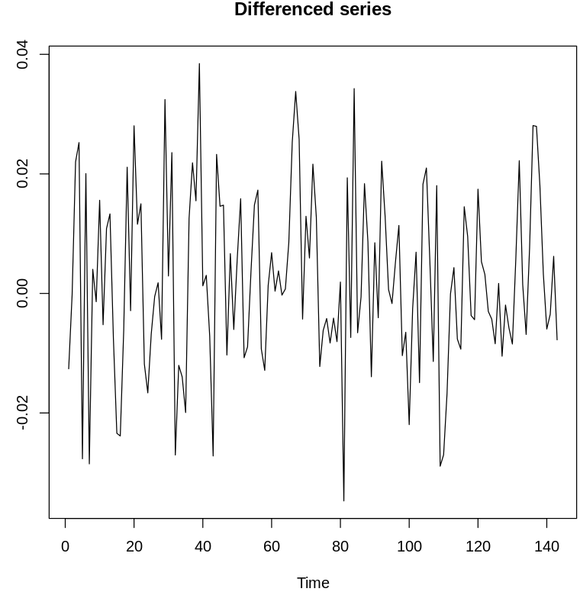
Maybe we can improve the score a little bit: Time series analysis for Case3, Case7, Case8
Case3:
d = 1

Slide 27
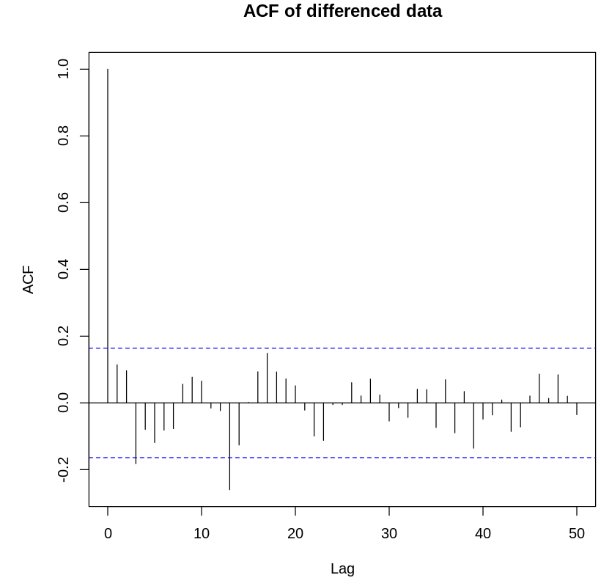
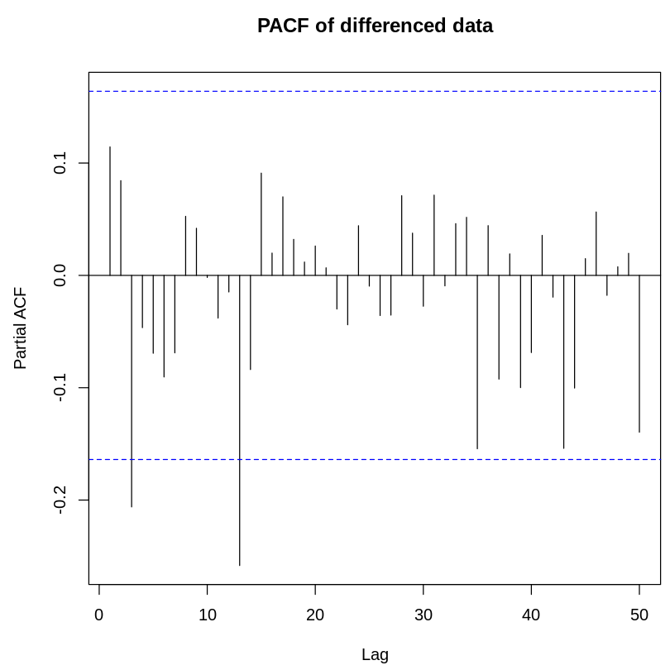
Case3:
ACF indicates stationarity. Candidates: Random Walk (MA(0)) or MA(3)
PACF: Candidates: AR(3)
ARIMA(3,1,0) or ARIMA(3,1,3)

Slide 28
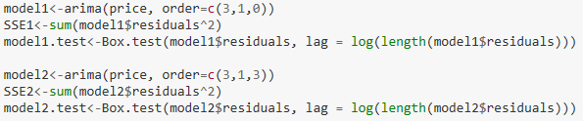
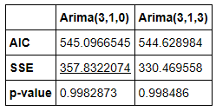
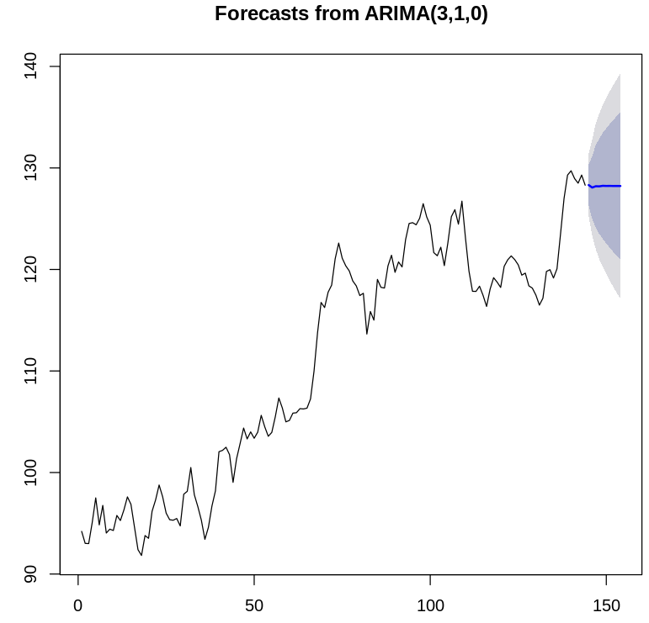
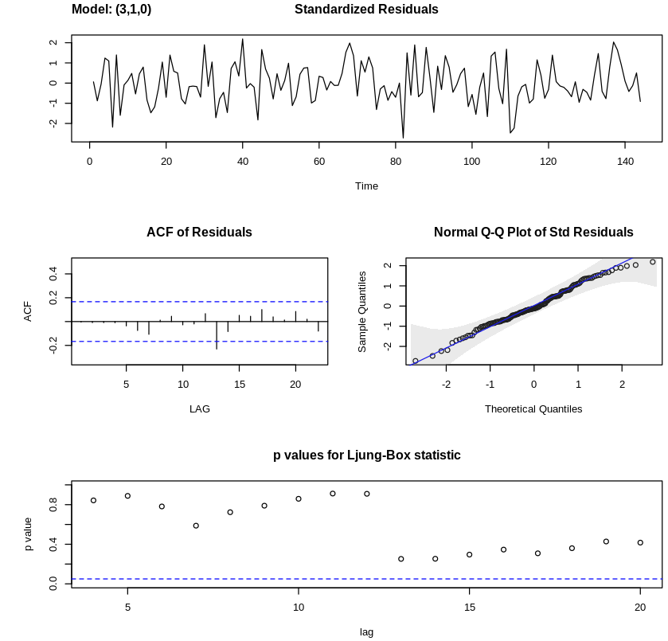

Case3:
Error term is independent
Error term is normally distributed
Error term is not autocorrelated

Slide 29
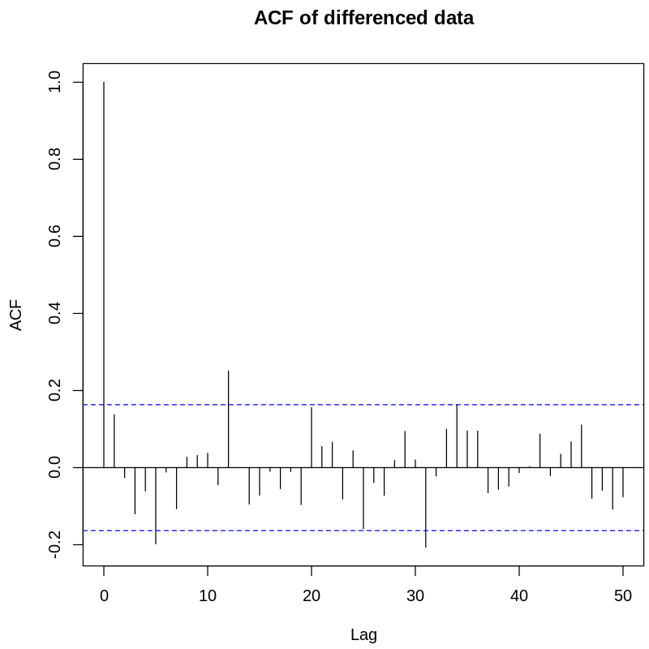
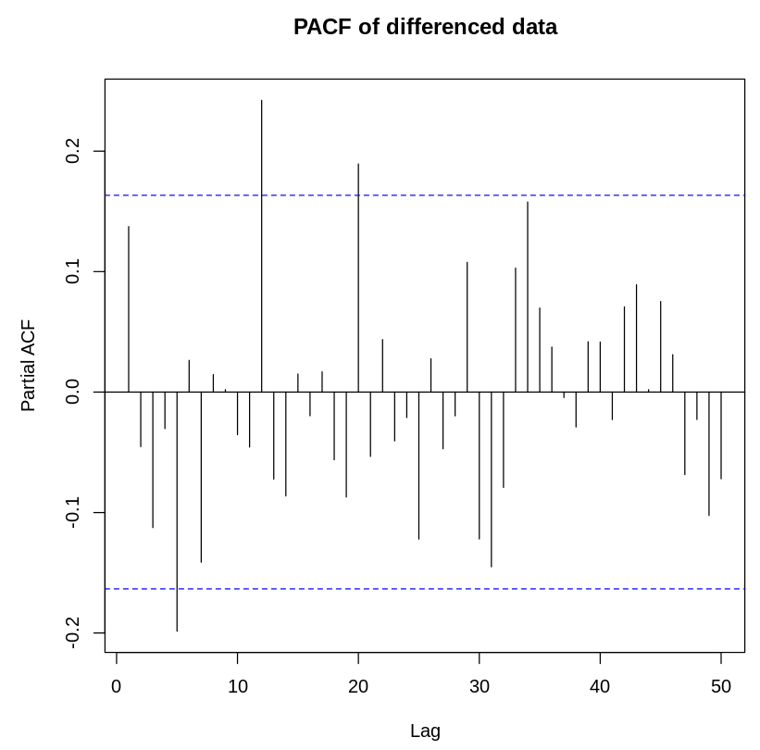



Case7
A Random Walk model (ARIMA(0,1,0))
Apply NÄIVE Method for forecasting…

Slide 30


Case8 (need reverse)
ARIMA(2,1,1) or ARIMA(14,1,1)

Slide 31



Case8 (need sequential reverse)
Error term is independent
Error term is normally distributed
Error term is not autocorrelated

Slide 32
After adding Time Series Models for Case3 and Case7: 58.15 to 58.50
Summary:
Large amount of inner missing points in each case: Piecewise Polynomial Interpolation Model (Cubic spline, Regularized Cubic Spline, the latter can be time consuming, but more accurate).
Outer missing points in each case: Polynomial Regression Model or Time Series Model, the latter can be complicated, though we can use auto.arima).
Our model framework in this study will show more robust performance when more outer missing points are involved.

Slide 33

API: Missing_Stock.py
1. Open Anaconda Prompt (or command window)
2. Go to the .py directory
3. Type command "Python Missing_Stock.py"
4. Type the correct location of the input stock data (e.g., C:/case/input/input03.txt)
5. Select the method for inner data interpolation (Type "1" for regularized cubic spline; Type "2" for cubic spline)
# Note: regularized cubic spline may be time consuming...
6. Press Enter, and wait for the predicted stock data output on the Prompt
7. Quit

Slide 34
Thanks so much!

