Slide 1
Ice Cream Locations
Soham Kelkar

Slide 2
Introduction
Get the best locations for ice cream shops in the Scarborough
People like to go to ice cream stores after eating at a restaurant
Choose the locations close to top restaurants in the city

Slide 3
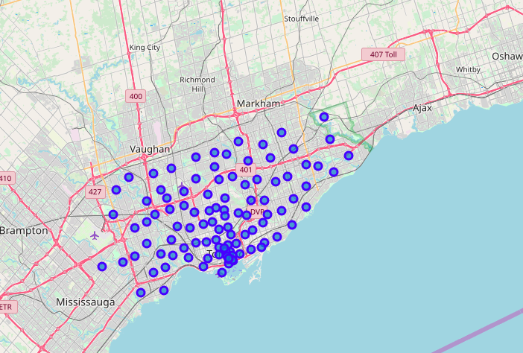
Map of Toronto
103 Neighbourhoods

Slide 4
Exploratory Analysis of Scarborough
17 neighbourhoods out of a total of 103 in Toronto
117 Unique Venue Categories in a 10 mile Radius
115 Restaurants across all neighbourhoods in Scarborough

Slide 5
Methodology
Get the data for neighbourhoods in Toronto
Analyse the data and filter it to get data for Scarborough
Group the data according to the neighbourhood
Get the locations of top 100 venues in a 10 mile radius
Filter the locations to get restaurant areas

Slide 6
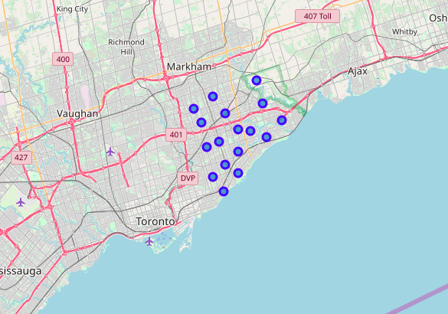
Top restaurants in Scarborough

Slide 7
Conclusion & Discussion
Include more factors that influence the decision of choosing an appropriate location for the ice cream shop
Use machine learning to identify the best location amongst all the obtained restaurants
From this project we can identify the regions that are best suited for ice cream shops based on the locations of restaurants

