Slide 1
MP1
Debajyoti Datta (dd3ar) fOR CS 6501

Slide 2
Spark configuration along with graphlab
Spark configuration with graphlab is slightly non-trivial.
In a virtual environment install graphlab (a large scale data processing library in python), and run spark along with it.
Ipython notebook for integration of all the separate components.

Slide 3

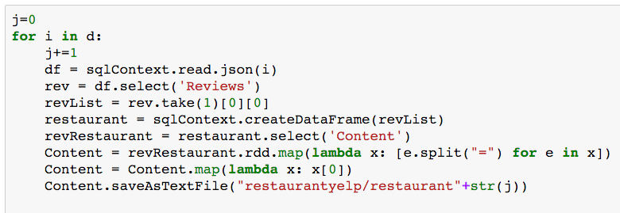
Data preprocessing

Slide 4
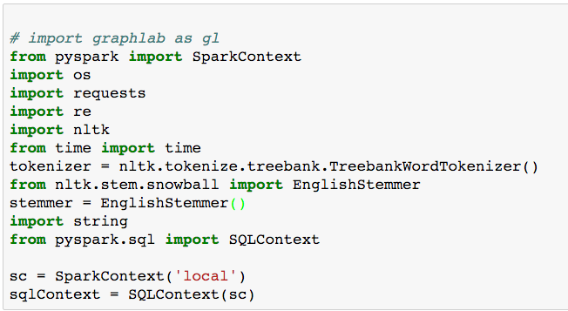
Spark context and initialization of SQLContext

Slide 5
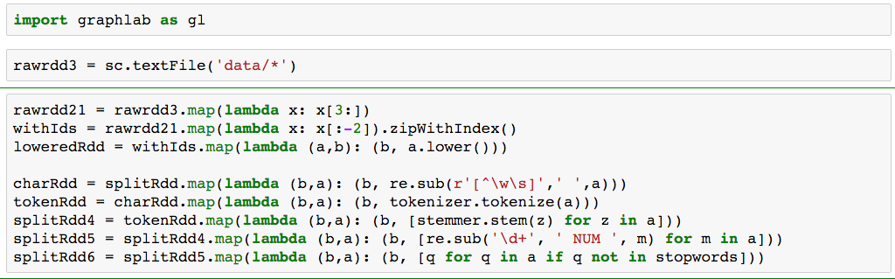
Loading data and parallel manipulation

Slide 6
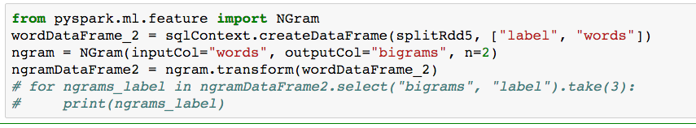
N-gram generation using SQL Context

Slide 7
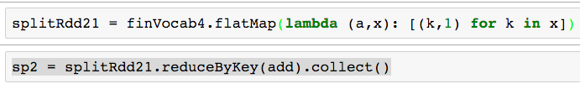
Map Reduce stage

Slide 8

Fast sorting from a list

Slide 9
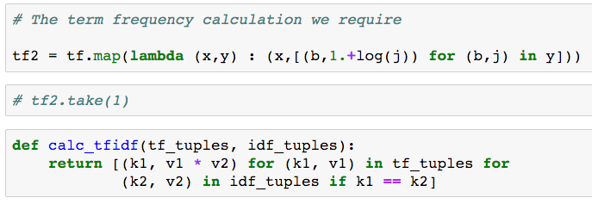
TF-IDF calculation

Slide 10
Thank you
Any Questions?

