Slide 1
Ch.26 Testing Mobile Applications

Slide 2
26.1 Mobile App Testing Strategy Question
A white paper posted by Soasta [Soa11] summarizes this:
Mobile technology is simply ramping up faster than other technologies in the past—it may be the fastest adoption curve in history. And this has important implications for your business model. You’ve got to be fast to market but also prepared for rapid adoption. If your application performs poorly, or fails under load, many competitors are ready to take your place—the barriers to entry are low.

Slide 3
26.1 Mobile App Testing Strategy Question
The strategy for testing mobile applications adopts the basic principles for all software testing. However, the unique nature of MobileApps demands the consideration of a number of specialized testing approaches.
So what are the unique nature of MobileApps ?
And what specialized testing approaches can we give?

Slide 4
26.1 Mobile App Testing Strategy Question
Do you have to build a fully functional prototype before you test with users?
Should you test with the user’s device or provide a device for testing?
What devices and user groups should you include in testing?
When is lab testing versus remote testing appropriate?

Slide 5
26.1 Mobile Testing Guidelines
Understand the network landscape and device landscape.
Conduct testing in uncontrolled real-world test conditions.
Select the right automation test tool.
Use the Weighted Device Platform Matrix method to identify the most critical hardware/ platform combinations to test.
Check the end-to-end functional flow in all possible platforms at least once.
Conduct performance, GUI, and compatibility testing using actual devices.
Measure MobileApp performance under realistic network load conditions.

Slide 6
26.2 Mobile App Testing Strategy
Conceptual testing—Getting input from prospective users of the MobileApp prior to beginning development helps ensure that no unnecessary features are included and no essential features have
been missed.
Unit and system testing—Implementing regular unit and system testing accommodates any software application that contains multiple components and interacts with networks.
User-experience testing—Users are involved early in the development process to ensure that the MobileApp lives up to the usability and accessibility expectations of the stakeholders on all supported devices.
Device compatibility testing—Testers verify that the MobileApp works correctly on all required hardware and software combinations.

Slide 7
26.2 Mobile App Testing Strategy
Performance testing—Testers check nonfunctional requirements unique to mobile devices (e.g., download times, processor speed, storage capacity, power availability).
Connectivity testing—Testers ensure that the MobileApp can access any needed networks or Web services and can tolerate weak or interrupted network access.
Security testing—Testers ensure that the MobileApp does not compromise the privacy or security requirements of its users.
Testing-in-the-wild—The app is tested under realistic conditions on actual user devices in a variety of networking environments around the globe.
Certification testing—Testers ensure that the MobileApp meets the standards established by the app stores that will distribute it.

Slide 8
26.3 The need for Automation
A MobileApp tester often encounters many configuration variants (devices, operating systems, and mobile networks) that may need to be included to ensure that a MobileApp is both functional and context aware.
To test a MobileApp efficiently and completely, automated testing can be useful for configuration testing or regression testing. However, that it may not be possible to automate all parts of MobileApp testing.
Automated testing tools can improve team morale when testers would otherwise be forced to process a large number of repetitive test cases mechanically. The automated tools can encourage earlier and more frequent testing, allowing the early discovery of MobileApp defects.

Slide 9
26.3 Automated Testing
Feasibility analysis
Proof of concept
Best practice test framework
Customize testing tools
Test under real world conditions
Rapid defect resolution
Reuse of test scripts

Slide 10
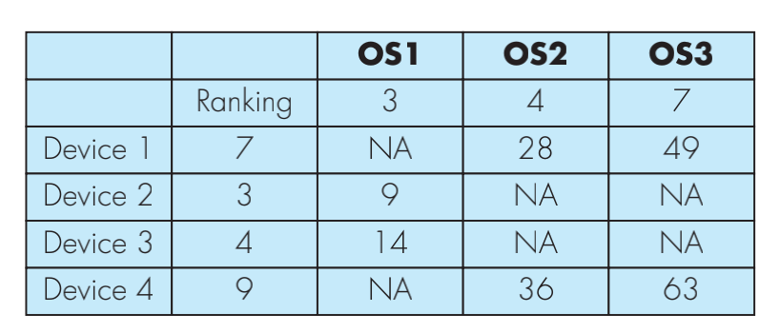
26.4 Building a Test Matrix
MobileApps are developed for multiple devices and designed to be used in many different contexts and locations.
A weighted device platform matrix (WDPM) helps ensure that test coverage includes each combination of mobile device and context variables.

Slide 11
26.5 Stress Test Cases
Running several mobile apps on the same device
Infecting system software with viruses or malware
Attempting to take over a device and use it to spread spam
Force the mobile app to process inordinately large numbers of transactions
Storing large amounts of data on the device

Slide 12
26.6 Mobile Usability Testing Components
Functionality
Information architecture
Screen Design
User input mechanisms
Mobile context taken into account
Interface usability
Trustworthiness
Feedback
Help facilities

Slide 13
26.6.1 Specialized Usability Tests
Gestures
Voice input and recognition
Virtual keyboard input
Alerts and errors
Case Study

Slide 14

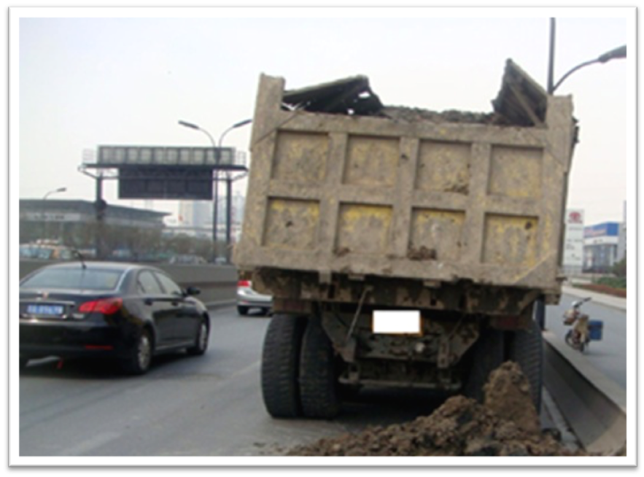

案卷拍拍 记录查询
1
现场抓拍
2
现场微信
12:30 20’’
12:31 10’’
上报提示
当前案卷已成功上报，案卷号： 201300432289。
确 认
拍照
按住说话
确认上报

Slide 15
26.6.2 “现场抓拍”测试用例要点
能否成功调用摄像头进行拍照？
能否成功调用麦克风发布语音消息？
语音消息过长（30秒以上）上传失败，是否有提示弹出？
语音消息过多（3条以上）上传失败，是否有提示弹出？
点击“确认上报”能否正确上报？上报成功后是否有提示？
遇到网络连接错误是否有警告？
上报成功后“记录查询”模块是否自动增加一条新的记录？

Slide 16
26.7 MobileApps Unique Testing
TEST ACROSS BORDERS：
Internationalization is the process of creating a software product so that it can be used in several countries and with various languages without requiring any engineering changes. Localization is the process of adapting a software application for use in targeted global regions by adding locale-specific requirements and translating text elements to appropriate languages.
REAL-TIME TESTING ISSUES：
Limited processing power and storage capacity may not allow loading of the diagnostic software needed to record the test-case performance.
Each mobile network uses its own unique infrastructure to support the mobile Web.

Slide 17
26.7 MobileApps Unique Testing
TESTING-IN-THE-WILD：
Some of the characteristics of in-the-wild testing include adverse and unpredictable environments, outdated browsers and plug-ins, unique hardware, and imperfect connectivity (both Wi-Fi and mobile carrier).
In order to mirror real-world conditions, the demographic characteristics of testers should match those of targeted users, as well as those of their devices. In addition, you should include use cases involving small numbers of users, less-popular browsers, as well as a diverse set of mobile devices.

Slide 18
26.7 MobileApps Unique Testing
CLOUD-BASED-TESTING：
Cloud-based testing can offer a standardized infrastructure and preconfigured software images, freeing the team from the need to worry about finding servers or purchasing their own licenses for software and testing tools.
Cloud service providers give testers access to scalable and ready to user virtual laboratories with a library of operating systems, test and execution management tools, and storage necessary for creating a test environment that closely mirrors the real world.

Slide 19
26.8.1 Mobile App Testing Tools
Mobile page compliance checkers
Mobile browser emulators
Device emulators
Key logging and playback
Network monitors
Mobile analytics collectors

Slide 20
26.8.2 Tool Sample:某在线测试云平台
云测试：一键提交，多设备多系统全自动测试服务
安装卸载测试：检测安装/卸载APP是否能正常完成
遍历测试：遍历APP所有控件，并记录崩溃现象和操作路径。
UI适配测试：判断APP是否完美匹配所有屏幕尺寸
稳定性测试：对APP进行压力测试
云调试远程可视化调试，快速定位并调试
    提供百余种真机测试机和模拟器
    降低开发成本
    针对某款测试机单独安装APP，对操作过程进行日志跟踪，远程可视化调试
在线测试云平台
    百度移动云测试中心：http://mtc.baidu.com/
    Testin 云测：http://www.testin.cn/

Slide 21
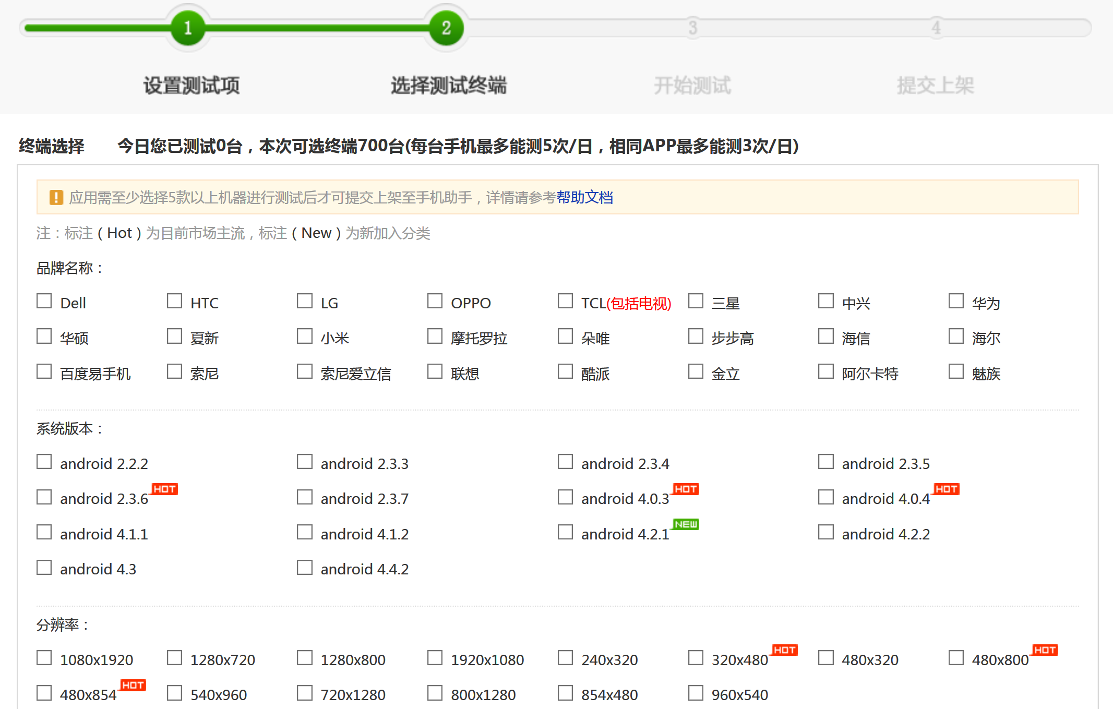
26.8.2 Tool Sample:某在线测试云平台

