Slide 1
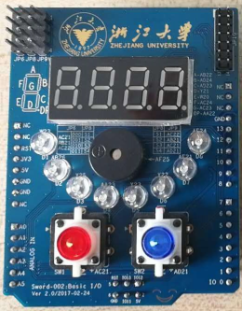
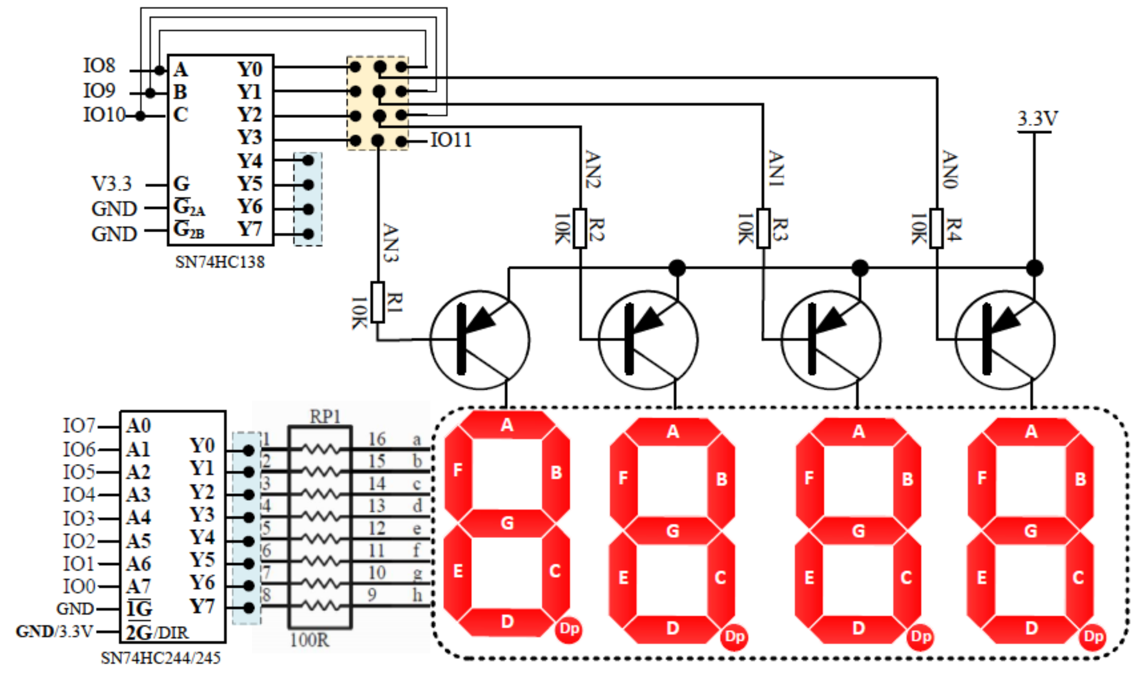
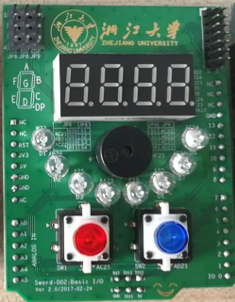
接口说明： Arduino子板-七段码
动态扫描译码兼容SP3
JP8、JP9短接扫描独立，但AN3，AN2与二个按键共用
JP8、JP6短接扫描经138译码，信号独立
JP6
JP9
JP8
共阳：低有效

Slide 2
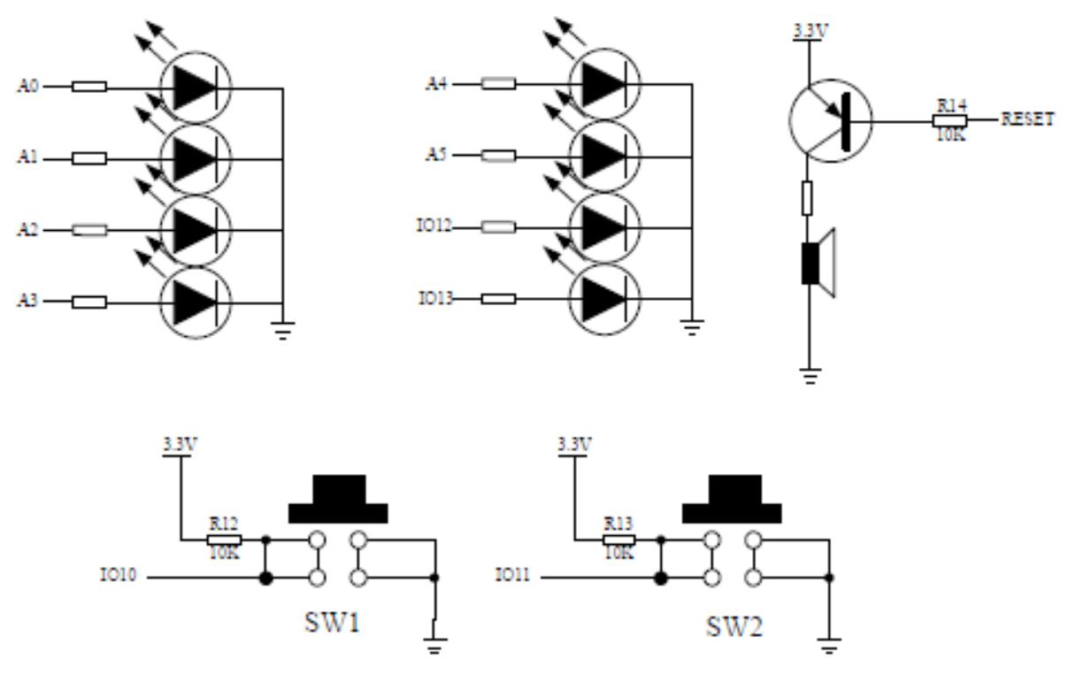
接口说明： Arduino子板-LED
共阴：高有效
LED直接输出兼容SP3
按键SW1、SW2
1个蜂鸣器
JP8、JP9短接（缺省）扫描独立，但AN3，AN2与二个按键共用

Slide 3
引脚约束：Arduino-Sword-002
NET "SEGMENT[0]" LOC = AB22 | IOSTANDARD = LVCMOS33 ;#a
NET "SEGMENT[1]" LOC = AD24 | IOSTANDARD = LVCMOS33 ;#b
NET "SEGMENT[2]" LOC = AD23 | IOSTANDARD = LVCMOS33 ;
NET "SEGMENT[3]" LOC = Y21 | IOSTANDARD = LVCMOS33 ;
NET "SEGMENT[4]" LOC = W20 | IOSTANDARD = LVCMOS33 ;
NET "SEGMENT[5]" LOC = AC24 | IOSTANDARD = LVCMOS33 ;
NET "SEGMENT[6]" LOC = AC23 | IOSTANDARD = LVCMOS33 ;#g
NET "SEGMENT[7]" LOC = AA22 | IOSTANDARD = LVCMOS33 ;#point
NET "AN[0]" LOC = AD21 | IOSTANDARD = LVCMOS33 ;
NET "AN[1]" LOC = AC21 | IOSTANDARD = LVCMOS33 ;
NET "AN[2]" LOC = AB21 | IOSTANDARD = LVCMOS33 ;
NET "AN[3]" LOC = AC22 | IOSTANDARD = LVCMOS33 ;
NET "LED[0]" LOC = AF24 | IOSTANDARD = LVCMOS33 ; #GPIOf0[0]
NET "LED[1]" LOC = AE21 | IOSTANDARD = LVCMOS33 ; #GPIOf0[11
NET "LED[2]" LOC = Y22 | IOSTANDARD = LVCMOS33 ; #GPIOf0[2]
NET "LED[3]" LOC = Y23 | IOSTANDARD = LVCMOS33 ; #GPIOf0[3]
NET "LED[4]" LOC = AA23 | IOSTANDARD = LVCMOS33 ; #GPIOf0[4]
NET "LED[5]" LOC = Y25 | IOSTANDARD = LVCMOS33 ; #GPIOf0[5]
NET "LED[6]" LOC = AB26 | IOSTANDARD = LVCMOS33 ; #GPIOf0[6]
NET "LED[7]" LOC = W23 | IOSTANDARD = LVCMOS33 ; #GPIOf0[7]
NET "Buzzer" LOC = AF25 | IOSTANDARD = LVCMOS33 ;
NET “SW1" LOC = AC21 | IOSTANDARD = LVCMOS33 ;
NET “SW2" LOC = AD21 | IOSTANDARD = LVCMOS33 ;

