Slide 1
CPU调度算法课堂练习

Slide 2
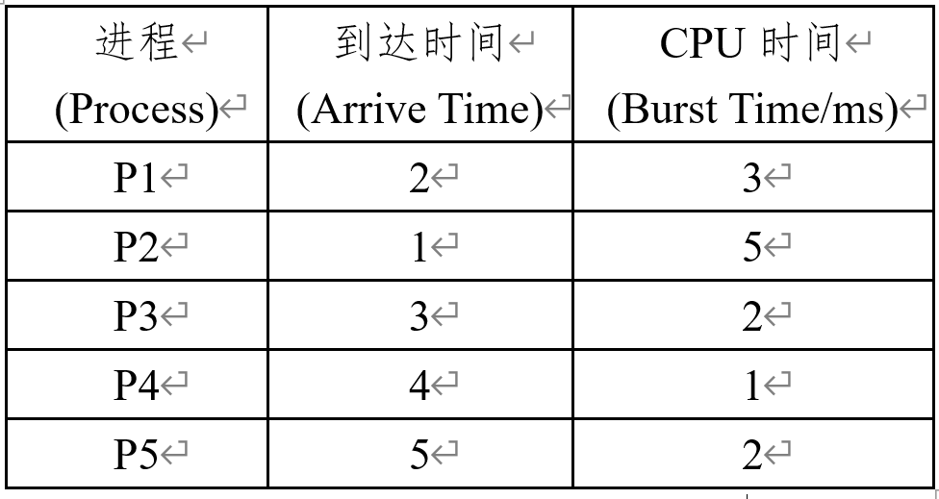
根据下表中进程的信息，按照不同的CPU调度(CPU scheduling)算法， 画出进程调度的甘特图(gantt chart)，并计算平均等待时间 (average waiting time）和平均周转时间。
使用First Come First Served (FCFS)调度算法；
使用Shortest Job First (SJF)算法
使用Shortest-Remaining-Time-First (SRTF)调度算法；
使用Round Robin (RR)调度算法， 时间片q=3ms。

Slide 3
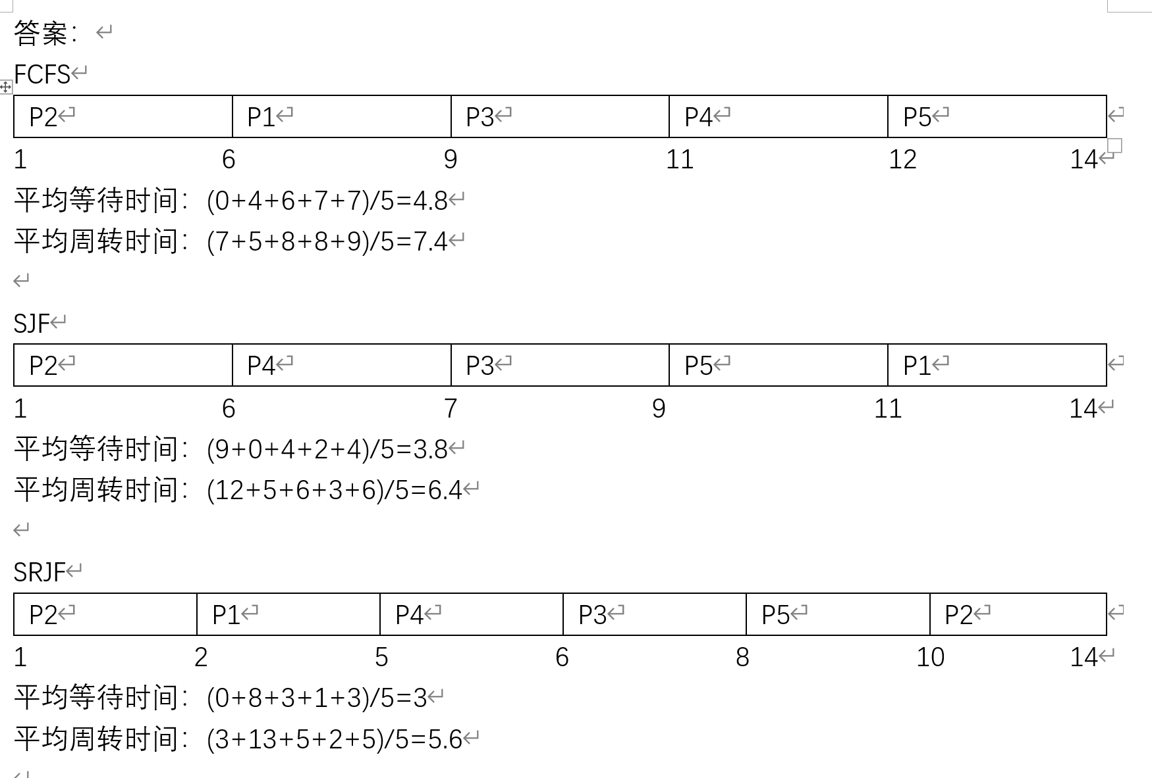
RR算法，时间片3ms：P2=3ms, P1 = 3ms; P3 = 2ms; P4=1ms, P2=2ms; P5=2ms
P2
P1
P3
P4
P2
P5
1
4
7
9
10 12 14
平均等待时间：(6+2+4+5+7)/5 = 4.8ms

Slide 4
Process | Arrival Time | Brust Time/ms
P1 | 0 | 5
P2 | 2 | 7
P3 | 7 | 4
P4 | 11 | 1
P5 | 12 | 3
Please calculate the average waiting time and turn around time using the following CPU scheduling algorithms:
1) FCFS: first come first served
2) SJF: non-preemptive shortest job first
3) SRTF: preemptive shortest job first (shortest remaining time first)
4） RR:T=4

Slide 5
FCFS
Process | Arrival Time | Brust Time/ms
P1 | 0 | 5
P2 | 2 | 7
P3 | 7 | 4
P4 | 11 | 1
P5 | 12 | 3
P1
P2
P3
P4
P5
0
5
12
16
17
20
P1: 0
P2:5-2=3
P3: 12-7=5
P4: 16-11=5
P5: (17-12)=5
Average: 18/5=3.6

Slide 6
SJF
Process | Arrival Time | Brust Time/ms
P1 | 0 | 5
P2 | 2 | 7
P3 | 7 | 4
P4 | 11 | 1
P5 | 12 | 3
P1
P2
P4
P5
P3
0
5
12
13
16
20
P1: 0
P2:5-2=3
P3: 16-7=9
P4: 12-11=1
P5: 13-12=1
Average: 14/5=2.8

Slide 7
T=4
Process | Arrival Time | Brust Time/ms
P1 | 0 | 5
P2 | 2 | 7
P3 | 7 | 4
P4 | 11 | 1
P5 | 12 | 3
P1
P2
P1
P3
P2
P4
P5
P1 P2 P1 P3 P2 P4 P5
0
4
8
9
13
16
17
20
P1: 0+(8-4)=4
P2: (4-2)+(13-8)=7
P3: (9-7)=2
P4: (16-11)=5
P5: (17-12)=5
Average: 23/5=4.6
P1
P2
P3
P4
P5
P1
P2
0
4
8
12
13
16
17
20
P1: 0+(16-4)=12
P2: (4-2)+(17-8)=11
P3: (8-7)=1
P4: (12-11)=1
P5: (13-12)=1
Average: 26/5=5.2

Slide 8
T=4
Process | Arrival Time | Brust Time/ms
P1 | 0 | 5
P2 | 2 | 7
P3 | 7 | 4
P4 | 11 | 1
P5 | 12 | 3
P1
P2
P1
P3
P2
P4
P5
P1 P2 P1 P3 P2 P4 P5
0
4
8
9
13
16
17
20
P1: 0+(8-4)=4
P2: (4-2)+(13-8)=7
P3: (9-7)=2
P4: (16-11)=5
P5: (17-12)=5
Average: 23/5=4.6

Slide 9
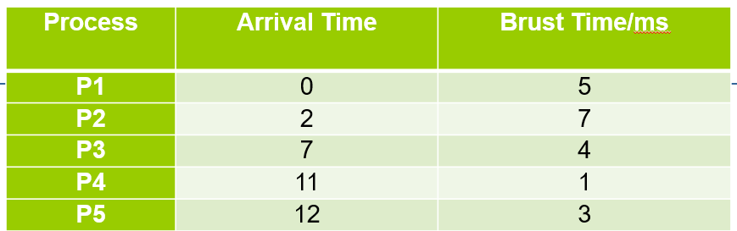
Shortest Remaining Job First
P1
P2
P3
P4
P5
P2
0
5
7
11
12
15
20
P1: 0
P2: (5-2)+(15-7)=11
P3: (7-7)=0
P4: (11-11)=0
P5: (12-12)=0
Average: 11/5=2.2

Slide 10
RR (T=5)
P1
P2
P3
P2
P4
P5
P1
P2
P3
P4
P5
P2
0
5
10
14
16
17
20
0
5
10
14
15
18
20
P1: 0
P2: (5-2)+(14-10)=7
P3: (10-7)=3
P4: (16-11)=5
P5: (17-12)=5
Average: 20/5=4
P1: 0
P2: (5-2)+(18-10)=11
P3: (10-7)=3
P4: (14-11)=3
P5: (15-12)=3
Average: 20/5=4

Slide 11
课堂测试
画出下列CPU调度算法对应的进程甘特图，分别计算各算法中进程的平均等待时间。
(1) 使用First Come First Served (FCFS)调度算法；
(2) 使用Shortest Job First(SJF)调度算法；
(3) 使用Shortest-Remaining-Time-First (SRTF)调度算法；
(4) 使用Round Robin(RR)调度算法，时间片为4ms。
进程(Process) | 到达时间(Arrive Time) | 服务时间(Brust Time /ms)
P1 | 0 | 3
P2 | 2 | 6
P3 | 3 | 1
P4 | 4 | 2
P5 | 8 | 2

