Slide 1
Text Emotion Recognition
Luo Wenyu, Ong Hui Lee Grace, Wang Anyi
Notes:
<10mins

Slide 2
Introduction to Project Idea
Text Emotion Recognition (TER)
Improved model based on existing methods
Local + global information
Notes:
In this project, we aim to utilise our understanding on Neural Networks and Deep Learning on the research issue of Text Emotion Recognition.
We will propose a potential deep learning technique that we developed after doing some investigations and implementation on existing methods such as CNN and RNN.
We attempted to improve on the existing methods and analysed the results that we obtained.
We also hope to capture both local emotions expressed by words, and global emotions expressed by sentences, by including methods that captures long term dependencies.
which identifies both local emotions expressed by words, and global emotions expressed by sentences.
which identifies both local emotions expressed by words, and global emotions expressed by sentences.

Slide 3
Existing techniques
Notes:
We will introduce a few existing techniques that can be used for this task and explain their results at the end

Slide 4
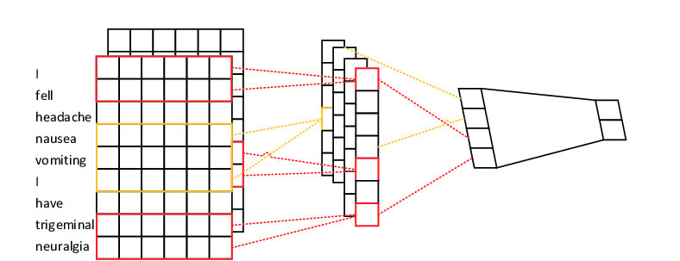
CNN
Word embeddings
Feature map
Max pooling
dropout
Notes:
The CNN uses several kernels that slide down on the word embedding input matrix to create the feature maps. Then a max pooling layer is applied to capture the more meaningful components of the feature map to use for the final softmax layer.

Slide 5
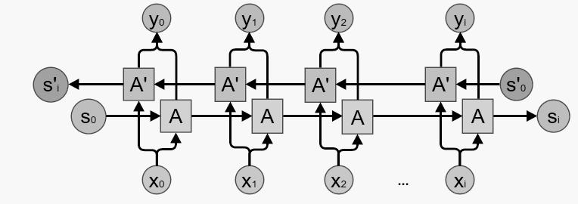
Bidirectional RNN
Left context
Right context
Notes:
Bidirectional RNN involves concatenating two RNNs together, one passing information in the forward direction and one backwards. This enables the model to capture both the left contextual information of words from start of sentence to current word, and the right contextual information of current word to end of sentence.
However, simple RNN models face the problem of vanishing gradient, causing learning to become inefficient. It also has difficulties in capturing long term dependencies when there is a large distance between information in a sentence.

Slide 6
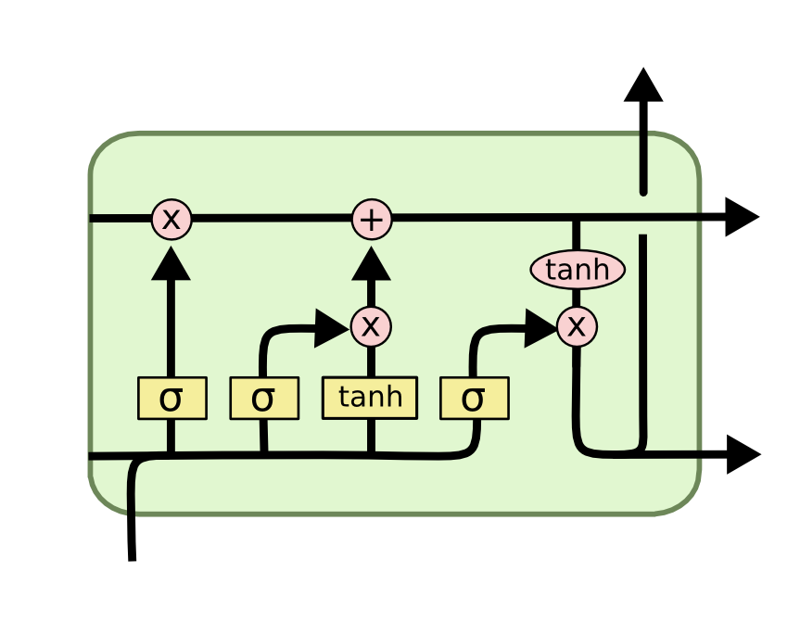
Bidirectional LSTM
Cell State
Notes:
LSTM models aim to solve the problem of vanishing gradients in RNN. LSTM units can maintain information in memory for long periods of time using the cell state that runs across the units. A set of gates is used to control when information enters the memory, when it's output, and when it's forgotten.
The structure of bidirectional LSTM is similar to the bidirectional RNN.

Slide 7
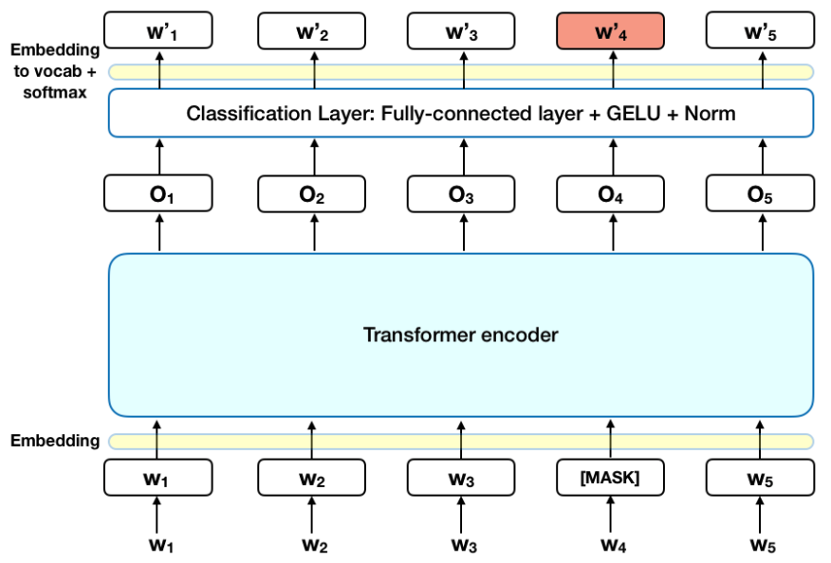
BERT
Notes:
BERT is a state of art model that uses a Transformer encoder to read the entire sequence of words at once. It enables the model to learn the context of a word based on its neighbours.

Slide 8
Our Method

Slide 9
Data pre processing
One hot encoding on sentiments:
Eg.
‘Joy’ → [1, 0, 0, 0, 0, 0, 0]
‘Anger’ → [0, 1, 0, 0, 0, 0, 0]
‘Love’ → [0, 0, 1, 0, 0, 0, 0]
Tokenize sentences using nltk.tokenize
Notes:
We first convert sentiments into one hot vectors. This will be the label used in our model.
The sentences are then tokenized using nltk.tokenize and converted to lowercase.

Slide 10
Data pre processing
Dictionary of token : count
{‘i’ : 24005, ‘know’ : 1315, ‘was’ : 2810, …}
Dictionary of token : id Dictionary of id : token
{‘<UNK>’ : 0, ‘i’ : 1, ‘!’ : 2, ...} {0 : ‘<UNK>’, 1 : ‘i’ , 2 : ‘!’, ...}
‘Wants to hang out with friends soon!’
→ {‘str_words’ : [‘wants’, ‘to’, ‘hang’, ‘out’, … ],
‘words’ : [466, 5, 713, 44, …] }
Notes:
We created three dictionaries, the first maps unique tokens to its number of occurrences in our data, the second maps tokens to their unique indexes, sorted in decreasing order of frequency, and the third mapping indexes to tokens.
Finally, we can represent each sentence as a dictionary. For example, the sentence “wants to hang out with friends” contains an array of tokens and an array of word indexes.
These preprocessings are necessary for creating our word embeddings later on.

Slide 11
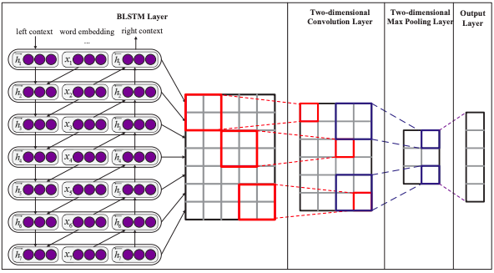
Model
Zhou, P., Qi, Z., Zheng, S., Xu, J., Bao, H., & Xu, B. Text classification improved by integrating bidirectional LSTM with two-dimensional max pooling. 26th International Conference on Computational Linguistics, vol. 2, no.1, 3485–3495, 2016.

Slide 12
Our Model Structure
glove/BERT word embeddings
BLSTM layer
forward
backward
Hidden vector
Softmax output
LSTM
LSTM
convolution
Max pooling
LSTM
LSTM
Self attention
LSTM
LSTM
LSTM
LSTM
x
multiplicative

Slide 13
Model
Zhou, P., Qi, Z., Zheng, S., Xu, J., Bao, H., & Xu, B. Text classification improved by integrating bidirectional LSTM with two-dimensional max pooling. 26th International Conference on Computational Linguistics, vol. 2, no.1, 3485–3495, 2016.
LSTM
LSTM
LSTM
LSTM
LSTM
LSTM
LSTM
LSTM

Slide 14
GloVe Embedding
unsupervised learning algorithm for obtaining vector representations for words.
Trained on 6 billion word corpus ( Wikipedia 2014 + Gigaword 5 )
word2vec
400000 pretrained 300 dimensional vectors
{'the': array([-0.038194, -0.24487 , 0.72812 , -0.39961 , 0.083172, 0.043953,......
-0.52028 , -0.1459 , 0.8278 , 0.27062 ]),
'of': array([-0.1529 , -0.24279 , 0.89837 , 0.16996 , 0.53516 , 0.48784 ,......
-0.56094 , -0.591 , 1.0039 , 0.20664 ]),
….}

Slide 15
BERT Embedding
bidirectional transformer-based language model using encoders
masked language modeling (hide 15% words)
'small_bert/bert_en_uncased_L-4_H-256_A-4' model, which uses a smaller transformer block

Slide 16
Results
Notes:
We have used three dataset to test out on different models. The first two datasets are from the project requirement, they are crowdflower and WASSA. We have also selected an extra dataset, emotions dataset from Kaggle.

Slide 17
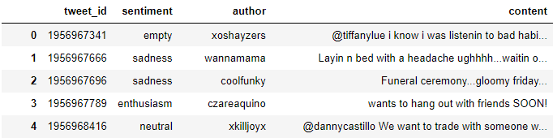
Dataset Used
Crowdflower
40000 rows of instances
13 unique labels
Notes:
For Crowdflower, there are 40k instances and 13 unique emotion labels.

Slide 18
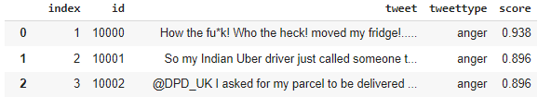
Dataset Used
WASSA
3960 rows of instances
4 unique labels
Contains sentiment score which indicates how strong the sentiment is
After setting threshold as 0.7, there are 625 instances left
Notes:
Wassa dataset contains 3960 instances with 4 different labels. As you can see from the table, except for the text and label, there is one more column called score, which indicates how strong the emotion is for the corresponding text. After initial experiments with all the data from WASSA, we realised that the results are not very ideal due to those sentences with low sentiments score. Hence we decided to only keep data that has a sentiment score of 0.7 or above. After pruning of data, we only have 625 instances.

Slide 19
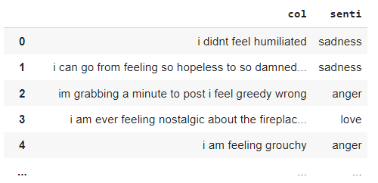
Dataset Used
Emotions
20000 rows of instances
6 unique labels
Notes:
For emotions, there are 20k instances with 6 unique labels.

Slide 20
Summary of datasets
Dataset | No. of Labels | Avg. Sentence Length | Max. Sentence Length | Train Size | Test Size | Vocab Size
Crowdflower | 13 | 73 | 167 | 28000 | 12000 | 52746
WASSA | 4 | 92 | 158 | 500 | 125 | 12393
Emotions | 6 | 96 | 300 | 16000 | 4000 | 15211
Notes:
Here is a summary statistics of the three datasets. The average sentence length for both WASSA and Emotions dataset are around 90 while crowdflower have a relatively lower average sentence length. The Max sentence length for crowdflower and WASSA are around 160. Emotions have some extremely long text with a maximum sentence length of 300. To split training and testing data, we used 70: 30 ratio for crowdflower due to its large data size, and we used 80:20 ration for the other two datasets.

Slide 21
Results obtained from different models
 | Dataset
 | Crowdflower | WASSA (0.7 threshold) | Emotions
CNN | 0.2506 | 0.8240 | 0.9070
Bi RNN | 0.2102 | 0.4521 | 0.7875
Bi LSTM | 0.2454 | 0.7040 | 0.9000
BERT | 0.40125 | 0.8886 | 0.9393
Bi RNN-CNN | 0.2915 | 0.2960 | 0.6071
Bi LSTM-CNN (Glove) | 0.2124 | 0.7840 | 0.9262
Bi LSTM-CNN (Glove) +att | 0.2399 | 0.7760 | 0.9275
Bi LSTM-CNN (BERT) |  |  | 0.7865
Bi LSTM-CNN (BERT) +att |  |  | 0.7990
Notes:
Now I’ll be showing the results we obtained from different models. The first few rows are existing methods, they are CNN, Bidirectional RNN, Bidirectional LSTM, Bert and Bidirectional RNN-CNN. The highlighted rows are our model, Bi LSTM-CNN with Glove embedding, BERT embedding, and also with self attention mechanisms incorporated. Due to time constraint, we only tested out our model on the emotions dataset. Based on the results, it can be observed that crordflower generally have lower validating accuracy at around 0.2. The highest accuracy is obtained by using BERT. While for WASSA dataset, the accuracy varies a lot for different methods, with the highest acc obtained form BERT, 0.8886 and the lowest result of 0.2960 obtained by using Bi RNn-Cnn, Emotions dataset generally yields high validating acc. The highest result 0/9393 is obtained by BERT also, and the lowest is obtained by Bi RNN-CNN. Notably, our model also yielded relatively good results as compared to other models except for BERT.
Based on the results, Glove embedding seems to perform better than BErt embedding. Hence we saved the best model obtained from bi LSTM CNN with glove embedding to recognise emotions expressed in words or sentences.

Slide 22
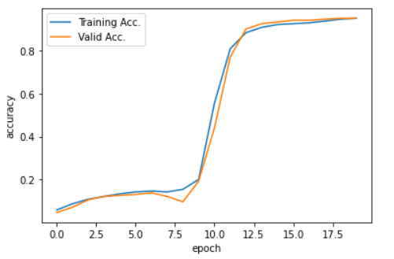
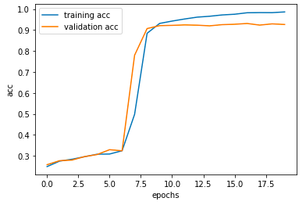
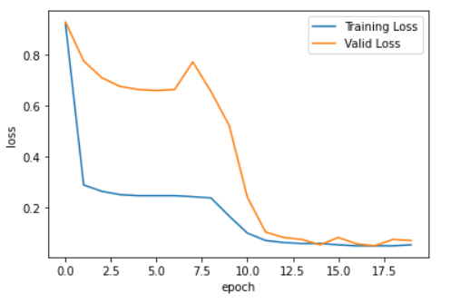
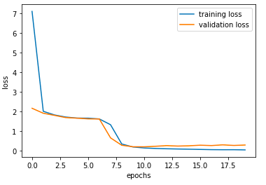
Effects of Attention
Without
Attention
With
Attention
Notes:
Moreover, Models with self attention generally yields better results as compare to those without self attention. As by incorporating attention mechanism, it is easier for the model to learn long term dependencies of sequential data. Attention helps to minimize the maximum path length between any two input and output positions in the neural network with different types of layers. The shorter the path between any combination of positions in the input and output sequences, the easier it is to learn long-term dependencies. As shown by the graphs, after implementing attention, the validating accuracy and loss graphs all become smoother.

Slide 23
Attempt to Detect Emotion
Local Emotion
Input: ‘A wonderful day’
Output:
[0.004831992089748383, 0.002158567076548934, 0.8076752424240112, 0.15726424753665924, 0.010409458540380001, 0.017660509794950485]
→ joy
Global Emotion
Input: 'i am not like everyone around me who are leading great lives and doing well at work.'
output:
[0.000549889518879354, 0.0001760266604833305, 0.8754567503929138, 0.01664547063410282,
0.107157863676548, 1.3987215425004251e-05]
→ joy
Input: 'i went to work in the morning and worked overtime and cried when i got home'
output:
[0.005073187872767448, 0.00014828183338977396, 0.12221956998109818, 0.0001271497312700376, 0.8724318146705627, 1.2256062831283998e-08]
→ sadness
Notes:
Below are three test cases. The input can be either a sentence or a phrase and the output obtained will include an array of six floats, representing the probability of the sentence or the phrase being classfieid to each label, and also the final predicted label. The first test case and the third test case gave seemingly correct input, where the first input is… and the predicted label is… and the third input is ,... and the output is … However the result for second test case seems unreliable as the input is … but the output is...
This is probably because of Long term negation dependency. We could improve the model by solving this issue in the future.

Slide 24
Thank You!
Notes:
This is the end of our video presentation. Thank you for your time!

