Slide 1

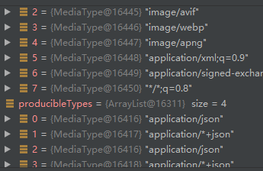
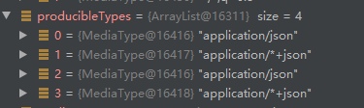
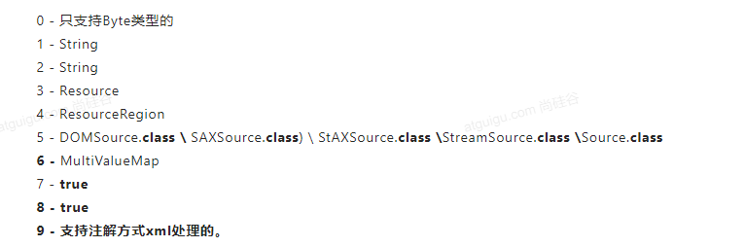
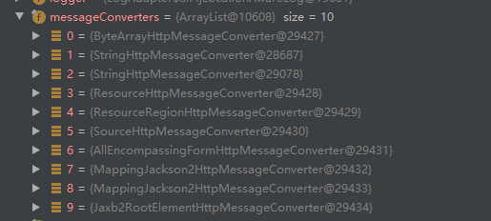
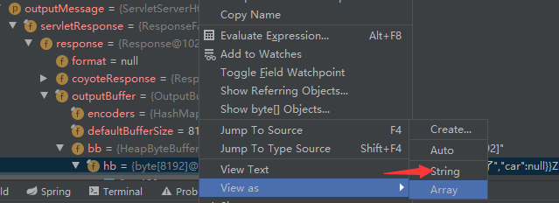
protected <T> void writeWithMessageConverters(@Nullable T value, MethodParameter returnType, ServletServerHttpRequest inputMessage, ServletServerHttpResponse outputMessage) throws IOException, HttpMediaTypeNotAcceptableException, HttpMessageNotWritableException { Object body; Class<?> valueType; Type targetType; //如果是字符串类型 if (value instanceof CharSequence) { body = value.toString(); valueType = String.class; targetType = String.class; } else {
//如果是对象类型,就像自定义对象 body = value;
//得到对象返回值类型 valueType = getReturnValueType(body, returnType); targetType = GenericTypeResolver.resolveType(getGenericType(returnType), returnType.getContainingClass()); } //如果是资源类型 if (isResourceType(value, returnType)) { outputMessage.getHeaders().set(HttpHeaders.ACCEPT_RANGES, "bytes"); if (value != null && inputMessage.getHeaders().getFirst(HttpHeaders.RANGE) != null && outputMessage.getServletResponse().getStatus() == 200) { Resource resource = (Resource) value; try { List<HttpRange> httpRanges = inputMessage.getHeaders().getRange(); outputMessage.getServletResponse().setStatus(HttpStatus.PARTIAL_CONTENT.value()); body = HttpRange.toResourceRegions(httpRanges, resource); valueType = body.getClass(); targetType = RESOURCE_REGION_LIST_TYPE; } catch (IllegalArgumentException ex) { outputMessage.getHeaders().set(HttpHeaders.CONTENT_RANGE, "bytes */" + resource.contentLength()); outputMessage.getServletResponse().setStatus(HttpStatus.REQUESTED_RANGE_NOT_SATISFIABLE.value()); } } } MediaType selectedMediaType = null;
//可能已经从前置处理器处理了一些headers,放到outputMessage,因此先从这个里面去拿 MediaType contentType = outputMessage.getHeaders().getContentType(); boolean isContentTypePreset = contentType != null && contentType.isConcrete(); if (isContentTypePreset) { if (logger.isDebugEnabled()) { logger.debug("Found 'Content-Type:" + contentType + "' in response"); } selectedMediaType = contentType; } else { HttpServletRequest request = inputMessage.getServletRequest();
//得到可以接受的mediaTypes类型 List<MediaType> acceptableTypes = getAcceptableMediaTypes(request);
//得到 List<MediaType> producibleTypes = getProducibleMediaTypes(request, valueType, targetType); if (body != null && producibleTypes.isEmpty()) { throw new HttpMessageNotWritableException( "No converter found for return value of type: " + valueType); }
List<MediaType> mediaTypesToUse = new ArrayList<>(); for (MediaType requestedType : acceptableTypes) { for (MediaType producibleType : producibleTypes) { if (requestedType.isCompatibleWith(producibleType)) { mediaTypesToUse.add(getMostSpecificMediaType(requestedType, producibleType)); } } } if (mediaTypesToUse.isEmpty()) { if (body != null) { throw new HttpMediaTypeNotAcceptableException(producibleTypes); } if (logger.isDebugEnabled()) { logger.debug("No match for " + acceptableTypes + ", supported: " + producibleTypes); } return; } MediaType.sortBySpecificityAndQuality(mediaTypesToUse); for (MediaType mediaType : mediaTypesToUse) {
//第一个满足的取出来 if (mediaType.isConcrete()) { selectedMediaType = mediaType; break; } else if (mediaType.isPresentIn(ALL_APPLICATION_MEDIA_TYPES)) { selectedMediaType = MediaType.APPLICATION_OCTET_STREAM; break; } } if (logger.isDebugEnabled()) { logger.debug("Using '" + selectedMediaType + "', given " + acceptableTypes + " and supported " + producibleTypes); } } if (selectedMediaType != null) { selectedMediaType = selectedMediaType.removeQualityValue(); for (HttpMessageConverter<?> converter : this.messageConverters) {
GenericHttpMessageConverter genericConverter = (converter instanceof GenericHttpMessageConverter ? (GenericHttpMessageConverter<?>) converter : null); if (genericConverter != null ?
//判断是否支持返回值类型,返回值类型可能不相同,如String,Map,List ((GenericHttpMessageConverter) converter).canWrite(targetType, valueType, selectedMediaType) : converter.canWrite(valueType, selectedMediaType)) { body = getAdvice().beforeBodyWrite(body, returnType, selectedMediaType, (Class<? extends HttpMessageConverter<?>>) converter.getClass(), inputMessage, outputMessage); if (body != null) { Object theBody = body; LogFormatUtils.traceDebug(logger, traceOn -> "Writing [" + LogFormatUtils.formatValue(theBody, !traceOn) + "]");
//加入一些部署的请求头 addContentDispositionHeader(inputMessage, outputMessage); if (genericConverter != null) {
//进行写入outputMessage genericConverter.write(body, targetType, selectedMediaType, outputMessage); } else {
//执行返回值转换 ((HttpMessageConverter) converter).write(body, selectedMediaType, outputMessage); } } else { if (logger.isDebugEnabled()) { logger.debug("Nothing to write: null body"); } } return; } } } if (body != null) { Set<MediaType> producibleMediaTypes = (Set<MediaType>) inputMessage.getServletRequest() .getAttribute(HandlerMapping.PRODUCIBLE_MEDIA_TYPES_ATTRIBUTE); if (isContentTypePreset || !CollectionUtils.isEmpty(producibleMediaTypes)) { throw new HttpMessageNotWritableException( "No converter for [" + valueType + "] with preset Content-Type '" + contentType + "'"); } throw new HttpMediaTypeNotAcceptableException(this.allSupportedMediaTypes); } }
public void invokeAndHandle(ServletWebRequest webRequest, ModelAndViewContainer mavContainer, Object... providedArgs) throws Exception { //获取返回值对象 Object returnValue = invokeForRequest(webRequest, mavContainer, providedArgs); setResponseStatus(webRequest); if (returnValue == null) { if (isRequestNotModified(webRequest) || getResponseStatus() != null || mavContainer.isRequestHandled()) { disableContentCachingIfNecessary(webRequest); mavContainer.setRequestHandled(true); return; } } else if (StringUtils.hasText(getResponseStatusReason())) { mavContainer.setRequestHandled(true); return; } //初始化isRequestHandled属性,如果这个属性的值为true那么就不经过视图解析器了 mavContainer.setRequestHandled(false); Assert.state(this.returnValueHandlers != null, "No return value handlers"); try {
//进行处理返回值 this.returnValueHandlers.handleReturnValue( returnValue, getReturnValueType(returnValue), mavContainer, webRequest); }
当返回值是一个对象的时候
@Nullable private ModelAndView getModelAndView(ModelAndViewContainer mavContainer, if (mavContainer.isRequestHandled()) { return null; }
responseBody方式的返回值处理器是
public void handleReturnValue(@Nullable Object returnValue, MethodParameter returnType, ModelAndViewContainer mavContainer, NativeWebRequest webRequest) throws Exception { //获取合适的handler处理器 HandlerMethodReturnValueHandler handler = selectHandler(returnValue, returnType); if (handler == null) { throw new IllegalArgumentException("Unknown return value type: " + returnType.getParameterType().getName()); } handler.handleReturnValue(returnValue, returnType, mavContainer, webRequest); }
这个处理器来处理这个返回值
@Override public void handleReturnValue(@Nullable Object returnValue, MethodParameter returnType, ModelAndViewContainer mavContainer, NativeWebRequest webRequest) throws IOException, HttpMediaTypeNotAcceptableException, HttpMessageNotWritableException { //设置不经过视图解析器getModelAndView,直接执行处理 mavContainer.setRequestHandled(true);
//获取原生的request对象 ServletServerHttpRequest inputMessage = createInputMessage(webRequest);
//获取原生的request对象 ServletServerHttpResponse outputMessage = createOutputMessage(webRequest); //接下来就是通过职责链模式选择HttpMessageConverter的实现类来进行数据转换操作
// Try even with null return value. ResponseBodyAdvice could get involved. writeWithMessageConverters(returnValue, returnType, inputMessage, outputMessage); } }
通过这些进行判断,哪个符合处理规则
@Override public boolean canWrite(Class<?> clazz, @Nullable MediaType mediaType) { return supports(clazz) && canWrite(mediaType); }
最终执行这个请求
@Override public boolean supports(Class<?> clazz) { return String.class == clazz; }

