Slide 1

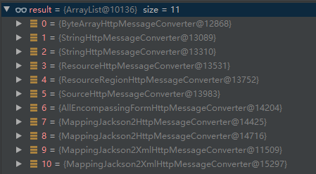
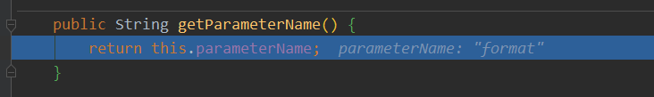
当在配置文件中开启这个注解
if (this.favorParameter) { ParameterContentNegotiationStrategy strategy = new ParameterContentNegotiationStrategy(this.mediaTypes); strategy.setParameterName(this.parameterName); if (this.useRegisteredExtensionsOnly != null) { strategy.setUseRegisteredExtensionsOnly(this.useRegisteredExtensionsOnly); } else { strategy.setUseRegisteredExtensionsOnly(true); // backwards compatibility } strategies.add(strategy);
spring: mvc: contentnegotiation: favor-parameter: true
http://localhost:8080/h7?format=xml
开启这个属性,就进行初始化操作
writeWithMessageConverters(returnValue, returnType, inputMessage, outputMessage);
List<MediaType> producibleTypes = getProducibleMediaTypes(request, valueType, targetType);
List<MediaType> acceptableTypes = getAcceptableMediaTypes(request);
protected List<MediaType> getProducibleMediaTypes( HttpServletRequest request, Class<?> valueClass, @Nullable Type targetType) { Set<MediaType> mediaTypes = (Set<MediaType>) request.getAttribute(HandlerMapping.PRODUCIBLE_MEDIA_TYPES_ATTRIBUTE); if (!CollectionUtils.isEmpty(mediaTypes)) { return new ArrayList<>(mediaTypes); } else if (!this.allSupportedMediaTypes.isEmpty()) { List<MediaType> result = new ArrayList<>(); for (HttpMessageConverter<?> converter : this.messageConverters) { if (converter instanceof GenericHttpMessageConverter && targetType != null) { if (((GenericHttpMessageConverter<?>) converter).canWrite(targetType, valueClass, null)) { result.addAll(converter.getSupportedMediaTypes()); } } else if (converter.canWrite(valueClass, null)) { result.addAll(converter.getSupportedMediaTypes()); } } return result; } else { return Collections.singletonList(MediaType.ALL); } }
return this.contentNegotiationManager.resolveMediaTypes(new ServletWebRequest(request));
多了一个参数内容协商策略
@Override public List<MediaType> resolveMediaTypes(NativeWebRequest request) throws HttpMediaTypeNotAcceptableException { for (ContentNegotiationStrategy strategy : this.strategies) { List<MediaType> mediaTypes = strategy.resolveMediaTypes(request); if (mediaTypes.equals(MEDIA_TYPE_ALL_LIST)) { continue; } return mediaTypes; } return MEDIA_TYPE_ALL_LIST; }
@Override public List<MediaType> resolveMediaTypes(NativeWebRequest webRequest) throws HttpMediaTypeNotAcceptableException { return resolveMediaTypeKey(webRequest, getMediaTypeKey(webRequest)); }
@Override @Nullable protected String getMediaTypeKey(NativeWebRequest request) { return request.getParameter(getParameterName()); }
public List<MediaType> resolveMediaTypeKey(NativeWebRequest webRequest, @Nullable String key) throws HttpMediaTypeNotAcceptableException { //通过判断是否key位空 if (StringUtils.hasText(key)) {
//从medisTypesmap集合中寻找当前key的value值,初始化的时候放入json和xml两个map MediaType mediaType = lookupMediaType(key); if (mediaType != null) { handleMatch(key, mediaType); return Collections.singletonList(mediaType); } mediaType = handleNoMatch(webRequest, key); if (mediaType != null) { addMapping(key, mediaType); return Collections.singletonList(mediaType); } }
//如果没有就返回/*/ return MEDIA_TYPE_ALL_LIST; }

