Slide 1
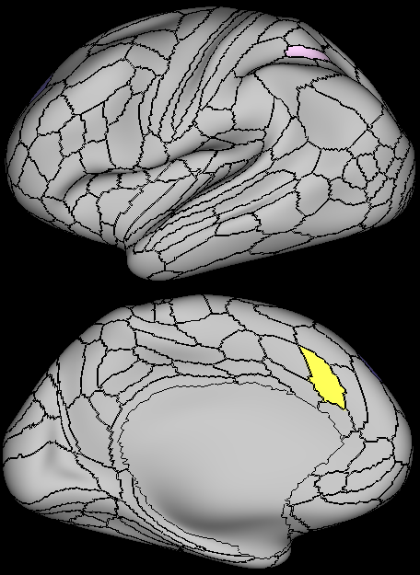
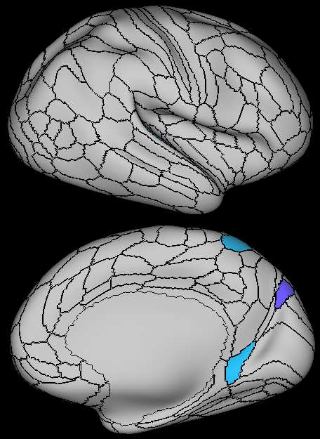
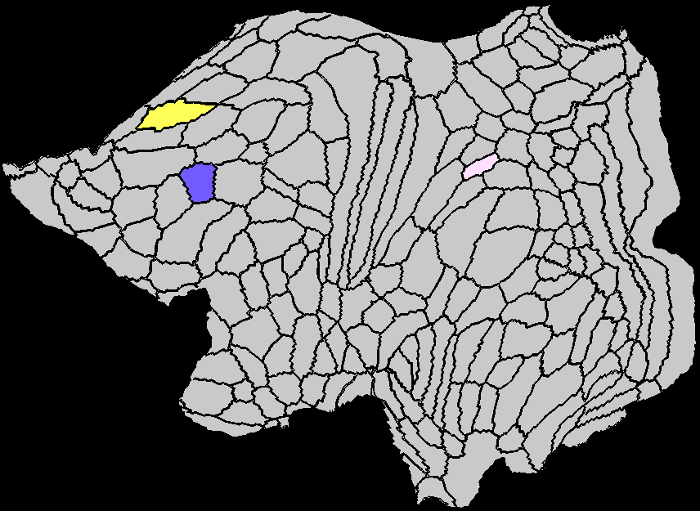
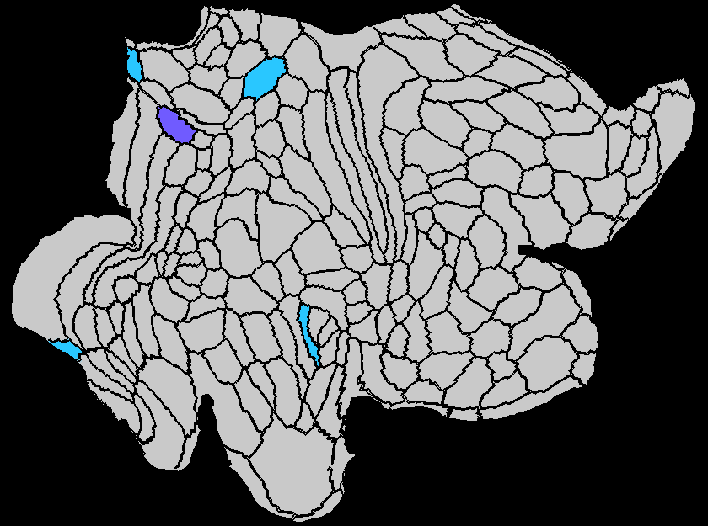
A
C
E
Strength
Clustering Coefficient
Local Efficiency
Betweenness Centrality
Eigenvector Centrality
B
D
F
Subgraph Centrality
K-coreness Centrality
Flow Coefficient
Page Rank Centrality
EMCI vs. HC

Slide 2
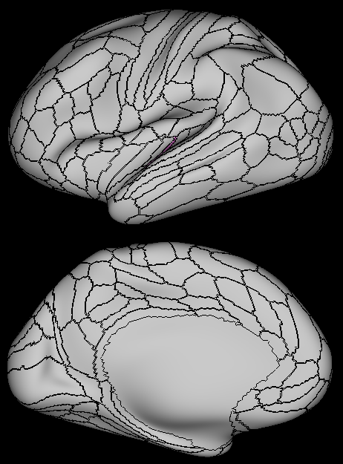
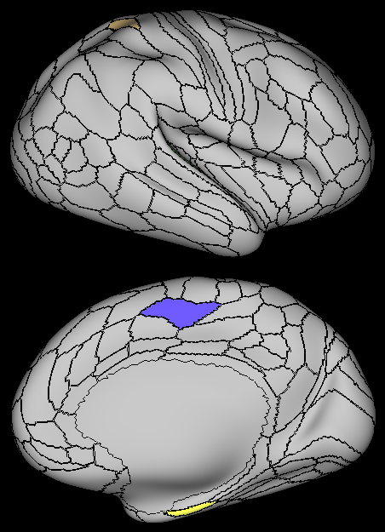
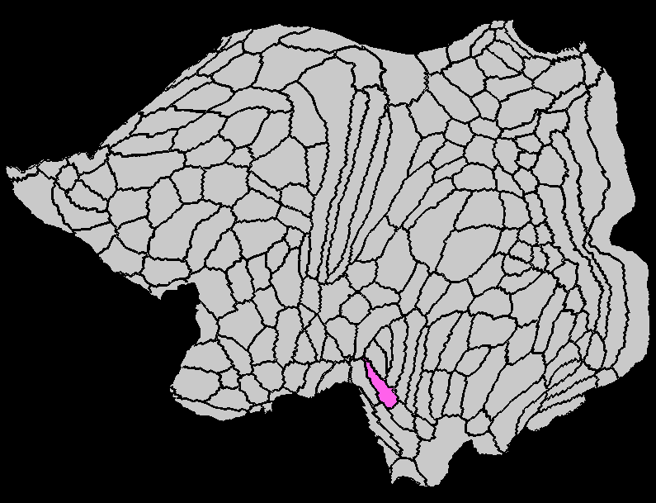
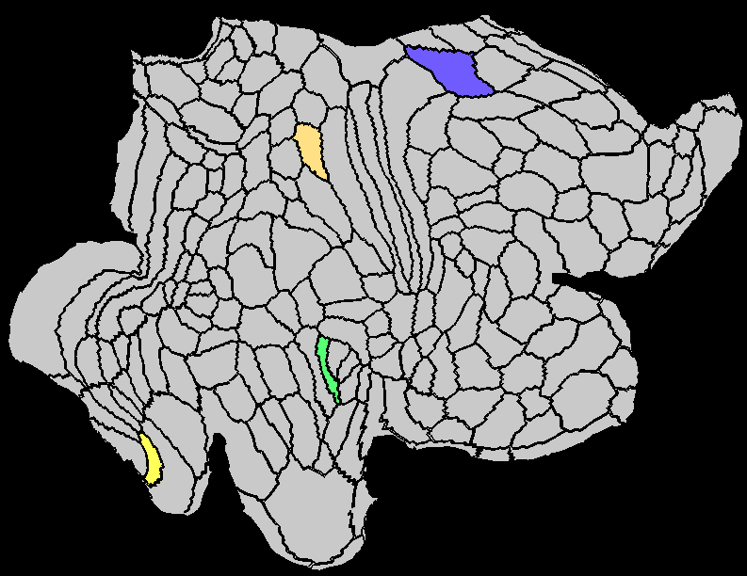
A
C
E
Strength
Clustering Coefficient
Local Efficiency
Betweenness Centrality
Eigenvector Centrality
B
D
F
Subgraph Centrality
K-coreness Centrality
Flow Coefficient
Page Rank Centrality
EMCI vs. LMCI

Slide 3
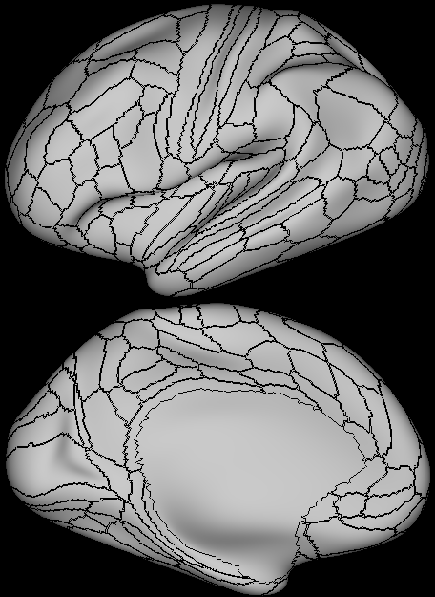
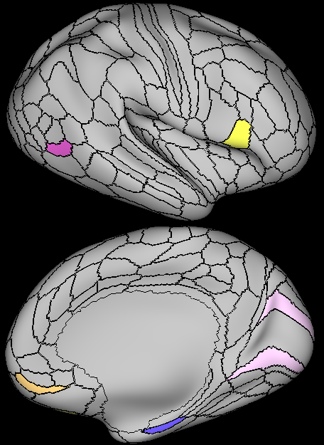
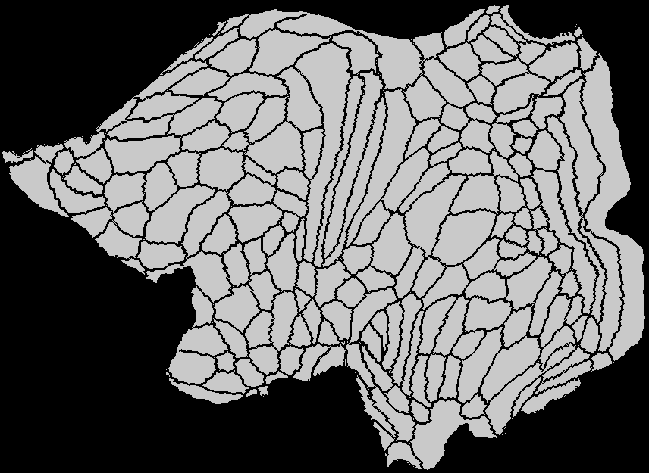
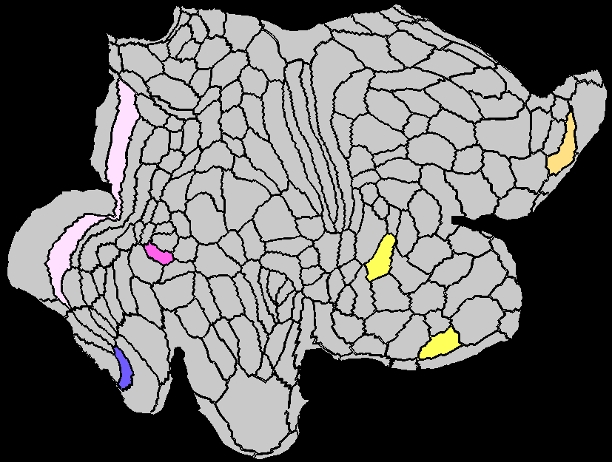
A
C
E
Strength
Clustering Coefficient
Local Efficiency
Betweenness Centrality
Eigenvector Centrality
B
D
F
Subgraph Centrality
K-coreness Centrality
Flow Coefficient
Page Rank Centrality
MCI vs. HC

Slide 4
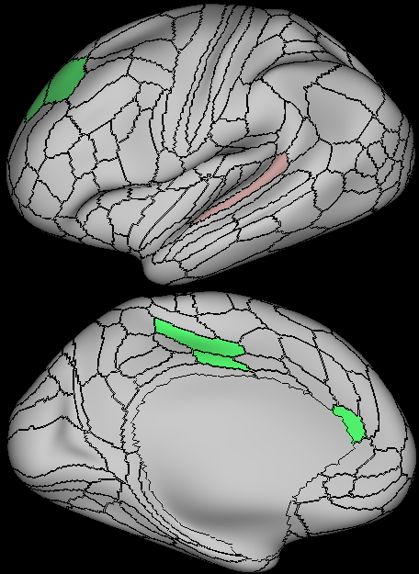
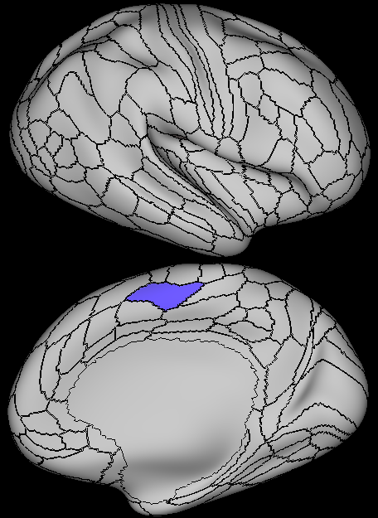
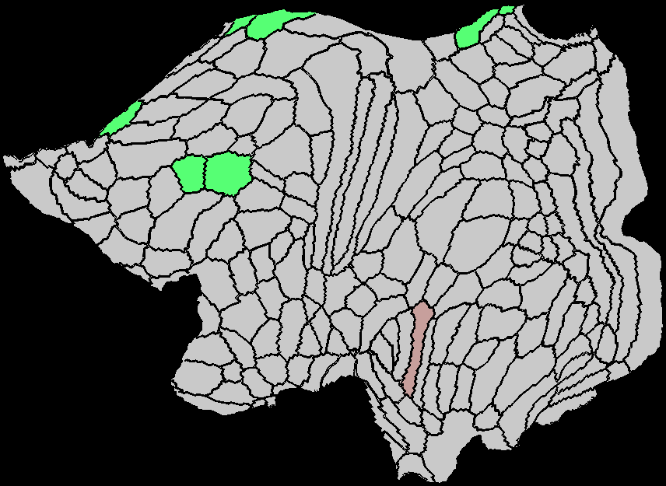
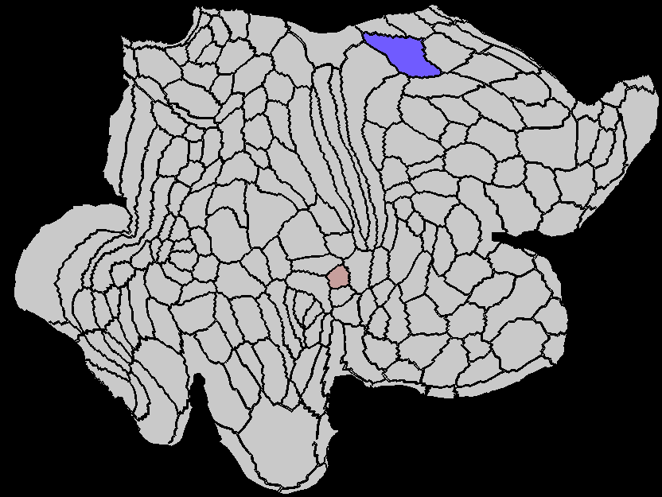
A
C
E
Strength
Clustering Coefficient
Local Efficiency
Betweenness Centrality
Eigenvector Centrality
B
D
F
Subgraph Centrality
K-coreness Centrality
Flow Coefficient
Page Rank Centrality
LMCI vs. HC

Slide 5
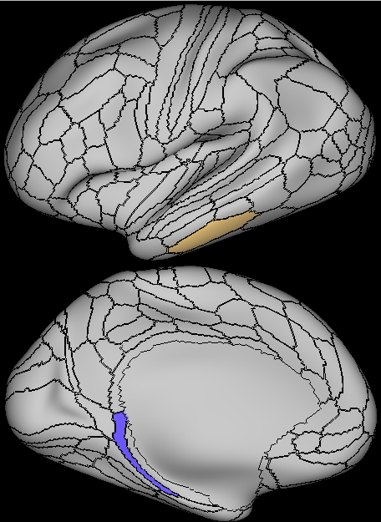
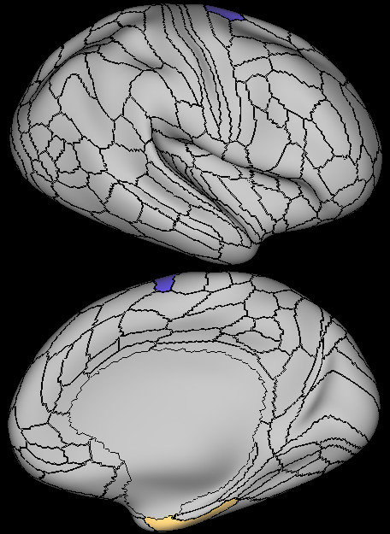
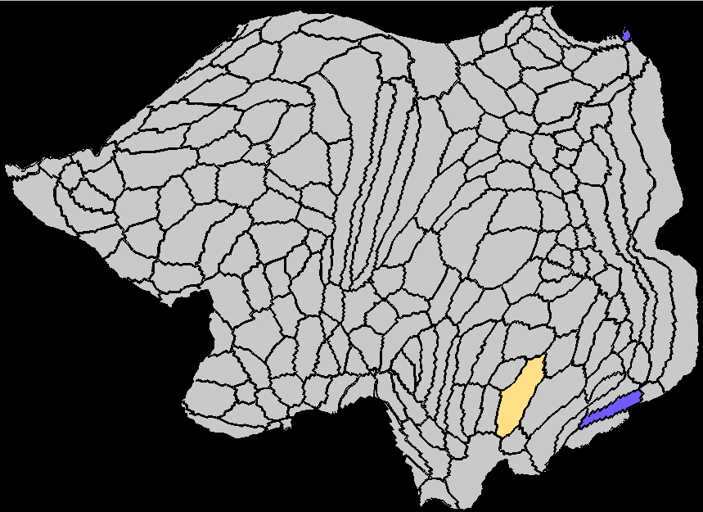
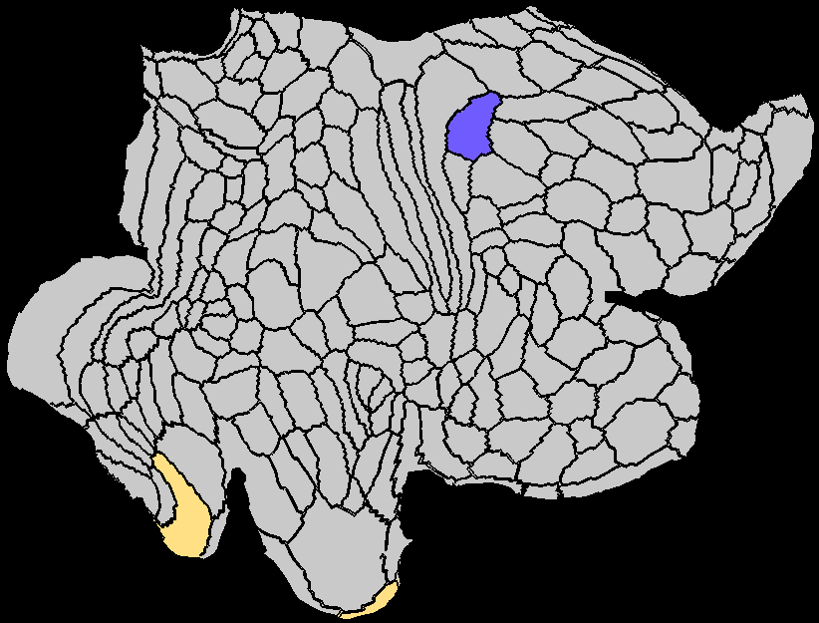
A
C
E
Strength
Clustering Coefficient
Local Efficiency
Betweenness Centrality
Eigenvector Centrality
B
D
F
Subgraph Centrality
K-coreness Centrality
Flow Coefficient
Page Rank Centrality
AD vs. HC

Slide 6
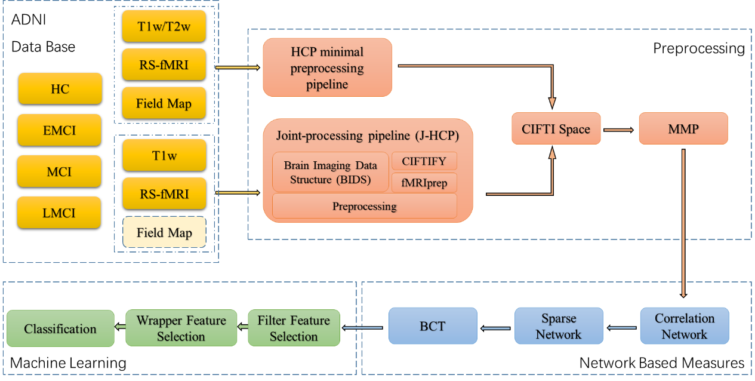
HC
EMCI
LMCI
AD

Slide 7
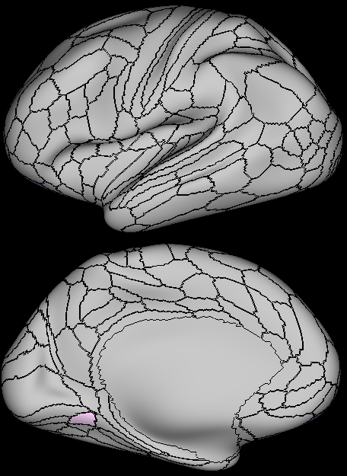
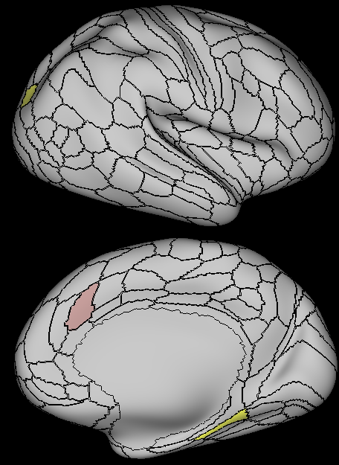
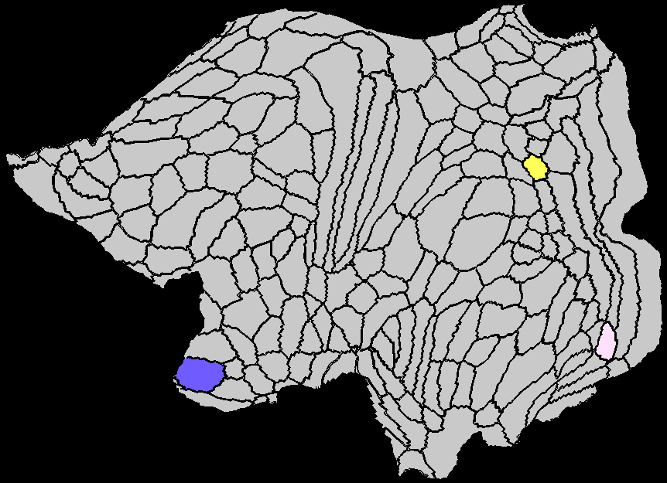
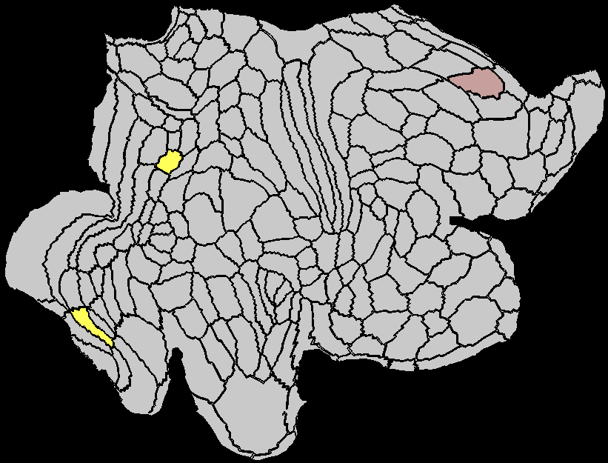
A
C
E
Strength
Clustering Coefficient
Local Efficiency
Betweenness Centrality
Eigenvector Centrality
B
D
F
Subgraph Centrality
K-coreness Centrality
Flow Coefficient
Page Rank Centrality
EMCI vs. MCI

Slide 8
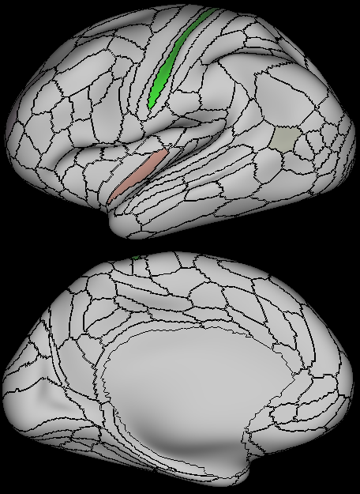
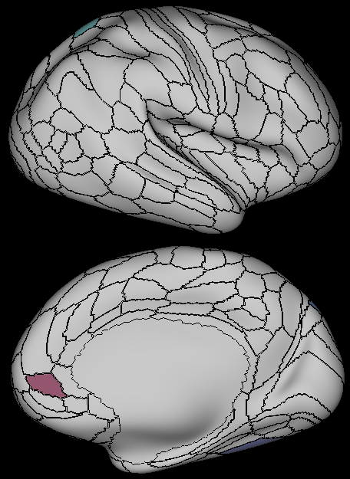
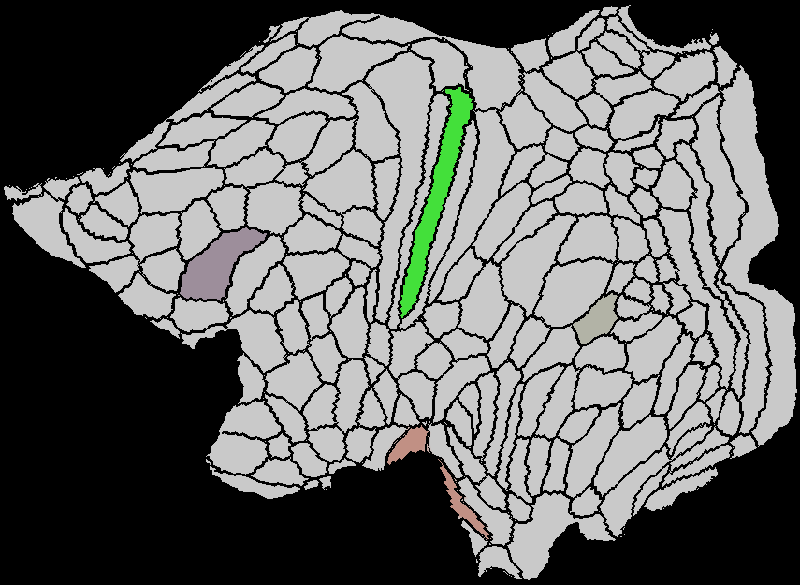
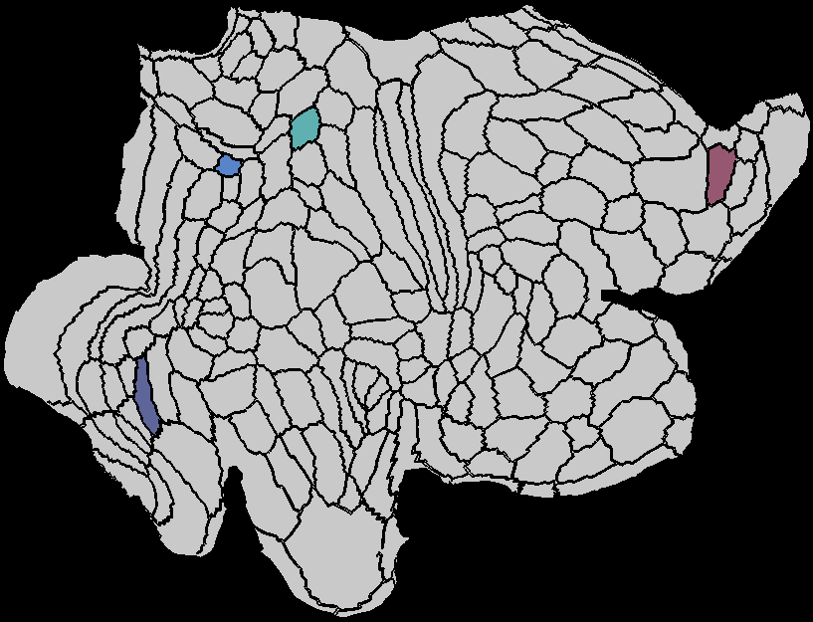
A
C
E
Strength
Clustering Coefficient
Local Efficiency
Betweenness Centrality
Eigenvector Centrality
B
D
F
Subgraph Centrality
K-coreness Centrality
Flow Coefficient
Page Rank Centrality
MCI vs. LMCI

Slide 9
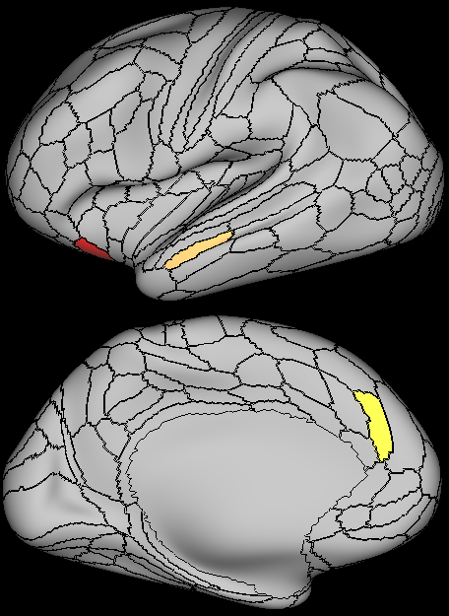
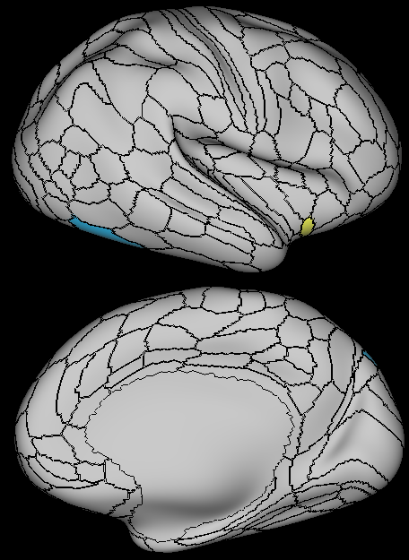
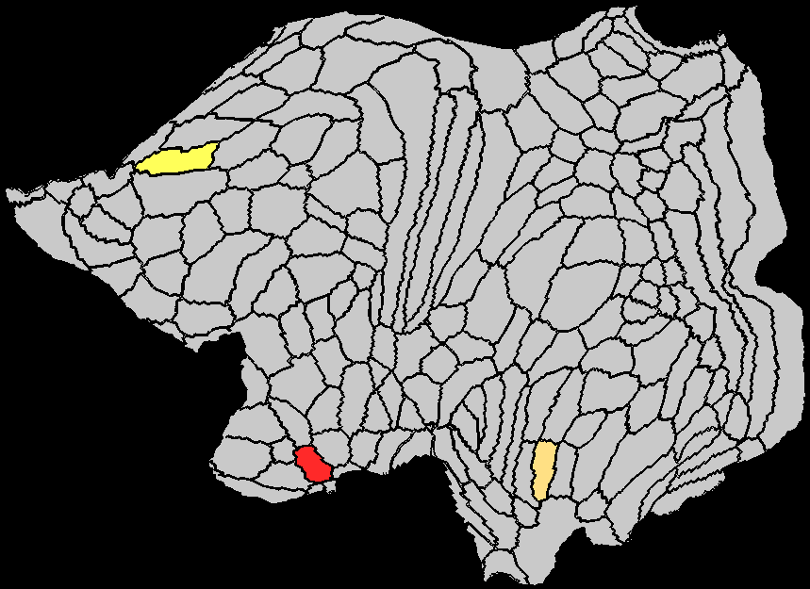
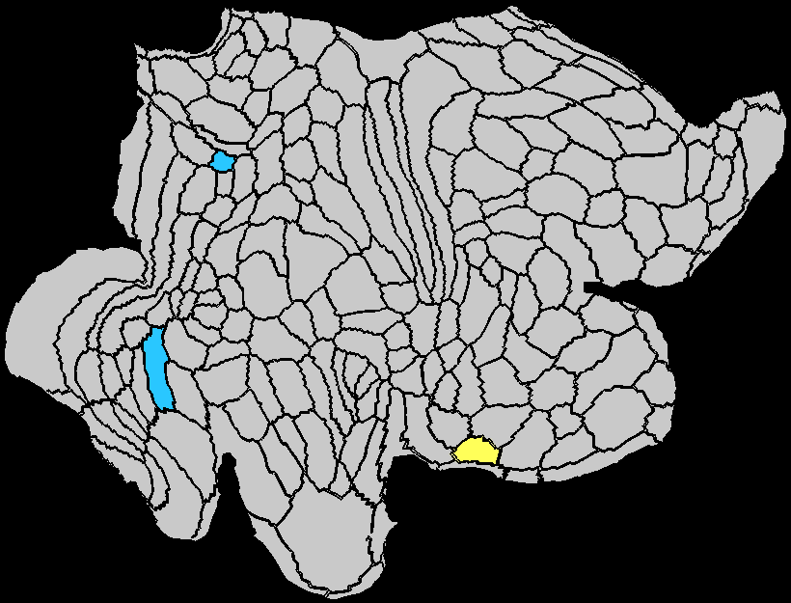
A
C
E
Strength
Clustering Coefficient
Local Efficiency
Betweenness Centrality
Eigenvector Centrality
B
D
F
Subgraph Centrality
K-coreness Centrality
Flow Coefficient
Page Rank Centrality
LMCI vs. AD

Slide 10
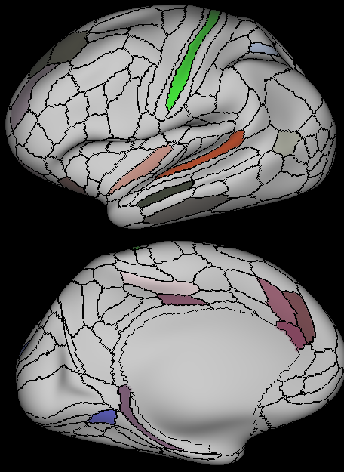
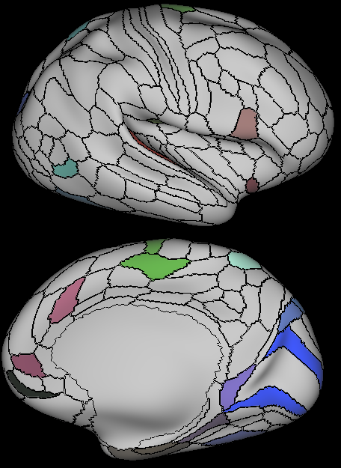
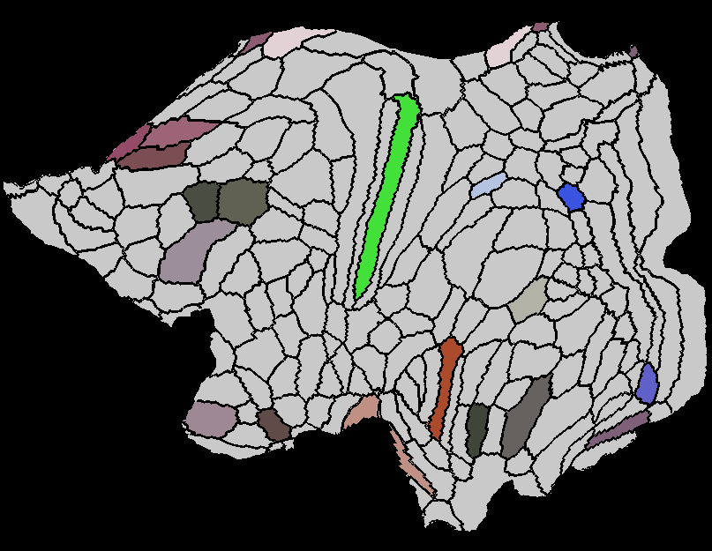
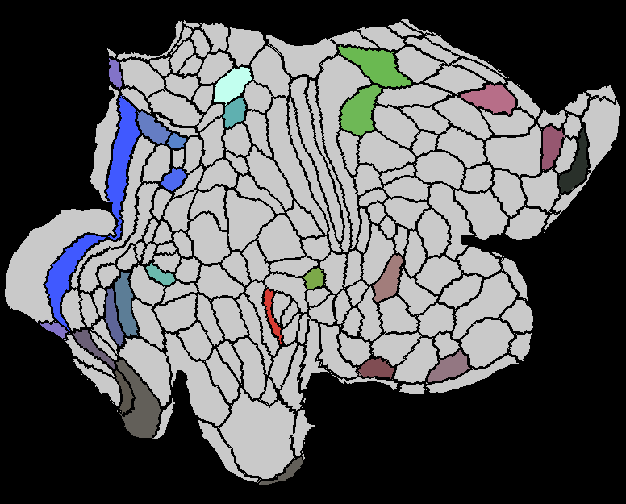
Features used in paper

Slide 11
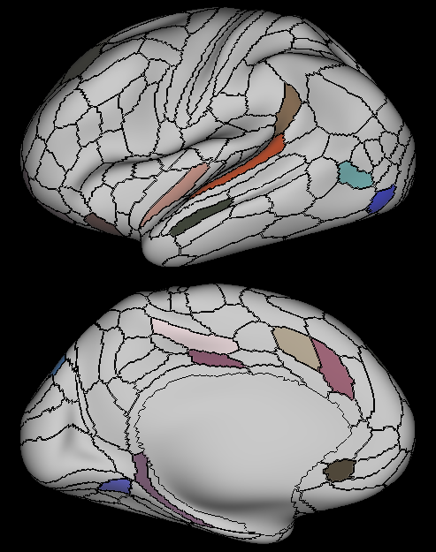
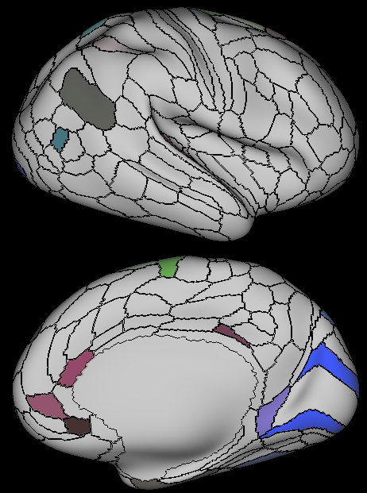
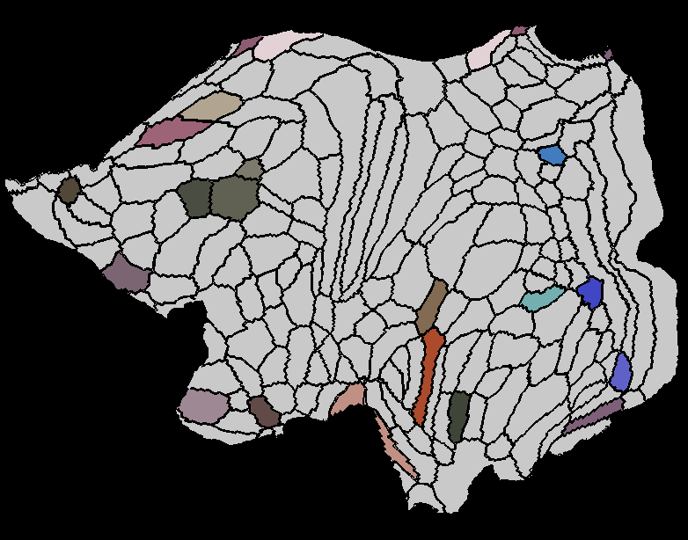
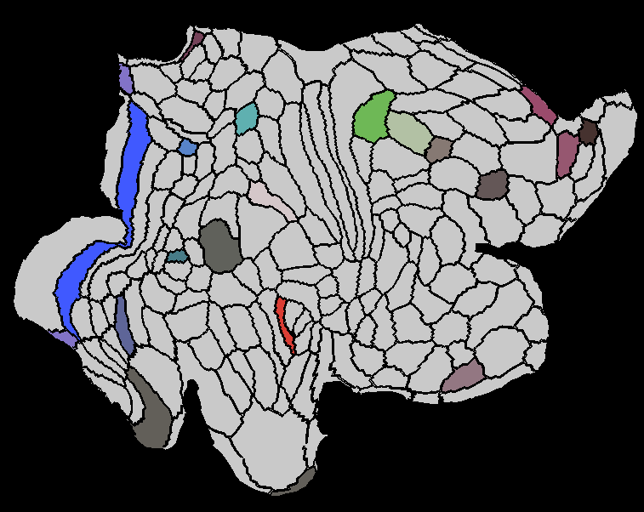
Significant Areas

Slide 12
