Slide 1
PDSN

Slide 2
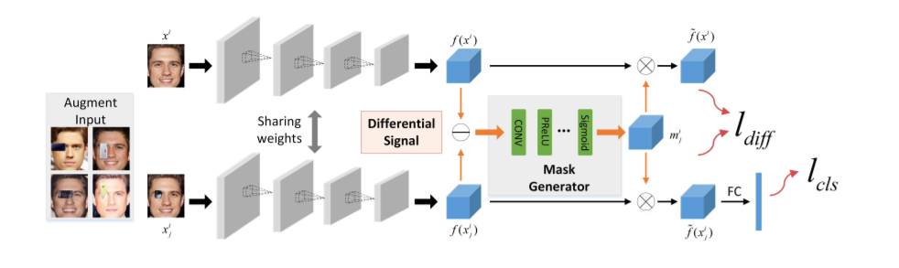
System structure

Slide 3
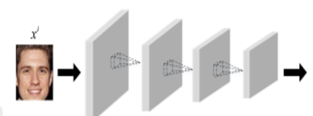
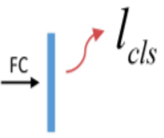

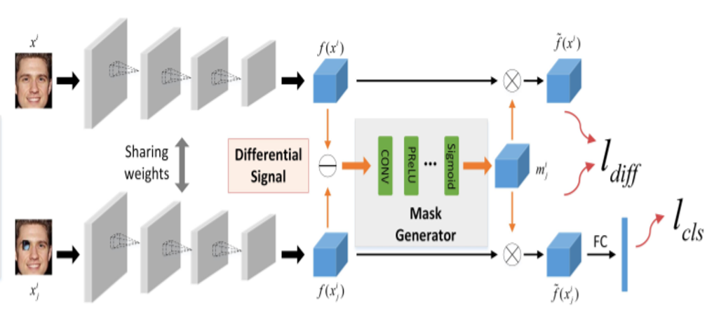
Train_stage
Lr=5e-6
Epoch=50
Batch_size=60
Accuracy =
Pretrain1:
Fine_tune:
Lr=5e-6
Epoch=85
Batch_size=60
Accuracy=95
train
train
LOSS_cls 修正 Siamese network
Pretrain2:
fixed
train
LOSS_diff and LOSS_cls 修正 mask generator 跟 Siamese network
這邊fine_tune的對象為cls (他沒看過遮蔽影像)
Lr=5e-6
Epoch=50
Batch_size=60
fixed
LOSS_diff 修正 mask generator

Slide 4
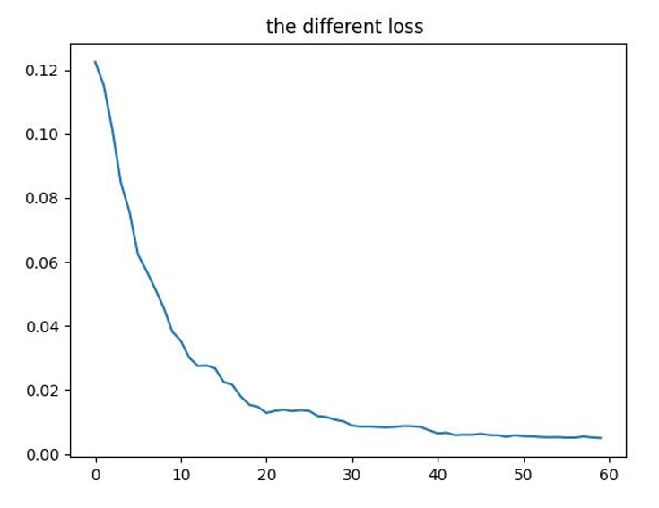
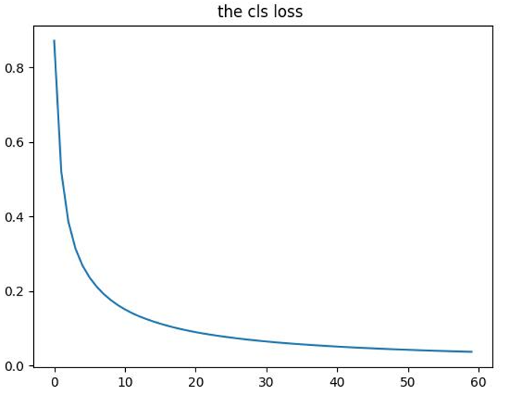
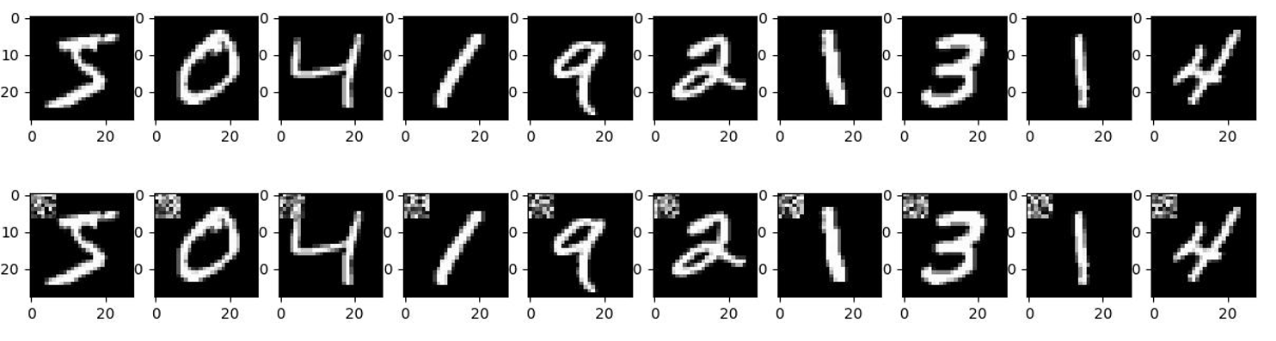
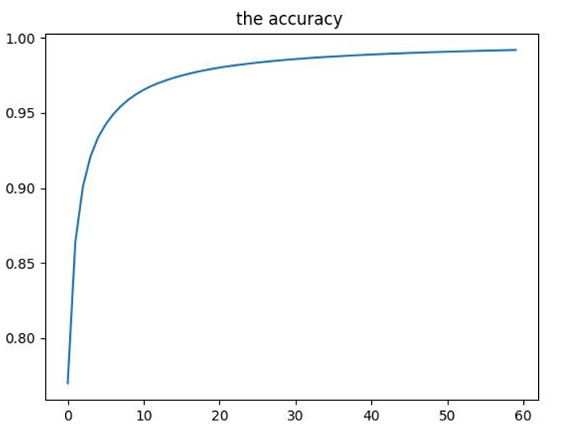
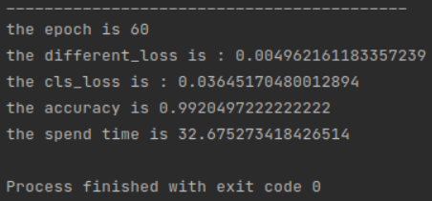

Result(occlusion image Mnist):
Train_data
Test_accuracy

Slide 5
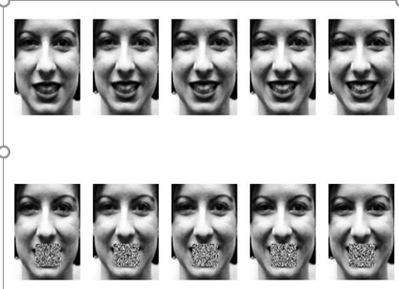
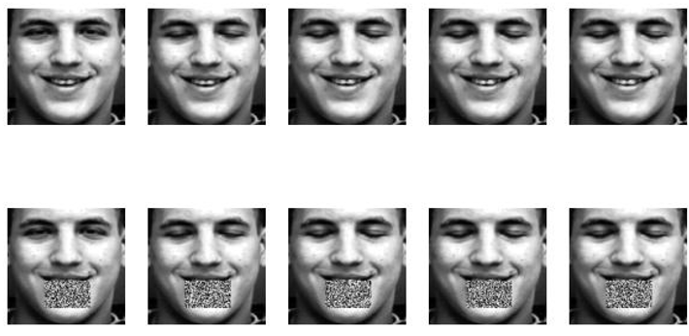
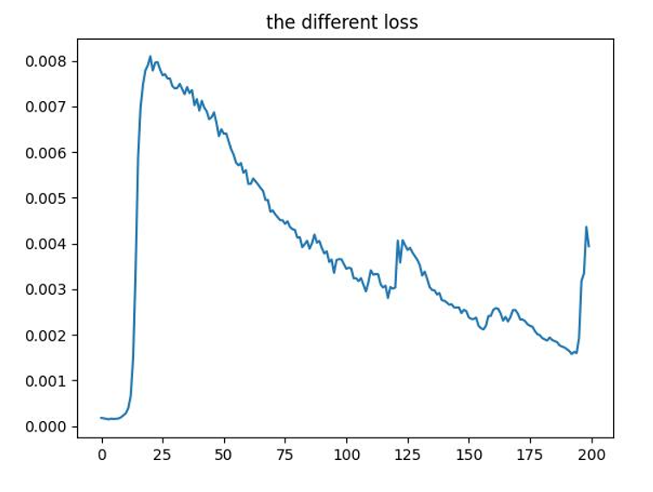
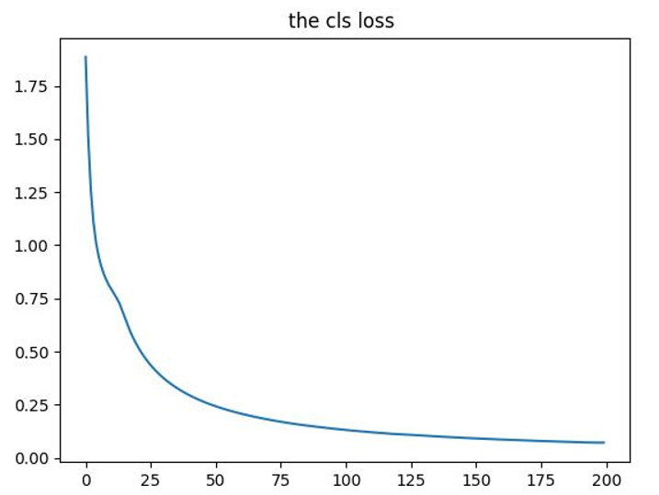
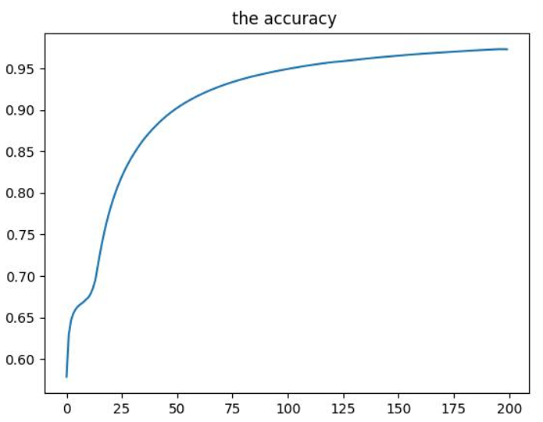
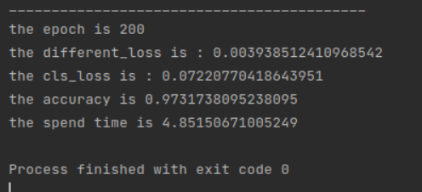

Result(occlusion image smile or unsmile face)
Train_data: Test_data:
Test_accuracy

Slide 6
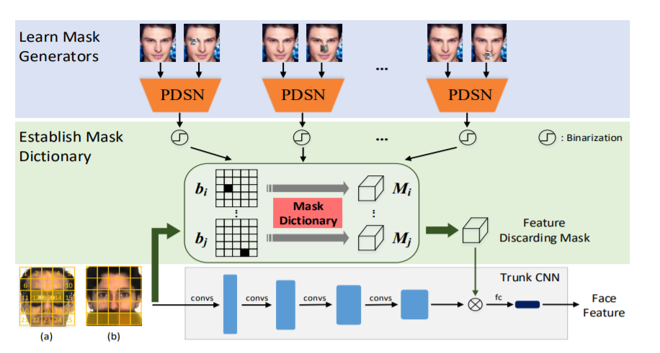
Next stpe:

Slide 7
Question:
Why the accuracy is optimizer the slowly

