Slide 1
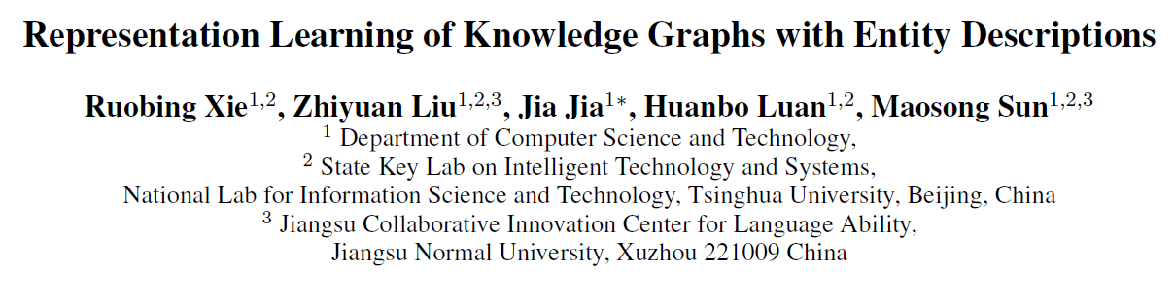

Slide 2
Knowledge graph
A typical KG usually describes knowledge as multi-relational data and represent as triple facts (head entity, relation, tail entity), also denoted as (h; r; t), indicating the relation between two entities.

Slide 3
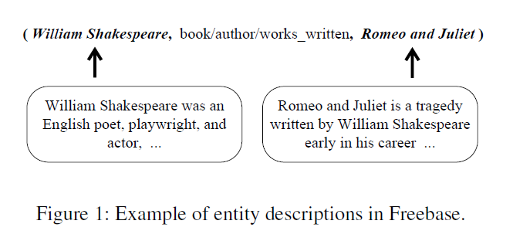

Slide 4
Problems
It is non-trivial for existing RL methods of KGs to utilize entity descriptions.
To address this problem, we propose a novel RL method for KGs, which is able to take advantages of both fact triples and entity description. We name the method as Description-Embodied Knowledge Representation Learning (DKRL).

Slide 5

For fact triples → TransE
  Learn to maximize the likelihood of these translations
    h + r = t
Given an entity → predict its description
  Two encoders to represent semantics of entity description
    CBOW → ignoring word orders in text
    CNN → takes word orders

Slide 6
Related Work
TransH attempts to solve the problem of TransE by modeling relations as hyperplanes and projecting h and t to the relational-specific hyperplane, allowing entities playing different roles in different relationships.
TransR (Lin et al. 2015b) models entities and relations in distinct semantic space and projects entities
from entity space to relation space when learning embeddings.

Slide 7
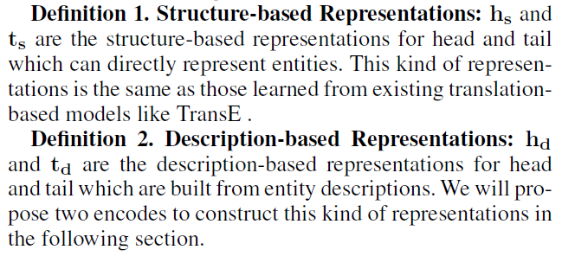
Definition

Slide 8
Method
The energy function of DKRL is then defined as
E = E_{S} + E_{D} (2)
where E_{S} is the energy function of structure-based representations, which shares the same formulation as TransE’s in Equation 1, while E_{D} is the energy function of description based representations.

Slide 9
E_{D} can be defined by a variety of measurements. To make the learning process of E_{D} to be compatible with E_{S} ,we define E_{D} as follow:
E_{D} = E_{DD} + E_{DS} + E_{SD} (3)
where E_{DD} = ||h_{d} + r –td|| in which head and tail are description-based representations.
Also we have E_{DS} =||h_{d} + r –t_{s}|| and E_{SD} =||h_{s} + r -t_{d}||, in which one of h or t uses description-based representation and the other uses structure-based representation.

Slide 10
Continuous Bag-of-words Encoder
From each short description, we can generate a set of keywords which are usually capable of capturing the main ideas of entities. We assume that similar entities should have similar descriptions, and correspondingly have similar keywords.
Those relations cannot be directly detected through structural information may be found in the internal contact of their keywords.

Slide 11

In the continuous bag-of-words encoder (CBOW), we select top n keywords in the description for each entity as the input

Slide 12
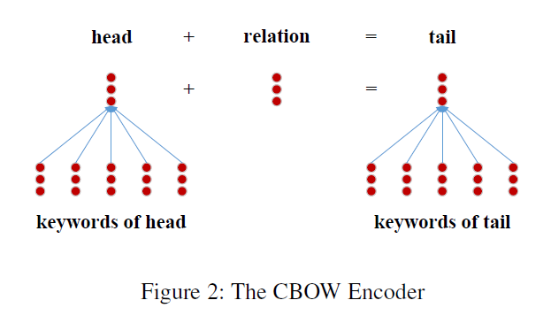

Slide 13
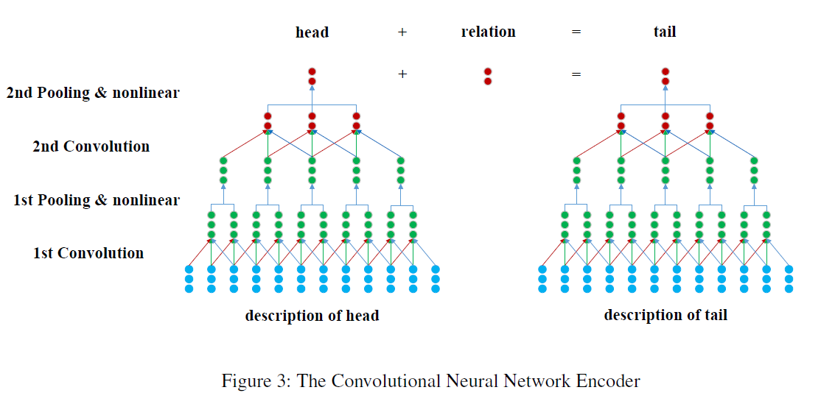
CNN encoder

Slide 14
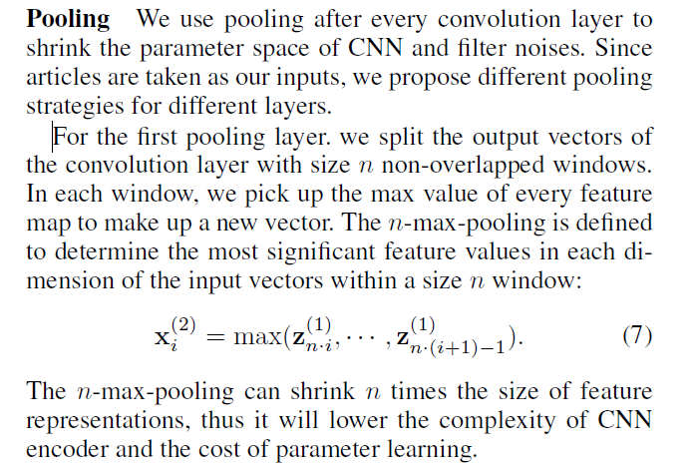

Slide 15
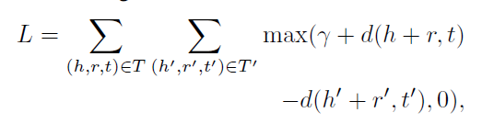
Training
The DKRL model can be stated as a parameter set =
(X, W⁽¹⁾ ,W⁽²⁾ ,E,R) where X, E, R stand for the embeddings of words, entities and relations, and W⁽¹⁾, W⁽²⁾ stand for the convolutional kernels in different layers. We minimize the following margin-based score function as objective for training:

Slide 16
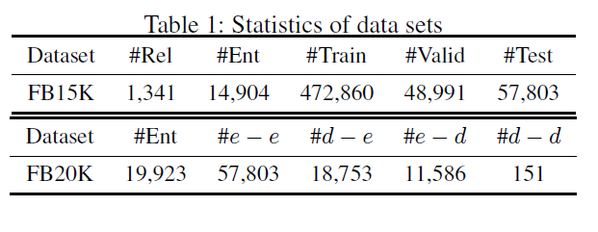
dataset
both the head and the tail are in training set (e — e), the head is a new entity but the tail is not (d — e), the tail is a new entity but the head is not (e — d), both the head and the tail are new entities (d — d).

Slide 17
Parameter setting
The optimal configurations of CNN are :
Learning rate, margin, window size, word embedding
Feature map, 4-max-pooling
CBOW : top 20 keywords

Slide 18
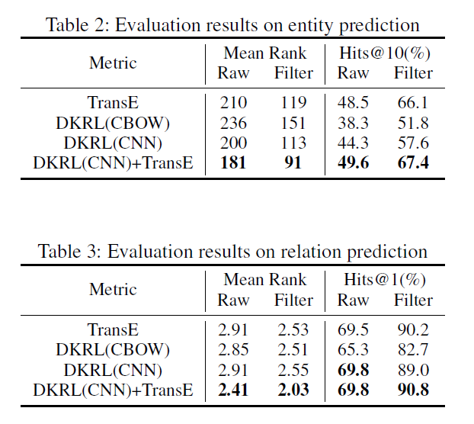

Slide 19
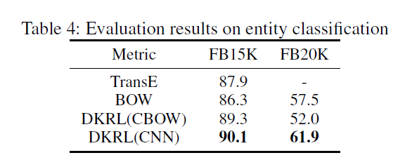

Slide 20
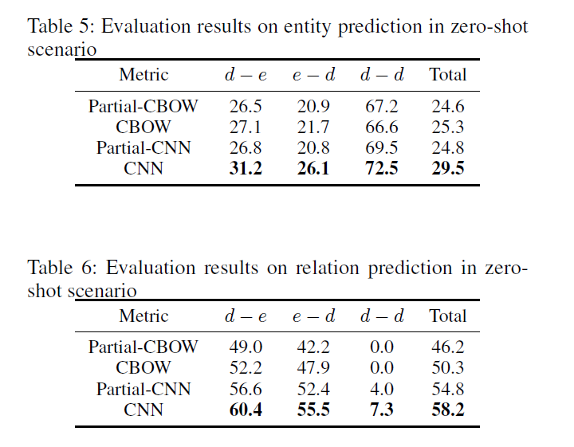

Slide 21
We will explore the following research directions in future:
(1) The DKRL model only consider entity descriptions for representation learning, while there are various of information like textual information of relations or entity types which could be added to our model. We may take advantages of those rich information in future.
(2) We verify the effectiveness of description-based representations only with TransE, and it is not difficult for further explorations with more sophisticated extension models of TransE (e.g. TransH, TransR and PTransE). We will explore to extend DKRL to these models for a better understanding of knowledge graphs.

