Slide 1
Optimal Hyperparameters for Deep LSTM-Networks for Sequence Labeling Tasks
EMNLP 2017
宁时贤
2017-08-01

Slide 2
摘要
尽可能大的数据集
删除损坏的训练样本（短文本、假输出标签等）
数据增强 - 创建新的例子（复制）
隐藏单元和图层的数量
保持较大的隐层数量（number of hidden units），避免欠拟合（特别是使用预训练表示时）
学习率
一般来说，学习率0.01是一个安全的赌注
momentum based methods 根据误差函数的曲率来改变学习速率
超参数调整- 拥抱随机搜索
混洗训练样例（Shuffling training example）

Slide 3
摘要
迭代次数
每次迭代后，若test error 和 train error 之间的差距减小，则继续迭代并保存模型参数
可视化
loss values, train error or test error, etc.
保持权重的维数在2的指数幂(64，128，512，1024)
权值初始化
uniform distribution ~ Uniform(-r, r) 当使用 tanh 时 r=sqrt(6/(fan_in+fan_out)), 当使用 sigmoid时 r=4*(sqrt(6/fan_in+fan_out)) , 其中 fan_in 是前一层的大小，fan_out 是后一层的大小。

Slide 4
摘要
the correct hyperparameter optimization often a “black art that requires expert experiences” (Snoek et al., 2012).
we evaluated over 50.000 different setups
five common linguistic sequence tagging tasks (POS, Chunking, NER, Entity Recognition, and Event Detection)
The contribution of this paper is an in-depth analysis which hyperparameters are crucial to optimize and which are of less importance.

Slide 5
评测参数
Evaluated Hyperparameters
预训练的词向量
神经网络的深度
字符级别表示
目标函数的优化器
梯度归一化策略
序列标签
Classifier.
Dropout.
Number of LSTM-Layers.
Number of Recurrent Units
Mini-batch Size.

Slide 6
LSTM的变体
various extensions to the architecture
Bidirectional LSTM-layers (Schuster and Paliwal, 1997)
variational dropout for recurrent networks (Gal and Ghahramani, 2016)
The BiLSTM-CRF (Huang et al., 2015)
the combination of word embeddings with character representations : the BiLSTM-CNN-CRF architecture (Ma and Hovy, 2016)
the BiLSTM-LSTM-CRF architecture (Lample et al., 2016)

Slide 7
Related Work
grid search
在人工定义超参数集中进行穷举搜索
计算量过大
Randomized search
Bayesian Optimization methods
从每次训练的结果来更好的估计下一批参数。设定一个参数和目标函数之间的统计模型
Automatic tuning of hyperparameters of an LSTM has led to state-of-the-art results in language modeling, outperforming models that are far more complex (Melis et al., 2017).

Slide 8
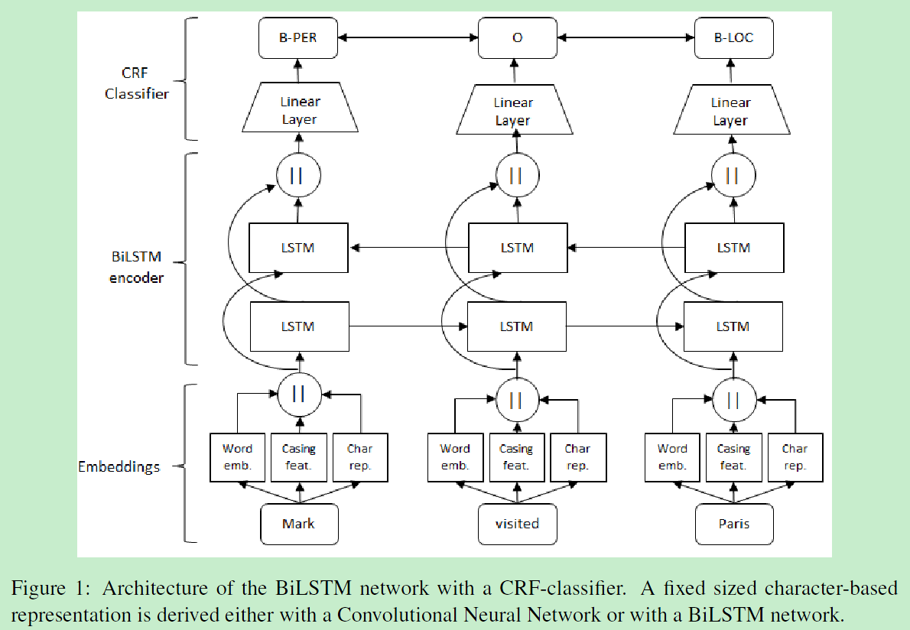
LSTM for Sequence Tagging
Notes:
词向量+词的大小写特征+字符特征（30d）
a BiLSTM-encoder
常用的最后一层分类器有：Softmax 和 CRF
Softmax 主要是利用softmax函数对句子中的每一个词预测其所属的标签的概率分布
CRF 最大化整个句子的标签概率，标签依赖性

Slide 9
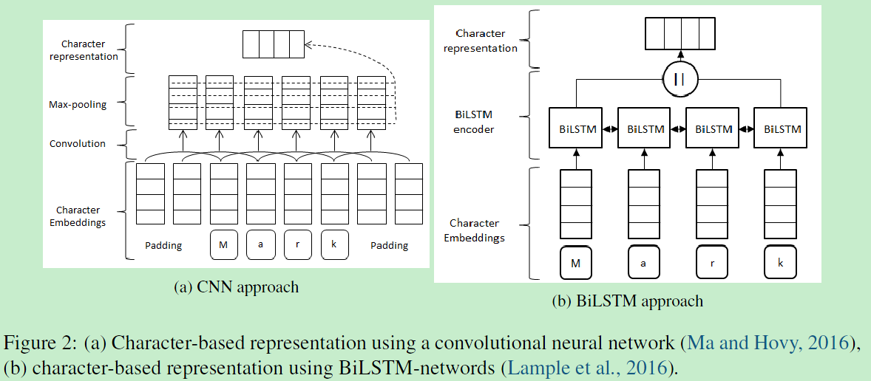
LSTM for Sequence Tagging
Notes:
a convolution with 30 filters and filter length of 3 is used, followed by a max-over-time pooling
25 recurrent units—拼接—50d

Slide 10
*Pre-trained Word Embeddings
Word2vec embeddings from Mikolov et al. (2013)
the Bag of Words
GloVe embeddings from Pennington et al. (2014)
the Komninos and Manandhar (2016) embeddings
FastText

Slide 11
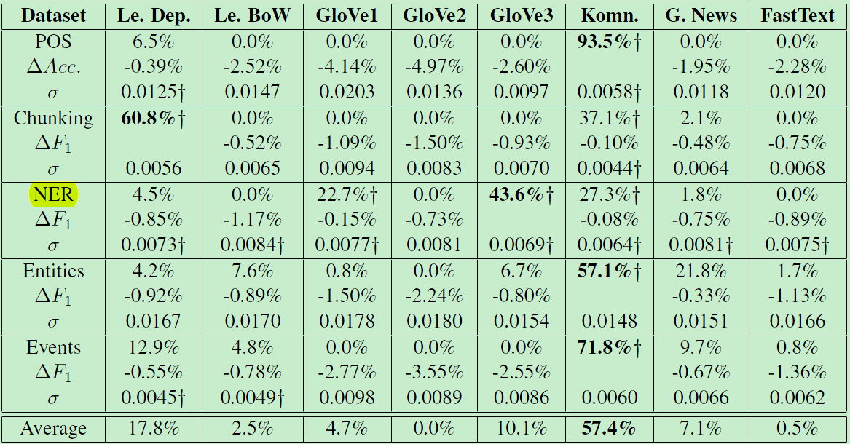
*Pre-trained Word Embeddings

Slide 12
*Pre-trained Word Embeddings
Conclusion.
The selection of the pre-trained word embeddings has a large impact on the performance of the system, a much larger impact than many other hyperparameters. On most tasks, the Komninos and Manandhar (2016) embeddings gave by a far margin the best performance.

Slide 13
Character Representation
The CNN approach by Ma and Hovy (2016) and the LSTM approach by Lample et al. (2016) performed on-par
CNN 的方法考虑字符的n元信息得到固定长度的字符表示，与字符的位置无关
BiLSTM 的方法考虑词的所有字符，与位置有关
Character-based representations were in a lot of tested configurations not that helpful and could not improve the performance of the network.

Slide 14
*Optimizer
SGD
Adagrad (Duchi et al., 2011)
Adadelta (Zeiler, 2012)
RMSProp (Hinton, 2012)
*Adam (Kingma and Ba, 2014)
*Nadam (Dozat, 2015)

Slide 15
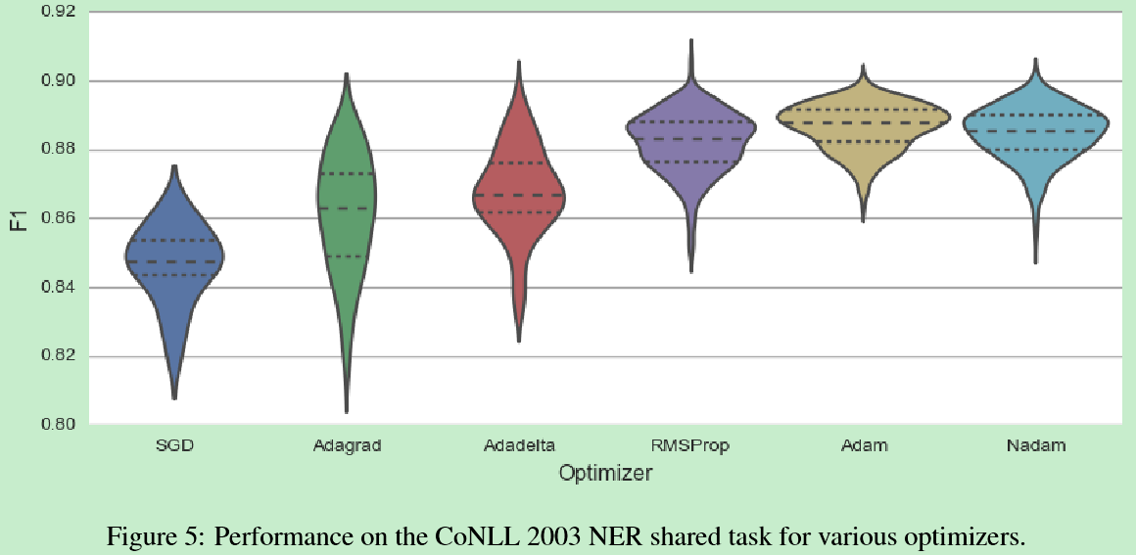
*Optimizer
Notes:
Nadam (Adam with Nesterov momentum) was on average the best optimizer.

Slide 16
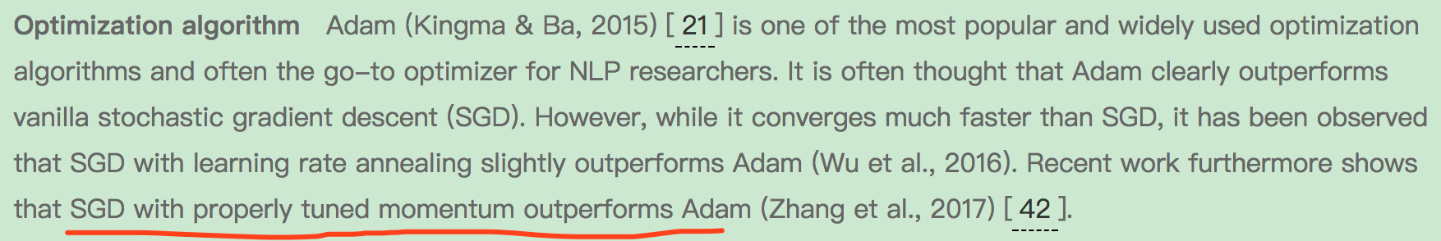
*Optimizer
Notes:
Nadam (Adam with Nesterov momentum) was on average the best optimizer.

Slide 17
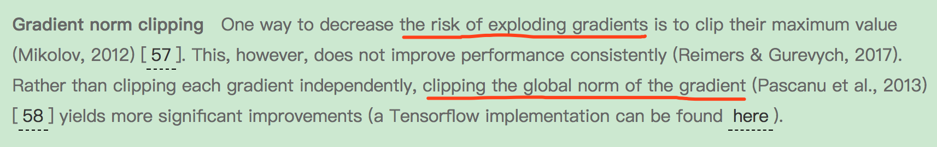
*gradient normalization
LSTM 解决了RNN的梯度消失问题，然而梯度爆炸问题仍然存在
梯度归一化策略（Pascanu et al., 2013）在模型训练过程中，当满足一定条件时，重新调整梯度，能够显著地提升性能

Slide 18
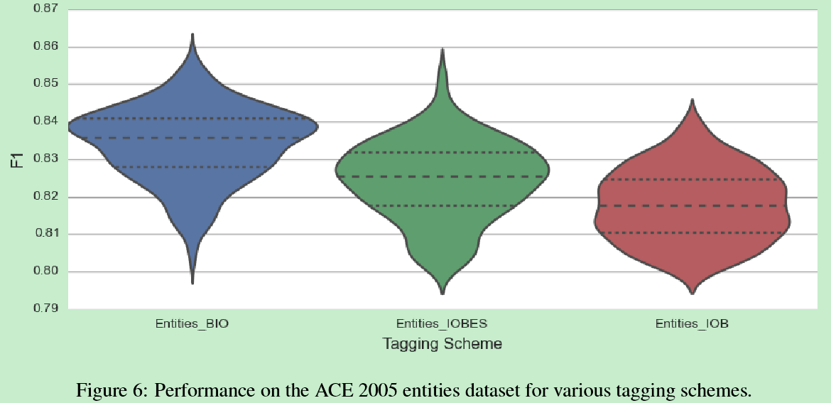
Tagging schemes
BIO
IOBES
IOB

Slide 19
Tagging schemes
分类器可能会预测不合法的标签，如：I 标签前面没有B 标签
相对于CRF classifier， softmax classifier 会产生大量的不合法标签（因 为没有考虑标签序列）
后处理策略：
将所有不合法的标签全部改为O

Slide 20
*Classifier
softmax classifier
CRF classifier
将CRF作为最后的分类层，对于标签之间有很强的依赖性的任务，大幅提升性能；反过来，Softmax 占优

Slide 21
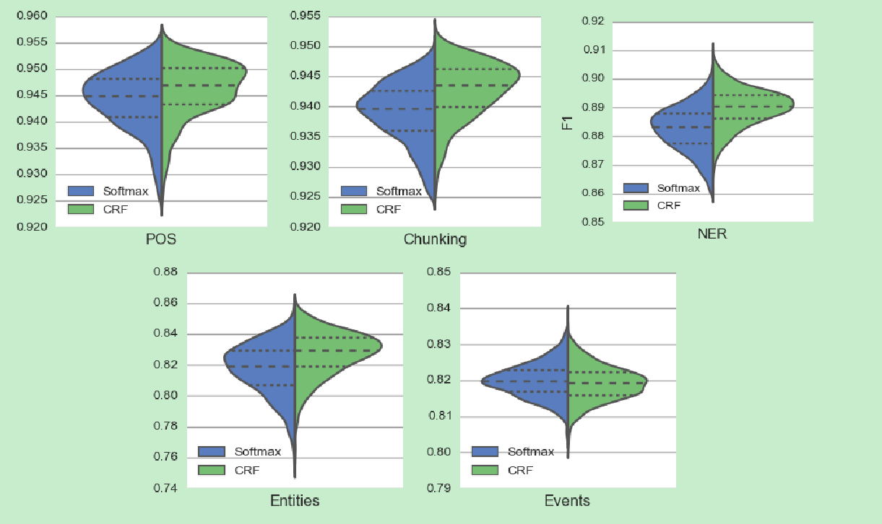
*Classifier

Slide 22
*Dropout
No dropout
naive dropout
Naïve dropout applies a new randomly selected dropout mask at every time step of the LSTM-layer.
*variational dropout
Variational dropout applies the same dropout mask for all time steps in the same sentence. Further, it applies dropout to the recurrent units.
{0.05，0.1，0.25，0.5}

Slide 23
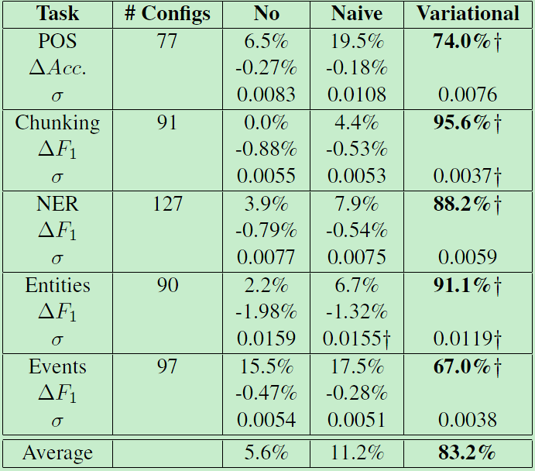
*Dropout

Slide 24
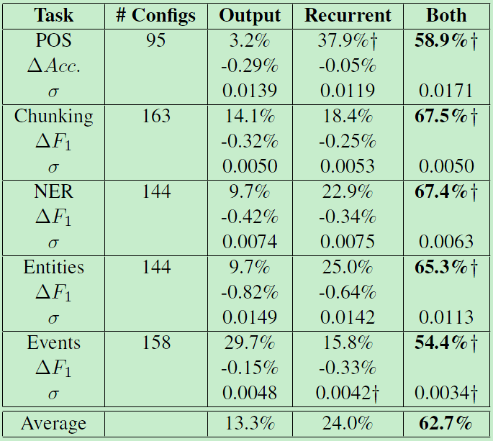
*Dropout

Slide 25
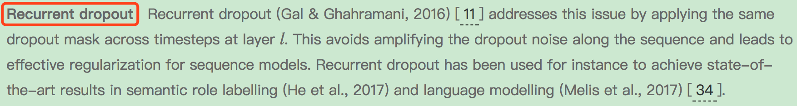
*Dropout
Variational dropout was on all tasks superior to no-dropout or naive dropout.
The best result was achieved, when dropout was applied both to the output units as well as to the recurrent units of the LSTM networks.
A dropout rate of 0.5 has been shown to be effective in most scenarios (Kim, 2014)

Slide 26
Number of LSTM-Layers
1, 2, and 3 stacked BiLSTM-layers
two stacked BiLSTM-layers resulted in the best performance
performance improvements of making the model deeper than 2 layers are minimal (Reimers & Gurevych, 2017)
Reimers, N., & Gurevych, I. (2017). Optimal Hyperparameters for Deep LSTM-Networks for Sequence Labeling Tasks. In arXiv preprint arXiv:1707.06799: Retrieved from https://arxiv.org/pdf/1707.06799.pdf

Slide 27
Number of Recurrent Units
{25，50，75，100，125}
递归单元的数量对于结果的性能影响不大
100 for each LSTM-network appears to be a good choice.

Slide 28
Mini-batch Size
1, 8, 16, 32, and 64 sentences
Conclusion:
For tasks with small training sets appears a mini-batch size of 8 a robust selection.
For tasks with larger training sets appears a mini-batch size of 32 a robust selection.

Slide 29
Layer connections
Different layers and connections:
i) highway layers
ii) residual connections
iii) dense connections.
Srivastava, R. K., Greff, K., & Schmidhuber, J. (2015). Training Very Deep Networks. In Advances in Neural Information Processing Systems.
He, K., Zhang, X., Ren, S., & Sun, J. (2016). Deep Residual Learning for Image Recognition. In CVPR.
Huang, G., Weinberger, K. Q., & Maaten, L. Van Der. (2016). Densely Connected Convolutional Networks. CVPR 2017.

Slide 30
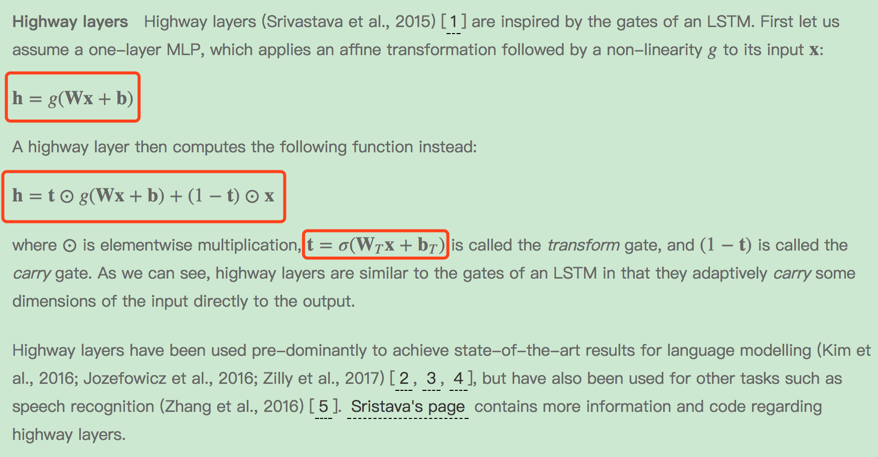
highway layers

Slide 31
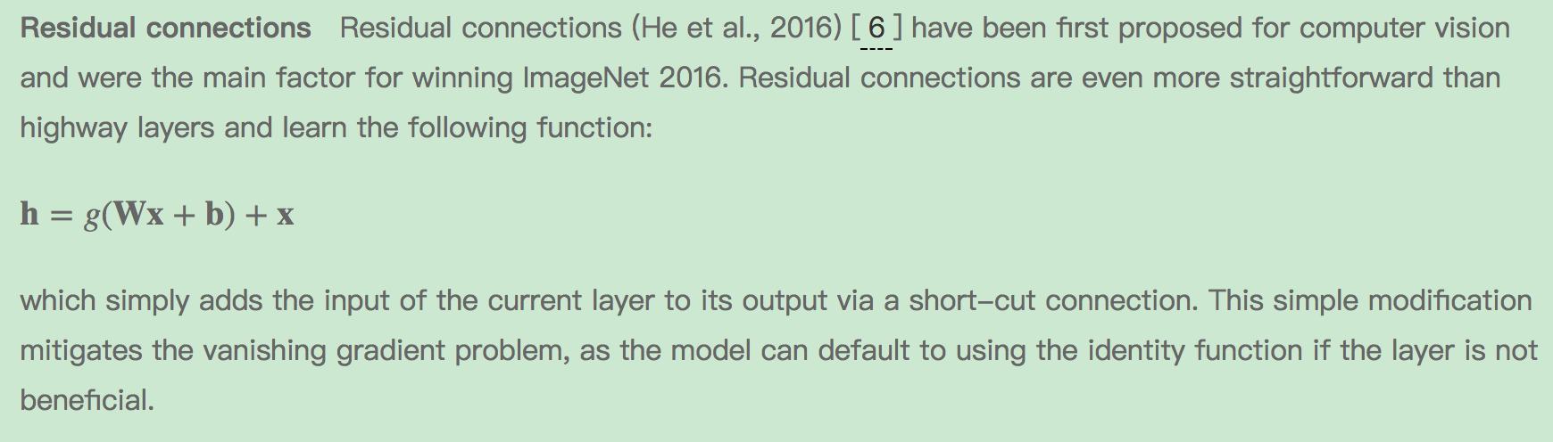
Residual connections

Slide 32
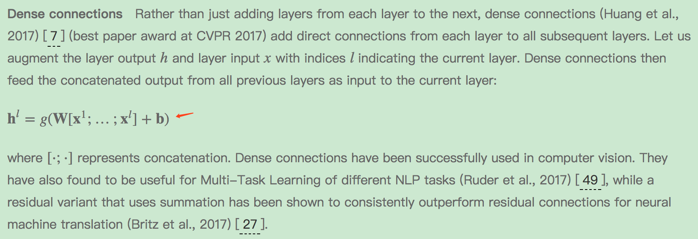
Dense connections

Slide 33
Multi-task learning
If additional data is available, multi-task learning (MTL) can often be used to improve performance on the target task. Have a look this blog post for more information on MTL.

Slide 34
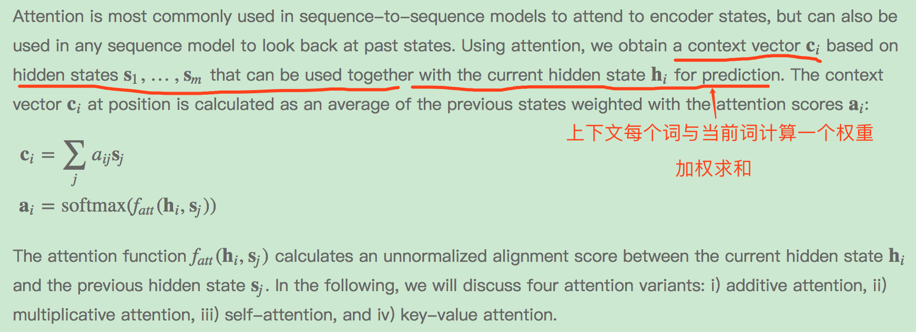
Attention

Slide 35



four attention variants
Additive attention
Multiplicative attention
Self-attention
Key-value attention

Slide 36
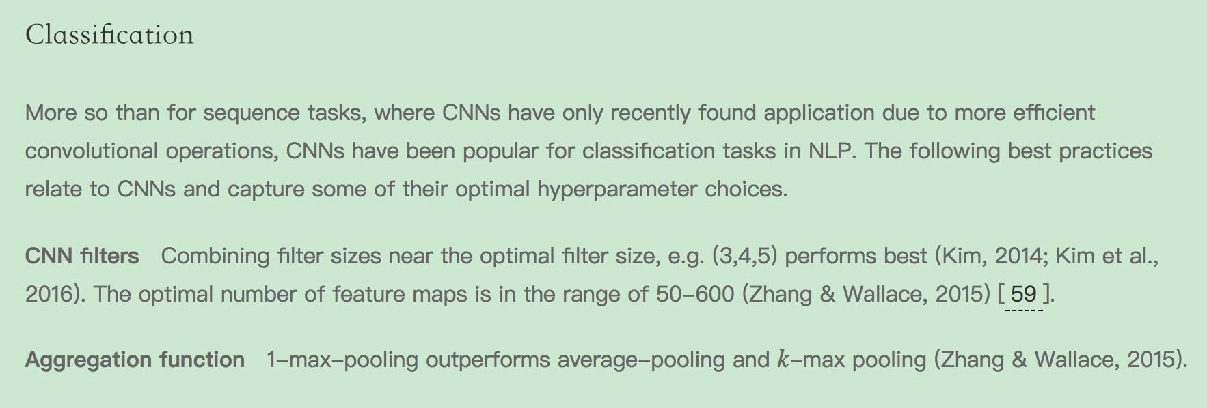
Task-specific best practices

Slide 37
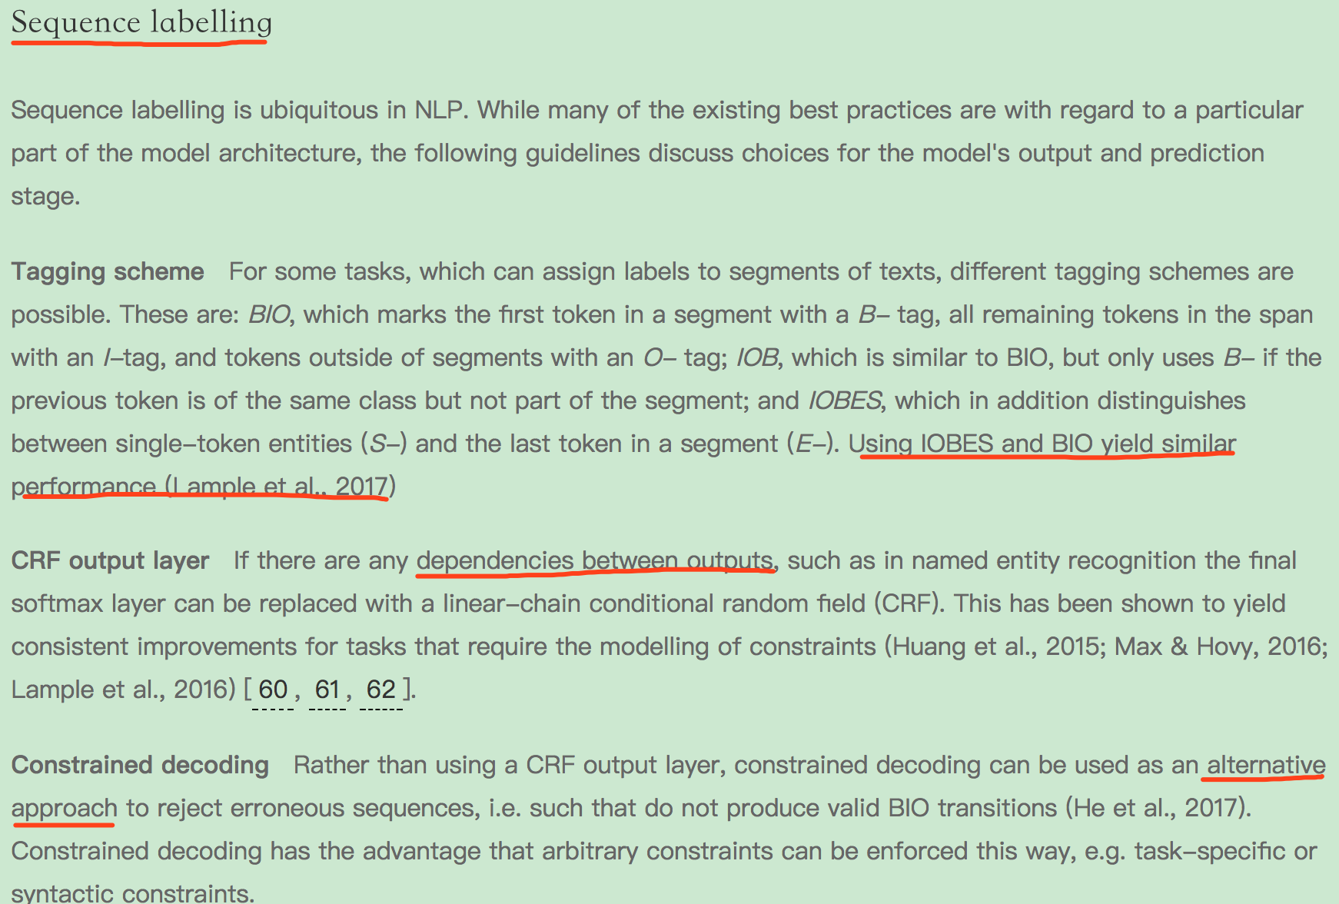
Task-specific best practices

Slide 38
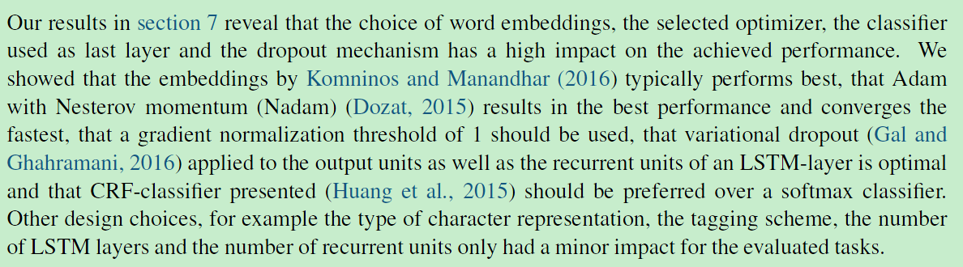
Conclusion
参考博客
http://ruder.io/deep-learning-nlp-best-practices/index.html#fn:34

