Slide 1
Learning Multiple Tasks with Multilinear Relationship Networks
Mingsheng Long, Zhangjie Cao, Jianmin Wang, Philip S. Yu
School of Software, Tsinghua University

Slide 2
摘要
现有的多任务学习方法不能衡量任务之间的相关性，不能同时学习到很好的特征表示。
作者提出了Multilinear Relationship Networks (MRN)
核心思想是在AlexNet或者VGGnet后面加上了tensor normal distribution，联合学习任务间的可迁移特征（transferable）和多线性关系（multilinear）。

Slide 3
Introduction
Multi-task learning is based on the idea that the performance of one task can be improved using related tasks as inductive bias [4].
Learn a shared representation in feature layers and multiple independent classifiers in classifier layer.
However, these deep multi-task learning methods do not explicitly model the task relationships.

Slide 4
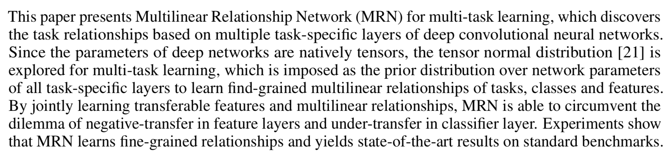
Introduction
本文提出多线性关系网络（MRN）

Slide 5
相关工作
There are generally two categories of approaches:
multi-task feature learning
learn a shared representation in the feature layers and multiple independent classifiers in the classifier layer
multi-task relationship learning
explicitly models the task relationship

Slide 6
前人工作缺点
大多数工作采用 multi-task feature learning，尽管这些方法都有所成效，但仍停留在浅层学习，不能表征任务间的关系（cannot embody task relationships）
without inferring the task relationships，this may result in under-transfer in the classifier layer

Slide 7
本文创新点
This paper presents a multilinear relationship network based on novel tensor normal priors to learn transferable features and task relationships that mitigate both under-transfer and negative-transfer.
与之前工作的两点不同
Tensor normal prior: first to explore tensor normal distribution as priors of network parameters in different layers to learn multilinear task relationships
Deep task relationship: our work learns multilinear task relationships from multiplayer parameter tensors.

Slide 8
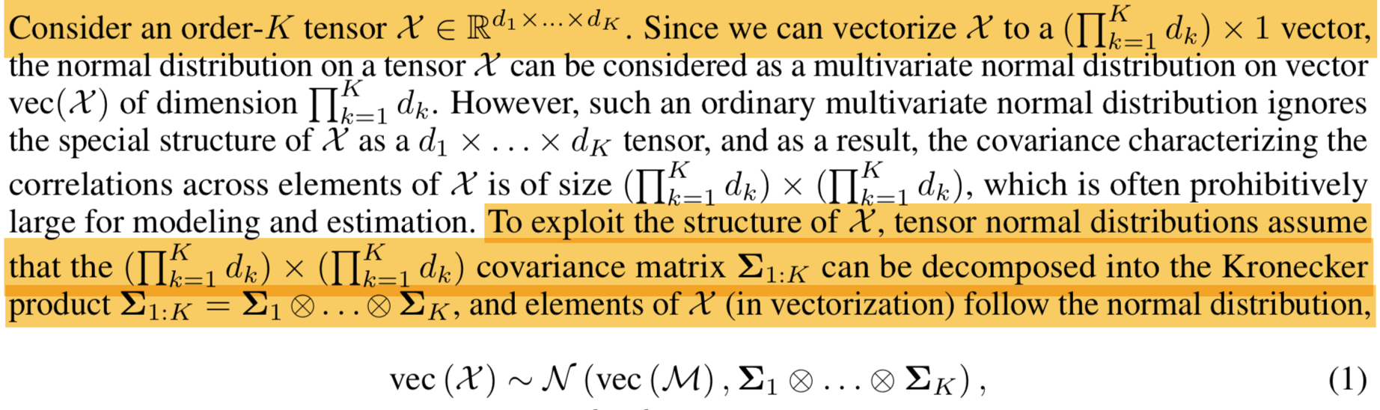

Tensor Normal Distribution
张量正态分布
协方差矩阵分解成克罗内克积形式

Slide 9
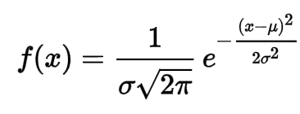
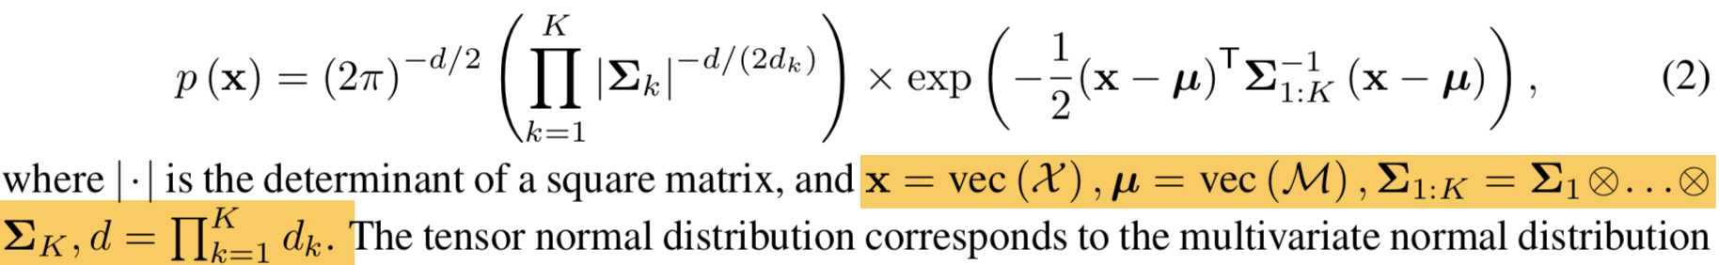
Tensor Normal Distribution
正态分布-概率密度函数
K 阶张量 X 符合张量正态分布，则其概率密度函数（probability density function）
Notes:
解释为：利用Kronecker decomposable covariance structure 的多变量正态分布

Slide 10
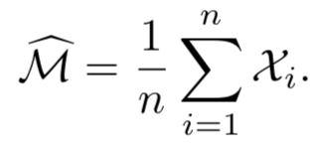
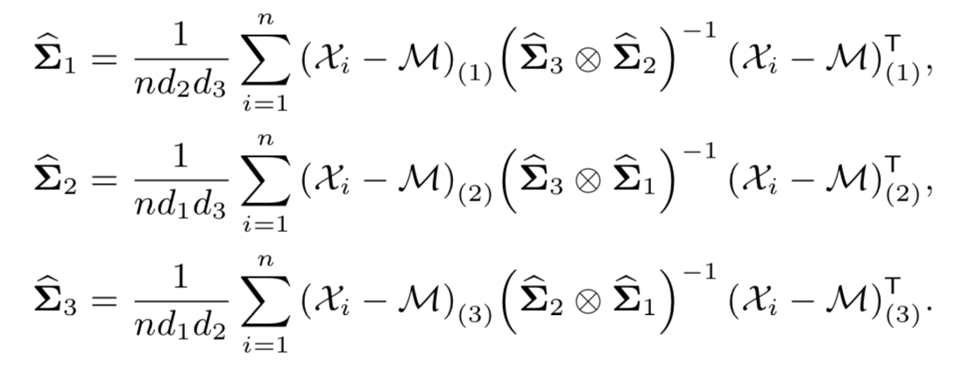
Tensor Normal Distribution
Maximum Likelihood Estimation
均值张量M的最大似然估计MLE
协方差矩阵的最大似然估计MLE
Notes:
n个符合三阶张量正态分布的样例x，

Slide 11
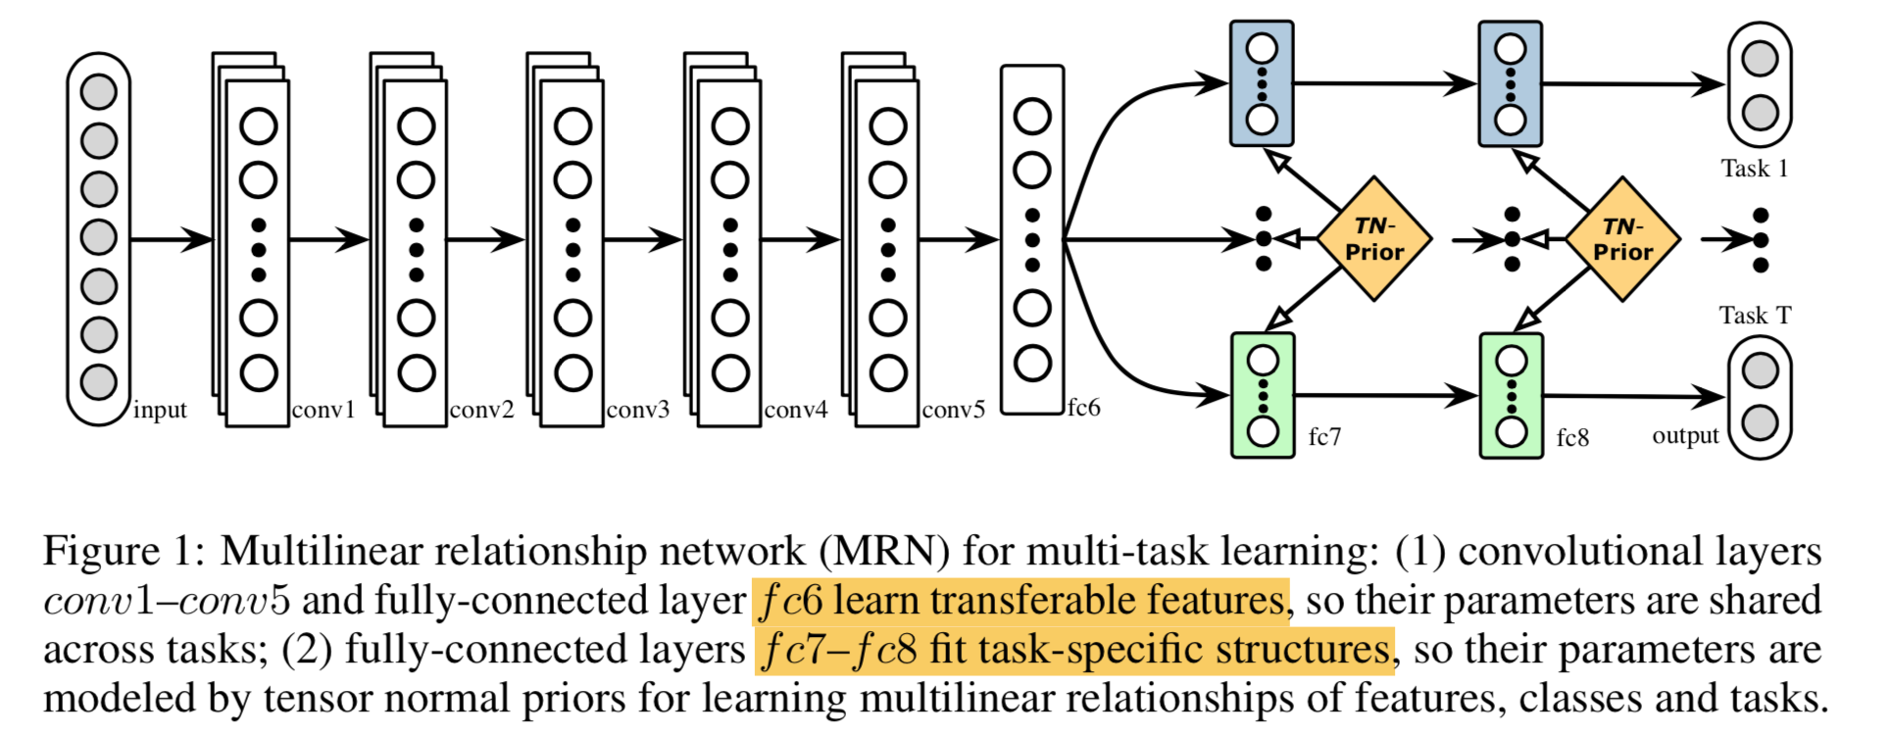
Multilinear Relationship Networks
This work models multiple tasks by jointly learning transferable representations and task relationships.

Slide 12
Multilinear Relationship Networks
Figure 1 shows the architecture of the proposed MRN model based on AlexNet
传统做法是通过 conv1–fc7 的深度网络，使得多个任务能够通过共享表示很好的相关联。但是任务之间关联性不强的话，学习能力很弱。
所以这篇论文的工作是通过贝叶斯框架，联合学习任务间的共享特征和多线性关系

Slide 13
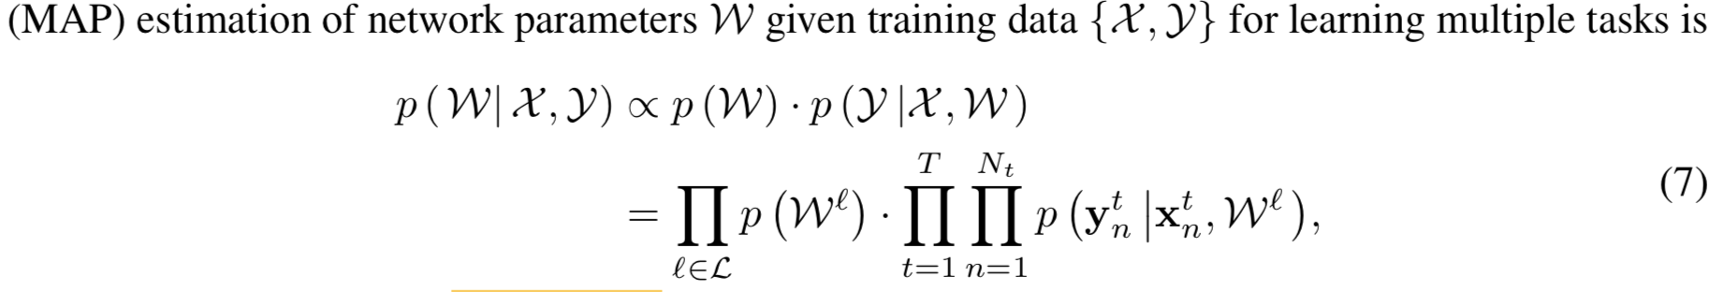
Multilinear Relationship Networks
网络参数估计
第l 层的参数张量
Notes:
n个符合三阶张量正态分布的样例x，

Slide 14
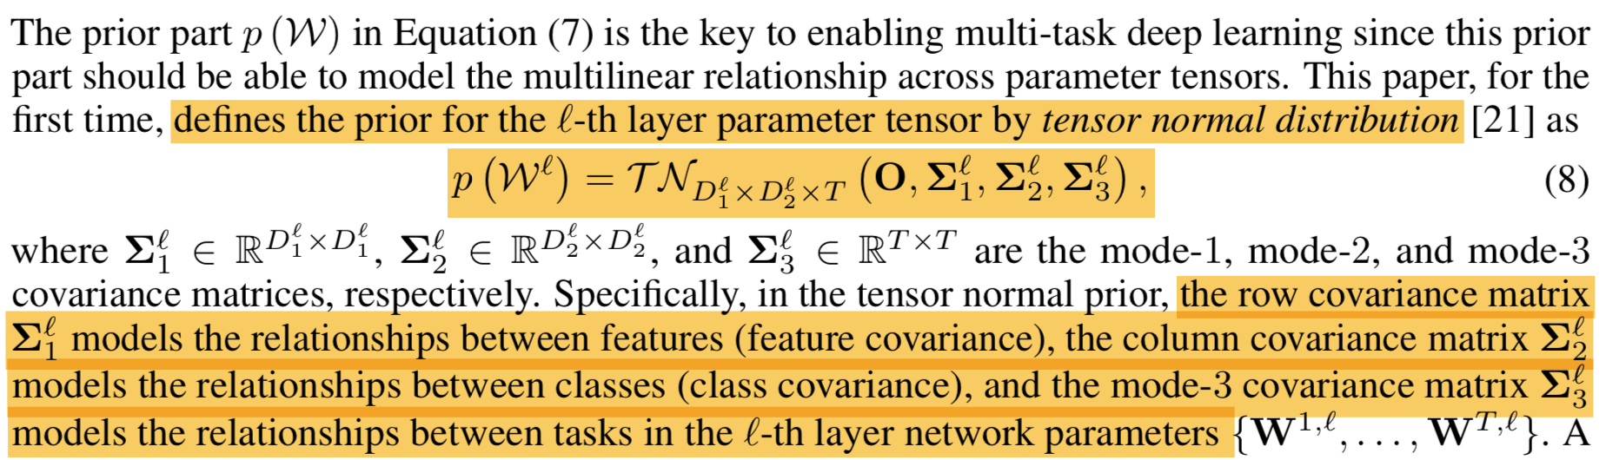
Multilinear Relationship Networks
CNN模型参数拟合
先验概率P(W) 估计

Slide 15
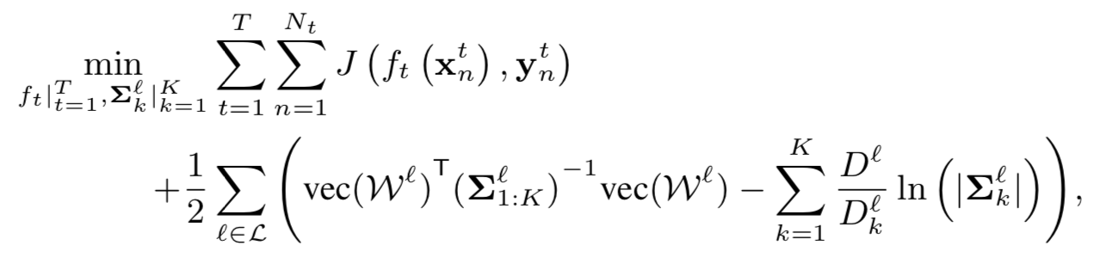
Multilinear Relationship Networks
MRN 优化目标（多线性关系学习）
Notes:
CNN 损失函数
张量正态分布 先验概率
取 K 阶张量正态分布的概率密度函数的 对数（第九页PPT）

Slide 16
Multilinear Relationship Networks
Algorithm
迭代更新
Parameter tensors W
Feature covariance
Class covariance
Task covariance

Slide 17
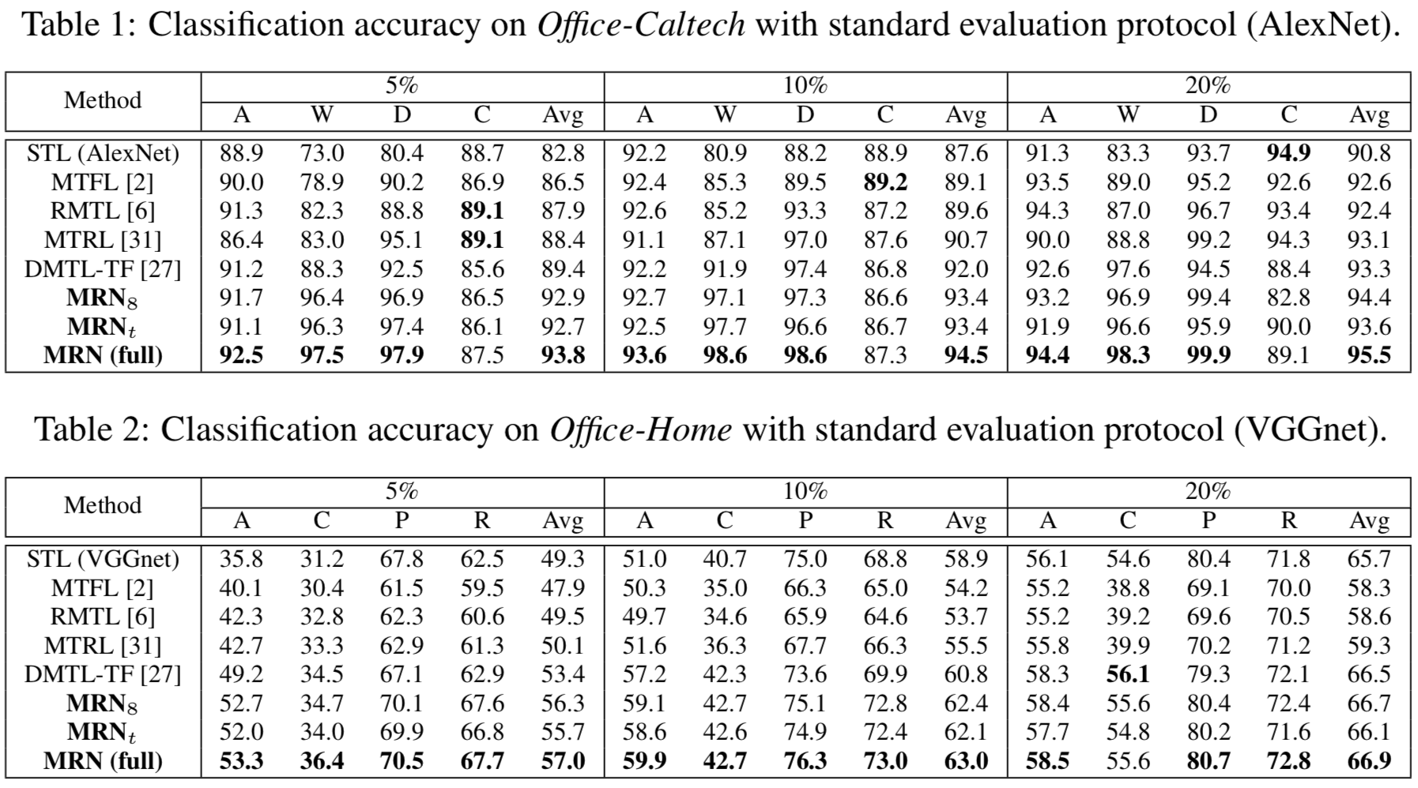
Experiments
Notes:
抽取每个任务的 5，10，20% 的训练数据
8：仅适用FC8
T: 仅适用任务协方差用于单个关系学习

Slide 18
Results

