Slide 1
Adversarial Multi-Criteria Learning for Chinese Word Segmentation
Xinchi Chen, Zhan Shi, Xipeng Qiu, Xuanjing Huang
Fudan University

Slide 2
What is Chinese word segmentation (CWS) ?
中国官员应邀到美国开会 中国/官员/应邀/到/美国/开会
大学生活好，还是中学生活好
大学/生活/好，还是/中学/生活/好
如果你饿了，我就下面给你吃
如果/你/饿/了，我/就/下/面/给/你/吃

Slide 3
Why CWS is important ?
Parsing
Text
classification
IR
Translation
QA
……

Slide 4
Evaluation
N：黄金标准分割的单词数
e：分词器错误标注的单词数
c：分词器正确标注的单词数

Slide 5
Reason
Diverse segmentation criteria →
Traditional Chinese corpus: AS, CITYU ,CKIP
simplified Chinese corpus: MSRA, PKU, CTB, NCC ,SXU.
Most existing methods focus on single criterion, it is a waste of resources if we fail to fully exploit these corpora.
Common underlying knowledge

Slide 6
Idea
Adversarial multi-criteria learning for CWS
integrating shared knowledge from multiple heterogeneous segmentation criteria.
Experiments on eight corpora show that the performance of each corpus obtains a significant improvement

Slide 7
Introduction
fundamental research
the state-of-the-art methods :
statistical supervised learning algorithms
and rely on a large-scale annotated corpus
Incompatible(矛盾)
Previous research showed that heterogeneous(异构的) corpora can help each other

Slide 8
contributions
Multi-criteria learning is first introduced for CWS, in which we propose three shared private models to integrate multiple segmentation criteria.
An adversarial strategy is used to force the shared layer to learn criteria-invariant features, in which an new objective function is also proposed instead of the original cross-entropy loss.

Slide 9
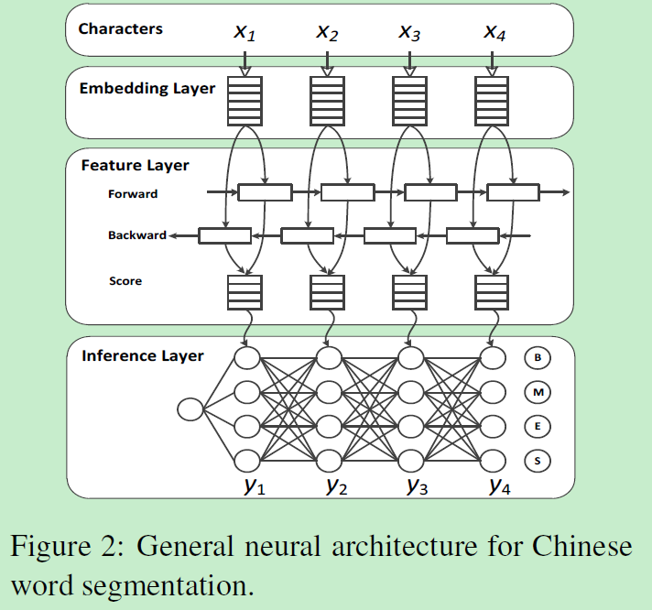
General Neural Model for CWS
a character embedding layer
feature extraction
A tag inference layer
无法同时处理多种异构的数据，
忽略了多种语料库间的共性

Slide 10
Multi-Criteria Learning for CWS
To exploit the shared information between these different criteria, we propose three sharing models for CWS task
consist of a private (criterion-specific) layer and a shared (criterion-invariant) layer
information flow
Notes:
私有层+共享层
信息流走向不同

Slide 11
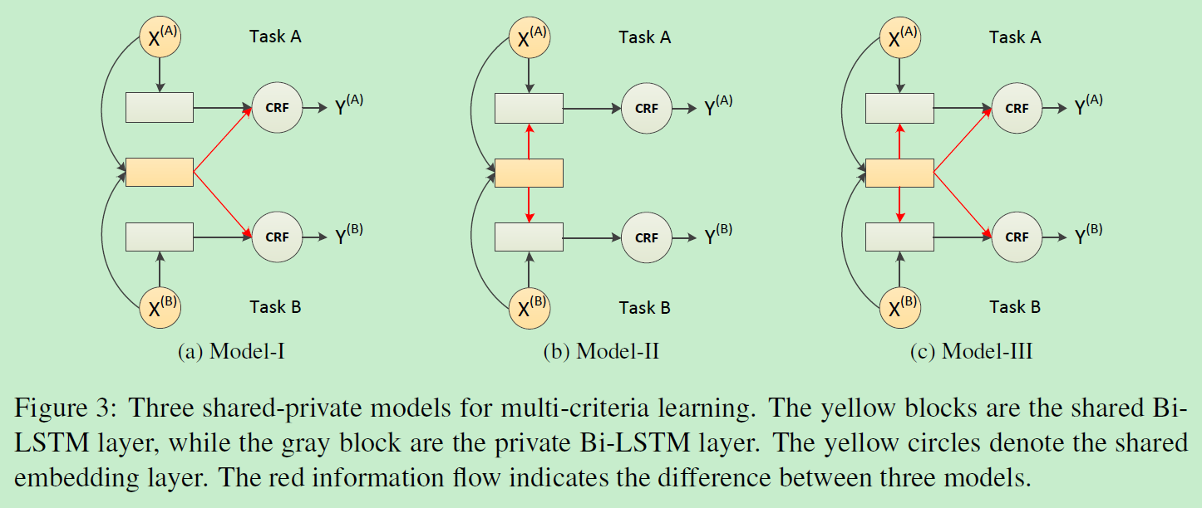
three sharing models

Slide 12
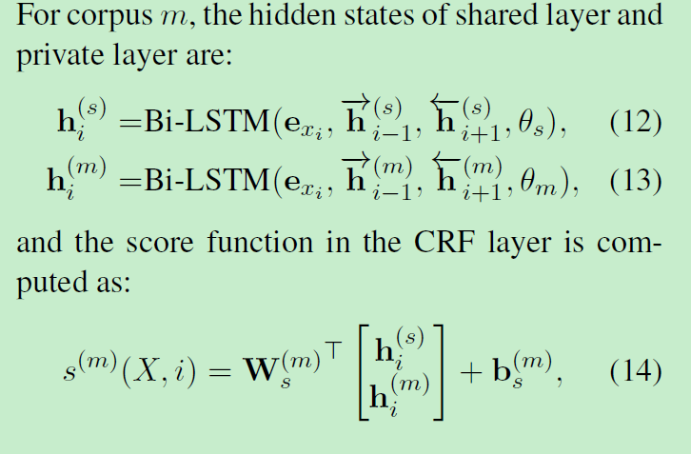
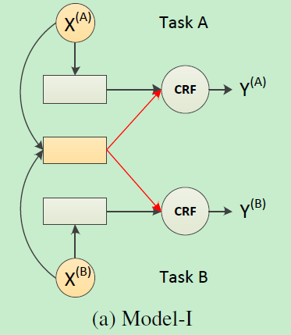
Model-I: Parallel Shared-Private Model

Slide 13
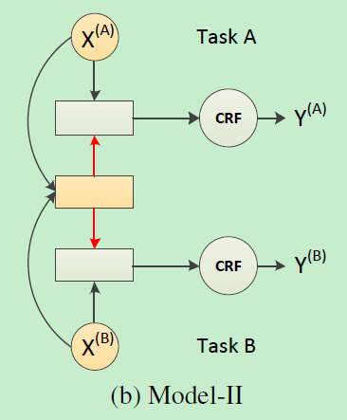
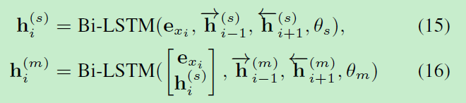

Model-II: Stacked Shared-Private Model

Slide 14
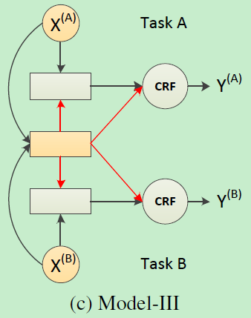
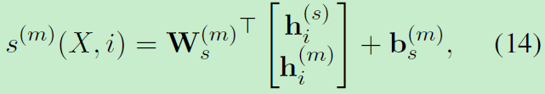
Model-III: Skip-Layer Shared-Private Model
a combination of Model-I and Model-II

Slide 15
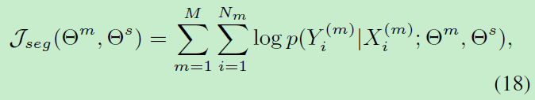



Objective function
Maximize the log conditional likelihood of true labels on all the corpora.

Slide 16
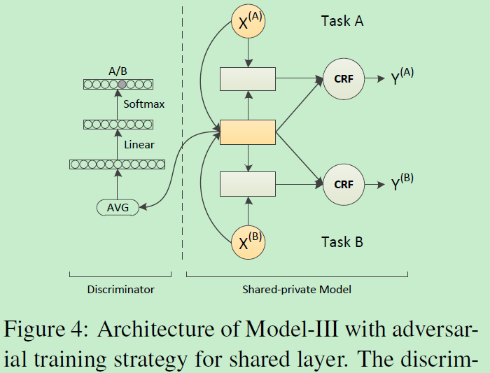
Incorporating Adversarial Training for Shared Layer
存在问题：由于共享 LSTM 模块所捕捉的特征并不「纯净」，里面可能混入了某个任务的私有特征，这些特征没有什么帮助，甚至可能导致其准确率下降
因此，需要把私有特征从共享模块中「剥离」出去，保证该模块仅仅抽取对所有语料都有用的特征，而论文作者巧妙地利用了对抗网络来达到这个目的
Notes:
具体来说，每当一个样本经过字向量层、共享 LSTM 层之后，我们会得到一个特征向量序列，该序列的长度与输入样本的字符长度相等。为了检查这些特征向量是否「纯净」，我们对它们求平均，得到一个固定长度的特征向量，再输入判别器网络模块，要求判别器预测该特征向量来源于 8 个语料中的哪一个。这是我们给判别器设定的目标。
也即，假如判别器能够准确预测每一个共享特征向量的来源语料，则说明这些共享特征中混入了太多私有信息，这是我们不希望发生的事情。所以我们反过来给共享 LSTM 模块设定一个目标，让它跟判别器对抗，想办法让判别器预测不准。假如共享 LSTM 模块成功让判别器分不清特征向量来自哪个语料，意味着我们已经把私有特征剥离出去了，从而保证了共享特征向量的纯净性。

Slide 17
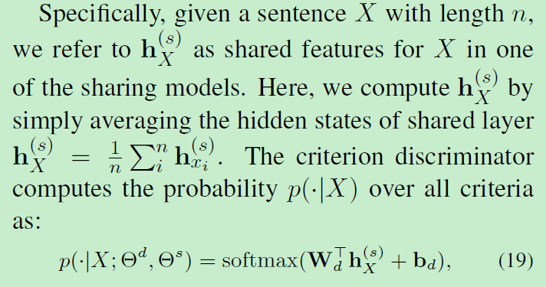
Adversarial Training

Slide 18

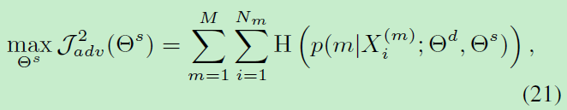

Adversarial loss function
The criterion discriminator maximizes the cross-entropy of predicted criterion distribution p( |X) and true criterion.(要求判别器预测该特征向量来源于 8 个语料中的哪一个)
An adversarial loss (让判别器预测不准)

Slide 19

Training

Slide 20
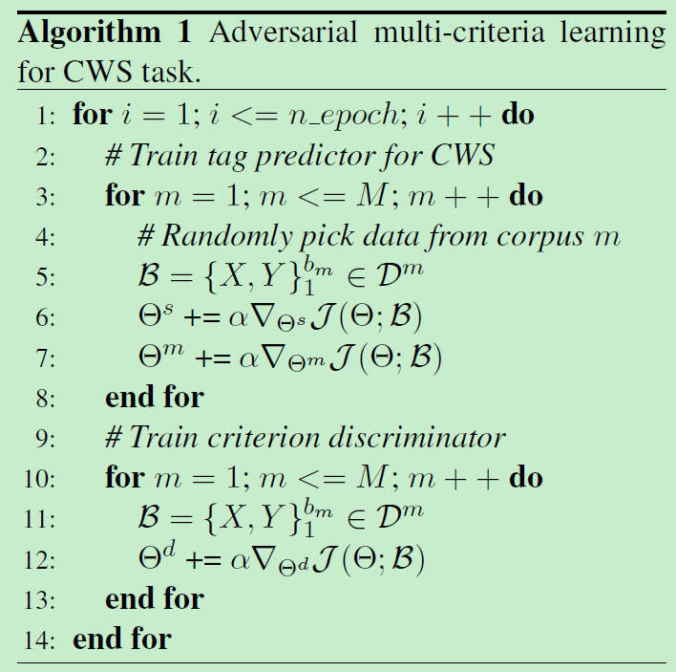
Training
先训练多任务分词模型
然后再进行对抗训练

Slide 21
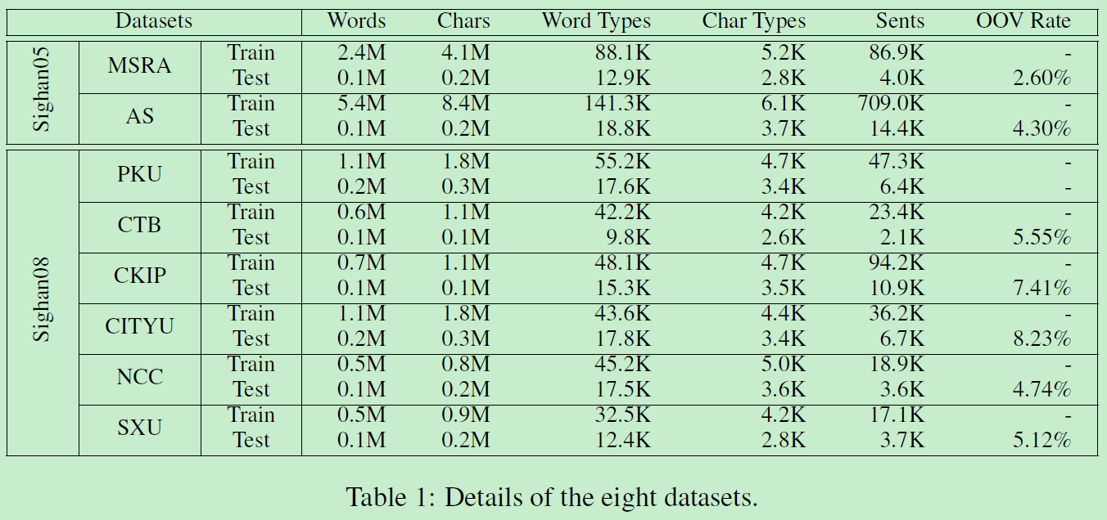
Experiments

Slide 22
词向量预训练（Wikipedia corpus）维度100
LSTM隐层维度100
学习率0.01
损失函数权重0.05
Dropout=0.2
Batch-size=512/256/128
…

Slide 23
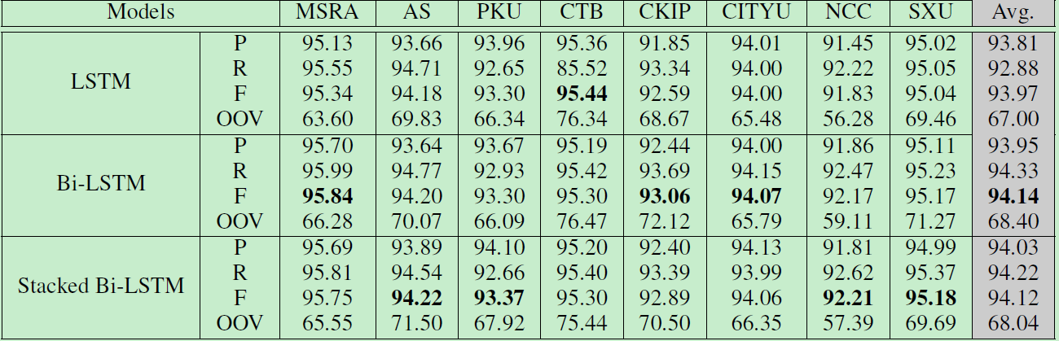
Overall Results

Slide 24
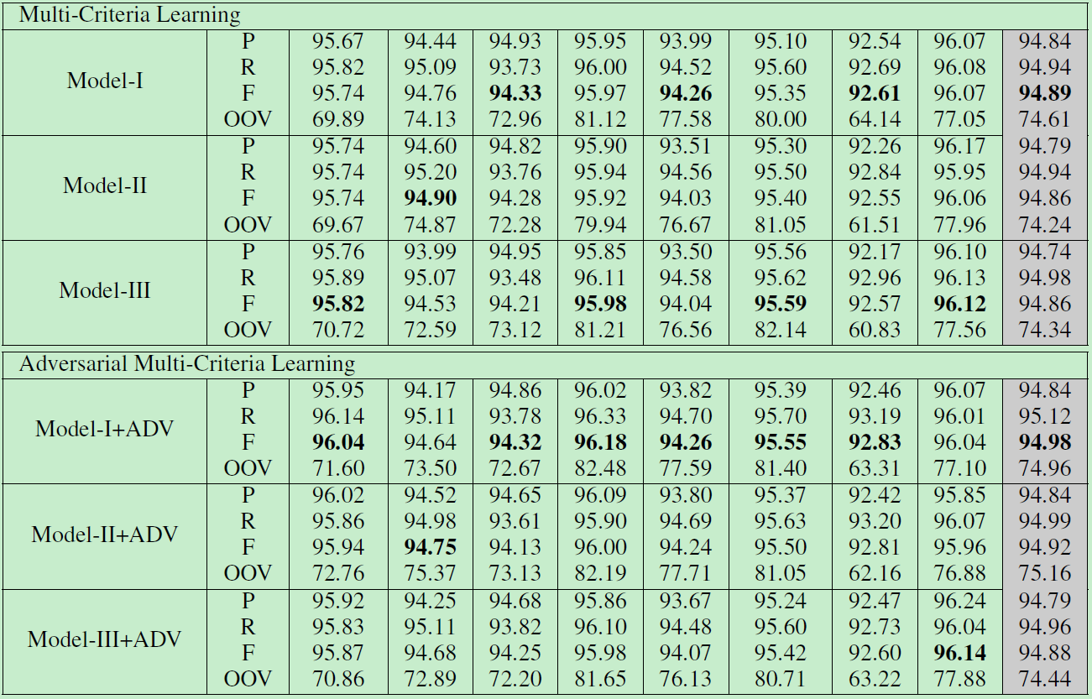

Slide 25
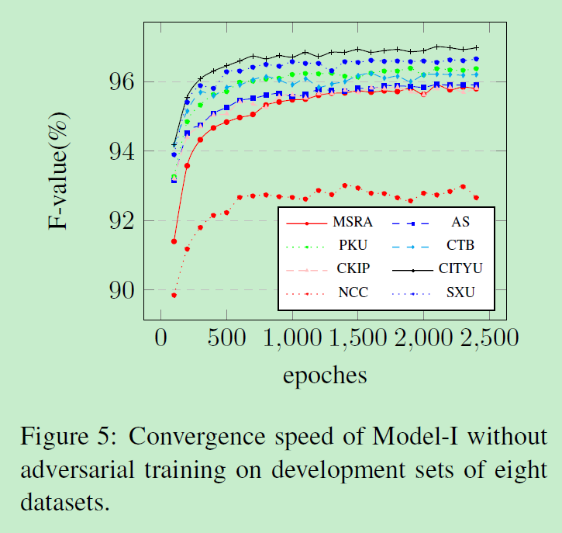
Convergence Speed

Slide 26
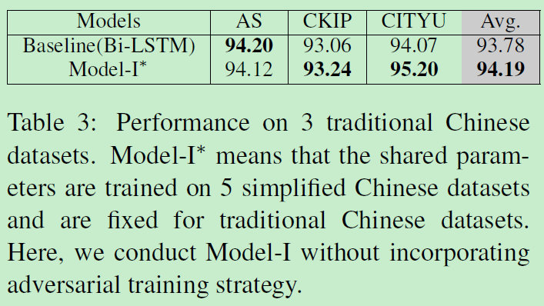
Knowledge Transfer
simplified Chinese to traditional Chinese(0.41%)

Slide 27
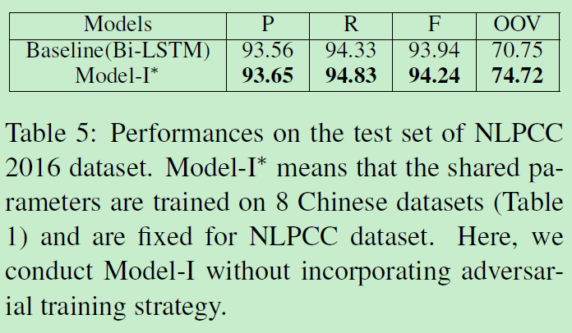
Knowledge Transfer
formal texts to informal texts (0.30%)

Slide 28
Conclusions & Future Works
作者借鉴了多任务学习的思想
融合多个语料的数据来提升共享字向量模块、共享 LSTM 模块的泛化性能，又让多个私有 LSTM 模块、私有 CRF 模块分别负责各个语料之间标准不一致之处，
巧妙地利用了对抗网络
把私有信息从共享模块中剥离到各个私有模块中去，既能充分享受到数据量增大带来的好处，又避免了不同语料之间相互掣肘，做到了「求同存异，共创双赢」。

