Slide 1
End-to-End Adversarial Memory Network for Cross-domain Sentiment Classification

Slide 2
Cross-domain Sentiment Classification
Due to the domain discrepancy, a sentiment classifier trained in a source domain may not work well when directly applied to a target domain
Manually select pivots
Deep learning methods lack the interpretability to directly identify the pivots

Slide 3
This paper
End-to-end Adversarial Memory Network (AMN)
Automatically capture the pivots using the attention mechanism
Offer a direct visualization of pivots, which makes the representations shared by domains more interpretable
Achieve better performance than the state-of-the-art methods.

Slide 4
AMN
MN-sentiment is for sentiment classification
MN-domain is for domain classification
Notes:
(1) They are the important sentiment words for sentiment classification;
(2) These words are shared in both domains.

Slide 5



AMN
Notes:
Nsl and Nsu denote the number of labeled data and unlabeled data
Nt is the number of unlabeled data in target domain.
The task of the cross-domain sentiment classification is to learn a robust classifier trained on labeled data in the source domain to predict the polarity of unlabeled examples from the target domain.

Slide 6
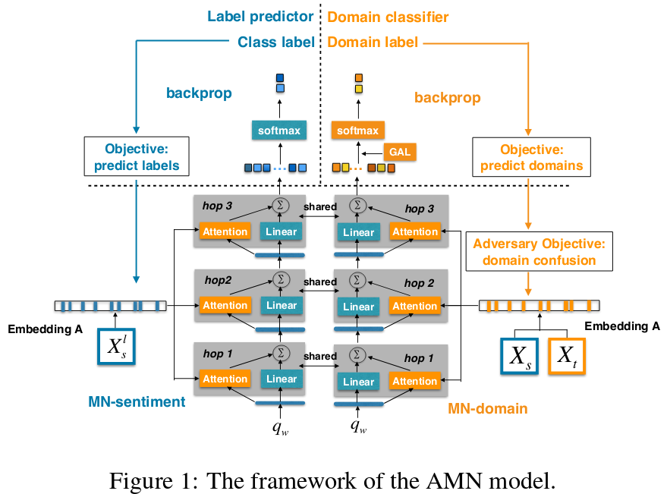
Notes:
These two networks are jointly trained so that the selected features minimize the sentiment classification errors and at the same time make a domain classifier incapable of discriminating samples from the source and target domains.

Slide 7


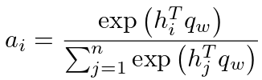
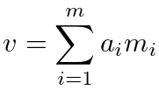
AMN

Slide 8
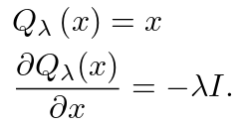
Gradient Reversal Layer (GRL)

Slide 9
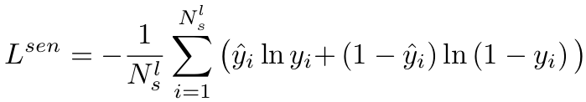
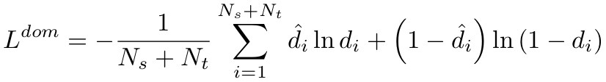

Loss function

Slide 10
Dataset
Amazon reviews dataset
2000 labeled reviews for each domain
1000 positive reviews (higher than 3 stars)
1000 negative reviews (3 stars or lower)
800 positive and 800 negative reviews from the source domain as the training data, the rest from the source domain as the validation data, and 200 positive and 200 negative reviews from the target domain for testing.
All data (labeled and unlabeled data) from both domains is used for domain classifier.

Slide 11
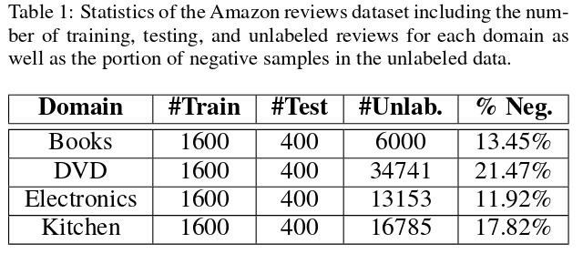
Experiments

Slide 12
