Slide 1
AutoExtend: Combining Word Embeddings with Semantic Resources
ACL2017
Sascha Rothe, Hinrich Schutze
LMU Munich

Slide 2
We present AutoExtend, a system that combines word embeddings with semantic resources by learning embeddings for non-word objects like synsets and entities and learning word embeddings that incorporate the semantic information from the resource.
The method is based on encoding and decoding the word embeddings
All we need as input is a set of word embeddings and a resource
WordNet, GermaNet, and Freebase as semantic resources.

Slide 3
there are many other resources that are undoubtedly useful in NLP, including lexical resources like WordNet and Wiktionary and knowledge bases like Wikipedia and Freebase.

Slide 4
Model
The basic idea behind AutoExtend is that it takes the embedding of an object that is a bundle of properties as input and “decodes” or “unravels” this embedding to the embeddings of these properties.
The basic input to AutoExtend is a semantic resource represented as a graph and an embedding space given as a set of vectors.

Slide 5
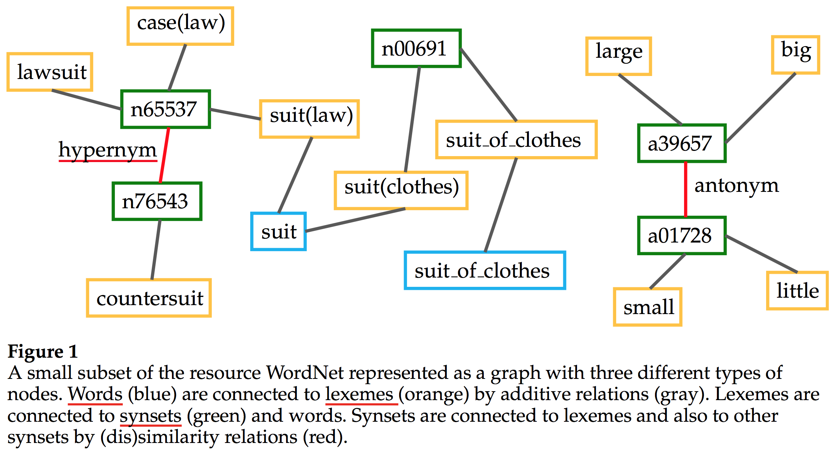

Slide 6
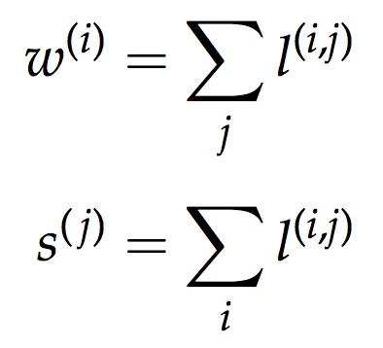
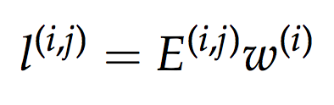
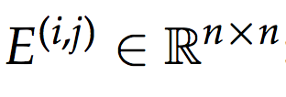
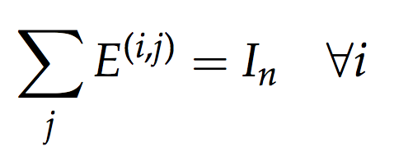
A lexeme pairs such a spelling with a particular meaning.
A synset is a set of lexemes with the same meaning in the sense that they are interchange- able for each other in context.
(i) words are sums of their lexemes
(ii) synsets are sums of their lexemes.

Slide 7
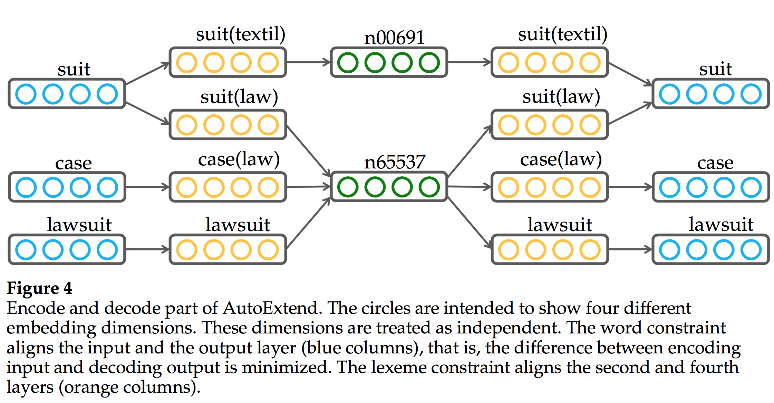

Slide 8
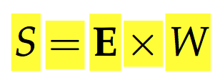


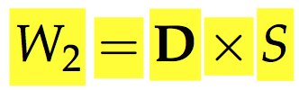
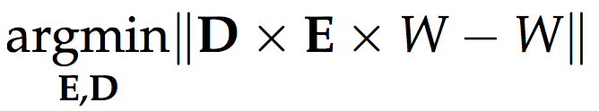
编码
解码
word constraint

Slide 9

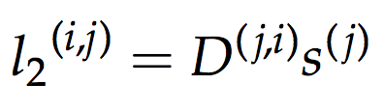
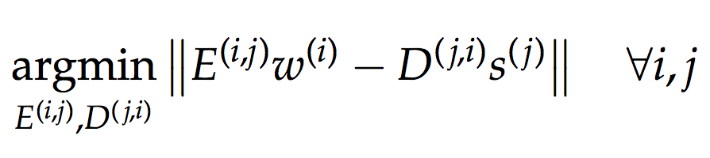
Lexeme Embeddings
编码
解码
lexeme constraint:

Slide 10
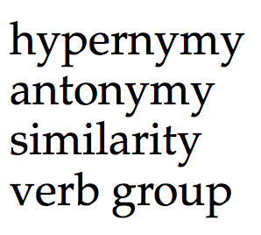
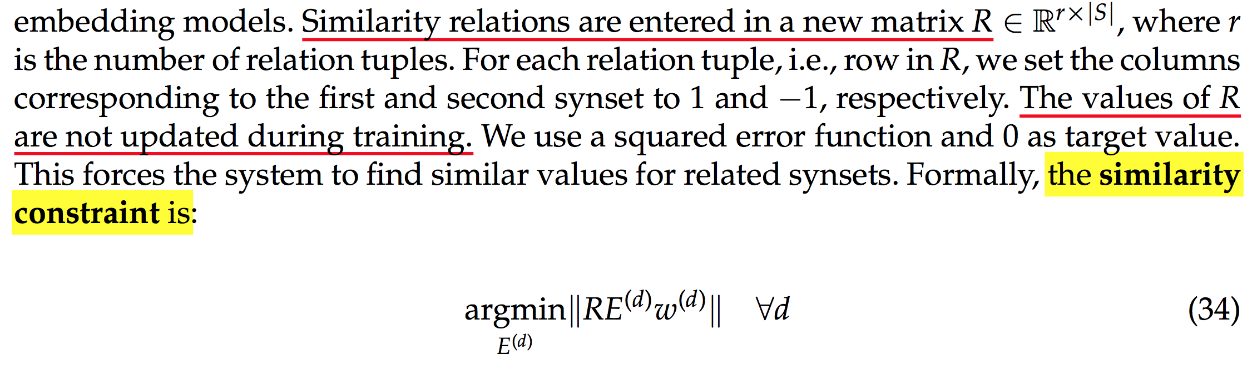
对于多数学习的同义词集表示较差，引入同义词集的关系约束similarity constraint

Slide 11
Our training objective is the minimization of the sum of these three constraints :
word constraint
the lexeme constraint
the similarity constraint
weighted by α, β, 1-α-β

Slide 12
实验
词义消歧
实体链接
词义相似度（两种）

Slide 13
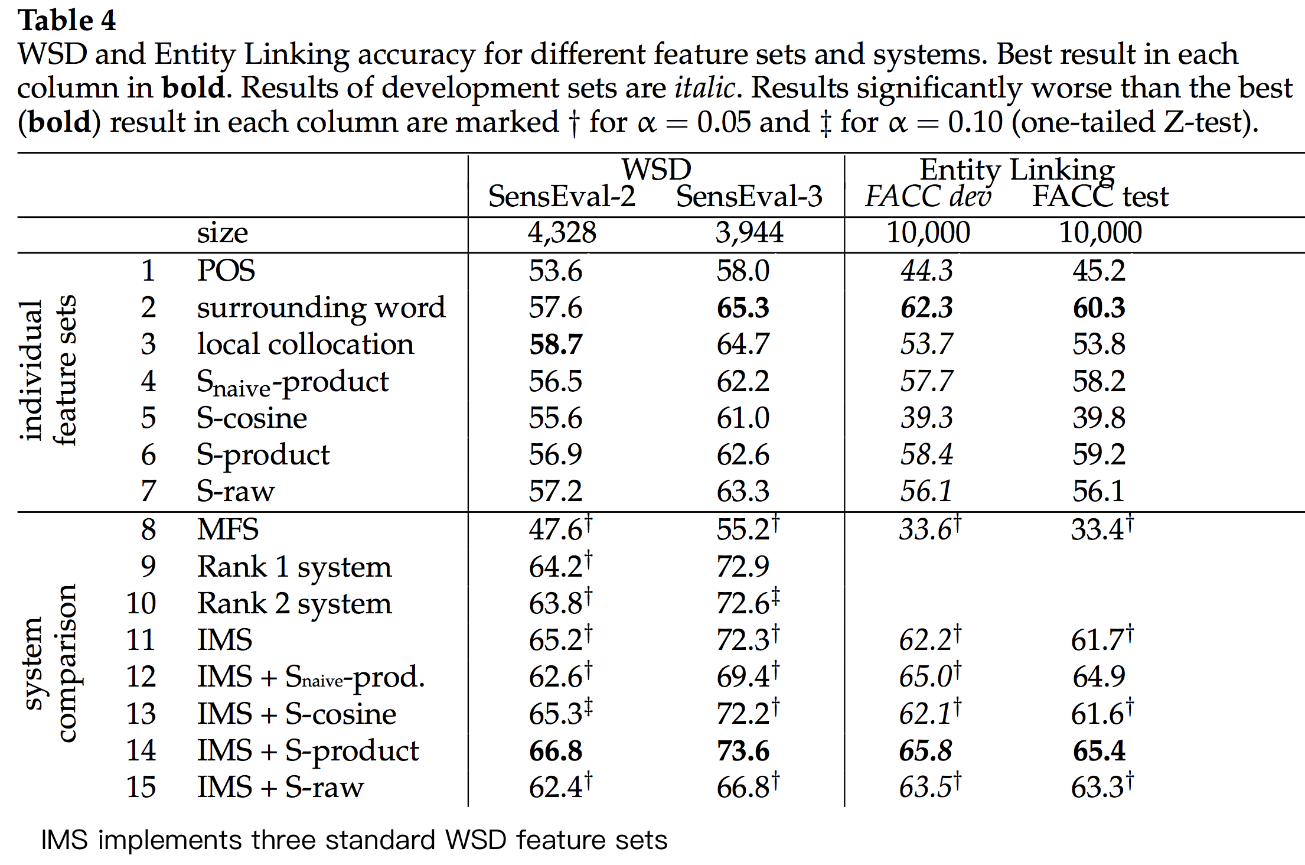
Word Sense Disambiguation
a linear SVM.

Slide 14
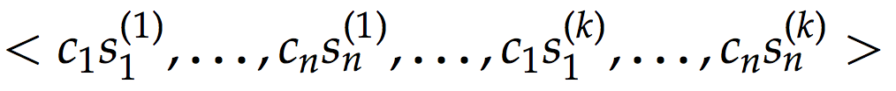
S-cosine
S-product
S-raw
S_{naive}-product
replace the synset vectors s^{( j)} with naive synset vectors z^{( j)}, defined as the sum of the word2vec vectors of the words that are members of synset j.

Slide 15
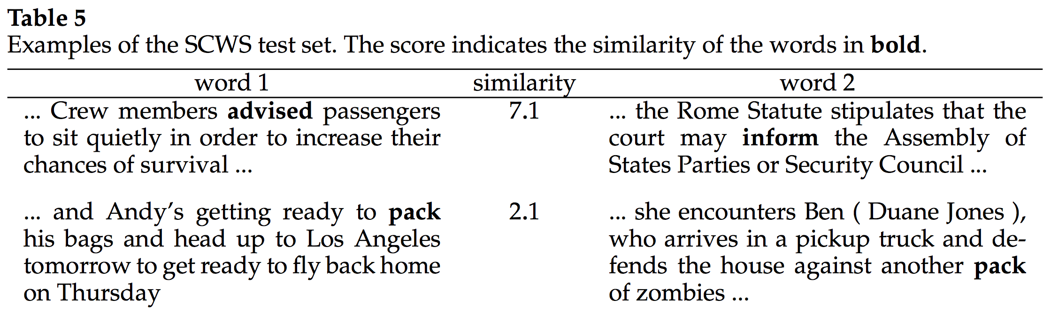
Word-in-Context Similarity
Word Similarity test set that does not only provide isolated words and corresponding similarity scores, but also a context for each word.

Slide 16
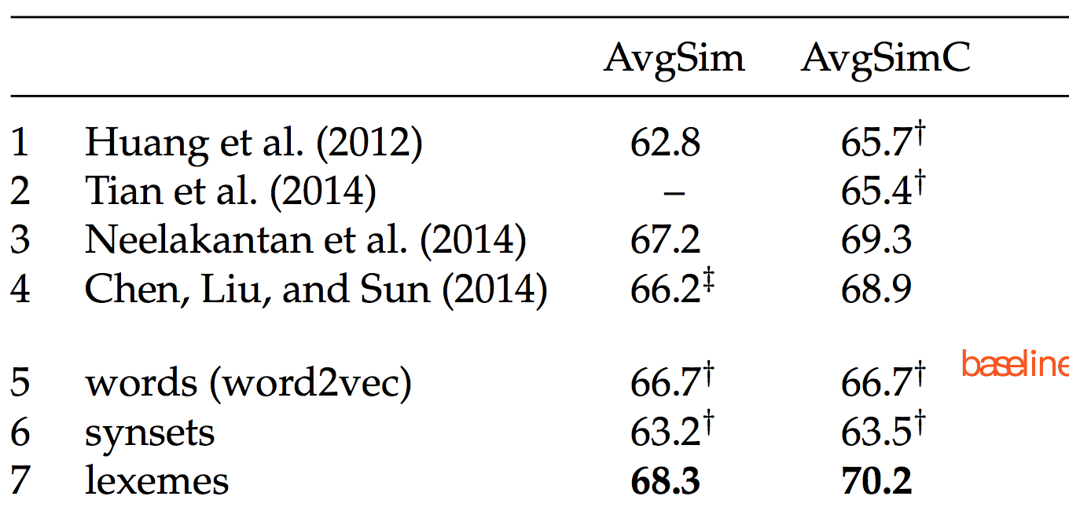
Thus, replacing a word’s embedding by the sum of the embeddings of its senses could generally improve the quality of embeddings

Slide 17
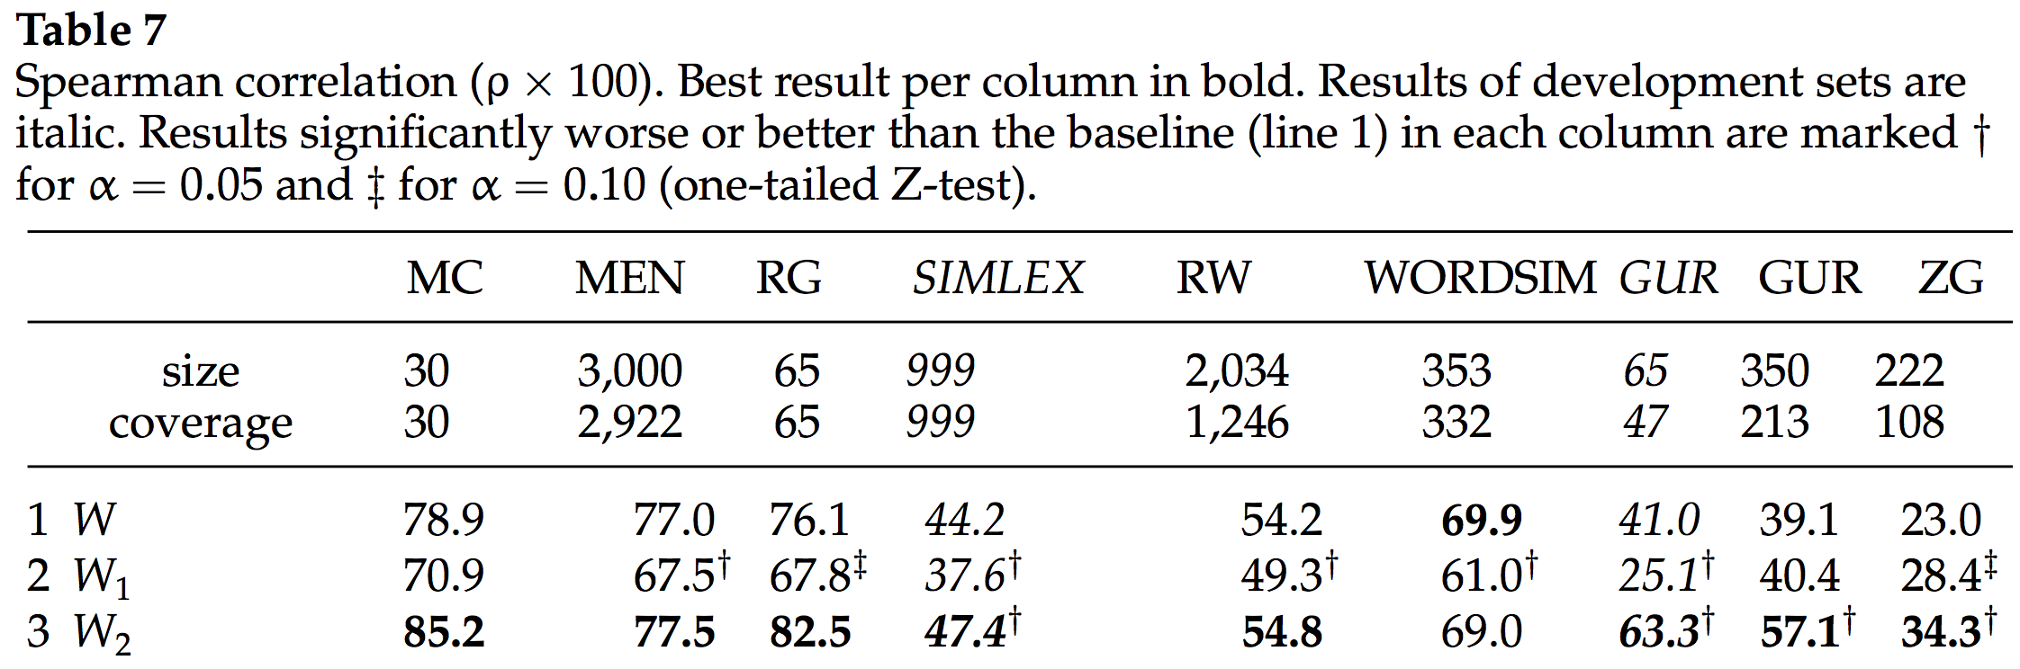
Word Similarity

Slide 18
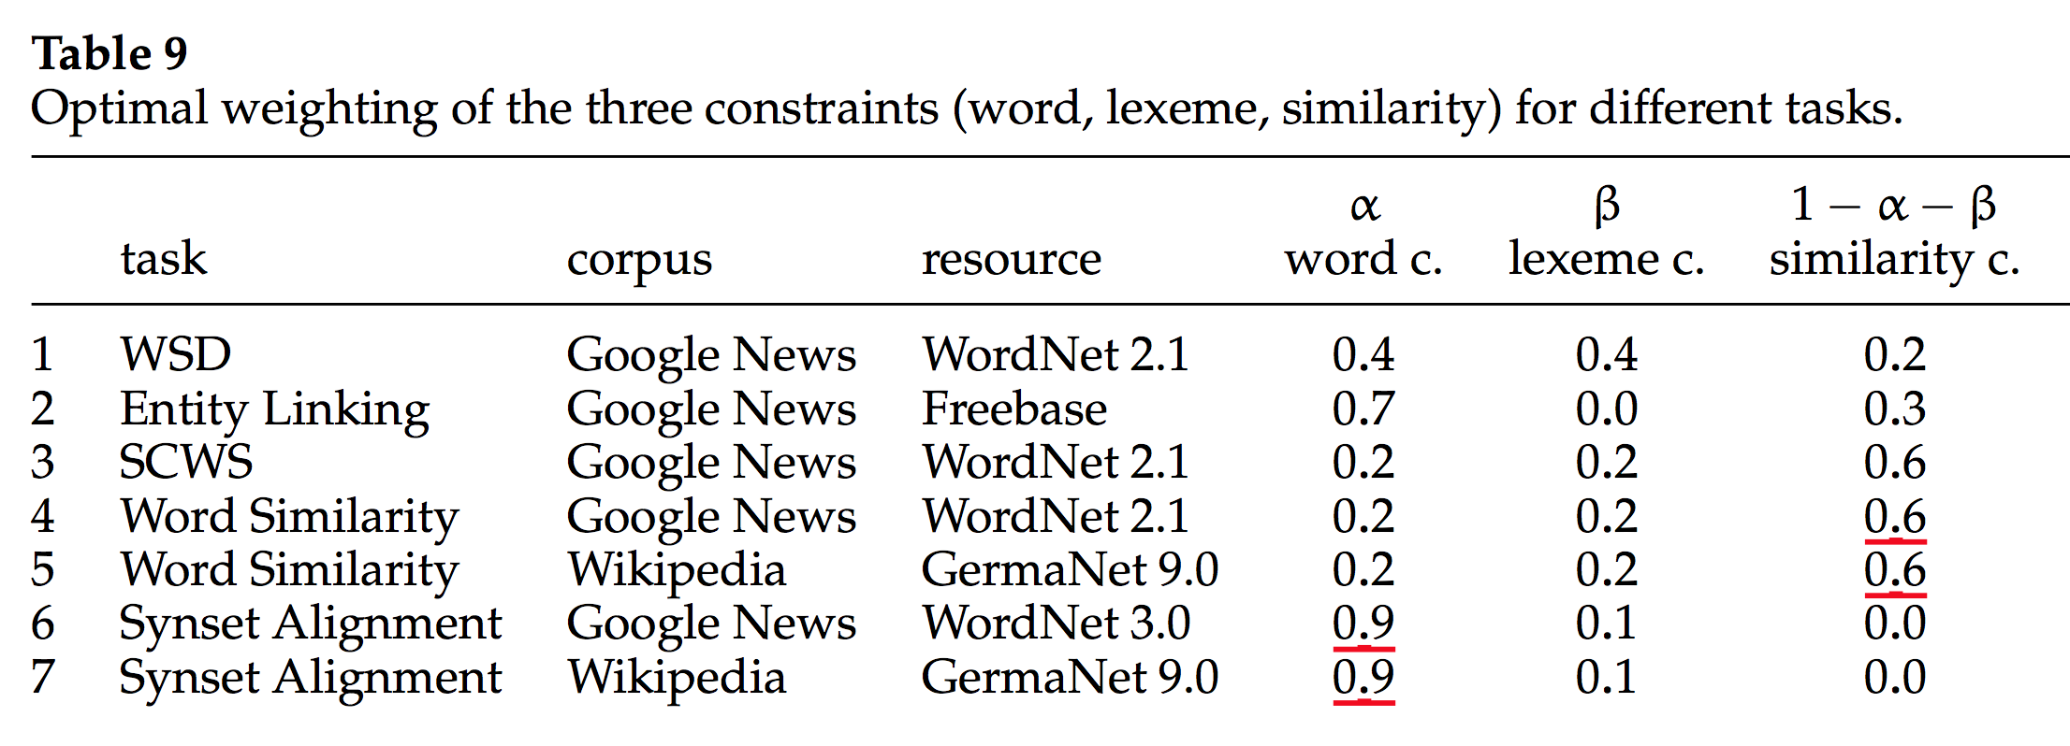
Analysis
The most important parameter of AutoExtend is the weighting α and β given to the objectives.

Slide 19
结论

