Slide 1
Neural networks Incorporating Dictionaries for Chinese Word Segmentation
Xiaoyu Liu (Fudan University) Advisor: Prof. Qi Zhang
1

Slide 2
Chinese Word Segmentation
Input (character sequence):
上海市复旦大学
(shang hai shi fu dan da xue)
Output (word sequence):
上海市 复旦大学
(Shanghai Fudan University)

Slide 3









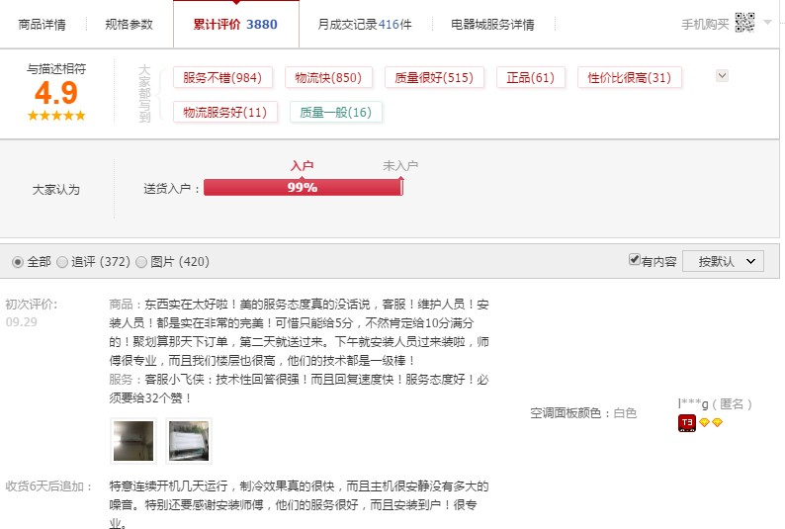


Importance of Chinese Word Segmentation
Parsing
Text Classification
Information Retrieval
Translation
Question Answering
……

Slide 4
Sequence Labeling Framework for CWS
上 | 海 | 市 | 复 | 旦 | 大 | 学
B | M | E | B | M | M | E
去 | 哈 | 尔 | 滨 | 旅 | 游
S | B | M | E | B | E
Label Set
B: Begin M: Middle E: End S:Single

Slide 5
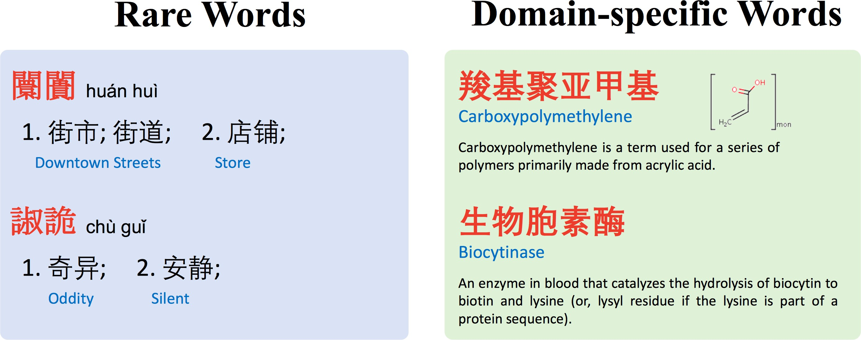
Motivation
Out-of-Vocabulary(OOV) word is the main problem for CWS.
OOV word : rare words, domain-specific words.
Dictionaries contain both commonly used words and rare words.

Slide 6
Motivation
Neural networks model + Dictionaries
How to integrate dictionaries?
We first define several feature templates to construct feature vectors for each character based on dictionaries and contexts.
Then, two different methods that extend the Bi-LSTM-CRF are proposed to introduce the feature vectors.

Slide 7
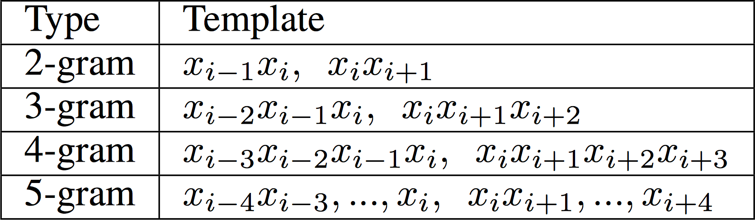
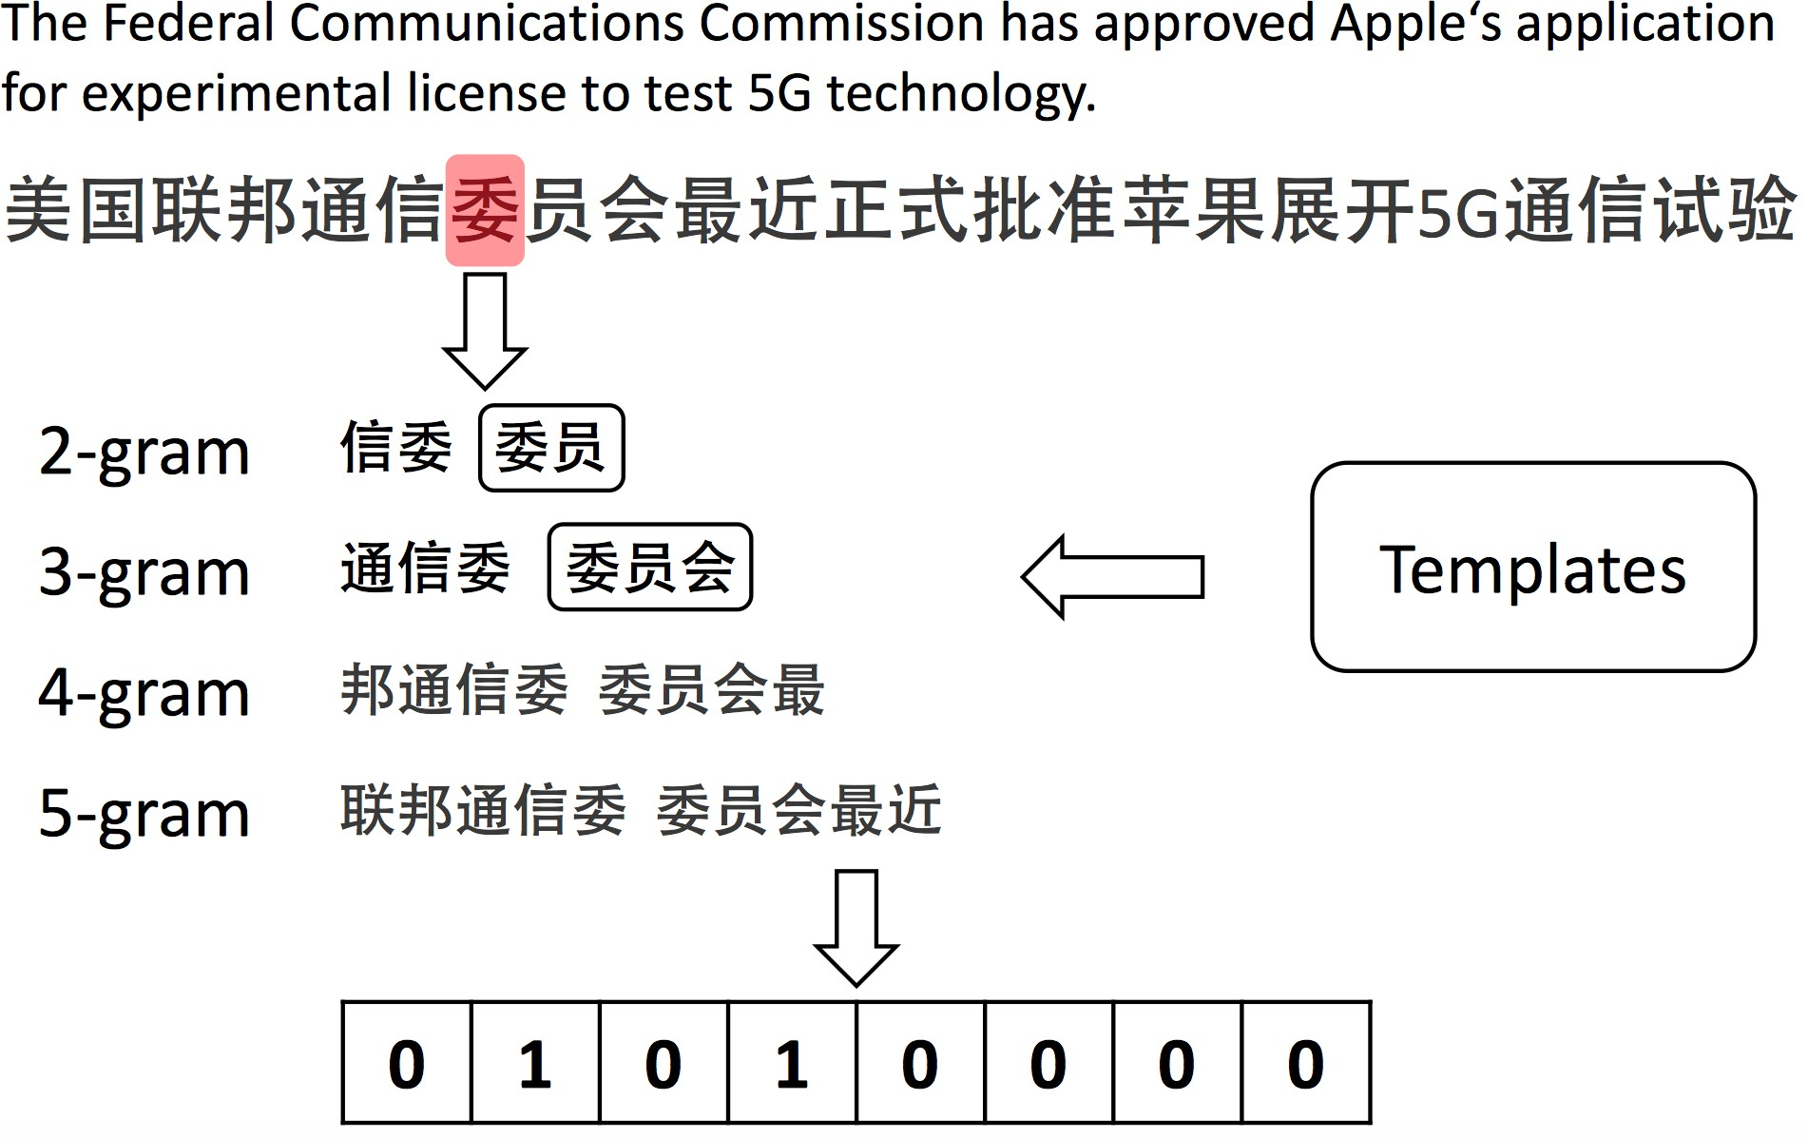
Feature Vector Construction
𝑥&
t_{i}

Slide 8
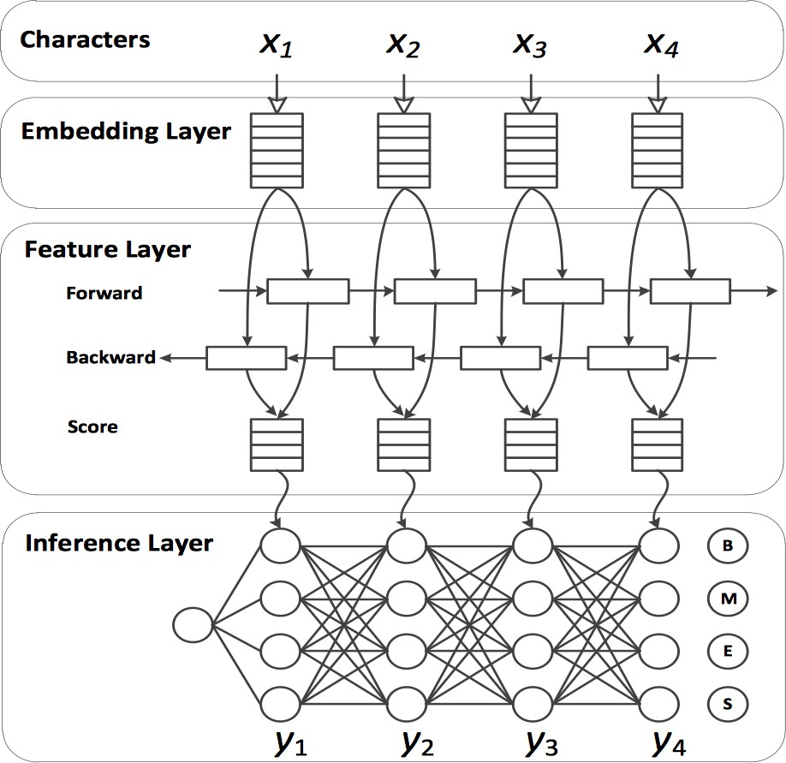
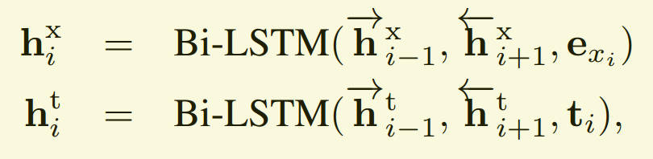

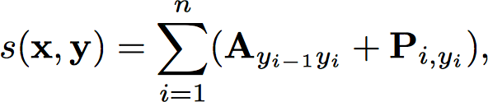
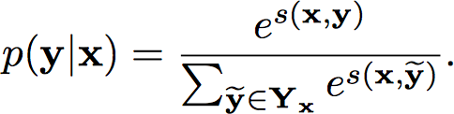
General Bi-LSTM-CRF Model
Bi-Lstm layer:
CRF layer:

Slide 9
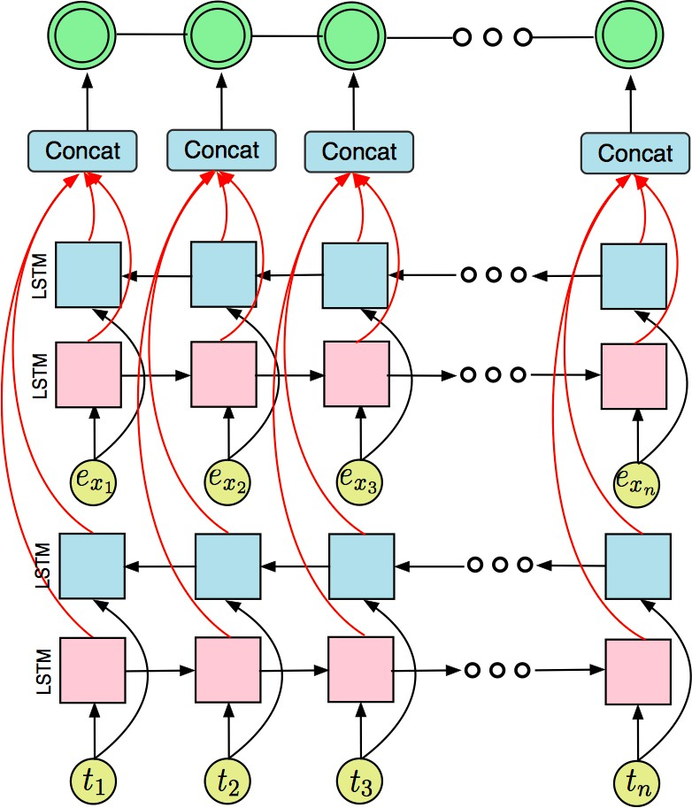
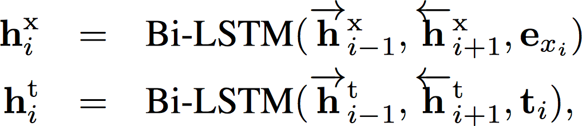

Model I
The e_{x} and t representcharacter embeddings and feature vectors.
Two parallel Bi-LSTMs are used to extract context informationand potential word boundary information.
Then we combine the two hidden states as the inputs of CRF layer.

Slide 10
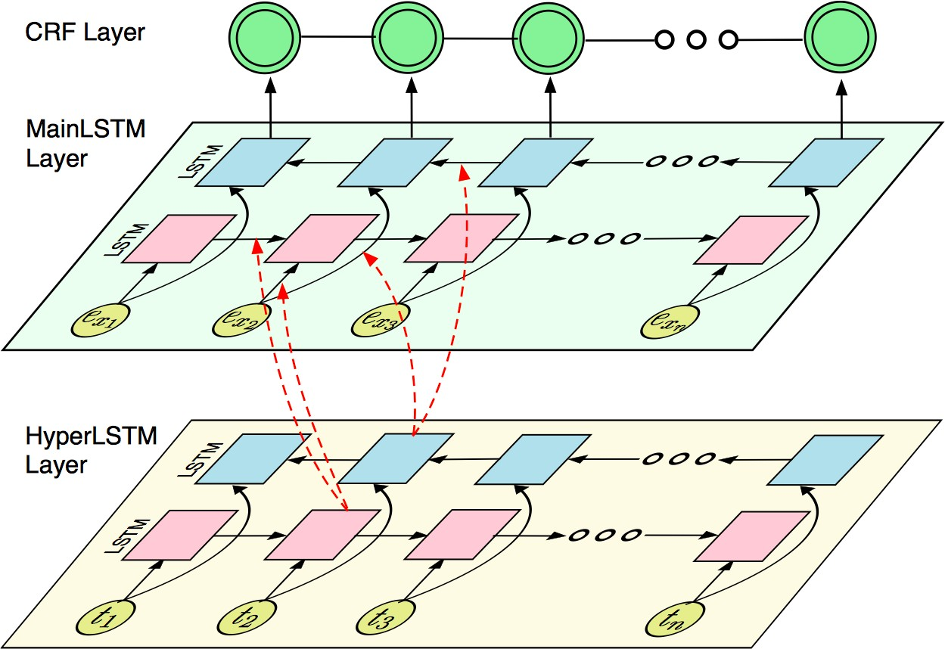
Model II
Feature vectors represent the different boundary candidates.
Under different boundary candidates, using different weights to model x_{i} could get better results.
Hypernetwork
We use a HyperLSTM to dynamically generate the weights for the MainLSTM. The HyperLSTM takes feature vectors t as inputs, while the MainLSTM takes embedding vectors e_{x} as inputs.

Slide 11
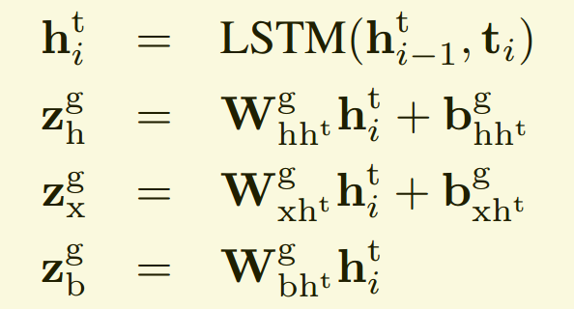
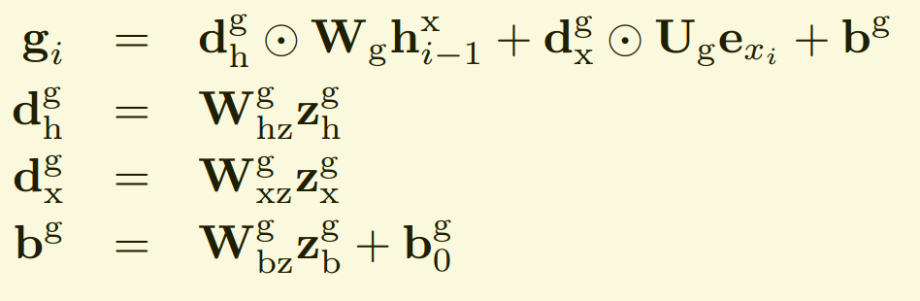
Model II
we use the embedding vectors z to generate the weights of the MainLSTM.

Slide 12
Experimental Results
Datasets
In-domain evaluation for CWS
Out-domain evaluation for CWS

Slide 13
Datasets
Nine Chinese word segmentation datasets
In-domain evaluation
PKU, MSR, AS, CITYU (from SIGHAN2005), and CTB6
(from Chinese TreeBank 6.0) have been commonly used by previous state-of-the-art models.
Cross-domain evaluation
SIGHAN2010 is usually used to evaluate domain adaptation algorithms for CWS. It contains four different test sets from the literature, computer, medical, and financial fields.

Slide 14
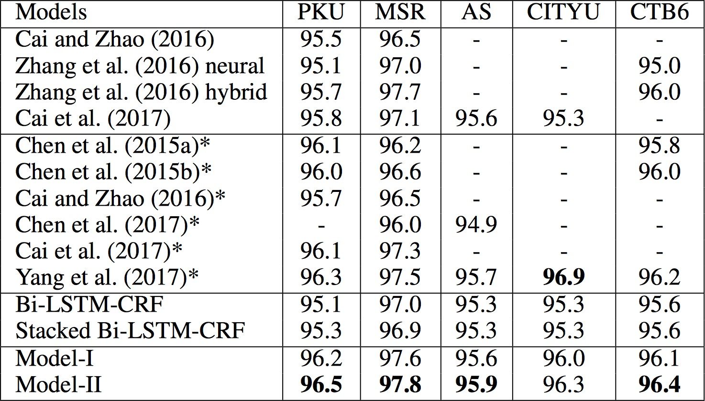
Indomain evaluation
There are four blocks. The first two blocks contains the latest neural network models, and the symbol * represents allowing the use of external resources. The last two blocks give the results of the baseline models and proposed models, respectively.

Slide 15
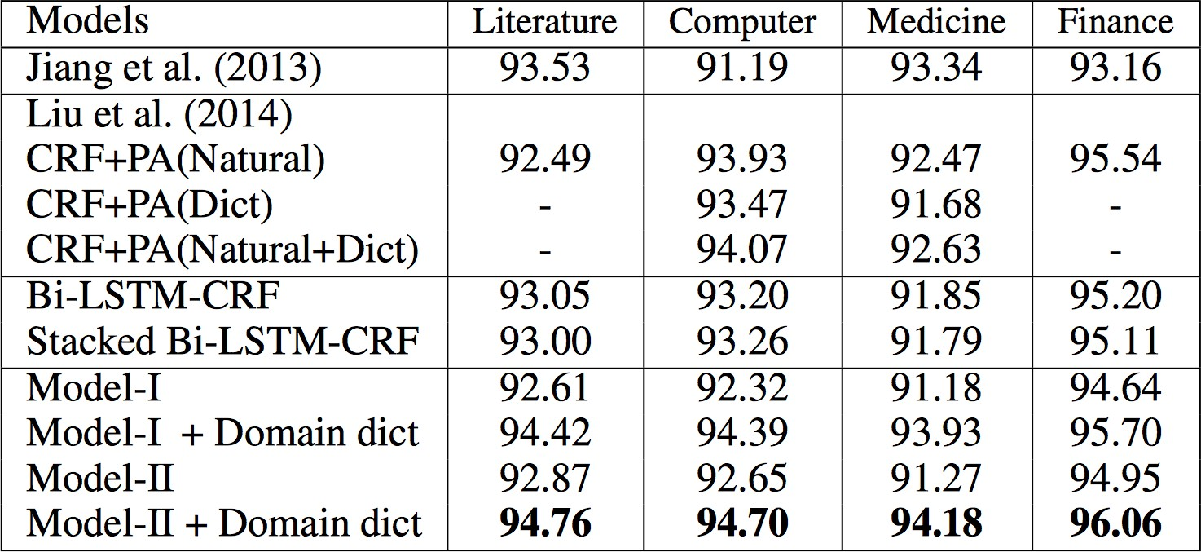
Cross-domain evaluation
The first two blocks contain latest domain adaption models. The last two blocks give the results of the baseline models and proposed models, and domain dict represents domain-specific dictionary.
We ﬁltered partial domain-speciﬁc words appearing in the external dictionary as domain-speciﬁc dictionaries。We regarded these out-of-vocabulary words appearing in the external dictionary as domain-speciﬁc words and randomly extracted some of them as the domain-speciﬁc dictionaries.

Slide 16
Conclusion
We studied the problem of integrating dictionaries into neural networks based methods for the Chinese word segmentation task.
We proposed two methods to integrate information extracted from dictionaries into neural network based methods for a CWS task. The methods can solve the problem caused by rare words and achieve significant improvements in the cross-domain CWS task.
In particular, when applying the model on different domains, we only need to add extra domain specific dictionaries. The other learned parameters can remain unchanged with no need for retraining.

Slide 17
Thank you for your attention!
16

