Slide 1
实体识别

Slide 2
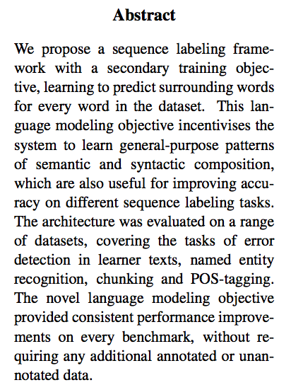
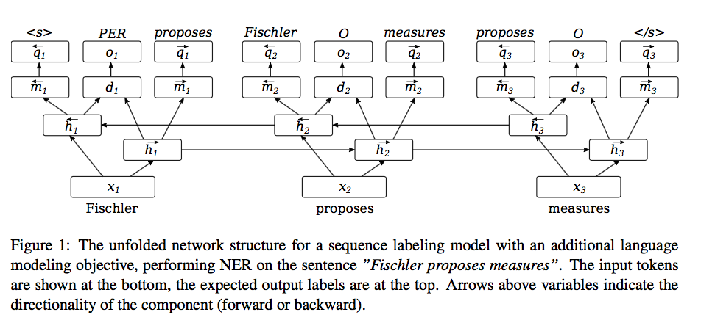
Semi-supervised Multitask Learning for Sequence Labeling. ACL2017

Slide 3
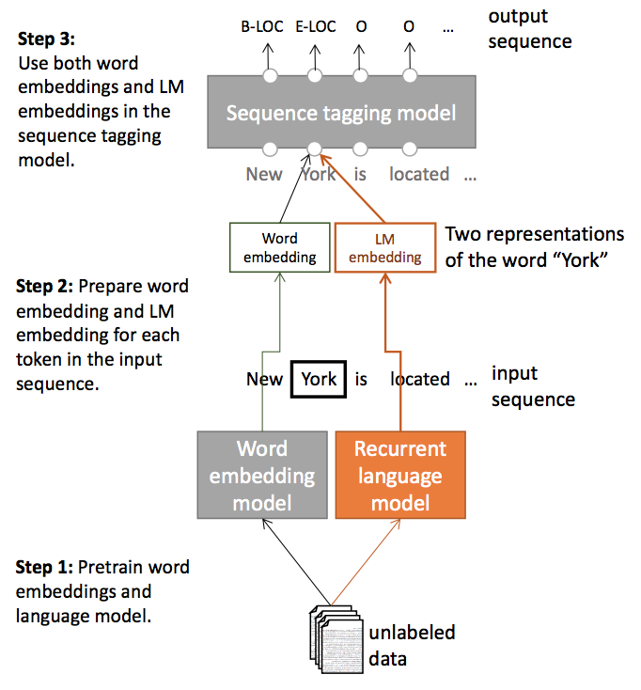
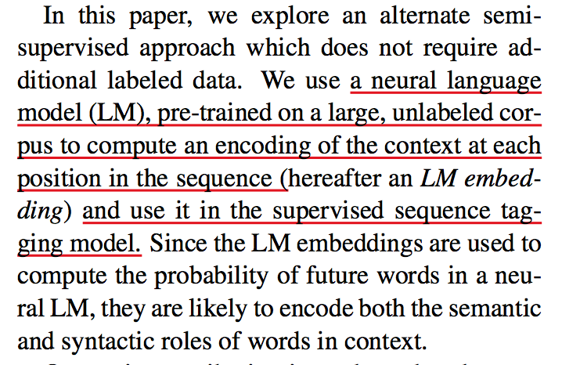
Semi-supervised sequence tagging with bidirectional language models. ACL2017

Slide 4
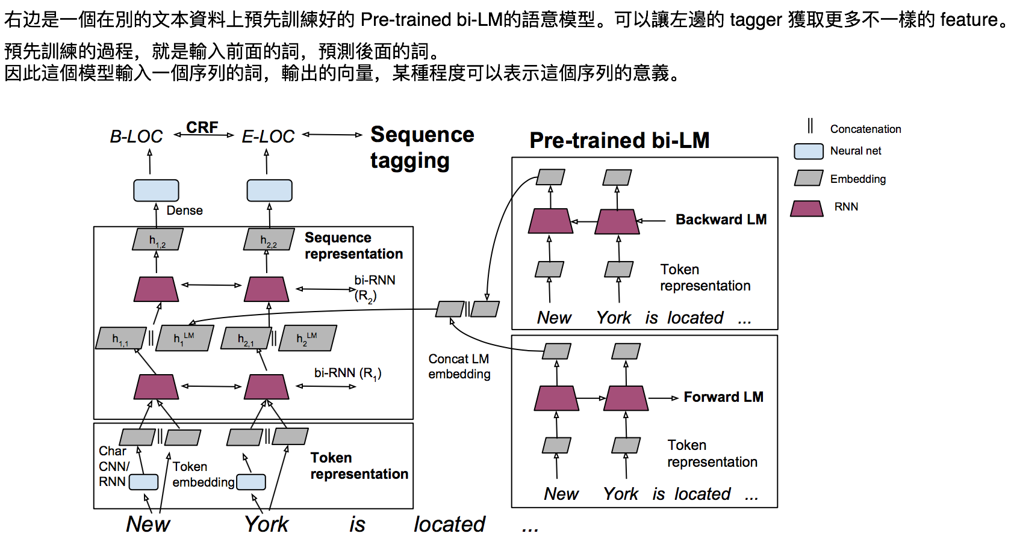
Semi-supervised sequence tagging with bidirectional language models. ACL2017

