Slide 1
Advances in RL
Parra Baoxiang WANG
Summer 2016

Slide 2
Introduction
This slides are about the recent advances brought to the community during ICML this year
This is the categorical showdown of the notes taken during the conference; available at https://github.com/wangbx66/icml16-notes

Slide 3
Content
Advances in DQN
Policy imitation
Policy off-policy evaluation
Integration of domain knowledge
Advertisement

Slide 4
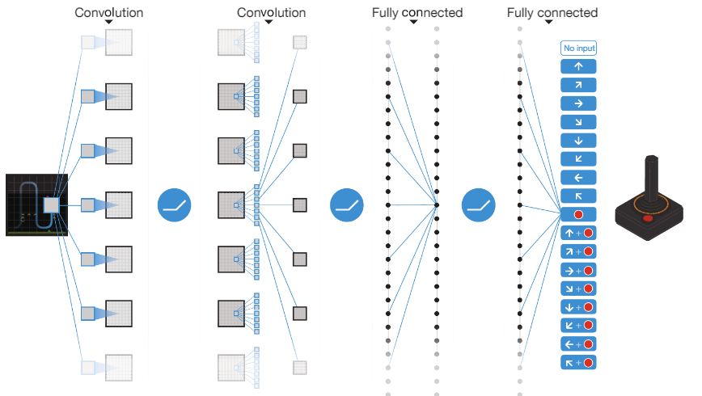

Advances in DQN
DQN – use a network to predict the $Q(s,a)$ value, indicating the evaluation of cumulative reward on state $s$ and action $a$

Slide 5
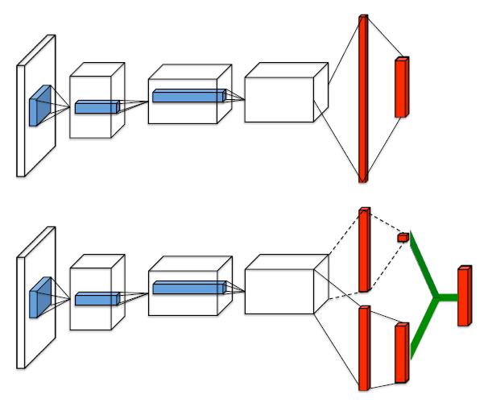

Advances in DQN
Opponent Modeling in Deep Reinforcement Learning
$DQN$
$Q=V+A$

Slide 6
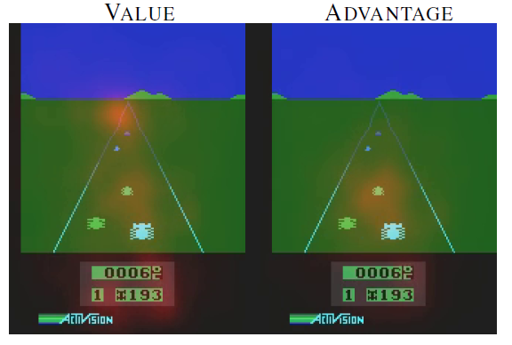
Advances in DQN
Very well-written; recommend to read
New state-of-the-art on Atari 2600

Slide 7
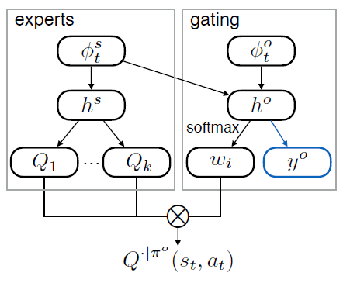
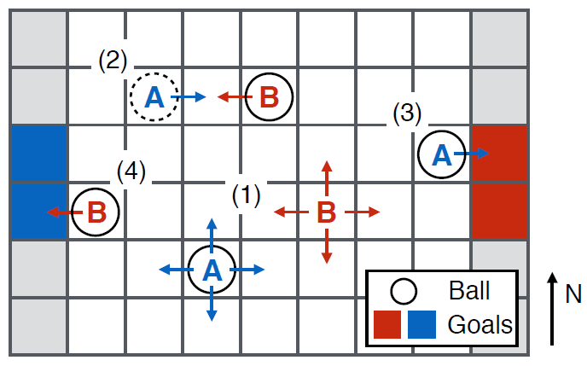
Advances in DQN
DRON: Opponent Modeling in Deep Reinforcement Learning
Driven by poker: agent exploits opponents

Slide 8
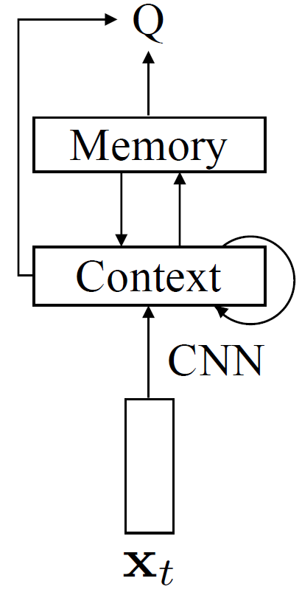
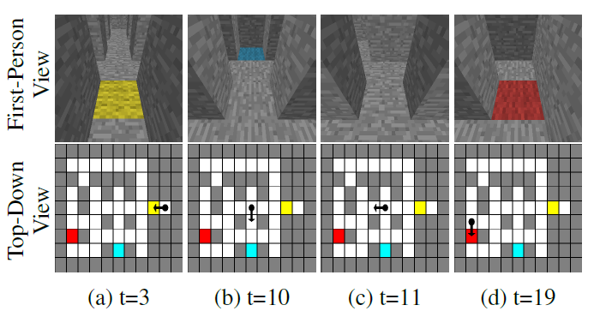
Advances in DQN
Control of Memory, Active Perception, and Action in Minecraft
Add a RAM-like unit for long term memory

Slide 9
Advances in DQN
Continuous DQN with model-based acceleration
Use imagination rollouts to reduce SC
Asynchro DRL
Use Asynchro optimization to reduce TC on single machine. Also applicable to Actor-critic

Slide 10
Policy Imitation and Evaluation
Imitation
Learn how user feels from their log
Learn how user makes decision based on their feeling
Simulate the user behaviors
Evaluation off-policy
Evaluate the performance of an alternate using the log of existing ones

Slide 11
Policy Imitation and Evaluation
Model-Free Imitation Learning via PG
Smooth Imitation Learning
Guided Cost Learning Algorithm
Data-Efficient Off-Policy Policy Evaluation
Doubly Robust Off-policy Value Evaluation

Slide 12
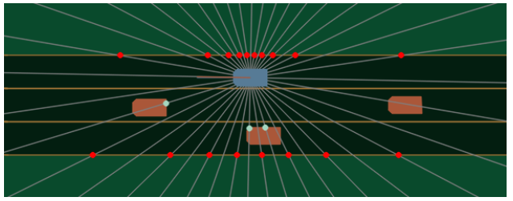
Policy Imitation and Evaluation
Model-Free Imitation Learning via PG
direct application of policy gradient on policy imitation
iteratively finding the cost function maxima and the policy minima

Slide 13
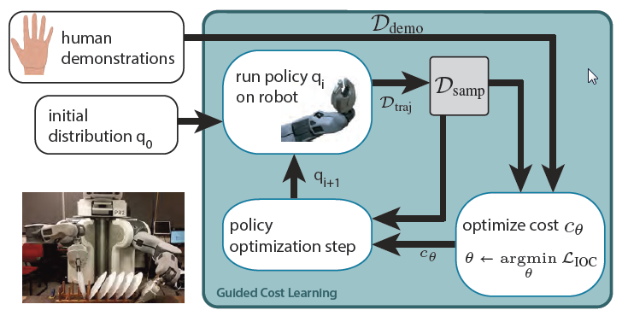

Policy Imitation and Evaluation
Guided Cost Learning Algorithm
Close to “deep iRL”
Iteratively optimize trajection sampler $q$ and cost function $c$

Slide 14
Domain Knowledge
Integrating Comparison: Tetris play
Comparaison: simple dominance, cumulative dominance, and noncompensation
Calculate some easy features (e.g. number of holes) after each feasible actions. These properties eliminates 70% - 90% of actions

Slide 15
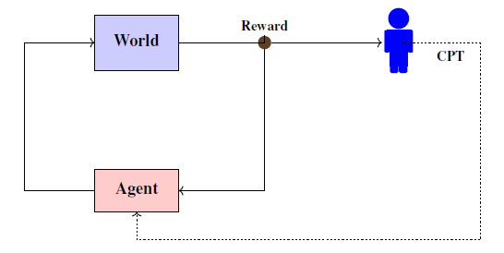
Domain Knowledge
Cumulative Prospect Theory Meets Reinforcement Learning
It provides a theoretical estimation of the CPT value, given the following arch

Slide 16
Advertisement: C³-UCB
Bandit problem: for sequential, slot machines plays
Contextual Bandit: consider the context corresponding to the arms. The slot machines can be generated to user-based search items, recommended movies, routers in pathing, etc.
https://github.com/wangbx66/contextual-bandit, with S.Li, W.Chen, S.Zhang

