Slide 1
MIPI (Mobile Industry Processor Interface) introduction
Tab@ July 9, 2009

Slide 2
Agenda
MIPI Overview
Specification Version
Display Interface
D-PHY
Operation Mode
Q & A

Slide 3
MIPI Overview

Slide 4
MIPI Overview
The Contents of MIPI
  Display Interface
    ➔ DCS : Display command set
    ➔ DPI : Display pixel interface
    ➔ DBI : Display bus interface
    ➔ DSI : Display serial interface
  Camera Interface
    ➔ Camera parallel interface
    ➔ Camera serial interface
  D-PHY Specification

Slide 5
Specification Version

Slide 6
Specification
Display Serial Interface v1.01.00_R9 ➔ 2/21, 2008
D-PHY v0.90.00 ➔ 10/ 8, 2007
Display Bus Interface v2.0 ➔ 11/16, 2005
Display Pixel Interface v2.0 ➔ 9/15, 2005
Display Command Set v1.01.00 ➔ 6/22, 2006

Slide 7
Display Interface

Slide 8
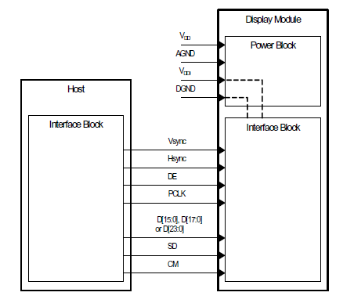
DPI
DPI (Display Pixel Interface)
相似於RGB I/F

Slide 9
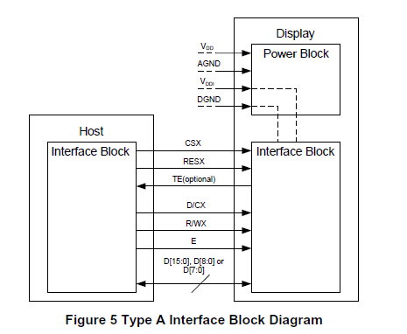
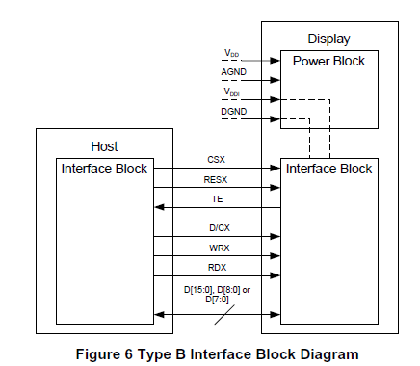
DBI
DBI (Display Bus Interface)
相似於CPU I/F(M68)
相似於CPU I/F(I80)

Slide 10
DSI
DSI (Display Serial Interface)
  Video mode
    Non-Burst Mode with Sync Pulses
    Non-Burst Mode with Events Pulses
    Burst mode
  Command mode
這些mode 皆是由不同的packet type 組合而成

Slide 11
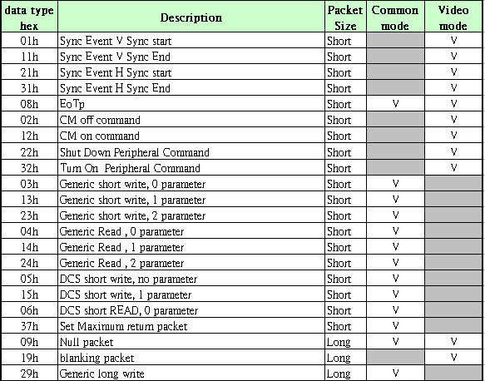
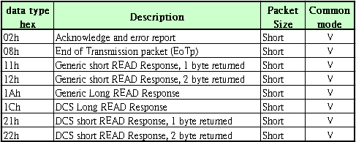
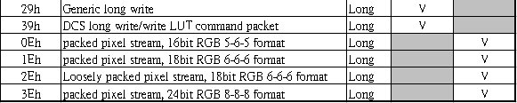
Packet Data types
Forward Transmission data type
Reverse Transmission data type

Slide 12
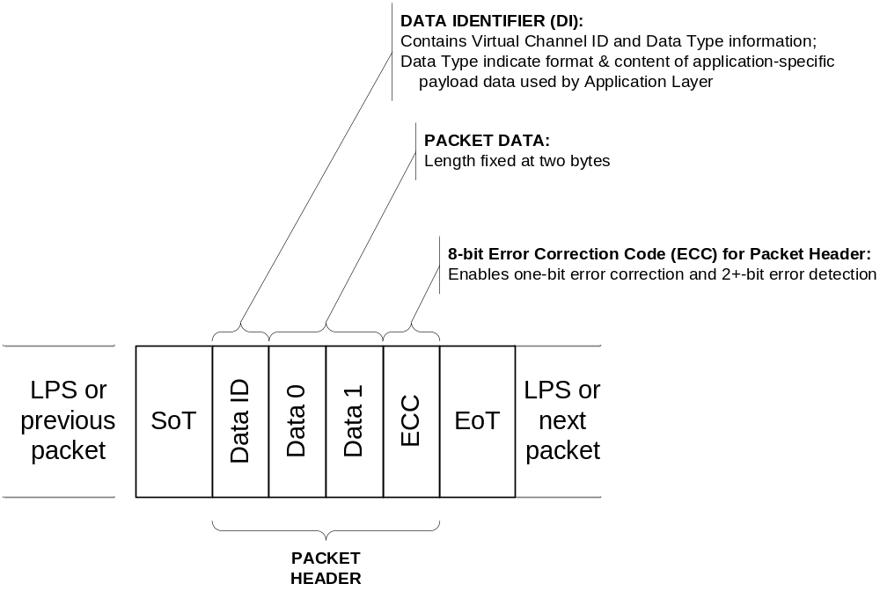
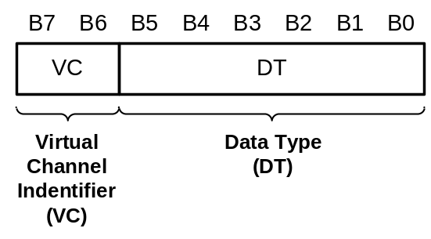
Short Packet Structure
Data ID Format
1 byte
2 byte
1 byte

Slide 13
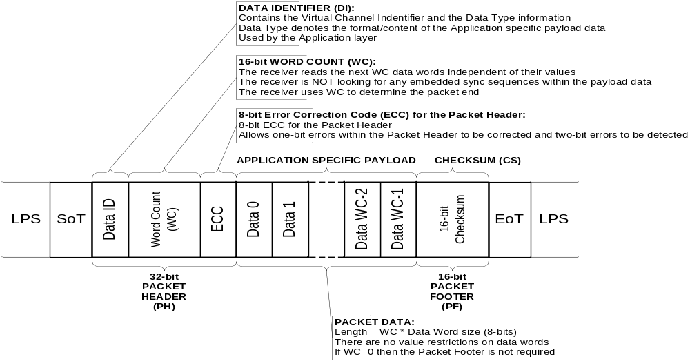
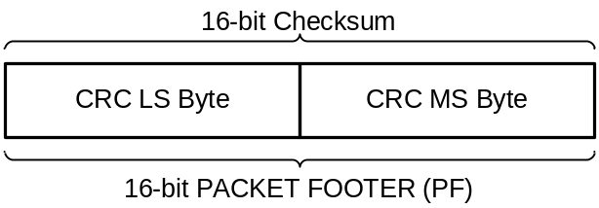
Long Packet Structure
Data ID Format

Slide 14

Video mode
Frame Buffer and Timing Control is in the host processor
由於Timing Control 在Host ,所以DSI 必須一直傳送packet data
Display Panel
Host
Processor
Display Refresh
Timing
Control
Bus
Interface
Bus
Interface
LCD
Display
Update
Frame
Buffer
Color
Frame
Buffer
Display
Driver

Slide 15
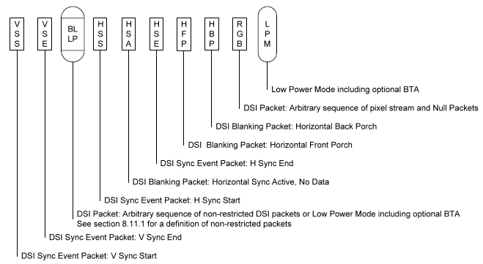
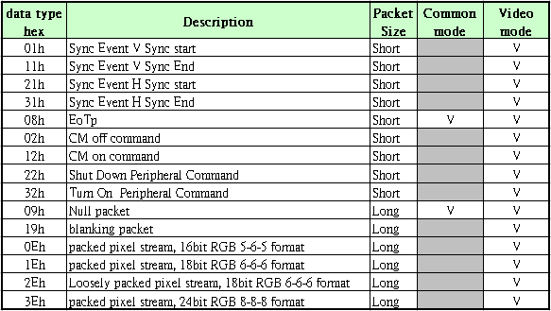
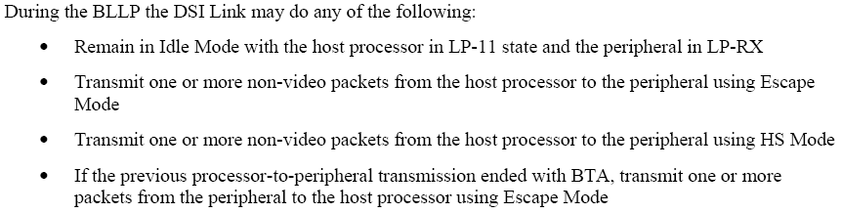
Data Type for Video mode
Packet components used in video mode
LP11
0Eh/1Eh/2Eh/3Eh
19h
19h
31h
19h
21h
19h/09/LP11
11h
01h

Slide 16
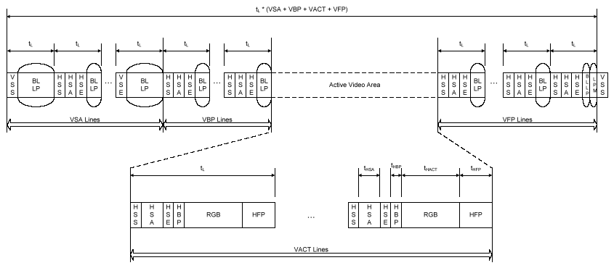
non-burst mode with sync pulses
Video Mode, non-burst mode with sync pulses
必須要由HSS & HSE 產生一個 HS pulse
必須要由VSS & VSE 產生一個 VS pulse

Slide 17
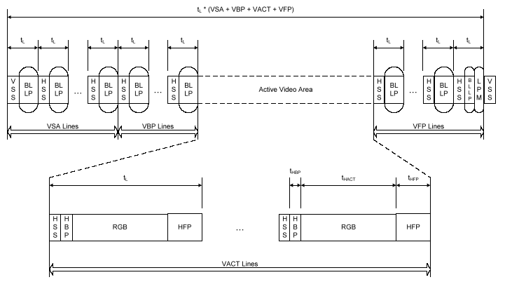
non-burst mode with sync event
Video Mode, non-burst mode with sync event
➔只要用VSS or HSS即可得知 Hsync & Vsync
W/O VSE and HSE packet

Slide 18
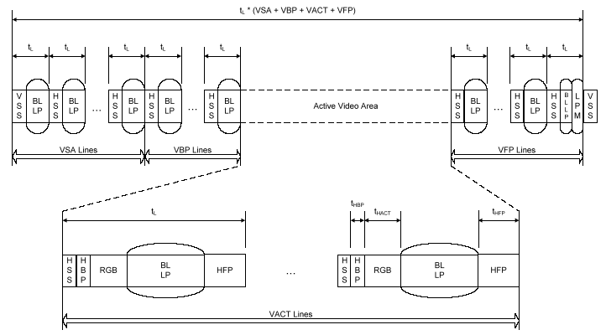
Video Mode Display
Video Mode, burst mode
Need extra line buffers and clock built in the LCD driver for displaying
將資料盡快送完,讓Blanking 區域越長越好,在Blanking區進入LP stage,以利省電

Slide 19
Command Mode
Frame Buffer, display Timing Controller on Display Panel
當Host 傳送packet data完畢後,可進入LP mode, 可達到省電機制
Host
Processor
Display
Panel
Commands &
Image Update
Data
Display
Controller
Bus
Interface
Image
Update
Data
Bus
Interface
LCD
Display
Color
Frame
Buffer

Slide 20
D-PHY

Slide 21
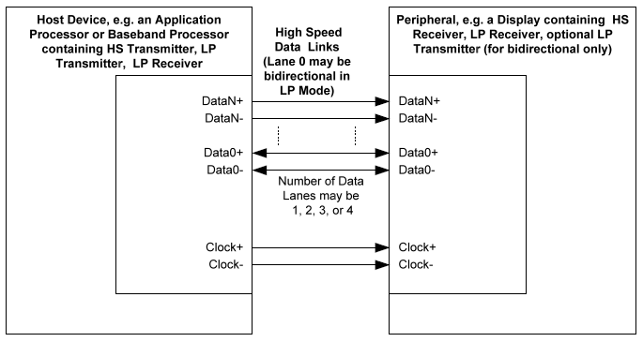
D-PHY Characteristics
1 Clock Lane, unidirectional
1 to 4 Data Lanes,
  Command-mode: data lane 0 必須為雙向
  Video mode : data lane 0 可以為雙向/單向
  其他 data lane 是單向.
Reverse direction transmission shall use low power mode only.
HS Bit rate, per lane –10Mbps~ 500 Mbps.
LP Bit rate, Max is 10Mbps

Slide 22
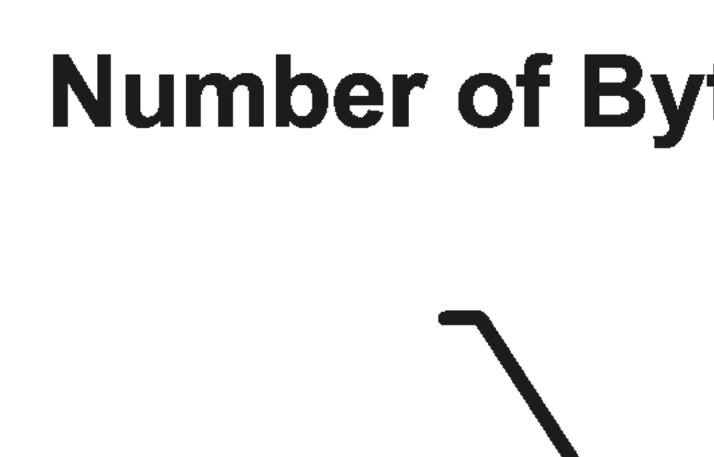
Multilane Data Transmission Example

Slide 23
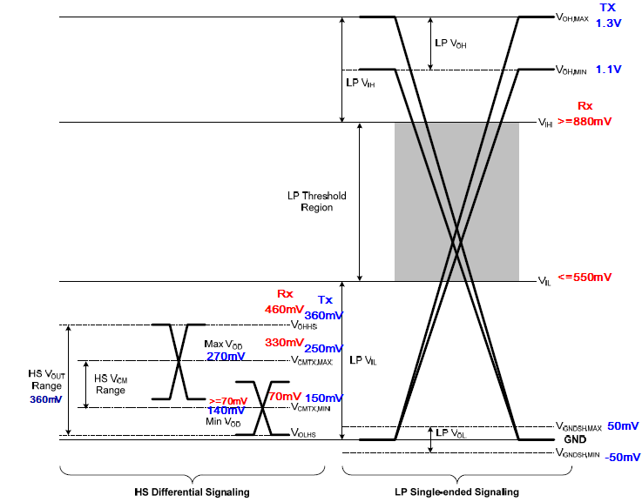
Signal Voltage for HS/LP

Slide 24
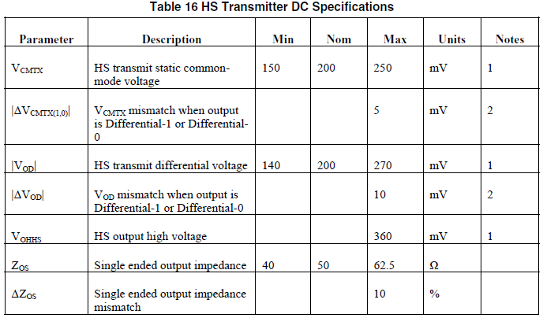
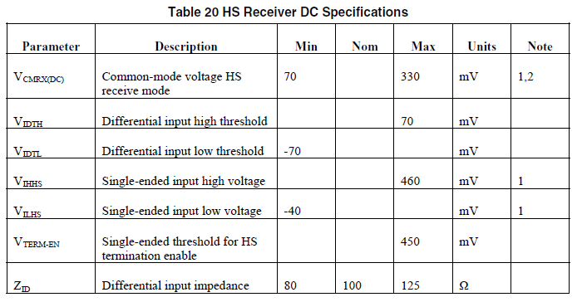
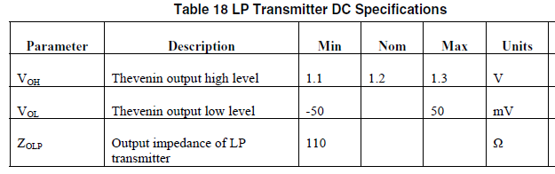
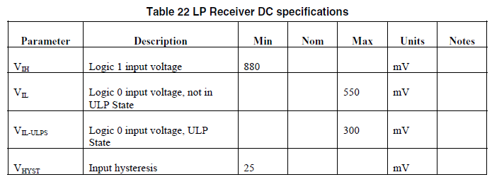
Tx / Rx DC Specification

Slide 25
Operation Mode

Slide 26
Data Lane Flow Diagram ➔ LP to HS
RX
RX
Escape
Trigger
Escape
Trigger
Mode
Init
Mode
Init
Ultra
Ultra
-
-
LP
LP
Wait
Slave
Wait
Slave
LP
LP
-
-
01
01
-
-
00
00
LP
LP
-
-
DT
DT
HS
HS
-
-
Prep
Prep
HS
HS
-
-
Rqst
Rqst
Stop
Stop
LP
LP
-
-
Rqst
Rqst
LP
LP
-
-
00
00
LP
LP
-
-
01
01
LP
LP
-
-
11
11
LP
LP
-
-
10
10
-
-
00
TX
00
TX
Escape
Triggers
Escape
Init
Triggers
Init
Mode
Ultra
Mode
Ultra
-
-
LP
SoT
LP
SoT
HS
HS
-
-
DT
DT
EoT
Master
EoT
Master
Turnaround
LP
Turnaround
LP
-
-
00
00
-
-
01
LP
01
LP
-
-
DT
DT
LP
LP
-
-
10>00 ... 00>10
10>00 ... 00>10
HS
HS
-
-
Prep
Prep
HS
HS
-
-
Rqst
Rqst
Stop
Stop
LP
LP
-
-
Rqst
Rqst
LP
LP
-
-
00
00
LP
LP
-
-
01
01
LP
LP
-
-
11
11
LP
LP
-
-
10
10
-
-
00
00
SoT
SoT
HS
HS
-
-
DT
DT
EoT
EoT
Turnaround
Turnaround
LP10>00>... >00>10
LP10>00>... >00>10

Slide 27
Data Lane Flow : LP to HS
CLK
LP-11
LP-01
LP-00
HS-0
HS-11101
/HS last bit
LP-11
T_{LPX}
T_{HS-PREPARE}
T_{HS-ZERO}
T_{HS-SYNC}
disconnect
terminator
Dp/Dn
SYNC
Data
LP-11
LP-11
LP-01
LP-00
T_{EOT}
capture
1st data bit
T_{HS-SETTLE}
T_{HS-TRAIL}

Slide 28
Data Lane Flow Diagram ➔ LP to BTA
RX
RX
Escape
Trigger
Escape
Trigger
Mode
Init
Mode
Init
Ultra
Ultra
-
-
LP
LP
Wait
Slave
Wait
Slave
LP
LP
-
-
01
01
-
-
00
00
LP
LP
-
-
DT
DT
HS
HS
-
-
Prep
Prep
HS
HS
-
-
Rqst
Rqst
Stop LP11
Stop
LP
LP
-
-
Rqst
Rqst
LP
LP
-
-
00
00
LP
LP
-
-
01
01
LP
LP
-
-
11
11
LP
LP
-
-
10
10
-
-
00
TX
00
TX
Escape
Triggers
Escape
Init
Triggers
Init
Mode
Ultra
Mode
Ultra
-
-
LP
SoT
LP
SoT
HS
HS
-
-
DT
DT
EoT
Master
EoT
Master
Turnaround
LP
Turnaround
LP
-
-
00
00
-
-
01
LP
01
LP
-
-
DT
DT
LP
LP
-
-
10>00 ... 00>10
10>00 ... 00>10
HS
HS
-
-
Prep
Prep
HS
HS
-
-
Rqst
Rqst
Stop
Stop
LP
LP
-
-
Rqst
Rqst
LP
LP
-
-
00
00
LP
LP
-
-
01
01
LP
LP
-
-
11
11
LP
LP
-
-
10
10
-
-
00
00
SoT
SoT
HS
HS
-
-
DT
DT
EoT
EoT
Turnaround
Turnaround
LP10>00>... >00>10
LP10>00>... >00>10

Slide 29
Link Turnaround
T_{TA-GO}
drive
overlap
LP-11
LP-10
LP-00
LP-10
LP-00
LP-00
LP-00
LP-10
LP-11
T_{TA-SURE}
T_{TA-GET}
All during Low-Power mode
Request sequence (LP11)-LP10-LP00-LP10-LP00…..

Slide 30
Data Lane Flow Diagram ➔ LP to Escape
RX
RX
Escape
Trigger
Escape
Trigger
Mode
Init
Mode
Init
Ultra
Ultra
-
-
LP
LP
Wait
Slave
Wait
Slave
LP
LP
-
-
01
01
-
-
00
00
LP
LP
-
-
DT
DT
HS
HS
-
-
Prep
Prep
HS
HS
-
-
Rqst
Rqst
Stop
Stop
LP
LP
-
-
Rqst
Rqst
LP
LP
-
-
00
00
LP
LP
-
-
01
01
LP
LP
-
-
11
11
LP
LP
-
-
10
10
-
-
00
TX
00
TX
Escape
Triggers
Escape
Init
Triggers
Init
Mode
Ultra
Mode
Ultra
-
-
LP
SoT
LP
SoT
HS
HS
-
-
DT
DT
EoT
Master
EoT
Master
Turnaround
LP
Turnaround
LP
-
-
00
00
-
-
01
LP
01
LP
-
-
DT
DT
LP
LP
-
-
10>00 ... 00>10
10>00 ... 00>10
HS
HS
-
-
Prep
Prep
HS
HS
-
-
Rqst
Rqst
Stop
Stop
LP
LP
-
-
Rqst
Rqst
LP
LP
-
-
00
00
LP
LP
-
-
01
01
LP
LP
-
-
11
11
LP
LP
-
-
10
10
-
-
00
00
SoT
SoT
HS
HS
-
-
DT
DT
EoT
EoT
Turnaround
Turnaround
LP10>00>... >00>10
LP10>00>... >00>10

Slide 31
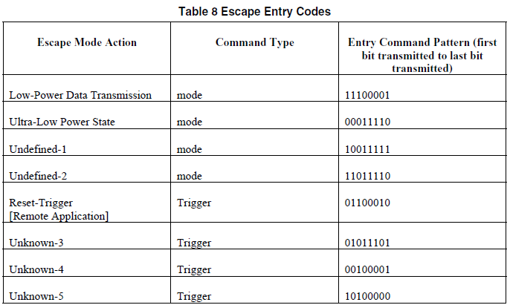
Escape Entry Codes
Low Power Data Transmission
  用來作為Low Power mode 傳送data的辨識碼
Ultra Low Power state
  ➔用來進入ULP mode 的辨識碼
Reset-Trigger
  ➔ 用來遠端控制用,收到此辨識碼,可要求Rx 動作

Slide 32
Escape Mode Signaling
Trigger Reset Example
LP-11>10>00>01>00>01>00>10>00>……..
Dp
Dn
0
1
1
0
0
0
1
0
Escape Mode Entry
Entry Command
Mark & Stop:
Exit Escape
LP Clk=EXOR(Dp,Dn)
CLK信号采取异或运算法则。
Escape Mode Entry指的是在LP模式下数据线电压的变化流程
Entry Command指的是在一个时钟周期内(从上升沿到下一个上升沿),线对之间的电压差电平,不会同时出现高或者低电平.

Slide 33
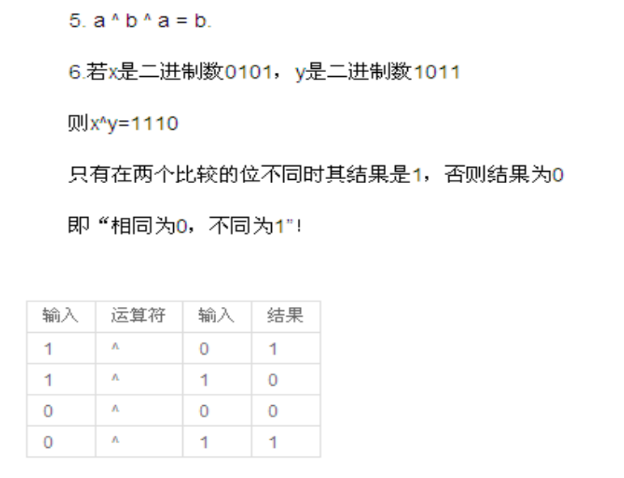
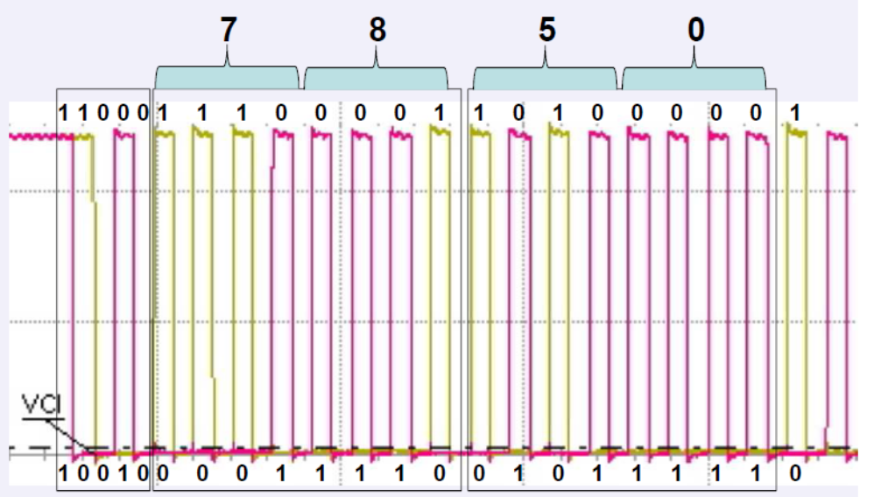
下面简单介绍MIPI的通道模式和线上电平。在正常的操作模式下，数据通道处于高速模式或者控
制模式。在高速模式下，通道状态是差分的0或者1，也就是线对内P比N高时，
定义为1，P比N低时，定义为0，此时典型的线上电压为差分200MV，
请注意图像信号仅在高速模式下传输；在控制模式下，高电平典型幅值为1.2V，
此时P和N上的信号不是差分信号而是相互独立的，当P为1.2V，N也为1.2V时，
MIPI协议定义状态为LP11，同理，当P为1.2V，N为0V时，定义状态为LP10，依
此类推，控制模式下可以组成LP11，LP10，LP01，LP00四个不同的状态;MIPI协议规
定控制模式4个不同状态组成的不同时序代表着将要进入或者退出高速模式等；比
如LP11-LP01-LP00序列后，进入高速模式。下图为线上电平的图示。

Slide 34
Escape Mode Signaling
Two Byte LPDT Example
Dp
Dn
Escape
Mode
Entry
LPDT
Command
First Data Byte
01110101
Pause:
Asynchronous
no transition
Second Data Byte
11010000
Exit
Escape
LP Clk = EXOR(Dp,Dn)

Slide 35
Clock Lane Flow Diagram
RX
RX
Init
Init
ULP
Slave
ULP
Slave
LP
LP
-
-
00
00
HS
HS
-
-
Prep
LP
Prep
LP
-
-
00
00
TX
LP to ULP
TX
Init
Init
HS
HS
-
-
Rqst
Rqst
Stop
Stop
ULP
ULP
-
-
Rqst
ULP
Rqst
Master
ULP
Master
LP
LP
-
-
00
00
LP
LP
-
-
01
01
LP
LP
-
-
11
11
LP
LP
-
-
10
HS
ULP
10
HS
-
-
Prep
LP
Prep
LP
-
-
00
LP to HS
00
LP
-
00
SoT
SoT
HS
HS
-
-
DT
DT
EoT
EoT
HS
HS
-
-
Prep
Prep
HS
HS
-
-
Rqst
Rqst
Stop
Stop
ULP
ULP
-
-
Rqst
Rqst
LP
LP
-
-
00
00
LP
LP
-
-
01
01
LP
LP
-
-
11
11
LP
LP
-
-
10
10
SoT
SoT
HS
HS
-
-
DT
DT
EoT
EoT

Slide 36
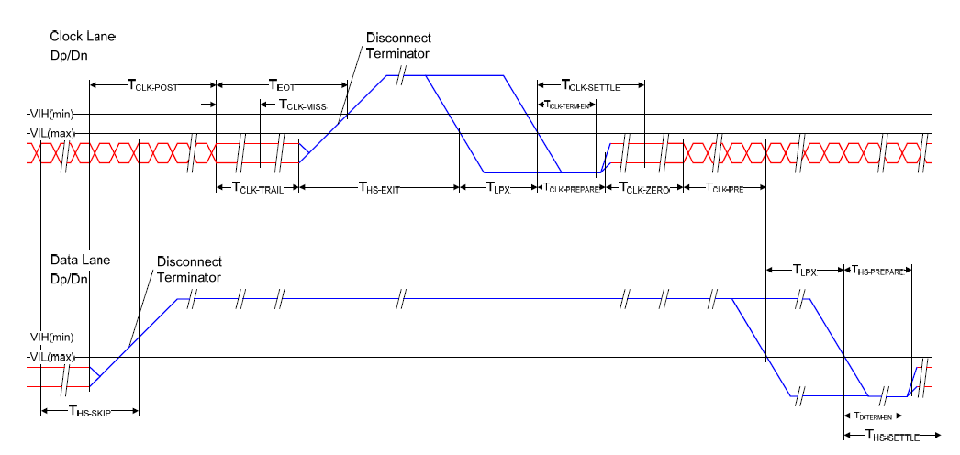
Clock Lane Flow : LP to HS
CLK
/HS last bit
LP11
LP01
LP00
HS-0
Dp/Dn

Slide 37
Q & A

Slide 38
Thank You

