Slide 1


Financial AI will be
trained in our markets
RL environments and human intelligence
for financial AI
Founded
Y Combinator
Raising
September 2026
Winter 2027
Seed round
Confidential · October 2026

Slide 2
02
Company Problem Product Traction Edge Market Round
Overview
RL environments and human intelligence for AI that does financial work
Revenue
Flagship
Buyers
$250K / month
Xitadel
Three segments
Data sales in September 2026, about
$3M a year; no outside capital
Quant research on stocks, baskets and
options, graded by the market
Frontier labs, financial firms
and vertical AI startups
Team
Supply
Market
Quant founders, all 21
7,000+ signed up
$2.8B a year
Cambridge, LSE and Duke mathematics
Jane Street, Citadel, Optiver, Millennium
Traders and experts for paid data work;
600+ GitHub stars on our benchmarks
Spent by investment managers on
alternative data in 2025 (Neudata)
How it fits
Funds already buy their edge as data. We sell the environments and trader data that AI needs to do financial work, and the market grades every result.
Confidential · October 2026
02

Slide 3





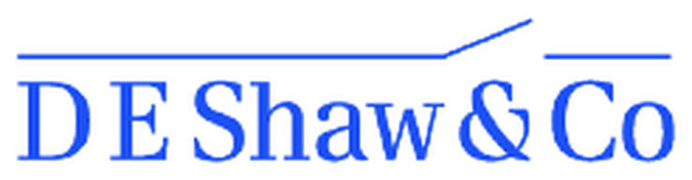
03
Company Problem Product Traction Edge Market Round
Team
Four 21-year-old founders. Together they turned down $1M+ in first-year pay to build SimReal
Charles CEO · 21
Henry CTO · 21
Amaris COO · 21
James CPO · 21
Employee #1 at United Stables, building it from scratch to $1.5B+. Listed on Binance within a month.
Led institutional partnerships with YZi Labs, SIG, DRW and Wintermute
Only intern on HSBC’s HKD stablecoin project, working on HKMA compliance
Hedge fund intern, Citadel
Cambridge Mathematics, St John’s College, First Class with Scholarship
Youngest researcher at the Cambridge AI research center, under Prof. Po-Ling Loh (IMS Fellow)
Ex-quant at Jane Street, Citadel and Optiver
Data scientist, Millennium Hong Kong
First graduate hire on Millennium’s alternative-data team
Co-organized Plug and Play’s first Hong Kong event, with HKSTP (200+ attendees)
Quant trading at Optiver
Asset management at Fidelity
Equity research at Jefferies
LSE, Mathematics
USAMO qualifier
Top 30 worldwide, Cambridge STEP maths competition (~IMO Medalist level)
British Physics Olympiad Top Gold
Duke, Mathematics and Statistics
LSE, Mathematics
AMC: global top 1%
British Mathematical Olympiad: Gold
Confidential · October 2026
03

Slide 4
04
Company Problem Product Traction Edge Market Round
Problem
Agents are moving into financial work. Their backtests lie
Looks right
What actually happens
Trading
Profitable in backtest
→
Loses money live
Research
Signal looks strong
→
Overfit to the past
Forecasting
Analysis sounds right
→
Outcome proves it wrong
Self-improvement
Score goes up
→
By fooling the backtest
6/32
In a live trading contest (Nof1’s Alpha Arena), frontier models made money in only 6 of 32 runs
A backtest you can fool will lie to you. A self-improving agent just gets better at fooling it
Source: Nof1, Alpha Arena (May 2026).
Confidential · October 2026
04

Slide 5
05
Company Problem Product Traction Edge Market Round
Why now
Agents are entering finance and improving themselves. Both need a test they cannot fake
What changed in 2026
What we have built
→
Xitadel: agents do quant research
Stocks, baskets and options, graded by the market
Funds are handing research to agents
An AI-agent hedge fund raised a $100M seed
Abundance, Apr 2026
→
Environments licensed like datasets
Exclusive to one fund, priced at 4–5x
Funds buy their edge as data
Investment managers spent $2.8B on alternative data in 2025, up 17%
Neudata, Feb 2026
→
A test it cannot fool
We try to break every environment before anyone trains on it
AI is improving itself
An agent rewrote its own code and improved 7 times in 8 days
Weco AIDE², Sep 2026
Our position
Environments gate self-improvement. Most neolabs have no revenue; we sell $250K of data a month
Sources: Abundance (Bloomberg, Apr 2026); Neudata, The state of the alternative data market in 2026 (Feb 2026); Weco AI, arXiv 2609.26457; Deedy Das neolab list (May 2026).
Confidential · October 2026
05

Slide 6
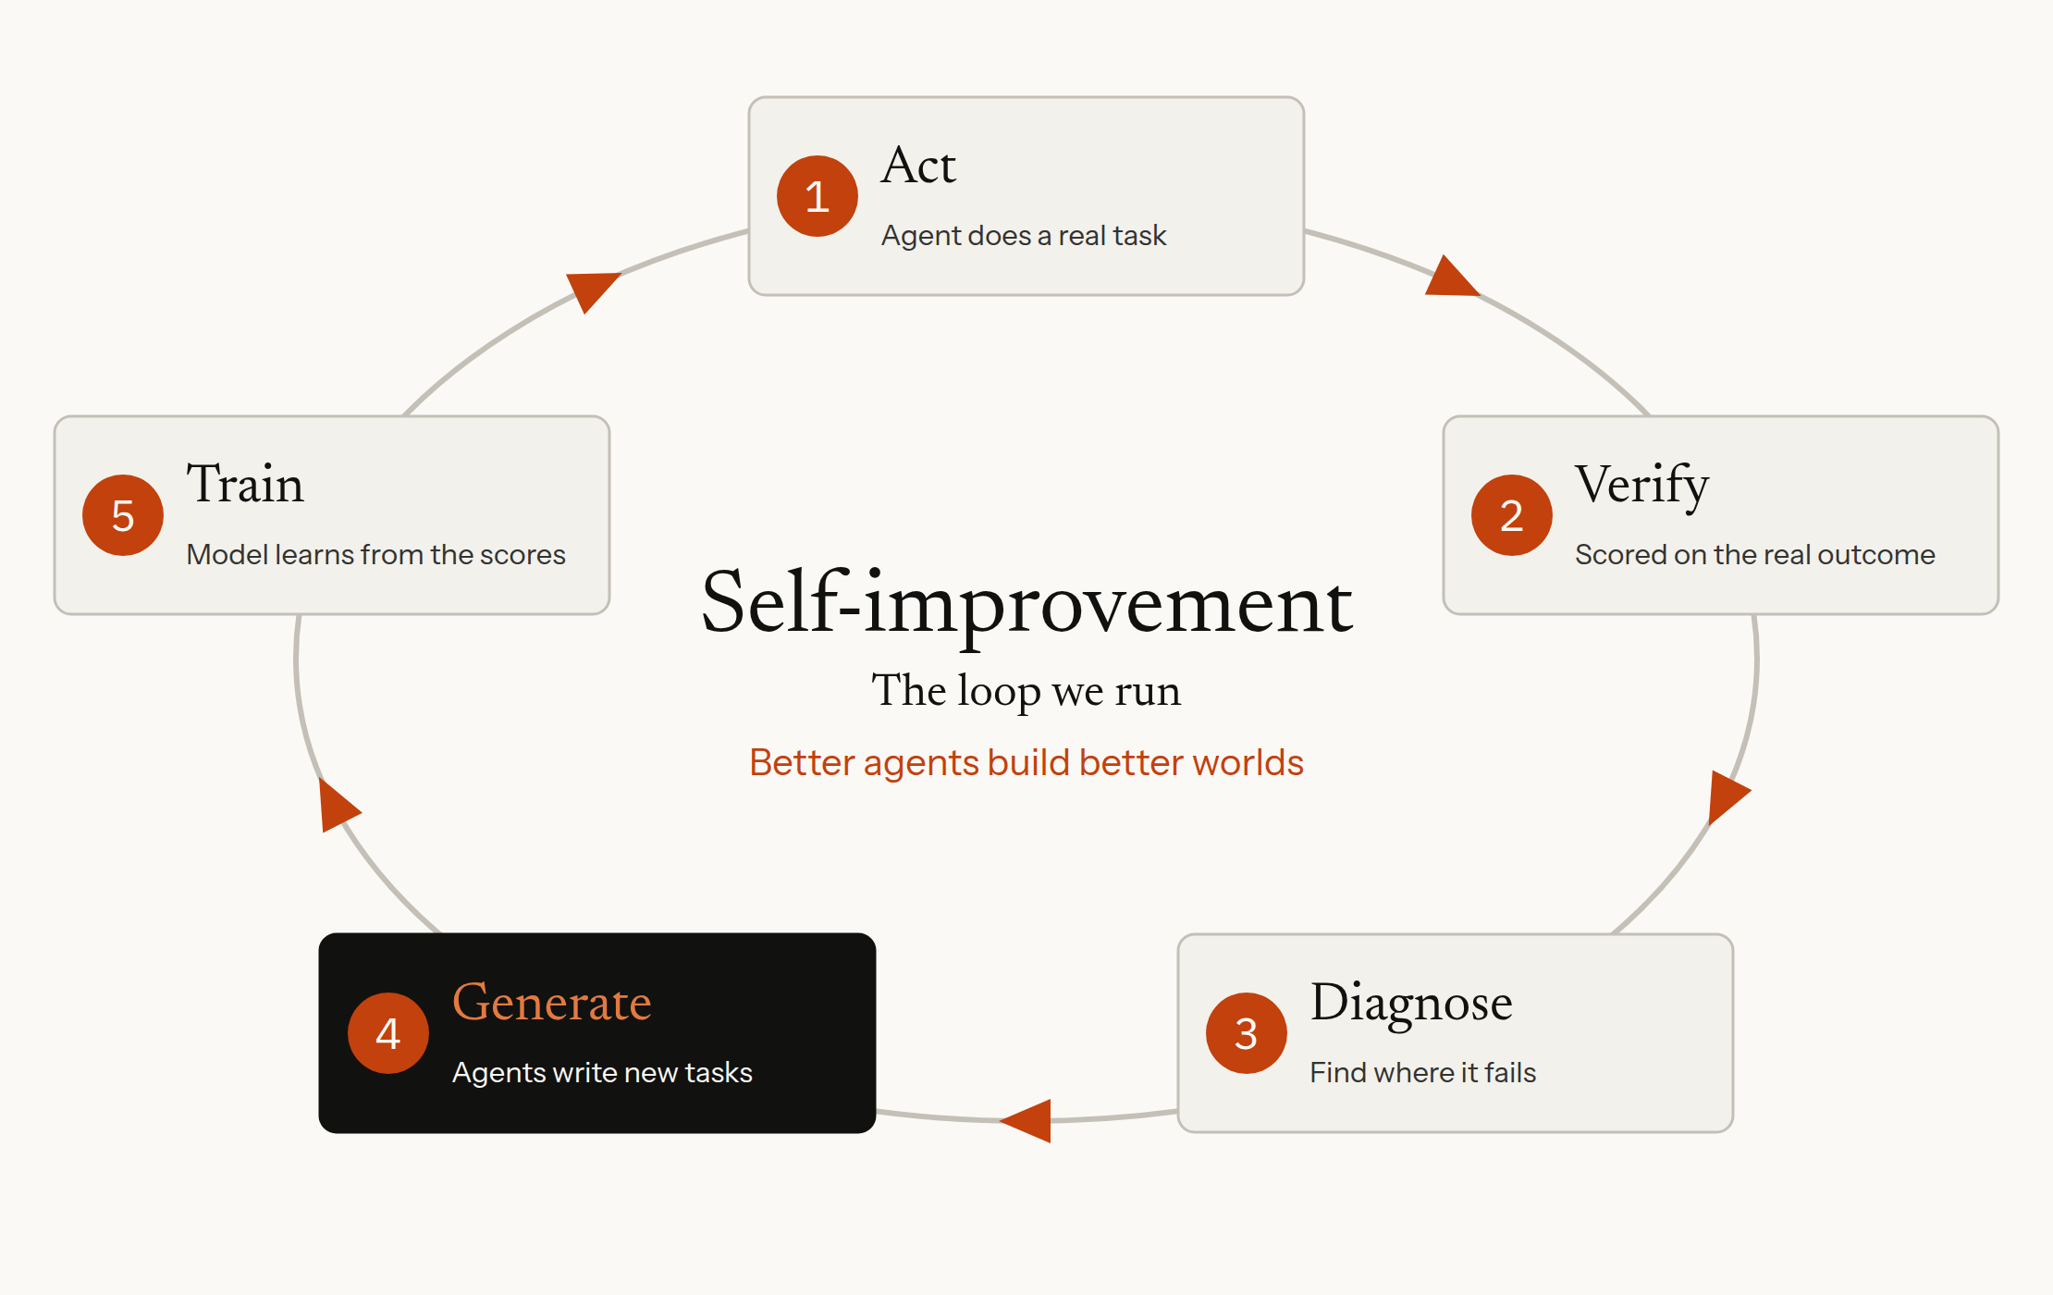
06
Company Problem Product Traction Edge Market Round
Solution
A loop that turns real outcomes into better agents, with AI inside it from day one
What’s different
Today
Experts grade by judgment; evaluations check a known answer
SimReal
The market grades. Every order is matched the way an exchange would match it, and we try to break each environment before anyone trains on it.
Training infrastructure: more per unit of compute
1/4
+64%
−1/3
the time per
practice run
scored attempts,
same compute
time spent saving
checkpoints
Loop figures come from separate internal tests and should not be added together.
Confidential · October 2026
06

Slide 7
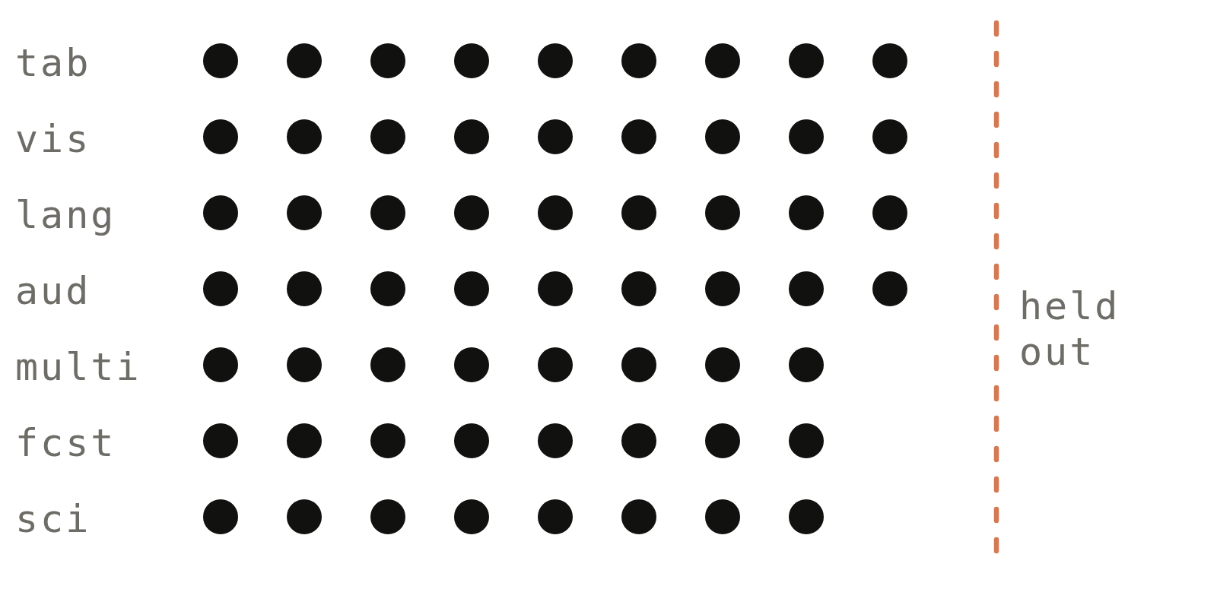
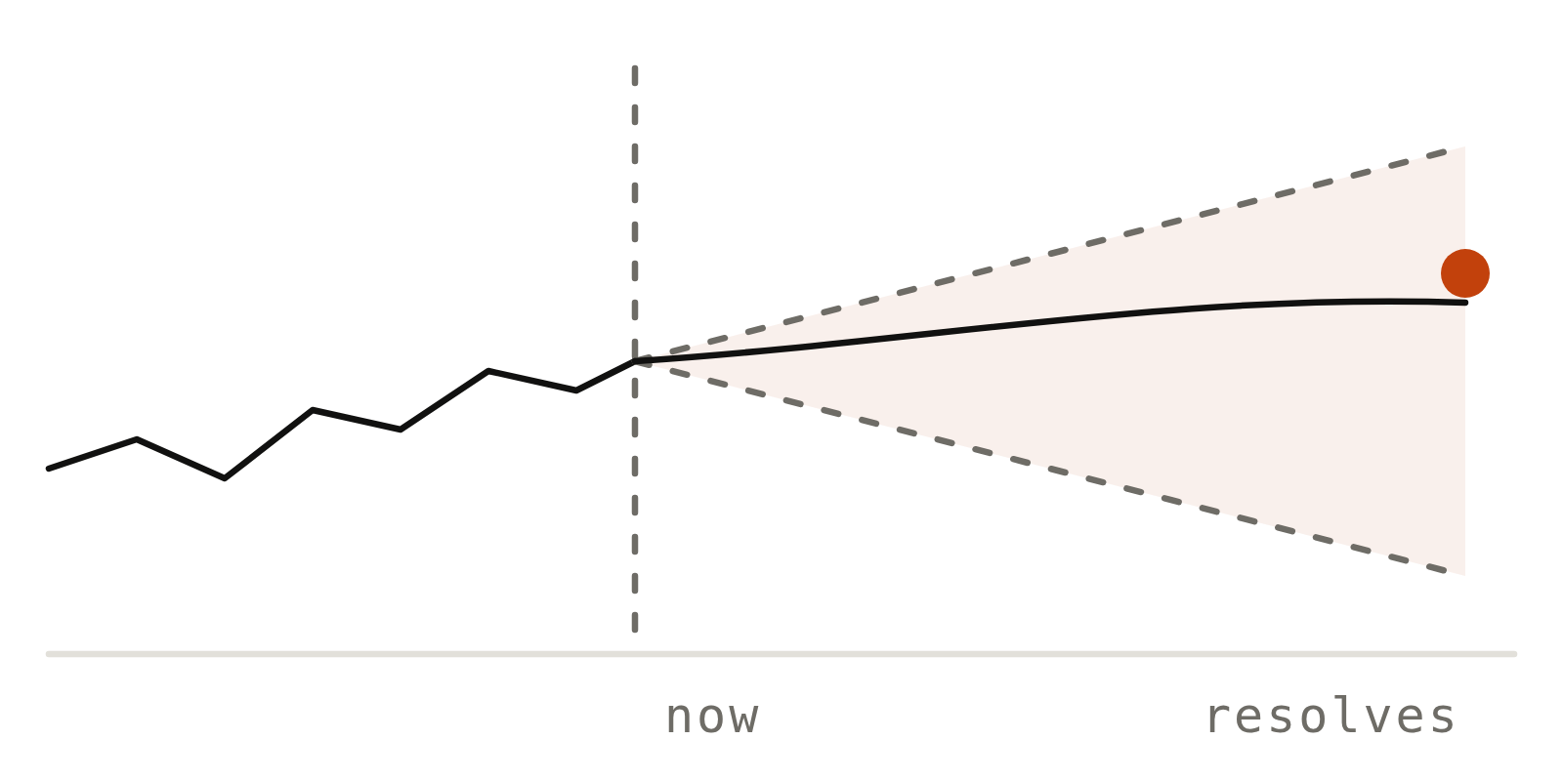
07
Company Problem Product Traction Edge Market Round
Product
Environments and trader data for financial AI. The market or the real outcome grades every result
Forecasting
FLAGSHIP · QUANT RESEARCH
Future Prediction
Xitadel open source
Agents forecast events with search and prediction-market tools, scored when the outcome is known. Copying the frozen market forecast earns zero.
An agent explores private, anonymized market data, writes trading strategies and tests them against bots that simulate other market participants.
Human intelligence
Trader data
What the agent works with
Stocks
ETF-style baskets
Options
Simulated market participants
Demonstrations and explanations from professional and retail traders: how they research and trade
A backtester
A visualizer to inspect every trade
Also built
Scored by
Accounting (Month-End Close) · ML research (MLBench)
Maths, reasoning and software benchmarks
P&L on a withheld trading day, penalized for drawdown and low Sharpe.
Each run yields a verifiable reward and a full research trajectory.
600+ GitHub stars across our open benchmarks
Month-End Close is private. GitHub stars as of October 2026. We are extending the same approach to more financial work.
Confidential · October 2026
07

Slide 8
08
Company Problem Product Traction Edge Market Round
Inside Xitadel
Explore, code, then a private held-out day. Scored on P&L against the best human strategy
→
→
01
02
03
Explore
Code
Held-out test
Private, anonymized order books and trades for stocks, baskets and options, with position limits and product rules
The agent writes a Python strategy, backtests it and uses a visualizer to inspect trades and fix failures
Run step by step on a private test day, against bots that simulate other market participants
Published results · score out of 100; human reference = 80
Score and controls
Best human
80
Score
max(0, P&L − 0.1 × max drawdown) × Sharpe factor (0.8–1.0)
Rescaled: best human = 80, twice it = 100 (the cap)
GPT 6
77.3
GLM 5.3
30.1
Selection
Tasks fixed before any model was scored; reserve test days replace any that become public
Kimi K3
27.7
Audit
Full results hash-committed (SHA-256); the training reward is separate from this score
DeepSeek V4 Pro
24.6
Published results are on the seven v1 tasks. Human reference: the strongest real strategy on each task from IMC Prosperity, a trading competition.
Confidential · October 2026
08

Slide 9
09
Company Problem Product Traction Edge Market Round
Traction
$250K of data sales in September 2026. About $3M a year, with no outside capital
Revenue mix
60% agent trajectories
Revenue
35% reasoning traces and rubrics from quant traders; 5% verified RL tasks
$250K
Day 14
7 environments shipped
Trading, forecasting, accounting, ML research, maths, reasoning, software
In September 2026
Training
Training loop running end to end
About $3M a year at this rate
4 paying customers: data suppliers and AI startups
Largest: a data supplier serving frontier labs, with a $100K order
Models train on past trading days and are scored on a withheld day
Supply
7,000+ signed up for paid data work
200K+ students and alumni of 21 top universities in reach
Pipeline
2 frontier labs in talks
For environment and data contracts
About $3M a year = September 2026 revenue x 12. Orders are placed on demand today; we are moving them to subscriptions.
Confidential · October 2026
09

Slide 10
10
Company Problem Product Traction Edge Market Round
Why us
An expert can’t grade a trade. Only the market can
01
02
03
04
An expert can’t grade a trade
Markets have no answer key
A neutral supplier
Revenue funds speed
Data vendors sell expert time, but no expert can say whether a strategy will make money. Our environments match every order the way an exchange would.
Evaluation companies grade against a known answer. In trading and forecasting the answer arrives with the outcome, and it shifts as others copy what works.
Funds won’t hand their data to a lab, and labs would rather buy finance expertise than build it. We can license an environment to one fund at 4–5x, the way funds buy data.
We sell $250K of data a month and have 7,000+ people signed up to write tasks, more than a small team or an in-house group can match.
Landscape
Quant environment startups
EdotEnv (YC S26)
Quant research environments for labs
Expert-data vendors
Mercor, Surge, Scale, AfterQuery
Expert time and contractor-built environments
Finance evaluation
Halluminate, Vals
Banking and private-equity work, graded against known answers
SimReal
Environments and trader data
Graded by the market or the real outcome; neutral to funds and labs
In short
They sell hours or answer keys; we sell results the market grades
Confidential · October 2026
10

Slide 11


















11
Company Problem Product Traction Edge Market Round
Human intelligence
Traders and quants show agents how the work is done. The market checks the result
Practitioners in our R&D have worked at top trading firms and markets, including
Professional and retail traders
Quant, maths and finance talent
Demonstrations and explanations of how they research and trade
Students and alumni of 21 top universities
→ Data for agents that trade
→ Data for agents that do financial research
200K+
Students and alumni
we can reach
7,000+
Signed up for
paid data work
21
Top universities
Students and alumni of
Logos show where practitioners have worked or studied; no endorsement implied.
Confidential · October 2026
11

Slide 12
12
Company Problem Product Traction Edge Market Round
Market
Funds already buy their edge as data. AI that does financial work needs it too
Financial firms: market data and analysis, 2025
Investment managers: alternative data, 2025
$49.2B / year
$2.8B / year
A record, up 6.5% (Burton-Taylor)
Up 17% in a year (Neudata)
$2B+
$100M+
4–5x
Mercor gross run-rate:
June 2026
AfterQuery run-rate, within about
15 months of founding
Exclusive environments cost 4–5x
non-exclusive ones (Epoch AI)
→ Labs pay billions for expert data
→ New data vendors scale fast
→ Exclusivity is priced like data
Sources: Burton-Taylor (TP ICAP), Financial Market Data/Analysis 2026; Neudata, The state of the alternative data market in 2026; Mercor (TechCrunch, Jul 2026); AfterQuery (Dealroom, Apr 2026); Epoch AI (Jan 2026). Run-rates are gross.
Confidential · October 2026
12

Slide 13
13
Company Problem Product Traction Edge Market Round
Business model
Three buyers, one set of environments. All three already buy our data
01
02
03
Frontier AI labs
Financial firms
Vertical AI startups
They buy
They buy
They buy
Environments, trajectories and expert data to train and test their models
Environments to train and test agents before they touch real money
Data and environments to train finance agents and prove they work
How we charge
How we charge
How we charge
Per environment and per task, on quarterly contracts
A paid pilot, then an annual licence; exclusive at 4–5x
Data subscriptions and environment licences
Estimated price
Estimated price
Pricing
$300K–$1M+
$200K–$800K
Subscription
Per lab, per quarter
Per firm, per year
Per dataset or environment
Market rates: $200–$2,000 a task (Epoch AI)
Pilot: $50K–$150K. Hedge funds and prop shops first; then banks, asset managers, exchanges
Several already buy our data
Recurring revenue from licences, data subscriptions and task updates; every new model needs new tasks
Estimates, not signed prices. Lab prices are market rates from Epoch AI interviews (January 2026). Financial-firm prices are our assumptions.
Confidential · October 2026
13

Slide 14
14
Company Problem Product Traction Edge Market Round
The round
Raising a seed round to scale financial environments, trader data and delivery
Raising
01
02
03
Financial environments
Self-improvement
Delivery
Seed
Take Xitadel’s playbook to more financial work
Scale the training loop to larger models and domains
Sign labs and financial firms directly, on subscriptions
Y Combinator
Winter 2027
Where the money goes
Where the money goes
Where the money goes
Engineers · Practitioner reviewers
Compute · Researchers
Delivery team · Sales
Milestone
Milestone
Milestone
10+ financial environments
Training loop on open-weight large models
20 customers
Three directions, each with a milestone →
business@simreal.co
Confidential · October 2026
14

