Slide 1
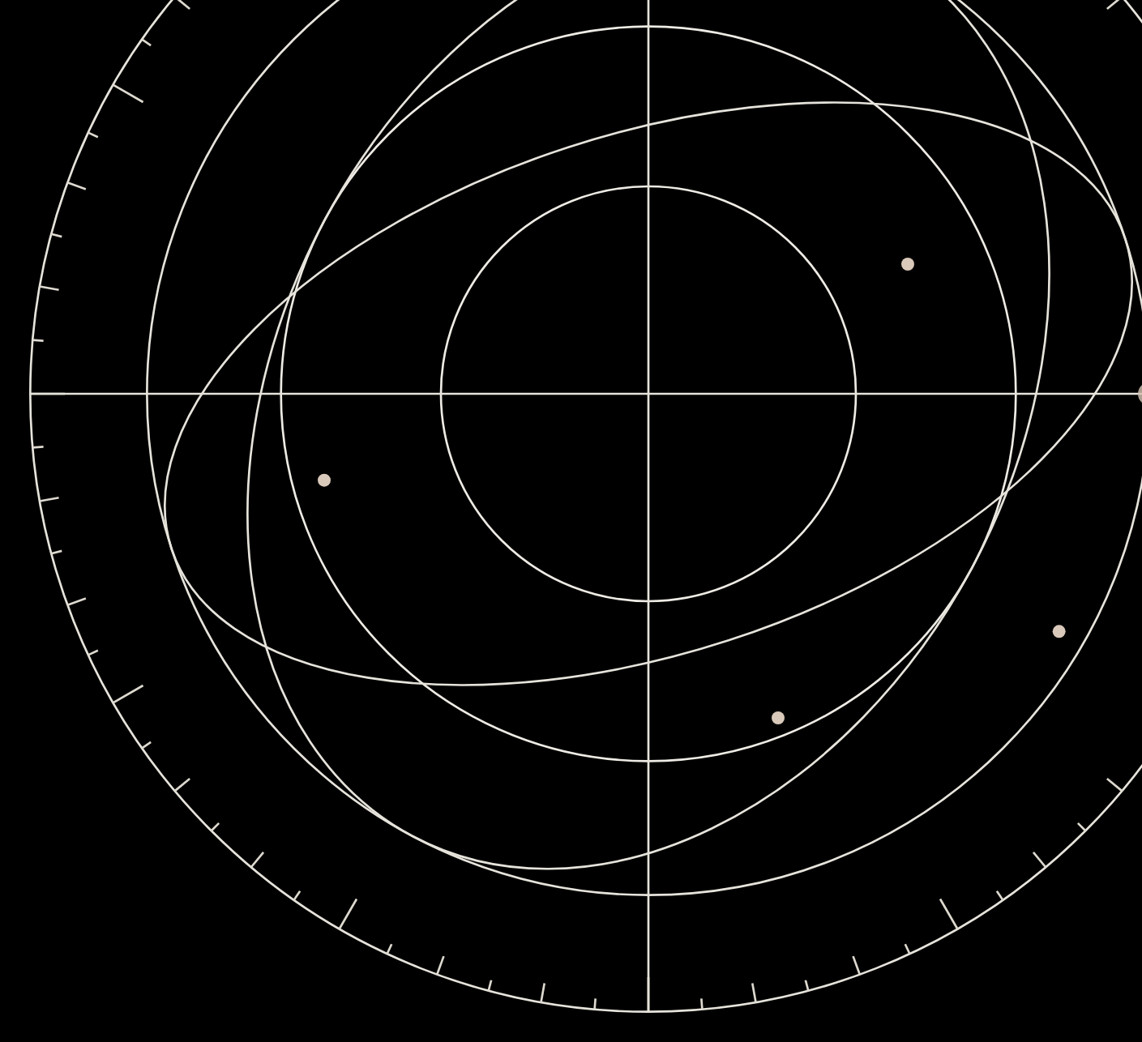

Every industry's best agents
will be trained in our worlds
An AI-native neolab building environments, verifiers
and data for self-improving AI
Founded
Raising
Investor presentation
September 10, 2026
Seed round
October 2026
Confidential · For invited investors only · October 2026

Slide 2
02
Company Problem Product Traction Market Edge Round
Overview
An AI-native neolab building RSI engines: the environments, verifiers and data that let agents improve themselves
Revenue
Product
Proof
$3M ARR
7 environments
+12%
Reached 24 days after founding
No outside capital
Trading, ML research, math, reasoning,
forecasting, software and accounting
A model trained in our trading environment
did better on trading days it had never seen
Open source
Team
Market
672 GitHub stars
Four quant founders
$8.5B a year
Across 5 open benchmarks,
all shipped in our first 14 days
Cambridge, LSE and Duke mathematics
Jane Street, Citadel, Optiver, Millennium
Spent today on training data
and RL environments
Confidential · For invited investors only · October 2026
02

Slide 3





03
Company Problem Product Traction Market Edge Round
Team
Four founders. Together they turned down $1M+ in first-year pay to build SimReal
Charles CEO · 21
Henry CTO · 21
Amaris COO · 21
James CPO
Employee #1 at United Stables, building it from scratch to $1.5B+. Listed on Binance within a month.
Led institutional partnerships with YZi Labs, SIG, DRW and Wintermute
Only intern on HSBC’s HKD stablecoin project, working on HKMA compliance
Hedge fund intern, Citadel
Cambridge Mathematics, St John’s College, First Class with Scholarship
Youngest researcher at the Cambridge AI research center, under Prof. Po-Ling Loh (IMS Fellow)
Ex-quant at Jane Street, Citadel and Optiver
Data scientist, Millennium Hong Kong
First graduate hire on Millennium’s alternative-data team
Co-organized Plug and Play’s first Hong Kong event, with HKSTP (200+ attendees)
Quant trading at Optiver
Asset management at Fidelity
Equity research at Jefferies
LSE, Mathematics
USAMO qualifier
Top 30 worldwide, Cambridge STEP maths competition (~IMO Medalist level)
British Physics Olympiad Top Gold
Duke, Mathematics and Statistics
LSE, Mathematics
AMC: global top 1%
British Mathematical Olympiad: Gold
Confidential · For invited investors only · October 2026
03

Slide 4
04
Company Problem Product Traction Market Edge Round
Problem
Agents can reason. They still fail at real work
Looks right
What actually happens
Trading
Wins on past data
→
Loses money live
Software
All tests pass
→
Breaks in production
Accounting
Books look closed
→
Month-end doesn't reconcile
Forecasting
Analysis sounds right
→
Outcome proves it wrong
6/32
In a live trading contest (Alpha Arena), frontier models made money in only 6 of 32 runs
The gap: agents have nowhere realistic to practice, and no source of truth to learn from
Confidential · For invited investors only · October 2026
04

Slide 5
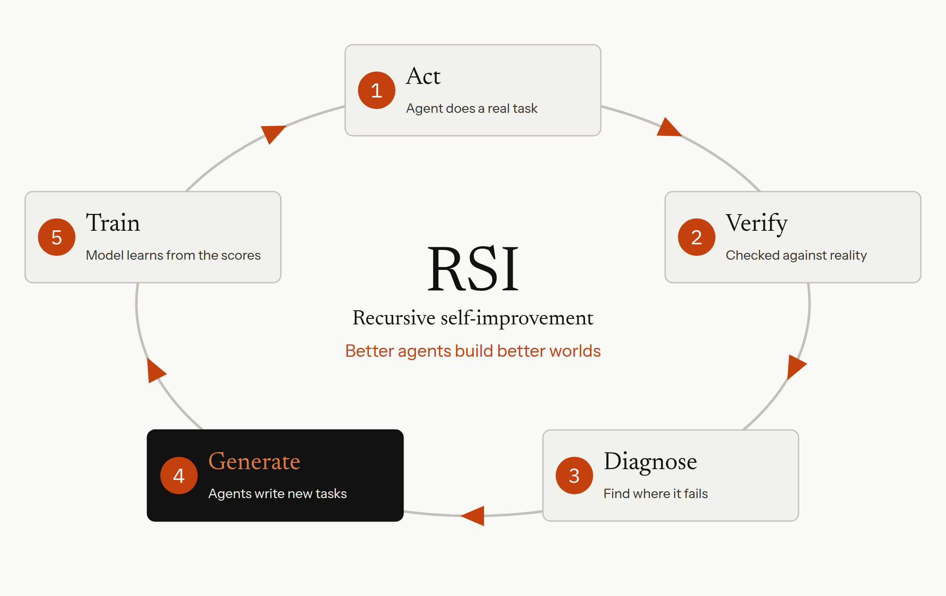
05
Company Problem Product Traction Market Edge Round
Solution
A loop that turns real outcomes into better agents, with AI inside it from day one
What's different
Today
Humans hand-write every task, label and rubric
SimReal
Agents help write new tasks and data, find failure modes and improve the environments they train in. Next, they will write the verifiers too. AI native from the start.
Proof point
+12%
on trading days it never saw,
after training in our loop
+12% is the best of several independent replications, measured on trading days held out from training.
Confidential · For invited investors only · October 2026
05

Slide 6
06
Company Problem Product Traction Market Edge Round
Product
Seven environments in 14 days. Each is scored by something the agent can't argue with
672
Domain
Environment
Scored by
Stars
Trading
Xitadel
Profit on unseen market days, vs. the best human
101
GitHub stars across
5 open benchmarks
ML research
SimReal-MLBench
The official Kaggle leaderboard, on hidden labels
301
As of October 4, 2026
Math
MathmoBench
Whether the proof is correct
101
Reasoning
Puzzle Benchmark
Hidden answers to 749 human-written puzzles
100
Give the agent a world to practice in.
Make the reward come from a market, a proof, hidden labels, an executable system or a real-world outcome.
Forecasting
FuturePredict
The real outcome, after the deadline
27
Software
SWE-Forward
Hidden tests the code must pass
Private
Accounting
Month-End Close
Whether the books reconcile
Private
SWE-Forward and Month-End Close are not open-sourced.
Confidential · For invited investors only · October 2026
06

Slide 7
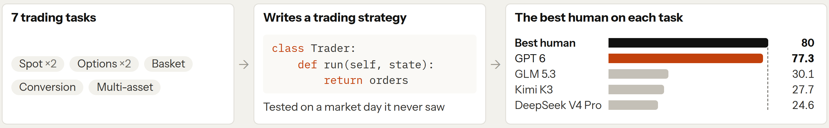
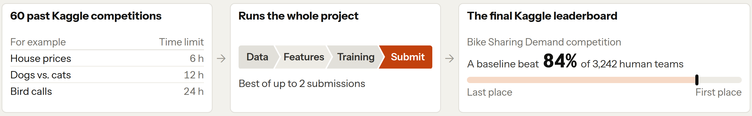
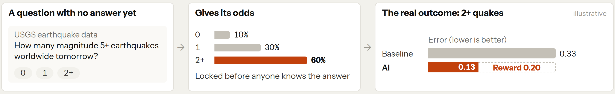
07
Company Problem Product Traction Market Edge Round
How it works
Three environments. Each scores the AI against something real
1 Given
2 The AI
3 Scored against
Trading
Xitadel
Published results
AI research
SimReal-MLBench
Baseline result, not an AI agent
Forecasting
FuturePredict
Illustrative numbers
Best human: on each task, the best real strategy from IMC Prosperity, a global trading competition. FuturePredict baseline: a reference forecast, also locked in advance.
Confidential · For invited investors only · October 2026
07

Slide 8
08
Company Problem Product Traction Market Edge Round
Traction
Founded September 10, 2026. $3M ARR in 24 days, with no outside capital
Day 14
Week 3
Day 24
Day 31
7
10+
$3M
672
Environments shipped
Types of data delivered
ARR
GitHub stars
Trading training loop working
Across 5 open benchmarks
Days counted from founding; as of October 4, 2026
Customers
Training infrastructure: more training per unit of compute
2
1/4
+64%
−1/3
Frontier labs in talks
Each practice run takes a quarter of the time
More scored attempts on the same compute
Less time spent saving model checkpoints
Infrastructure figures come from separate internal tests and should not be added together.
Confidential · For invited investors only · October 2026
08

Slide 9
09
Company Problem Product Traction Market Edge Round
Why now
Agents are starting to improve themselves. Environments are now the bottleneck
What changed in 2026
What we have built
→
SimReal-MLBench: an exam for AI research
302 GitHub stars
AI is doing AI research
OpenAI: agents do 3.1 days of work for every researcher-day
OpenAI, Sep 2026
→
RSI working in trading
Up to +12% on unseen trading days
AI is improving itself
An agent rewrote its own code and improved 7 times in 8 days
Weco AIDE², Sep 2026
→
Seven environments in 14 days
200K+ experts to build more
Environments are the bottleneck
When the environment gets noisy, top agents drop from 83.9% to 57.6%
Breaking the Environment Wall, Sep 2026
Our position
Environments gate RSI; they are our core research. Most neolabs have no revenue; we hit $3M ARR in 24 days
Sources: OpenAI (Sep 6, 2026); Weco AI, arXiv 2609.26457; Breaking the Environment Wall, arXiv 2609.29773; Deedy Das neolab list (May 2026). +12% is the best of several replications.
Confidential · For invited investors only · October 2026
09

Slide 10
10
Company Problem Product Traction Market Edge Round
Market
$8.5B a year today. One vendor, Mercor, grew revenue 27x in 16 months
→
Today: training data and RL environments
2030: the AI economy
$8.5B / year
$700B / year
Combined revenue of 50+ vendors
If AI becomes a $7T economy and 10% goes to training
27x
10x
18x
Mercor run-rate revenue:
$75M to $2B in 16 months
Mercor valuation:
$2B to $20B in 17 months (in talks)
Snorkel AI's new data business:
growth in one year
→ Demand for expert data is exploding
→ Investors are paying up
→ Demand is shifting to experts and environments
Sources: Deedy Das market map (Jul 2026); Mercor (TechCrunch, Dealroom); Snorkel AI (Sep 2026). The 2030 figure is our estimate.
Confidential · For invited investors only · October 2026
10

Slide 11
11
Company Problem Product Traction Market Edge Round
Business model
We sell environments, data and evals. Frontier labs pay today; enterprise and personal agents next
Now
Next
Later
Frontier AI labs
Enterprise agents
Personal agents
They buy
They buy
They buy
Environments, verified tasks and evals to post-train their models
Custom environments and tests that prove an agent can do the job
Fit an agent to one person‘s habits and strategies before it acts for them
How we charge
How we charge
How we charge
Per environment and per task, on quarterly contracts
A paid pilot, then an annual license
A monthly subscription, direct or through agent apps
Estimated price
Estimated price
Estimated price
$300K–$1M+
$200K–$800K
$5–$10
Per lab, per quarter
Per customer, per year
Per user, per month
Market rates: $200–$2,000 a task; about $300K for a complex environment
Pilot: $50K–$150K over 8–12 weeks
For reference, consumer AI plans cost about $20 a month
One set of environments serves all three, and every new model needs new tasks
Estimates, not signed prices. Lab prices are market rates from Epoch AI interviews with environment builders and AI labs (January 2026). Enterprise and personal prices are our assumptions.
Confidential · For invited investors only · October 2026
11

Slide 12
12
Company Problem Product Traction Market Edge Round
Why us
Data vendors sell expert hours. We build assets that compound with every customer
Expert-data vendors
SimReal
What compounds
Expert hours. Each project starts from scratch.
Proprietary environments, verifiers and maps of where models fail, plus the models we train in them. Every customer and loop adds to them.
Cost curve
Rises with headcount
Falls with scale: once a verifier exists, new data is generated and checked automatically
Proof of quality
Spot checks and reviewer judgment
Hidden tests, out-of-sample results, hash-locked published results and measured training gains (+12%)
Velocity
A new domain means new recruiting
7 environments in 14 days; $3M ARR in 24 days.
Network
Large expert pools, paid by the hour
Practitioners from top trading firms and 200K+ reachable experts, whose work our verifiers check
In short
They sell hours; we sell verified gains. Their costs rise with scale; ours fall
Confidential · For invited investors only · October 2026
12

Slide 13

















13
Company Problem Product Traction Market Edge Round
Network
Experts from the most competitive entry-level jobs and from research, the work agents are now built to do
Practitioners in our R&D come from top trading firms and markets, including
The most competitive entry-level jobs
Research
Trading, finance, software and more
AI, mathematics and quantitative research
→ Data for agents that streamline everyday work
→ Data for agents that automate research
200K+
Reachable experts
7,000+
Experts on the waitlist
21
Top universities
Students and alumni of
Logos show where practitioners work or study; no endorsement implied.
Confidential · For invited investors only · October 2026
13

