Slide 1


Financial AI will be
trained in our markets
RL environments and human intelligence
for financial AI
Founded
Raising
Contact
September 2026
Seed round
business@simreal.co
Confidential · October 2026

Slide 2
02
Company Problem Product Traction Edge Market Round
Overview
RL environments and human intelligence for AI that does financial work
Revenue
Product
Buyers
$250K / month
Environments + data
Three segments
Data sales in September 2026, about
$3M a year; no outside capital
Market and forecasting environments,
plus financial expert data
Frontier labs, financial firms
and vertical AI startups
Team
Supply
Market
Quant founders, all 21
7,000+ signed up
$2.8B a year
Cambridge, LSE and Duke mathematics
Jane Street, Citadel, Optiver, Millennium
Financial experts
for paid data work
Spent by investment managers on
alternative data in 2025 (Neudata)
How it fits
Funds already buy their edge as data. We sell the environments and expert data AI needs to do financial work.
Confidential · October 2026
02

Slide 3






03
Company Problem Product Traction Edge Market Round
Team
Three 21-year-old founders. Together they turned down $1M+ in first-year pay to build SimReal
Charles CEO · 21
Henry CTO · 21
Amaris COO · 21
Employee #1 at United Stables, building it from scratch to $1.5B+. Listed on Binance within a month.
Led institutional partnerships with YZi Labs, SIG, DRW and Wintermute
Only intern on HSBC’s HKD stablecoin project, working on HKMA compliance
Hedge fund intern, Citadel
Cambridge Mathematics, St John’s College, First Class with Scholarship
Youngest researcher at the Cambridge AI research center, under Prof. Po-Ling Loh (IMS Fellow)
Ex-quant at Jane Street, Citadel and Optiver
Data scientist, Millennium Hong Kong
First graduate hire on Millennium’s alternative-data team
Co-organized Plug and Play’s first Hong Kong event, with HKSTP (200+ attendees)
LSE, Mathematics
USAMO qualifier
Top 30 worldwide, Cambridge STEP maths competition (~IMO Medalist level)
British Physics Olympiad Top Gold
Duke, Mathematics and Statistics
Confidential · October 2026
03

Slide 4
04
Company Problem Product Traction Edge Market Round
Problem
Agents are moving into financial work. Their backtests lie
Looks right
What actually happens
Trading
Profitable in backtest
→
Loses money live
Research
Signal looks strong
→
Overfit to the past
Forecasting
Analysis sounds right
→
Outcome proves it wrong
Accounting
Books look closed
→
Month-end doesn’t reconcile
6/32
In a live trading contest (Nof1’s Alpha Arena), frontier models made money in only 6 of 32 runs
A backtest you can fool will lie to you. Agents need a test the market grades
Source: Nof1, Alpha Arena (May 2026).
Confidential · October 2026
04

Slide 5
05
Company Problem Product Traction Edge Market Round
Why now
Agents are entering financial work. Funds already pay for an edge
What changed in 2026
What we have built
→
Market environments
Stocks, baskets and options, graded by the market
Funds are handing research to agents
An AI-agent hedge fund raised a $100M seed
Abundance, Apr 2026
→
Environments licensed like datasets
Exclusive to one fund, priced at 4–5x
Funds buy their edge as data
Investment managers spent $2.8B on alternative data in 2025, up 17%
Neudata, Feb 2026
Our position
Most AI-data startups in this space have no revenue yet. We sell $250K of data a month
Sources: Abundance (Bloomberg, Apr 2026); Neudata, The state of the alternative data market in 2026 (Feb 2026).
Confidential · October 2026
05

Slide 6
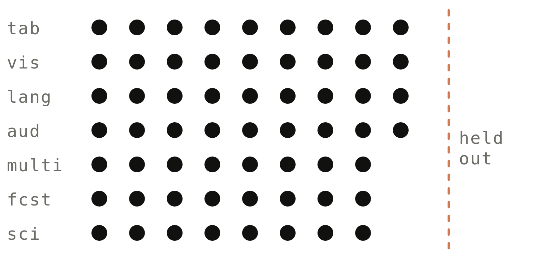
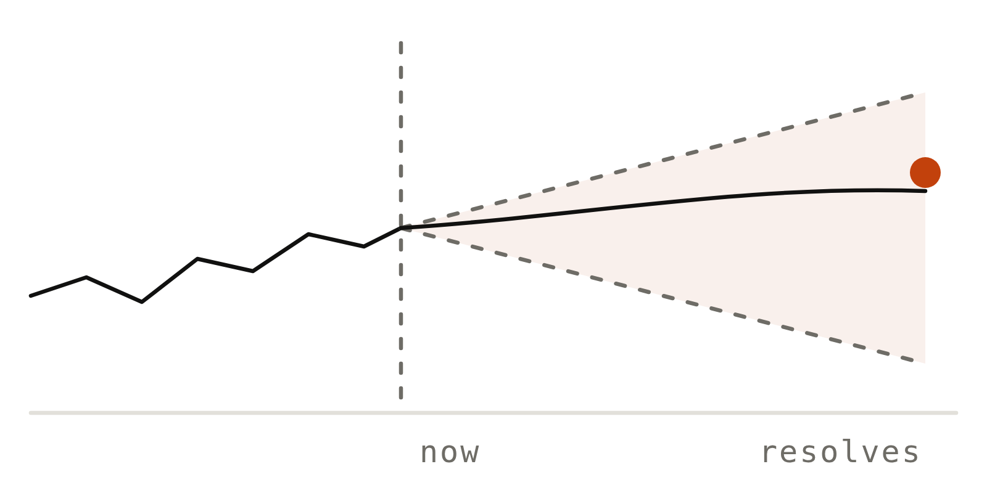
06
Company Problem Product Traction Edge Market Round
Product
Environments and expert data for financial AI. The market grades every result
01
02
03
Market environments
Forecasting environments
Financial expert data
Open source: Xitadel
Future Prediction
Expert data and trajectories
Agents research stocks, baskets and options and build strategies, tested against simulated market participants.
Agents forecast events with search and prediction-market tools. Copying the market’s forecast earns zero.
Demonstrations, reasoning traces and grading rubrics from financial professionals, plus agent trajectories.
Graded by
Graded by
Graded by
P&L on a withheld trading day
The real outcome, once it is known
Checked against the market result
Also built: accounting (Month-End Close), ML research, maths, reasoning and software benchmarks 600+ GitHub stars
Confidential · October 2026
06

Slide 7
07
Company Problem Product Traction Edge Market Round
Traction
$250K of data sales in September 2026. About $3M a year, with no outside capital
Revenue mix
Revenue
60% agent trajectories
$250K
35% reasoning traces and rubrics from finance professionals; 5% verified RL tasks
Day 14
7 environments shipped
In September 2026
Trading, forecasting, accounting, ML research, maths, reasoning, software
About $3M a year at this rate
4 paying customers: data suppliers and AI startups
Largest: a data supplier serving frontier labs, with a $100K order
Supply
7,000+ signed up for paid data work
200K+ students and alumni of 21 top universities in reach
Pipeline
2 frontier labs in talks
For environment and data contracts
About $3M a year = September 2026 revenue x 12. Orders are placed on demand today; we are moving them to subscriptions.
Confidential · October 2026
07

Slide 8
08
Company Problem Product Traction Edge Market Round
Why us
An expert can’t grade a trade. Only the market can
01
02
03
04
An expert can’t grade a trade
Markets have no answer key
A neutral supplier
Revenue funds speed
No expert can say whether a strategy will make money. Our environments match every order the way an exchange would.
In trading and forecasting the answer arrives with the outcome, and it shifts as others copy what works.
Funds won’t hand their data to a lab. We license environments to funds and labs alike, exclusively at 4–5x.
$250K of data a month and 7,000+ people signed up to write tasks.
Landscape
Quant environment startups
EdotEnv (YC S26)
Quant research environments for labs
Expert-data vendors
Mercor, Surge, Scale, AfterQuery
Expert time and contractor-built environments
Finance evaluation
Halluminate, Vals
Banking and private-equity work, graded against known answers
SimReal
Environments and financial expert data
Graded by the market or the real outcome; neutral to funds and labs
In short
They sell hours or answer keys; we sell results the market grades
Confidential · October 2026
08

Slide 9


















09
Company Problem Product Traction Edge Market Round
Human intelligence
Financial professionals show agents how the work is done. The market checks the result
Practitioners in our R&D have worked at top trading firms and markets, including
Financial professionals
Quant, maths and finance talent
Demonstrations and explanations of how they research and decide
Students and alumni of 21 top universities
→ Data for agents that do financial work
→ Data for agents that do financial research
200K+
Students and alumni
we can reach
7,000+
Signed up for
paid data work
21
Top universities
Students and alumni of
Logos show where practitioners have worked or studied; no endorsement implied.
Confidential · October 2026
09

Slide 10
10
Company Problem Product Traction Edge Market Round
Market
Funds already buy their edge as data. AI that does financial work needs it too
Financial firms: market data and analysis, 2025
Investment managers: alternative data, 2025
$49.2B / year
$2.8B / year
A record, up 6.5% (Burton-Taylor)
Up 17% in a year (Neudata)
$2B+
$100M+
4–5x
Mercor gross run-rate:
June 2026
AfterQuery run-rate, within about
15 months of founding
Exclusive environments cost 4–5x
non-exclusive ones (Epoch AI)
→ Labs pay billions for expert data
→ New data vendors scale fast
→ Exclusivity is priced like data
Sources: Burton-Taylor (TP ICAP), Financial Market Data/Analysis 2026; Neudata, The state of the alternative data market in 2026; Mercor (TechCrunch, Jul 2026); AfterQuery (Dealroom, Apr 2026); Epoch AI (Jan 2026). Run-rates are gross.
Confidential · October 2026
10

Slide 11
11
Company Problem Product Traction Edge Market Round
Business model
Three buyers, one set of environments. All three already buy our data
01
02
03
Frontier AI labs
Financial firms
Vertical AI startups
They buy
They buy
They buy
Environments, trajectories and expert data to train and test their models
Environments to train and test agents before they touch real money
Data and environments to train finance agents and prove they work
How we charge
How we charge
How we charge
Per environment and per task, on quarterly contracts
A paid pilot, then an annual licence; exclusive at 4–5x
Data subscriptions and environment licences
Estimated price
Estimated price
Pricing
$300K–$1M+
$200K–$800K
Subscription
Per lab, per quarter
Per firm, per year
Per dataset or environment
Market rates: $200–$2,000 a task (Epoch AI)
Pilot: $50K–$150K. Hedge funds and prop shops first; then banks, asset managers, exchanges
Several already buy our data
Recurring revenue from licences, data subscriptions and task updates; every new model needs new tasks
Estimates, not signed prices. Lab prices are market rates from Epoch AI interviews (January 2026). Financial-firm prices are our assumptions.
Confidential · October 2026
11

Slide 12
12
Company Problem Product Traction Edge Market Round
The round
Raising a seed round to scale financial environments, expert data and delivery
Raising
01
02
03
Financial environments
Expert data
Delivery
Seed
Take the trading playbook to more financial work
Grow the expert network into a data subscription
Sign labs and financial firms directly, on subscriptions
round
Where the money goes
Where the money goes
Where the money goes
Engineers · Practitioner reviewers
Expert network · Quality review
Delivery team · Sales
Milestone
Milestone
Milestone
10+ financial environments
Subscriptions replace one-off orders
20 customers
Three directions, each with a milestone →
business@simreal.co
Confidential · October 2026
12

