Slide 1

我们毕业啦
其实是答辩的标题地方
基于条形码识别技术的取药验证系统设计与实现
答辩人
王英
指导老师
邢立冬

Slide 2
课题意义
创新点
系统实现
课题难点
CONTANTS
总结与展望

Slide 3

课题意义
It was the best of times, it was the worst of times; it was the age of wisdom, it was the age of foolishness.

Slide 4
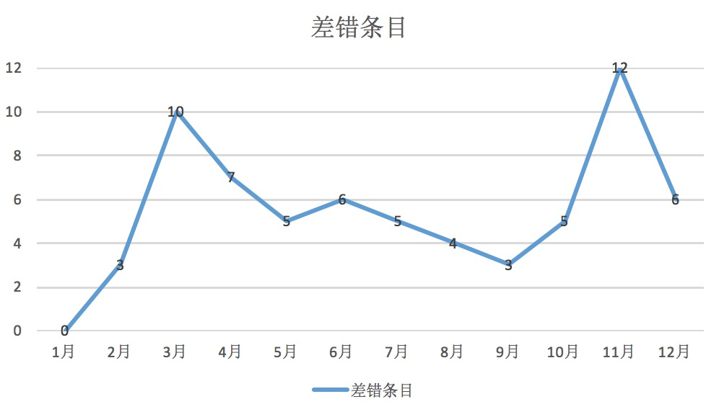
课题意义
创新点
系统实现
课题难点
总结与展望
目前医院取药验证
取药出错数量及影响

Slide 5
课题意义
创新点
系统实现
课题难点
总结与展望
解放人力
验证准确
做好本系统
降低损失
符合“智慧医疗”

Slide 6
创新点
It was the best of times, it was the worst of times; it was the age of wisdom, it was the age of foolishness.

Slide 7

课题意义
创新点
系统实现
课题难点
总结与展望
输入速度快
可靠性高
采集信息量大
灵活实用
条形码识别技术优势

Slide 8
课题意义
创新点
系统实现
课题难点
总结与展望
国外处理取药验证方法

Slide 9
系统实现
It was the best of times, it was the worst of times; it was the age of wisdom, it was the age of foolishness.

Slide 10
课题意义
创新点
系统实现
课题难点
总结与展望
整体逻辑

Slide 11
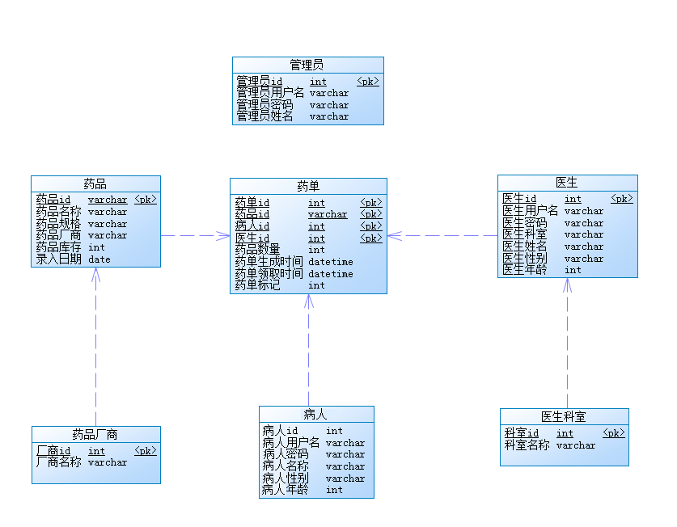
课题意义
创新点
系统实现
课题难点
总结与展望
数据库设计

Slide 12
课题意义
创新点
系统实现
课题难点
总结与展望
前端实现
HTML
CSS
Javascript
Jquery
webpack
后端实现
JAVA
MySQL
SpringMVC
Mybatis

Slide 13
课题意义
创新点
系统实现
课题难点
总结与展望
实现效果

Slide 14
课题难点
It was the best of times, it was the worst of times; it was the age of wisdom, it was the age of foolishness.

Slide 15
课题意义
创新点
系统实现
课题难点
总结与展望
逻辑处理
It was the best of times, it was the worst of times; it was the age of wisdom, it was the age of foolishness. It was the epoch of belief, and it was the epoch of incredulity. It was the season of light, and it was the season of darkness. It was the spring of hope, and it was the winter of despair.
A
难点
后端实现
It was the best of times, it was the worst of times; it was the age of wisdom, it was the age of foolishness. It was the epoch of belief, and it was the epoch of incredulity. It was the season of light, and it was the season of darkness. It was the spring of hope, and it was the winter of despair.
前后端联调
B
C
It was the best of times, it was the worst of times; it was the age of wisdom, it was the age of foolishness. It was the epoch of belief, and it was the epoch of incredulity. It was the season of light, and it was the season of darkness. It was the spring of hope, and it was the winter of despair.

Slide 16
总结与展望
It was the best of times, it was the worst of times; it was the age of wisdom, it was the age of foolishness.

Slide 17
课题意义
创新点
系统实现
课题难点
总结与展望
ADD TITLE
ADD TITLE
It was the best of times, it was the worst of times; it was the age of wisdom, it was the age of foolishness.
It was the best of times, it was the worst of times; it was the age of wisdom, it was the age of foolishness.
1
2
总结
ADD TITLE
4
3
ADD TITLE
It was the best of times, it was the worst of times; it was the age of wisdom, it was the age of foolishness.
It was the best of times, it was the worst of times; it was the age of wisdom, it was the age of foolishness.

Slide 18
论文绪论
研究背景
研究方法
研究结果
问题讨论
论文总结
ADD YOUR TITLE
A
It was the best of times, it was the worst of times; it was the age of wisdom, it was the age of foolishness. It was the epoch of belief, and it was the epoch of incredulity. It was the season of light, and it was the season of darkness. It was the spring of hope, and it was the winter of despair.
ADD YOUR TITLE
B
It was the best of times, it was the worst of times; it was the age of wisdom, it was the age of foolishness. It was the epoch of belief, and it was the epoch of incredulity. It was the season of light, and it was the season of darkness. It was the spring of hope, and it was the winter of despair.
ADD YOUR TITLE
C
It was the best of times, it was the worst of times; it was the age of wisdom, it was the age of foolishness. It was the epoch of belief, and it was the epoch of incredulity. It was the season of light, and it was the season of darkness. It was the spring of hope, and it was the winter of despair.

Slide 19
THANKS
答辩人
王英

