Slide 1

LOGO
西安邮电学校
基于加权多节点频谱感知算法研究
我们毕业啦
其实是答辩的标题地方
答辩人
刘新宇
指导老师
弥寅/卢光跃

Slide 2
论文绪论
研究背景
研究方法
研究结果
CONTANTS
问题讨论
论文总结

Slide 3

论文绪论
It was the best of times, it was the worst of times; it was the age of wisdom, it was the age of foolishness.

Slide 4
论文绪论
研究背景
研究方法
研究结果
问题讨论
论文总结
“
It was the best of times, it was the worst of times; it was the age of wisdom, it was the age of foolishness. It was the epoch of belief, and it was the epoch of incredulity. It was the season of light, and it was the season of darkness. It was the spring of hope, and it was the winter of despair.
It was the best of times, it was the worst of times; it was the age of wisdom, it was the age of foolishness. It was the epoch of belief, and it was the epoch of incredulity. It was the season of light, and it was the season of darkness. It was the spring of hope, and it was the winter of despair.
It was the best of times, it was the worst of times; it was the age of wisdom, it was the age of foolishness. It was the epoch of belief, and it was the epoch of incredulity. It was the season of light, and it was the season of darkness. It was the spring of hope, and it was the winter of despair.
”

Slide 5
论文绪论
研究背景
研究方法
研究结果
问题讨论
论文总结
1
It was the best of times, it was the worst of times; it was the age of wisdom, it was the age of foolishness. It was the epoch of belief, and it was the epoch of incredulity. It was the season of light, and it was the season of darkness. It was the spring of hope, and it was the winter of despair.
2
It was the best of times, it was the worst of times; it was the age of wisdom, it was the age of foolishness. It was the epoch of belief, and it was the epoch of incredulity. It was the season of light, and it was the season of darkness. It was the spring of hope, and it was the winter of despair.
3
It was the best of times, it was the worst of times; it was the age of wisdom, it was the age of foolishness. It was the epoch of belief, and it was the epoch of incredulity. It was the season of light, and it was the season of darkness. It was the spring of hope, and it was the winter of despair.

Slide 6
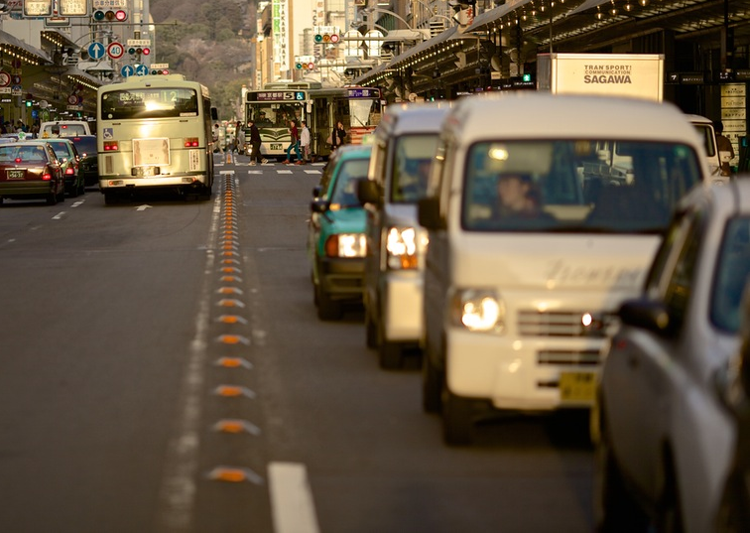
论文绪论
研究背景
研究方法
研究结果
问题讨论
论文总结
It was the best of times, it was the worst of times; it was the age of wisdom, it was the age of foolishness. It was the epoch of belief, and it was the epoch of incredulity. It was the season of light, and it was the season of darkness. It was the spring of hope, and it was the winter of despair.
It was the best of times, it was the worst of times; it was the age of wisdom, it was the age of foolishness. It was the epoch of belief, and it was the epoch of incredulity. It was the season of light, and it was the season of darkness. It was the spring of hope, and it was the winter of despair.

Slide 7
研究背景
It was the best of times, it was the worst of times; it was the age of wisdom, it was the age of foolishness.

Slide 8
论文绪论
研究背景
研究方法
研究结果
问题讨论
论文总结
ADD TITLE
It was the best of times, it was the worst of times; it was the age of wisdom, it was the age of foolishness.
ADD TITLE
It was the best of times, it was the worst of times; it was the age of wisdom, it was the age of foolishness.
ADD TITLE
It was the best of times, it was the worst of times; it was the age of wisdom, it was the age of foolishness.

Slide 9
论文绪论
研究背景
研究方法
研究结果
问题讨论
论文总结
TEXT
keyword
TEXT
keyword
keyword
TEXT
keyword
TEXT
TITLE
TITLE
TITLE
TITLE
It was the best of times, it was the worst of times; it was the age of wisdom, it was the age of foolishness. It was the epoch of belief, and it was the epoch of incredulity. It was the season of light, and it was the season of darkness. It was the spring of hope, and it was the winter of despair.
It was the best of times, it was the worst of times; it was the age of wisdom, it was the age of foolishness. It was the epoch of belief, and it was the epoch of incredulity. It was the season of light, and it was the season of darkness. It was the spring of hope, and it was the winter of despair.
It was the best of times, it was the worst of times; it was the age of wisdom, it was the age of foolishness. It was the epoch of belief, and it was the epoch of incredulity. It was the season of light, and it was the season of darkness. It was the spring of hope, and it was the winter of despair.
It was the best of times, it was the worst of times; it was the age of wisdom, it was the age of foolishness. It was the epoch of belief, and it was the epoch of incredulity. It was the season of light, and it was the season of darkness. It was the spring of hope, and it was the winter of despair.

Slide 10
论文绪论
研究背景
研究方法
研究结果
问题讨论
论文总结
TEXT
TEXT
TEXT
TEXT
TEXT
It was the best of times, it was the worst of times; it was the age of wisdom, it was the age of foolishness. It was the epoch of belief, and it was the epoch of incredulity. It was the season of light, and it was the season of darkness. It was the spring of hope, and it was the winter of despair.

Slide 11
研究方法
It was the best of times, it was the worst of times; it was the age of wisdom, it was the age of foolishness.

Slide 12
论文绪论
研究背景
研究方法
研究结果
问题讨论
论文总结
TEXT
TEXT
TEXT
TEXT
It was the best of times, it was the worst of times; it was the age of wisdom, it was the age of foolishness. It was the epoch of belief, and it was the epoch of incredulity.
It was the best of times, it was the worst of times; it was the age of wisdom, it was the age of foolishness. It was the epoch of belief, and it was the epoch of incredulity.
It was the best of times, it was the worst of times; it was the age of wisdom, it was the age of foolishness. It was the epoch of belief, and it was the epoch of incredulity.
It was the best of times, it was the worst of times; it was the age of wisdom, it was the age of foolishness. It was the epoch of belief, and it was the epoch of incredulity.

Slide 13
论文绪论
研究背景
研究方法
研究结果
问题讨论
论文总结
ADD YOUR TITLE
It was the best of times, it was the worst of times; it was the age of wisdom, it was the age of foolishness. It was the epoch of belief, and it was the epoch of incredulity. It was the season of light, and it was the season of darkness. It was the spring of hope, and it was the winter of despair.
ADD YOUR TITLE
It was the best of times, it was the worst of times; it was the age of wisdom, it was the age of foolishness. It was the epoch of belief, and it was the epoch of incredulity. It was the season of light, and it was the season of darkness. It was the spring of hope, and it was the winter of despair.

Slide 14
论文绪论
研究背景
研究方法
研究结果
问题讨论
论文总结
ADD TITLE
ADD TITLE
It was the best of times, it was the worst of times; it was the age of wisdom, it was the age of foolishness.
It was the best of times, it was the worst of times; it was the age of wisdom, it was the age of foolishness.
ADD TITLE
ADD TITLE
It was the best of times, it was the worst of times; it was the age of wisdom, it was the age of foolishness.
It was the best of times, it was the worst of times; it was the age of wisdom, it was the age of foolishness.

Slide 15
研究结果
It was the best of times, it was the worst of times; it was the age of wisdom, it was the age of foolishness.

Slide 16
论文绪论
研究背景
研究方法
研究结果
问题讨论
论文总结
It was the best of times, it was the worst of times; it was the age of wisdom, it was the age of foolishness.
It was the best of times, it was the worst of times; it was the age of wisdom, it was the age of foolishness.

Slide 17
论文绪论
研究背景
研究方法
研究结果
问题讨论
论文总结
TEXT
TEXT
TEXT
It was the best of times, it was the worst of times; it was the age of wisdom, it was the age of foolishness. It was the epoch of belief, and it was the epoch of incredulity. It was the season of light, and it was the season of darkness. It was the spring of hope, and it was the winter of despair.

Slide 18
论文绪论
研究背景
研究方法
研究结果
问题讨论
论文总结
It was the best of times, it was the worst of times; it was the age of wisdom, it was the age of foolishness.

Slide 19
问题讨论
It was the best of times, it was the worst of times; it was the age of wisdom, it was the age of foolishness.

Slide 20
论文绪论
研究背景
研究方法
研究结果
问题讨论
论文总结
ADD TITLE
ADD TITLE
It was the best of times, it was the worst of times; it was the age of wisdom, it was the age of foolishness.
s
It was the best of times, it was the worst of times; it was the age of wisdom, it was the age of foolishness.
T
TEXT
w
o
ADD TITLE
ADD TITLE
It was the best of times, it was the worst of times; it was the age of wisdom, it was the age of foolishness.
It was the best of times, it was the worst of times; it was the age of wisdom, it was the age of foolishness.

Slide 21
论文绪论
研究背景
研究方法
研究结果
问题讨论
论文总结
ADD YOUR TITLE
1
It was the best of times, it was the worst of times; it was the age of wisdom, it was the age of foolishness. It was the epoch of belief, and it was the epoch of incredulity. It was the season of light, and it was the season of darkness. It was the spring of hope, and it was the winter of despair.
TEXT
ADD YOUR TITLE
It was the best of times, it was the worst of times; it was the age of wisdom, it was the age of foolishness. It was the epoch of belief, and it was the epoch of incredulity. It was the season of light, and it was the season of darkness. It was the spring of hope, and it was the winter of despair.
2
3
ADD YOUR TITLE
It was the best of times, it was the worst of times; it was the age of wisdom, it was the age of foolishness. It was the epoch of belief, and it was the epoch of incredulity. It was the season of light, and it was the season of darkness. It was the spring of hope, and it was the winter of despair.

Slide 22
论文总结
It was the best of times, it was the worst of times; it was the age of wisdom, it was the age of foolishness.

Slide 23
论文绪论
研究背景
研究方法
研究结果
问题讨论
论文总结
ADD YOUR TITLE
A
It was the best of times, it was the worst of times; it was the age of wisdom, it was the age of foolishness. It was the epoch of belief, and it was the epoch of incredulity. It was the season of light, and it was the season of darkness. It was the spring of hope, and it was the winter of despair.
ADD YOUR TITLE
B
It was the best of times, it was the worst of times; it was the age of wisdom, it was the age of foolishness. It was the epoch of belief, and it was the epoch of incredulity. It was the season of light, and it was the season of darkness. It was the spring of hope, and it was the winter of despair.
ADD YOUR TITLE
C
It was the best of times, it was the worst of times; it was the age of wisdom, it was the age of foolishness. It was the epoch of belief, and it was the epoch of incredulity. It was the season of light, and it was the season of darkness. It was the spring of hope, and it was the winter of despair.

Slide 24
THANKS
NAME
DAMEN

Slide 25



