Slide 1
In Search of an Understandable
Consensus Algorithm
Diego Ongaro
John Ousterhout
Stanford University

Slide 2
Motivation (I)
"Consensus algorithms allow a collection of machines to work as a coherent group that can survive the failures of some of its members."
  Very important role in building fault-tolerant distributed systems

Slide 3
Motivation (II)
Paxos
  Current standard for both teaching and implementing consensus algorithms
  Very difficult to understand and very hard to implement
Raft
  New protocol (2014)
  Much easier to understand
  Several open-source implementations

Slide 4
Key features of Raft
Strong leader:
  Leader does most of the work:
    Issues all log updates
Leader election:
  Uses randomized timers to elect leaders.
Membership changes:
  New joint consensus approach where the majorities of two different configurations are required

Slide 5
Replicated state machines
Allows a collection of servers to
  Maintain identical copies of the same data
  Continue operating when some servers are down
    A majority of the servers must remain up
Many applications
Typically built around a distributed log

Slide 6
The distributed log (I)
Each server stores a log containing commands
Consensus algorithm ensures that all logs contain the same commands in the same order
State machines always execute commands
in the log order
  They will remain consistent as long as command executions have deterministic results

Slide 7
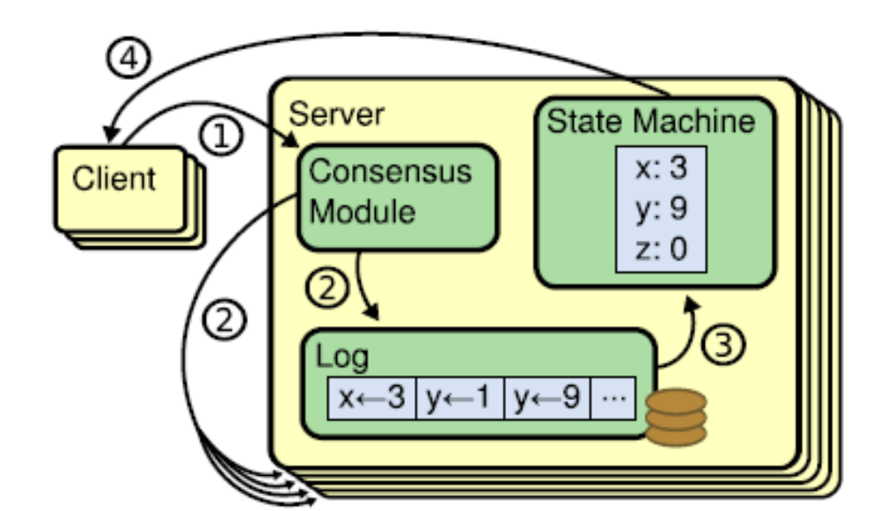
The distributed log (II)

Slide 8
The distributed log (III)
Client sends a command to one of the servers
Server adds the command to its log
Server forwards the new log entry to the other servers
Once a consensus has been reached, each server state machine process the command and sends it reply to the client

Slide 9
Consensus algorithms (I)
Typically satisfy the following properties
  Safety:
    Never return an incorrect result under all kinds of non-Byzantine failures
  Availability:
    Remain available as long as a majority of the servers remain operational and can communicate with each other and with clients.

Slide 10
Two types of failures
Non-Byzantine
  Failed nodes stop communicating with other nodes
    "Clean" failure
    Fail-stop behavior
Byzantine
  Failed nodes will keep sending messages
    Incorrect and potentially misleading
    Failed node becomes a traitor

Slide 11
Consensus algorithms (II)
  Robustness:
    Do not depend on timing to ensure the consistency of the logs
  Responsiveness:
    Commands will typically complete as soon as a majority of the servers have responded to a single round of remote procedure calls
      One or two slow servers will not impact overall system response times

Slide 12
Paxos limitations (I)
Exceptionally difficult to understand
  “The dirty little secret of the NSDI* community is that at most five people really, truly understand every part of Paxos ;-).”
  – Anonymous NSDI reviewer
*The USENIX Symposium on Networked Systems
Design and Implementation

Slide 13
Paxos limitations (II)
Very difficult to implement
  “There are significant gaps between the description of the Paxos algorithm and the needs of a real-world system…the final system will be based on an unproven protocol.” – Chubby authors

Slide 14
Designing for understandability
Main objective of RAFT
  Whenever possible, select the alternative that is the easiest to understand
Techniques that were used include
  Dividing problems into smaller problems
  Reducing the number of system states to consider
    Could logs have holes in them? No

Slide 15
Problem decomposition
Old technique
René Descartes' third rule for avoiding fallacies:
  The third, to conduct my thoughts in such order that, by commencing with objects the simplest and easiest to know, I might ascend by little and little, and, as it were, step by step, to the knowledge of the more complex

Slide 16
Raft consensus algorithm (I)
Servers start by electing a leader
  Sole server habilitated to accept commands from clients
  Will enter them in its log and forward them to other servers
  Will tell them when it is safe to apply these log entries to their state machines

Slide 17
Raft consensus algorithm (II)
Decomposes the problem into three fairly independent subproblems
  Leader election:
  How servers will pick a—single—leader
  Log replication:
  How the leader will accept log entries from clients, propagate them to the other servers and ensure their logs remain in a consistent state
  Safety

Slide 18
Raft basics: the servers
A RAFT cluster consists of several servers
  Typically five
Each server can be in one of three states
  Leader
  Follower
  Candidate (to be the new leader)
Followers are passive:
  Simply reply to requests coming from their leader

Slide 19
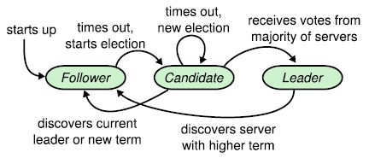
Server states

Slide 20
Raft basics: terms (I)
Epochs of arbitrary length
  Start with the election of a leader
  End when
    No leader can be selected (split vote)
    Leader becomes unavailable
Different servers may observe transitions between terms at different times or even miss them

Slide 21
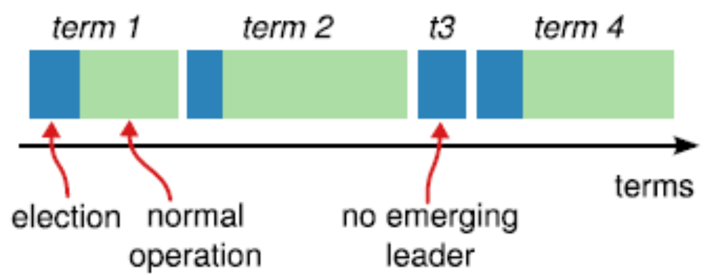
Raft basics: terms (II)

Slide 22
Raft basics: terms (III)
Terms act as logical clocks
  Allow servers to detect and discard obsolete information (messages from stale leaders, …)
Each server maintains a current term number
  Includes it in all its communications
A server receiving a message with a high number updates its own number
A leader or a candidate receiving a message with a high number becomes a follower

Slide 23
Raft basics: RPC
Servers communicate through idempotent RPCs
  RequestVote
    Initiated by candidates during elections
  AppendEntry
    Initiated by leaders to
      Replicate log entries
      Provide a form of heartbeat
        Empty AppendEntry( ) calls

Slide 24
Leader elections
Servers start being followers
Remain followers as long as they receive valid RPCs from a leader or candidate
When a follower receives no communication over a period of time (the election timeout), it starts an election to pick a new leader

Slide 25
The leader fails
Log
State
machine
Client
Log
State
machine
Log
State
machine
Followers notice at different times the lack of heartbeats
Decide to elect a new leader

Slide 26
Starting an election
When a follower starts an election, it
  Increments its current term
  Transitions to candidate state
  Votes for itself
  Issues RequestVote RPCs in parallel to all the other servers in the cluster.

Slide 27
Acting as a candidate
A candidate remains in that state until
  It wins the election
  Another server becomes the new leader
  A period of time goes by with no winner

Slide 28
Winning an election
Must receive votes from a majority of the servers in the cluster for the same term
  Each server will vote for at most one candidate in a given term
    The first one that contacted it
Majority rule ensures that at most one candidate can win the election
Winner becomes leader and sends heartbeat messages to all of the other servers
  To assert its new role

Slide 29
Hearing from other servers
Candidates may receive an AppendEntries RPC from another server claiming to be leader
If the leader’s term is at greater than or equal to the candidate’s current term, the candidate recognizes that leader and returns to follower state
Otherwise the candidate ignores the RPC and remains a candidate

Slide 30
Split elections
No candidate obtains a majority of the votes in the servers in the cluster
Each candidate will time out and start a new election
  After incrementing its term number

Slide 31
Avoiding split elections
Raft uses randomized election timeouts
  Chosen randomly from a fixed interval
Increases the chances that a single follower will detect the loss of the leader before the others

Slide 32
Example
Follower with the shortest timeout
becomes the new leader
Follower A
Timeouts
Follower B
Leader
X
Last heartbeat

Slide 33
Log replication
Leaders
  Accept client commands
  Append them to their log (new entry)
  Issue AppendEntry RPCs in parallel to all followers
  Apply the entry to their state machine once it has been safely replicated
    Entry is then committed

Slide 34
A client sends a request
Log
State
machine
Client
Log
State
machine
Log
State
machine
Leader stores request on its log and forwards it to its followers

Slide 35
The followers receive the request
Log
State
machine
Client
Log
State
machine
Log
State
machine
Followers store the request on their logs and acknowledge its receipt

Slide 36
The leader tallies followers' ACKs
Log
State
machine
Client
Log
State
machine
Log
State
machine
Once it ascertains the request has been processed by a majority of the servers, it updates its state machine

Slide 37
The leader tallies followers' ACKs
Log
State
machine
Client
Log
State
machine
Log
State
machine
Leader's heartbeats convey the news to its followers: they update their state machines

Slide 38
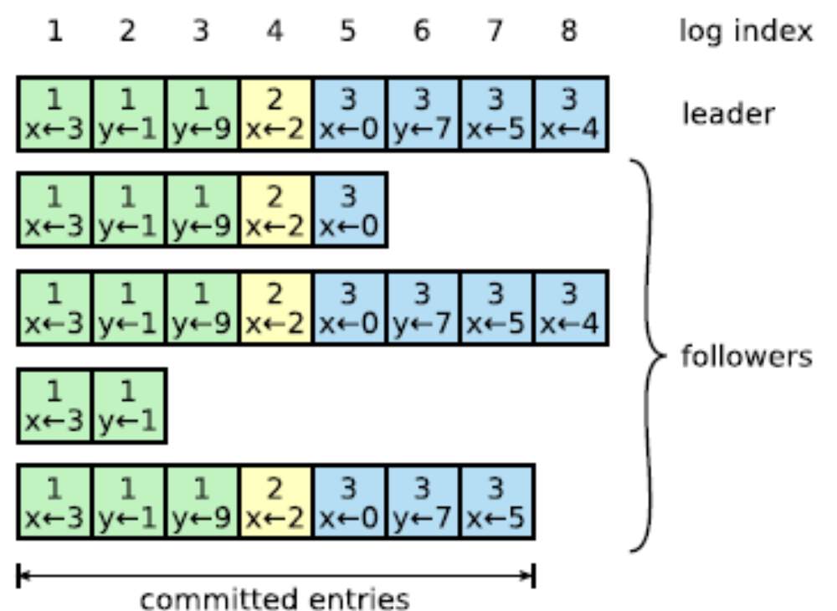
Log organization
Colors
identify
terms

Slide 39
Handling slow followers ,…
Leader reissues the AppendEntry RPC
  They are idempotent

Slide 40
Committed entries
Guaranteed to be both
  Durable
  Eventually executed by all the available state machine
Committing an entry also commits all previous entries
  All AppendEntry RPCS—including heartbeats—include the index of its most recently committed entry

Slide 41
Why?
Raft commits entries in strictly sequential order
  Requires followers to accept log entry appends in the same sequential order
    Cannot "skip" entries
Greatly simplifies the protocol

Slide 42

Raft log matching property
If two entries in different logs have the same index and term
  These entries store the same command
  All previous entries in the two logs are identical

Slide 43
Handling leader crashes (I)
Can leave the cluster in a inconsistent state if the old leader had not fully replicated a previous entry
  Some followers may have in their logs entries that the new leader does not have
  Other followers may miss entries that the new leader has

Slide 44
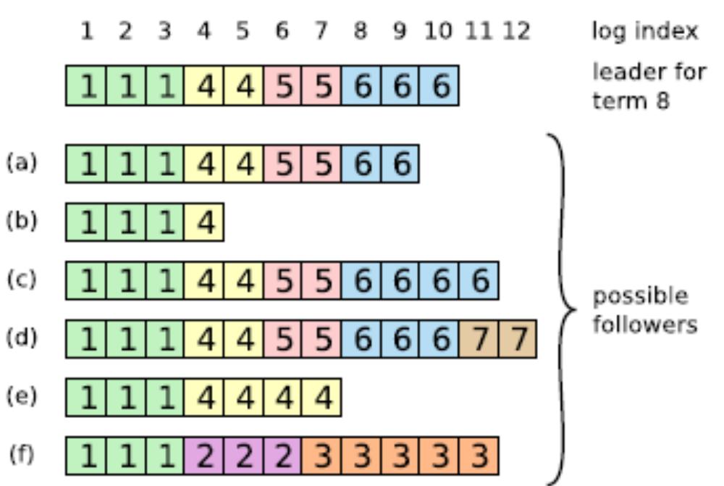
Handling leader crashes (II)
(new term)

Slide 45
An election starts
Log
State
machine
Log
State
machine
Candidate for leader position requests votes of other former followers
  Includes a summary of the state of its log

Slide 46
Former followers reply
Log
State
machine
Log
State
machine
?
Former followers compare the state of their logs with credentials of candidate
Vote for candidate unless
  Their own log is more "up to date"
  They have already voted for another server

Slide 47
Handling leader crashes (III)
Raft solution is to let the new leader to force followers' log to duplicate its own
  Conflicting entries in followers' logs will be overwritten

Slide 48
The new leader is in charge
Log
State
machine
Log
State
machine
Newly elected candidate forces all its followers to duplicate in their logs the contents of its own log

Slide 49
How? (I)
Leader maintains a nextIndex for each follower
  Index of entry it will send to that follower
New leader sets its nextIndex to the index just after its last log entry
  11 in the example
Broadcasts it to all its followers

Slide 50
How? (II)
Followers that have missed some AppendEntry calls will refuse all further AppendEntry calls
Leader will decrement its nextIndex for that follower and redo the previous AppendEntry call
  Process will be repeated until a point where the logs of the leader and the follower match
Will then send to the follower all the log entries it missed

Slide 51
How? (III)
By successive trials and errors, leader finds out that the first log entry that follower (b) will accept is log entry 5
It then forwards to (b) log entries 5 to 10

Slide 52
Interesting question
How will the leader know which log entries it can commit
  Cannot always gather a majority since some of the replies were sent to the old leader
Fortunately for us, any follower accepting an AcceptEntry RPC implicitly acknowledges it has processed all previous AcceptEntry RPCs
Followers' logs cannot skip entries

Slide 53
A last observation
Handling log inconsistencies does not require a special sub algorithm
  Rolling back EntryAppend calls is enough

Slide 54
Safety
Two main issues
  What if the log of a new leader did not contain all previously committed entries?
    Must impose conditions on new leaders
  How to commit entries from a previous term?
    Must tune the commit mechanism

Slide 55
Election restriction (I)
The log of any new leader must contain all previously committed entries
  Candidates include in their RequestVote RPCs information about the state of their log
    Details in the paper
  Before voting for a candidate, servers check that the log of the candidate is at least as up to date as their own log.
    Majority rule does the rest

Slide 56
Election restriction (II)
Servers holding
the last committed
log entry
Servers having
elected the
new leader
Two majorities of the same cluster must intersect

Slide 57
Committing entries from a previous term
A leader cannot immediately conclude that an entry from a previous term even is committed even if it is stored on a majority of servers.
  See next figure
Leader should never commits log entries from previous terms by counting replicas
Should only do it for entries from the current term
Once it has been able to do that for one entry, all prior entries are committed indirectly

Slide 58
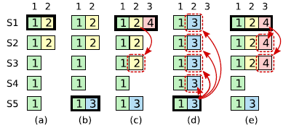
Committing entries from a previous term

Slide 59
Explanations
In (a) S1 is leader and partially replicates the log entry at index 2.
In (b) S1 crashes; S5 is elected leader for term 3 with votes from S3, S4, and itself, and accepts a different entry at log index 2.
In (c) S5 crashes; S1 restarts, is elected leader, and continues replication.
  Log entry from term 2 has been replicated on a majority of the servers, but it is not committed.

Slide 60
Explanations
If S1 crashes as in (d), S5 could be elected leader (with votes from S2, S3, and S4) and overwrite the entry with its own entry from term 3.
However, if S1 replicates an entry from its current term on a majority of the servers before crashing, as in (e), then this entry is committed (S5 cannot win an election).
At this point all preceding entries in the log are committed as well.

Slide 61
Cluster membership changes
Not possible to do an atomic switch
  Changing the membership of all servers at one
Will use a two-phase approach:
  Switch first to a transitional joint consensus configuration
  Once the joint consensus has been committed, transition to the new configuration

Slide 62
The joint consensus configuration
Log entries are transmitted to all servers, old and new
Any server can act as leader
Agreements for entry commitment and elections requires majorities from both old and new configurations
Cluster configurations are stored and replicated in special log entries

Slide 63
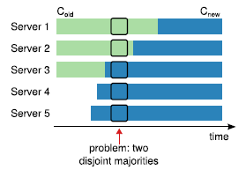
The joint consensus configuration

Slide 64
Implementations
Two thousand lines of C++ code, not including tests, comments, or blank lines.
About 25 independent third-party open source implementations in various stages of development
Some commercial implementations

Slide 65
Understandability
See paper

Slide 66
Correctness
A proof of safety exists

Slide 67
Performance
See paper

Slide 68
Conclusion
Raft is much easier to understand and implement than Paxos and has no performance penalty

