Slide 1
Riding Mechanic: An iOS App for Vehicle Monitoring and Analysis
Student Name: Dezheng Wang
Faculty Advisor: Dr. Elliott Forbes

Slide 2
Introduction
Difficult to image life without driving.
Possible to use OBD applications to deepen knowledge to cars
Disadvantages of OBD applications in APP Store
Advantages of Riding Mechanic
OBD and OBD-II
OBD-II scanner

Slide 3
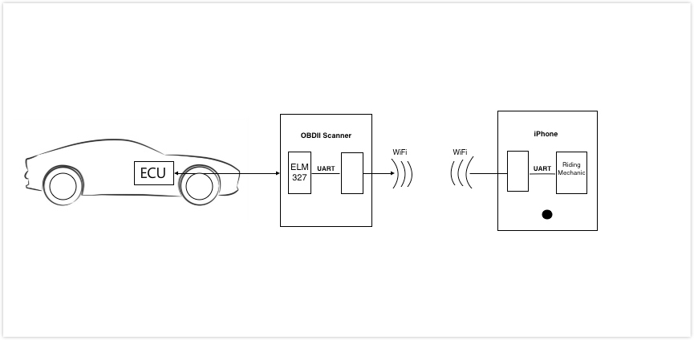
Continued
© Freelancer Technology Pty Limited

Slide 4
Continued
Onboard Diagnostic Parameter IDs (OBD-II PIDs)
Diagnostic Trouble Code (DTCs)
AT command set (Hayes command set)

Slide 5
Requirement Analysis
User requirements
Functional requirements
Non-functional requirements

Slide 6
System Architecture
Goal
Prototype: Incremental model
Identify Key technical risks
Identify thread safety
Constrains
OBD-II Wi-Fi scanner
Data download and upload
Database server

Slide 7
Continued
Key scenarios
Login , register, reset password and logout
Download and upload user information
Connect to scanner’s Wi-Fi
Keep sending OBD-II PIDs
Save trip information
Search trip information
Download and upload trip information

Slide 8
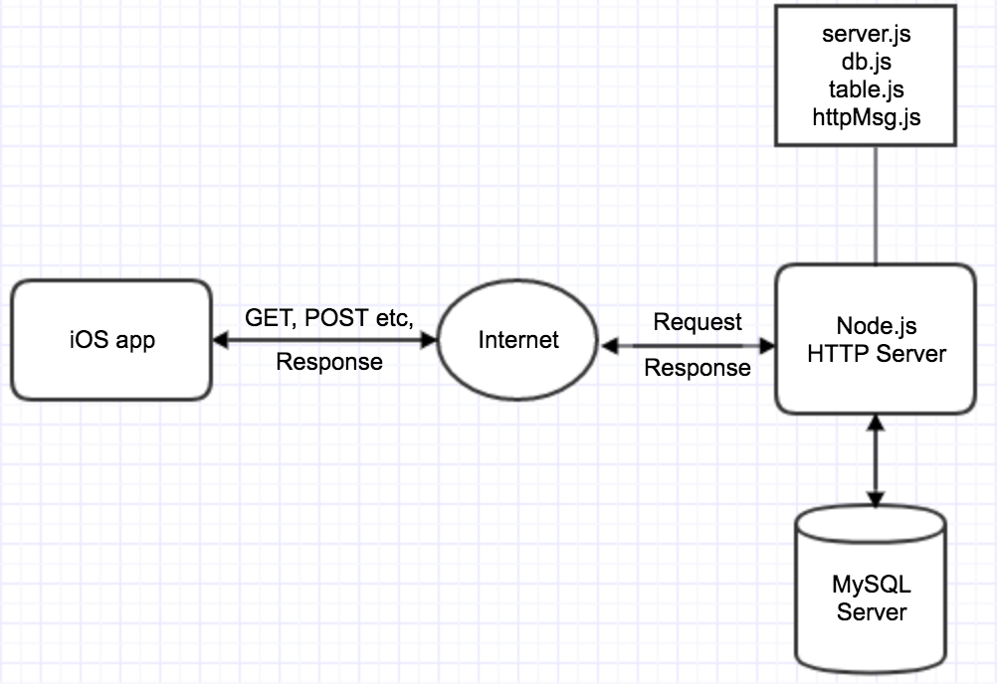

Slide 9
Continued
Application Overview
Combination architecture styles: client/server, object-oriented
Tools and programming languages for server and client
Key issues and solution
Performance, reliability, security
Thread safety (UI, other activities)
Extra data about the car

Slide 10
Detailed system design
Database design
User table
Trip table
Relationship between user table and trip table
Password encryption and decryption

Slide 11
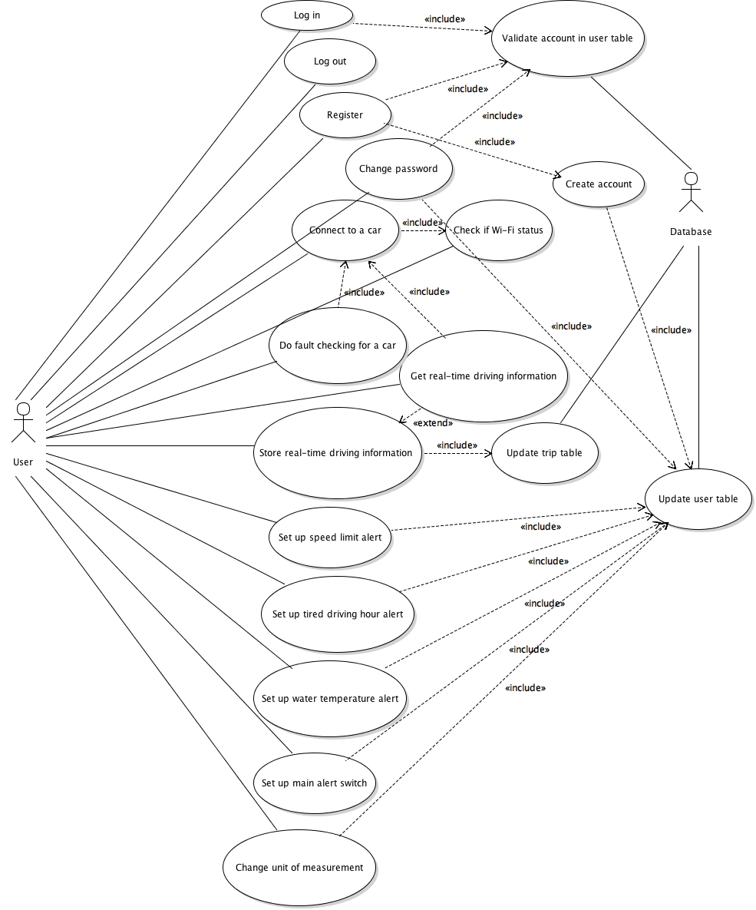
Continued

Slide 12
Continued
How distance was calculated
How fuel cost was calculated
How sharp acceleration times and sharp braking times were calculated

Slide 13
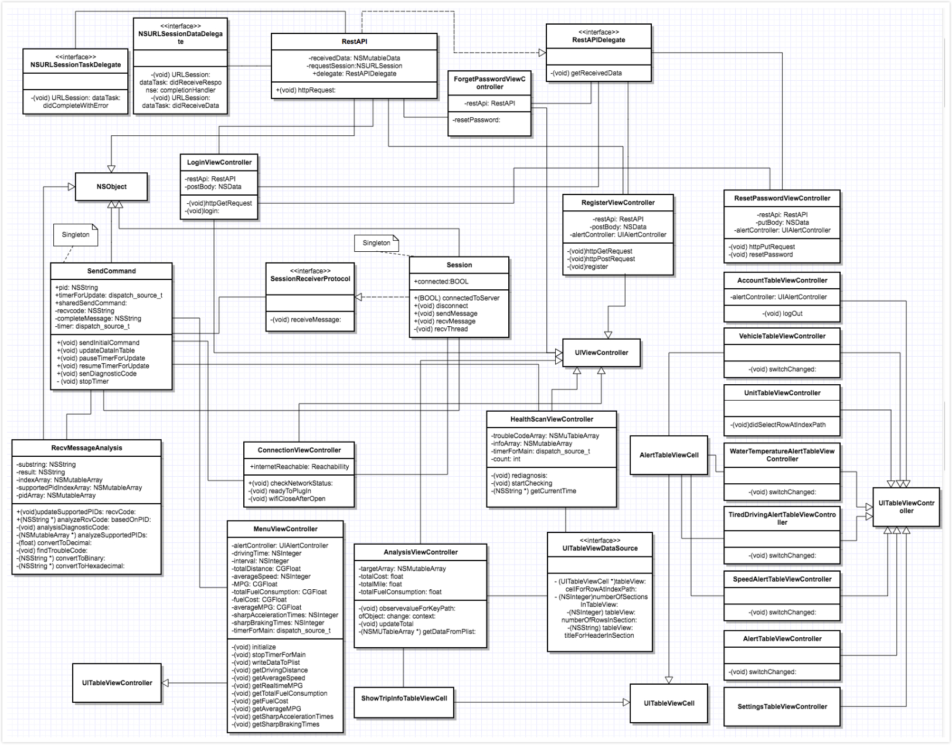
Continued

Slide 14
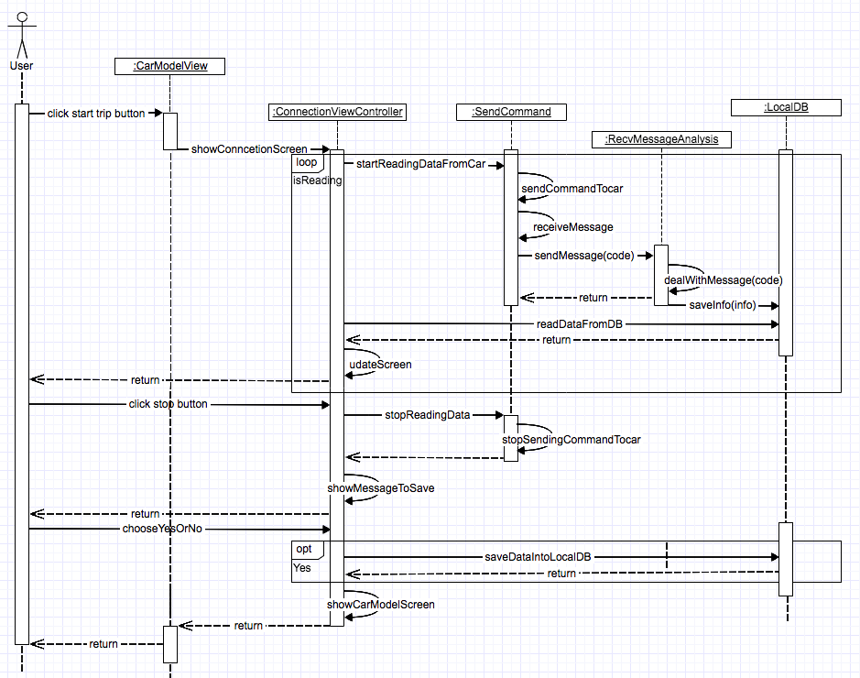
Continued

Slide 15
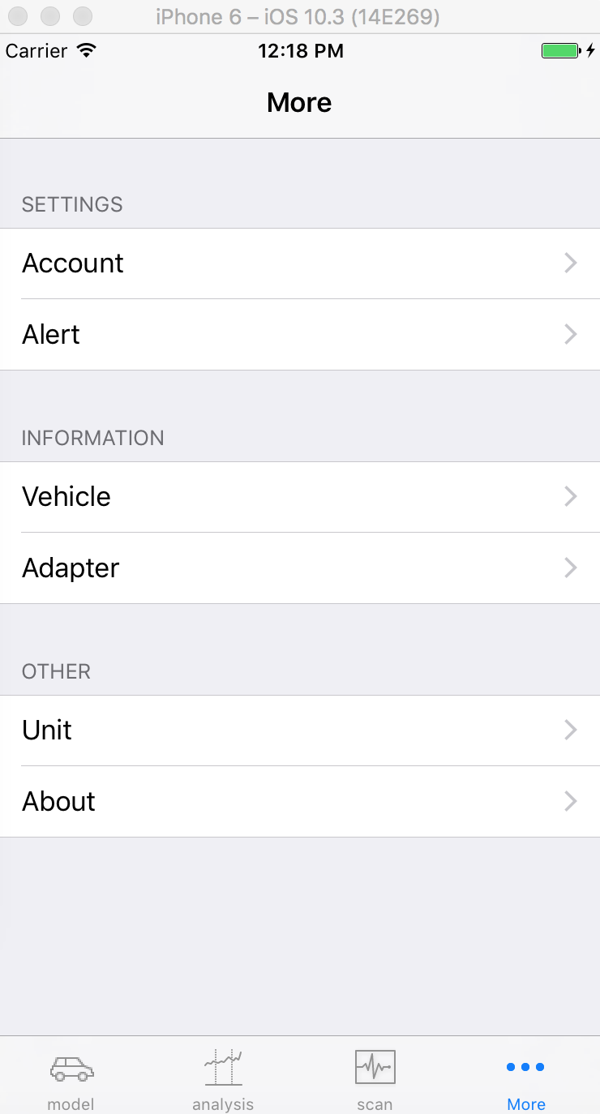
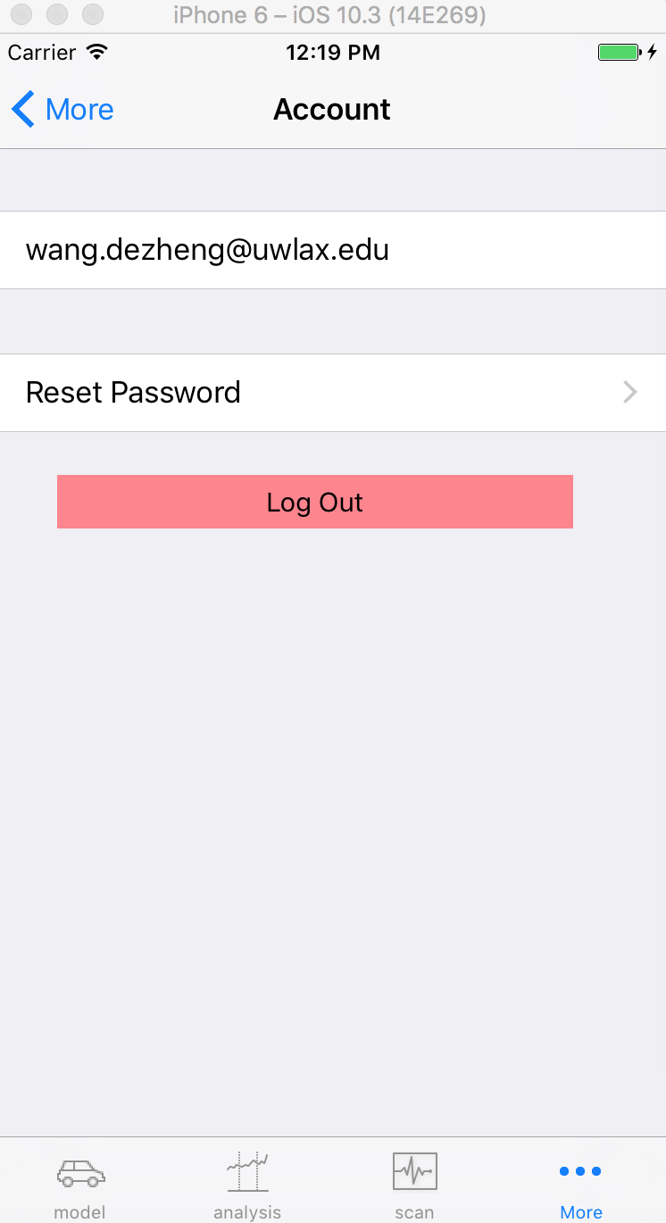
Continued
User Interface design
Tab bar
Navigation bar
Table view
Alert

Slide 16
Testing
Testing plan
Server side, Postman
Client side
UI testing in Xcode
Code coverage

Slide 17
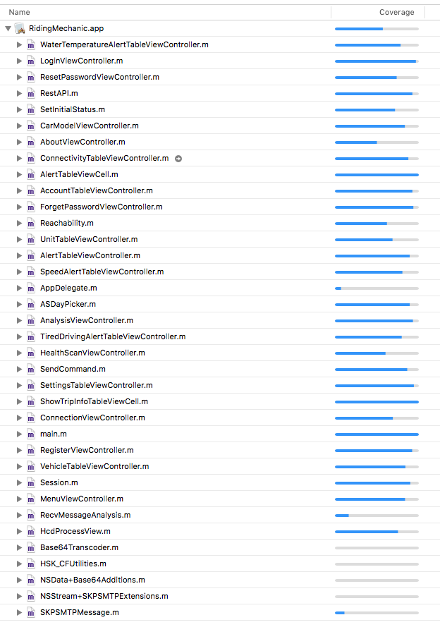

Slide 18
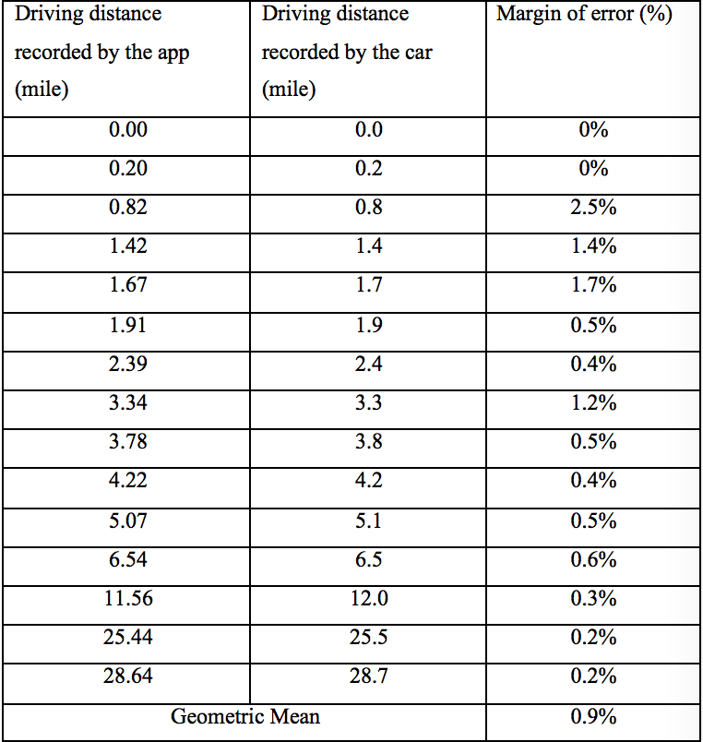
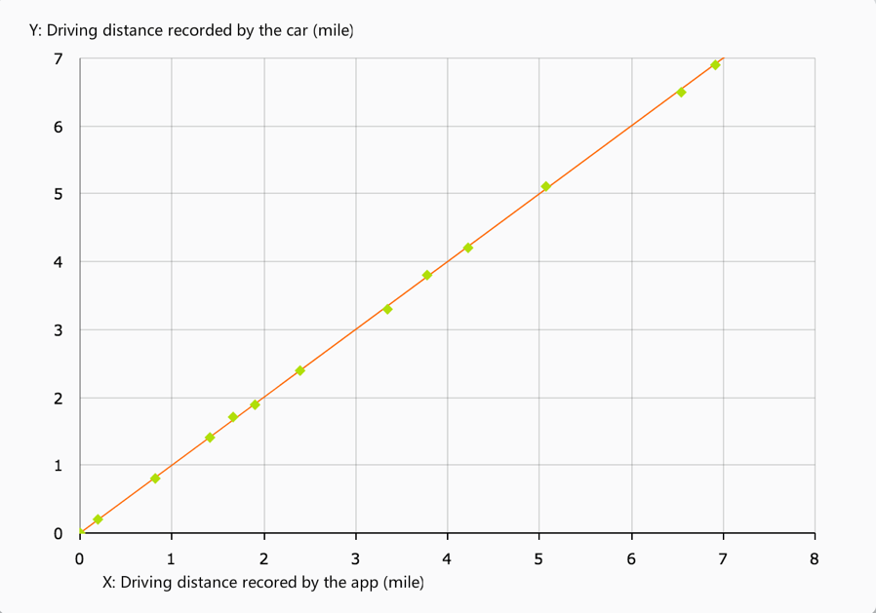
Continued

Slide 19
Conclusion
Conclusion
Achievement
Defects
Future Work

Slide 20
Demo

