Slide 1
Riding Mechanic: An iOS App for Vehicle Monitoring and Analysis
Student Name: Dezheng Wang
Faculty Advisor: Dr. Elliott Forbes

Slide 2
Introduction
Difficult to imagine life without driving.
On-Board Diagnostic applications
Disadvantages of OBD applications in APP Store
Advantages of Riding Mechanic

Slide 3
Introduction
OBD and OBD-II
Purpose
Difference
OBD-II scanner
Work with OBD-II port
Wi-Fi scanner and Bluetooth scanner
ELM327

Slide 4
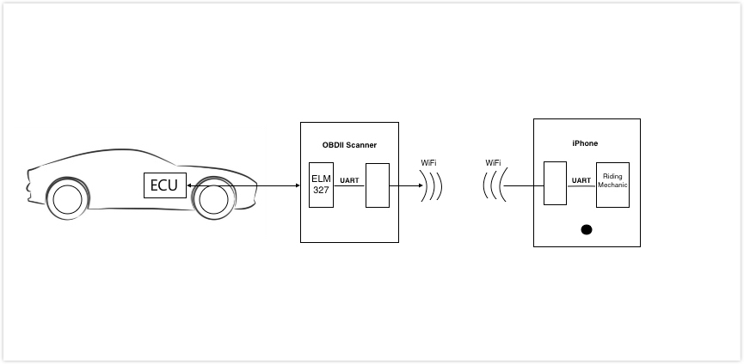
Introduction
© Freelancer Technology Pty Limited

Slide 5
Introduction
Onboard Diagnostic Parameter IDs (OBD-II PIDs)
Ten modes
PIDs used in this project
Return value

Slide 6
Introduction
Diagnostic Trouble Code (DTCs)
How characters are encoded
Consist of five characters
Each letter’s meaning
DTCs in this project

Slide 7
Introduction
AT command set (Hayes command set)
Why it is important
Compared to OBD-II commands

Slide 8
Requirement Analysis
User requirements
I want to do
Functional requirements
The system must have
Non-functional requirements
The system should have

Slide 9
System Architecture
Goal
Prototype: Incremental model
Identify Key technical risks
Identify thread safety
Constrains
OBD-II Wi-Fi scanner
Data download and upload
Database server

Slide 10
System Architecture
Key scenarios
Login , register, reset password and logout
Download and upload user information
Connect to scanner’s Wi-Fi
Keep sending OBD-II PIDs
Save trip information
Search trip information
Download and upload trip information

Slide 11
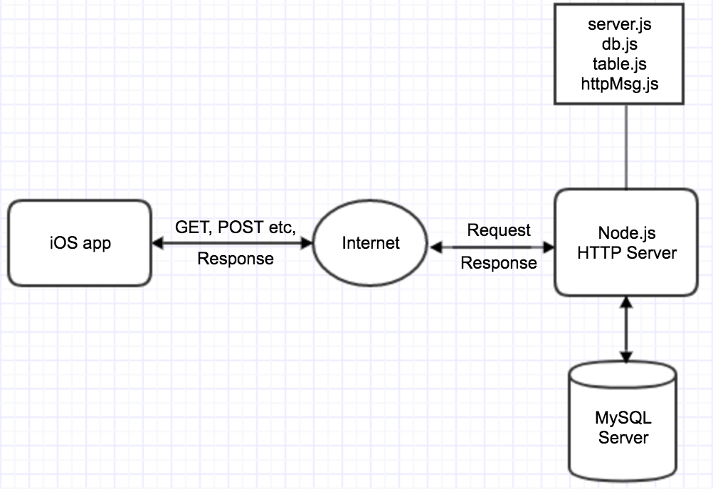
High level architecture

Slide 12
System Architecture
Application Overview
Combination architecture styles: client/server, object-oriented
Tools and programming languages for server and client
Key issues and solution
Performance, reliability, security
Thread safety (UI, other activities)
Extra data about the car

Slide 13
Detailed system design
Database design
User table
Trip table
Relationship between user table and trip table
Password encryption and decryption

Slide 14
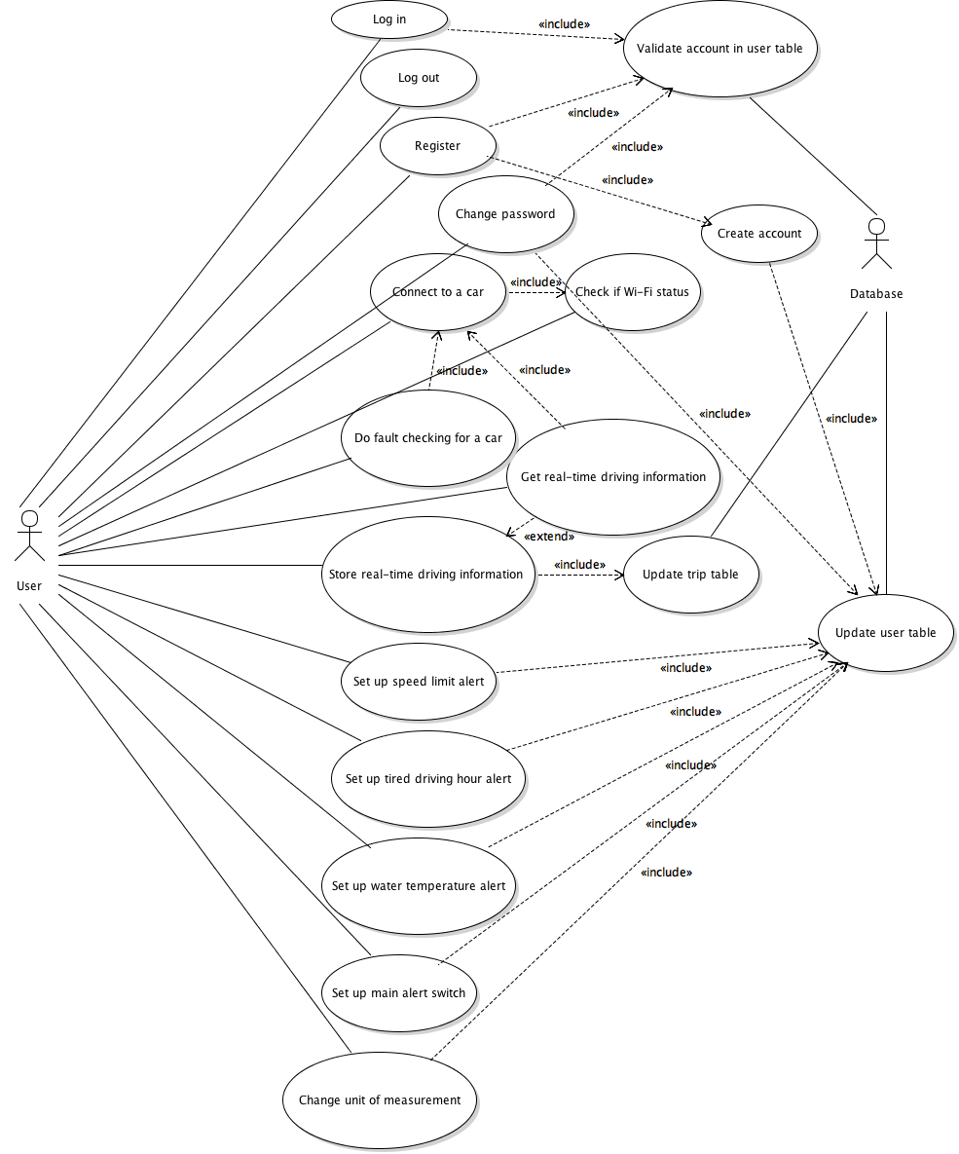
Use case diagram

Slide 15
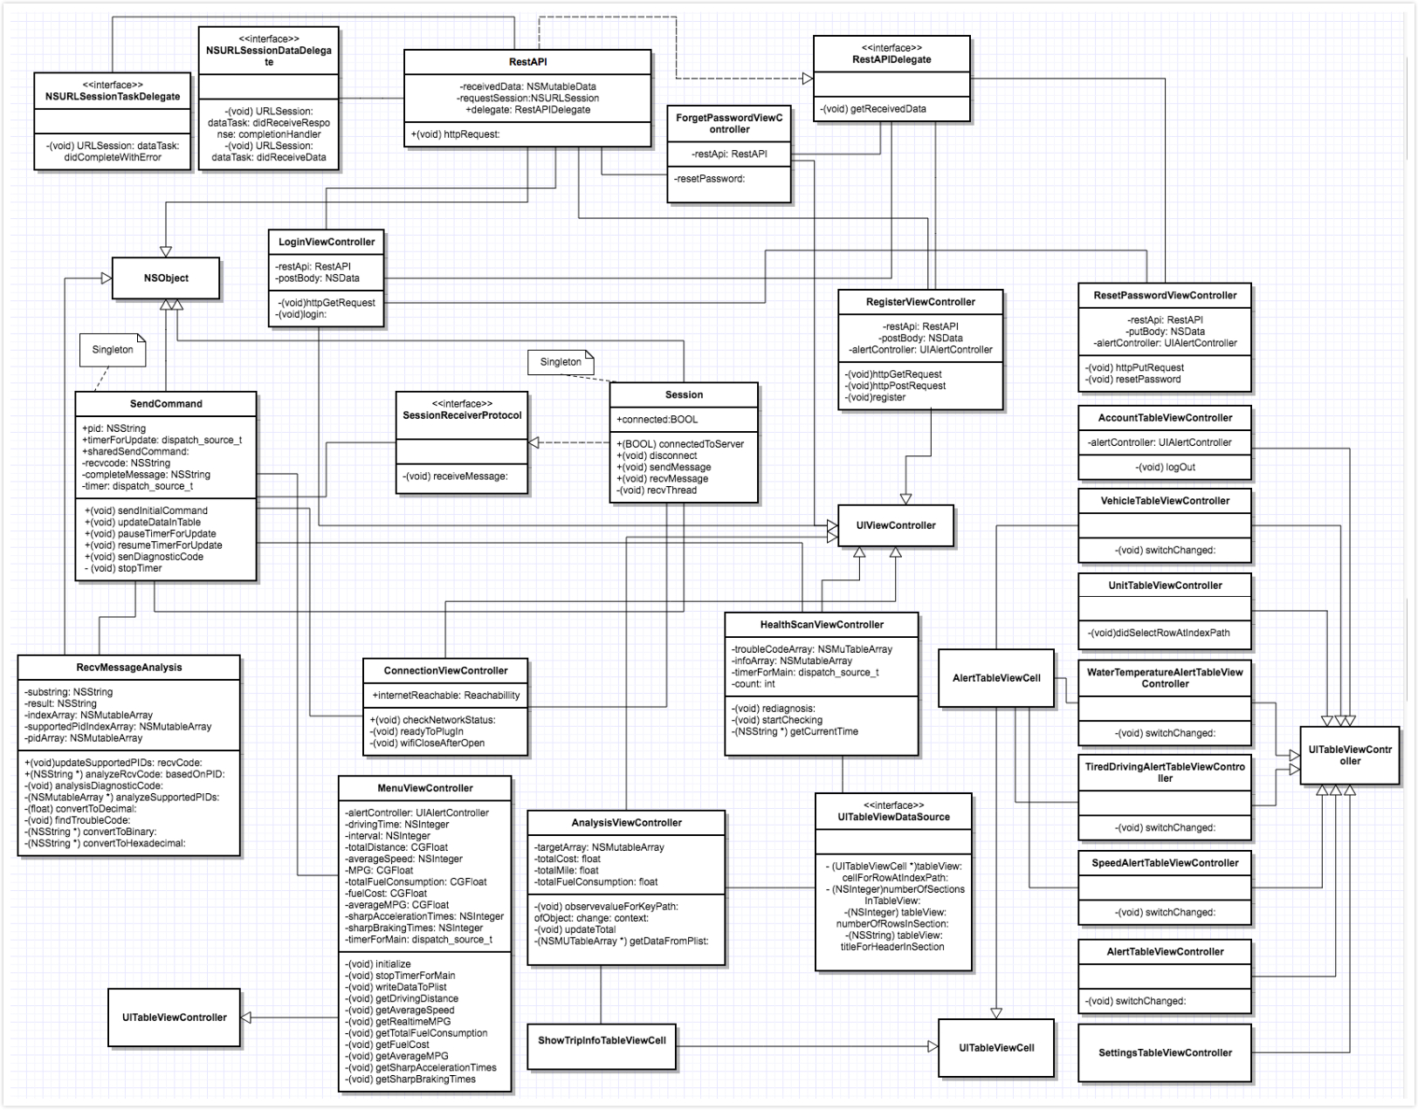
Class diagram

Slide 16
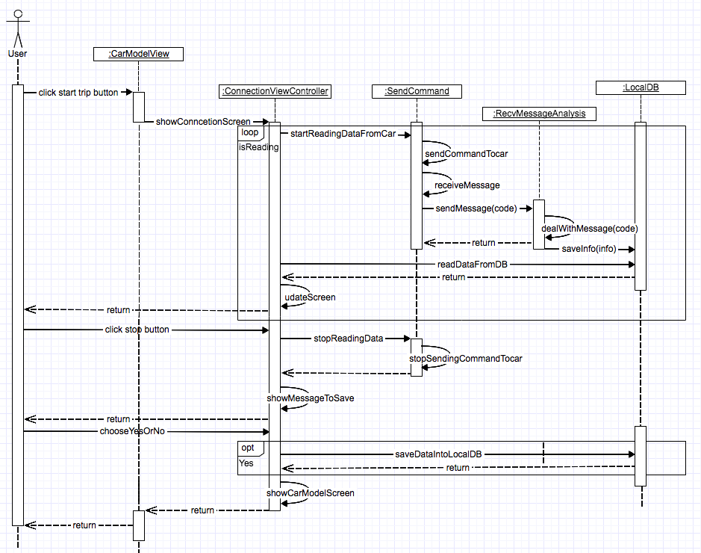
Sequence diagram

Slide 17
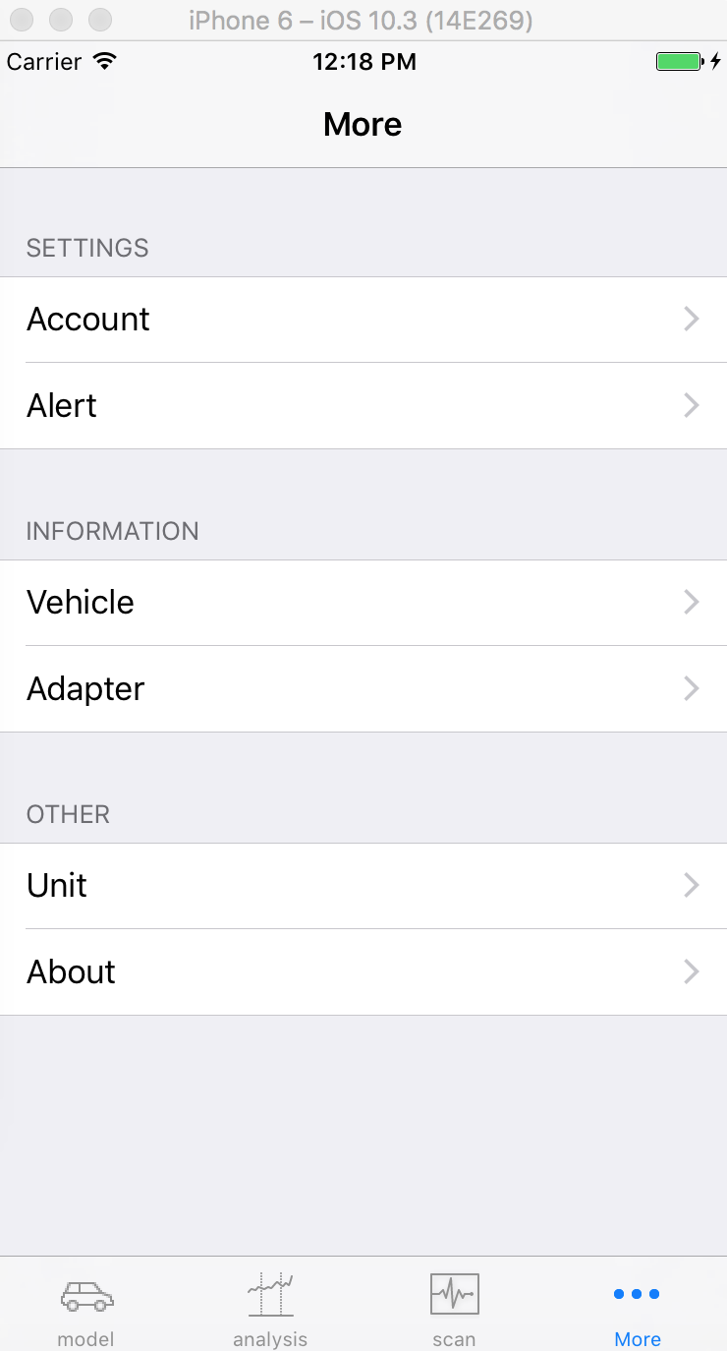
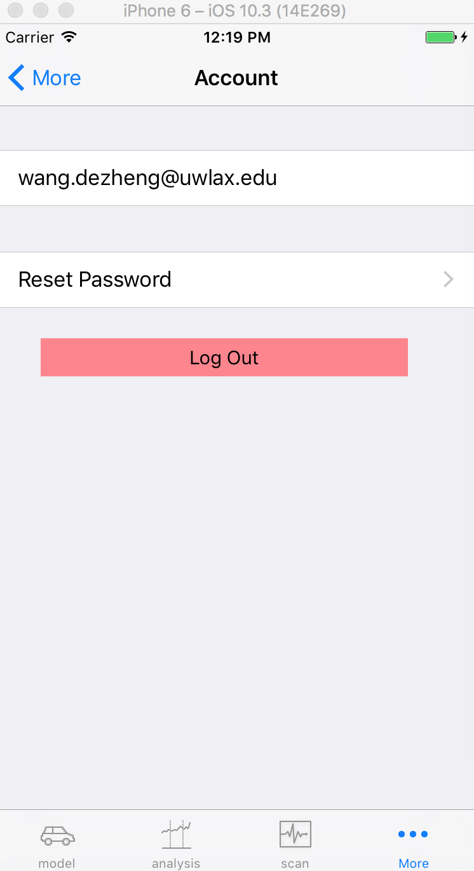
GUI design
User Interface design
Tab bar
Navigation bar
Table view
Alert

Slide 18
Key values
How distance was calculated
How fuel cost was calculated
How sharp acceleration times and sharp braking times were calculated

Slide 19
Testing
Testing plan
Server side, Postman
Client side
UI testing in Xcode

Slide 20
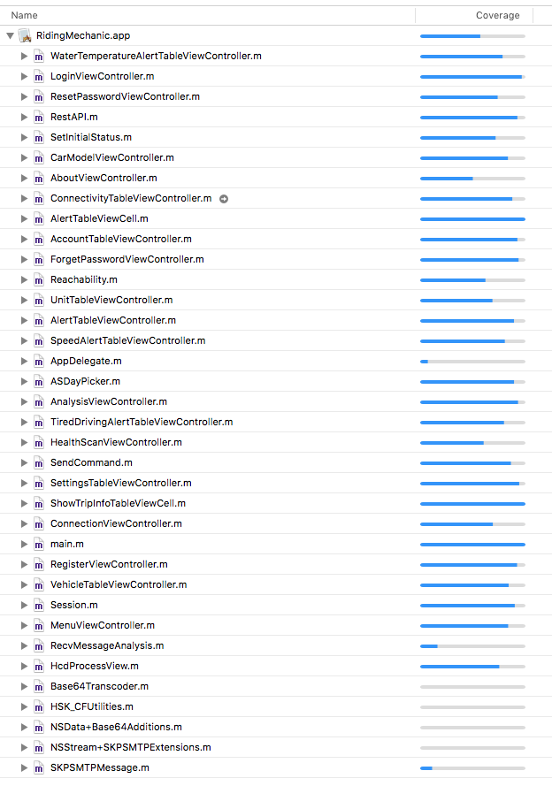
Code coverage

Slide 21
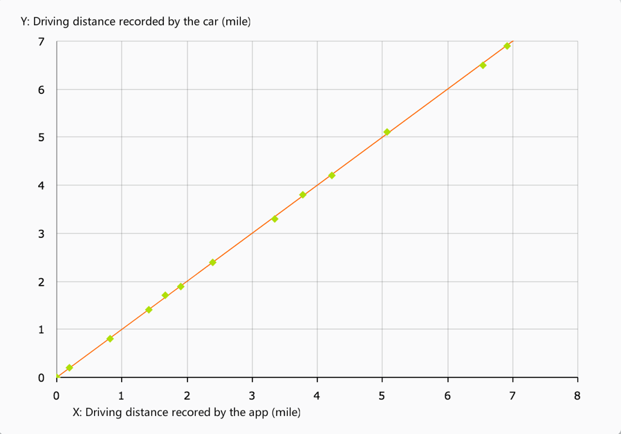
Comparison

Slide 22
Conclusion
Conclusion
Achievement
Defects
Future Work

Slide 23
Demo
Register, login, reset password
Start a trip, read real-time data, record a trip
Set speed alert, start a trip, record a trip
Search trip information
Read diagnostic trouble codes form the car
Repeat those steps on another car

