Slide 1
Riding Mechanic: An iOS App for Vehicle Monitoring and Analysis
Student Name: Dezheng Wang
Faculty Advisor: Dr. Elliott Forbes

Slide 2
Glossary
Onboard Diagnostic systems (OBD)
Onboard Diagnostic II scanner (OBD-II scanner)
Onboard Diagnostic II Parameter IDs (OBD-II PIDs)
Diagnostic Trouble Codes (DTCs)
Attention command set (AT command)
ELM327

Slide 3
Introduction
Difficult to image life without driving.
Possible to use OBD applications to deepen knowledge to cars
Disadvantages of OBD applications in APP Store
Advantages of Riding Mechanic
OBD and OBD-II
OBD-II scanner used in Riding Mechanic

Slide 4
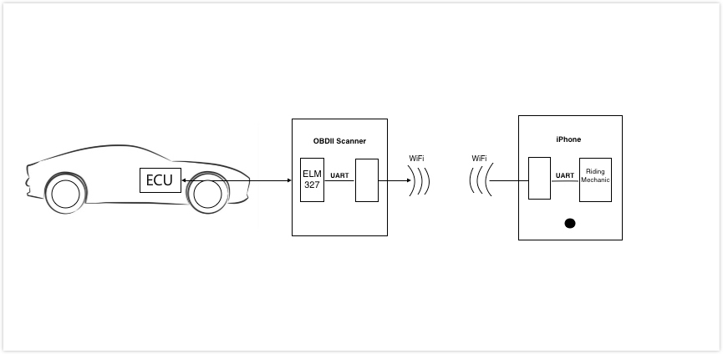
Continued
© Freelancer Technology Pty Limited

Slide 5
Continued
Onboard Diagnostic Parameter IDs (OBD-II PIDs)
Ten modes
PIDs used in this project
Diagnostic Trouble Code (DTCs)
Consist of five characters
Each letter’s meaning
AT command set (Hayes command set)
Compared to OBD commands

Slide 6
Requirement Analysis
User requirements
I want to do
Functional requirements
The system must have
Non-functional requirements
The system should have

Slide 7
System Architecture
Goal
Prototype: Incremental model
Identify Key technical risks
Identify thread safety
Constrains
OBD-II Wi-Fi scanner
Data download and upload
Database server

Slide 8
Continued
Key scenarios
Login , register, reset password and logout
Download and upload user information
Connect to scanner’s Wi-Fi
Keep sending OBD-II PIDs
Save trip information
Search trip information
Download and upload trip information

Slide 9
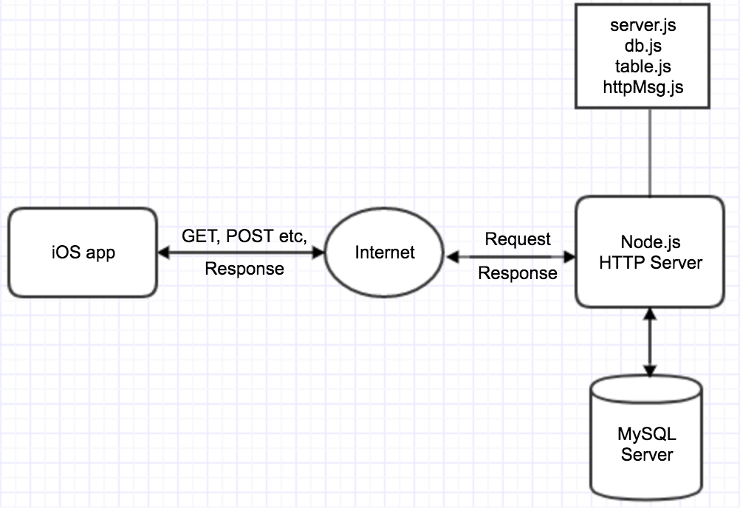

Slide 10
Continued
Application Overview
Combination architecture styles: client/server, object-oriented
Tools and programming languages for server and client
Key issues and solution
Performance, reliability, security
Thread safety (UI, other activities)
Extra data about the car

Slide 11
Detailed system design
Database design
User table
Trip table
Relationship between user table and trip table
Password encryption and decryption

Slide 12
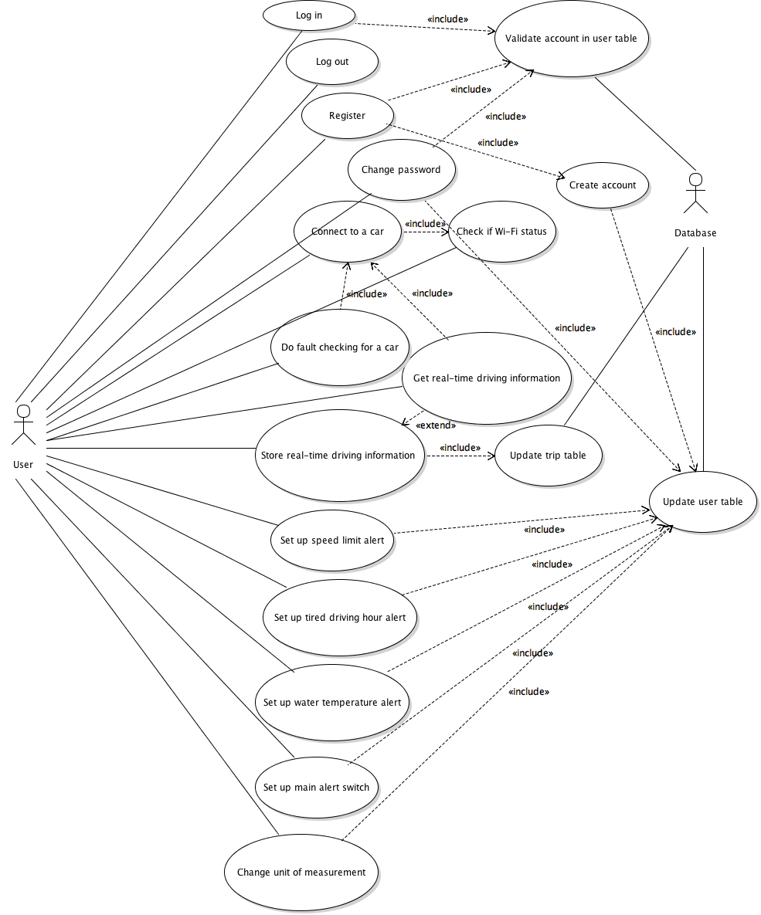
Continued

Slide 13
Continued
How distance was calculated
How fuel cost was calculated
How sharp acceleration times and sharp braking times were calculated

Slide 14
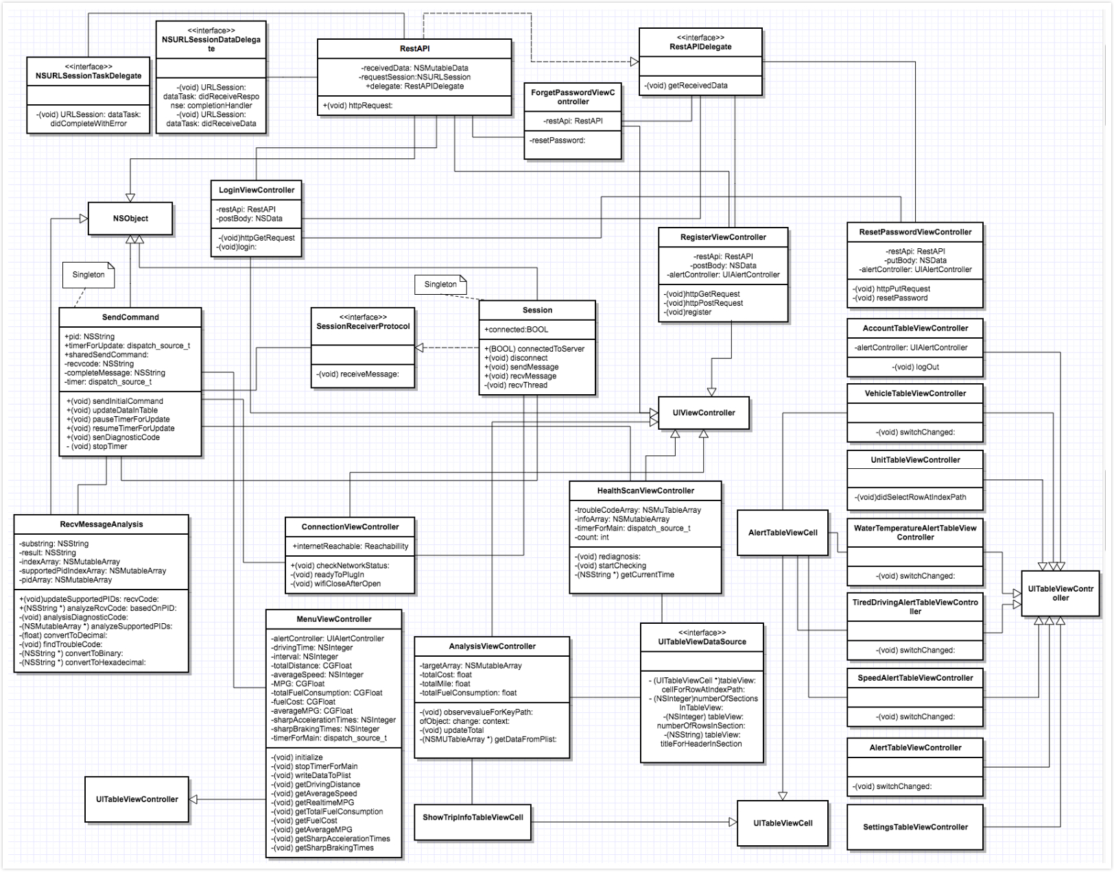
Continued

Slide 15
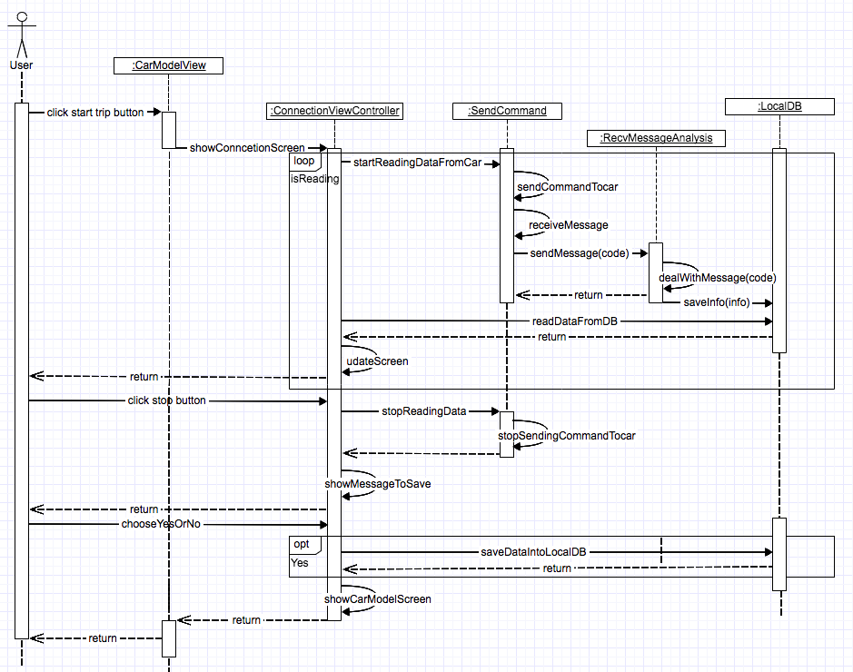
Continued

Slide 16
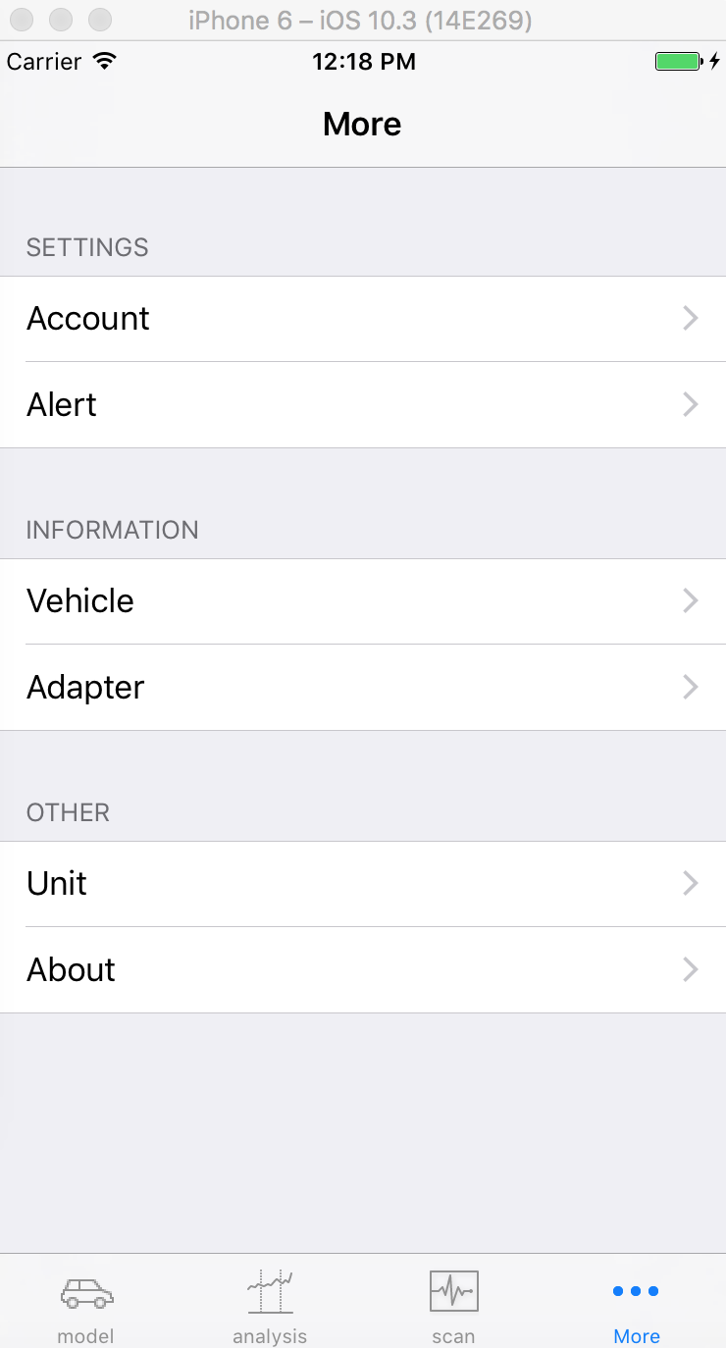
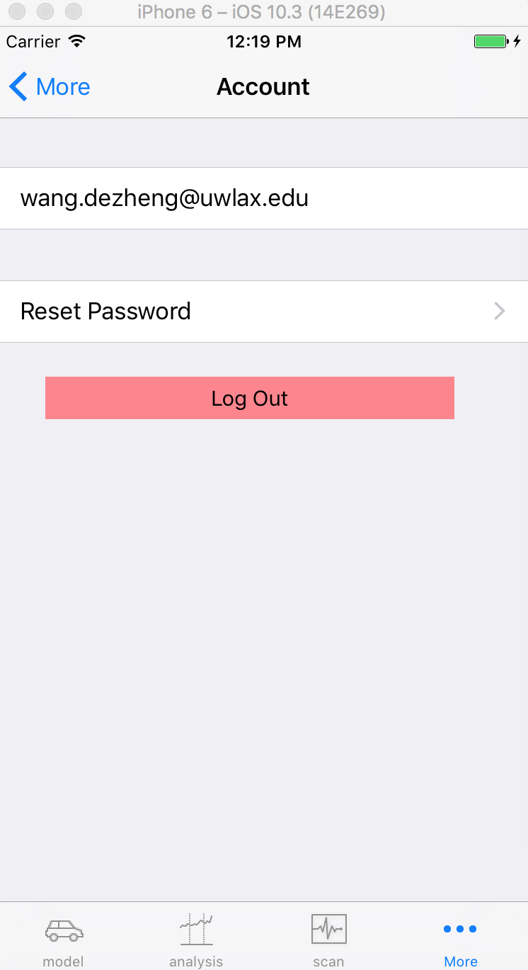
Continued
User Interface design
Tab bar
Navigation bar
Table view
Alert

Slide 17
Testing
Testing plan
Server side, Postman
Client side
UI testing in Xcode
Code coverage

Slide 18
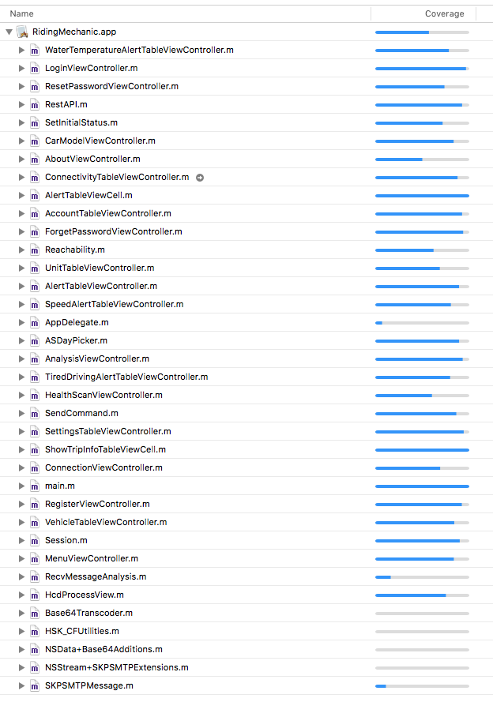

Slide 19
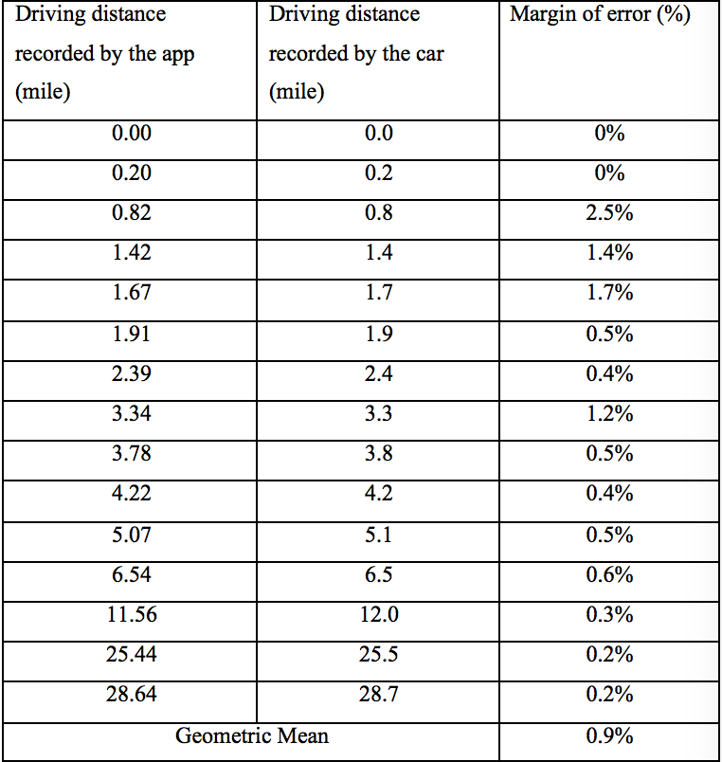
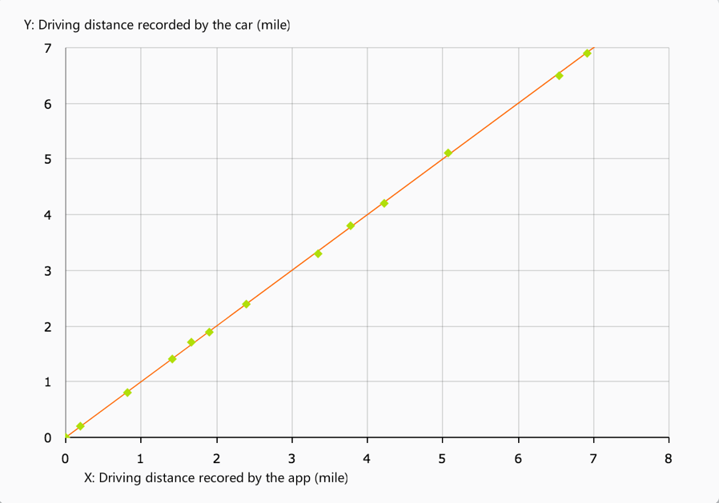
Continued

Slide 20
Conclusion
Conclusion
Achievement
Defects
Future Work

Slide 21
Demo

