Slide 1
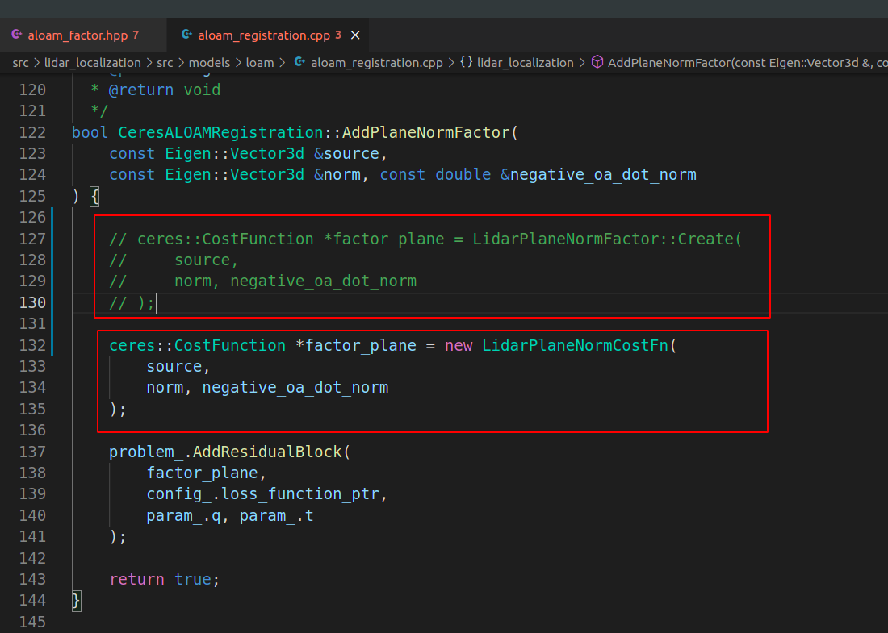
具体代码见aloam_factor.hpp class LidarPlaneNormCostFn

Slide 2
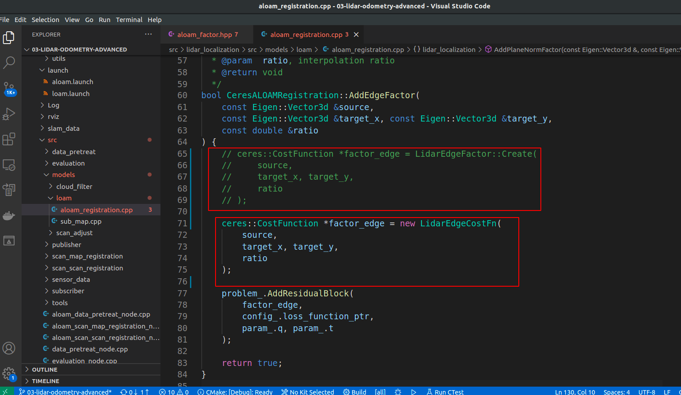
具体代码见aloam_factor.hpp class LidarEdgeCostFn

Slide 3
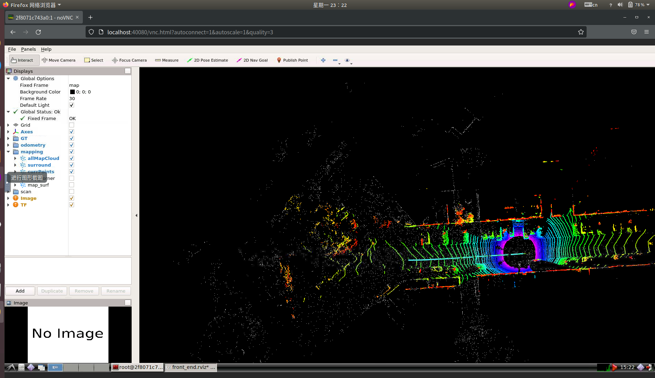

Slide 4
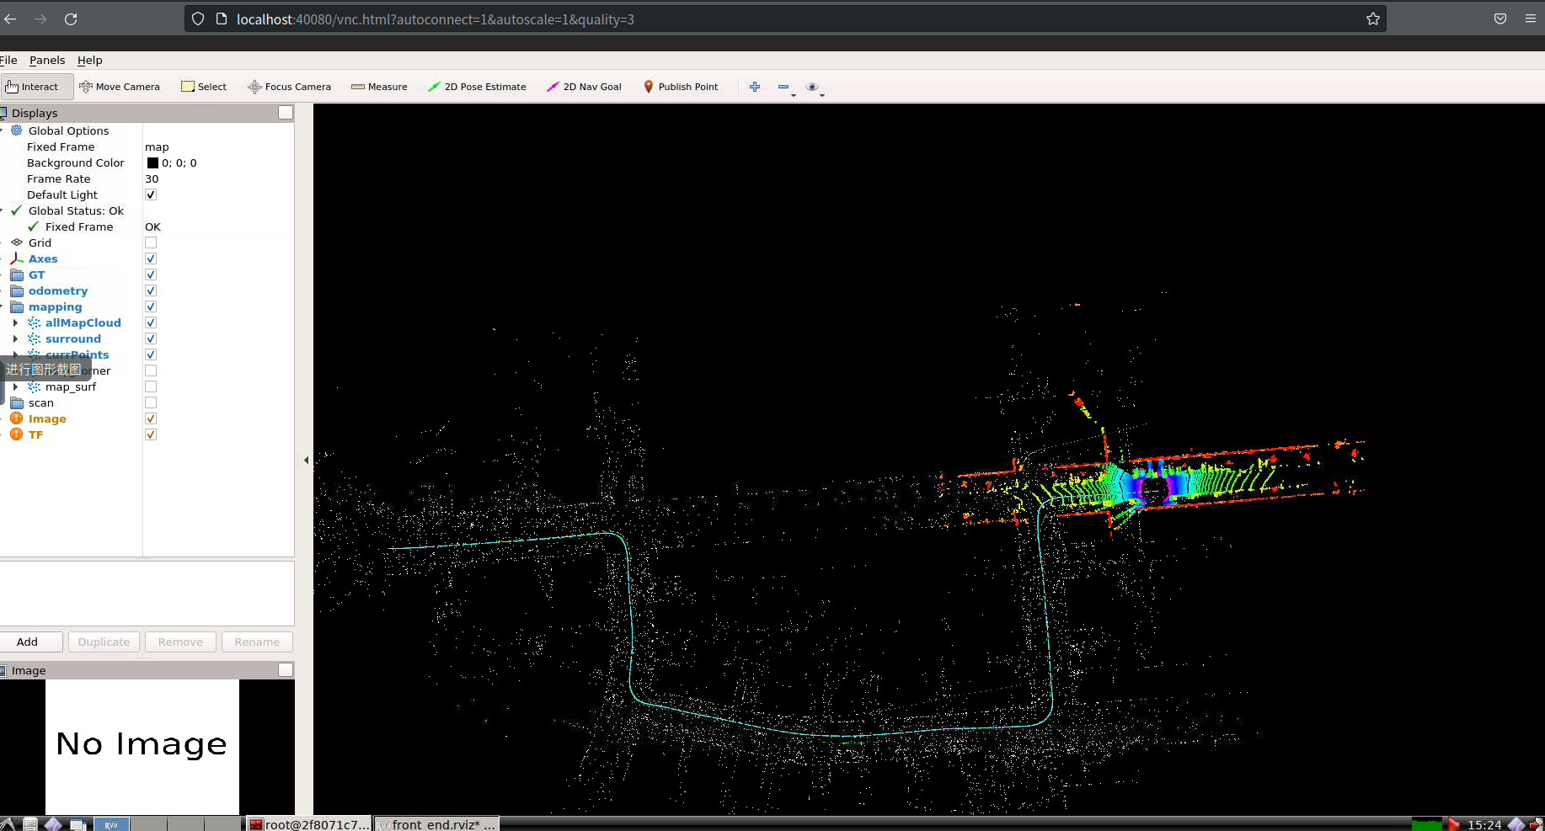

Slide 5
